Slide 1

Web Design Fundamentals
PROJECT
DATE
WEEK 3
INSTRUCTOR
MARK DODGSON

Slide 2


Topics
Week Two Recap.
What are hyperlinks?
How to create a hyperlink.

Slide 3
Markup Language Basics

Slide 4
Markup Language Basics
Tags identify the type of content being displayed.
Most tags have both an opening and a closing tag.
<p>copy goes here</p>

Slide 5
Basic Structure

Slide 6
Basic Structure
<!DOCTYPE HTML>

Slide 7
Basic Structure
<!DOCTYPE HTML><html>
</html>

Slide 8
Basic Structure
<!DOCTYPE HTML>
<html>
  <head>
  </head>
</html>
Notes:
The head of the document contains all of the non visual elements that help to make the page work. The might contain META tags which would contain things like key words and page descriptions.
The head might also contain links to CSS and JavaScript files which help with the look and presentation of a webpage.
Things inside the head tag are not necessarily visual or structural elements, they just help make the page look and function like you want it to.

Slide 9
Basic Structure
<!DOCTYPE HTML>
<html>
  <head>
  <title>Title of the document</title>
  </head>
</html>
Notes:
The only element that is required in the head tag is the “title tag”. This is the name that appears at the top of your browser when a user visits your site. This title tag plays a large part in SEO.

Slide 10
Basic Structure
<!DOCTYPE HTML>
<html>
  <head>
  <title>Title of the document</title>
  </head>
  <body>
  </body>
</html>
Notes:
The body tag is the part of the document that contains all of the visual and structural elements. Paragraphs, images, quotes, lists and links are just a few of the elements that would be contained in the body tags.
Anything that you see in the browser is contained in the body tags in the order that you want it to appear.
The structure here is the same for every site HTML document you will ever work on.

Slide 11
Types Of Tags

Slide 12
Types Of Tags
Block Level Tags
Inline Level Tags
Empty Element Tags

Slide 13
Block Level Tags
A block-level element is an element that creates large blocks of content like paragraphs or page divisions.
Block-level elements start new lines of text when you use them, and can contain other blocks
as well as inline elements and text or data.
The paragraph tag is the only block level tag
that cannot contain another block level tag.
It can only contain inline level elements.

Slide 14
Inline Level Tags
An inline element is an element that defines text or data in the document like STRONG makes the enclosed text strongly emphasized.
They don't start new lines when you use them, and they generally only contain other inline tags and text or data.
Inline level tags typically show up in a line of text. These include i, b, em, strong, img and a special generic tag called span.

Slide 15
Empty Element Tags
Empty element tags are tags that don’t contain any text or data.
They don’t have a closing tag,
instead they are self terminating.
Ex: Horizontal rule looks like <hr />.
A break looks like <br />

Slide 16
Syntax Rules

Slide 17
Syntax Rule
If one tag is open within a tag, that tag
must close before the parent tag.
<p>Paragraph of copy with a <strong>line that is bold</strong></p>

Slide 18
Phrase Markup

Slide 19
Phrase Markup Elements
For non visual browsers
They are all inline level elements.
These tags do not guarantee that they will appear bold or italic in a browser they are for adding meaning to word or section of a document.
(using CSS can force the look)
Ex: Strong, em, acronym

Slide 20
Font Markup

Slide 21
Font Markup Elements
For visual browsers - These are deprecated tags
They define the visual appearance of text
within a document for use in a visual browser.
they are all inline level elements.
Ex: b, i, strike

Slide 22
Hyperlinks

Slide 23
Hyperlinks
Hyperlinks have an opening and a closing tag
<a href=”http://www.mohawkcollege.ca”>link</a>
They are inline tags

Slide 24
Hyperlinks
Absolute path hyperlinks
Relative path hyperlinks
Anchor tag hyperlinks
Email hyperlinks

Slide 25
Absolute Path Hyperlinks
They are the full path including the protocol
http://www.mohawkcollege.ca

Slide 26
Relative Path Hyperlinks
These are links within your folder structure. They are relative to the location of your current page.
They are not links to external websites
products/computers.html

Slide 27
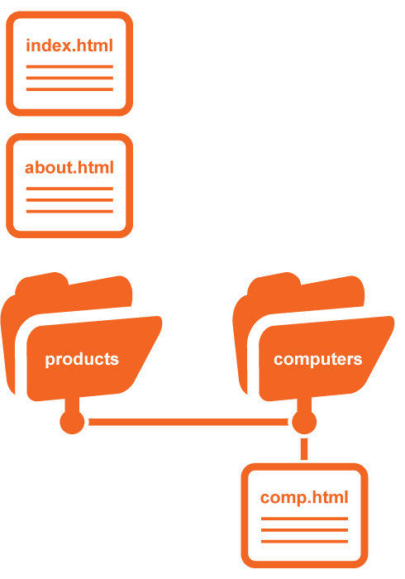
Moving Forward
(link from index.html or about.html to comp.html)
products/computers/comp.html
Moving Backwards
(link on comp.html
links to index.html)
../../index.html

Slide 28
Anchor Tag Hyperlinks

Slide 29
Anchor Tag Hyperlinks
These are links to content within the
same page you are currently viewing.
There are 2 components,
the hyperlink and the named anchor.
You need to create a named anchor for a particular section. <a name="tips"></a> or <a name=”tips” />
To link to the specific section you
create a hyperlink using a fragment.
<a href="#tips">Visit The Tips Section</a>

Slide 30
Email Hyperlinks

Slide 31
Email hyperlinks
These are links to an email address.
<a href=”mailto:info@mohawkcollege.ca”>Email Us</a>
They can also contain subject line information
<a href=”mailto:info@mohawkcollege.ca?subject=Looking For Information”>Email Us</a>

