Slide 1
Goodreads Book Recommendations
Mark Durrenberger
Springboard Data Science Intensive Capstone Project

Slide 2
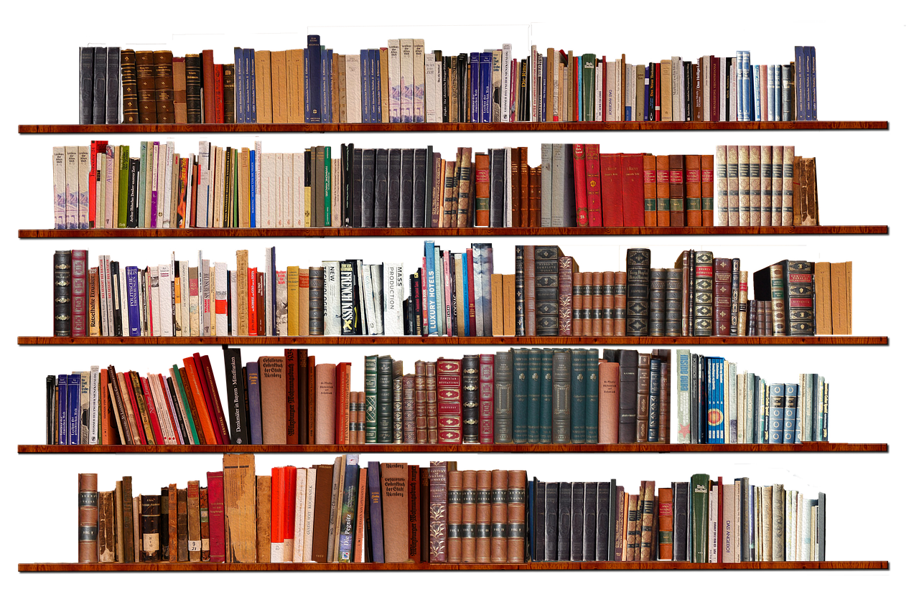
The Problem
Goodreads
User-based reviews & ratings of books
Millions of reviews/ratings
Generate revenue through book recommendations
Data Goal: Build a model to predict reader ratings of books
Business Goal: Use model to improve recommendation system, driving higher purchase rates among users

Slide 3
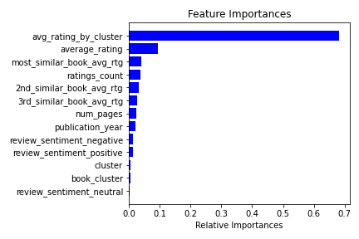
Key Finding
Most predictive feature:
Reader’s average rating by book cluster
Business Takeaways
Expand book features
Refine clustering
Improve our recommendations
Increase affiliate revenue

Slide 4
My Process - Data Collection
Combined two datasets, dozens of combined attributes
Kept features below as starting point
Books dataset - lists various features of individual books:
Genre
Text Description
Author(s)
Avg Rating
# of ratings
Publication Date
Reviews dataset - features of reviews by a specific reader
Rating (1 through 5)
Review text
Used data collected by Mengting Wan, available here: https://sites.google.com/eng.ucsd.edu/ucsdbookgraph/home

Slide 5
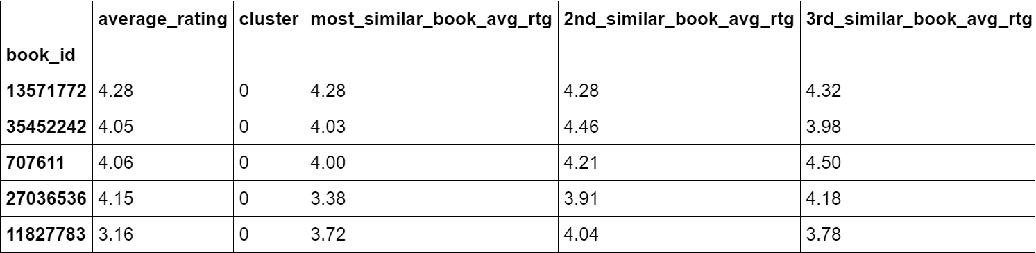
Feature Engineering - Book Features
Average rating of similar books
Cosine similarity rankings of all books
Rank top 3 most similar by each book
Reader’s average rating by book “cluster”
K-Means Clustering on books
Groupby user & cluster: mean rating

Slide 6


Feature Engineering - Review Features
Average rating by book cluster
Books clusters from last step
Groupby reader and book cluster
Assign mean rating by cluster
Sentiment Rating for each review
Natural Language Processing (NLP)
nltk Python package
SentimentIntensityAnalyzer
Review Text
Positive
Neutral
Negative

Slide 7
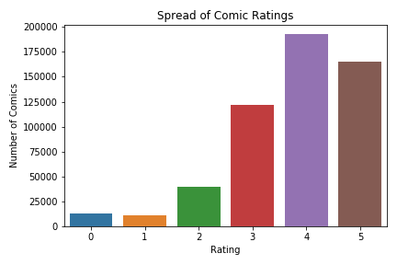
Target Feature
Predict rating a given reader would give to a specific book
Rating | % of Overall Ratings
0 | 2%
1 | 2%
2 | 7%
3 | 22%
4 | 35%
5 | 30%
Upsampling of minority classes to account for imbalanced classes

Slide 8
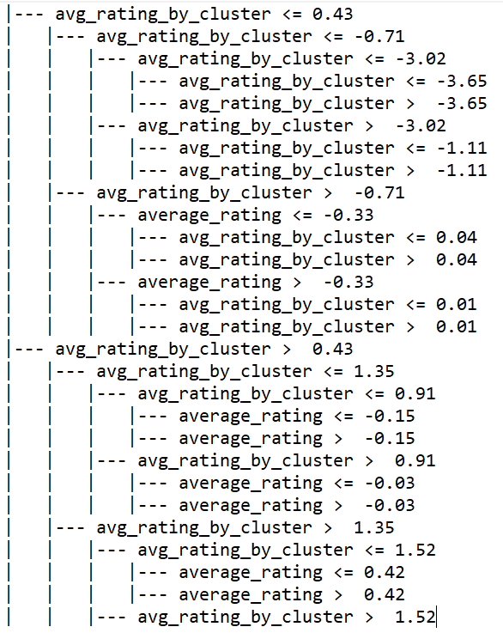
Model Parameter Tuning
Grid Search cross validation to optimize parameters for each algorithm
K-Nearest Neighbors Decision Tree Random Forest
n_neighbors = 13
< top 4 levels almost all split on avg_rating_by_cluster

Slide 9
Model Metrics
Metric | KNN | Decision Tree | Random Forest
accuracy | 0.55 | 0.57 | 0.57
precision | 0.58 | 0.62 | 0.63
recall | 0.43 | 0.45 | 0.44
f1-score | 0.47 | 0.49 | 0.48

Slide 10
Further Research
Expand across genres
Incorporate implicit features -
clicks, page views, etc.
Include other user interactions -
Shelves - “to read”, “to buy”, etc.
Utilize cover image art as an additional feature

