Slide 1
Goodreads Book Recommendations
Mark Durrenberger
Springboard Data Science Intensive Capstone Project

Slide 2

The Problem
Goodreads
User-based reviews & ratings of books
Millions of reviews/ratings
Generate revenue through book recommendations
Goal: Build a model to predict reader ratings of books

Slide 3
Data Collection
Books - features of individual books
Genre
Text Description
Author(s)
Avg Rating
# of ratings
Publication Date
Reviews - features of reviews by a specific reader
Rating (1 through 5)
Review text
Used data collected by Mengting Wan, available here: https://sites.google.com/eng.ucsd.edu/ucsdbookgraph/home

Slide 4
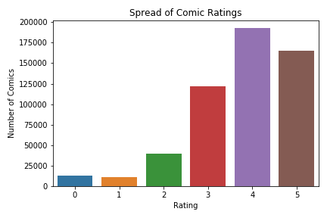
Target Feature
Predict rating a given reader would give to a specific book
Rating | % of Overall Ratings
0 | 2%
1 | 2%
2 | 7%
3 | 22%
4 | 35%
5 | 30%

Slide 5
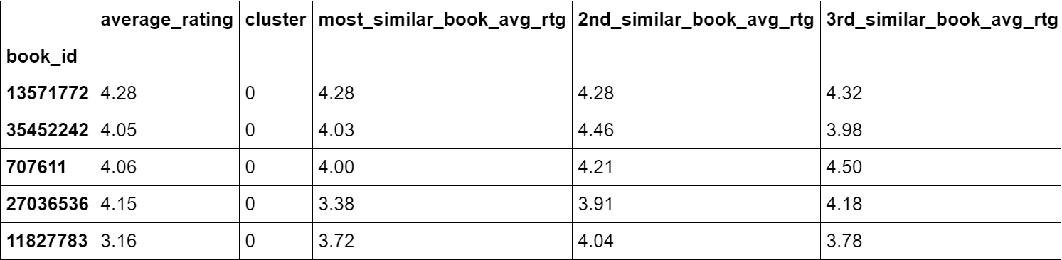
Feature Engineering - Book Features
Average rating of similar books
Cosine similarity rankings of all books
Rank top 3 most similar by each book
Reader’s average rating by book “cluster”
K-Means Clustering on books
Groupby user & cluster: mean rating

Slide 6
Feature Engineering - Review Features
“Positive” “Neutral” “Negative”
Natural Language Processing (NLP)
nltk Python package
SentimentIntensityAnalyzer
Examine text of each review
Assign sentiment

Slide 7
Modelling - Optimal Hyperparameters
K-Nearest Neighbors
N_neighbors: 13
Leaf_size: 3
P: 2
Decision Tree
Max_depth: 9
Min_samples_leaf: 13
Criterion: entropy
Random Forest
N_estimators: 300
Max_depth: 15
Min_samples_leaf: 5

Slide 8
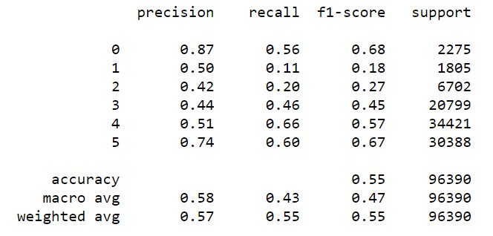
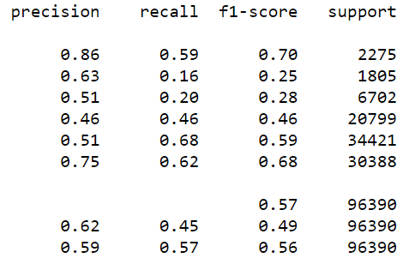
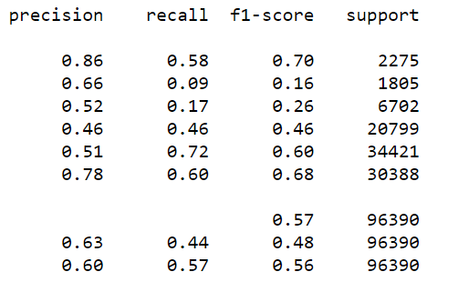
Model Results
K-Nearest Neighbors
Best model performance:
Decision Tree
Best model performance:
Random Forest
Best model performance:

Slide 9
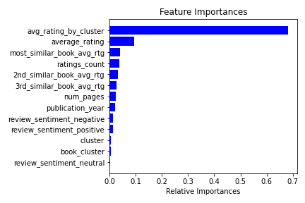
Recommendations
Most predictive feature:
Reader’s average rating by book cluster
Focus on refining clustering
Expand book data features

Slide 10
Further Research
Expand across genres
Incorporate implicit features -
clicks, page views, etc.
Include other user interactions -
Shelves - “to read”, “to buy”, etc.
Utilize cover image art as an additional feature

