Slide 1
Agenda
1. Sales Trends – High-level Summary
2. Key Question:
“What factors drive customer purchases ‘up market’?”
3. Other Summaries/Trends

Slide 2
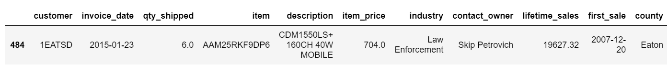
Timeframe
23 Jan. 2015
First sales
23 Sep. 2020
Final sales

Slide 3
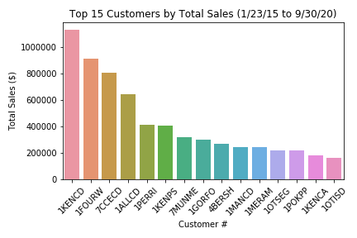
1. Sales Summary – 2015:9/30/2020
Total Sales | $12,919,911 | % of Total Sales
By top Customer | $1,129,461 | 8.7%
By top 4 | $3,492,509 | 27%
By top 15 | $6,477,592 | 50%

Slide 4
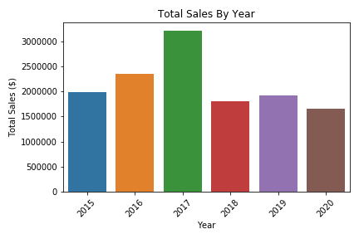
1. Sales Summary – Total Sales by Year
* Partial year 2020

Slide 5
1. Sales Summary - “6 Box”
Year: | 2015 | 2016 | 2017 | 2018 | 2019
Above $30k | 10 | 14 | 16 | 9 | 21
$10k - $30k | 17 | 21 | 18 | 18 | 20
$0 - $10k | 143 | 132 | 136 | 170 | 165
Total Customers: | 170 | 167 | 170 | 197 | 206

Slide 6
2. Key Question
“What factors drive customer purchases up market?”

Slide 7
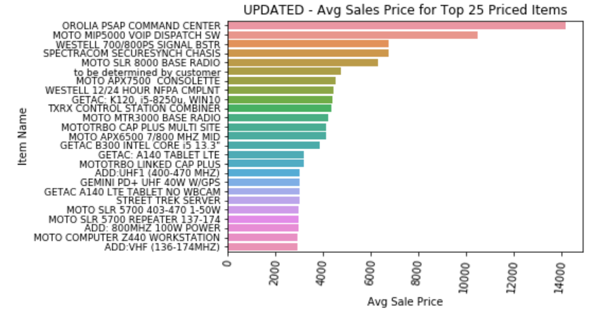
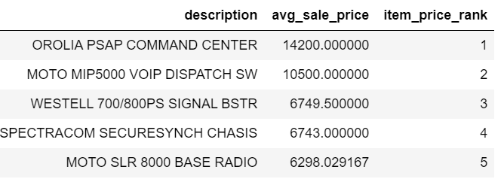
2. Set Up – Item Rank by Price
Ignore items under $40
Rank every item by Avg price
Highest: Orolia PSAP Command Center
Lowest: Moto Batt LIION 2300T

Slide 8
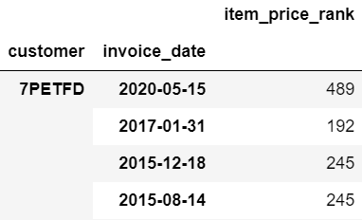
2. When does a customer purchase a higher priced item than ever before?
< No(GETAC Adapter - $108)
< YES(Moto XPR3500E - $513)
< No(Moto Min VI Pager - $420)
< No(Moto Min VI Pager - $420)

Slide 9
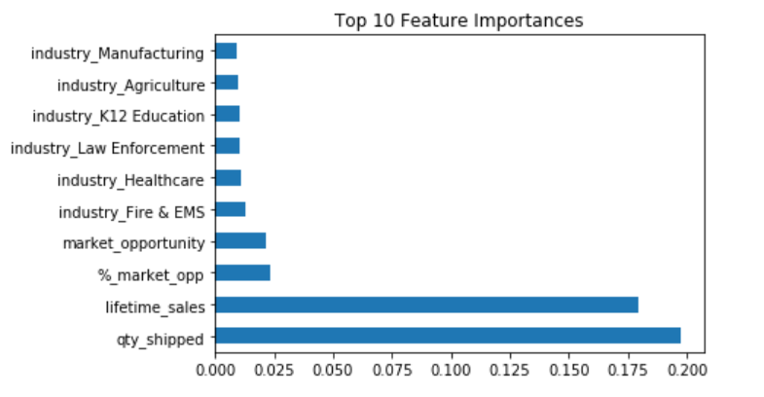
2. What factors matter?
Sales/Qty ⬄ Higher Priced Purchases

Slide 10
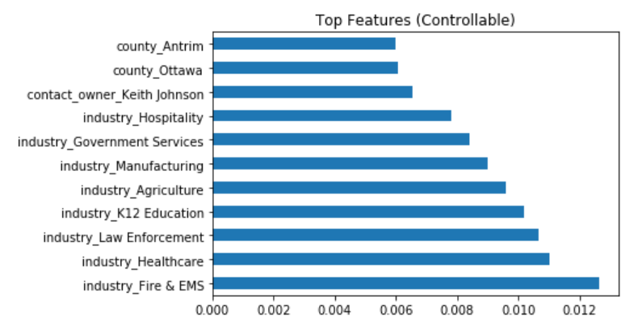
2. “Controllable” Factors that Matter
What factors relate to higher priced purchases?

Slide 11


3. Other Summaries

Slide 12

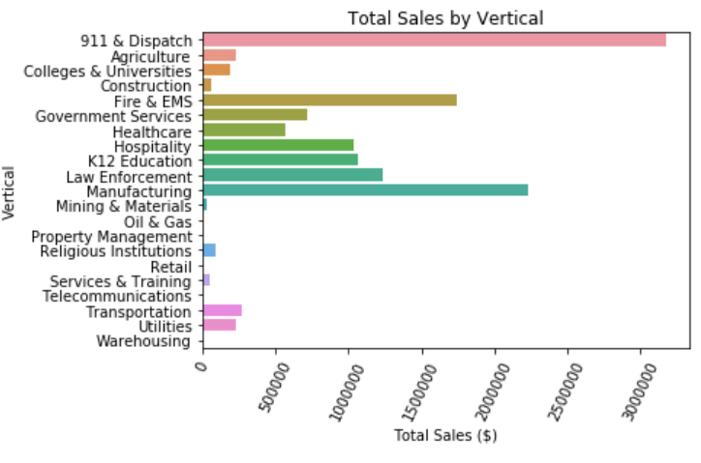
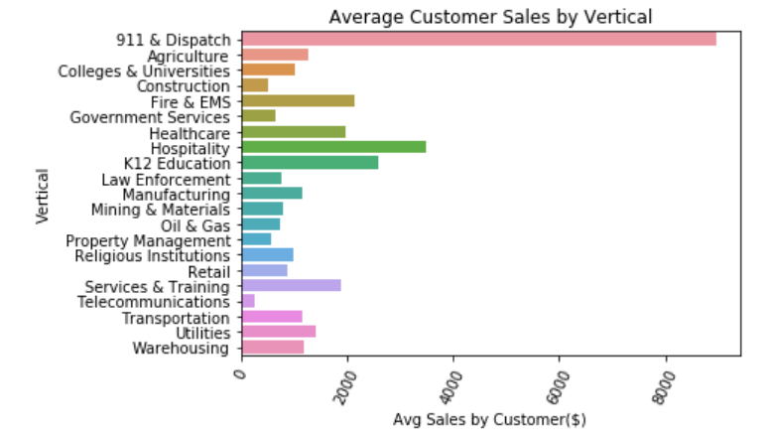
Total & Average Sales by Vertical
911 & Dispatch: Bread & Butter
Hospitality 2nd Highest Avg

Slide 13
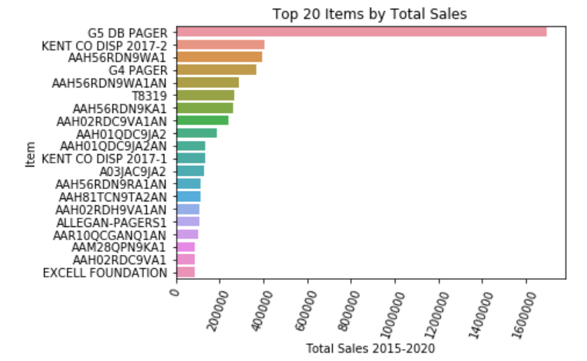
Top Total Sales by Item

