Slide 1

Sleeper Cities Analysis
Bootcamp: UTA-VIRT-DATA-PT-02-2021-U-B-TTH
Mark Esposito - Ryan Meredith - Joseph Worland - Elard Yong
July 2021

Slide 2
Presentation Introduction
Questions & Answers
✓ Selected topic
Predicting “Sleeper Cities” primed for explosive growth
✓ Reason why they selected their topic
Help different customers determine their next big move
I.e. construction, restaurant, entertainment…
✓ Description of their source of data
Census.gov, Realtor.com, & more...
✓ Questions they hope to answer with the data
Using different sets of data, can we accurately predict which cities will be the
next fastest growing cities in the country?

Slide 3



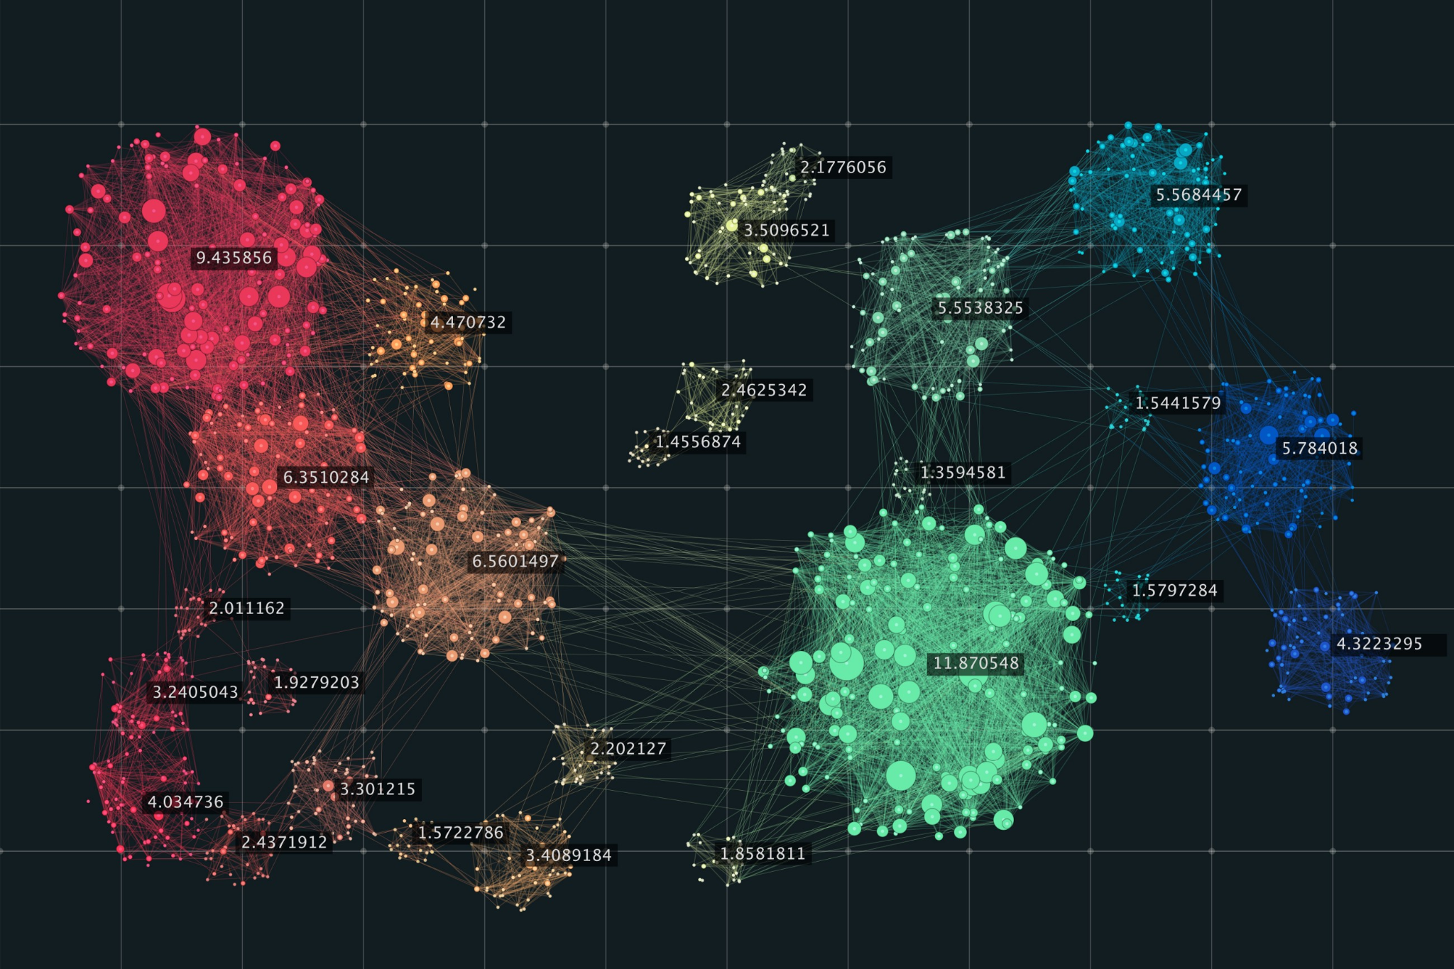




Data Pipeline Management
Four Stages of data
S1
S2
S3
S4
Data Collection
Data Storage
ETL
Machine Learning Modeling
Collecting housing, income, weather data, and other data from sources like US Census - BEA - Realtor.com, etc.
Store raw and cleaned data on MongoDB Atlas Clusters as collections (JSON)
Utilizing Jupyter notebooks and Python to Extract JSON lists from MongoDB. Transforming, cleaning, and preparing the data to be Loaded into a unsupervised ML model.
Creating unsupervised ML model from sklearn to create clusters.

