Slide 1

Sleeper Cities Analysis
Bootcamp: UTA-VIRT-DATA-PT-02-2021-U-B-TTH
Mark Esposito - Ryan Meredith - Joseph Worland - Elard Yong
July 2021

Slide 2
Presentation Introduction
Questions & Answers
✓ Selected topic
Predicting “Sleeper Cities” primed for explosive growth
✓ Reason why they selected their topic
Help different customers determine their next big move
I.e. construction, restaurant, entertainment…
✓ Description of their source of data
Census.gov, Realtor.com, & more…
✓ Questions they hope to answer with the data
Using different sets of data, can we accurately predict which cities will be the
next fastest growing cities in the country?

Slide 3
Presentation
Data Exploration
✓ Housing
Median listing price
Active listing count
New listing count
Average listing price
Total listing count
✓ Income
Average income per capita per city
✓ Population
2019 population of metro area/city
✓ Weather
Temperature
Wind Speed
Wind Direction
Dew Point (association to humidity)
Air Pressure
*For further breakdown of Data Exploration please refer to the “Data Exploration” section of the README file of our GitHub repository.

Slide 4
Presentation
Data Analysis
How to evaluate the cluster analysis…
Once the Kmeans and Affinity Propagation method have generated there respective clusters, we then incorporate the classifications with the original dataset so the true values prior to standardization are joined and exported as datasets.
With these datasets we can then see which cities were clustered with Austin, TX and compare the original value for housing, income, population, and weather to see if these do indeed share similar traits or have varying values in order to validate the clustering methods.
*For further breakdown of Data Analysis please refer to the README file of our GitHub repository.

Slide 5



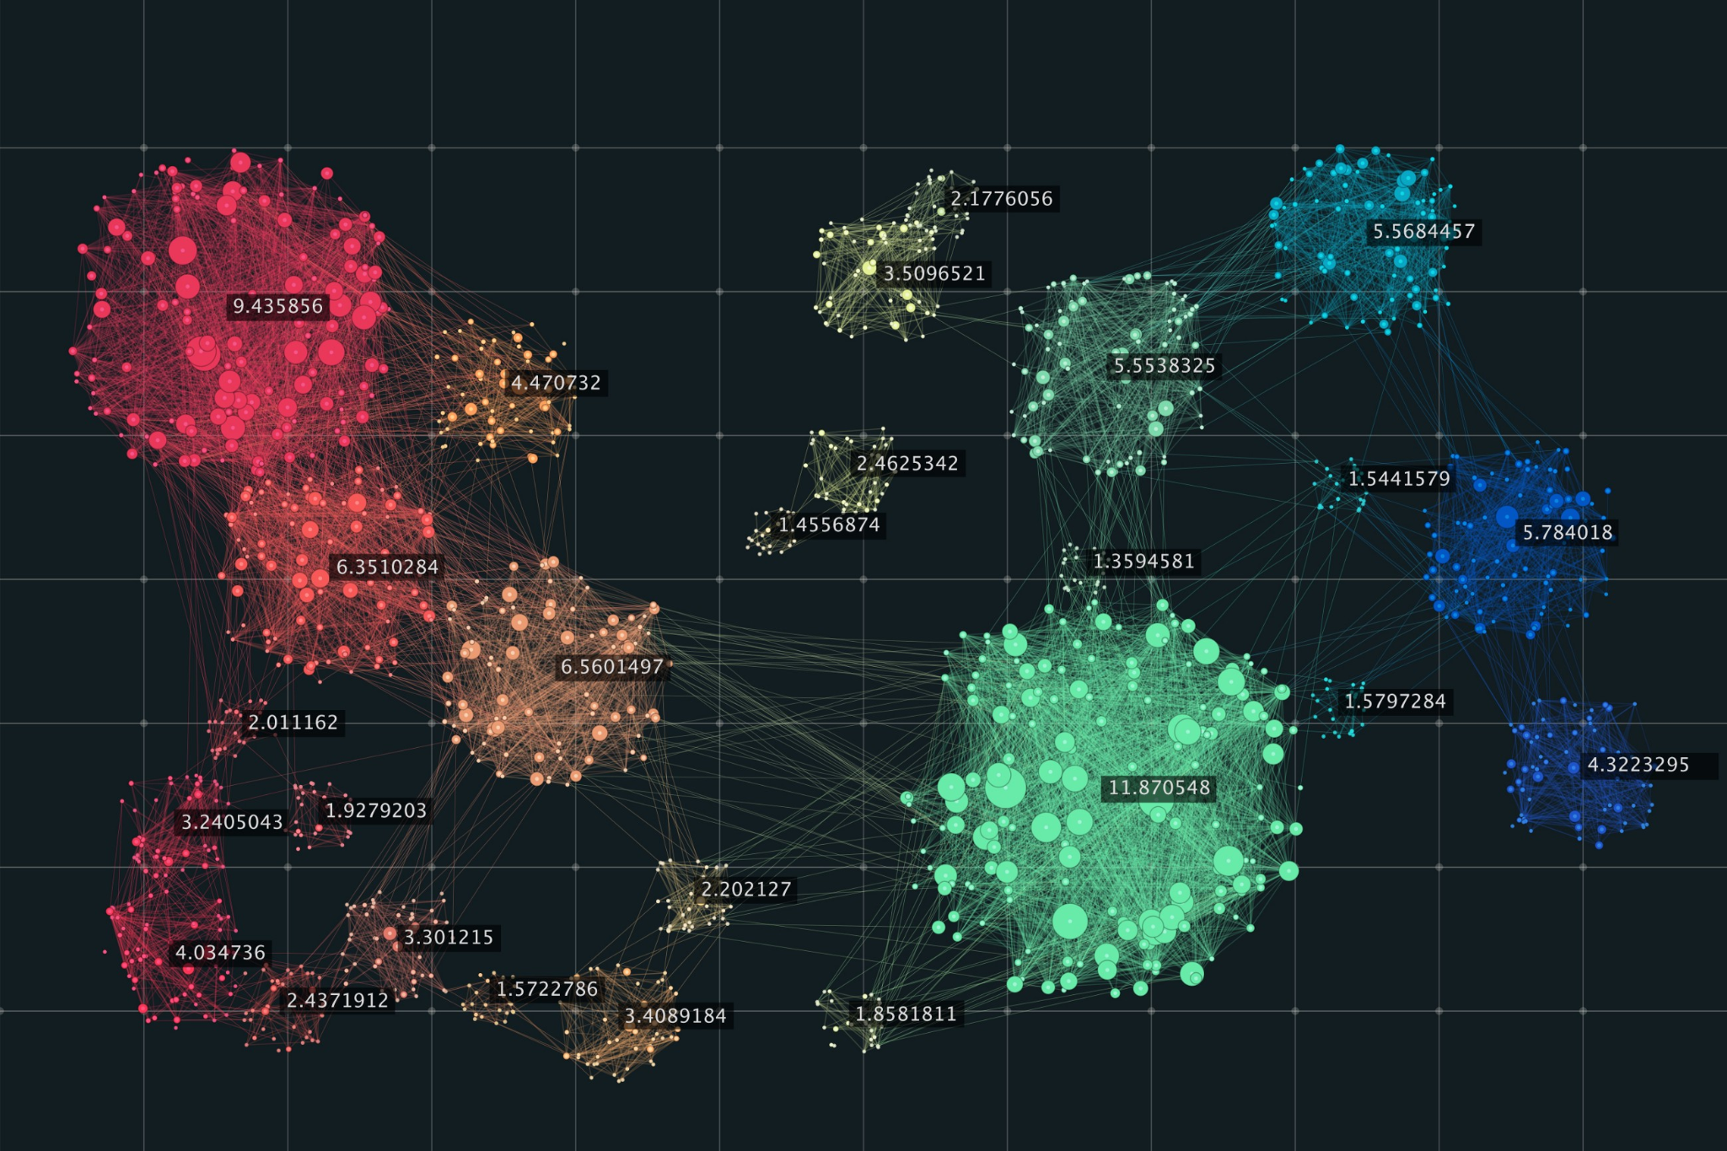




Data Pipeline Management
Four Stages of data
S1
S2
S3
S4
Data Collection
Data Storage
ETL
Machine Learning Modeling
Collecting housing, income, weather data, and other data from sources like US Census - BEA - Realtor.com, etc.
Stored raw files on AWS S3 buckets, and utilizing AWS RDS and Postgres for our Database.
Utilizing Jupyter notebooks and Python to Extract JSON lists from MongoDB. Transforming, cleaning, and preparing the data to be Loaded into a unsupervised ML model.
Creating unsupervised ML model from sklearn to create clusters.

Slide 6
Database Structure - Schema
Population & Income Data
_id object
metro_area/city object
income int64
Population int64
Housing Data
_id object
date object
metro_area/city object
median_listing_price float64
active_listing_count int64
median_days_on_market float64
new_listing_count int64
price_increased_count int64
price_reduced_count int64
pending_listing_count int64
average_listing_price float64
total_listing_count int64
Final Database
_id object
date object
metro_area/city object
median_listing_price float64
active_listing_count int64
median_days_on_market float64
new_listing_count int64
price_increased_count int64
price_reduced_count int64
pending_listing_count int64
average_listing_price float64
total_listing_count int64
Weather Data
_id object
metro_area/city object
temperature int64
wind_speed int64
pressure int64
Data Explanation:

Slide 7
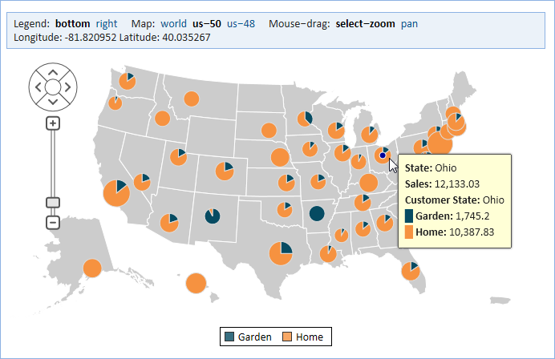
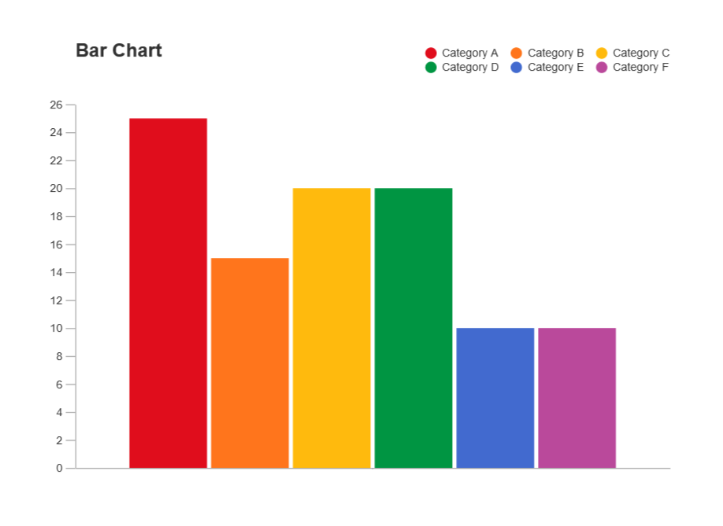
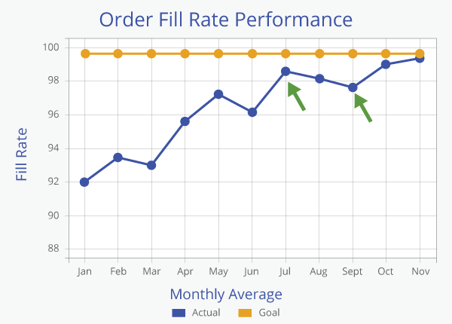
Dashboard Draft
City 1
City 2
City 3
…
Criteria 1
Criteria 2
Criteria 3
….
Map
Showing all cities
Filtering criteria:
Top 100
Top 50
Top 10
Line Graph
Austin as model city
Weather data over 12 months
Housing data over 12 months

