Slide 1
Car_With_Hand_Motion

Slide 2
Components
1. AT_MEGA32
2. 1 flexible sensor
3. Battery
4. 2 pot resistance (5k)
5. Resistance (1k,10k)
6. Jumper wires
7. 2 Bluetooth Modules(HC-05)
8. L293D driver
9. 2 Motors.

Slide 3
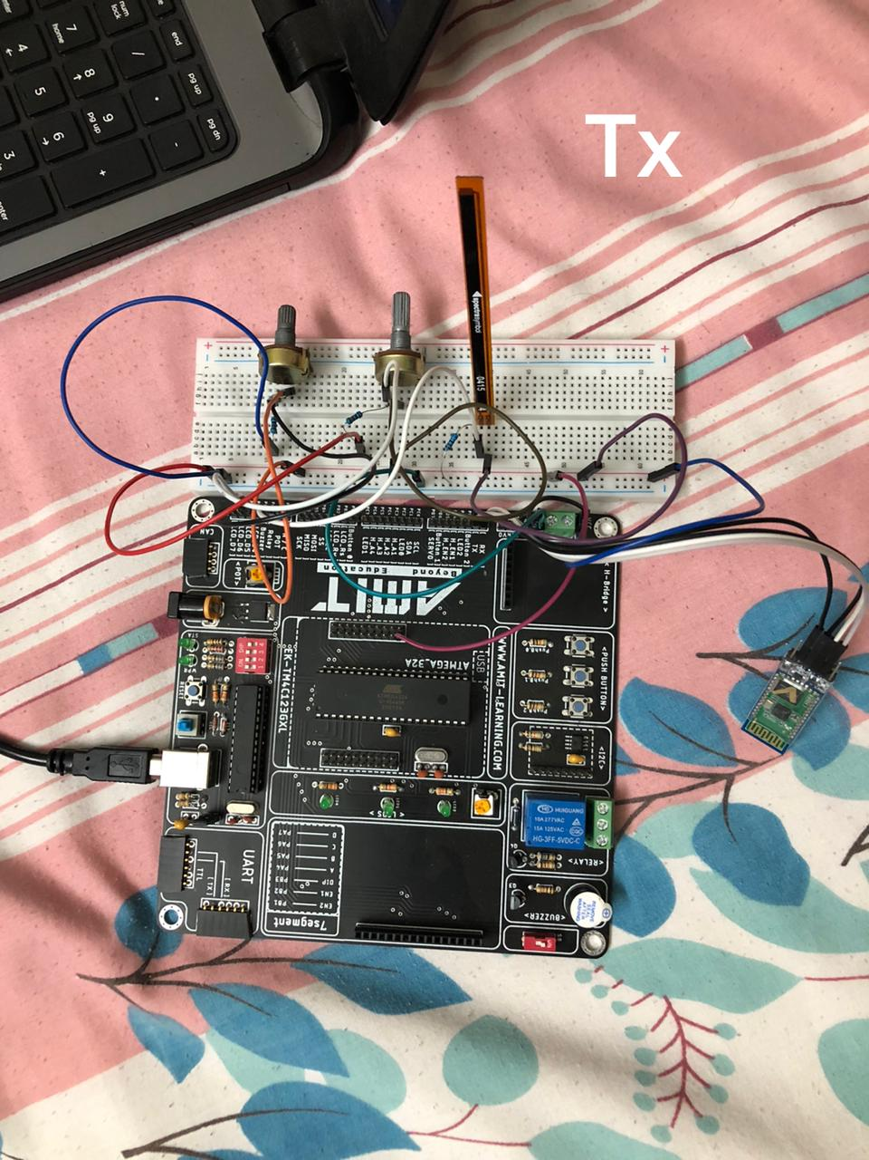
At Transmitter(TX)
How To Use Our Car
a flex sensor :
- that when we make it straight the motor in stop state
-when we move it 30 degree the motors of car move forward
-when we move it more than 60 degree the motors of car move backward
Middle pot resistance :
-This a variable resistance instead of flexible sensor.
-This middle pot is the control speed of car motors so you can increase the speed or decrease it by this pot
Last pot resistance :
-This a variable resistance instead of flexible sensor.
-This pot is the Right & Left directions of car motors so
when we move it left the motors of car move Left
when we move it right the motors of car move Right
when we move it at middle the motors will stop

Slide 4
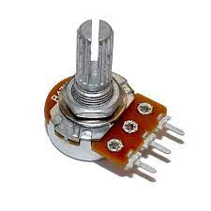
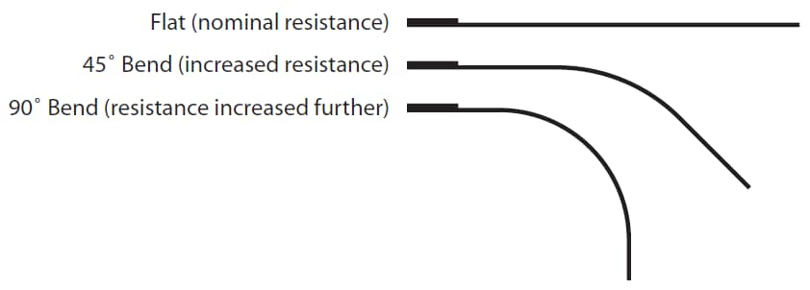
Potentiometer 1
Potentiometer 2
Stop at the middle
Increase speed
Decrease speed
Left Direction
Right Direction
Flexible sensor
Stop
Forward
Backward

Slide 5
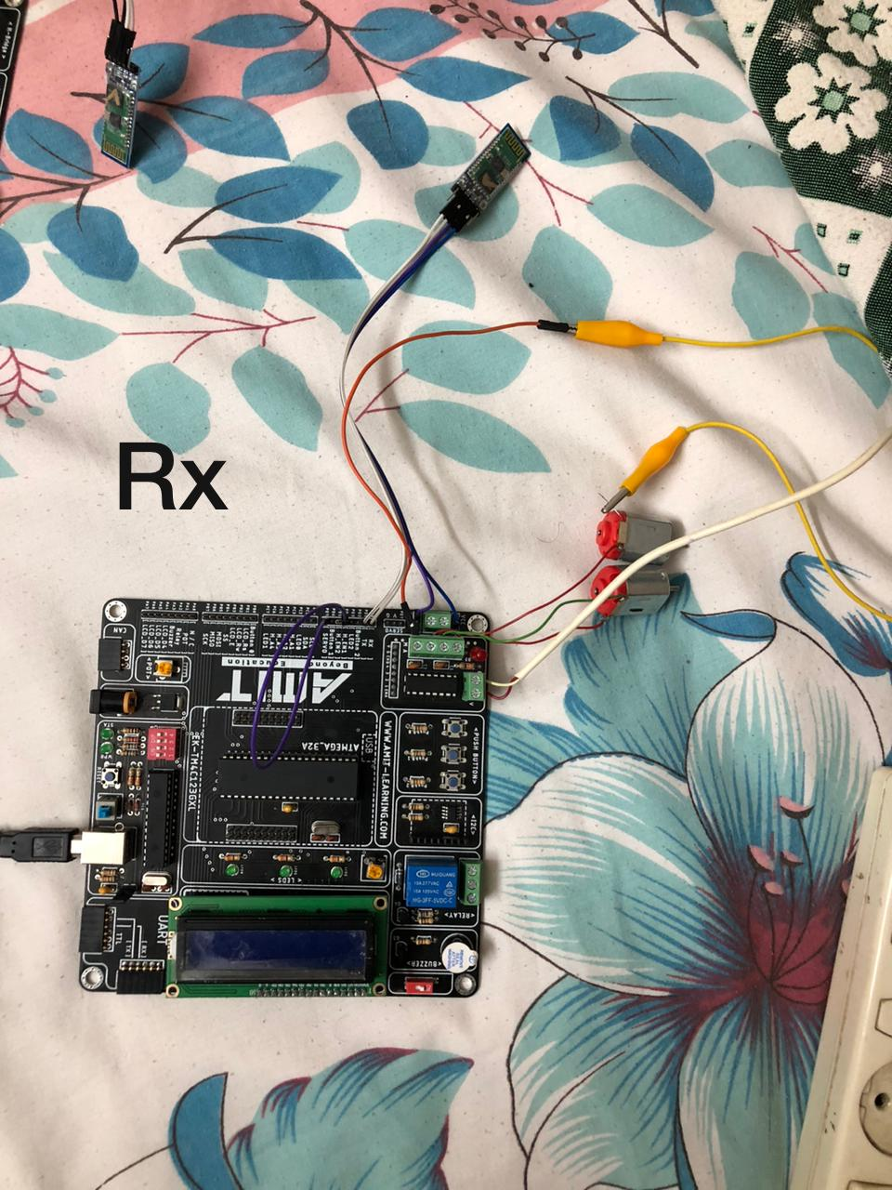
At Receiver (RX)
Lcd :
-It display the direction & speed of motor
Like : Froward
Speed: 99%
Bluetooth module :
-Hc-05 module which receives the signal from Bluetooth module of transmitter
L293D driver :
-This driver which is make the car directions
Battery :
-That is an input to the L293D driver
Motors:
- 2 motors for the car

Slide 6
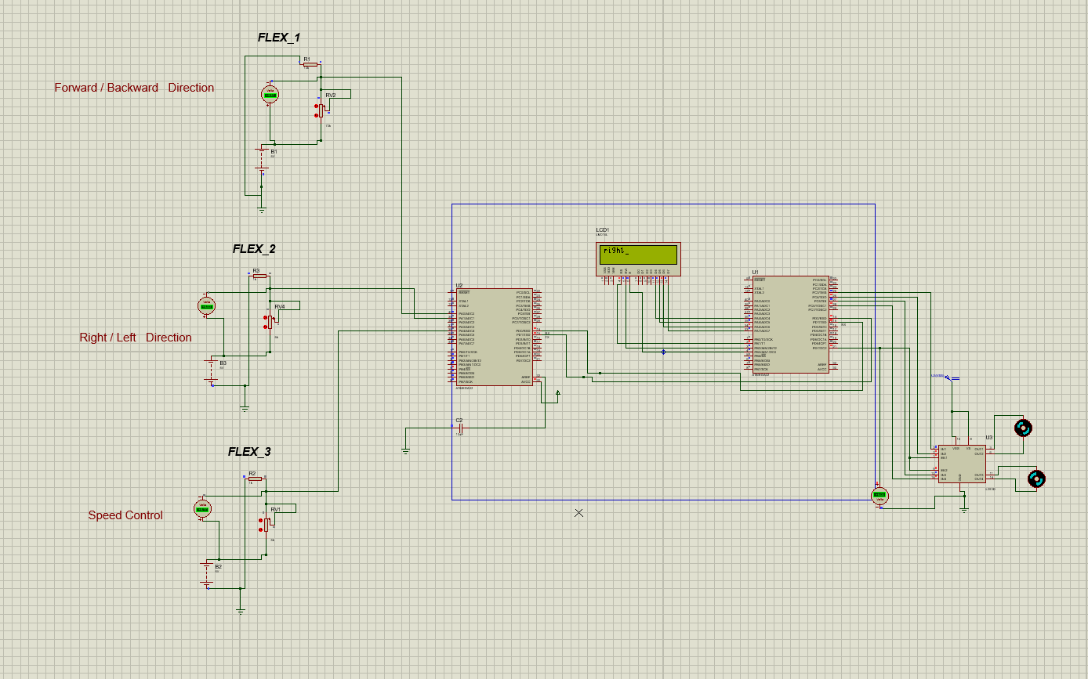
Circuit diagram

Slide 7
Applications
-This project aims to control a car direction and speed using hand motion or finger motion.
This project has tremendous applications especially in health domain. For example:
a person who is disabled and is on wheelchair can control his wheelchair just by using hand motion.
We know how dangerous it can be to meet a covid-19 positive patient. This project can be used there as well to open doors wirelessly, to supply food to patients through robot or robotic car just by using hand gestures.

Slide 8
Thanks

