Slide 1
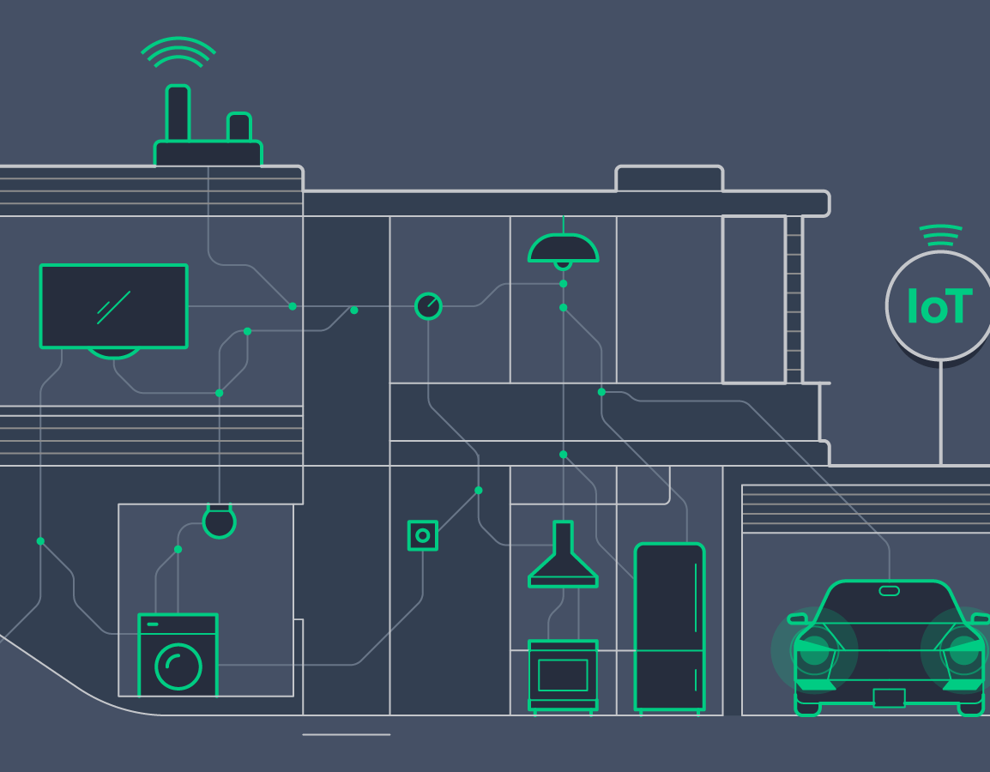

Smart Home using OS
A proposal for our Graduation Project
Seifeldin Ahmed Ismail
Mark Akram Salah
Ahmed Sherif Sayed
Michael Malak Mikhael

Slide 2
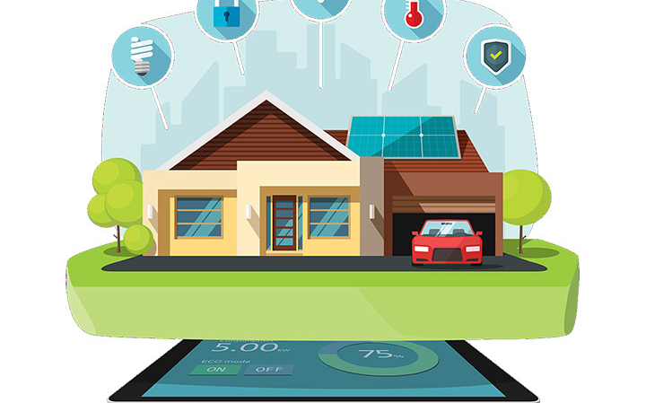
Problem Statement
In an era characterized by rapid technological advancements and an ever-growing dependence on connectivity, the concept of a "smart home" has emerged as a transformative force in the way we live and interact with our living spaces. A smart home represents the convergence of cutting-edge technology, convenience, and efficiency to enhance our quality of life. This introduction serves as a gateway to our ambitious project, one that delves into the heart of this digital revolution and aims to redefine the very essence of home living.
2

Slide 3
Agenda
1- Understanding Smart Homes
2-Key Components and Devices
3-Working Principles
4-Simulation
5-Q & A
3

Slide 4
1-Understanding Smart Homes
1-Home Automation:
Smart homes rely on automation to perform tasks and functions without the need for manual intervention. This includes controlling lighting, heating, cooling, security cameras, and even appliances. Automation can be based on schedules, triggers, or user input.
2-Security:
Smart homes often incorporate security systems that include motion sensors, door/window sensors, and alarms. Users can receive real-time alerts and monitor their homes remotely, enhancing security and peace of mind.
3-Energy Efficiency:
Smart thermostats and lighting systems can optimize energy usage by adjusting settings based on occupancy, time of day, and user preferences. This can result in energy savings and reduced utility bills.
4

Slide 5
2-Key Components and Devices
Interfacing
Modules
KEYPAD
LCD
H-Bridge
7-Segments
Relays
Transistors
Microcontroller
STM32F401CC
RTOS
RCC
GPIO
ADC
UART
SYSTICK
Components
Sensors
Heater
Fan
Doors
Buzzers
Leds
LM35
LDR
GAS sensor
5

Slide 6
3-Working Principles
Automatic Control
Manual Control

Slide 7
3-Working Principles
Room_1
When Temp get above 25 → Fan On & Heater Off
When Temp get Below 20 → Fan Off & Heater On
Temp between 25 & 20 → Fan Off & Heater Off
Temp above 30 OR below 10 → BUZZER &LED ON
Room_2
When LDR Detect motion → Open Door
Otherwise door closed
Kitchen
When Gas sensor get activated led & buzzers on
Otherwise off
Garage
When LDR Detect Car → Open Door
Otherwise door closed
Real Time Clock
Shows Real Time
7

Slide 8
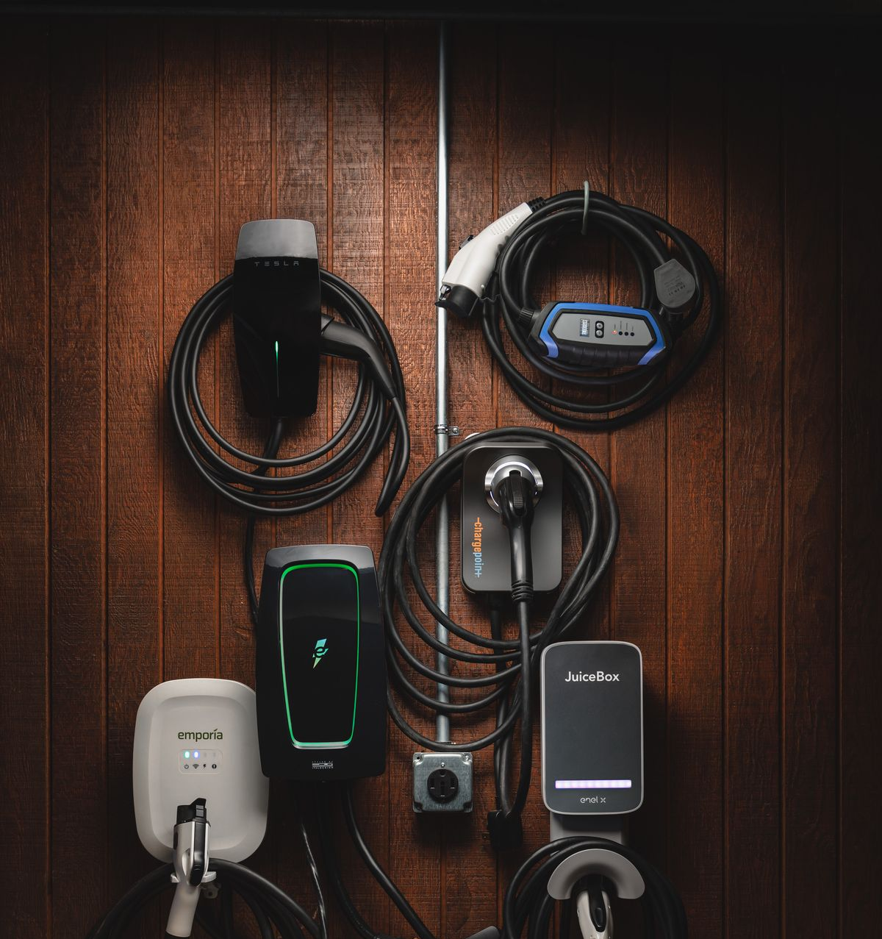
4-Simulation
8

Slide 9
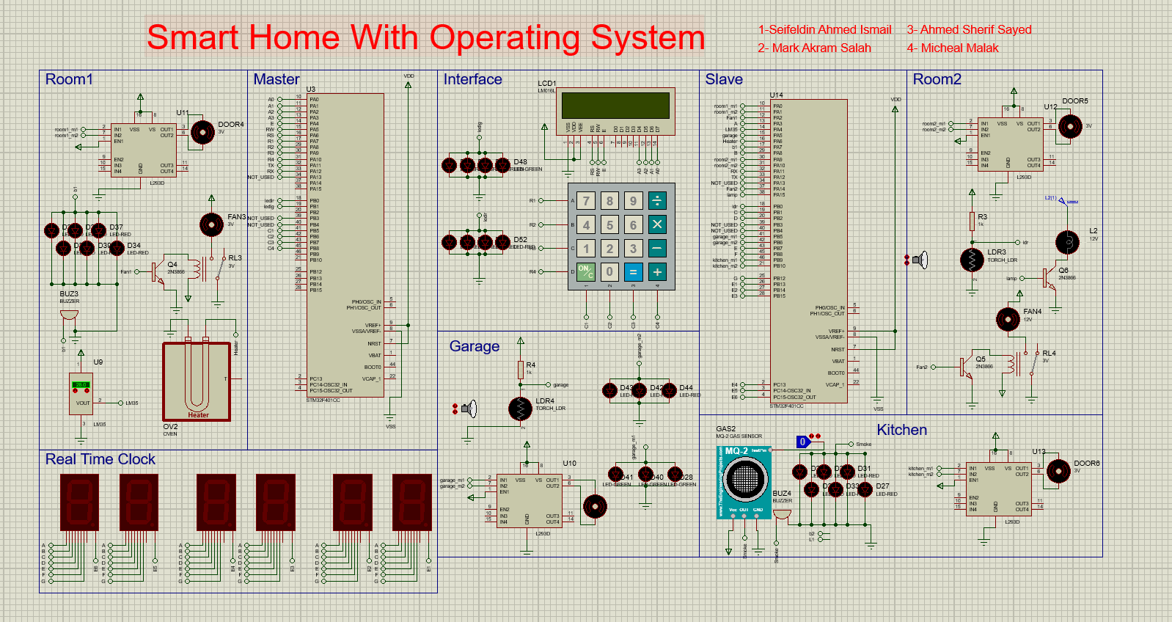
9

Slide 10
Q & A?
10

Slide 11
Thank you

