Slide 1

UC Berkeley’s CS61A – Lecture 02 – Names
The Hard Part of Computer Science? Getting Into Class! www.nytimes.com/2019/01/24/technology/computer-science-courses-college.html
“College students are rushing in record numbers to study CS.
On campuses across the country, from major state universities to small private colleges, the surge in student demand for computer science courses is far outstripping the supply of professors, as the tech industry snaps up talent. … “demand is unbounded” … “It’s going to get worse before it gets better,”

Slide 2
Announcements
There’s still room for lots of students to join the course! (so, I’ll sign all Concurrent Enrollment forms)…yay!
Our website cs61a.org has all the information you need, link to Piazza, no need for bcourses for this course
We just had discussion first week, we’ll have lab and discussion next week
You don’t have to come to lecture, today and onward there will only be one lecture 2-3pm, so 500/1250 of you have to decide to watch the webcast only. We can’t have anyone in the aisles per fire marshall rules. Videos will be available a few hours afterwards on CalCentral or bcourses, but we’ll also eventually link to them from the calendar.
Don’t take a handout if you won’t use it, write on it, and keep it.
Make sure you’re reading the textbook as well! (there are readings for every lecture)
Take CS10 concurrently if you don’t have any programming experience. Follow me after class and we’ll walk together to CS10 lecture. There was also lab yesterday.
First homework (including the survey) out tonight and the first project early next week

Slide 3
Names, Assignment, and User-Defined Functions (Goal: Get you to have a correct understanding of the Notational Machine of Python, the “set of abstractions that define the structure and behavior of a computing device” –Guzdial)
(Demo1)
computinged.wordpress.com/2016/03/07/notional-machines-and-misconceptions-in-cs-developing-a-research-agenda-at-dagstuhl/

Slide 4
Types of Expressions
Primitive expressions:
2
add
'hello'
Number or Numeral
Name
String
Call expressions:
max ( 2 , 3 )
Operator
Operand
Operand
An operand can also be a call expression
max(min(pow(3, 5), -4), min(1, -2))

Slide 5





Discussion Question 1
What is the value of the final expression in this sequence?
>>> f = min
>>> f = max
>>> g, h = min, max
>>> max = g
>>> max(f(2, g(h(1, 5), 3)), 4)
???

Slide 6
Environment Diagrams

Slide 7
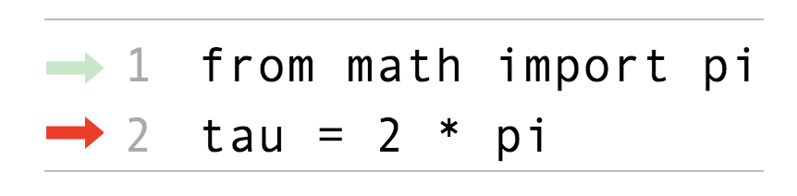
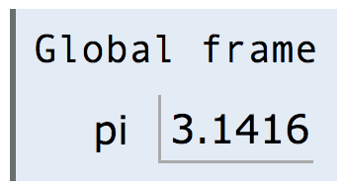
Environment Diagrams
Environment diagrams visualize the interpreter’s process.
Just executed
Import statement
Name
Value
Next to execute
Assignment statement
Code (left):
Frames (right):
Statements and expressions
Each name is bound to a value
Arrows indicate evaluation order
Within a frame, a name cannot be repeated
(Demo2)
http://pythontutor.com/composingprograms.html#code=from%20math%20import%20pi%0Atau%20%3D%202%20*%20pi&cumulative=false&curInstr=1&mode=display&origin=composingprograms.js&py=3&rawInputLstJSON=%5B%5D

Slide 8
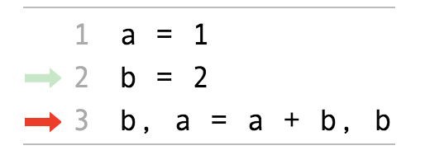
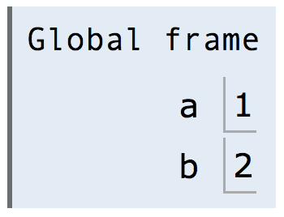
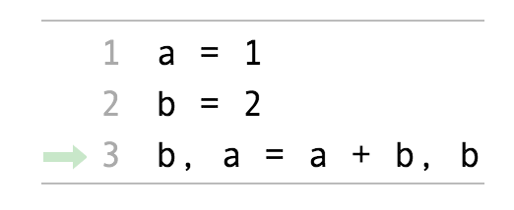
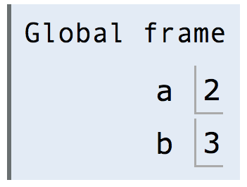
Assignment Statements
Just executed
Next to execute
Just executed
Execution rule for assignment statements:
Evaluate all expressions to the right of = from left to right.
Bind all names to the left of = to those resulting values in the current frame.
http://pythontutor.com/composingprograms.html#code=a%20%3D%201%0Ab%20%3D%202%0Ab,%20a%20%3D%20a%20%2B%20b,%20b&cumulative=false&curInstr=0&mode=display&origin=composingprograms.js&py=3&rawInputLstJSON=%5B%5D

Slide 9
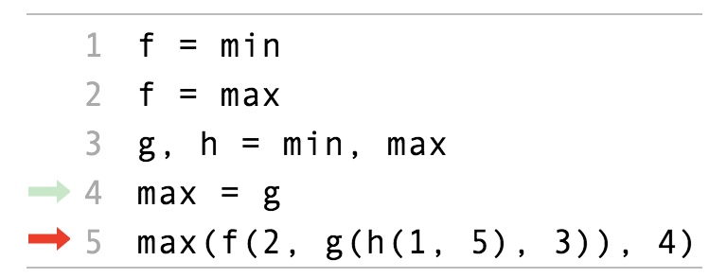
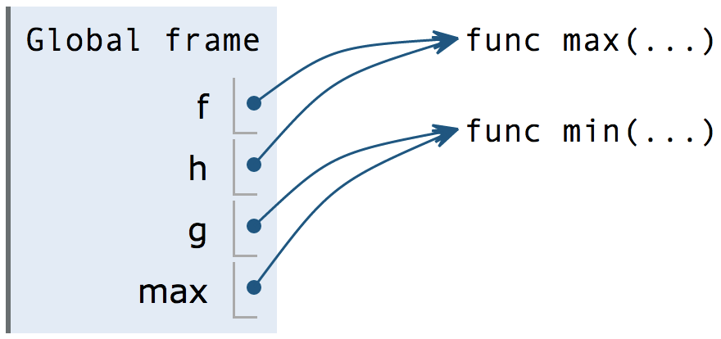
Discussion Question 1 Solution
(Demo3)
3
func min(...)
3
4
f(2, g(h(1, 5), 3))
func max(...)
2
3
3
g(h(1, 5), 3)
func min(...)
5
3
h(1, 5)
func max(...)
1
5
http://pythontutor.com/composingprograms.html#code=f%20%3D%20min%0Af%20%3D%20max%0Ag,%20h%20%3D%20min,%20max%0Amax%20%3D%20g%0Amax%28f%282,%20g%28h%281,%205%29,%203%29%29,%204%29&cumulative=false&curInstr=0&mode=display&origin=composingprograms.js&py=3&rawInputLstJSON=%5B%5D

Slide 10
Defining Functions

Slide 11
Defining Functions
Assignment is a simple means of abstraction: binds names to values
Function definition is a more powerful means of abstraction: binds names to expressions
Function signature indicates how many arguments a function takes
>>> def
<name>(<formal parameters>):
return <return expression>
Function body defines the computation performed when the function is applied
Execution procedure for def statements:
Create a function with signature <name>(<formal parameters>)
Set the body of that function to be everything indented after the first line
Bind <name> to that function in the current frame

Slide 12
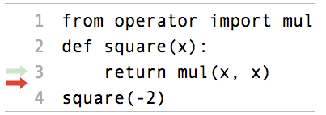
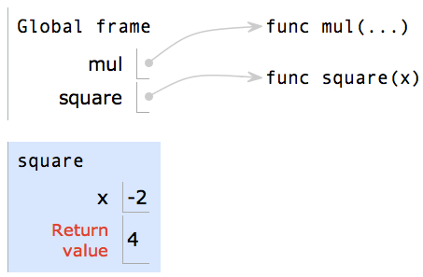
Calling User-Defined Functions
Procedure for calling/applying user-defined functions (version 1):
Add a local frame, forming a new environment
Bind the function's formal parameters to its arguments in that frame
Execute the body of the function in that new environment
(Demo4)
Built-in function
Original name of function called
User-defined function
Local frame
Formal parameter bound to argument
Return value (not a binding!)
http://pythontutor.com/composingprograms.html#code=from%20operator%20import%20mul%0Adef%20square%28x%29%3A%0A%20%20%20%20return%20mul%28x,%20x%29%0Asquare%28-2%29&cumulative=true&curInstr=0&mode=display&origin=composingprograms.js&py=3&rawInputLstJSON=%5B%5D

Slide 13
Calling User-Defined Functions
Procedure for calling/applying user-defined functions (version 1):
Add a local frame, forming a new environment
Bind the function's formal parameters to its arguments in that frame
Execute the body of the function in that new environment
A function’s signature has all the information needed to create a local frame
http://pythontutor.com/composingprograms.html#code=from%20operator%20import%20mul%0Adef%20square%28x%29%3A%0A%20%20%20%20return%20mul%28x,%20x%29%0Asquare%28-2%29&cumulative=true&curInstr=0&mode=display&origin=composingprograms.js&py=3&rawInputLstJSON=%5B%5D

Slide 14
Looking Up Names In Environments
Every expression is evaluated in the context of an environment.
So far, the current environment is either:
The global frame alone, or
A local frame, followed by the global frame.
Most important two things I’ll say all day:
An environment is a sequence of frames.
A name evaluates to the value bound to that name in the earliest frame of the current environment in which that name is found.
E.g., to look up some name in the body of the square function:
Look for that name in the local frame.
If not found, look for it in the global frame. (Built-in names like “max” are in the global frame too, but we don’t draw them in environment diagrams.)
(Demo5)

