Slide 1
UC Berkeley’s CS61A – Lecture 08 – Function Examples II
New 3D printer shapes objects with rays of light www.sciencedaily.com/releases/2019/01/190131143330.htm https://youtu.be/jcwYFBeetH0
“A new 3D printer uses light to transform gooey liquids into complex solid objects in only a matter of minutes. The printer can create objects that are smoother, more flexible and more complex than what is possible with traditional 3D-printers. It can also encase an already existing object with new materials, which current printers struggle to do.”

Slide 2
Announcements
Homework 2 is released and is due Friday 2/8 @ 11:59pm.
Hog has been released! Entire project due Thursday 2/7
You can work with a partner on Phases 2 & 3.
Submit everything by Wednesday 2/6 for an early submission bonus point.
Midterm 1
HKN Review Session Saturday 2/9 12-3 PM in HP Auditorium
CSM Review Session Sunday 2/10 2-4 PM in GPB100
Exam will take place Monday 2/11 7-8pm
Don’t come to lecture on Monday! (We’ll teach Recursion, not on the Midterm, watch video)
Academic Honesty and Dishonesty frank discussion

Slide 3
(PRINTED AGAIN SINCE NO HANDOUT ON MONDAY) Return Statements
A return statement completes the evaluation of a call expression and provides its value
f(x) for user-defined function f: switch to a new environment; execute f's body
return statement within f: switch back to the previous environment; f(x) now has a value
Only one return statement is ever executed while executing the body of a function
def end(n, d):
"""Print the final digits of N in reverse order until D is found.
>>> end(34567, 5)
7
6
5
"""
while n > 0:
last, n = n % 10, n // 10
print(last)
if d == last:
return None
(Demo)

Slide 4
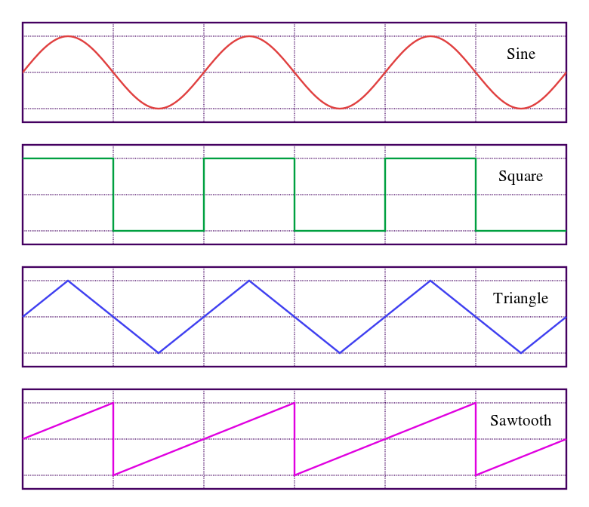
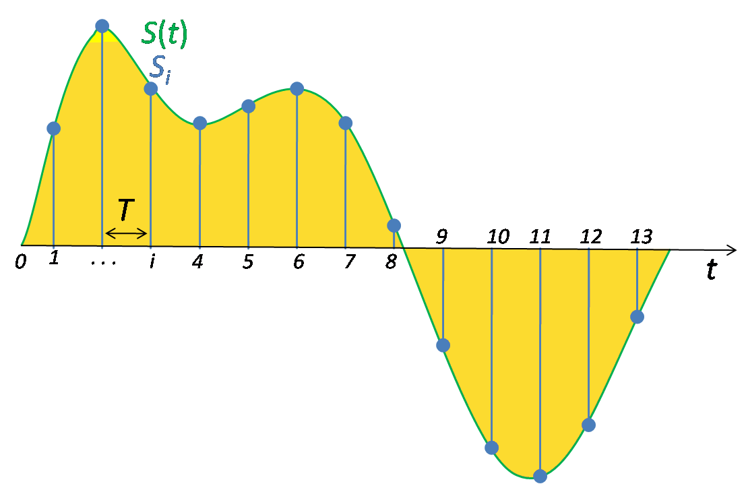
(PRINTED AGAIN SINCE NO HANDOUT ON WEDNESDAY) WAV Files
The Waveform Audio File Format encodes a sampled sound wave
A triangle wave is the simple wave form with the most pleasing sound
(Demo)
https://en.wikipedia.org/wiki/Triangle_wave https://en.wikipedia.org/wiki/Sampling_(signal_processing)

Slide 5
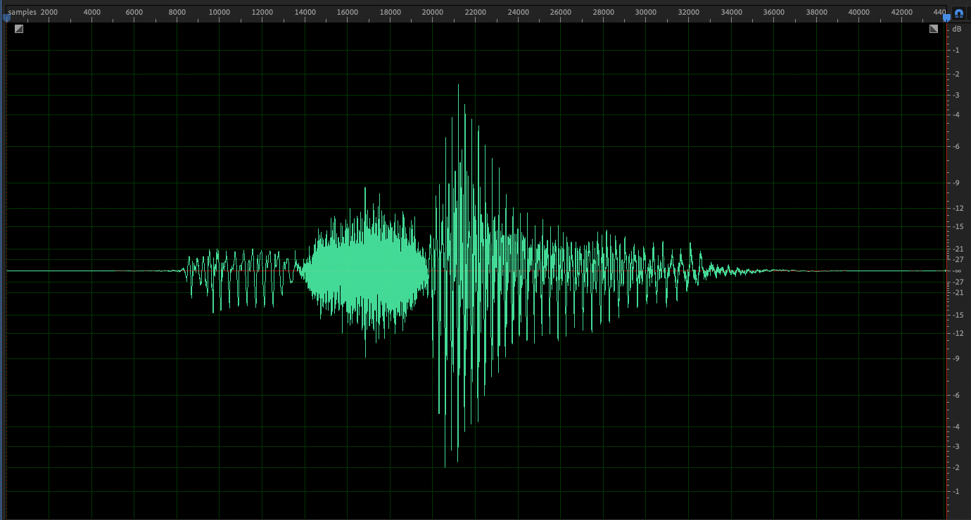

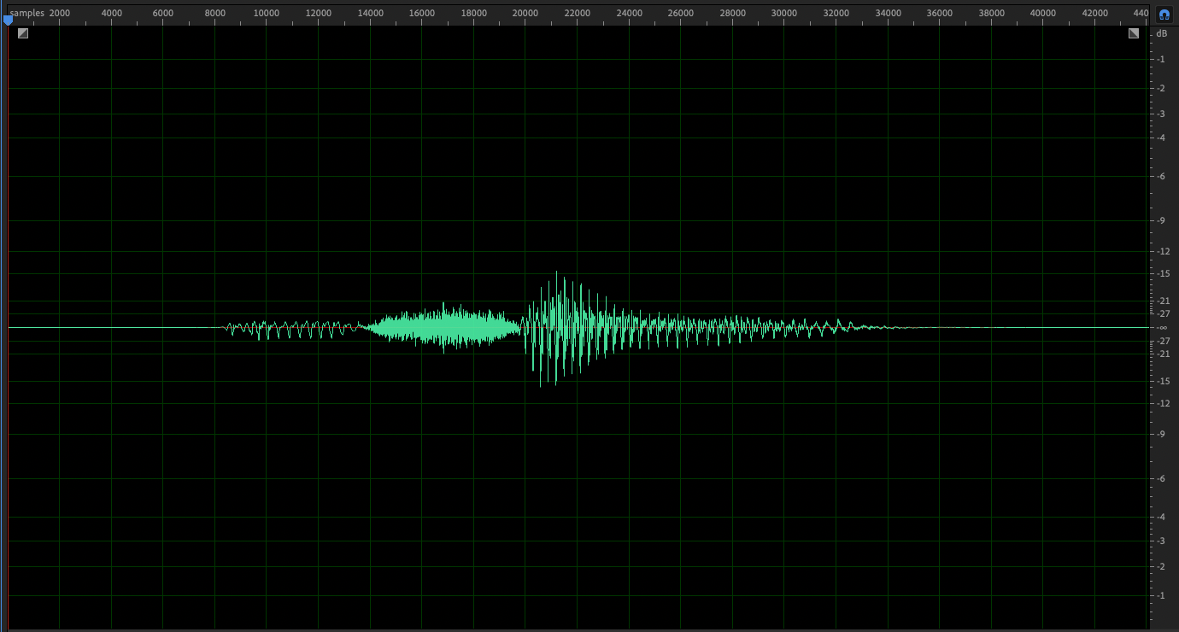
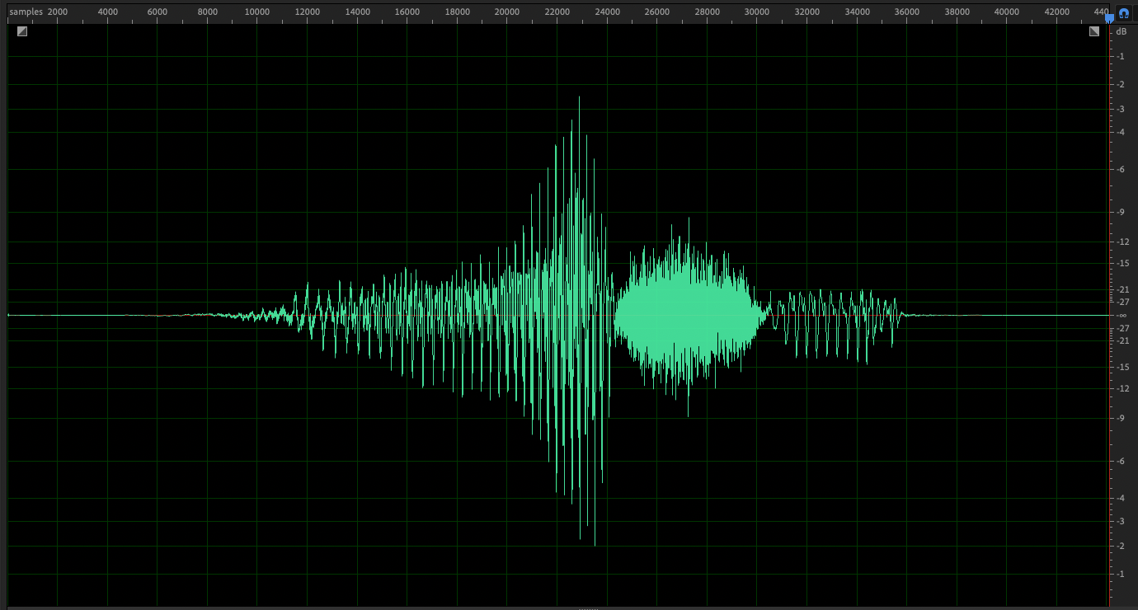
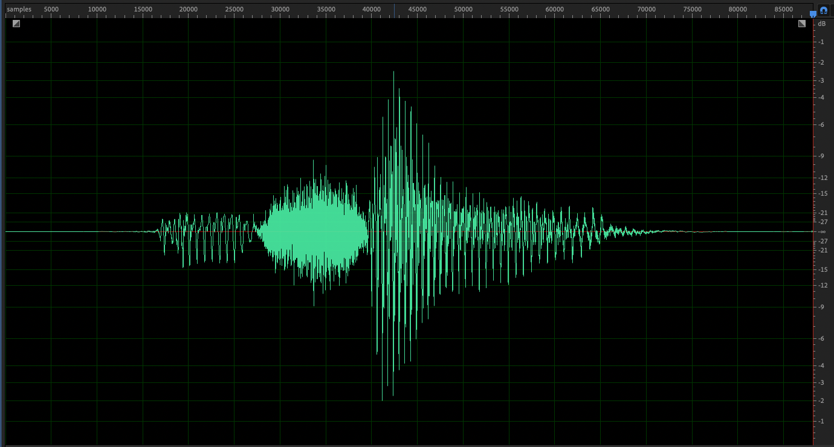

Sound demo that should have been
open_close(lambda sample: sample)
…
for sample in L:
out.writeframes(encode(mapper(sample)))
open_close(lambda sample: sample/4)
for sample in L[::-1]:
out.writeframes(encode(mapper(sample)))
for sample in L:
out.writeframes(encode(mapper(sample)))
out.writeframes(encode(mapper(sample)))
everyother = False
for sample in L:
if everyother:
out.writeframes(encode(mapper(sample)))
everyother = not everyother

Slide 6
Abstraction

Slide 7
Functional Abstractions
def square(x):
return mul(x, x)
def sum_squares(x, y):
return square(x) + square(y)
What does sum_squares need to know about square?
Yes
Square takes one argument.
Square has the intrinsic name square.
Square computes the square of a number.
Square computes the square by calling mul.
No
Yes
No
def square(x):
return pow(x, 2)
def square(x):
return mul(x, x-1) + x
If the name “square” were bound to a built-in function, sum_squares would still work identically.

Slide 8
Choosing Names
Names typically don’t matter for correctness
but
they matter a lot for composition
From:
To:
Names should convey the meaning or purpose of the values to which they are bound.
The type of value bound to the name is best documented in a function's docstring.
Function names typically convey their effect (print), their behavior (triple), or the value returned (abs).
true_false
rolled_a_one
d
dice
helper
take_turn
my_int
num_rolls
l, I, O
k, i, m

Slide 9
Which Values Deserve a Name
Reasons to add a new name
More Naming Tips
Names can be long if they help document your code: average_age = average(age, students) is preferable to # Compute average age of students aa = avg(a, st)
Names can be short if they represent generic quantities: counts, arbitrary functions, arguments to mathematical operations, etc. n, k, i - Usually integers x, y, z - Usually real numbers f, g, h - Usually functions
Repeated compound expressions:
if sqrt(square(a) + square(b)) > 1:
x = x + sqrt(square(a) + square(b))
hypotenuse = sqrt(square(a) + square(b))
if hypotenuse > 1:
x = x + hypotenuse
PRACTICAL GUIDELINES
Meaningful parts of complex expressions:
x1 = (-b + sqrt(square(b) - 4 * a * c)) / (2 * a)
discriminant = square(b) - 4 * a * c
x1 = (-b + sqrt(discriminant)) / (2 * a)

Slide 10
Testing

Slide 11
Test-Driven Development
Write the test of a function before you write the function.
A test will clarify the domain, range, & behavior of a function.
Tests can help identify tricky edge cases.
Develop incrementally and test each piece before moving on.
You can't depend upon code that hasn't been tested.
Run your old tests again after you make new changes.
Bonus idea: Run your code interactively.
Don't be afraid to experiment with a function after you write it.
Interactive sessions can become doctests. Just copy and paste.
(Demo1)

Slide 12
Currying

Slide 13
Function Currying
def make_adder(n):
return lambda k: n + k
>>> make_adder(2)(3)
5
>>> add(2, 3)
5
There's a general relationship between these functions
(Demo2)
Curry: Transform a multi-argument function into a single-argument, higher-order function

Slide 14
Decorators

Slide 15
Function Decorators
(Demo3)
@trace1
def triple(x):
return 3 * x
Function decorator
Decorated function
is identical to
def triple(x):
return 3 * x
triple = trace1(triple)
Why not just use this?

Slide 16
Review

Slide 17
What Would Python Display?
The print function returns None. It also displays its arguments (separated by spaces) when it is called.
Interactive
Output
from operator import add, mul
def square(x):
return mul(x, x)
This expression
Evaluates to
5
5
5
A function that takes any argument and returns a function that returns that arg
print(5)
None
5
print(print(5))
None
5
None
None
def delay(arg):
print('delayed')
def g():
return arg
return g
delayed
delayed
6
delay(delay)()(6)()
6
Names in nested def statements can refer to their enclosing scope
delayed
4
None
print(delay(print)()(4))
None

Slide 18
def horse(mask):
horse = mask
def mask(horse):
return horse
return horse(mask)
mask = lambda horse: horse(2)
horse(mask)
Global frame
horse
func horse(mask) [parent=Global]
mask
f1:
horse [parent=Global]
mask
horse
func λ(horse) [parent=Global]
Return Value
2
f2:
λ [parent=Global]
func mask(horse) [parent=f1]
horse
Return Value
2
mask [parent=f1]
f3:
horse
2
Return Value
2

