Slide 1
UC Berkeley’s CS61A – Lecture 09 – Recursion
The future of buying glasses … no need to go in! https://www.pcmag.com/news/366345/got-an-iphone-x-try-on-warby-parker-glasses-at-home
“The company just added a new augmented reality-powered Virtual Try-On feature to its iOS app that lets you see how those glasses will look on your mug, without having to physically try them on. The feature uses Apple's ARKit and TrueDepth technology to beam the frames onto your face—similar to a Snapchat lens.
"Unlike other VR applications, our Virtual Try-On tool uses an in-house placement algorithm that mimics unique 3D facial curvatures (because you and your eyewear are 3D!), resulting in a lifelike fitting room experience that reflects realistic frame color, texture, size, and fit," a Warby Parker spokesperson said.”

Slide 2
Announcements
Midterm tonight 7-8pm all across campus
This lecture (Recursion) will not be on it, so don’t attend this lecture in person!
No lab this week 2/11 – 2/13

Slide 3
Recursive Functions

Slide 4
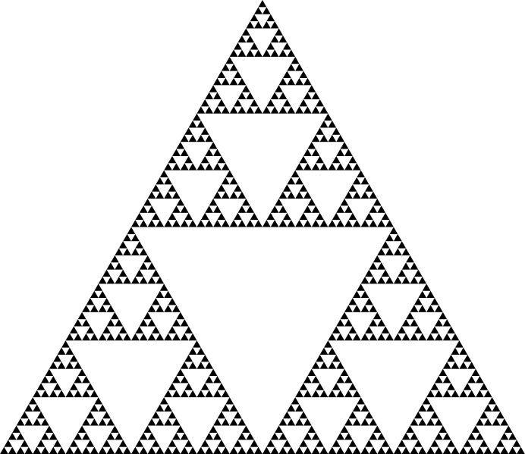
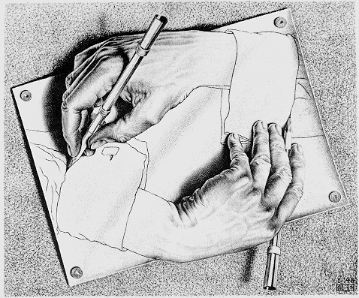
Recursive Functions
Definition: A function is called recursive if the body of that function calls itself, either directly or indirectly
Implication: Executing the body of a recursive function may require applying that function
Drawing Hands, by M. C. Escher (lithograph, 1948)

Slide 5
Digit Sums
2+0+1+8 = 11
If a number a is divisible by 9, then sum_digits(a) is also divisible by 9
Useful for typo detection!
The Bank of 61A
A checksum digit is a function of all the other digits; It can be computed to detect typos
1234 5678 9098 7658
OSKI THE BEAR
Credit cards actually use the Luhn algorithm, which we'll implement after sum_digits

Slide 6
The Problem Within the Problem
The sum of the digits of 6 is 6.
Likewise for any one-digit (non-negative) number (i.e., < 10).
The sum of the digits of 2019 is
201
9
Sum of these digits
+
This digit
That is, we can break the problem of summing the digits of 2019 into a smaller instance of
the same problem, plus some extra stuff.
We call this recursion

Slide 7
Sum Digits Without a While Statement
def split(n):
"""Split positive n into all but its last digit and its last digit."""
return n // 10, n % 10
def sum_digits(n):
"""Return the sum of the digits of positive integer n."""
if n < 10:
return n
else:
all_but_last, last = split(n)
return sum_digits(all_but_last) + last

Slide 8
The Anatomy of a Recursive Function
The def statement header is similar to other functions
Conditional statements check for base cases
Base cases are evaluated without recursive calls
Recursive cases are evaluated with recursive calls
def sum_digits(n):
"""Return the sum of the digits of positive integer n."""
if n < 10:
return n
else:
all_but_last, last = split(n)
return sum_digits(all_but_last) + last
(Demo1)

Slide 9
Recursion in Environment Diagrams

Slide 10
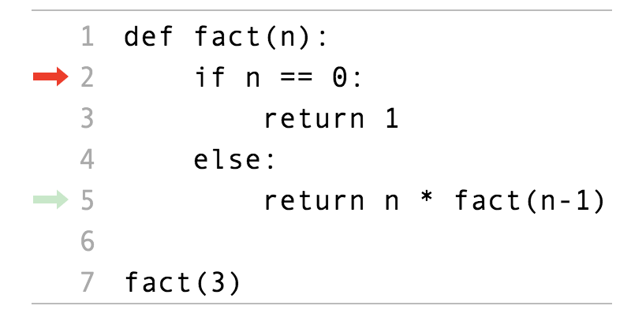
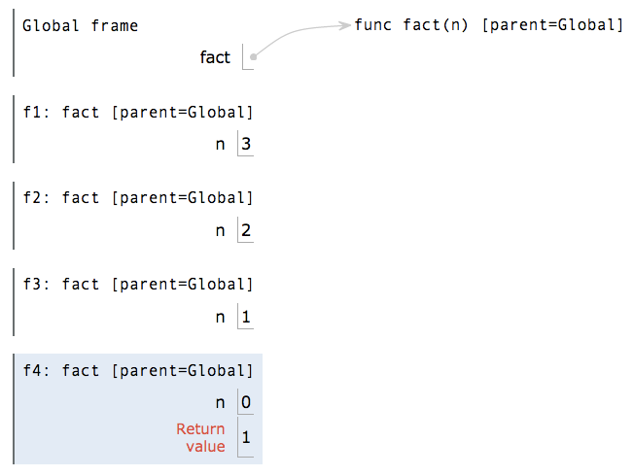
Recursion in Environment Diagrams
(Demo2 pythontutor)
The same function fact is called multiple times
Different frames keep track of the different arguments in each call
What n evaluates to depends upon the current environment
Each call to fact solves a simpler problem than the last: smaller n
http://pythontutor.com/composingprograms.html#code=def%20fact%28n%29%3A%0A%20%20%20%20if%20n%20%3D%3D%200%3A%0A%20%20%20%20%20%20%20%20return%201%0A%20%20%20%20else%3A%0A%20%20%20%20%20%20%20%20return%20n%20*%20fact%28n%20-%201%29%0A%20%20%20%20%20%20%20%20%0Afact%283%29&cumulative=true&curInstr=0&mode=display&origin=composingprograms.js&py=3&rawInputLstJSON=%5B%5D

Slide 11


Iteration vs Recursion
Iteration is a special case of recursion
Using while:
Using recursion:
def fact_iter(n):
total, k = 1, 1
while k <= n:
total, k = total*k, k+1
return total
def fact(n):
if n == 0:
return 1
else:
return n * fact(n-1)
Math:
Names:
n, total, k, fact_iter
n, fact
(Demo3 trace!)

Slide 12
Verifying Recursive Functions

Slide 13

The Recursive Leap of Faith
def fact(n):
if n == 0:
return 1
else:
return n * fact(n-1)
Is fact implemented correctly?
Verify the base case
Treat fact as a functional abstraction!
Assume that fact(n-1) is correct
Verify that fact(n) is correct
Photo by Kevin Lee, Preikestolen, Norway

Slide 14
Mutual Recursion

Slide 15
The Luhn Algorithm
Used to verify credit card numbers
From Wikipedia: http://en.wikipedia.org/wiki/Luhn_algorithm
First: From the rightmost digit, which is the check digit, moving left, double the value of every second digit; if product of this doubling operation is greater than 9 (e.g., 7 * 2 = 14), then sum the digits of the products (e.g., 10: 1 + 0 = 1, 14: 1 + 4 = 5)
Second: Take the sum of all the digits
1 | 3 | 8 | 7 | 4 | 3
2 | 3 | 1+6=7 | 7 | 8 | 3
= 30
The Luhn sum of a valid credit card number is a multiple of 10
(Demo4)

Slide 16
Recursion and Iteration

Slide 17
Converting Recursion to Iteration
Can be tricky: Iteration is a special case of recursion.
Idea: Figure out what state must be maintained by the iterative function.
def sum_digits(n):
"""Return the sum of the digits of positive integer n."""
if n < 10:
return n
else:
all_but_last, last = split(n)
return sum_digits(all_but_last) + last
A partial sum
What's left to sum
(Demo5)

Slide 18
Converting Iteration to Recursion
More formulaic: Iteration is a special case of recursion.
Idea: The state of an iteration can be passed as arguments.
def sum_digits_iter(n):
digit_sum = 0
while n > 0:
n, last = split(n)
digit_sum = digit_sum + last
return digit_sum
Updates via assignment become...
def sum_digits_rec(n, digit_sum):
if n == 0:
return digit_sum
else:
n, last = split(n)
return sum_digits_rec(n, digit_sum + last)
...arguments to a recursive call

