Slide 1
UC Berkeley’s CS61A – Lecture 11 – Data Abstraction
India is Cracking Down on E-commerce and Free Speech www.wired.com/story/india-is-cracking-down-ecommerce-free-speech/
“When it comes to cracking down on tech giants, India is on a roll. The country was the first to reject Facebook’s contentious plan to offer free internet access to parts of the developing world in 2016. Since December, Indian policymakers have taken a page from China’s playbook, enacting sweeping restrictions in an attempt to curtail the power of ecommerce behemoths like Amazon, and pushing proposals that would require internet companies to censor “unlawful” content, break user encryption, and forbid Indian data from being stored on foreign soil. In the past week alone, Indian officials have demanded that Twitter CEO Jack Dorsey come before Parliament to answer accusations of bias, called for a ban on TikTok, and opened an investigation into claims that Google abused its Android mobile operating system to unfairly promote its own services.”

Slide 2
Announcements
Optional Hog strategy contest ends Friday 2/22.
Homework 3 is due Thursday 2/21.

Slide 3
Counting Partitions (Review)
The number of partitions of a positive integer n, using parts up to size m, is the number of ways in which n can be expressed as the sum of positive integer parts up to m in increasing order.
count_partitions(6, 4)
2 + 4 = 6
1 + 1 + 4 = 6
3 + 3 = 6
1 + 2 + 3 = 6
1 + 1 + 1 + 3 = 6
2 + 2 + 2 = 6
1 + 1 + 2 + 2 = 6
1 + 1 + 1 + 1 + 2 = 6
1 + 1 + 1 + 1 + 1 + 1 = 6

Slide 4
Data Abstraction
Compound values combine other values together
A date: a year, a month, and a day
A geographic position: latitude and longitude
Data abstraction lets us manipulate compound values as units
Isolate two parts of any program that uses data:
How data are represented (as parts)
How data are manipulated (as units)
Data abstraction: A methodology by which functions enforce an abstraction barrier between representation and use
All Programmers
Great Programmers

Slide 5
Rational Numbers
numerator
denominator
Exact representation of fractions
A pair of integers
As soon as division occurs, the exact representation may be lost! (Demo)
Assume we can compose and decompose rational numbers:
Constructor
rational(n, d) returns a rational number x
numer(x) returns the numerator of x
denom(x) returns the denominator of x
Selectors

Slide 6
Rational Number Arithmetic
3
3
9
nx
ny
nx*ny
*
=
*
=
2
5
10
dx
dy
dx*dy
3
3
21
nx
ny
nx*dy + ny*dx
+
=
+
=
2
5
10
dx
dy
dx*dy
Example
General Form

Slide 7
Rational Number Arithmetic Implementation
def mul_rational(x, y):
return rational(numer(x) * numer(y),
denom(x) * denom(y))
Constructor
nx
ny
nx*ny
*
=
Selectors
Selectors
dx
dy
dx*dy
def add_rational(x, y):
nx, dx = numer(x), denom(x)
ny, dy = numer(y), denom(y)
return rational(nx * dy + ny * dx, dx * dy)
def print_rational(x):
print(numer(x), '/', denom(x))
def rationals_are_equal(x, y):
return numer(x) * denom(y) == numer(y) * denom(x)
nx
ny
nx*dy + ny*dx
+
=
dx
dy
dx*dy
rational(n, d) returns a rational number x
numer(x) returns the numerator of x
denom(x) returns the denominator of x
These functions implement an abstract representation
for rational numbers

Slide 8
Pairs

Slide 9
Representing Pairs Using Lists
>>> pair = [1, 2]
>>> pair
[1, 2]
>>> x, y = pair
>>> x
1
>>> y
2
>>> pair[0]
1
>>> pair[1]
2
>>> from operator import getitem
>>> getitem(pair, 0)
1
>>> getitem(pair, 1)
2
A list literal:
Comma-separated expressions in brackets
"Unpacking" a list
Element selection using the selection operator
Element selection function
More lists next lecture

Slide 10
Representing Rational Numbers
def rational(n, d):
"""Construct a rational number that represents N/D."""
return [n, d]
Construct a list
def numer(x):
"""Return the numerator of rational number X."""
return x[0]
def denom(x):
"""Return the denominator of rational number X."""
return x[1]
Select item from a list
(Demo)

Slide 11
Reducing to Lowest Terms
Example:
3
5
5
2
1
1
*
=
+
=
2
3
2
5
10
2
15
1/3
5
25
1/25
1
*
=
*
=
6
1/3
2
50
1/25
2
Greatest common divisor
from fractions import gcd
def rational(n, d):
"""Construct a rational that represents N/D in lowest terms."""
g = gcd(n, d)
return [n//g, d//g]
def gcd(a, b):
"""Return the greatest common divisor of A and B."""
if b == 0:
return a
else:
return gcd(b, a % b)
(Demo)

Slide 12
Abstraction Barriers

Slide 13
Abstraction Barriers
Parts of the program that... | Treat rationals as... | Using...
Use rational numbers to perform computation | whole data values | add_rational, mul_rational rationals_are_equal, print_rational
Create rationals or implement rational operations | numerators and denominators | rational, numer, denom
Implement selectors and constructor for rationals | two-element lists | list literals and element selection
Implementation of lists

Slide 14
Violating Abstraction Barriers. AKA “Data Abstraction Violations”, or DAVs
Does not use constructors
Twice!
add_rational( [1, 2], [1, 4] )
def divide_rational(x, y):
return [ x[0] * y[1], x[1] * y[0] ]
No selectors!
And no constructor!

Slide 15
Data Representations

Slide 16
What are Data?
We need to guarantee that constructor and selector functions work together to specify the right behavior
Behavior condition: If we construct rational number x from numerator n and denominator d, then numer(x)/denom(x) must equal n/d
Data abstraction uses selectors and constructors to define behavior
If behavior conditions are met, then the representation is valid
You can recognize an abstract data representation by its behavior
(Demo)

Slide 17
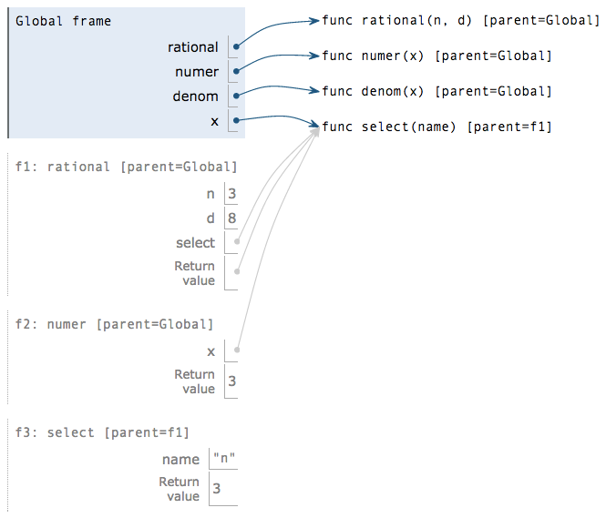
Rationals Implemented as Functions
def rational(n, d):
def select(name):
if name == 'n':
return n
elif name == 'd':
return d
return select
def numer(x):
return x('n')
def denom(x):
return x('d')
This function represents a rational number
Constructor is a higher-order function
Selector calls x
x = rational(3, 8)
numer(x)
pythontutor.com/composingprograms.html#code=def%20rational%28n,%20d%29%3A%0A%20%20%20%20def%20select%28name%29%3A%0A%20%20%20%20%20%20%20%20if%20name%20%3D%3D%20'n'%3A%0A%20%20%20%20%20%20%20%20%20%20%20%20return%20n%0A%20%20%20%20%20%20%20%20elif%20name%20%3D%3D%20'd'%3A%0A%20%20%20%20%20%20%20%20%20%20%20%20return%20d%0A%20%20%20%20return%20select%0A%20%20%20%20%0Adef%20numer%28x%29%3A%0A%20%20%20%20return%20x%28'n'%29%0A%0Adef%20denom%28x%29%3A%0A%20%20%20%20return%20x%28'd'%29%0A%20%20%20%20%0Ax%20%3D%20rational%283,%208%29%0Anumer%28x%29&mode=display&origin=composingprograms.js&cumulative=true&py=3&rawInputLstJSON=[]&curInstr=0

