Slide 1

P1- Steel Production Data
16.01.2025
Markus Strümpl
190.015 AML

Slide 2
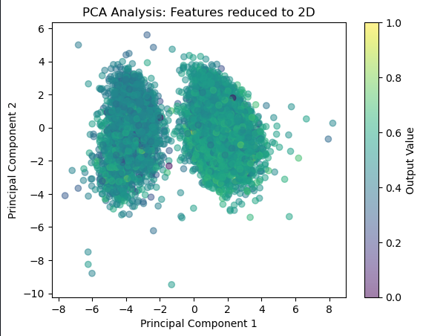
Project Overview & Objectives
Predicting Steel Production Quality from Sensor Data
The Goal: Predict a continuous quality output [0, 1] using 21 normalized process parameters.
Target: Achieve an R2 score of ≥0.50 to prove predictive capability.
The Challenge: High-dimensional industrial data with complex, non-linear interactions.

Slide 3
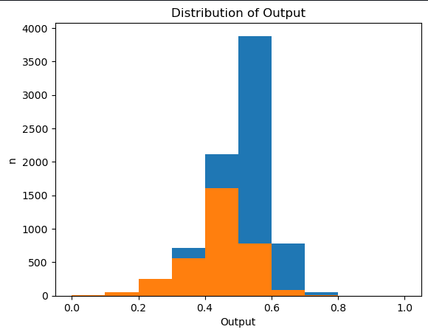

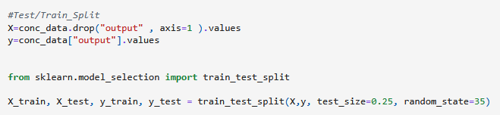
Regression Modles & Shallow DNNs
Linear Regression (R2≈0.25): Failed to capture the distributed signal. Proved that steel quality cannot be modeled by simple additive weights.
Random Forest (R2≈0.47): Improved significantly by branching through feature interactions, but hit a ceiling due to the discrete nature of the output.
Shallow Neural Network (R2≈0.32): Reached R2≈0.39. It confirmed that non-linear architectures are necessary but showed that basic layers still missed local process details.

Slide 4
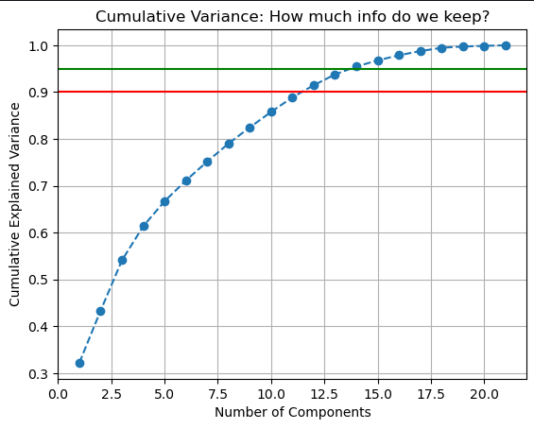
Why Simple Models Were Destined to Fail
Distributed Information: PCA revealed that the first two components only explain 43% of the variance.
Dimensionality: It takes 11+ components to reach 90% variance, proving there are no "shortcuts" or single dominant sensors.
Finding: The data is non-linear and "rugged." Information is spread across almost all 21 inputs, requiring models that can look at many features simultaneously.

Slide 5
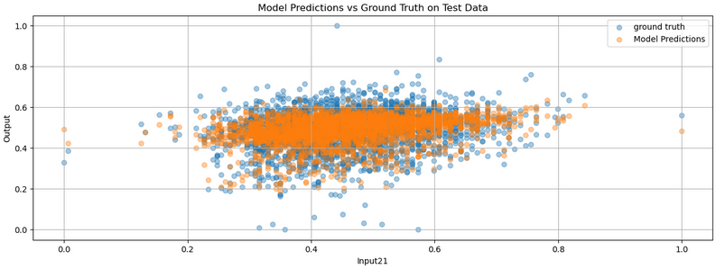
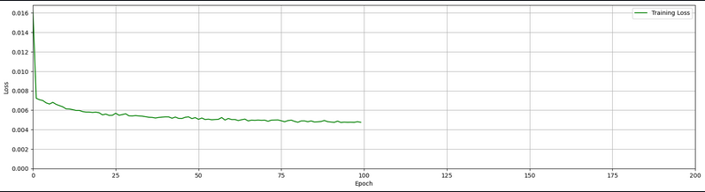
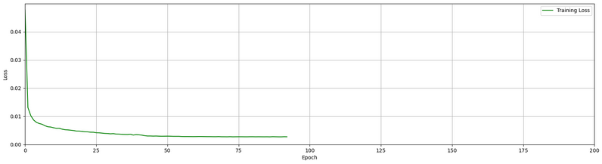
The Deep Learning Pivot
Optimizing the Neural Network (NNopt)
DNN_opt
Advanced Architecture: Moved to a deeper 6-layer structure (512→256→128→64→64→1) with BatchNormalization and Dropout.
Adaptive Strategies: Implemented ReduceLROnPlateau and EarlyStopping to navigate the loss landscape.
Robust Loss: Switched to Huber Loss to handle outliers and discrete-looking output strips more effectively.
Result: Pushed performance from R2≈ 0.32 to ≈0.43, but still fell short of the 0.50 target.
Val_loss DNN_std
Val_loss DNN_opt

Slide 6

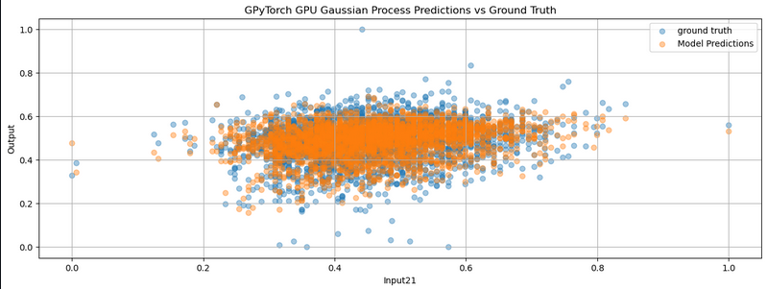
The Top Performer
Mixed Gaussian Process via GPyTorch
Kernel Strategy: Combined a Matern 1.5 kernel (for local wiggles) with a Linear kernel (for global trends).
Automatic Relevance Determination (ARD): Optimized 21 independent lengthscales to learn which sensors were the true quality drivers.
GPU Acceleration: Used the RTX 3070 to handle the heavy matrix math, turning a 2-hour CPU task into a fast, iterative process.
The Result: Successfully beat the R2=0.50 target.

Slide 7
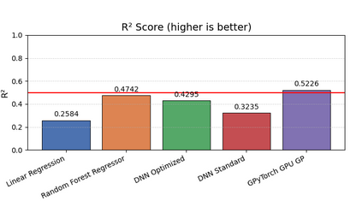
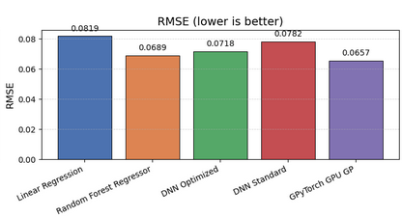
Conclusion & Future Outlook
Summary: We successfully met the 0.50 R2 goal by switching from standard CPU models to a GPU-accelerated Mixed Gaussian Process.
The "Honest" Verdict: While 0.52 is our best score, it remains a weak fit. 48% of the variance is still unexplained.
Next Steps:
Feature Engineering: Look for physical relationships between sensors to create new inputs.
Data Quality: Investigate the "discrete" steps in the output to see if higher-resolution data is available.

