Slide 1
Applied Mechanism Design For Social Good
John P Dickerson
Duncan C McElfresh
CMSC828M
Tuesdays & Thursdays
2:00pm – 3:15pm

Slide 2
Markets come in many forms …
… some of which don’t conform to conventional notions of markets …
… and some in which money may play little or no role.
– excerpt from Who Gets What – and Why
Notes:
Markets and marketplaces come in many forms …
… some of which don’t conform to conventional notions of markets …
… and some in which money may play little or no role.

Slide 3












Example: Matching markets
In matching problems, prices do not do all – or any – of the work
Agents are paired with other (groups of) agents, transactions, or contracts
Workers to firms
Children to schools
Residents to hospitals
Patients to deceased donors
Advertisements to viewers
Riders to rideshare drivers

Slide 4
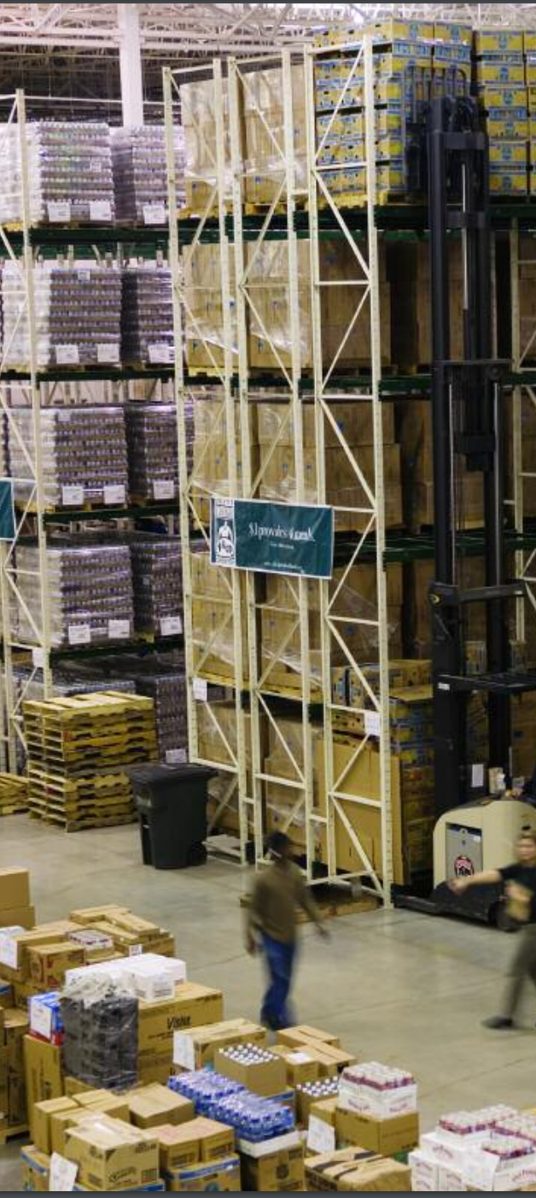
Example: Food Bank Allocation
Food banks supply nutrition to the needy for free or at a reduced cost
Much of that food comes from donors (e.g. supermarkets, manufacturers)
Distribution is overseen by a large non-profit organization, Feeding America
Previously: centralized allocation based on perceived need of food banks
Currently: food banks bid in an online auction using a fake currency for loads of donated food.

Slide 5




Example: Kidney Exchange
Wife
Husband
D₁ P₁
Donors
Patients
D₂ P₂
Brother
Brother
(2- and 3-cycles, all surgeries performed simultaneously)

Slide 6
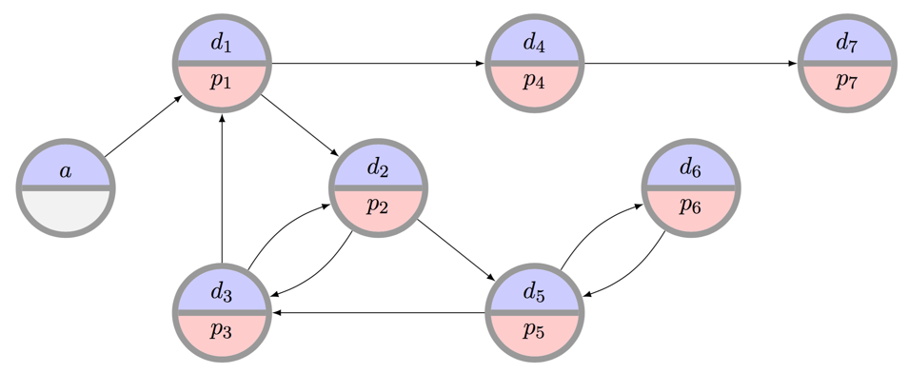

Example: Kidney Exchange
What is the “best” matching objective?
Maximize matches right now or over time?
Maximize transplants or matches?
Prioritization schemes (i.e. fairness)?
Modeling choices?
Incentives? Ethics? Legality?
Can we design a mechanism that performs well in practice, is computationally tractable, and is understandable by humans?

Slide 7
Administrative Details
Meet twice per week, discuss 1-2 papers per class
Course project: semester-long, can be applied, can be theoretical – the goal is to create a publishable paper!
We’ll have a few guest lecturers “from the real world”
John Dickerson – john@cs.umd.edu – jpdickerson.com
Academia’s currency!
CMSC828M
Tuesdays & Thursdays
2:00pm – 3:15pm

