Slide 1
Applied Mechanism Design For Social Good
John P Dickerson
Lecture #10 – 02/27/2020
CMSC828M
Tuesdays & Thursdays
2:00pm – 3:15pm

Slide 2
Announcements
Projects?

Slide 3
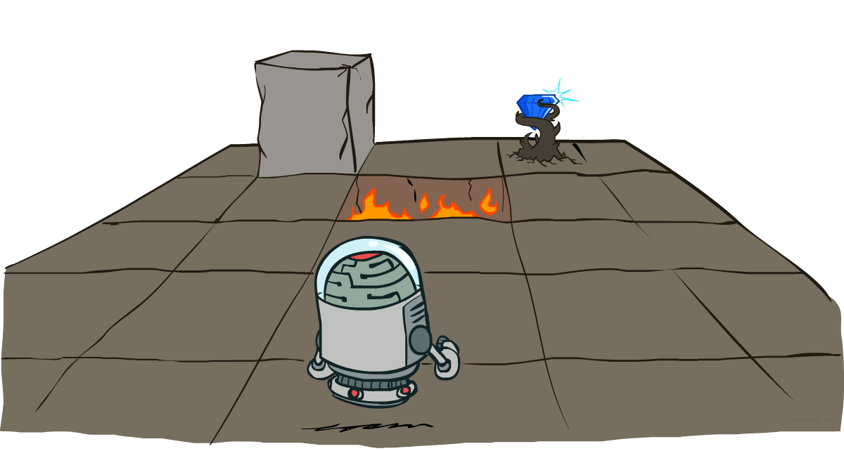
Markov Decision Processes
Slide credits: CMU AI and http://ai.berkeley.edu

Slide 4
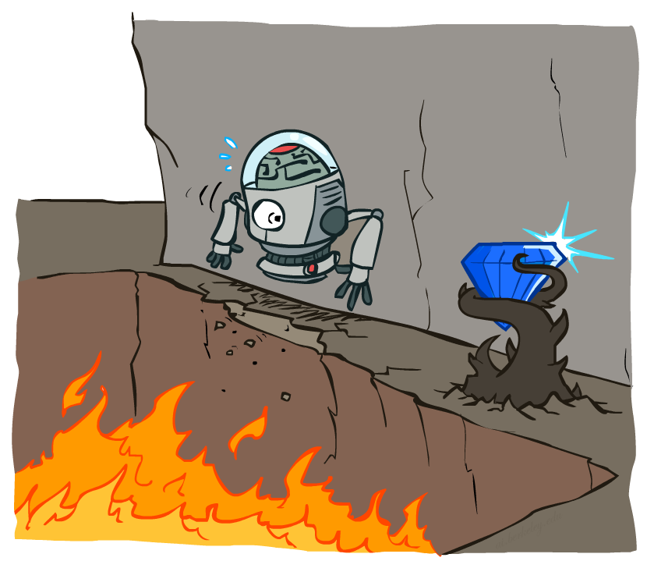
Non-Deterministic Search

Slide 5
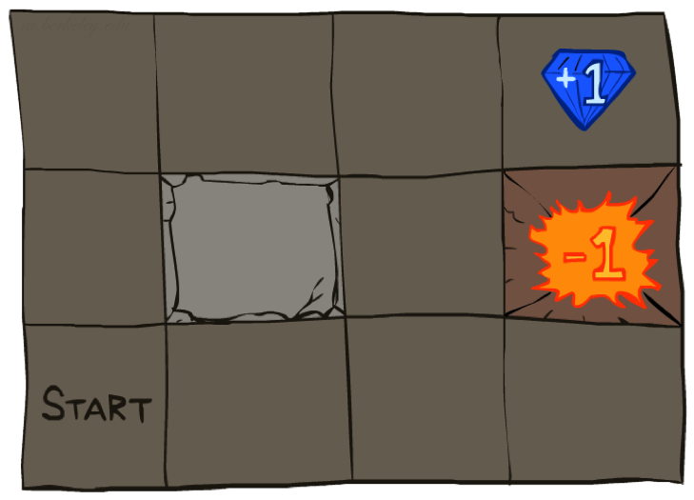




Example: Grid World
A maze-like problem
The agent lives in a grid
Walls block the agent’s path
Noisy movement: actions do not always go as planned
If agent takes action North
80% of the time: Get to the cell on the North (if there is no wall there)
10%: West; 10%: East
If path after roll dice blocked by wall, stays put
The agent receives rewards each time step
“Living” reward (can be negative)
Additional reward at pit or target (good or bad) and will exit the grid world afterward
Goal: maximize sum of rewards
Notes:
If agent takes action North, then 80% of the time agent ends with going to the cell on the North (if there is no wall there)
10%, action North takes the agent West; 10% East
If there is a wall in the direction the agent would have been taken, the agent stays put
Small “living” reward each step (can be negative)
Big rewards come at the end (good or bad)

Slide 6
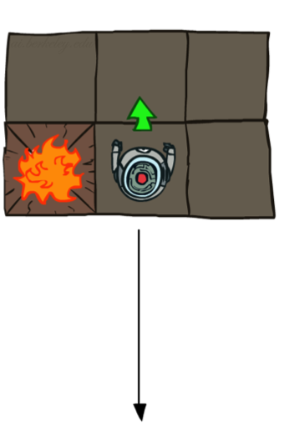
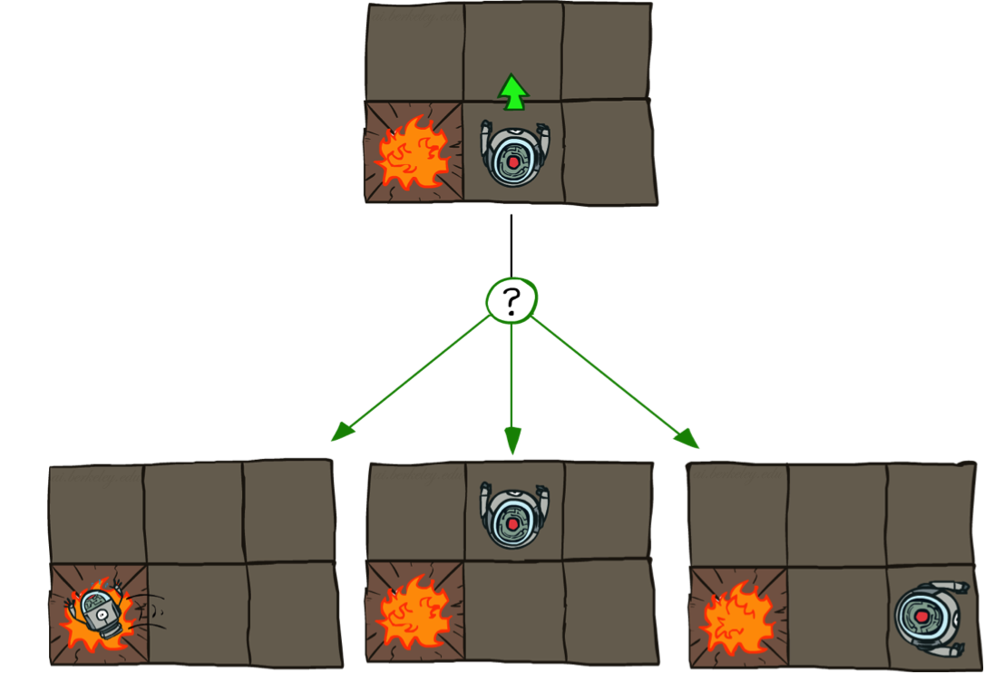
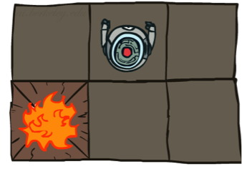
Grid World Actions
Deterministic Grid World
Stochastic Grid World

Slide 7

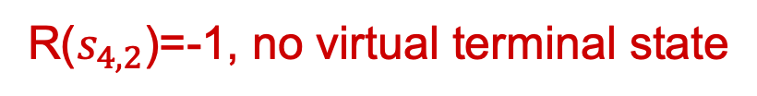
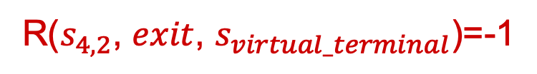
Markov Decision Process (MDP)
An MDP is defined by a tuple (S,A,T,R):
S: a set of states
A: a set of actions
T: a transition function
T(s, a, s’) where s ∈ S, a ∈ A, s’ ∈ S is P(s’| s, a)
R: a reward function
R(s, a, s’) is reward at this time step
Sometimes just R(s) or R(s’)
Sometimes also have
$γ$: discount factor (introduced later)
$μ$: distribution of initial state (or just start state $s_{0}$)
Terminal states: processes end after reaching these states
The Grid World problem as an MDP
R($s_{4,2}$, $exit$, $s_{virtual_terminal}$)=-1
R($s_{4,2}$)=-1, no virtual terminal state
How to define the terminal states & reward function for the Grid World problem?
Notes:
T(s,a,s’): Probability that a from s leads to s’
T is also called the model or the dynamics
In search problems: did not talk about actions, but about successor functions --- now the information inside the successor function is unpacked into actions, transitions and reward
Write out S, A, example entry in T, entry in R
Reward function different from the book : R(s,a,s’)
In book simpler for equations, but not useful for the projects.
Need to modify expectimax a tiny little bit to account for rewards along the way, but that’s something you should be able to do, and so you can already solve MDP’s (not in most efficient way)

Slide 8
Markov Decision Process (MDP)
An MDP is defined by a tuple (S,A,T,R)
Why is it called Markov Decision Process?
Decision:
Process:
Notes:
T(s,a,s’): Probability that a from s leads to s’
T is also called the model or the dynamics
In search problems: did not talk about actions, but about successor functions --- now the information inside the successor function is unpacked into actions, transitions and reward
Write out S, A, example entry in T, entry in R
Reward function different from the book : R(s,a,s’)
In book simpler for equations, but not useful for the projects.
Need to modify expectimax a tiny little bit to account for rewards along the way, but that’s something you should be able to do, and so you can already solve MDP’s (not in most efficient way)

Slide 9
Markov Decision Process (MDP)
An MDP is defined by a tuple (S,A,T,R)
Why is it called Markov Decision Process?
Decision:
Process:
Agent decides what action to take at each time step
The system (environment + agent) is changing over time
Notes:
T(s,a,s’): Probability that a from s leads to s’
T is also called the model or the dynamics
In search problems: did not talk about actions, but about successor functions --- now the information inside the successor function is unpacked into actions, transitions and reward
Write out S, A, example entry in T, entry in R
Reward function different from the book : R(s,a,s’)
In book simpler for equations, but not useful for the projects.
Need to modify expectimax a tiny little bit to account for rewards along the way, but that’s something you should be able to do, and so you can already solve MDP’s (not in most efficient way)

Slide 10
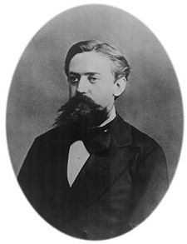

What is “Markovian” about MDPs?
Markov property: Conditional on the present state, the future and the past are independent
With respect to MDPs, it means outcome of an action depend only on current state
Andrey Markov
(1856-1922)
Russian mathematician
Notes:
Roughly speaking, a process satisfies the Markov property if one can make predictions for the future of the process based solely on its present state just as well as one could knowing the process's full history, hence independently from such history, that is, conditional on the present state of the system, its future and past states are independent.
(sometimes characterized as "memorylessness")
Like search: successor function only depended on current state
Can make this happen by stuffing more into the state;
Very similar to search problems: when solving a maze with food pellets, we stored which food pellets were eaten

Slide 11
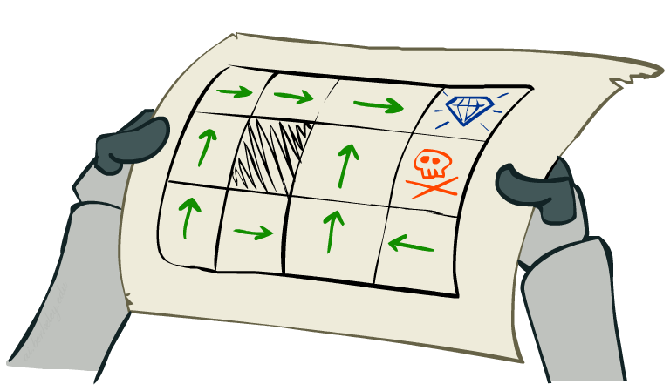
Policies
In deterministic single-agent search problems, we wanted an optimal plan, or sequence of actions, from start to a goal
For MDPs, we focus on policies
Policy = map of states to actions
π(s) gives an action for state s
We want an optimal policy π*: S → A
An optimal policy is one that maximizes expected utility if followed

Slide 12
Policies
Recall: An MDP is defined S,A,T,R
Keep S,A,T fixed, optimal policy may vary given different R
What is the optimal policy if R(s,a,s’)=-1000 for all states other than pit and target?
What is the optimal policy if R(s,a,s’)=0 for all states other than pit and target, and reward=1000 and -1000 at pit and target respectively?

Slide 13
Discussion Point!
{A, B, C, D} are optimal policies for one of each of the following “reward for living” scenarios: {-0.01, -0.03, -0.04, -2.0}. Which policy maps to which reward setting?
{B, A, C, D}
{B, C, A, D}
{C, B, A, D}
{D, A, C, B}
A)
B)
C)
D)
Notes:
R(s) = the “living reward”

Slide 14
Discussion Point!
{A, B, C, D} are optimal policies for one of each of the following “reward for living” scenarios: {-0.01, -0.03, -0.04, -2.0}. Which policy maps to which reward setting?
{B, A, C, D}
{B, C, A, D}
{C, B, A, D}
{D, A, C, B}
A)
B)
C)
D)
Notes:
R(s) = the “living reward”

Slide 15
Discussion Point! Policies
R(s) = -0.01
R(s) = -0.03
R(s) = -0.4
R(s) = -2.0
Notes:
R(s) = the “living reward”

Slide 16
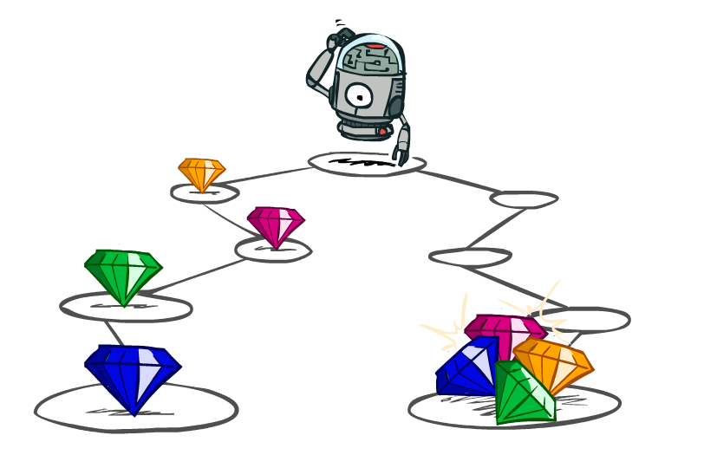
Utilities of Sequences

Slide 17
Utilities of Sequences
What preferences should an agent have over reward sequences?
More or less?
Now or later?
[1, 2, 2]
or
[2, 3, 4]
[0, 0, 1]
or
[1, 0, 0]

Slide 18




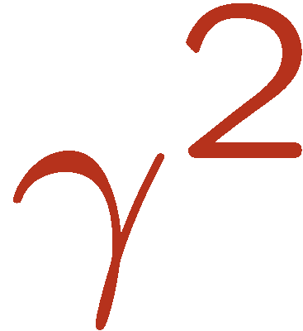

Discounting
It’s reasonable to maximize the sum of rewards
It’s also reasonable to prefer rewards now to rewards later
One solution: utility of rewards decay exponentially
Worth Now
Worth Next Step
Worth In Two Steps

Slide 19

Discounting
How to discount?
Each time we descend a level, we multiply in the discount once
Why discount?
Sooner rewards probably do have higher utility than later rewards
Also helps our algorithms converge
Notes:
Rewards in the future (deeper in the tree) matter less
Interesting: running expectimax, if having to truncate the search, then not losing much; e.g., less then \gamma^d / (1-\gamma)

Slide 20
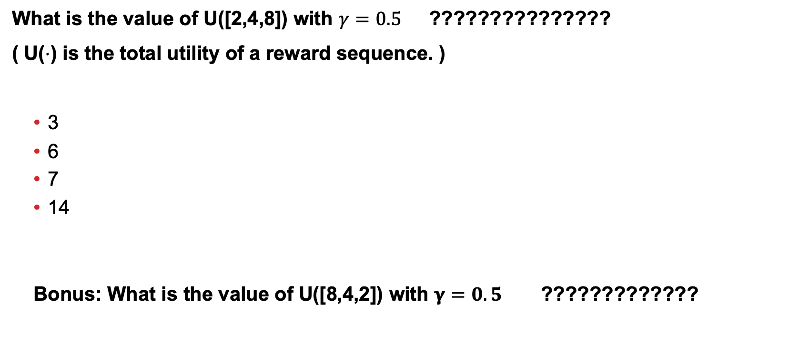
Discussion Point!
What is the value of U([2,4,8]) with $γ=0.5$ ???????????????
( U($⋅$) is the total utility of a reward sequence. )
3
6
7
14
Bonus: What is the value of U([8,4,2]) with $γ=0.5$ ?????????????
Notes:
Rewards in the future (deeper in the tree) matter less
Interesting: running expectimax, if having to truncate the search, then not losing much; e.g., less then \gamma^d / (1-\gamma)

Slide 21
Discussion Point!
What is the value of U([2,4,8]) with $γ=0.5$ ???????????????
( U($⋅$) is the total utility of a reward sequence. )
3
6
7
14
Bonus: What is the value of U([8,4,2]) with $γ=0.5$ ?????????????
$$γ^{0}×2+γ^{1}×4+γ^{2}×8=2+0.5×4+0.5×0.5×8=2+2+2=6$$
$$γ^{0}×8+γ^{1}×4+γ^{2}×2=8+0.5×4+0.5×0.5×2=8+2+0.5=10.5$$
Notes:
Rewards in the future (deeper in the tree) matter less
Interesting: running expectimax, if having to truncate the search, then not losing much; e.g., less then \gamma^d / (1-\gamma)

Slide 22
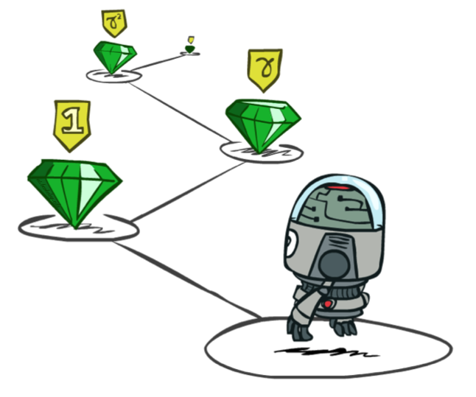
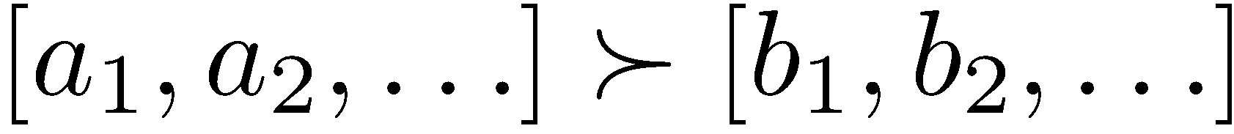

Stationary Preferences
Theorem: if we assume stationary preferences:
Then: there are only two ways to define utilities
Additive utility:
Discounted utility:

Slide 23

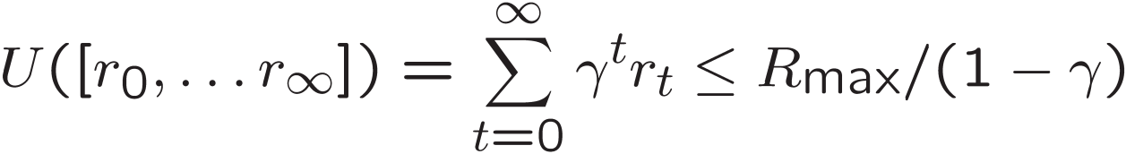
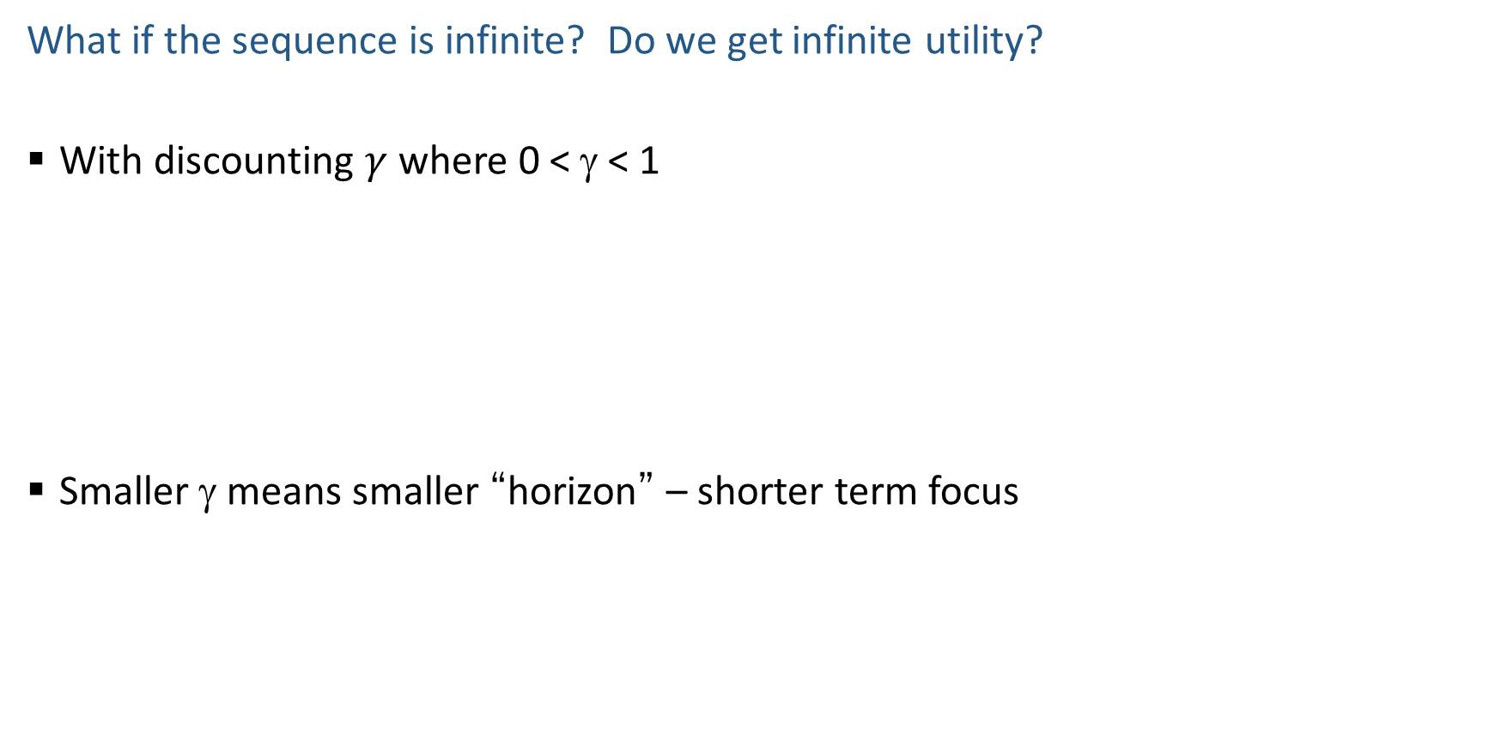
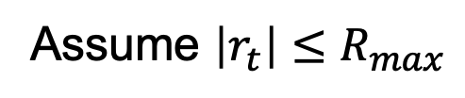
Infinite Utilities?!
Assume $\left|r_{t}\right|≤R_{max}$
What if the sequence is infinite? Do we get infinite utility?
With discounting $γ$ where 0 < γ < 1
Smaller γ means smaller “horizon” – shorter term focus

Slide 24



Optimal Policy with Discounting
Given:
Actions: East, West, and Exit (only available in exit states a, e)
Transitions: deterministic
For $γ=1$, what is the optimal policy?

Slide 25
Optimal Policy with Discounting
Given:
Actions: East, West, and Exit (only available in exit states a, e)
Transitions: deterministic
For $γ=1$, what is the optimal policy?

Slide 26
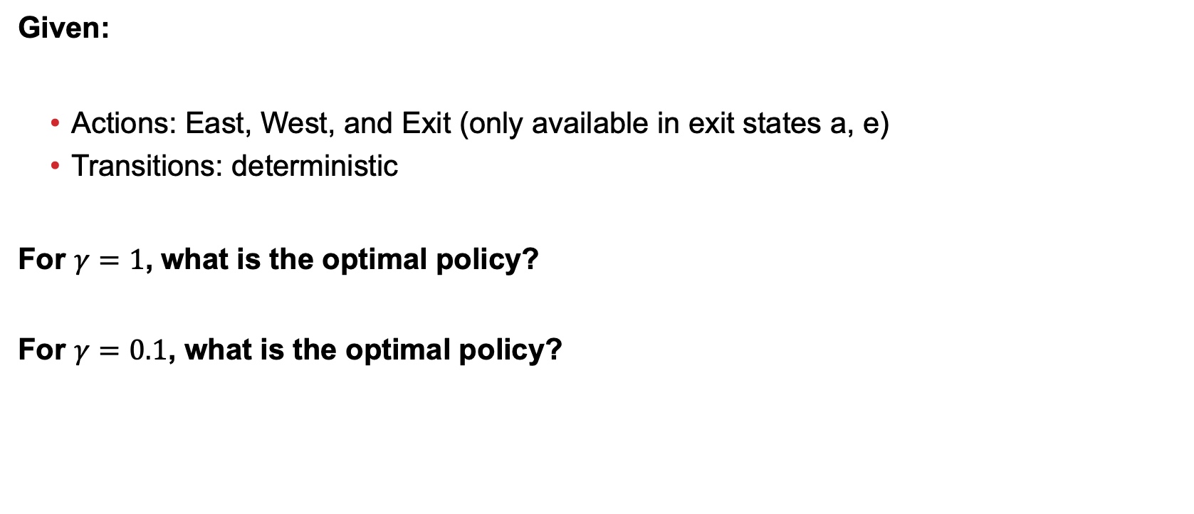
Optimal Policy with Discounting
Given:
Actions: East, West, and Exit (only available in exit states a, e)
Transitions: deterministic
For $γ=1$, what is the optimal policy?
For $γ=0.1$, what is the optimal policy?

Slide 27
Optimal Policy with Discounting
Given:
Actions: East, West, and Exit (only available in exit states a, e)
Transitions: deterministic
For $γ=1$, what is the optimal policy?
For $γ=0.1$, what is the optimal policy?

Slide 28
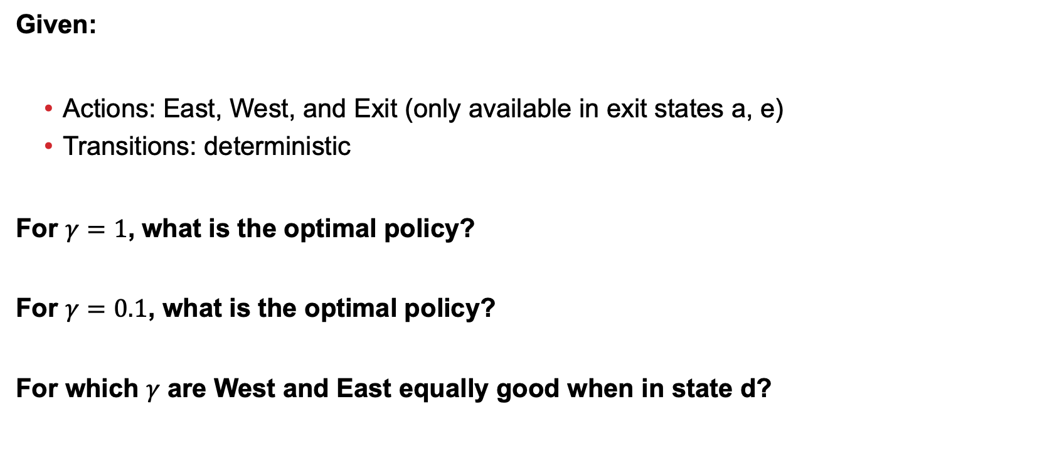
Optimal Policy with Discounting
Given:
Actions: East, West, and Exit (only available in exit states a, e)
Transitions: deterministic
For $γ=1$, what is the optimal policy?
For $γ=0.1$, what is the optimal policy?
For which $γ$ are West and East equally good when in state d?

Slide 29

Optimal Policy with Discounting
Given:
Actions: East, West, and Exit (only available in exit states a, e)
Transitions: deterministic
For $γ=1$, what is the optimal policy?
For $γ=0.1$, what is the optimal policy?
For which $γ$ are West and East equally good when in state d?
$$γ^{3}×10=γ^{1}×1$$

Slide 30
MDP Quantities (So Far!)
s
Markov decision processes:
States S
Actions A
Transitions P(s’|s,a) (or T(s,a,s’))
Rewards R(s,a,s’) (and discount γ)
Start state s0
MDP quantities so far:
Policy = map of states to actions
Utility = sum of (discounted) rewards
a
s, a
s,a,s’
s’

Slide 31
Solving MDPs

Slide 32
MDP Quantities
Markov decision processes:
States S
Actions A
Transitions P(s’|s,a) (or T(s,a,s’))
Rewards R(s,a,s’) (and discount γ)
Start state s₀
MDP quantities:
Policy = map of states to actions
Utility = sum of (discounted) rewards
(State) Value = expected utility starting from a state (max node)
Q-Value = expected utility starting from a state-action pair, i.e., q-state (chance node)
s
a
s, a
s,a,s’
s’

Slide 33
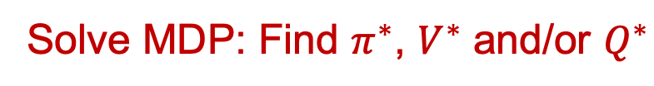
MDP Optimal Quantities
s
a
The optimal policy:
π*(s) = optimal action from state s
The (true) value (or utility) of a state s:
V*(s) = expected utility starting in s and acting optimally
The (true) value (or utility) of a q-state (s,a):
Q*(s,a) = expected utility starting out having taken action a from state s and (thereafter) acting optimally
s, a
s,a,s’
s’
Solve MDP: Find $π^{∗}$, $V^{∗}$ and/or $Q^{∗}$
Notes:
Demo just shows V and Q values, snapshots on next slides.

