Slide 1
Data Science Project
Early Stage Diabetes Prediction Using Machine Learning.

Slide 2
Supervised By
Dr.Ghada Khoriba
Eng.Mai Mohamed
Eng.Ahmed Kamal

Slide 3
Dataset
This dataset contains the sign and symptom data of newly diabetic or would be diabetic patient. This has been collected using direct questionnaires from the patients

Slide 4
Steps to be Followed
Importing Essential Libraries.
Data Preparation & Data Cleaning.
Data Visualization
Train Test Split
Machine Learning Models
Model Evaluation

Slide 5
Importing Essential Libraries
Numpy
Pandas
Matplotlib
Scikit-learn
Seaborn

Slide 6
Data Preparation & Data Cleaning
Checking for null values
Checking imbalanced dataset
Data normalization
Data processing dictionary
Data correlation

Slide 7
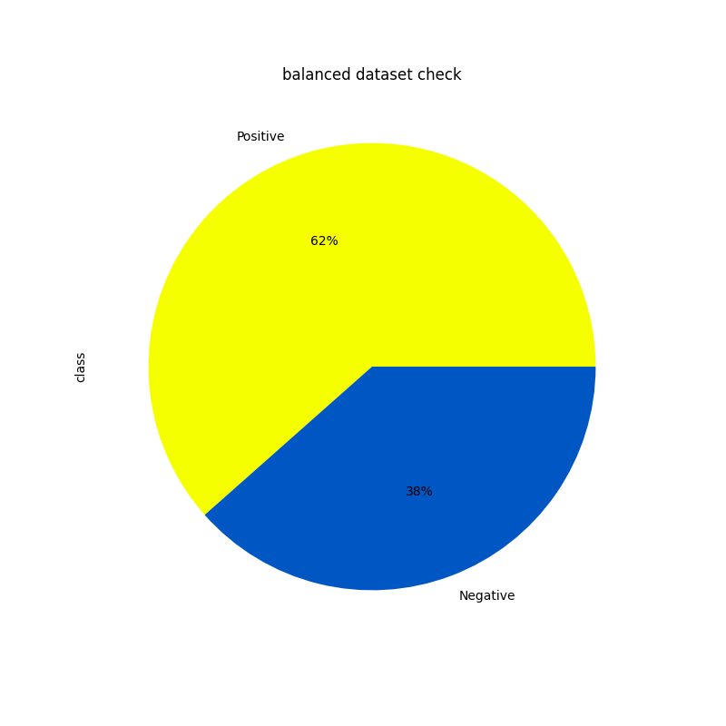
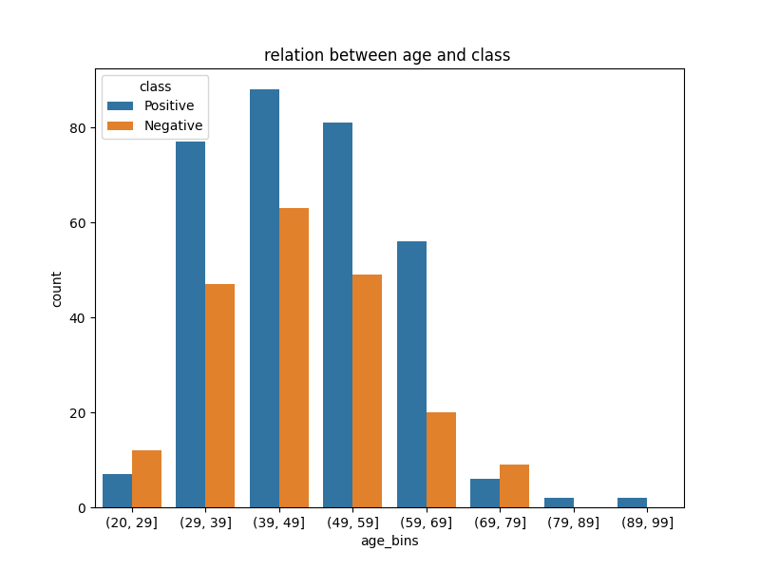
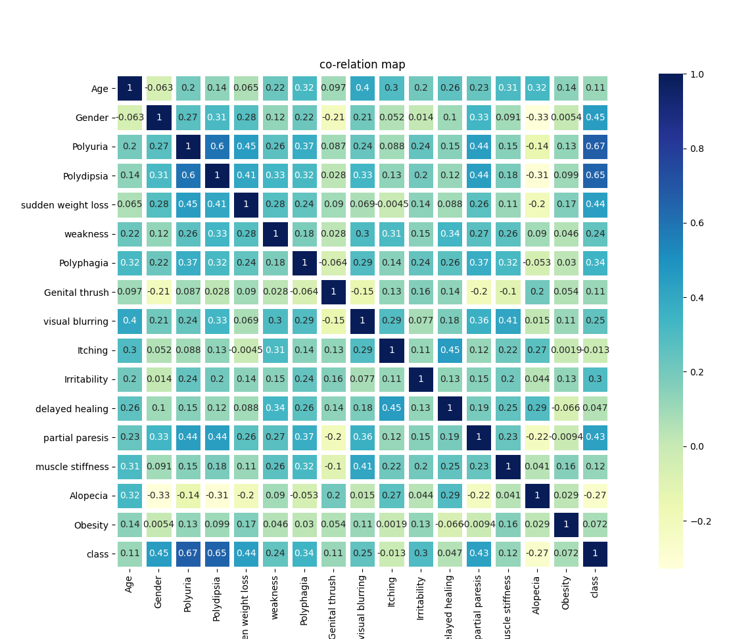
Data Preparation & Data Cleaning

Slide 8
Data Visualization
Pie plot :
Ratio between positive and negative
Count plot :
Relation between age and class
Bar Plot :
Comparison between accuracies
Heat map :
Correlation between features
Confusion matrix for each model
Logistic regression
K-Nearest-Neighbors
K-Fold
Random forest
Gaussian
SVM

Slide 9

Train Test Split
Data has been spitted into 25% for testing 75% for training in our machine learning algorithms

Slide 10
Machine Learning Models
Machine Learning Model | Model Accuracy(%)
Logistic regression | 96.92
K-Folds cross-validator | 90.76
K-Nearest neighbors | 93.84
Random Forest | 95.38
SVM | 94.61
Gaussian | 91.53

Slide 11
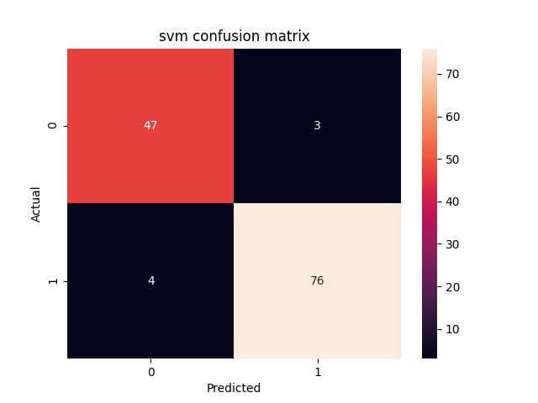
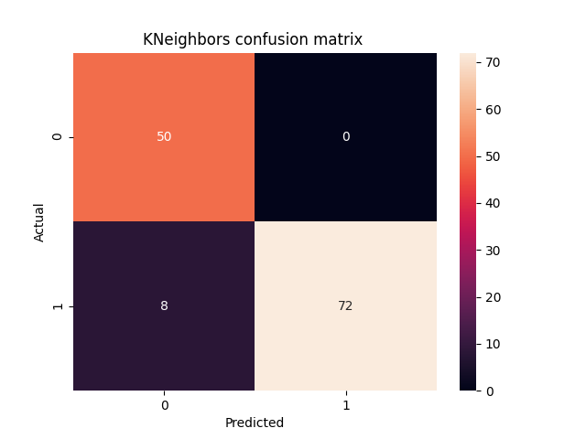


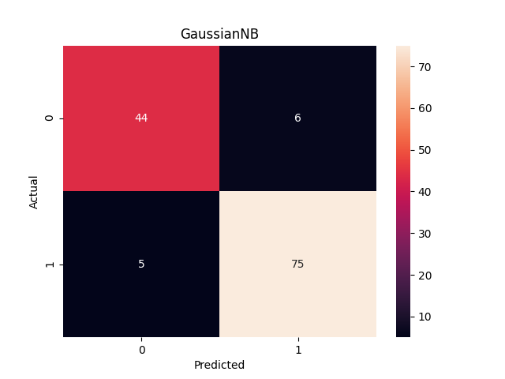
Machine Learning Models

Slide 12
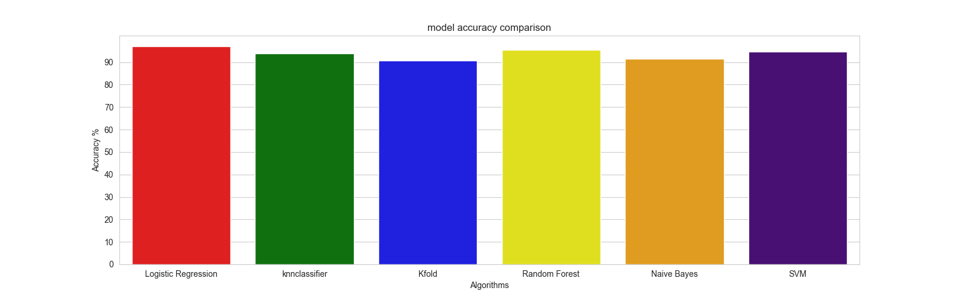
Model Evaluation
Upon using 6 models it has been proven that our supervised , classification problem has acquired the best accuracy using logistic regression

Slide 13
Thank You

