Slide 1

Cyclist Case study: in what ways this business can be improved

Slide 2
Hello and welcome ! My name is Mark Ferrao
Contact
E-mail: markferraox@gmail.com
Github: https://github.com/markferrao10
LinkedIN:linkedin.com/in/mark-ferrao-ab0061170

Slide 3
contents
Background
Project purpose
The challenge
Verdict
Solutions/recommendation

Slide 4
Background
In 2016, Cyclistic launched a successful bike-share offering. Since then, the program has grown to a fleet of 5,824 bicycles that are geo tracked and locked into a network of 692 stations across Chicago. The bikes can be unlocked from one station and returned to any other station in the system anytime.
Cyclistic’s marketing strategy is building general awareness and appealing to broad consumer segments.
One market development that helped make these things possible was the flexibility of its pricing plans: single-ride passes, full-day passes and annual memberships.
Customers who purchase single-ride or full-day passes are referred to as casual riders
Customers who purchase annual memberships are Cyclistic members.

Slide 5

Project purpose
Support or oppose the decision making process to make a marketing strategy

Slide 6
The Challange
How do members and casual riders use bike differently?

Slide 7
Key findings : average ride time

Slide 8
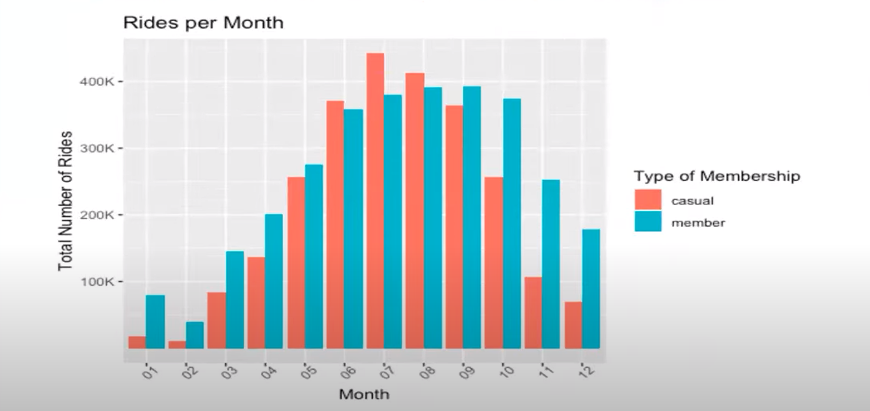
Key findings : Rides per month

Slide 9
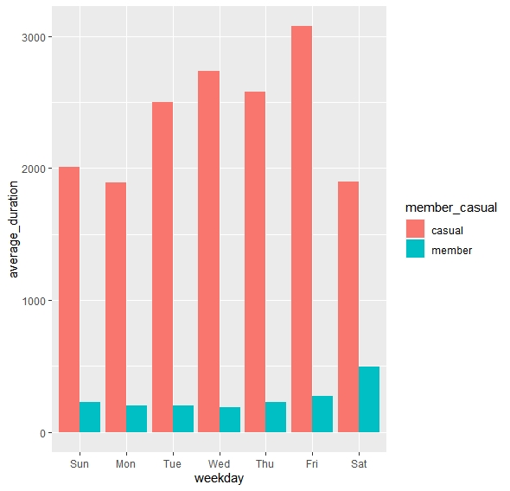
What did the data tell us: Average ride time

Slide 10
Key findings: male and female riders in a week
weekdays

Slide 11
Key findings: Average distance covered by our customers

Slide 12
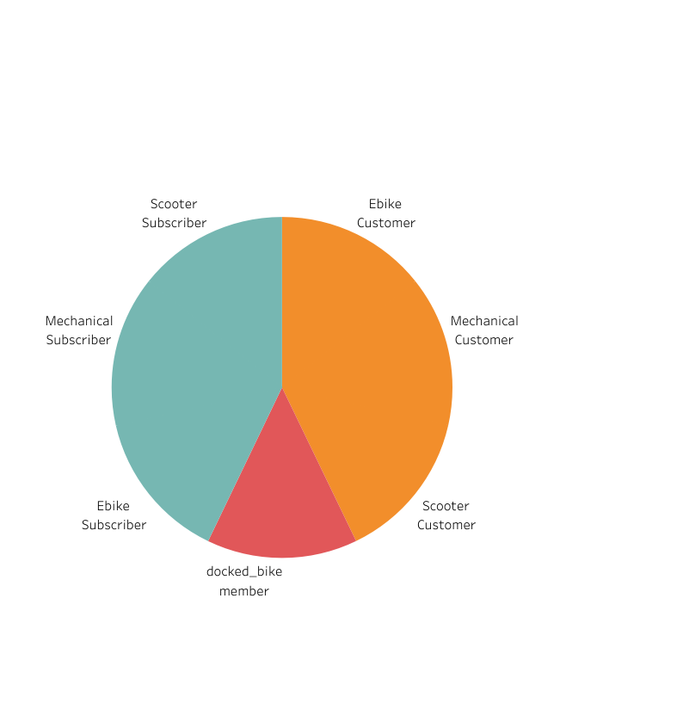
Key findings: types of bikes used
What did the data tell us:

Slide 13
THE VERDICT
Casual users tend to ride more in warmer months ie. June –August. Their participation exceeded that of the long term members
Casual riders spent on average a lot longer time per ride than their counterparts

Slide 14
The verdict
The data also showed that casual riders prefer to use the service during the weekdays. The members utilized the service during their typical work week.
Long term riders trended to stick to mechanical bikes as opposed to Ebikes, scooters or docked bikes.
This suggests that more mechanical bikes because – pricing and movement between each other be a factor.
Also the unreliability of ebikes.

Slide 15

Recommendations
Marketing strategy: market penetration
Improving product
Providing effective monthly plans with lots of facilities and discounts
Increase reach
Attract competition customers and dealers
Attract non members by providing sign in discount

Slide 16




Market penetration Increase reach by targeting customers
you save a lot of money.
You burn 4000- 8000 calories
Increase Healthy life
Go green

Slide 17
Things to consider
The evidence is inconclusive
More and accurate data is required
There may be more riders that meets the eye
Moving forward to make a conclusion will be a risk for a marketing strategy
Age : This would add a dynamic to customers who are being targeted in reference to age. is the existing market effective? is there potential for more inclusive targeting ?

Slide 18
Sources
Data source
Jan2020 – Jan 2019

Slide 19
Thank you

