Slide 1

Running Spark on DC/OS
XXX
Presented by Mark Johnson

Slide 2
Spark & Mesos Overview
XXX Show the spark architecture
XXX Highlight network segmentation

Slide 3
Spark on DC/OS
Scalable programs without programming
Consistent DNS connections
Programs run the same on dev, staging and Production

Slide 4
Part I: Spark Installation & Setup

Slide 5
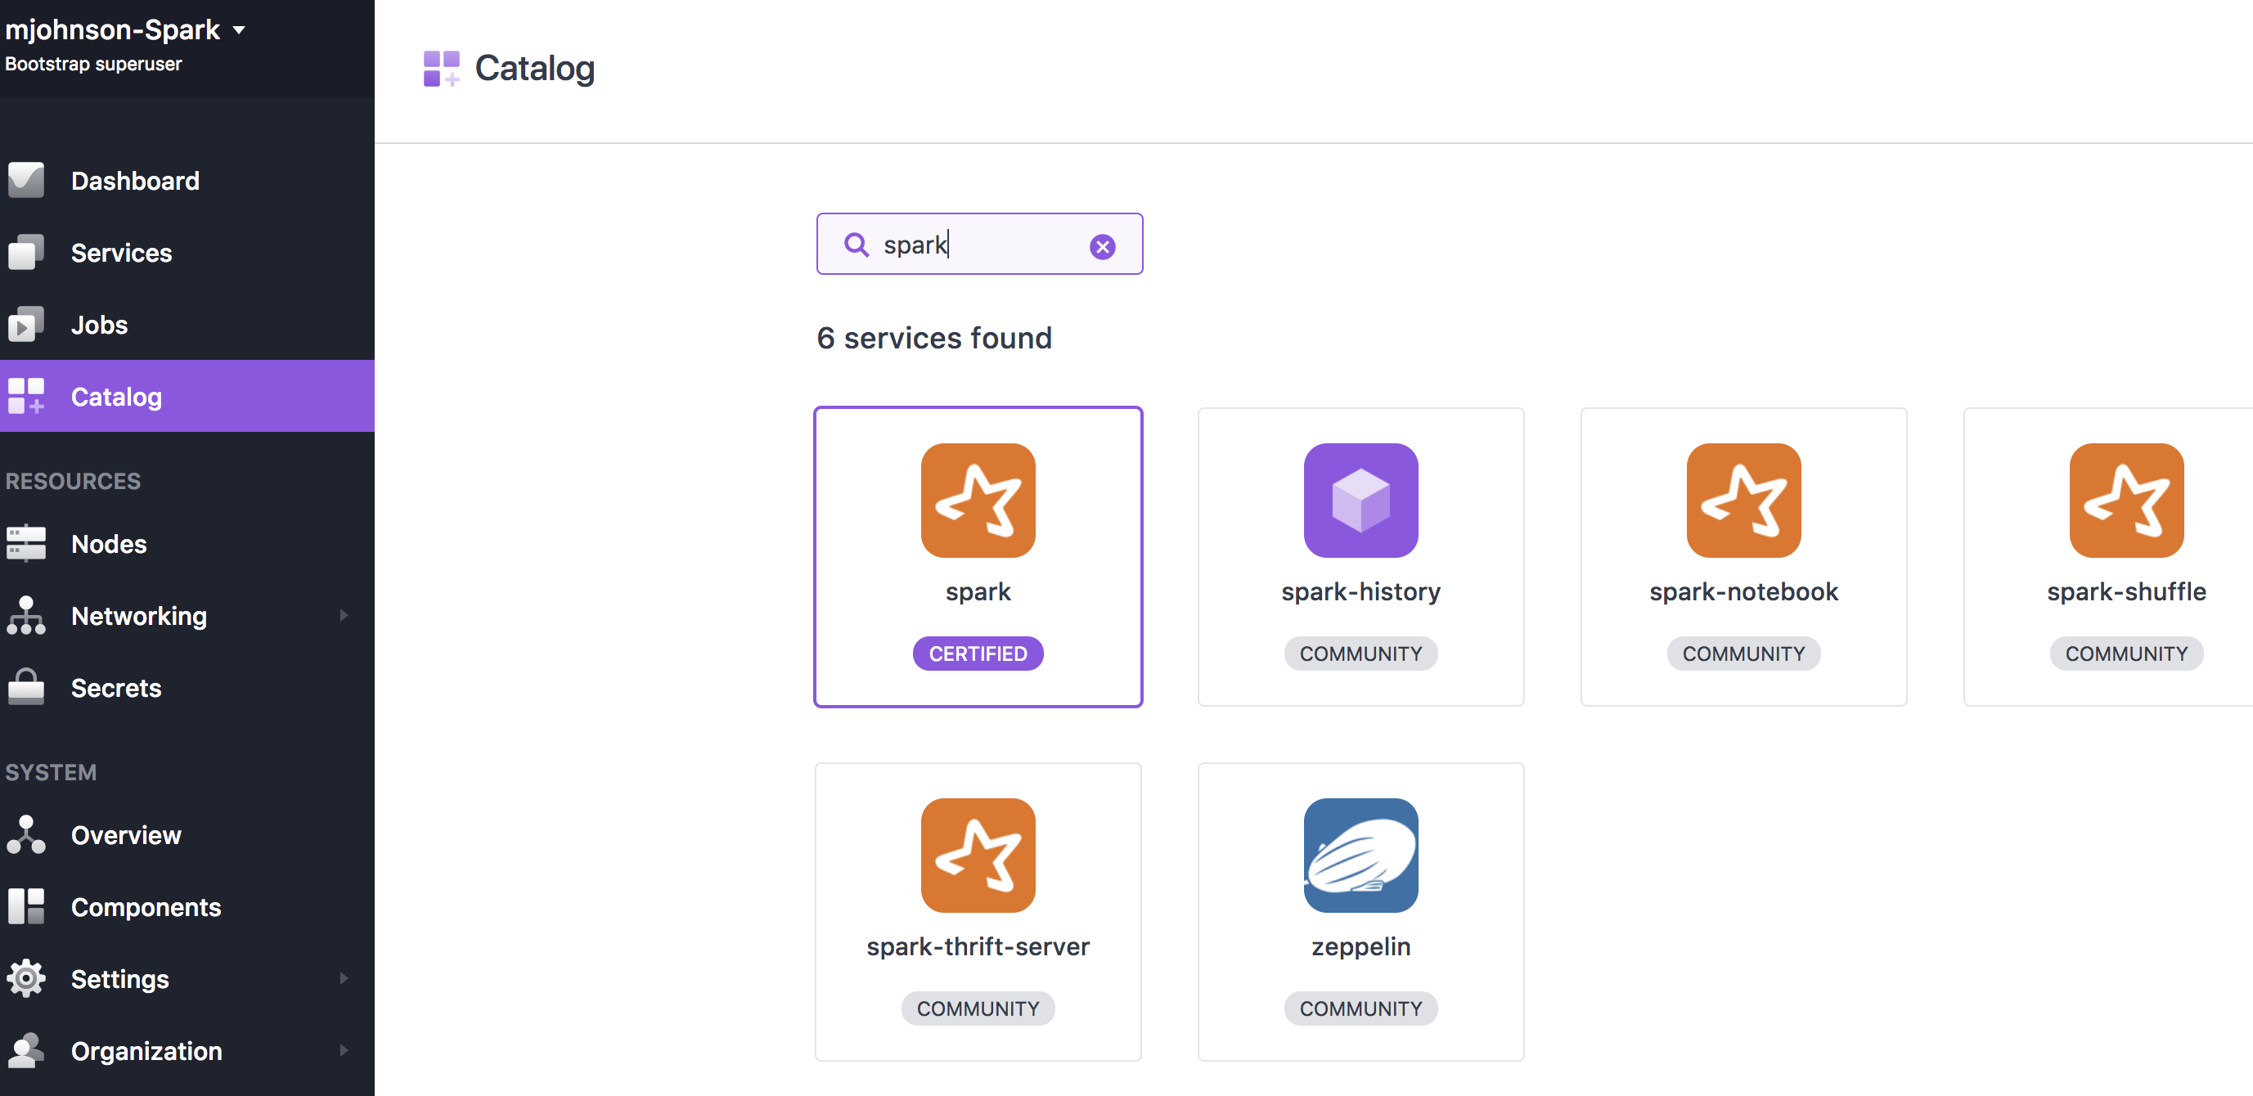
GUI Based Spark installation

Slide 6
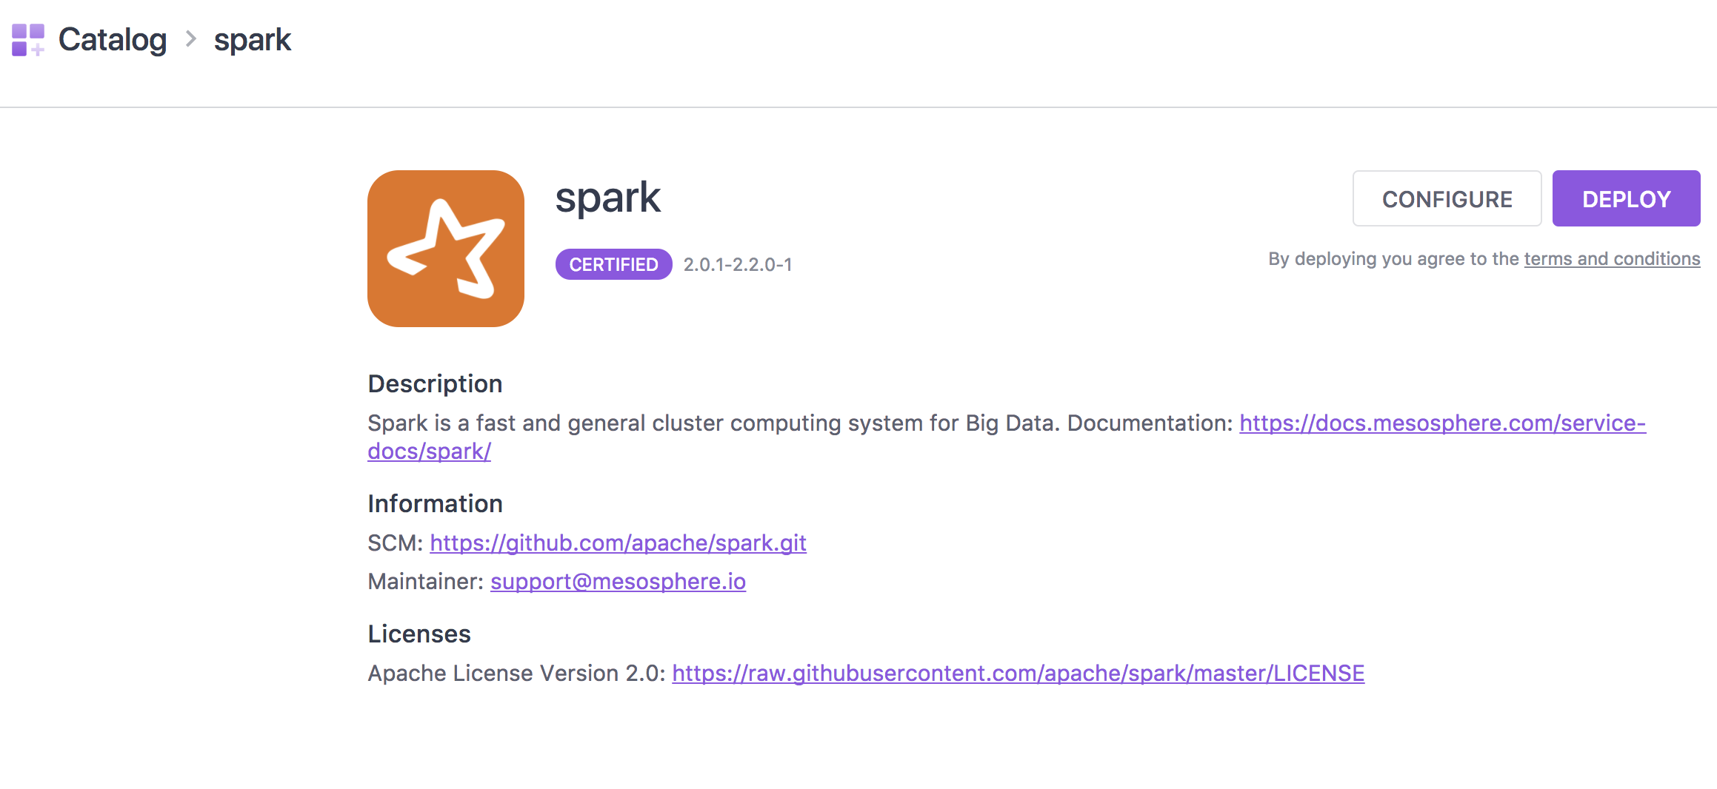

Slide 7
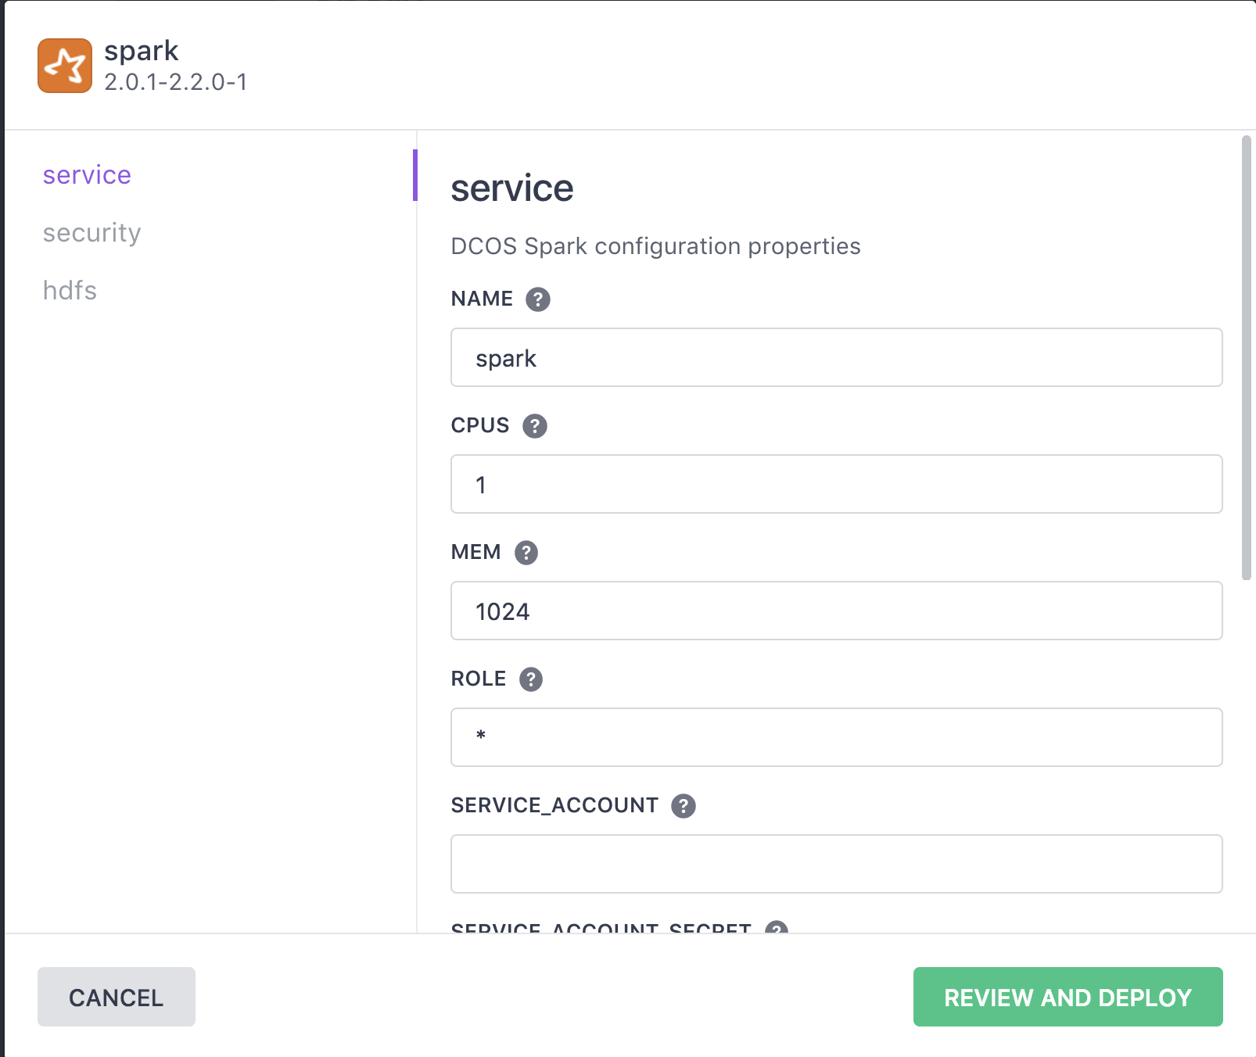

Slide 8
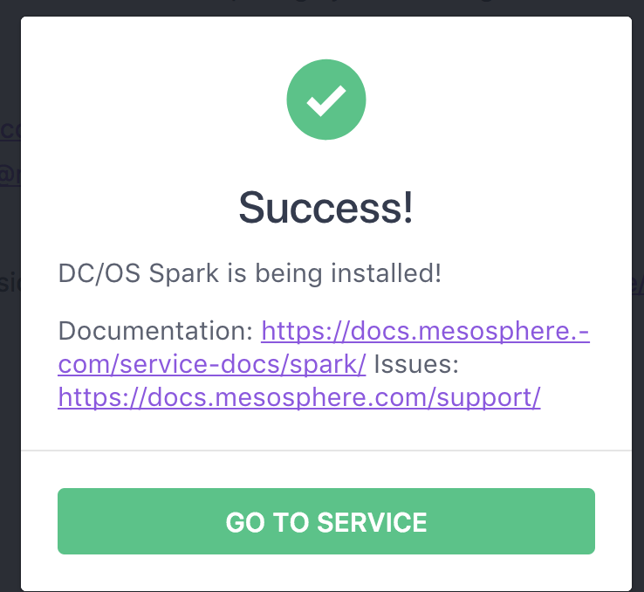

Slide 9
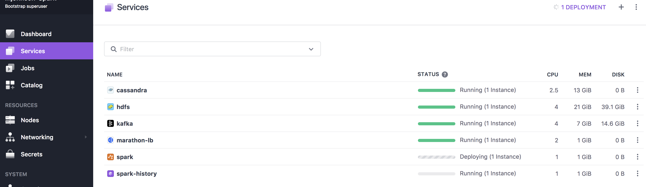

Slide 10
Command Line Spark Installation
dcos package install spark --app-id=/production
dcos package install spark --package-version=1.0.1-1.6.2 --app- id=/spark162
dcos package install --yes spark --options=spark-dispatcher-options.json

Slide 11
DC/OS Spark Command Line Options
dcos spark run …
dcos spark status {submission id}
dcos spark log {submission id}
dcos spark kill {submission id}
dcos webui

Slide 12
Part II: Running Spark Programs

Slide 13
Run Spark from the command line
dcos spark run --submit-args="--conf spark.mesos.executor.docker.image=mesosphere/spark:1.1.0-2.1.1-hadoop-2.6 https://downloads.mesosphere.com/spark/examples/pi.py 30" --verbose

Slide 14
Scheduled Spark Jobs

Slide 15
Part III: Data Access with Spark

Slide 16
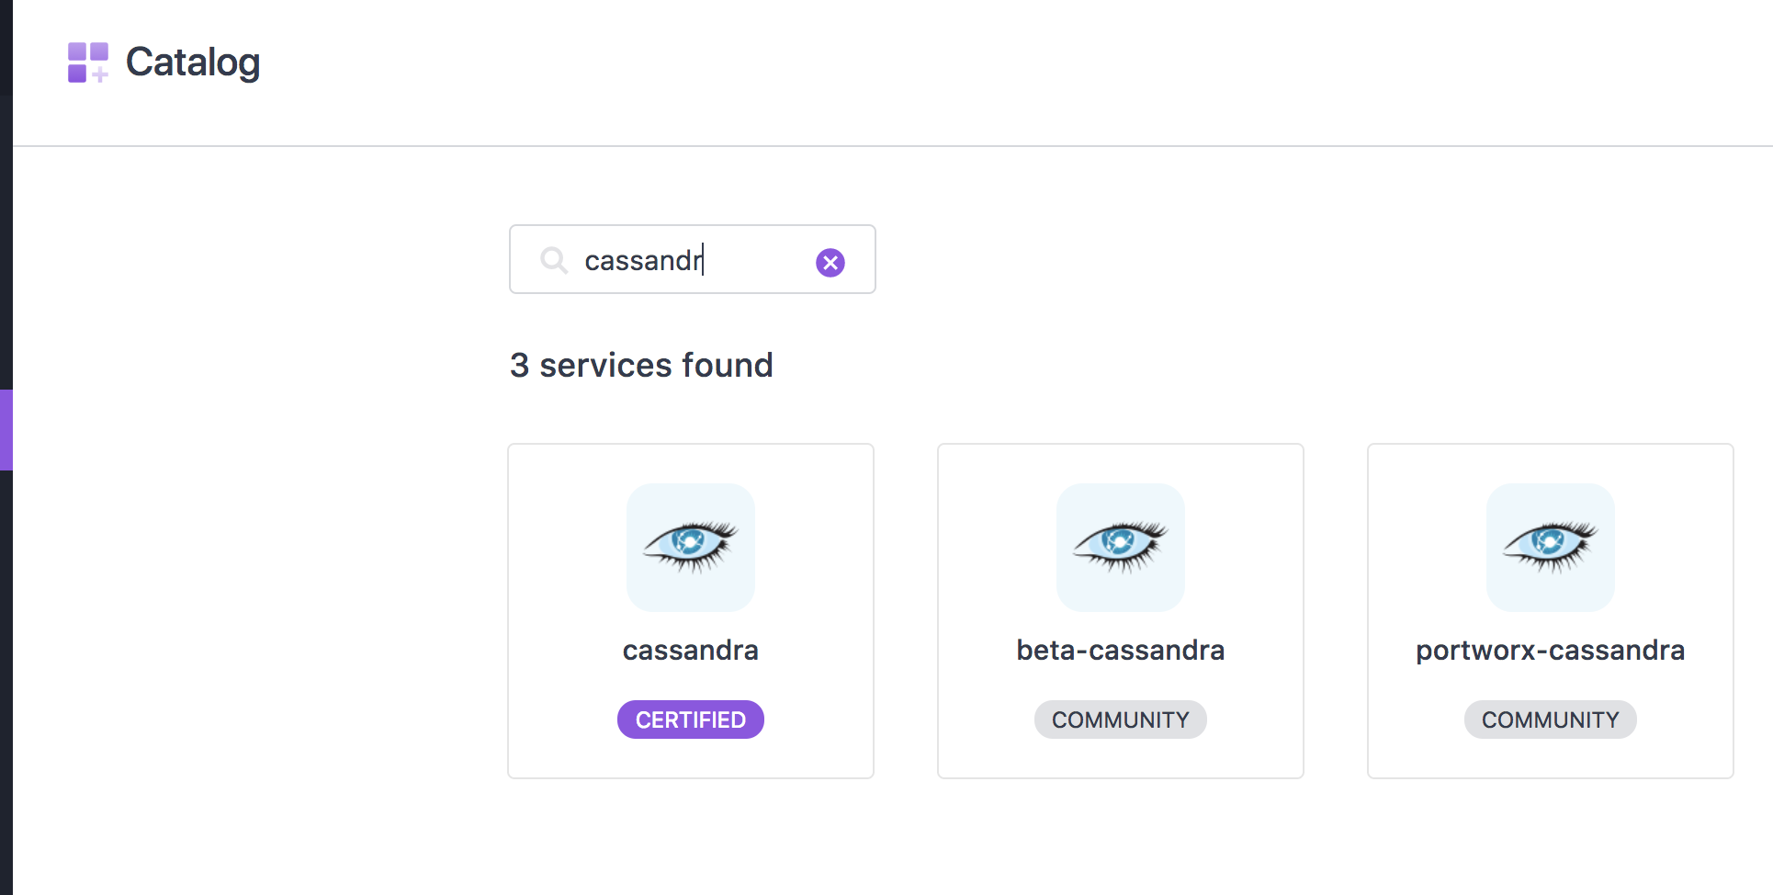
Spark & Cassandra

Slide 18
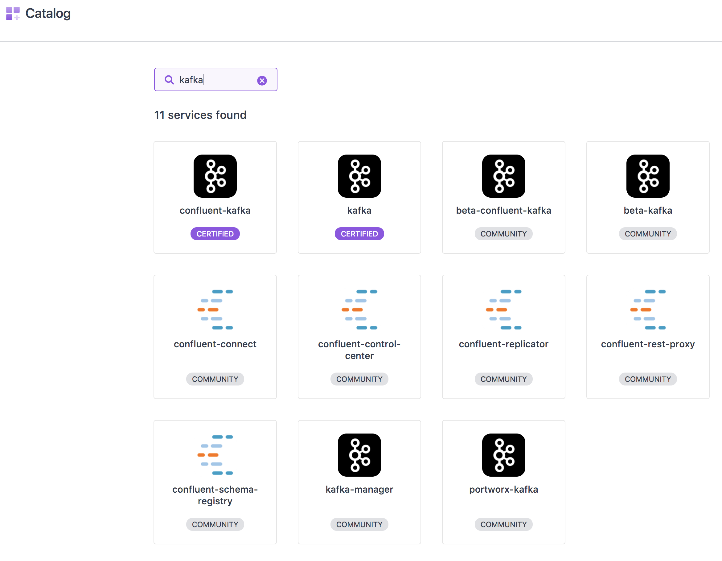
Spark & Kafka

Slide 19
Kafka Producer
from kafka import KafkaProducer import time kafka_url = "broker.kafka.l4lb.thisdcos.directory:9092" topic_name = "example_topic" def acked(err, msg): if err is not None: print("Failed to deliver message: {0}: {1}" .format(msg.value(), err.str())) else: print("Message produced: {0}".format(msg.value())) p = KafkaProducer(bootstrap_servers=kafka_url) while True: p.send(topic_name, b"test") p.send(topic_name, b"\xc2Hola, mundo!") print("Posted msg") time.sleep(1) p.flush(30)

Slide 20
Kafka Consumer
from kafka import KafkaConsumer kafka_url = " broker.kafka.l4lb.thisdcos.directory:9092 " topic_name = "example_topic" consumer = KafkaConsumer(bootstrap_servers=kafka_url, auto_offset_reset='earliest') consumer.subscribe(topic_name) for message in consumer: print (message) consumer.close()

Slide 21
Spark & HDFS

Slide 22
Spark with Kerberos

Slide 23
Spark & Elastic Search

Slide 24
Park IV: Spark Debugging and Monitoring

Slide 25
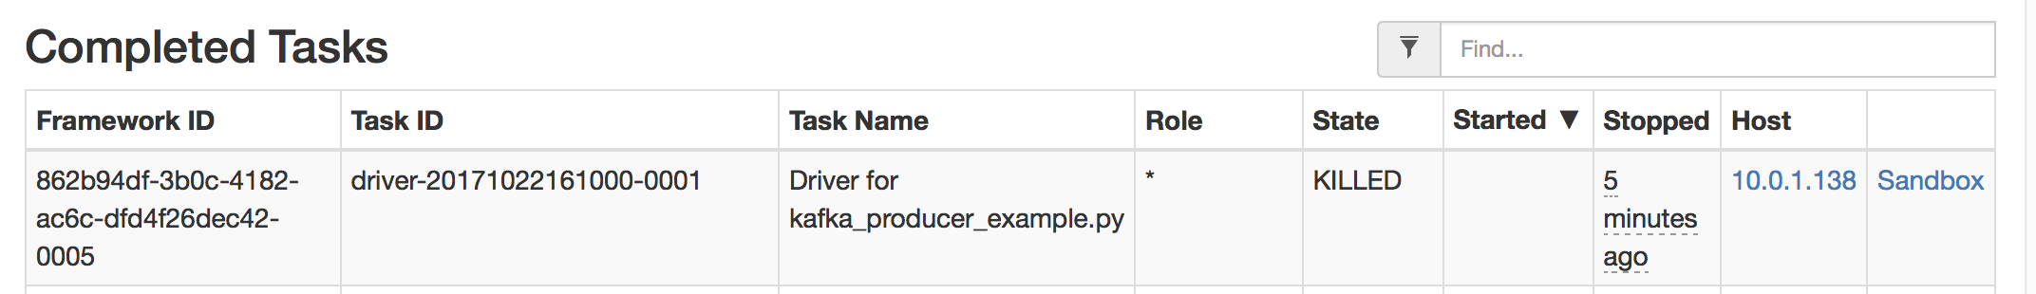
Mesos Task Screen

Slide 26
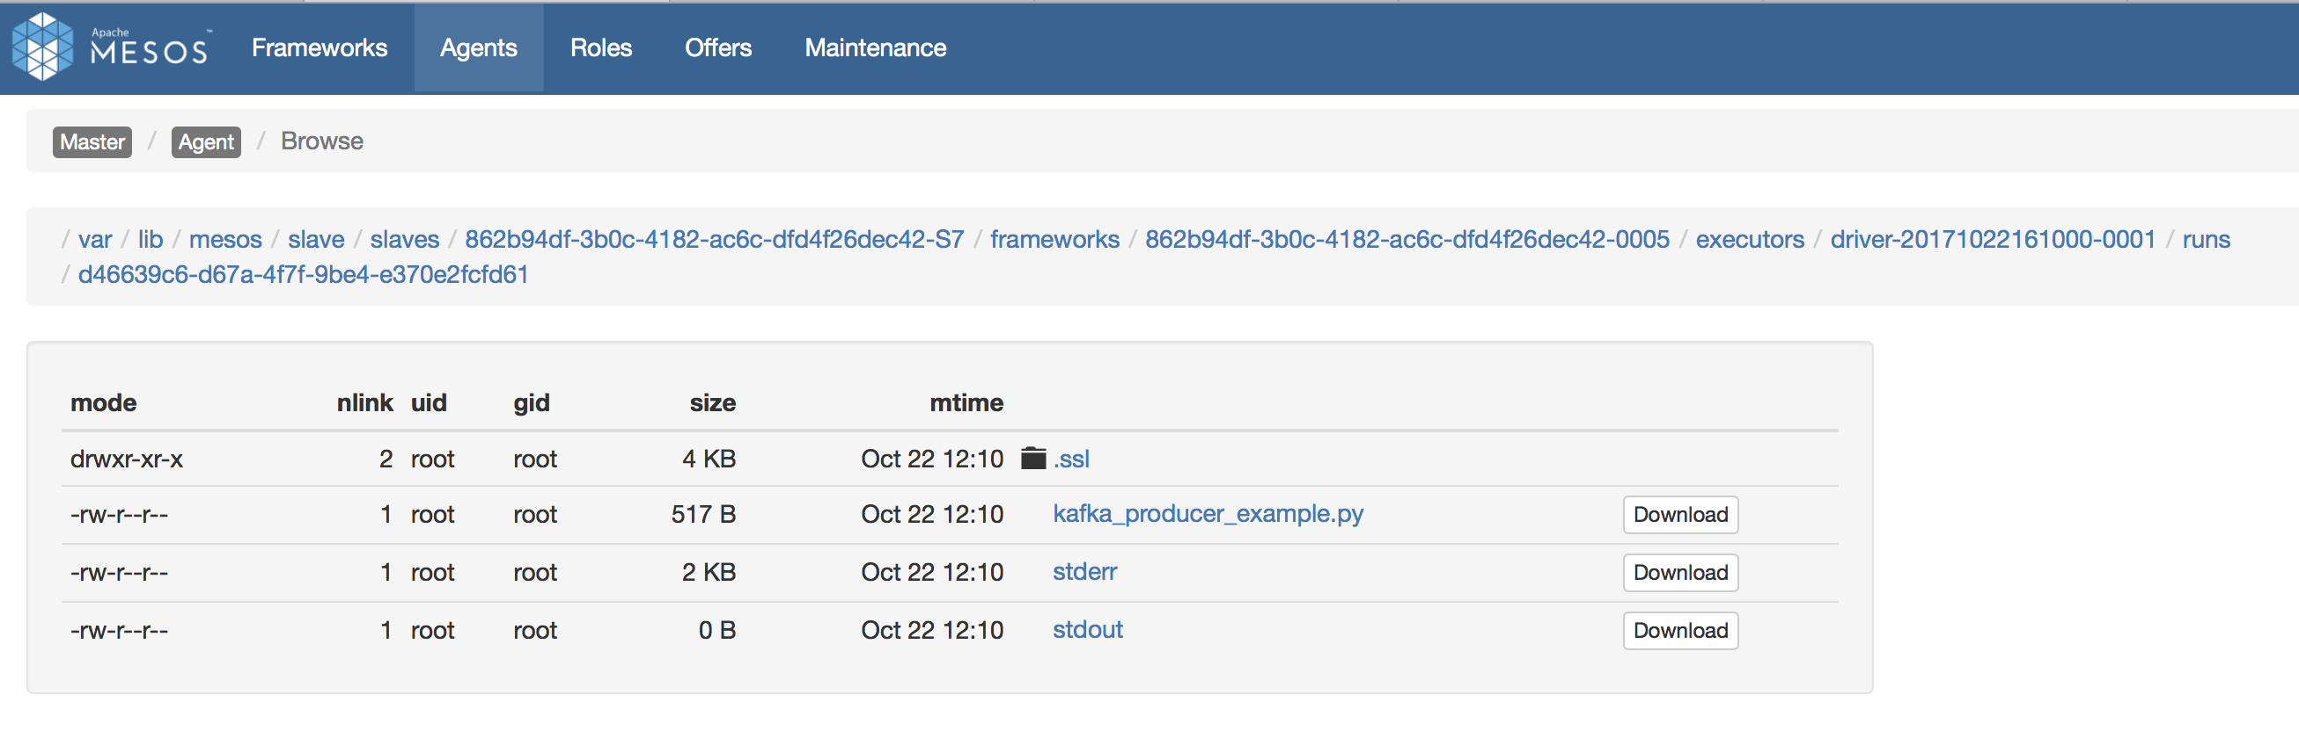
Mesos Sandbox

Slide 27
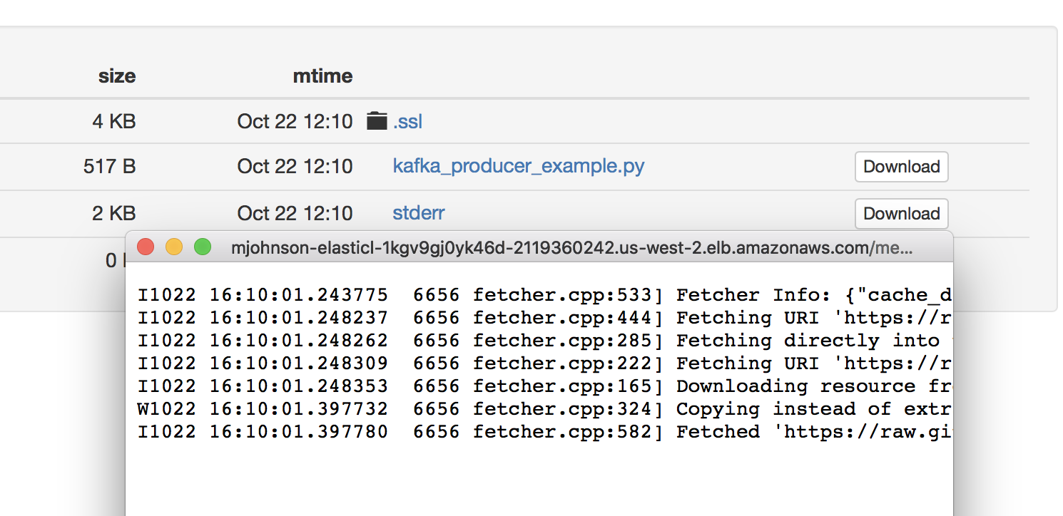
Mesos Sandbox: Viewing Logs

Slide 28
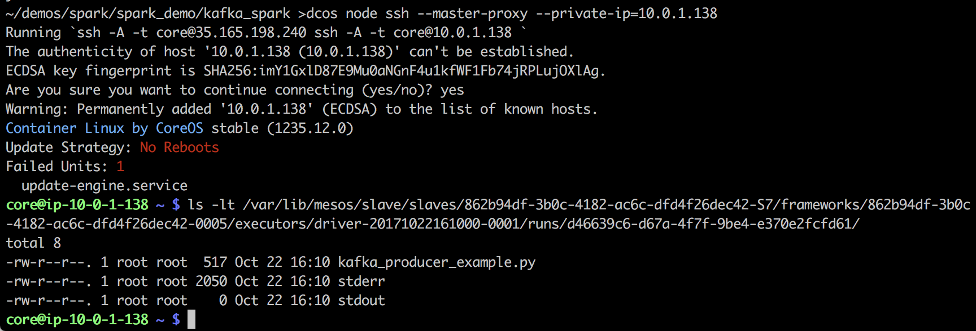
View Sandbox on Host

Slide 29
Spark History

Slide 30
Spark Program Debugging
Ssh –N –L 9000:

Slide 31
Part V: Data Analytics

Slide 32
Zeppelin Notebooks

Slide 33
Linking Data sources

Slide 34
MESOSPHERE DC/OS ENTERPRISE FEATURES
1.10
New for 1.10
Mesosphere DC/OS
Mesosphere DC/OS Enterprise
Open source platform for modern apps
Production-grade solution for mission-critical apps
Kubernetes (Beta) container orchestration
Marathon container orchestration with pods support
Production-certified data services (e.g., Spark, Kafka, Cassandra)
Distributed fault tolerant jobs scheduler (Cron)
Universe of 100+ platform services from easily deployed with a single single-click or CLI command; Developed by Mesosphere, DC/OS community, and commercial partners
Apache Mesos distributed systems kernel w/ Universal Container Runtime
Management of persistent and external volumes
Virtual networks with IP per container and Container Network Interface (CNI) Support
Distributed load balancer, service discovery and name-based VIPs
GPU-based scheduling
Guided on-premise and cloud installation templates (AWS, Azure)
Powerful CLI and GUI
Non-disruptive DC/OS upgrades
Platform monitoring & troubleshooting tools
Application-level logging, metrics & debugging
In-Place Upgrade for Data services
Validated DC/OS upgrades with automated pre and post upgrade health checks
Role-Based Access Control for containers, jobs, and data services
Identity management integration (Active Directory/LDAP/SAML 2.0/OpenID Connect)
Secrets Management (Key/Value and File-based)
Public key infrastructure w/ Custom certificate authority integration
Security audit logging
Fine-grained access control lists for containers and services w/ folder integration
Service accounts
High Performance L4/L7 Ingress load balancer (Edge-LB)
Emergency patching
Support for open-source Mesosphere-developed frameworks* | Cassandra, Kafka, Spark, Jenkins, Elastic, HDFS | Cassandra, Kafka, Spark, Jenkins, Elastic, HDFS
Support options | Premium | Standard, Premium
List price | Premium: $3,000 | Standard: $3,250 Premium: $3,950
Platform Services
DC/OS Catalog
Resource Management
Management & Monitoring
Features
Ops & troubleshoot
Security
Multi-tenancy
Adv. Network
Support
Price
* Does not include support for baseline technology, e.g. Apache Spark

Slide 35
Appendix

