Slide 1
Student Performance Tracker
Chad Baily, Luke Masters, Shivam Mehta, Dan Seymour, Aiden Smith, and Rice Tyler

Slide 2
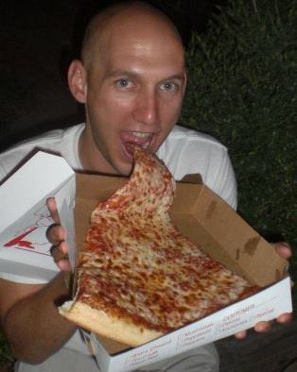
Mark Floryan
Mark floryan
Assistant Professor at UVA
Undergrad at UVa
PHD at the University of Massachusetts.
His research leverages student data to facilitate development of intelligent education systems.

Slide 3








Technology Used

Slide 4
Requirements
As a student...
As a professor...
Course topics are shown as nodes to make a mental map type system.
Progress is shown on a topic level.
Practice problems are provided to improve my ability on a specific topic, and improve my grade.
There is a high level overview of all topics, their relationships and my current grades.
Supporting documents are provided.
An overview of all student’s performance
I want to view ALL topics in a class.
I want to be able to upload a document that will set up a class.
Connect third party API’s to load grades and homework scores.
I want to be able to search for a student and - view their progress.

Slide 5
Demo

Slide 6
Challenges
Dealing with an incomplete implementation of a framework (visjs)
Changing requirements for external connections
Understanding async operations
Understanding project architecture
Requirement changes

Slide 7
Requirement Changes
DAN.
Changes to make uploading more intuitive.
Dynamic and Configurable Grading.

Slide 8
What Worked Well / Not So Well
The Good
Floryan had a kid
Team communication
Pull requests
Regular team meetings
Commorodary
The Bad
Floryan had a kid
Not merging for a long time
Only one person working on a feature
Vue wrappers of JS libraries
Communication of Customer Desires

Slide 9
Future work
Better transfer of data across between previous courses and new courses.
Improved uploading (remove from front-end)
Refactoring certain structures
Lot of nested async requests that make ordering operations difficult
Import external quizzes into our quiz suite
Have a progress bar of expected progress through a course
Link SPT to SIS such that topics become prerequisites of courses
TA view / multiple professors to a course

Slide 10
Questions?

Slide 11
http://bit.ly/2U3JJdA
Why you are all here

