Slide 1
Student Performance Tracker
Technical Work Summary

Slide 2
Contributors
Client: Mark Floryan
Developers:
Jimmy Patterson
Corey Lando
Taylor Nelson
Andrew Abraham
Connor Anderson
Jack Herd
Alex Nguyen
Ryan Kann

Slide 3
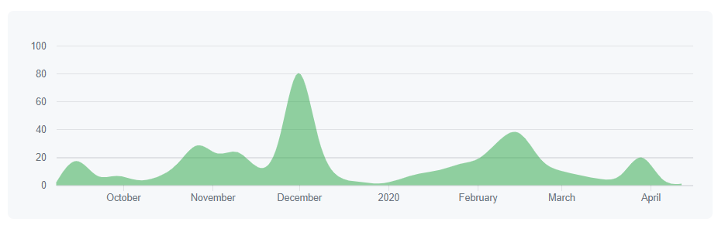
High-Level Design
The Student Performance Tracker is an
Online Course Environment
Taking (and retaking) Quizzes
Reviewing and Administering Grades
Notes:
Original content:
environment in which students can interface with a course
e.g. taking quizzes, uploading homework assignments, reviewing grades

Slide 4
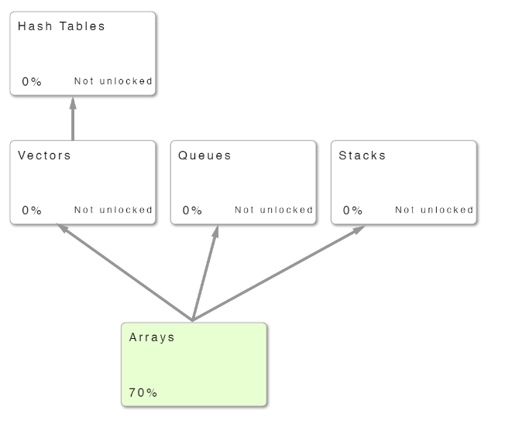
High-Level Design
The Student Performance Tracker is a
Specialized Pedagogical Tool
Graph-Based Structure
Competency-Bucket Grading
Adjustable Grading Metrics
Notes:
Original content:
tool for professors to easily translate a particular type of course into a system their students can use to learn
These types of courses consist of topics arranged like a directed, acyclical graph, where learning one topic unlocks a new topic based on the first.
Grades in these courses are based on competency (0 for not competent, 1 for competent), rather than being based on percentage grades on a per-topic basis.
resource for professors to analyze, review, and customize a course, seeing students’ grades and tailoring mastery thresholds to fit their class.

Slide 5
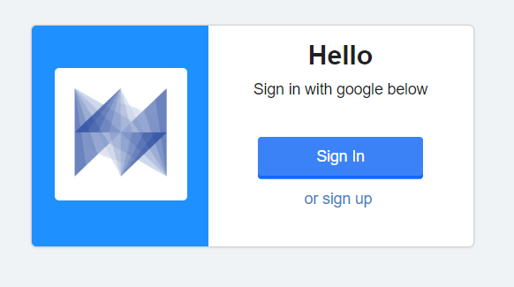
Fall ‘19 and Spring ‘20 Goals
Security
Improving Google OAuth efficiency
Protecting exposed API Endpoints
Course Alignment
Changing grading policies
Locking course topics
Notes:
original :
A foundation already existed for the Student Performance Tracker, so this team was specifically tasked to improve the application in four areas:
Security: Introducing Google OAuth and protecting exposed areas of the API, ensuring that permissions worked correctly
Course Alignment: Allowing professors to fine-tune their courses, showing competencies and grades effectively, locking and unlocking topics

Slide 6
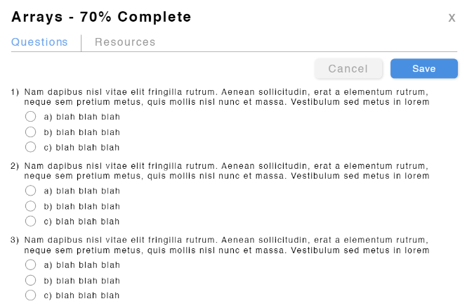
Fall ‘19 and Spring ‘20 Goals
Scaling
Smarter Queries
Batching
Less Frontend Computing
Quizzes
Stream Question System
Live Feedback
Novel Grading Metric
Notes:
Original:
Effectiveness at Scale: Making smart queries, improving the interaction between the frontend and the backend
Quizzes: Adding a completely new feature by which students can earn grades in real time, incorporating new systems for grading

Slide 7
What We’re Working With

Slide 8

Tech & Tools Used
Django, Django REST Framework
Vue, Vuex
PostgreSQL
HTML, Javascript, CSS, Webpack
Docker, Docker Compose
Nginx
Gunicorn
Letsencrypt, Certbot
Bash helper scripts
Travis-CI

Slide 9
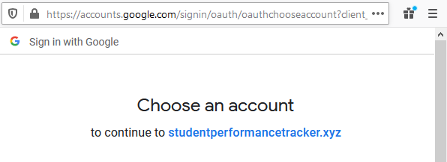
Backend
Authentication Classes with OAth
REST framework and tests all needed to authenticate properly

Slide 10

Backend
Models were re-written
Views were re-written to work with new models
Rewrite backend tests

Slide 11



Frontend Tools
Vue/Vuex
Javascript & HTML

Slide 12


Frontend Challenges
Vuex was unfamiliar to the team at first
Testing frontend properly was difficult
Previous team left us with hardly any functional tests

Slide 13


Getting the codebase ready for production
Nginx and Gunicorn replace the django dev server
Nginx replaces npm serve
One bash script to enable HTTPS

Slide 14
4 Goals for the Student Performance Tracker
Security and Authentication
Performance at Scale
Course Alignment
Quizzes and Grading

Slide 15
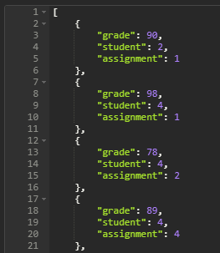

1. Security and Authentication
Student grades were viewable by anyone
Google Oauth tokens were exposed
No HTTPS

Slide 16
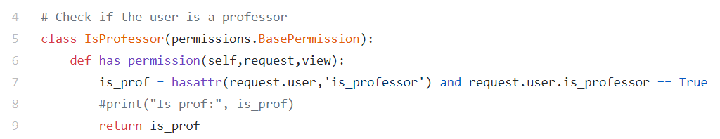
Django REST Framework Auth and Permissions
Grades only viewable by that student, or by professors
Removed hundreds of lines of code
Secured passwords, tokens, quiz answers
Added HTTPS

Slide 17
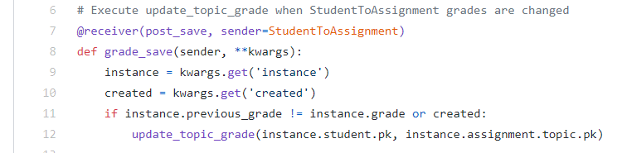
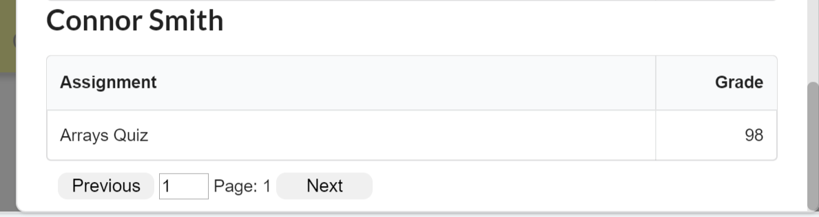
2. Performance at Scale
Added pagination at DB level
Minimized data sent to frontend
Calculate and cascade grades only when necessary
Moved work from frontend to backend
Notes:
Original content:
tool for professors to easily translate a particular type of course into a system their students can use to learn
These types of courses consist of topics arranged like a directed, acyclical graph, where learning one topic unlocks a new topic based on the first.
Grades in these courses are based on competency (0 for not competent, 1 for competent), rather than being based on percentage grades on a per-topic basis.
resource for professors to analyze, review, and customize a course, seeing students’ grades and tailoring mastery thresholds to fit their class.

Slide 18
3. Course Alignment
Goal: Bring the features of the app into alignment with the professor’s desired course structure.
Notes:
Original content:
environment in which students can interface with a course
e.g. taking quizzes, uploading homework assignments, reviewing grades

Slide 19
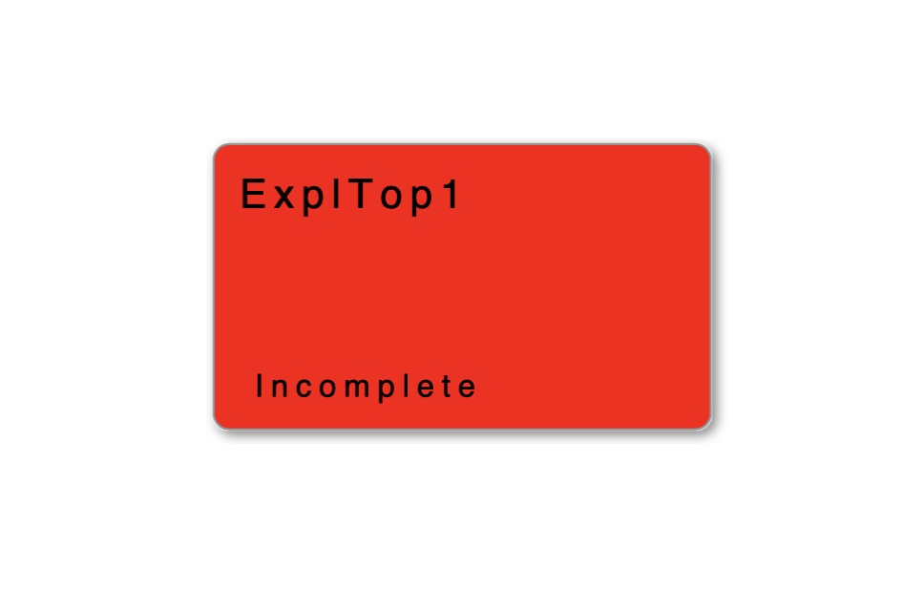
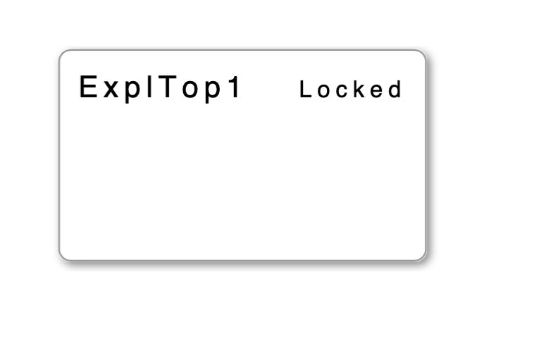
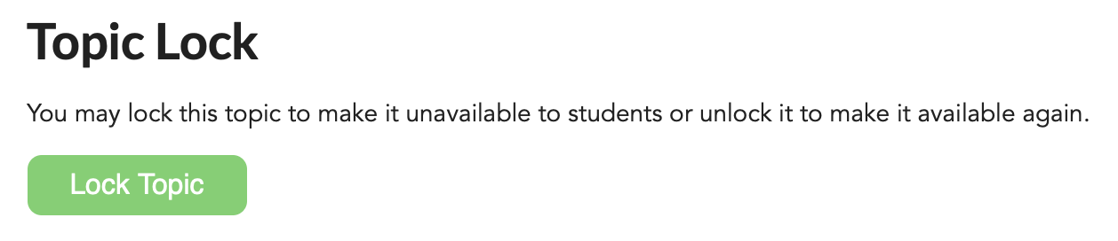
3. Course Alignment
Topic Locking
Notes:
Original content:
environment in which students can interface with a course
e.g. taking quizzes, uploading homework assignments, reviewing grades

Slide 20
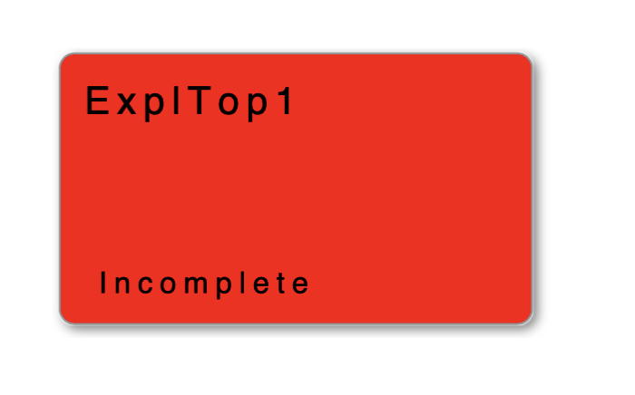
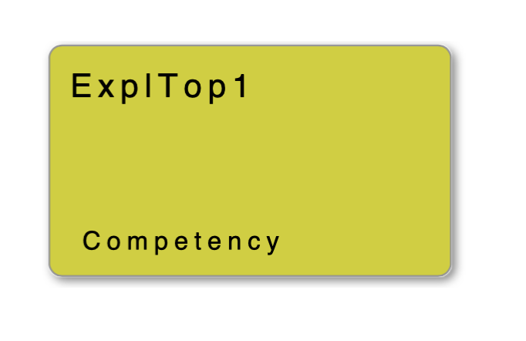
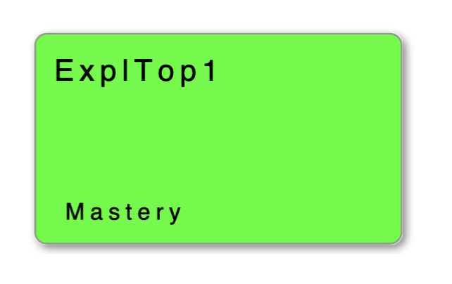



3. Course Alignment
Grade Display and Grade Cascading
Notes:
Original content:
environment in which students can interface with a course
e.g. taking quizzes, uploading homework assignments, reviewing grades

Slide 21
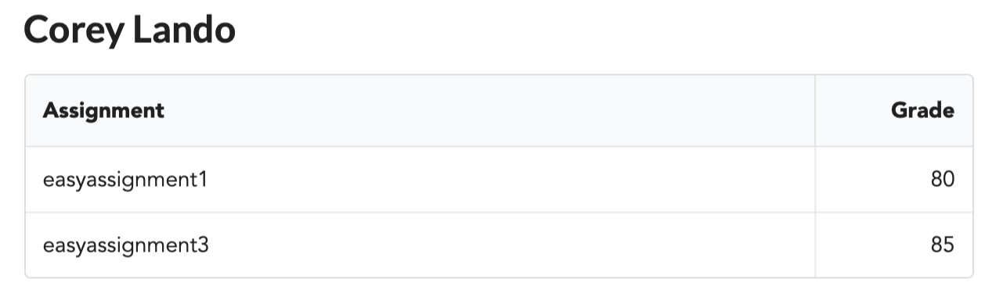
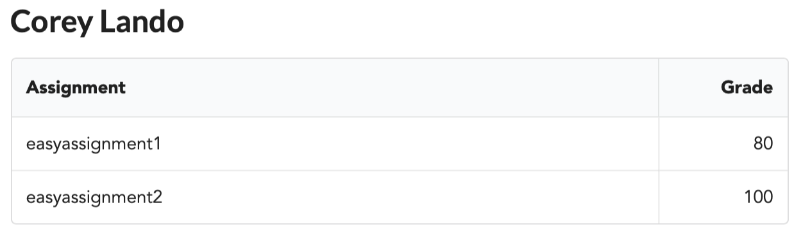
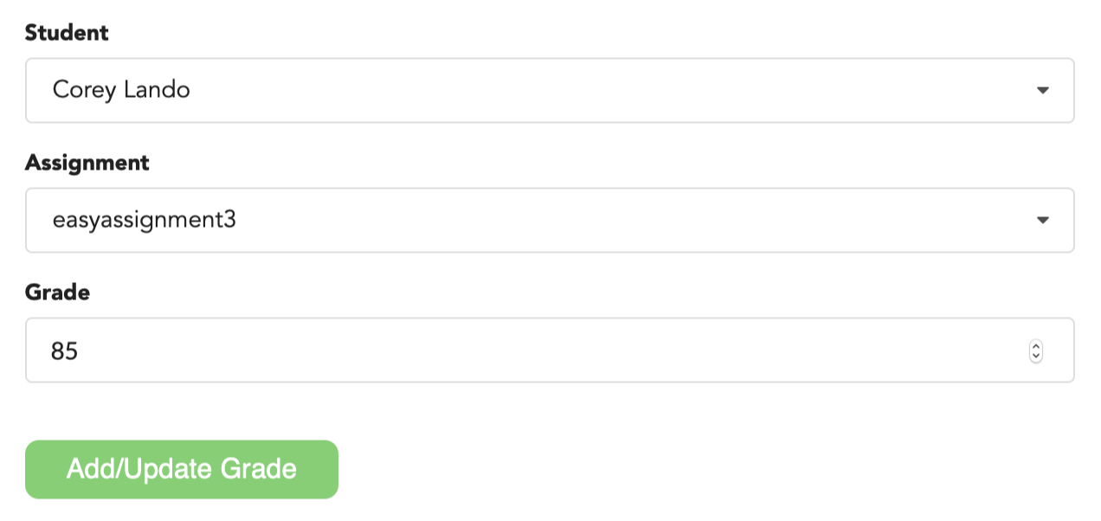
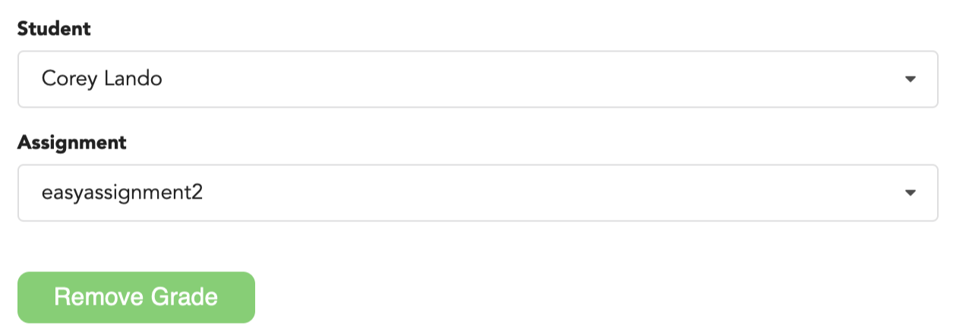
3. Course Alignment
Tools and Individual Grading
Notes:
Original content:
environment in which students can interface with a course
e.g. taking quizzes, uploading homework assignments, reviewing grades

Slide 22
3. Course Alignment
CSV Functionality - DEMO
Notes:
Original content:
environment in which students can interface with a course
e.g. taking quizzes, uploading homework assignments, reviewing grades

Slide 23
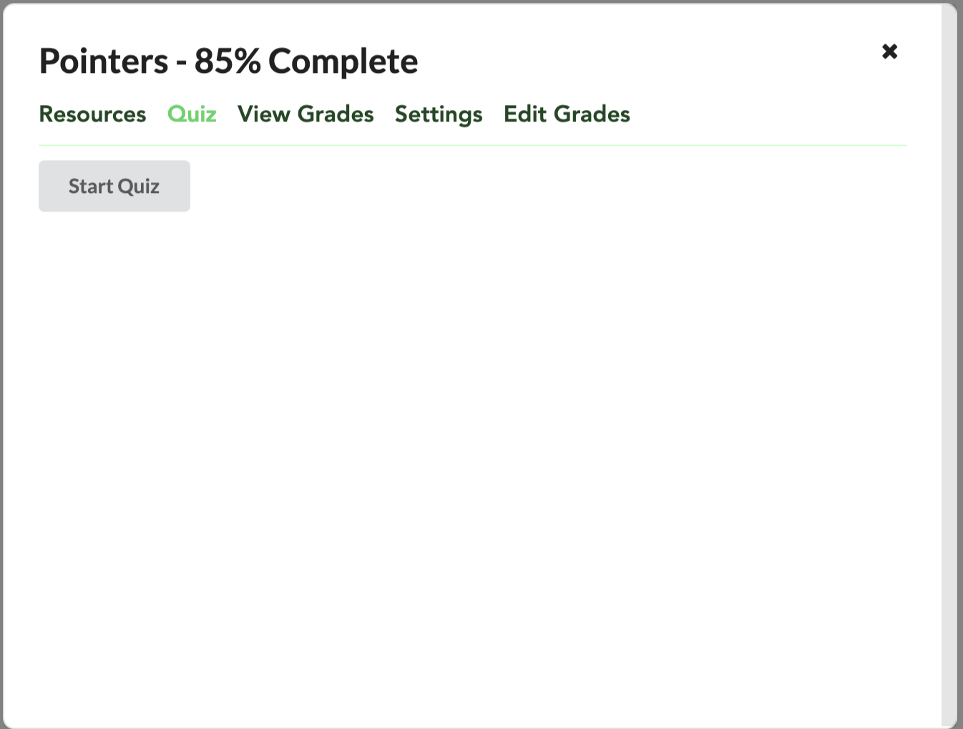
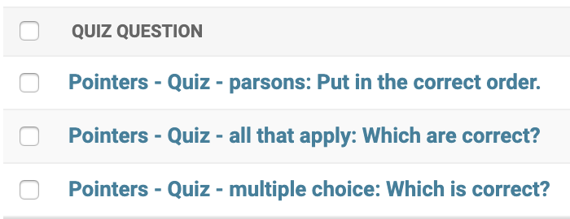
4. Quizzes and Grading - Overview
Specialized assignment
Pool of various types of questions
Selects predetermined subset
Notes:
original :
A foundation already existed for the Student Performance Tracker, so this team was specifically tasked to improve the application in four areas:
Security: Introducing Google OAuth and protecting exposed areas of the API, ensuring that permissions worked correctly
Course Alignment: Allowing professors to fine-tune their courses, showing competencies and grades effectively, locking and unlocking topics

Slide 24
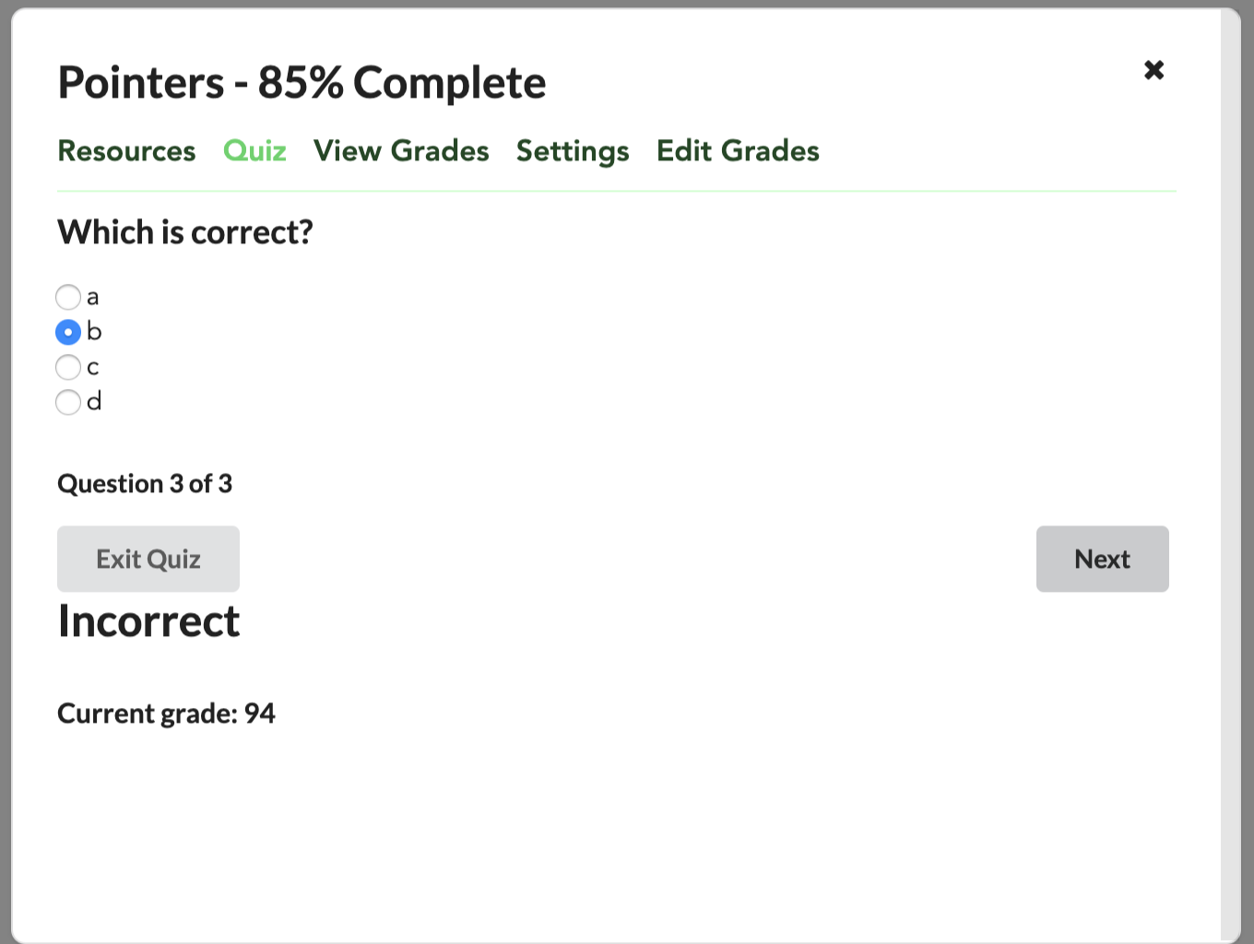
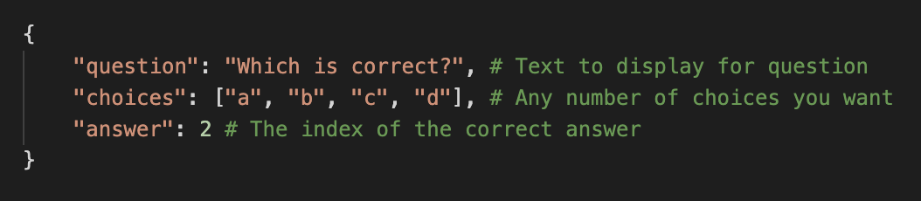
4. Quizzes and Grading - Multiple Choice
Select 1 radio button and submit
JSON produced by CSV
Notes:
original :
A foundation already existed for the Student Performance Tracker, so this team was specifically tasked to improve the application in four areas:
Security: Introducing Google OAuth and protecting exposed areas of the API, ensuring that permissions worked correctly
Course Alignment: Allowing professors to fine-tune their courses, showing competencies and grades effectively, locking and unlocking topics

Slide 25
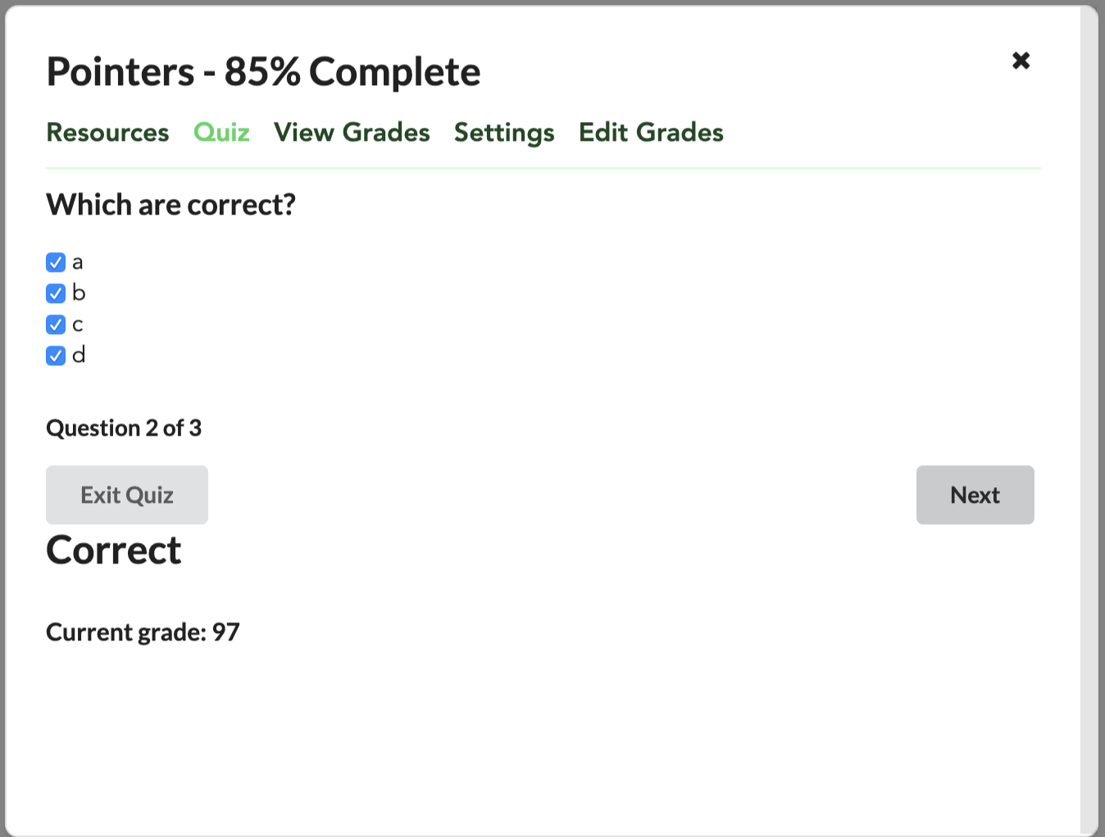
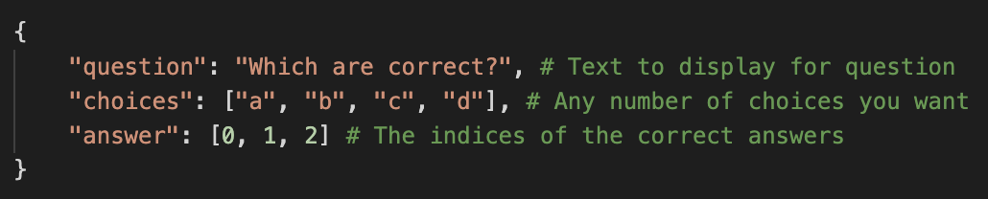
4. Quizzes and Grading - Select All That Apply
Select any checkboxes and submit
All or nothing (no partial credit)
JSON produced by CSV
Notes:
original :
A foundation already existed for the Student Performance Tracker, so this team was specifically tasked to improve the application in four areas:
Security: Introducing Google OAuth and protecting exposed areas of the API, ensuring that permissions worked correctly
Course Alignment: Allowing professors to fine-tune their courses, showing competencies and grades effectively, locking and unlocking topics

Slide 26
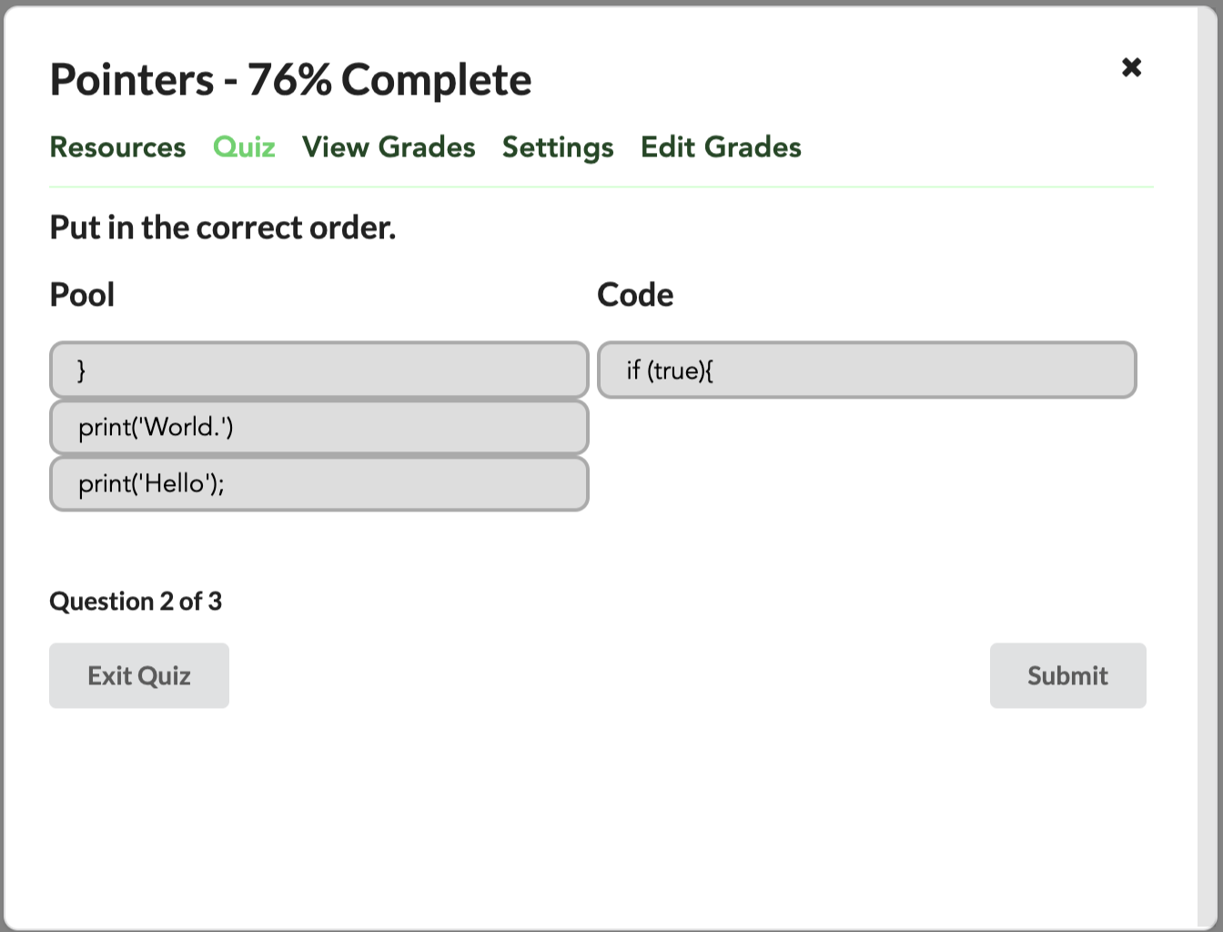
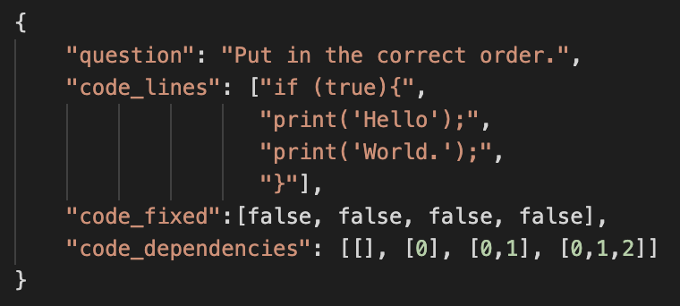
4. Quizzes and Grading - Parsons
Click and drag code snippets
Graded based on list of predecessors
No “red herring” boxes
Notes:
original :
A foundation already existed for the Student Performance Tracker, so this team was specifically tasked to improve the application in four areas:
Security: Introducing Google OAuth and protecting exposed areas of the API, ensuring that permissions worked correctly
Course Alignment: Allowing professors to fine-tune their courses, showing competencies and grades effectively, locking and unlocking topics

Slide 27
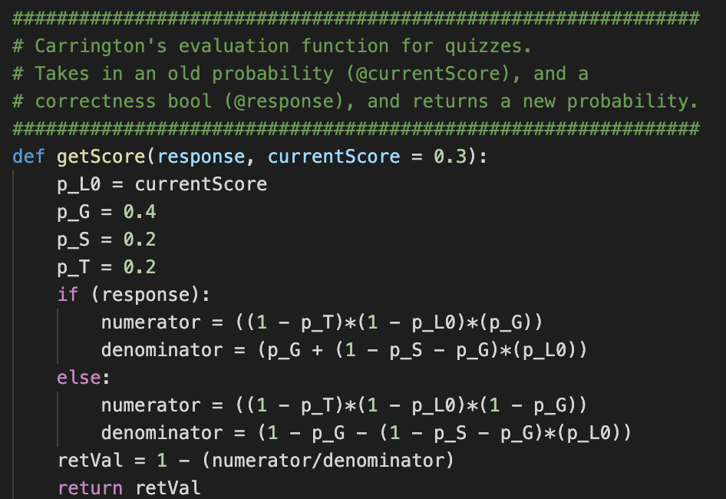
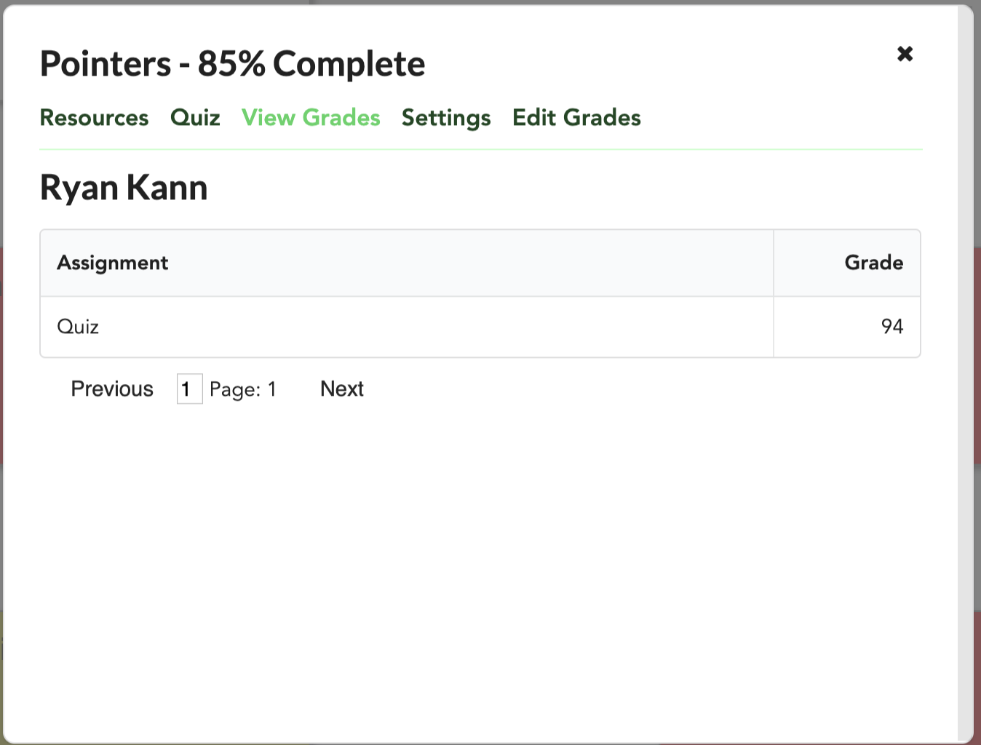
4. Quizzes and Grading - Grading Scheme
Dynamic grading based on correctness percentage over period of time.
Notes:
original :
A foundation already existed for the Student Performance Tracker, so this team was specifically tasked to improve the application in four areas:
Security: Introducing Google OAuth and protecting exposed areas of the API, ensuring that permissions worked correctly
Course Alignment: Allowing professors to fine-tune their courses, showing competencies and grades effectively, locking and unlocking topics

Slide 28
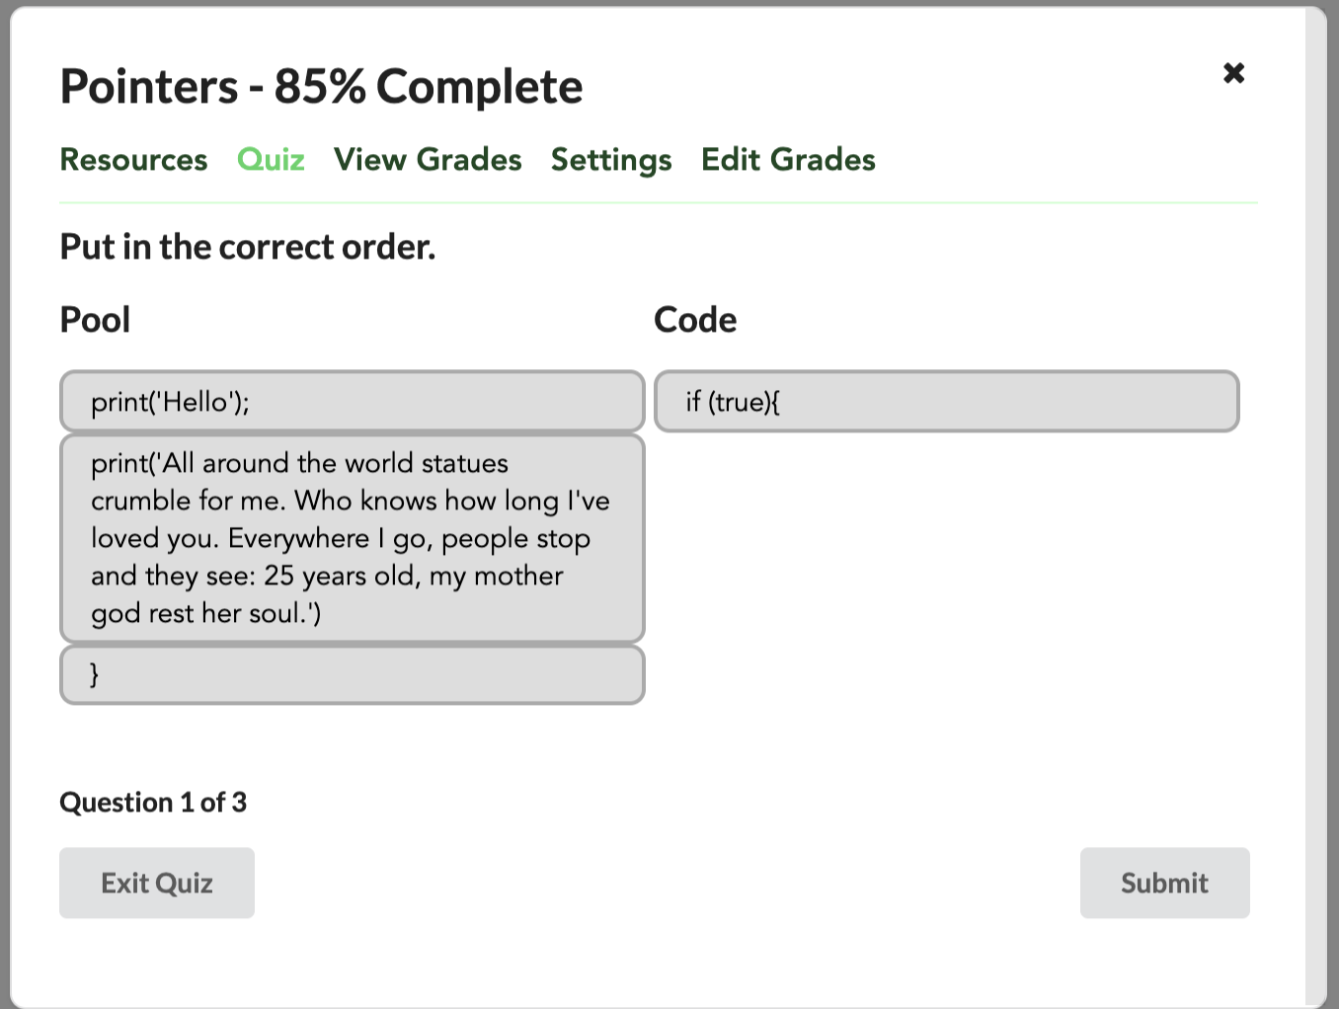
4. Quizzes and Grading
Notes:
original :
A foundation already existed for the Student Performance Tracker, so this team was specifically tasked to improve the application in four areas:
Security: Introducing Google OAuth and protecting exposed areas of the API, ensuring that permissions worked correctly
Course Alignment: Allowing professors to fine-tune their courses, showing competencies and grades effectively, locking and unlocking topics

