Slide 1
CS4710: Artificial Intelligence Search
Many AI problems boil down to graph search. What are the primary techniques for searching graphs? What do we do when the graph is very large?

Slide 2
Quick Review of Graphs
Yes, I realize several of you have seen this many times!

Slide 3
Definition: Directed graph
Directed Graph
A directed graph, or digraph, is a pair
G = (V, E)
where V is a set whose elements are called vertices, and
E is a set of ordered pairs of elements of V.
Vertices are often also called nodes.
Elements of E are called edges, or directed edges, or arcs.
For directed edge (v, w) in E, v is its tail and w its head;
(v, w) is represented in the diagrams as the arrow, v -> w.
In text we simple write vw.

Slide 4
Definition: Undirected graph
Undirected Graph
A undirected graph is a pair
G = (V, E)
where V is a set whose elements are called vertices, and
E is a set of unordered pairs of distinct elements of V.
Vertices are often also called nodes.
Elements of E are called edges, or undirected edges.
Each edge may be considered as a subset of V containing two elements,
{v, w} denotes an undirected edge
In diagrams this edge is the line v---w.
In text we simple write vw, or wv
vw is said to be incident upon the vertices v and w

Slide 5
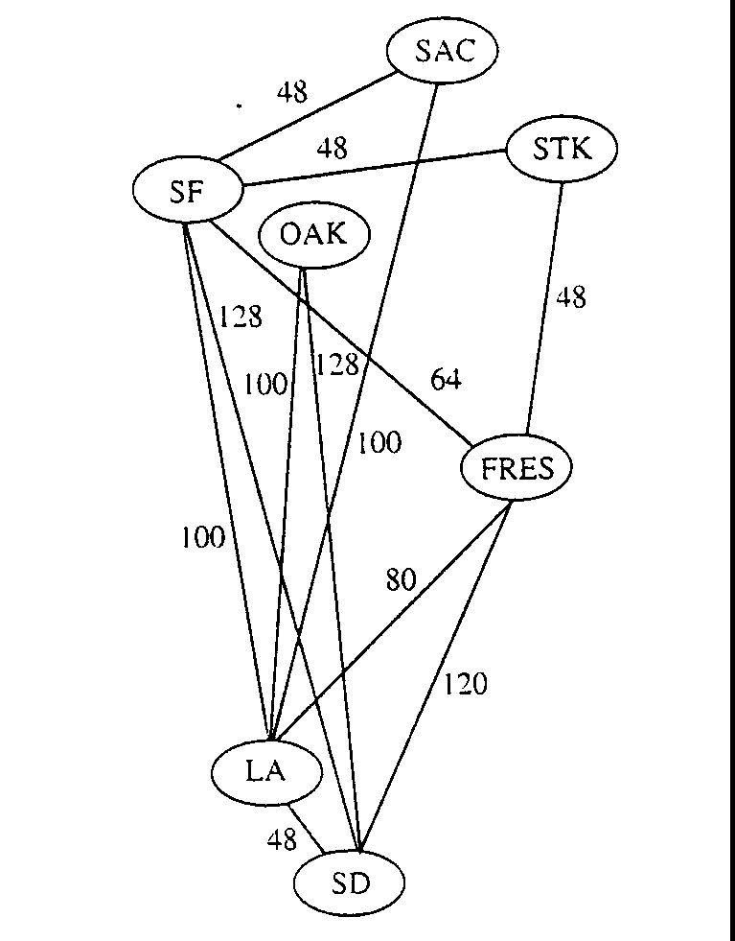
Definitions: Weighted Graph
A weighted graph is a triple (V, E, W)
where (V, E) is a graph (directed or undirected) and
W is a function from E into R, the reals (integer or rationals).
For an edge e, W(e) is called the weight of e.

Slide 6
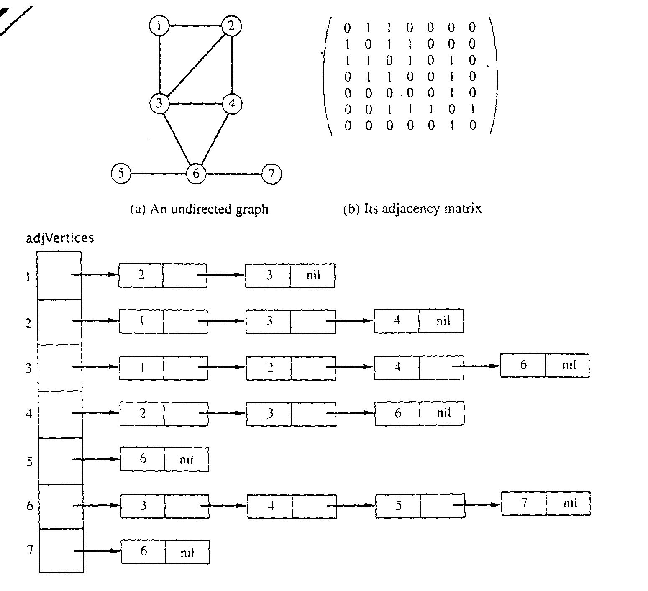
Graph Representations using Data Structures
Adjacency Matrix Representation
Let G = (V,E), n = |V|, m = |E|, V = {v1, v2, …, vn)
G can be represented by an n × n matrix

Slide 7
Array of Adjacency Lists Representation

Slide 8
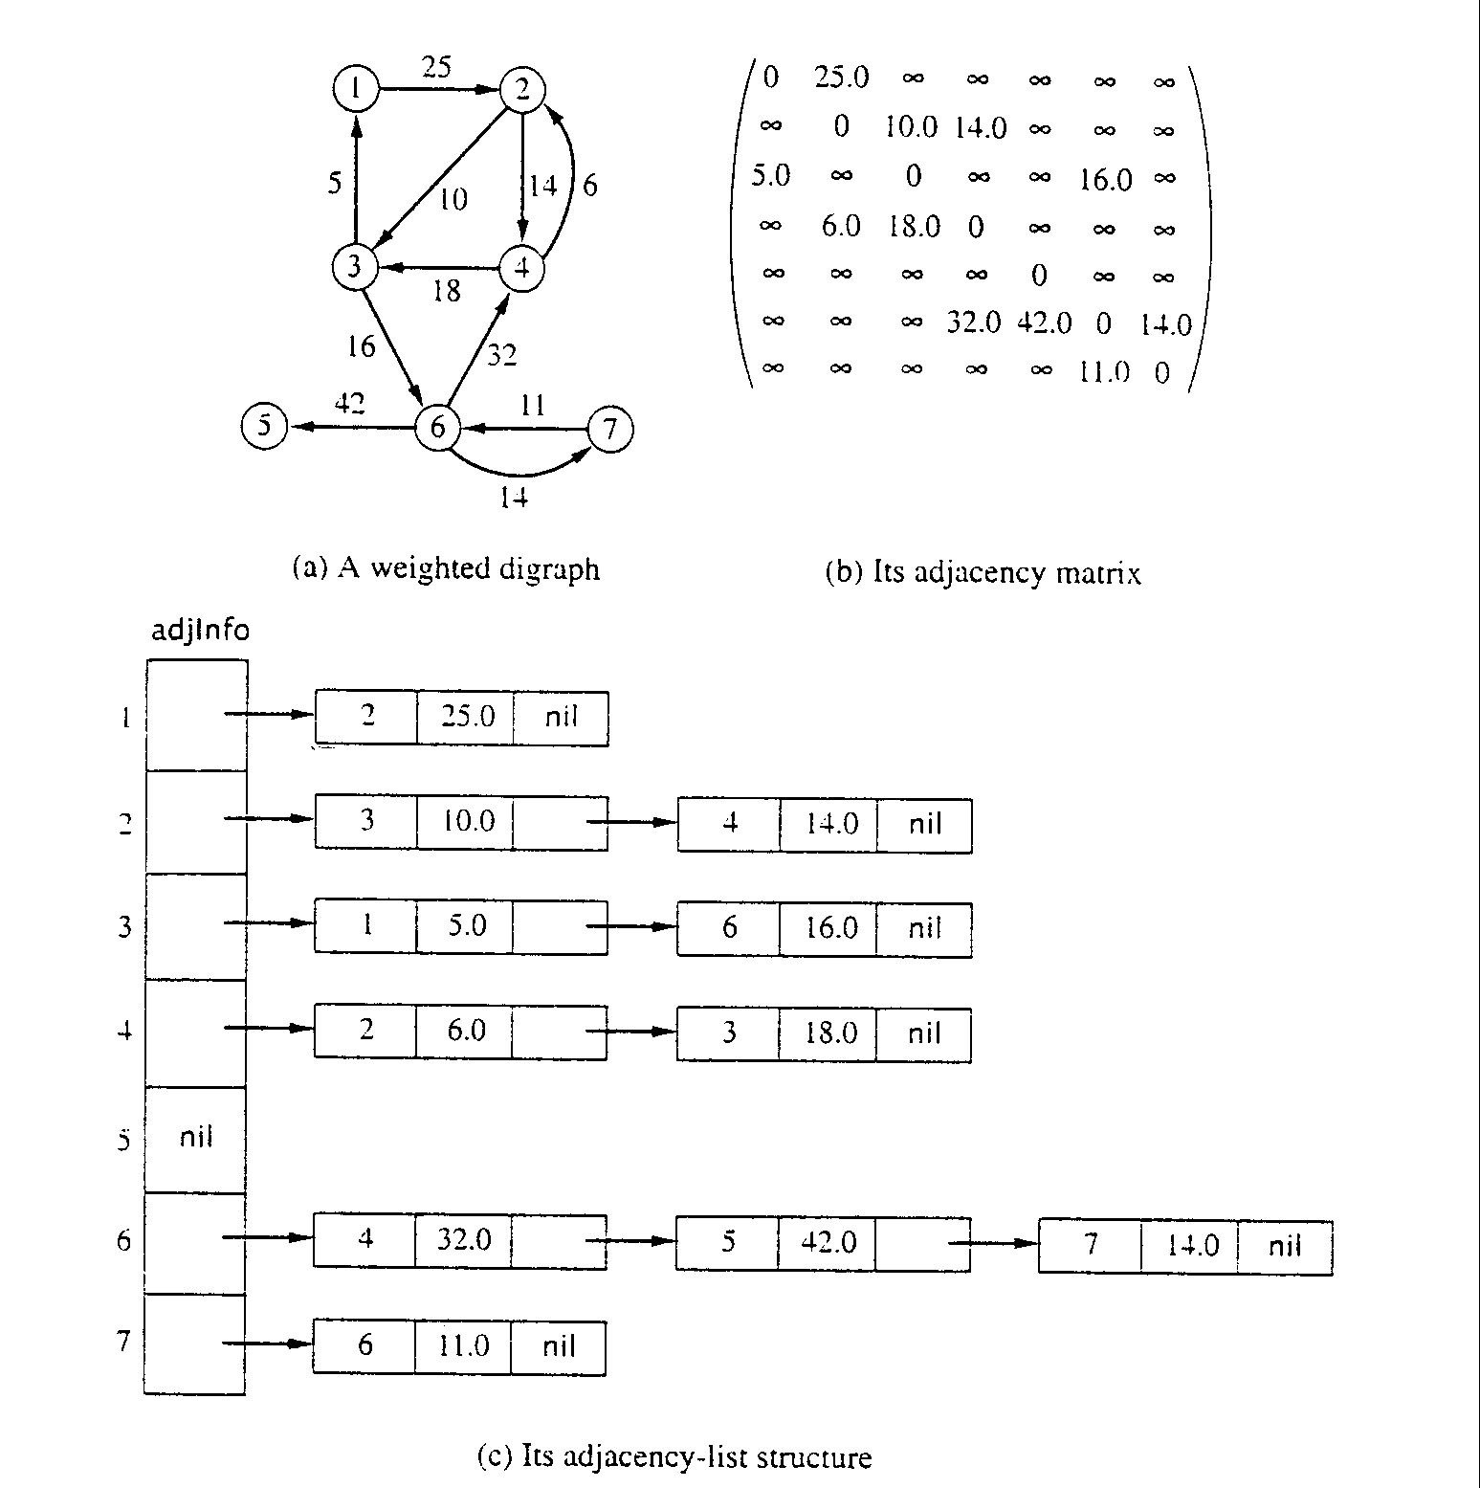
Adjacency Matrix for weight digraph

Slide 9
Array of Adjacency Lists Representation
from -> to, weight

Slide 10
Problems Solved With Search

Slide 11
AI Problems Solved by Search
Path Planning
Robot or some agent is searching a path through an environment
Game Playing
Searching through a set of states of a game to find a winning path for the AI
E.g., chess, checkers, etc.
Puzzle Solving
Rubik’s Cube, etc.
Is this really “intelligence”…you decide.

Slide 12
Breadth-First Search

Slide 13
Traversal Strategies
Note: traversal algorithms start at some vertex
Which? Trees have a root, but graphs don’t.
Might matter, might not.
Breadth-First and Depth-First are most basic strategies
Often aren’t fit for AI problems where state space is VERY large
We’ll review them first, then discuss slightly better approaches

Slide 14
BFS Strategy
Breadth-first search: Strategy (for digraph)
choose a starting vertex, distance d = 0
vertices are visited in order of increasing distance from the starting vertex,
examine all edges leading from vertices (at distance d) to adjacent vertices (at distance d+1)
then, examine all edges leading from vertices at distance d+1 to distance d+2, and so on,
until no new vertex is discovered

Slide 15
BFS Strategy: More Details
Maintain a Queue (Let’s call it Q)
Start at some node ‘s’ (push ‘s’ to Q and mark as visited)
While Q not empty
Pop a node ‘n’ from queue
Process ‘n’ if necessary (depending on problem you are solving)
For each non-visited neighbor of ‘n’
Mark neighbor as visited
Push neighbor onto Q
Repeat

Slide 16
Breadth-first search: Analysis
For a digraph having V vertices and E edges
Each edge is processed once in the while loop for a cost of θ(E)
Each vertex is put into the queue once and removed from the queue and processed once, for a cost θ(V)
Extra space is used for color array and queue, there are θ(V)
From a tree (breadth-first spanning tree)
the path in the tree from start vertex to any vertex contains the minimum possible number of edges
Not all vertices are necessarily reachable from a selected starting vertex

Slide 17
Breadth-first search: More Analysis
In AI, graphs are often very large. So…
Let ‘d’ be the shallowest depth of any goal node
Let ‘b’ be the branching factor
Average number of branches coming off of each node in graph
Runtime of BFS in terms of these factors is:
Time: O(b^d) why?
Space: O(b^d) why?
Notice that b^d is bounded by E Why?

Slide 18
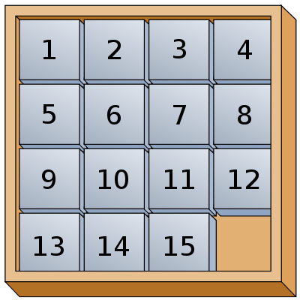
Problem Solving Time!

Slide 19
Depth-First Search

Slide 20
DFS: the Strategy in Words
Depth-first search: Strategy
Go as deep as can visiting un-visited nodes
Choose any un-visited vertex when you have a choice
When stuck at a dead-end, backtrack as little as possible
Back up to where you could go to another unvisited vertex
Then continue to go on from that point
Eventually you’ll return to where you started
Reach all vertices? Maybe, maybe not

Slide 21
Observations about the DFS Strategy
Note: we must keep track of what nodes we’ve visited
DFS traverses a subset of E (the set of edges)
Creates a tree, rooted at the starting point: the Depth-first Search Tree (DFS tree)
Each node in the DFS tree has a distance from the start. (We often don’t care about this, but we could.)
At any point, all nodes are either:
Un-discovered
Finished (you backed up from it), or
Discovered (I.e. visited) but not finished
On the path from the current node back to the root
We might back up to it

Slide 22
DFS Strategy 1: Use a stack
Maintain a Stack (Let’s call it S)
Start at some node ‘s’ (push ‘s’ to S and mark as visited)
While S not empty
Pop a node ‘n’ from S
Process ‘n’ if necessary (depending on problem you are solving)
For each non-visited neighbor of ‘n’
Mark neighbor as visited
Push neighbor onto S
Repeat
Sound familiar? Same as BFS but uses stack instead of queue!
Or we can implement recursively (see next slide)

Slide 23
DFS Strategy 2: Recursion
def dfs(graph, start):
visited = {}
dfs_recurse(graph, start, visited)
def dfs_recurse(graph, curnode, visited):
visited[curnode] = True
alist = graph.get_adjlist(curnode)
for v in alist:
if v not in visited:
print " dfs traversing edge:", curnode, v
dfs_recurse(graph, v, visited)
//
return

Slide 24
Time Complexity of DFS
For a digraph having V vertices and E edges
Each edge is processed once in the while loop of dfs_recurse() for a cost of θ(E)
Think about adjacency list data structure.
Traverse each list exactly once. (Never back up)
There are a total of 2*E nodes in all the lists
Must visit every node potentially
Thus over all time-complexity is θ(V+E)
Remember: this means the larger of the two values
Note: This is considered “linear” for graphs since there are two size parameters for graphs.

Slide 25
Time Complexity of DFS
In terms of d and b
Time: O(b^d) Why?
Space: O(d)
Notice ‘d’ here is actually the maximum depth the search reaches. In a moment we will bound this more tightly.
Why? Depends on implementation, but when can we get ‘d’ space?

Slide 26
Pros and Cons
BFS
Finds path with lowest number of edges
Uses a lot of memory on large well connected graphs. How much?
Same time complexity as DFS
DFS
Memory efficient
Will often find ‘some’ path very quickly
Doesn’t find path with lowest number of edges

Slide 27
DFS w/ Iterative Deepening

Slide 28
Motivation
When search spaces are HUGE, we want:
The memory efficiency of DFS
The optimality of BFS
Can we combine the two approaches somehow?

Slide 29
Depth-Limited Search
IDEA!
Run a depth-first search with extra parameter ‘d’
‘d’ is the maximum depth the DFS is willing to search
Depth is distance from the start node
Once you see a node of depth ‘d’, ignore it’s neighbors and back up as you would normally

Slide 30
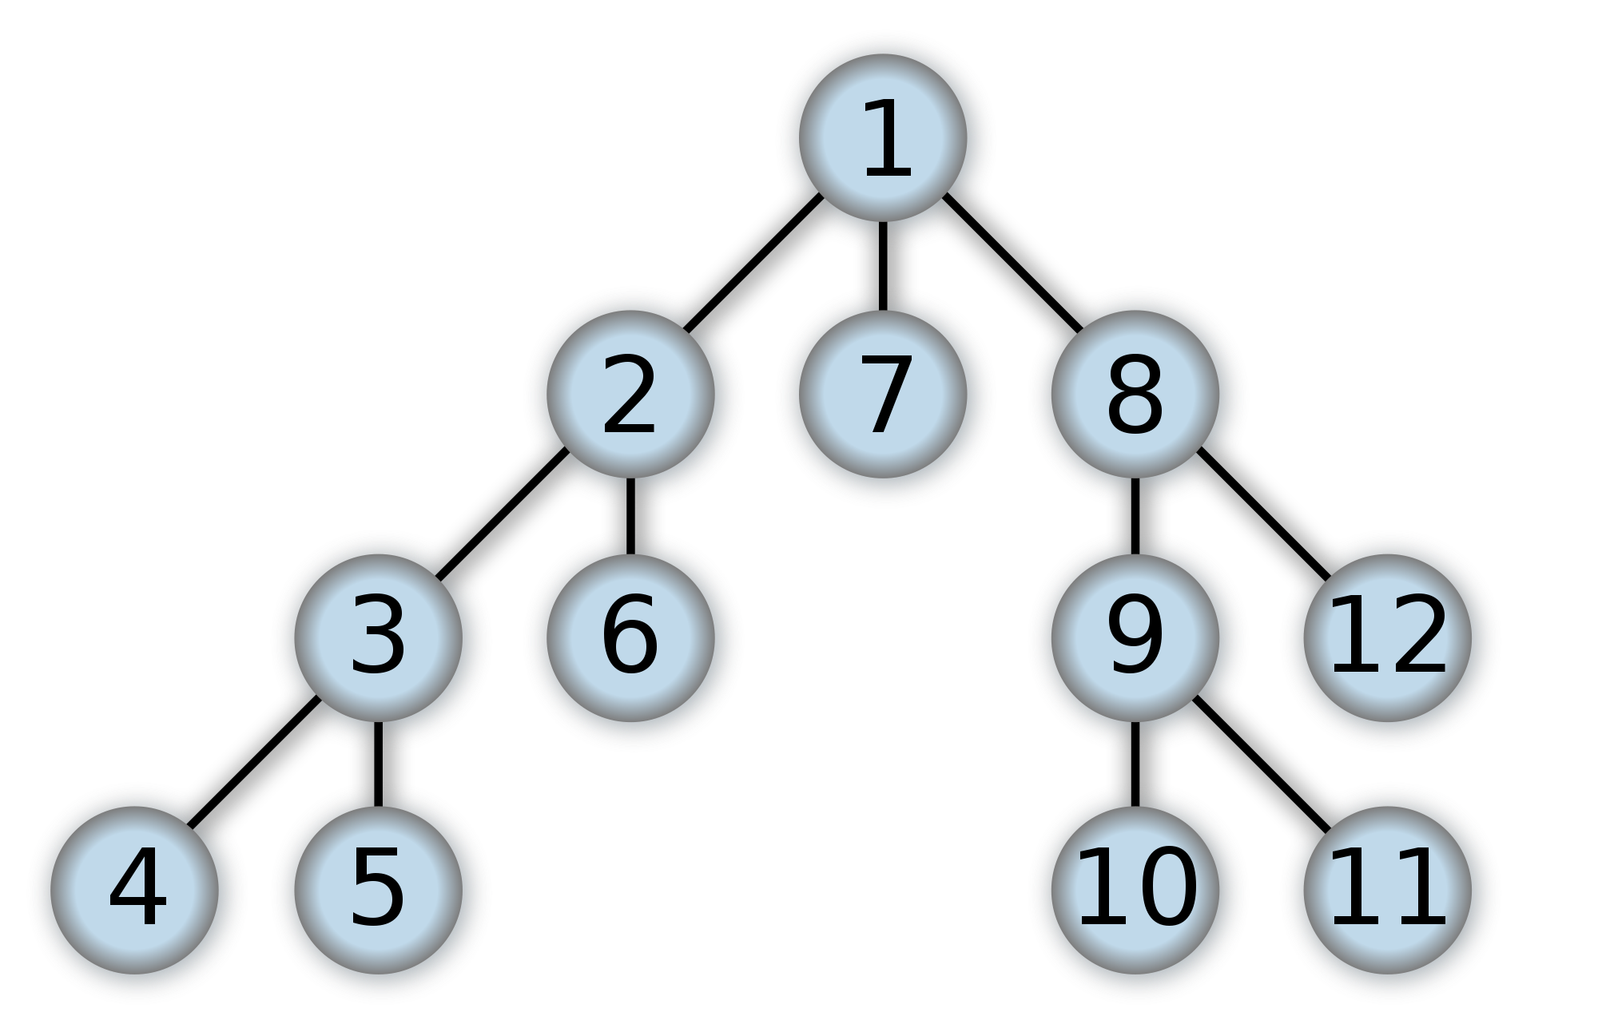
Depth-Limited Search
D = 2

Slide 31
Depth-Limited Search
Problems with this?
Will this ever find a goal node if that node is beyond depth ‘d’?
How do we deal with these problems?

Slide 32
What is Iterative Deepening?
IDEA!
Run Depth-Limited search over and over with increasing ‘d’ value
Analysis? What are the pros and cons?

Slide 33
Iterative Deepening Example
D = 1

Slide 34
Iterative Deepening Example
D = 2

Slide 35
Iterative Deepening Example
D = 3

Slide 36
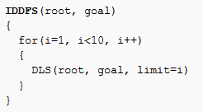
Iterative Deepening Pseudo-Code

Slide 37
Iterative Deepening: Analysis
Time Complexity:
DFS multiple times so O(b^d * d) = O(b^d)
Same as DFS or BFS
Space Complexity:
Same as DFS, so O(d)
But this seems so wasteful? Why is this a good approach?
Some form of Iterative deepening often used when goal depth is unknown and state space is very large

Slide 38
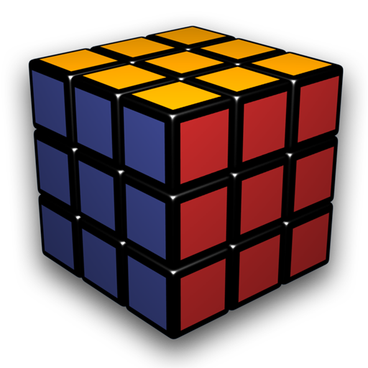
Iterative Deepening: Example
AI that solves a rubik’s cube
How will we solve this problem?
Want to find smallest number of moves that lead to the solved state

Slide 39
Iterative Deepening: Example
About how many states does the cube have? Let’s estimate
8 corner blocks, 3 orientations each
8! * 3^8 permutations
Some are not possible, but that is ok
12 edge pieces, 2 orientations each
12! * 2^12 permutations
Again, some of these not possible but ok
Total: ~ 4.325*10^19

Slide 40
Iterative Deepening: Example
Breadth-First Search!
Analysis:
b >= 12
d = ? LB Guess: 20
Space / Time
12^20 = 3.83*10^21
Wait what? Many of these repeated, but means we could have whole search space in memory at once!!
Too much memory at once!

Slide 41
Iterative Deepening: Example
Iterative Deepening!
Will still find shortest solution
Analysis:
b >= 12
d = ? LB Guess: 20
Time: Still might search whole space, no way around this
Space: d = 20
Probably larger in practice but still very feasible

Slide 42
Heuristic Search

Slide 43

Understanding Heuristic Searches
All of the following algorithms use two lists
The open list
The closed list
Open list keeps track of promising nodes
When a node is examined from open list
Taken off open list and checked to see whether it has reached the goal
If it has not reached the goal
Used to create additional nodes
Then placed on the closed list
You already know some of these algorithms
BFS, Dijkstra, etc.

Slide 44

Overall Structure of the Algorithms
1. Create start point node – push onto open list
2. While open list is not empty
A. Pop node from open list (call it currentNode)
B. If currentNode corresponds to goal, break from step 2
C. Create new nodes (successors nodes) for cells around currentNode and push them onto open list
D. Put currentNode onto closed list

Slide 45

Breadth-First | Characteristics of
Finds a path from the start to the goal by examining the search space ply-by-ply
Exhaustive search
Systematic, but not clever
Consumes substantial amount of CPU and memory
Guarantees to find paths that have fewest number of nodes in them
Not necessarily the shortest distance!
Complete algorithm

Slide 46

Best-First
Uses problem specific knowledge to speed up the search process
Head straight for the goal
Computes the distance of every node to the goal
Uses the distance (or heuristic cost) as a priority value to determine the next node that should be brought out of the open list
…but what is a heuristic? See next slide!

Slide 47
Heuristics
A Heuristic is a guess. For search problems, a heuristic is an estimate of how much the cost to the goal node will be.
Notice that each node in the graph will have its own heuristic value
E.g., h(n3) returns a guess as to the cost of the path from node n3 to the goal node
If your heuristic guess is perfect, then you don’t need to search, because you know the answer!
So…as an engineer you can try using different methods for guessing this value.
In general, the closer your heuristic guess, the more efficient your search can be.
So worth it to work hard to get the heuristic as close to actual cost as possible.

Slide 48
Heuristics
A Heuristic is a guess. For search problems, a heuristic is an estimate of how much the cost to the goal node will be.
Can you answer these questions:
What happens if your heuristic guess is exactly right every time?
What happens if your heuristic is the same for every node? (e.g., h(x) = 5 for all x)
What happens if your heuristic is erroneous? (e.g., h(x) > h(y) but x actually closer to goal than y)

Slide 49
About Heuristics
Heuristics are intended to orient the search along promising paths
The time spent computing heuristics must be recovered by a better search
After all, a heuristic function could consist of solving the problem; then it would perfectly guide the search
Deciding which node to expand is sometimes called meta-reasoning
Heuristics may not always look like numbers and may involve large amount of knowledge

Slide 50

Best-First | Characteristics of
Same as BFS, Dijkstra, etc. except the priority value on the priority queue is different.
Use h(x) as the priority value
Situation where Best-First finds a suboptimal path
Heuristic search
Uses fewer resources than Breadth-First
Tends to find good paths
No guarantee to find most optimal path
Why?
Complete algorithm

Slide 51
Example: Robot Navigation
*Red is starting point, green the goal node

Slide 52
Robot Navigation: Best-First Search
f(N) = h(N), with h(N) = Manhattan distance to the goal
8
7
6
5
4
3
2
3
4
5
6
7
5
4
3
5
6
3
2
1
0
1
2
4
7
6
5
8
7
6
5
4
3
2
3
4
5
6

Slide 53
Robot Navigation
f(N) = h(N), with h(N) = Manhattan distance to the goal
8
7
6
5
4
3
2
3
4
5
6
7
5
4
3
5
6
3
2
1
0
0
1
2
4
7
7
6
5
8
7
6
5
4
3
2
3
4
5
6
What happened???

Slide 54
Greedy Search
f(N) = h(N) → greedy best-first
Is it complete?
If we eliminate endless loops, yes
Is it optimal?
No! Need something better

Slide 55
A* Pathfinding

Slide 56
More informed search
We kept looking at nodes closer and closer to the goal, but were accumulating costs as we got further from the initial state
Our goal is not to minimize the distance from the current head of our path to the goal, we want to minimize the overall length of the path to the goal!
Let g(N) be the cost of the best path found so far between the initial node and N
f(N) = g(N) + h(N)

Slide 57
Robot Navigation
f(N) = g(N)+h(N), with h(N) = Manhattan distance to goal
8+3
8+3
7+4
7+4
6+5
6+3
5+6
5+6
4+7
4+7
3+8
3+8
2+9
8
7
6
5
4
3
2+9
3+10
2
3
4
5
6
7+2
7+2
5+6
4+7
3+8
7
5
4
3+8
3
5
6+1
6+1
2+9
2+9
1+10
6
3
2
1+10
0+11
1
0
1
2
4
7+0
7+0
6+1
7
6+1
6
5
8+1
8+1
7+2
7+2
6+3
6+3
5+4
5+4
4+5
4+5
3+6
3+6
2+7
8
7
6
5
4
3
2+7
3+8
2
3
4
5
6

Slide 58
A* Search
Evaluation function: f(N) = g(N) + h(N) where:
g(N) is the cost of the best path found so far to N
h(N) is an admissible heuristic
Then, best-first search with this evaluation function is called A* search
Important AI algorithm developed by Fikes and Nilsson in early 70s. Originally used in Shakey robot.

Slide 59
Admissible heuristic
Let h*(N) be the true cost of the optimal path from N to a goal node
Heuristic h(N) is admissible if: 0 ≤ h(N) ≤ h*(N)
An admissible heuristic is always optimistic

Slide 60
Consistent Heuristic
The admissible heuristic h is consistent (or satisfies the monotone restriction) if for every node N and every successor N’ of N: h(N) ≤ c(N,N’) + h(N’) h(Goal) = 0
(triangular inequality)
h() is consistent -> h() is admissible
Converse not necessarily true. Can you prove this?
N
c(N,N’)
N’
h(N)
h(N’)

Slide 61
Claims
If h is consistent, then the function f along any path is non-decreasing: f(N) = g(N) + h(N) f(N’) = g(N) +c(N,N’) + h(N’)
N
c(N,N’)
N’
h(N)
h(N’)

Slide 62
Claims
If h is consistent, then the function f along any path is non-decreasing: f(N) = g(N) + h(N) f(N’) = g(N) +c(N,N’) + h(N’) h(N) ≤ c(N,N’) + h(N’) f(N) ≤ f(N’)
N
c(N,N’)
N’
h(N)
h(N’)

Slide 63
Claims
If h is consistent, then the function f along any path is non-decreasing: f(N) = g(N) + h(N) f(N’) = g(N) +c(N,N’) + h(N’) h(N) ≤ c(N,N’) + h(N’) f(N) ≤ f(N’)
If h is consistent, then whenever A* expands a node it has already found an optimal path to the state associated with this node
N
c(N,N’)
N’
h(N)
h(N’)

Slide 64
Back to the Puzzle!

Slide 65
Optimality of A*
Theorem: If h(n) is admissible, then A* is optimal.
Corollary: If h(n) is not admissible, then A* is not necessarily optimal
Can you find a counter-example to prove this claim?
Work on this in pairs. Give me:
1. A counter-example to the corollary above
2. A intuitive proof of the theorem above

Slide 66
Heuristic Accuracy
h(N) = 0 for all nodes is admissible and consistent. Hence, breadth-first and uniform-cost are particular A* !!!
Let h1 and h2 be two admissible and consistent heuristics such that for all nodes N: h1(N) ≤ h2(N).
Then, every node expanded by A* using h2 is also expanded by A* using h1.
h2 is more informed than h1

Slide 67

A* | Summary
Uses both heuristic cost and given cost to order the open list
Final Cost = Given Cost + (Heuristic Cost * Heuristic Weight)
Avoids Best-First trap!
Heuristic search
On average, uses fewer resources than Dijkstra and Breadth-First
Admissible heuristic
Can never overestimate the cost
guarantees it will find the most optimal path
Complete algorithm

Slide 68
Thinking about these algorithms
Dijkstra’s Algo:
w1 = 1, w2 = 0
f(x) is distance to node x
No Heuristic included
Best-first search:
w1 = 0, w2 = 1
g(x) is heuristic guess of distance to goal
A*
w1 =1, w2 = 1
f(x) distance to node x
g(x) heuristic guess of distance to goal
g(x) <= actual distance to goal
Each algorithm uses the following function to determine the “priority” of each node:
P(x) = w1*f(x) + w2*g(x)
w1 & w2 are binary weights (1 or 0)
f(x) is distance traveled so far to node x
g(x) is heuristic guess as to distance from this node to goal.

