Slide 1
CS4710: Artificial Intelligence Multi-Agent Systems
Many systems require multiple intelligent agents that work together. Let’s study a couple brief techniques involving these systems.

Slide 2

Topics
What is a Multi-Agent System (MAS)?
Examples of MAS
Multi-agent CSP
Contract-Net Protocol
Negotiation

Slide 3
What is MAS?

Slide 4
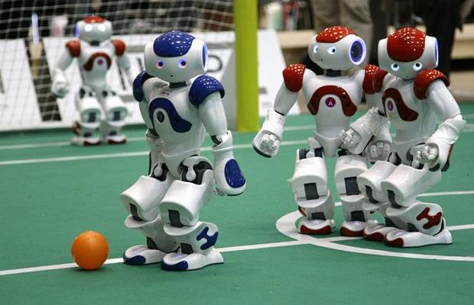
Multiple-Agents
A multi-agent system, in general, is any system that involves multiple agents interacting autonomously.
Some properties:
The agents act autonomously, each with own info about the world and other agents
Outcome depends on the actions of all agents
Each agent can have its own utility

Slide 5
Multiple-Agents: Utility
Most interesting MAS problems force systems to balance the following:
Global Utility: Total utility shared by the entire system. Usually involves agents working together.
Local Utility: The utility of each individual agent.
* Sometimes you will have one or both

Slide 6
Cooperative vs. Competitive MAS
Likewise, we have two extreme types of MAS:
Fully Cooperative: Every agent shares the same utility function (this is what a global utility function is).
Fully Competitive: When one agent can only win when the other agent loses.
*Most practical systems fall somewhere in between these extremes

Slide 7
Distributed CSP Problems

Slide 8
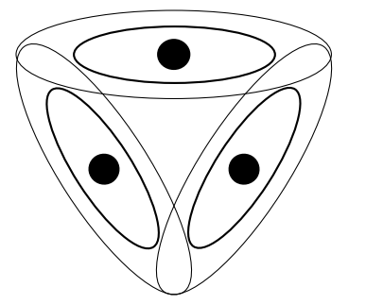
Constraint-Satisfaction Problems
CSP problems contain:
A set of variables
A domain of values each variable can take
A set of constraints on which values variables can take simultaneously
Examples:
Graph coloring
TSP
Knapsack problem

Slide 9
Constraint-Satisfaction Problems
Example:
Consider three sensors (see image) can work on one of three frequencies. All work fine, but no two agents can work on the same frequency. How to select a valid assignment?
Things to remember:
The decision cannot be made centrally
Agents can communicate with one another
Communication is perfect
Messages arrive in order

Slide 10
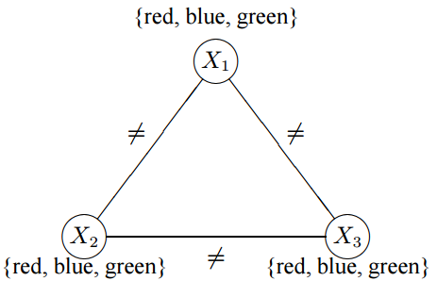
Constraint-Satisfaction Problems
Example:
Consider three sensors (see image) can work on one of three frequencies. All work fine, but no two agents can work on the same frequency. How to select a valid assignment?
Really, this is equivalent to a graph coloring problem, so let’s solve this problem instead.

Slide 11
A Filtering Algorithm
A simple (kind of dumb) algorithm to start with.
Idea:
have agents communicate their possible values to nearby agents.
Have each agent attempt to rule out values from its own list when possible.
If an agents list changes, update nearby agents of the change.

Slide 12
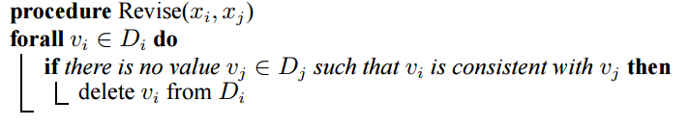
A Filtering Algorithm

Slide 13
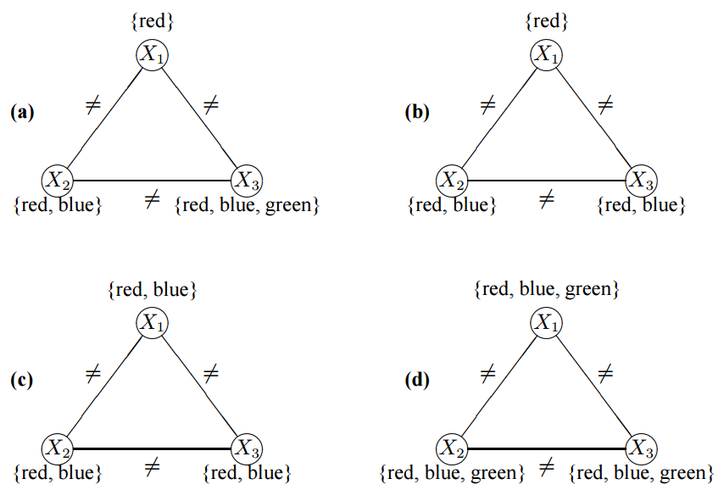
A Filtering Algorithm
What will happen on these?

Slide 14
A Filtering Algorithm
What will happen on these?
Works fine, solution found
Works, discovers no solution possible
Halts, doesn’t know if there is a solution even though there is not
Halts, doesn’t know if there is a solution even though there is
Algorithm is:
Sound (returns yes/no correctly)
Not Complete (doesn’t always find an answer)

Slide 15
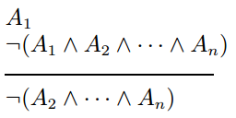
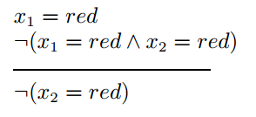
A Filtering Algorithm
This algorithm applies logic rules of the following form:
Example:

Slide 16
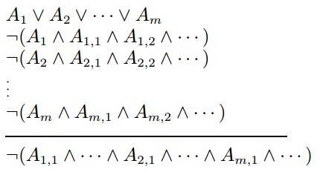
Hyper-resolution
Idea:
We can make this algorithm better by strengthening the inference rules that are being applied.
To the left, we have a generalization of the rule from the previous slide.
Can handle the case where another agent can take on multiple values.

Slide 17
Hyper-resolution
Top row is the values another agent told us it can take.
Next n rows is the invalid combinations (constraints) that multiple agents can take
Last row is the conclusion, a new constraint that must be satisfied for there to be a solution.

Slide 18
Hyper-resolution
Each Ai,j in the formula represents what we call a NoGood (a silly name, I know)
A NoGood, is a propositional representation of a set of values that cannot be taken on in a valid solution
e.g., !(x1 = red ^ x2 = red)
Usually stored as tuples (can be higher dimension)
e.g., {x1=red, x2=red}

Slide 19
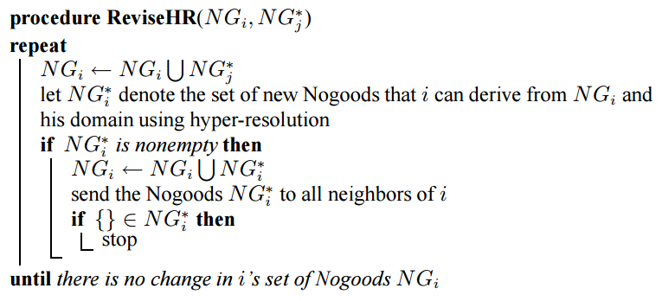
Hyper-resolution
So, now we have a complete and sound algorithm, let’s see an example though.

Slide 20
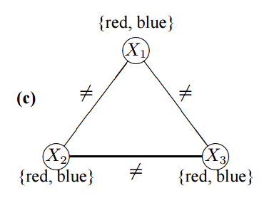
Hyper-resolution: Example
X1: {X1=red, X2=red}
{X1=red, X3=red}
{X1=blue, X2=blue}
{X1=blue, X3=blue}
{X1=red OR X1=blue}
X1 knows these at the beginning because these are the constraints involving X1
No communication needed to know this.

Slide 21
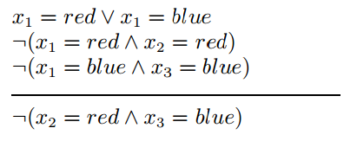
Hyper-resolution: Example
Using Hyper-resolution, we can reason that:
So, X1 has learned that it cannot be the case that X2 is red and X3 is blue (otherwise there will be no solution)
X1 needs to 1) generate more rules of this form and 2) send this new rules to its neighbors

Slide 22
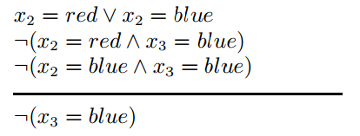
Hyper-resolution: Example
X2 receives these rules (from previous slide) from X1 and can now reason:
Woah! Now X2 can tell X3 to eliminate blue from its set of choices. Cool!
X3 updates its X3=blue OR X3 = red rule to just X3=red

Slide 23
Pros and Cons
FILTERING ALGORITHM
Pros:
Fast, efficient!
Sound (if answer found it is correct)
Cons:
Not complete
HYPER-RESOLUTION
Pros:
Complete and Sound
Easy to Implement
Cons:
Can be intractable

Slide 24
Contract-Net Protocol

Slide 25
CNP
Basic Idea:
Several independent agents exist in a system
Want a protocol for communicating and distributing tasks throughout the system
Needs to be standardized so agent communication is understood by all parties

Slide 26
Requirements
Utility:
System must have concept of global & local utility
Agents must be aware of this utility
Sub-tasks:
System must support independent tasks requirements which can be broken down into sub-tasks
Help
System must support agents asking for and receiving help (e.g., please do this task for me)

Slide 27
Contract Net Protocol (CNP)
Multiple agents in a network, can communicate with one another.
Each node has tasks (or even receives new tasks direct from environment)
Node can either work on the task or contract that task out to another agent
Other agent needs to agree to do the task
Optional:
Agent needs to pay the contractor to do the work, etc.

Slide 28
Task Distribution
Five Steps:
Recognition
Announcement
Bidding
Awarding
Expediting

Slide 29
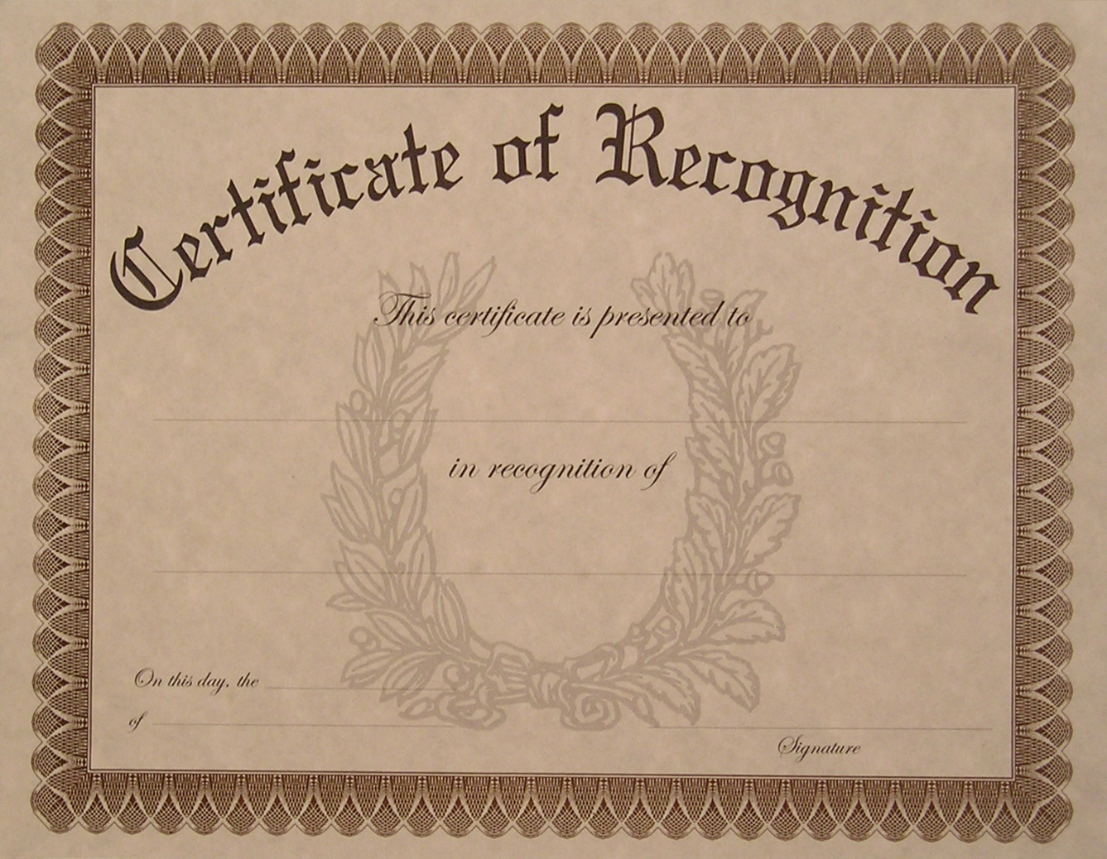
Recognition
An agent realizes it has a task ‘X’ that it needs help on.
This task can come direct from environment…
Or…can be a task that was just contracted to this agent.
‘X’ could be a sub-task of a much larger task
Need to cook thanksgiving dinner
Sub-task: need to make potatoes, but I don’t know how
Only contract out this one part

Slide 30

Announcement
Agent sends out a call for bids.
Let’s other agents know what task it needs accomplishing
Along with other parameters (payments, utility that will be gained, urgency, etc.)
Usually has a time-limit
Task must be done by ‘t’ time

Slide 31

Bidding
Other agents that are interested in the contract send in a bid to the original agent
Usually contains pertinent info:
When that agent can finish by
Perhaps a lower price they are willing to work for
How much local utility they will lose in the process

Slide 32

Awarding
Original agent awards the contract to one bidder. Let’s that bidder know.
Usually there is some penalty if the contractor ends up not fulfilling the promise.
Original agent now free to wait for contractor to do the work.

Slide 33

Expediting
New agent may choose to sub-contract the task to yet another agent. This is fine, the process simply begins again.

Slide 34
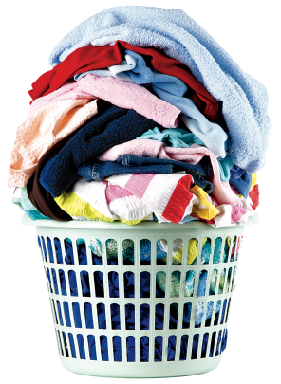
Example: Smart-Home
Suppose the Laundry agent has the task:
Do_Laundry
This tasks has several sub-tasks
Collect_Laundry
Wash_Cycle
Dry_Cycle
Alert_Done
Laundry machine can’t do the first one, needs help!

Slide 35
Announcement
Laundry let’s other agents know about this task.
Important Meta-Information?
What do you think?

Slide 36
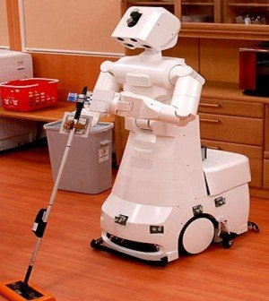
Bidding
Other agents, capable of performing the task, bid on it.
What info might they send to the laundry machine agent?
What else might influence the decision to bid?

Slide 37
Awarding
Laundry chooses an agent to award the task to.

Slide 38
Expediting
Robot might choose to sub-contract the task. Why might the robot do this?
Thoughts?

Slide 39
Is This “Intelligence”
You decide, but…think about my thanksgiving at my house:
Agents: Me and my family
Local Utility: Everyone has something they prefer doing
My dad wants to watch football
My mom wants to not cook and chat
My mother-in-law wants to eat
Global Utility:
Everyone wants a big delicious meal, for no fights to occur etc.
Contracts:
Hey Mom, I need help with the potatoes
Mom chooses to give up local utility to increase global utility

Slide 40
Negotiation

Slide 41
Automated Negotiation in Multi-agent Systems (MAS)
$100
$1
Conflict of interest
Cooperative behavior in competitive situation
Applications: distributed problem solving, resource allocation, e-commerce
My agent will negotiate with you

Slide 42
Classification of Negotiation
Protocols:
auctions
bargaining //HW 4 uses this one
voting, etc.
Negotiated Items:
single attribute (e.g., price)
multiple attribute (e.g., price and quality)
orderings (e.g., top choice, second choice, etc.) //HW 4 uses this

Slide 43
Auctions
Very efficient, but:
Scheduled in advanced
Non-negotiable
Only for price
Controlled by auctioneer
Alternative: Bargaining!!
Notes:
SCHEDULED IN ADVANCED: Some online auctions are announced several days before open, and the auction span from several hours to several weeks. Buyer must wait for several weeks.
NON-NEGOTIABLE: After announcement, auctioneer wouldn’t accept input/ comment from buyers, such as change of some item’s parts, delivery methods, etc.
ONLY FOR PRICE: most auction only negotiate price (bid the price). The only exception is combinatorial auction, which is rarely deployed because of the winner determination problem.
CONTROLLED BY AUCTIONEER: auctioneer declared the auction type according to its preference, and he/she may set a reserve or minimum price to secure his/her position.

Slide 44
Axiomatic vs. Strategic Bargaining
Axiomatic bargaining
Bargainers provide information (proposals, facts, and other arguments)
Arbitrator sets axioms
Arbitrator decides outcomes (guaranteed)
E.g. Egalitarian bargaining solution, Nash bargaining solution, etc.
Notes:
We will focus on alternating-offer bargaining

Slide 45
Axiomatic vs. Strategic Bargaining
Strategic bargaining
Set a protocol, both bargainers agreed on it
Start bargaining (Bargainers offer proposals)
Bargainers decide final outcomes (not guaranteed)
We will be coding up this one (fyi)
E.g. alternating-offer bargaining
Notes:
We will focus on alternating-offer bargaining

Slide 46
Alternating-offer Bargaining
Scenario 1:
Buyer: How much?
Seller: $1000.
Buyer: $500?
Seller: $800.
Buyer: $600?
Seller: $700!
Buyer: OK, $700.
Notes:
There is a solution in scenario 1,
but no solution in scenario 2, why?
People can predict future outcome! Can autonomous agents do that?

Slide 47
Alternating-offer Bargaining
Scenario 2:
Buyer: How much?
Seller: $1000.
Buyer: $10.
Seller hangs up the phone.
Uh Oh!!!!!
Notes:
There is a solution in scenario 1,
but no solution in scenario 2, why?
People can predict future outcome! Can autonomous agents do that?

Slide 48
Alternating-offer Bargaining Space: an Example
Unit price
buyer’s private valuation
Buyer’s acceptable set
0
quality
Notes:
AFTER THE FIRST ANIMATION
A buyer willing to accept an offer which fall inside ‘buyer’s acceptable set’, i.e. given specific price for specific quality. As the quality increase, buyer willing to pay more.
The overlapping area between ‘buyer’s acceptable set’ and ‘seller’s acceptable set’ is the feasible set, in which a bargaining solution falls in.

Slide 49
Alternating-offer Bargaining Space: an Example
Unit price
Seller’s acceptable set
seller’s private valuation
buyer’s private valuation
Buyer’s acceptable set
0
quality
Notes:
AFTER THE FIRST ANIMATION
A buyer willing to accept an offer which fall inside ‘buyer’s acceptable set’, i.e. given specific price for specific quality. As the quality increase, buyer willing to pay more.
The overlapping area between ‘buyer’s acceptable set’ and ‘seller’s acceptable set’ is the feasible set, in which a bargaining solution falls in.

Slide 50
Alternating-offer Bargaining Space: an Example
Unit price
Seller’s acceptable set
seller’s private valuation
No solution here
buyer’s private valuation
Buyer’s acceptable set
0
quality
Notes:
AFTER THE FIRST ANIMATION
A buyer willing to accept an offer which fall inside ‘buyer’s acceptable set’, i.e. given specific price for specific quality. As the quality increase, buyer willing to pay more.
The overlapping area between ‘buyer’s acceptable set’ and ‘seller’s acceptable set’ is the feasible set, in which a bargaining solution falls in.

Slide 51
Alternating-offer Bargaining Space: an Example
Seller’s proposal start from here
Unit price
Seller’s acceptable set
seller’s private valuation
buyer’s private valuation
Buyer’s proposal start from here
Buyer’s acceptable set
0
quality
Notes:
AFTER THE FIRST ANIMATION
A buyer willing to accept an offer which fall inside ‘buyer’s acceptable set’, i.e. given specific price for specific quality. As the quality increase, buyer willing to pay more.
The overlapping area between ‘buyer’s acceptable set’ and ‘seller’s acceptable set’ is the feasible set, in which a bargaining solution falls in.

Slide 52
Alternating-offer Bargaining Space: an Example
Unit price
Seller’s acceptable set
seller’s private valuation
possible solutions here
buyer’s private valuation
Buyer’s acceptable set
0
quality
Notes:
AFTER THE FIRST ANIMATION
A buyer willing to accept an offer which fall inside ‘buyer’s acceptable set’, i.e. given specific price for specific quality. As the quality increase, buyer willing to pay more.
The overlapping area between ‘buyer’s acceptable set’ and ‘seller’s acceptable set’ is the feasible set, in which a bargaining solution falls in.

Slide 53
Alternating-offer Bargaining
Bargaining problem: <X, D, ≥₁, ≥₂>
X: feasible set
D: disagreement
≥: preference order of bargainers 1 and 2.
Goal: achieve x∈X
Solving method: backward induction (Game-theoretic approach)
Assumptions:
Perfect rationality
Perfect foresight

Slide 54
Backward Induction
A simple game theory algorithm
Idea: Compare the benefit of accepting the opponents most recent offer with a guess of what will happen if you reject
Kind of like minimax in that we take the best path down a decision tree
Opponent Gives Offer
Reject Offer
Expected Reward: ??
Accept Offer
Reward: 5
Opp: 100
Goal is to calculate expected reward and compare to accept reward, choose the better option!

Slide 55
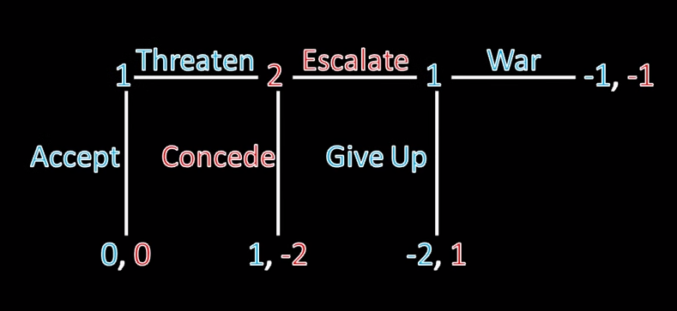
Backward Induction: Simple Example
From: https://www.youtube.com/watch?t=214&v=pyLKkN5HpDY

Slide 56
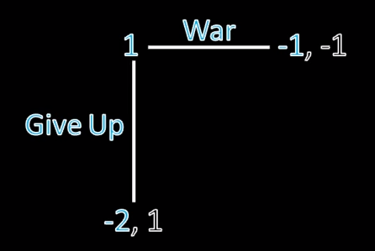
Backward Induction: Simple Example
If we get to this state, blue player will always choose war!
Sounds like minimax still ☺
From: https://www.youtube.com/watch?t=214&v=pyLKkN5HpDY

Slide 57
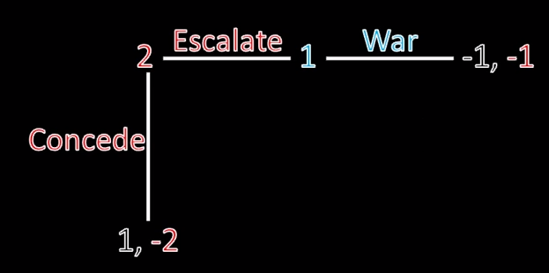
Backward Induction: Simple Example
What will red player choose?
Escalate! Why?
From: https://www.youtube.com/watch?t=214&v=pyLKkN5HpDY

Slide 58
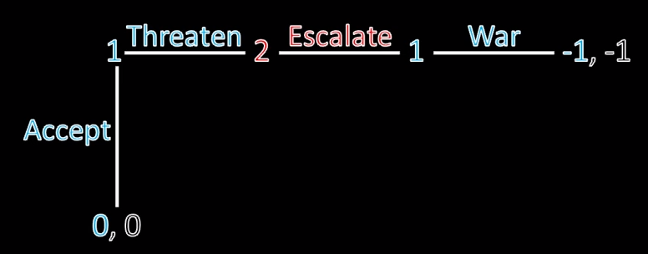
Backward Induction: Simple Example
So, what will happen?
From: https://www.youtube.com/watch?t=214&v=pyLKkN5HpDY

Slide 59
Backward Induction
Backward induction assumes perfect information. So, decision tree can be perfectly calculated.
Best strategy then is to estimate what your opponent will do with probability functions and make the best decision you can.
Opponent Gives Offer
Reject Offer
Expected Reward: ??
Accept Offer
Reward: 5
Opp: 100
Goal is to calculate expected reward and compare to accept reward, choose the better option!

Slide 60
Other Features of Alternating-offer Protocol
Argumentation (persuade opponent’s belief)
Strategic delay
Free revision (non-monotonic)
Range offer (instead of one point offer)
Notes:
We propose alternating-offer protocol with the following characteristics:
Allowing argumentation, strategic delay, free revision and range offer. We will show some examples in the next slides.

Slide 61
Strategic delay & Argumentation
Strategic delay:
Buyer: How much?
Seller: $1000.
Buyer: …
Seller: $800.
Buyer: hmmm….
Seller: $700!
Buyer: …
Seller: $500!
Buyer: $300.
Seller: OK, $300!
Argumentation:
Buyer: How much?
Seller: $1000.
Buyer: $500?
Seller: My price is lower than others’.
Buyer: $700?
Seller: $1000 is very cheap.
Buyer: $800, OK?
Seller: OK, $800.

Slide 62
Free revision & Range offer
Free revision:
Buyer: How much?
Seller: $1000.
Buyer: $500?
Seller: 800.
Buyer: $600?
…….(Seller got a call)
Seller: $2000.
Buyer: What?
Seller: The market price increases now.
Range offer:
Buyer: How much?
Seller: $1000.
Buyer: I can’t afford more than $500.
Seller: $499.
Buyer: $400, OK?
Seller: OK, $400.

