Slide 1
CS4710: Artificial Intelligence Intro to Machine Learning
Intelligent beings (e.g., humans) are excellent at learning. How can we try to program systems to learn interesting new things?

Slide 2
Introduction

Slide 3

Learning
What are some different ways in which human beings learn?
We will focus on these:
Rote Learning
Learning by example / recognizing patterns
Learning by observing similarities
Learning by practice

Slide 4
Rote Learning
Memorizing what is learned
Difficult to transfer knowledge to different domains or different problems
Easy (ish) to recall the information
Hard to apply the information
Computers are GREAT at this
String knowledge = “America declared independence in 1776”
The computer is learning!!!!
…but it can’t DO anything with that knowledge

Slide 5
Learning by Doing
Learn to do something by practicing and retrying until you get better
Painting, math, sports, etc.
How can computers do this?
This is called Reinforcement Learning and is a well-studied area

Slide 6
Learning by Doing
Reinforcement Learning Models usually contain (at a minimum):
A concept of reward
A set of actions an agent can take
A set of ways to observe the environment
Sound familiar? Can be modeled with Markov Decision Processes

Slide 7

Reinforcement Learning: Example
Suppose we want an agent that plays Mario
A concept of reward
Going to the right = reward (maximize this)
A set of actions an agent can take
Buttons on the controller (jump, etc.)
A set of ways to observe the environment
Depends. What are the options here?

Slide 8
Learning by Example
If I show you a bunch of examples of a new species of animal, you’ll know how to recognize that animal
I didn’t explicitly teach you anything, so how did you do it?
This is called Supervised Learning because a supervisor (teacher, etc.) is telling you the answer to many examples
Then, hopefully you can perform the task independently afterward

Slide 9
Learning by Example
This is called Supervised Learning because a supervisor (teacher, etc.) is telling you the answer to many examples
For supervised learning, we will need:
Many examples with the correct answer!
A set of characteristics to look for in each example
E.g., looking at cardinals, we notice the male cardinals are red and the females are green’ish
We call these features

Slide 10
Learning by Observing Similarities
What if we are looking at pictures of animals, but aren’t given the ground truth of what animal is in which picture?
We can still group similar photos together
E.g., these are all birds, these are all green, etc.
This is called clustering, and is a form of unsupervised learning.

Slide 11
Supervised Learning

Slide 12
Supervised Learning
Sometimes also called classification if you are placing examples into discrete classes
We are given a bunch of data points, each one with the ground truth classification that we care about
Goal: Build a model that allows us to accurately predict new data points not in the original set

Slide 13
Example: Predicting Grades
Student | A last year? | Remote? | Works Hard? | Drinks? | A this year?
Richard | Yes | Yes | No | Yes | No
Allen | Yes | Yes | Yes | No | Yes
Alison | No | No | Yes | No | No
Jeff | No | Yes | No | Yes | No
Gail | Yes | No | Yes | Yes | Yes
Simon | No | Yes | Yes | Yes | No

Slide 14
Supervised Learning
The data we are given (previous slide as example) is called a training set
After training your model, you can run it on new data called the test set to judge the accuracy of your model
…we’ll see more of this later in a moment

Slide 15
Example: Predicting Grades
Some possible learned rules?
You will get an A this year if:
A Last Year && Work Hard
(Remote && Don’t Drink) || (!Remote && Drink)
Will these hold up if given a new test set? Probably not…
Student | A last year? | Remote? | Works Hard? | Drinks? | A this year?
Richard | Yes | Yes | No | Yes | No
Allen | Yes | Yes | Yes | No | Yes
Alison | No | No | Yes | No | No
Jeff | No | Yes | No | Yes | No
Gail | Yes | No | Yes | Yes | Yes
Simon | No | Yes | Yes | Yes | No

Slide 16
Decision Tree Induction

Slide 17
Decision Trees
A Decision Tree is a tree that when followed, provides a prediction of interest for a given data point
Think of this as a flow chart
Each node is a feature and based on the value of that feature, we recurse on the appropriate branch of the tree
Leaf nodes are classifications of the data point

Slide 18
Example Decision Tree
Chest pain began
> 48 hours ago
No
Yes
Prior history of angina or heart attack?
Heart Attack Possible
Yes
No
Longest pain episode > 1 hour
Heart Attack Unlikely
No
Yes
Heart Attack Unlikely
Pain worse than prior angina?
No
Yes
Heart Attack Unlikely
Heart Attack Possible

Slide 19
Decision Tree Induction
More common approach to learning
Idea! Use the training set to build a decision tree
Requirements:
Want the tree to be as small as possible

Slide 20
Similar Example
Student | A last year? | Remote? | Works Hard? | Drinks? | A this year?
Richard | Yes | Yes | No | Yes | Yes
Allen | Yes | Yes | Yes | No | Yes
Alison | No | No | Yes | No | Yes
Jeff | No | Yes | No | Yes | No
Gail | Yes | No | Yes | Yes | Yes
Simon | No | Yes | Yes | Yes | No

Slide 21
Algorithm
SelectFeature(Examples){
Pick Feature that best splits Examples into different result categories
For each Value of Feature
Find Subset S of Examples such that Feature == Value
If all examples in S are in same result category
Mark relevant node in the tree with that category
Else
Call SelectFeature(S)
}

Slide 22
Algorithm: Example
Student | A last year? | Remote? | Works Hard? | Drinks? | A this year?
Richard | Yes | Yes | No | Yes | Yes
Allen | Yes | Yes | Yes | No | Yes
Alison | No | No | Yes | No | Yes
Jeff | No | Yes | No | Yes | No
Gail | Yes | No | Yes | Yes | Yes
Simon | No | Yes | Yes | Yes | No
SelectFeature(Examples){
Pick Feature that best splits Examples into different result categories
For each Value of Feature
Find Subset S of Examples such that Feature == Value
If all examples in S are in same result category
Mark relevant node in the tree with that category
Else
Call SelectFeature(S)
}

Slide 23
Algorithm: Example
Student | A last year? | Remote? | Works Hard? | Drinks? | A this year?
Richard | Yes | Yes | No | Yes | Yes
Allen | Yes | Yes | Yes | No | Yes
Alison | No | No | Yes | No | Yes
Jeff | No | Yes | No | Yes | No
Gail | Yes | No | Yes | Yes | Yes
Simon | No | Yes | Yes | Yes | No
SelectFeature(Examples){
Pick Feature that best splits Examples into different result categories
For each Value of Feature
Find Subset S of Examples such that Feature == Value
If all examples in S are in same result category
Mark relevant node in the tree with that category
Else
Call SelectFeature(S)
}

Slide 24
Algorithm: Example
Student | A last year? | Remote? | Works Hard? | Drinks? | A this year?
Richard | Yes | Yes | No | Yes | Yes
Allen | Yes | Yes | Yes | No | Yes
Alison | No | No | Yes | No | Yes
Jeff | No | Yes | No | Yes | No
Gail | Yes | No | Yes | Yes | Yes
Simon | No | Yes | Yes | Yes | No
{1,2,3,4,5,6}
A last year?
Yes
No
{1,2,5}
{3,4,6}
SelectFeature(Examples){
Pick Feature that best splits Examples into different result categories
For each Value of Feature
Find Subset S of Examples such that Feature == Value
If all examples in S are in same result category
Mark relevant node in the tree with that category
Else
Call SelectFeature(S)
}

Slide 25
Algorithm: Example
Student | A last year? | Remote? | Works Hard? | Drinks? | A this year?
Richard | Yes | Yes | No | Yes | Yes
Allen | Yes | Yes | Yes | No | Yes
Alison | No | No | Yes | No | Yes
Jeff | No | Yes | No | Yes | No
Gail | Yes | No | Yes | Yes | Yes
Simon | No | Yes | Yes | Yes | No
{1,2,3,4,5,6}
A last year?
Yes
No
{1,2,5}
{3,4,6}
SelectFeature(Examples){
Pick Feature that best splits Examples into different result categories
For each Value of Feature
Find Subset S of Examples such that Feature == Value
If all examples in S are in same result category
Mark relevant node in the tree with that category
Else
Call SelectFeature(S)
}

Slide 26
Algorithm: Example
Student | A last year? | Remote? | Works Hard? | Drinks? | A this year?
Richard | Yes | Yes | No | Yes | Yes
Allen | Yes | Yes | Yes | No | Yes
Alison | No | No | Yes | No | Yes
Jeff | No | Yes | No | Yes | No
Gail | Yes | No | Yes | Yes | Yes
Simon | No | Yes | Yes | Yes | No
{1,2,3,4,5,6}
A last year?
Yes
No
{1,2,5}
YES
{3,4,6}
SelectFeature(Examples){
Pick Feature that best splits Examples into different result categories
For each Value of Feature
Find Subset S of Examples such that Feature == Value
If all examples in S are in same result category
Mark relevant node in the tree with that category
Else
Call SelectFeature(S)
}

Slide 27
Algorithm: Example
Student | A last year? | Remote? | Works Hard? | Drinks? | A this year?
Richard | Yes | Yes | No | Yes | Yes
Allen | Yes | Yes | Yes | No | Yes
Alison | No | No | Yes | No | Yes
Jeff | No | Yes | No | Yes | No
Gail | Yes | No | Yes | Yes | Yes
Simon | No | Yes | Yes | Yes | No
{1,2,3,4,5,6}
A last year?
Yes
No
{1,2,5}
YES
{3,4,6}
SelectFeature(Examples){
Pick Feature that best splits Examples into different result categories
For each Value of Feature
Find Subset S of Examples such that Feature == Value
If all examples in S are in same result category
Mark relevant node in the tree with that category
Else
Call SelectFeature(S)
}

Slide 28
Algorithm: Example
Student | A last year? | Remote? | Works Hard? | Drinks? | A this year?
Richard | Yes | Yes | No | Yes | Yes
Allen | Yes | Yes | Yes | No | Yes
Alison | No | No | Yes | No | Yes
Jeff | No | Yes | No | Yes | No
Gail | Yes | No | Yes | Yes | Yes
Simon | No | Yes | Yes | Yes | No
{1,2,3,4,5,6}
A last year?
Yes
No
{1,2,5}
YES
{3,4,6}
SelectFeature(Examples){
Pick Feature that best splits Examples into different result categories
For each Value of Feature
Find Subset S of Examples such that Feature == Value
If all examples in S are in same result category
Mark relevant node in the tree with that category
Else
Call SelectFeature(S)
}

Slide 29
Algorithm: Example
Student | A last year? | Remote? | Works Hard? | Drinks? | A this year?
Richard | Yes | Yes | No | Yes | Yes
Allen | Yes | Yes | Yes | No | Yes
Alison | No | No | Yes | No | Yes
Jeff | No | Yes | No | Yes | No
Gail | Yes | No | Yes | Yes | Yes
Simon | No | Yes | Yes | Yes | No
{1,2,3,4,5,6}
A last year?
Yes
No
{1,2,5}
YES
{3,4,6}
Drinks?
SelectFeature(Examples){
Pick Feature that best splits Examples into different result categories
For each Value of Feature
Find Subset S of Examples such that Feature == Value
If all examples in S are in same result category
Mark relevant node in the tree with that category
Else
Call SelectFeature(S)
}

Slide 30
Algorithm: Example
Student | A last year? | Remote? | Works Hard? | Drinks? | A this year?
Richard | Yes | Yes | No | Yes | Yes
Allen | Yes | Yes | Yes | No | Yes
Alison | No | No | Yes | No | Yes
Jeff | No | Yes | No | Yes | No
Gail | Yes | No | Yes | Yes | Yes
Simon | No | Yes | Yes | Yes | No
{1,2,3,4,5,6}
A last year?
Yes
No
{1,2,5}
YES
{3,4,6}
Drinks?
SelectFeature(Examples){
Pick Feature that best splits Examples into different result categories
For each Value of Feature
Find Subset S of Examples such that Feature == Value
If all examples in S are in same result category
Mark relevant node in the tree with that category
Else
Call SelectFeature(S)
}
Yes
No
{4,6}
{3}

Slide 31
Algorithm: Example
Student | A last year? | Male? | Works Hard? | Drinks? | A this year?
Richard | Yes | Yes | No | Yes | Yes
Allen | Yes | Yes | Yes | No | Yes
Alison | No | No | Yes | No | Yes
Jeff | No | Yes | No | Yes | No
Gail | Yes | No | Yes | Yes | Yes
Simon | No | Yes | Yes | Yes | No
{1,2,3,4,5,6}
A last year?
Yes
No
{1,2,5}
YES
{3,4,6}
Drinks?
SelectFeature(Examples){
Pick Feature that best splits Examples into different result categories
For each Value of Feature
Find Subset S of Examples such that Feature == Value
If all examples in S are in same result category
Mark relevant node in the tree with that category
Else
Call SelectFeature(S)
}
Yes
No
{4,6}
{3}

Slide 32
Algorithm: Example
Student | A last year? | Remote? | Works Hard? | Drinks? | A this year?
Richard | Yes | Yes | No | Yes | Yes
Allen | Yes | Yes | Yes | No | Yes
Alison | No | No | Yes | No | Yes
Jeff | No | Yes | No | Yes | No
Gail | Yes | No | Yes | Yes | Yes
Simon | No | Yes | Yes | Yes | No
{1,2,3,4,5,6}
A last year?
Yes
No
{1,2,5}
YES
{3,4,6}
Drinks?
SelectFeature(Examples){
Pick Feature that best splits Examples into different result categories
For each Value of Feature
Find Subset S of Examples such that Feature == Value
If all examples in S are in same result category
Mark relevant node in the tree with that category
Else
Call SelectFeature(S)
}
Yes
No
{4,6}
NO
{3}

Slide 33
Algorithm: Example
Student | A last year? | Remote? | Works Hard? | Drinks? | A this year?
Richard | Yes | Yes | No | Yes | Yes
Allen | Yes | Yes | Yes | No | Yes
Alison | No | No | Yes | No | Yes
Jeff | No | Yes | No | Yes | No
Gail | Yes | No | Yes | Yes | Yes
Simon | No | Yes | Yes | Yes | No
{1,2,3,4,5,6}
A last year?
Yes
No
{1,2,5}
YES
{3,4,6}
Drinks?
SelectFeature(Examples){
Pick Feature that best splits Examples into different result categories
For each Value of Feature
Find Subset S of Examples such that Feature == Value
If all examples in S are in same result category
Mark relevant node in the tree with that category
Else
Call SelectFeature(S)
}
Yes
No
{4,6}
NO
{3}

Slide 34
Algorithm: Example
Student | A last year? | Remote? | Works Hard? | Drinks? | A this year?
Richard | Yes | Yes | No | Yes | Yes
Allen | Yes | Yes | Yes | No | Yes
Alison | No | No | Yes | No | Yes
Jeff | No | Yes | No | Yes | No
Gail | Yes | No | Yes | Yes | Yes
Simon | No | Yes | Yes | Yes | No
{1,2,3,4,5,6}
A last year?
Yes
No
{1,2,5}
YES
{3,4,6}
Drinks?
SelectFeature(Examples){
Pick Feature that best splits Examples into different result categories
For each Value of Feature
Find Subset S of Examples such that Feature == Value
If all examples in S are in same result category
Mark relevant node in the tree with that category
Else
Call SelectFeature(S)
}
Yes
No
{4,6}
NO
{3}
YES

Slide 35
Algorithm: Example
Student | A last year? | Remote? | Works Hard? | Drinks? | A this year?
Richard | Yes | Yes | No | Yes | Yes
Allen | Yes | Yes | Yes | No | Yes
Alison | No | No | Yes | No | Yes
Jeff | No | Yes | No | Yes | No
Gail | Yes | No | Yes | Yes | Yes
Simon | No | Yes | Yes | Yes | No
{1,2,3,4,5,6}
A last year?
Yes
No
{1,2,5}
YES
{3,4,6}
Drinks?
SelectFeature(Examples){
Pick Feature that best splits Examples into different result categories
For each Value of Feature
Find Subset S of Examples such that Feature == Value
If all examples in S are in same result category
Mark relevant node in the tree with that category
Else
Call SelectFeature(S)
}
Yes
No
{4,6}
NO
{3}
YES

Slide 36
Decision Tree Induction
The ID3 Algorithm

Slide 37
ID3 Algorithm
SelectFeature(Examples){
Pick Feature that best splits Examples into different result categories (HOW TO DO THIS?)
For each Value of Feature
Find Subset S of Examples such that Feature == Value
If all examples in S are in same result category
Mark relevant node in the tree with that category
Else
Call SelectFeature(S)
}

Slide 38
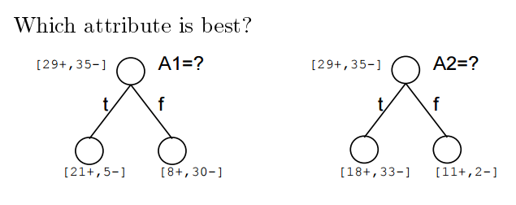
ID3 Algorithm: Which Attribute Best?
A1 and A2 are the features
29+, 35- means 29 positive training examples and 35 negative training examples
T and F (on edges) are the values of the features (so Boolean features in this image)
…so which feature split is better?

Slide 39
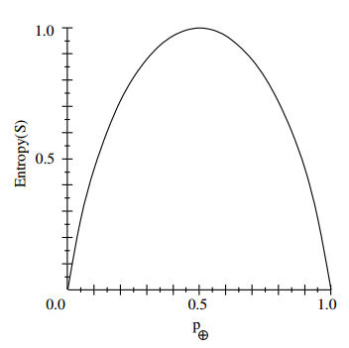
ID3 Algorithm: Entropy
Suppose:
S is sample of training examples
P₊ is proportion of positive examples in S
P₋ is proportion of negative examples in S
Entropy measure the impurity of S:
Entropy(S) = -P₊*log₂(P₊) – P₋*log₂(P₋)

Slide 40
Entropy: Information Theory
Entropy(S) is the expected number of bits needed to encode class (+ or -) of randomly drawn member of S (under optimal, shortest-length code)
Think Huffman Codes here
Optimal length code assigns –log₂(p) bits to message having probability of p
So, over all possibilities we take a weighted average:
Entropy(S) = -P₊*log₂(P₊) – P₋*log₂(P₋)

Slide 41
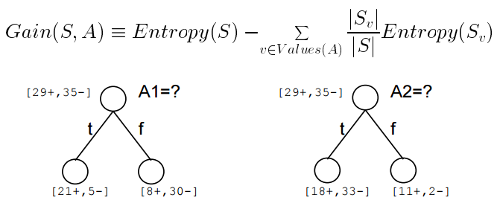
Information Gain
Information Gain is the amount the entropy has dropped given that you split on a specific feature at this step of the algorithm.
Gain(S,A) = expected reduction in entropy due to sorting on A

Slide 42
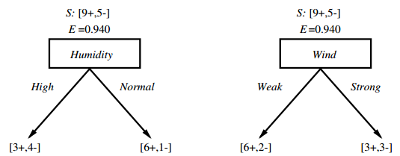
Which Attribute Better?
Try it on your own!

Slide 43
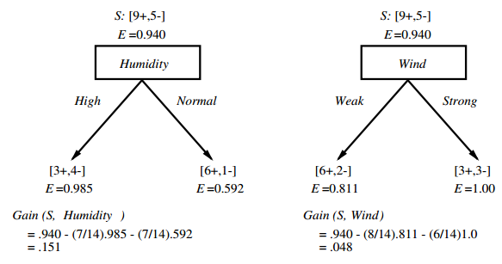
Which Attribute Better?

Slide 44
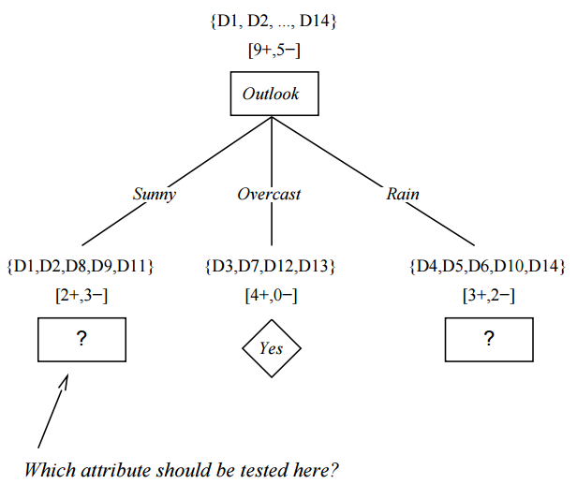
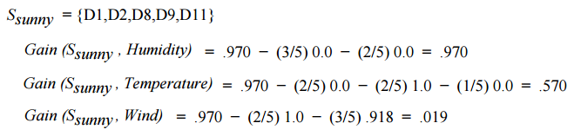

Slide 45
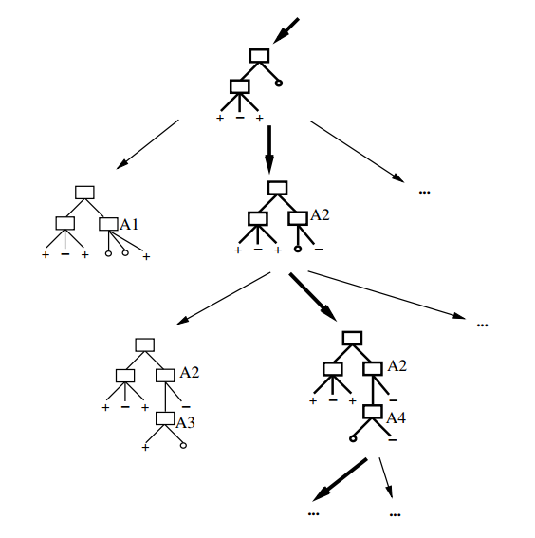
Thinking of ID3 as Space-Search
Hypothesis space is complete
- The best decision tree MUST be in there
ID3 outputs a specific decision tree though
Is it the best one?
No back-tracking
Local-minima (so probably not optimal)
Search choices are stochastic, so pretty robust to noisy data

Slide 46
ID3 is Biased!
Preference for shorter trees with high information gains near the root. ID3 is a greedy algorithm.
Bias is a preference, not a restriction (i.e., defines the choice we make when searching, but whole tree is available)
Occam’s Razor: Prefer the shortest hypothesis

Slide 47
ID3: Why Preference for Shorter Hypothesis?
Pros:
Fewer short hypotheses
Shorter = more general
Longer hypothesis might be coincidence
Cons:
There are many ways to define short hypotheses
e.g., all trees with a prime number of nodes that use attributes beginning with letter Z

Slide 48
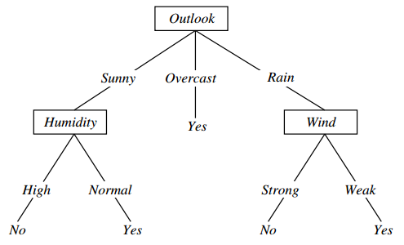
ID3: Overfitting
Overfitting is a problem in many AI algorithms in which learned rules infer noisy variations in data as real underlying differences.
Consider adding this example to earlier tree:
[Sunny, Hot,
Normal Humidity,
Strong Wind,
Play Tennis = NO ]
What is the effect on this tree →

Slide 49
Defining Overfitting
Consider a hypothesis h over both training data and actual distribution:
Error over training data: TrainError(h) Error over entire distribution D: DError(h)
Hypothesis h overfits the training data if there is another hypothesis h’ such that:
TrainError(h) < TrainError(h’)
AND
DError(h) > DError(h’)
Why does this make sense?

Slide 50
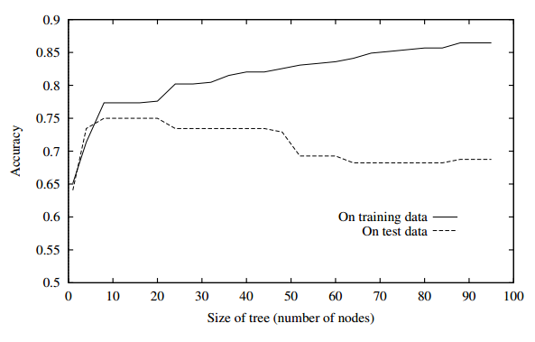
Defining Overfitting

Slide 51
Avoiding Overfitting
Stop growing when data split not statistically significant.
E.g., 101 positive examples and 1 negative at a node. No need to split here.
Grow full tree, then post-prune
Additionally:
Split data into a training set and a validation (or test) set.
Build tree (train) on training set only. Validate on validation set only.
Greedily remove rules in tree until you improve accuracy on validation set.

Slide 52
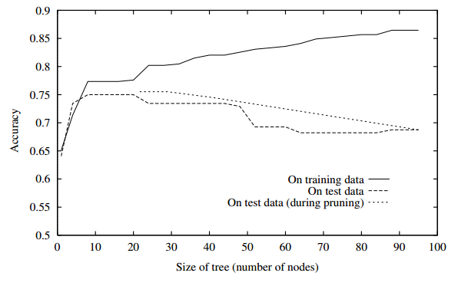
Post-Pruning to fight Overfitting

