Slide 1
CS4710: Artificial Intelligence Local Search
A different kind of search problem ☺

Slide 2
Classical Search Vs. Local Search
Classical Search
Observable
Deterministic
Known Environment
Solution of sequence of actions
Local Search
All that matters is the solution state
Don’t care about solution path
Impossible to search whole space (too large)
Often continuous search space

Slide 3
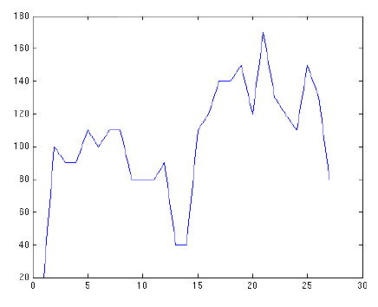
Local Search: Characteristics/Advantages
Sometimes continuous search space (though not always)
Concept of ‘neighboring’ solution states
Very Little Memory
Usually Constant
Can often find reasonable solutions in infinite (continuous) state spaces

Slide 4
Local Search: Characteristics/Advantages
Usually no ‘start state’. We just generate one however we want.
Search space is usually VERY large, so not possible to search everything.

Slide 5
Local Search: Random Walk
1. Pick a random point
2. Pick random neighbor
3. Move to neighbor (no matter what)
Issues?

Slide 6
Local Search: Random Walk Improvement
1. Pick ‘x’ random points
Maybe 1000 or more?
2. Look at your neighbors of each
3. Each moves in a random direction
Issues?

Slide 7
Local Search: Greedy Algorithm
1. Pick a random point
2. Pick random neighbor
3. Move only if neighbor is better
4. Keep going up until you find the maximum
Issues?

Slide 8
Random Walk vs. Hill Climbing
Random Walk
Walks around randomly, so very good at exploring the search space.
Very good at finding the various “hills” in the search space.
NOT good at climbing up hills or optimizing any promising solution states.
Hill Climbing
Good at optimizing a solution state, due to climbing nature.
BAD at exploring various parts of search space.
Often stuck in local maxima.

Slide 9
Random Walk vs. Hill Climbing
Pseudo code for both algorithms
Given current state S
Generate neighbor state S’:
if (util(S’) > util(S)) move with probability p;
else move with probability 1-p;
Repeat constant number of times
//For hill-climbing, p=1.0 For random-walk, p=0.5
//so ‘p’ is what gives us control over algorithm’s behavior…hmmmmmm

Slide 10
Simulated Annealing

Slide 11
Annealing
Annealing is the process used to temper or harden metals and glass by heating them to a high temperature and then gradually cooling them, thus allowing the material to reach a low-energy crystalline state.
Simulated annealing is just a search algorithm motivated by this idea.

Slide 12
Annealing
Idea!
What if system has a ‘temperature‘
At high temps, system explores much more, but at low temps, is more conservative (closer to hill-climbing)

Slide 13
Simulated Annealing
Choose random initial state, high initial temperature, and cooling rate
Choose random neighbor state
Randomly decide whether to move to neighbor based on temperature
Better neighbors have higher probability of being moved to. More detail later.
Reduce temperature
Repeat steps 2-5 until cooled

Slide 14
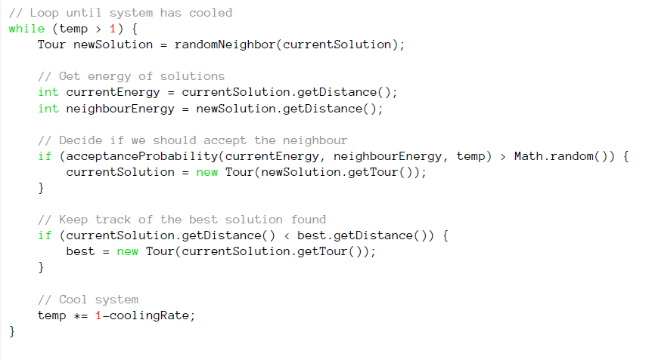
Simulated Annealing

Slide 15
Simulated Annealing
Example Animation (Wikipedia):
Simulated Annealing In Action

Slide 16
Simulated Annealing: Probability Function
Requirements:
Needs to be a function of ΔE where:
ΔE = Val(newState) – Val(curState)
Needs to give higher probability of moving to higher jumps
Needs to be a function of the temperature, which starts high and cools over time.
More likely to move to a worse state at higher temperatures.
As temp cools, becomes more conservative

Slide 17
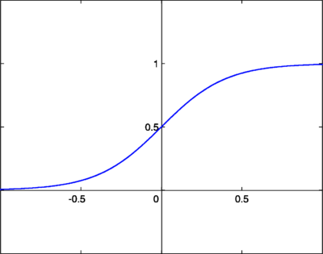
Simulated Annealing: Sigmoid Function
Y = 1 / (1 + e^{-X})
First attempt:
X = ΔE

Slide 18
Simulated Annealing: Sigmoid Function
Y = 1 / (1 + e^{-X})
Second attempt:
X = ΔE / T

Slide 19
Simulated Annealing: Sigmoid Function
Y = 1 / (1 + e^{-X})
X = ΔE / T
How does ΔE affect P?
How does T affect P?

Slide 20
Simulated Annealing

Slide 21
Choosing a Cooling Rate
No silver bullet
Generally, high temperature and low cooling rate are best

Slide 22
Simulated Annealing: Advantages
Can deal with arbitrary systems and cost functions
Is relatively easy to code, even for complex problems
Generally gives good solutions
Optimal? No! But often will return optimal solution in practice

Slide 23
Simulated Annealing: Complexity
O(1) Time
Why?
O(1) Space
Why?

Slide 24
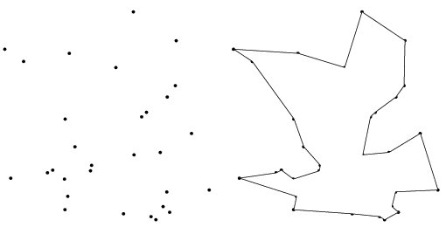
Simulated Annealing: TSP
We all know the Traveling Salesperson Problem.
This problem is NP-Complete
…but we can use SA to find very good solutions (not always optimal though).
How would we do this?

Slide 25
Simulated Annealing: TSP
Choose a random tour (i.e., a random order for the cities)
Pick a new candidate tour by finding a random neighbor tour (how to find this?)
Use sigmoid function to determine if you will follow that path or not
Function of temperature and difference in costs of tours
Keep track of best tour seen so far
Cool the temperature a bit
Repeat
Return best tour found at any time

Slide 26
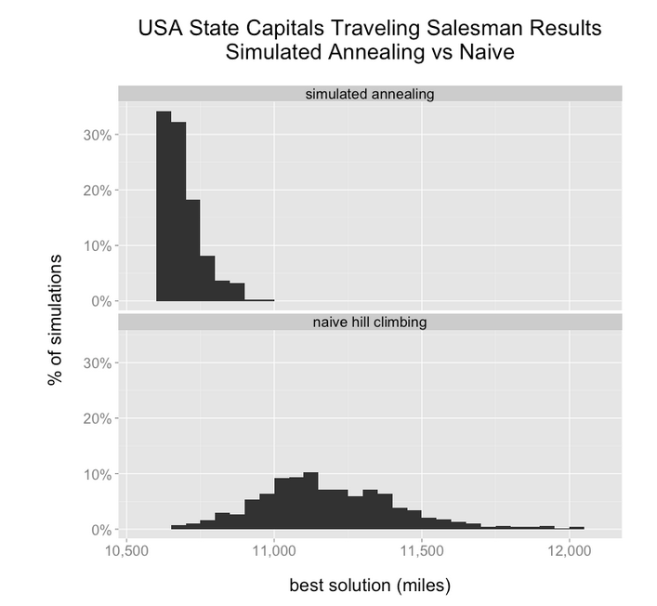
From: http://toddwschneider.com/posts/traveling-salesman-with-simulated-annealing-r-and-shiny/

Slide 27
Genetic Algorithms

Slide 28
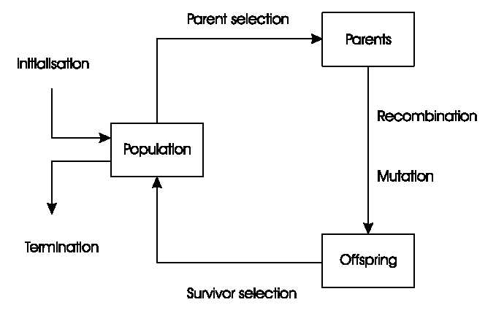
General Scheme of GAs

Slide 29
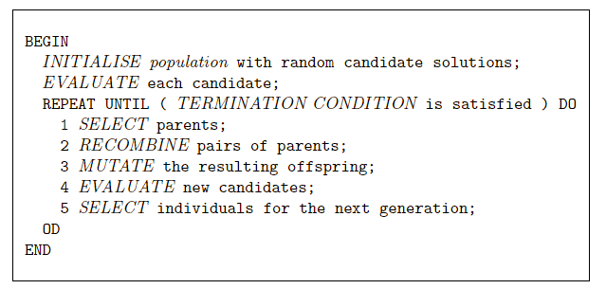
Pseudo-code for typical GA

Slide 30
Representations
Candidate solutions (individuals) exist in phenotype space
They are encoded in chromosomes, which exist in genotype space
Encoding : phenotype=> genotype
Decoding : genotype=> phenotype
Chromosomes contain genes, which are in (usually fixed) positions called loci (sing. locus) and have a value (allele)
In order to find the global optimum, every feasible solution must be represented in genotype space
Short version: You must be able to represent ALL solutions to the problem simply (say…as a string)

Slide 31
Evaluation (Fitness) Function
Represents the requirements that the population should adapt to
a.k.a. quality function or objective function
Assigns a single real-valued fitness to each phenotype which forms the basis for selection
So the more discrimination (different values) the better
Typically we talk about fitness being maximised
Some problems may be best posed as minimisation problems, but conversion is trivial
Short version: fitness function evaluates HOW GOOD a solution you’ve seen solves the given problem. Higher values mean the solution is closer to optimal.

Slide 32
Population
Holds (representations of) possible solutions
Usually has a fixed size and is a multi-set of genotypes
Selection operators usually take whole population into account i.e., reproductive probabilities are relative to current generation
Diversity of a population refers to the number of different fitnesses / phenotypes / genotypes present (note not the same thing)

Slide 33
Parent Selection Mechanism
Assigns variable probabilities of individuals acting as parents depending on their fitnesses
Usually probabilistic
high quality solutions more likely to become parents than low quality
but not guaranteed
even worst in current population usually has non-zero probability of becoming a parent
This stochastic nature can aid escape from local optima
What does this mean?? You should understand this idea. Only matters when search space is VERY large, otherwise we could just exhaustively search all possible offspring and return max fitness

Slide 34
Parent Selection Mechanism
Use our friend, the sigmoid function.
How would this work?
Need to map fitness quality onto the x-axis so that good solutions have high probabilities of being chosen as parents.
Then, flip some coins to see which parents get selected.

Slide 35
Variation Operators
Role is to generate new candidate solutions
Usually divided into two types according to their arity (number of inputs):
Arity 1 : mutation operators
Arity >1 : Recombination operators
Arity = 2 typically called crossover

Slide 36
Mutation
Acts on one genotype and delivers another
Element of randomness is essential and differentiates it from other unary heuristic operators
Importance ascribed depends on representation and dialect:
Binary GAs – background operator responsible for preserving and introducing diversity
EP for FSM’s/ continuous variables – only search operator
GP – hardly used
May guarantee connectedness of search space and hence convergence proofs

Slide 37
Recombination
Merges information from parents into offspring
Choice of what information to merge is stochastic
Most offspring may be worse, or the same as the parents
Hope is that some are better by combining elements of genotypes that lead to good traits
Principle has been used for millennia by breeders of plants and livestock

Slide 38
Survivor Selection
a.k.a. replacement
Most EAs use fixed population size so need a way of going from (parents + offspring) to next generation
Often deterministic
Fitness based : e.g., rank parents+offspring and take best
Age based: make as many offspring as parents and delete all parents
Sometimes do combination (elitism)

Slide 39
Initialization / Termination
Initialization usually done at random,
Need to ensure even spread and mixture of possible allele values
Can include existing solutions, or use problem-specific heuristics, to “seed” the population
Termination condition checked every generation
Reaching some (known/hoped for) fitness
Reaching some maximum allowed number of generations
Reaching some minimum level of diversity
Reaching some specified number of generations without fitness improvement

Slide 40
Fun Example
Smart Rockets:
http://www.blprnt.com/smartrockets/

Slide 41
Example: the 8 queens problem
Place 8 queens on an 8x8 chessboard in
such a way that they cannot check each other
Harder when NxN board and need to place N queens

Slide 42
The 8 queens problem: representation
Phenotype:
a board configuration
Genotype:
a permutation of
the numbers 1 - 8
Obvious mapping
1
3
5
2
6
4
7
8

Slide 43
8 Queens Problem: Fitness evaluation
Penalty of one queen:
the number of queens she can check.
Penalty of a configuration:
the sum of the penalties of all queens.
Note: penalty is to be minimized
Fitness of a configuration:
inverse penalty to be maximized

Slide 44
The 8 queens problem: Mutation
Small variation in one permutation, e.g.:
swapping values of two randomly chosen positions,
1
3
5
2
6
4
7
8
1
3
7
2
6
4
5
8

Slide 45
The 8 queens problem: Recombination
Combining two permutations into two new permutations:
choose random crossover point
copy first parts into children
create second part by inserting values from other parent:
in the order they appear there
beginning after crossover point
skipping values already in child
1
3
5
2
6
4
7
8
1
3
5
4
2
8
7
6
8
7
6
5
4
3
2
1
8
7
6
2
4
1
3
5

Slide 46
The 8 queens problem: Selection
Parent selection:
Pick 5 parents and take best two to undergo crossover
Survivor selection (replacement)
insert the two new children into the population
sort the whole population by decreasing fitness
delete the worst two

Slide 47
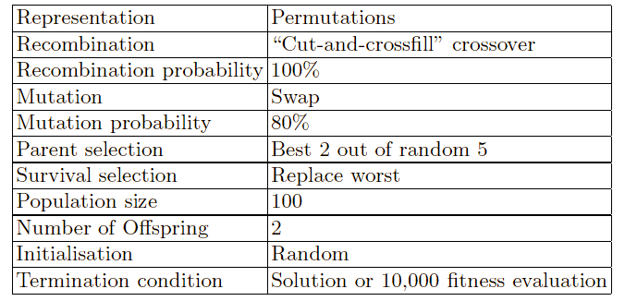
8 Queens Problem: summary
Note that this is only one possible
set of choices of operators and parameters

Slide 48
Practice: 3-Coloring
Do on your own:
Design a GA that attempts to 3-color a graph

