Slide 1
Fenwick Trees
Advanced Algorithms
Mark Floryan
Material From:
https://cp-algorithms.com/data_structures/fenwick.html

Slide 2
Advanced Array Structures
In this deck we will look at:
- Fenwick Trees

Slide 3
Fenwick Trees

Slide 4

Motivation
Goal: Given a list of integers $A=\{a_{1},a_{2},…,a_{n}\}$ and a function that operates on continuous ranges in A, called $f(l,r)$ where $l,r∈Z;l≤r$
Support the following operations:
1. Calculate (for any l,r) the value of $f\left(l,r\right)=f(a_{l},…,a_{r})$ in $O(\log{n)}$ time
2. Update the value of an element of A in $O(\log{n)}$ time.
3. Use no more than $O(n)$ memory (so no more than list A itself)
**Note: This will work for any function f(), but sum(l, r) is a common first one to start with

Slide 5
Why would we want this?
A = {5, 10, 1, 11, 29, 3, 2, 209, 85, 6, 9, 11}
Suppose: That f() is a function we care about over any range. Max and min (for stock prices), average (for sensor data), or sum (for sales)
Suppose: That our stream of integers are stock prices over time, or sensor data across many time points, or sales per day (etc.).
Perhaps our company needs to be able to pull f() over any arbitrary range in A thousands of time per day

Slide 6

Naïve Approach 1
A = {5, 10, 1, 11, 29, 3, 2, 209, 85, 6, 9, 11}
Assume: For now that f() is just the sum function:
$$f\left(l,r\right)=\sum_{i=l}^{r}{a_{i}}$$
Store: A as normal with no alterations
Compute sum by simply traversing the array. This is O(n) time. TOO SLOW!
Update value by simply updating it directly. This is O(1) time. Good!!

Slide 7

Naïve Approach 2
A = {5, 10, 1, 11, 29, 3, 2, 209, 85, 6, 9, 11}
T = {5,15,16,27, 56, 59,61,270,355,361,…}
Store: sum from index 1 to i in cell i.
Assume: For now that f() is just the sum function:
$$f\left(l,r\right)=\sum_{i=l}^{r}{a_{i}}$$
How would we compute sum from l to r ?? What is the time complexity?
How do we update a value?

Slide 8

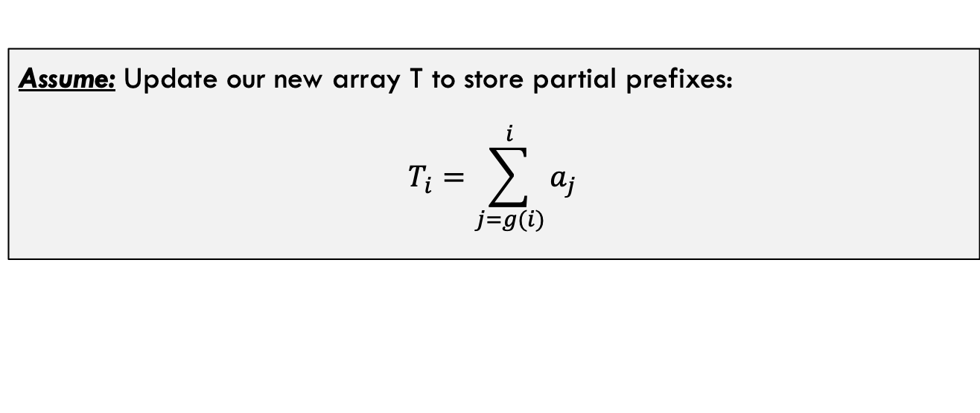

Generalizing the Naïve Approach
IDEA: Let’s balance the two approaches. Store prefixes but not always the range from 0 to i such that we can get fast runtimes for computing f(l,r) AND fast runtimes for updating a value.
Assume: Update our new array T to store partial prefixes:
$$T_{i}=\sum_{j=g(i)}^{i}{a_{j}}$$
**Note:
For Naïve Approach 1: $∀_{i} g\left(i\right)=i$
For Naïve Approach 2: $∀_{i} g\left(i\right)=0$
$$0≤g\left(i\right)≤i$$
What should g(i) be??

Slide 9
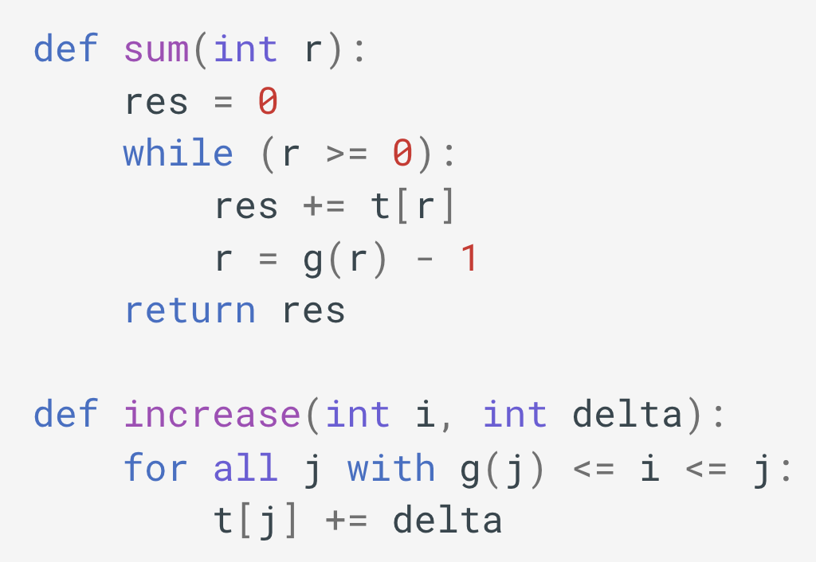

Generalizing the Naïve Approach
Implementation: Regardless of what we choose for g(i), the following pseudo-code will work (here we are assuming f() is the sum function for simplicity).
Notice: sum() calculates the sum from index 0 to r. So, if we want to calculate the sum of a range we still use:
$$f\left(l,r\right)=sum\left(r\right)−sum(l−1)$$
Not obvious to see how to make this one fast? We will see how in a moment.

Slide 10

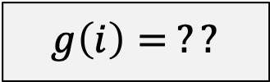
Defining Function G
$$g\left(i\right)= ??$$
Requirements:
Should be fast ($O(1)$) to compute
For any i, should take $O(\log{i)}$ iterations to reach zero
Needs to be ”reversible” so we can efficiently find, for some i, the set satisfying $∀_{j} g\left(j\right)≤i≤j$

Slide 11

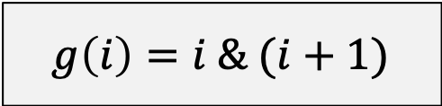

Defining Function G
Bitwise AND
$$g\left(i\right)=i \& (i+1)$$
Strengths:
Extremely fast to compute
For any i, takes $O(\log{i)}$ iterations to reach zero
Is easily reversible (We will see how in a moment)
Intuitively:
Turns all trailing 1’s in binary representation to 0s
Examples:
$$g\left(11\right)=g\left({1011}_{2}\right)={1000}_{2}=8$$
$$g\left(12\right)=g\left({1100}_{2}\right)={1100}_{2}=12$$
$$g\left(13\right)=g\left({1101}_{2}\right)={1100}_{2}=12$$

Slide 12






Example Iteration of sum(14)
$$g\left(i\right)=i \& (i+1)$$
$$T=\{t_{0}, t_{1}, t_{2}, t_{3}, t_{4},t_{5},t_{6},t_{7},t_{8},t_{9},t_{10},t_{11},t_{12},t_{13}, t_{14}\}$$
DONE!
add t₇ to res
$$g\left(7\right) \\ =g\left({0111}_{2}\right) \\ ={0000}_{2}=0$$
add t₁₁ to res
$$g\left(11\right) \\ =g\left({1011}_{2}\right) \\ ={1000}_{2}=8$$
add t₁₃ to res
$$g\left(13\right) \\ =g\left({1101}_{2}\right) \\ ={1100}_{2}=12$$
add t₁₄ to res
$$g\left(14\right) \\ =g\left({1110}_{2}\right) \\ ={1110}_{2}=14$$
** Notice: The number of trailing 1’s increases by 1 each time, this is why we will terminate in $Θ(\log{n)}$

Slide 13

Concrete Example!
$$A=\{1, 2, 3, 4, 5, 6, 7, 8, 9, 10, 11, 12\}$$
$$T=\{ \}$$
g() values for reference:
$$g\left(0\right)=g\left({0000}_{2}\right)={0000}_{2}=0$$
$$g\left(1\right)=g\left({0001}_{2}\right)={0000}_{2}=0$$
$$g\left(2\right)=g\left({0010}_{2}\right)={0010}_{2}=2$$
$$g\left(3\right)=g\left({0011}_{2}\right)={0000}_{2}=0$$
$$g\left(4\right)=g\left({0100}_{2}\right)={0100}_{2}=4$$
$$g\left(5\right)=g\left({0101}_{2}\right)={0100}_{2}=4$$
$$g\left(6\right)=g\left({0110}_{2}\right)={0110}_{2}=6$$
$$g\left(7\right)=g\left({0111}_{2}\right)={0000}_{2}=0$$
$$g\left(8\right)=g\left({1000}_{2}\right)={1000}_{2}=8$$
$$g\left(9\right)=g\left({1001}_{2}\right)={1000}_{2}=8$$
$$g\left(10\right)=g\left({1010}_{2}\right)={1010}_{2}=10$$
$$g\left(11\right)=g\left({1011}_{2}\right)={1000}_{2}=8$$
$$g\left(12\right)=g\left({1100}_{2}\right)={1100}_{2}=12$$
Now, let’s do:
sum(3,8) sum(1,10) sum(5,6)

Slide 14

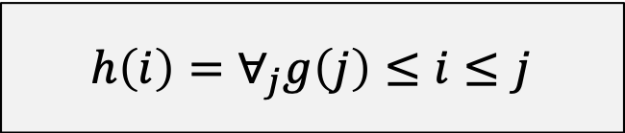
Update: Reversing G()
$$h\left(i\right)=∀_{j}g\left(j\right)≤i≤j$$
Requirements:
Should be fast ($O(1)$) to compute
For any i, should take $O(\log{i)}$ iterations to loop over set
Needs to correctly cover all cells in array that need to be updated

Slide 15


Update: Reversing G()
Bitwise OR
$$h\left(j\right)=j | (j+1)$$
Strengths / Notes:
Sets the lowest 0 bit to a 1
Intuitively, this reverses g() because g() removes ALL trailing 1’s and turns them to 0’s. h() puts those 1’s back (one invocation of h() per digit)
Is VERY fast to compute
Examples:
$h\left(10\right)={h(1010}_{2})={1011}_{2}=11$
$h\left(11\right)=h\left({1011}_{2}\right)={1111}_{2}=15$
$h\left(15\right)=h\left({1111}_{2}\right)={11111}_{2}=31$

Slide 16

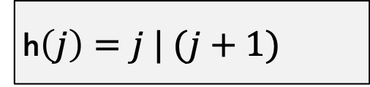




Example Iteration of Update(4, 2)
** Example: t9 does not need to be updated because:
$$g\left(9\right)=g\left(1001_{2}\right)=1000_{2}=8>4$$
h$\left(j\right)=j | (j+1)$
$$T=\{t_{0}, t_{1}, t_{2}, t_{3}, t_{4},t_{5},t_{6},t_{7},t_{8},t_{9},t_{10},t_{11},t_{12},t_{13}, t_{14}\}$$
add 2 to t₄
h$\left(4\right)$
$$=h\left({0100}_{2}\right) \\ ={0101}_{2}=5$$
add 2 to t₅
h$\left(5\right)$
$$=h\left({0101}_{2}\right) \\ ={0111}_{2}=7$$
add 2 to t₇
h$\left(7\right)$
$$=h\left({0111}_{2}\right) \\ ={1111}_{2}=15$$
15 is out of bounds.
DONE!
** Notice: We change one digit from 0 to 1 on each iteration, so all will be changed in $Θ(\log{n)}$ time.

Slide 17

Concrete Example!
$$A=\{1, 2, 3, 4, 5, 6, 7, 8, 9, 10, 11, 12\}$$
$$T=\{1, 3, 3, 10, 5, 11, 7, 36, 9, 19, 11, 42\}$$
g() values for reference:
$$g\left(0\right)=g\left({0000}_{2}\right)={0000}_{2}=0$$
$$g\left(1\right)=g\left({0001}_{2}\right)={0000}_{2}=0$$
$$g\left(2\right)=g\left({0010}_{2}\right)={0010}_{2}=2$$
$$g\left(3\right)=g\left({0011}_{2}\right)={0000}_{2}=0$$
$$g\left(4\right)=g\left({0100}_{2}\right)={0100}_{2}=4$$
$$g\left(5\right)=g\left({0101}_{2}\right)={0100}_{2}=4$$
$$g\left(6\right)=g\left({0110}_{2}\right)={0110}_{2}=6$$
$$g\left(7\right)=g\left({0111}_{2}\right)={0000}_{2}=0$$
$$g\left(8\right)=g\left({1000}_{2}\right)={1000}_{2}=8$$
$$g\left(9\right)=g\left({1001}_{2}\right)={1000}_{2}=8$$
$$g\left(10\right)=g\left({1010}_{2}\right)={1010}_{2}=10$$
$$g\left(11\right)=g\left({1011}_{2}\right)={1000}_{2}=8$$
$$g\left(12\right)=g\left({1100}_{2}\right)={1100}_{2}=12$$
Now, let’s do:
update(3,5) update(0,10)

Slide 18
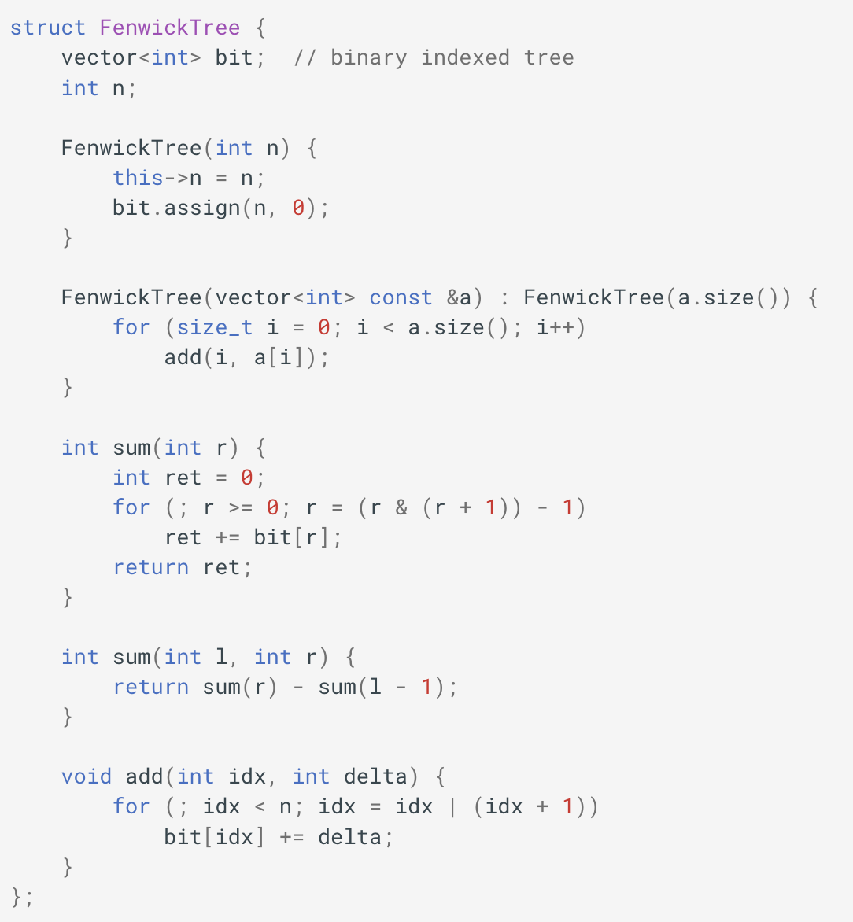
Final Update Code

Slide 19
Fenwick Tree Implementation
Implementation: Full implementation for f() = sum() in one dimension.
What is the runtime of this constructor? Can we make it faster?

Slide 20
Fenwick Tree Linear Time Constructor

Slide 21

Fenwick Tree Implementation
Implementation: Full implementation for f() = sum() in one dimension.
This is $Θ(n\log{n})$
Can we make this $Θ(n)$

Slide 22
Fenwick Tree Implementation
Key Observation
Key Observation:
Each element a[i] contributes to bit[i] and everything bit[i|(i+1)]. So, if we push the change up one “level”, we can then push it up again eventually when we each index i|(i+1)

Slide 23
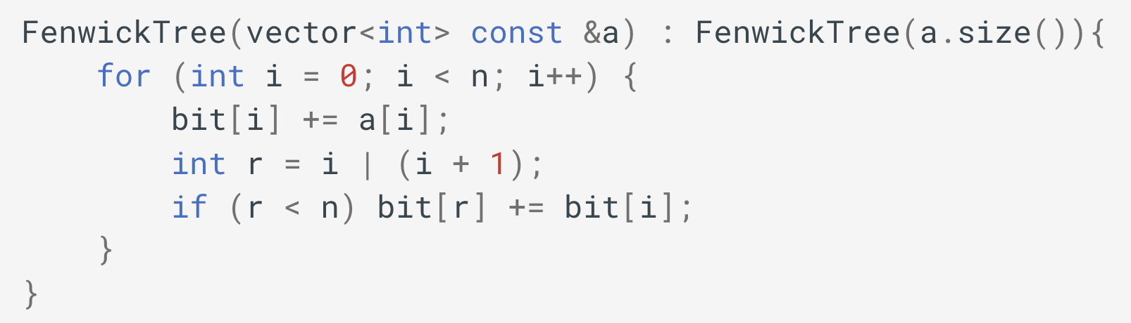




Fenwick Tree Fast Construction
Recall that $i | (i+1)$ is the function $h(i)$
$$T=\{t_{0}, t_{1}, t_{2}, t_{3}, t_{4},t_{5},t_{6},t_{7},t_{8},t_{9},t_{10},t_{11},t_{12},t_{13}, t_{14}\}$$
$$A=\{0, 1, 2, 3, 4, 5, 6, 7, 8, 9, 10, 11, 12, 13, 14\}$$
When loop at i=8:
$$r=i\left|\left(i+1\right)=8\right|9=9 \\ bit\left[9\right]+=bit\left[8\right]=36$$
Consider t₉:
$$9_{10}={1001}_{2}$$
$t_{9}=36$ //sum from 0 to 8
When loop at i=9:
$$bit\left[9\right]+=a\left[9\right]=36+9=45$$

Slide 24
Fenwick Tree for min Function

Slide 25
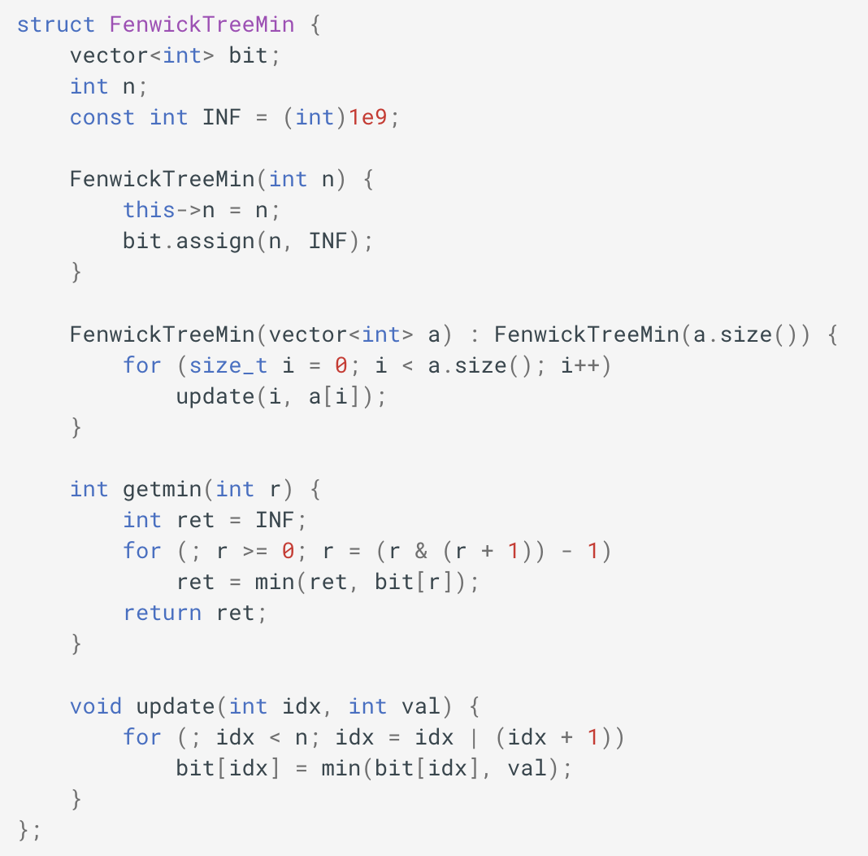
Fenwick Tree Implementation
Implementation: Partial implementation with f() = min()
getmin() returns min from index 0 to r
Can you adapt to return min from a given left and right index? Why or why not?
What about update(int idx, int val), does this method have any restrictions?

Slide 26
Function must be invertible
Invertible Functions
Fenwick tree supports arbitrary range and updates if the function of interest (e.g., sum) is invertible. An invertible function is one in which you can determine the inputs given the output (and in our case, all but one of the outputs)
“Normal”, “Forward” use of a function like sum()
Given one input (b) and the output (c), can you compute the second original input?
a
b
?
b
Sum(a, b)
Sum(a, b)
? = a+b
c

Slide 27
Function must be invertible
Invertible Functions
Fenwick tree supports arbitrary range and updates if the function of interest (e.g., sum) is invertible. An invertible function is one in which you can determine the inputs given the output (and in our case, all but one of the outputs)
?
b
Sum(0, r) (c in diagram)
Sum(a, b)
Sum(0, l-1) (b in diagram)
Sum(l, r) (? in diagram)
c
For Sum(), this is fine, but consider min(a,b) and you’ll notice that it cannot be inverted unless c is not equal to b

Slide 28
Function must be invertible
Invertible Functions
A similar relationship occurs with updates
Total Sum D
?? (A+C)
? B + delta
A
B
C
delta
Sum(a, b)
Update element B by delta
D’ = (A + B + C) + delta
= D + delta
New Sum D’ = D + delta

Slide 29
One More Operation:
Sums that Exceed Given Threshold

Slide 30

Threshold Search
Consider the operation:
thresholdSearch(int t): Given a threshold value $t$, return the smallest index $i$ such that $Sum\left[0,i\right]≥t$
A =
3
7
1
4
5
4
3
1
1
2
Example:
Consider thresholdSearch(14)
This call should return index 3 because:
$Sum\left[0,3\right]=15≥14$ and 3 is the smallest given this constraint.

Slide 31

Threshold Search
Consider the operation:
thresholdSearch(int t): Given a threshold value $t$, return the smallest index $i$ such that $Sum\left[0,i\right]≥t$
A =
3
7
1
4
5
4
3
1
1
2
Option 1: Binary Search
thresholdSearch(int t):
l = 0; r=T.size()-1
while(l<r):
mid = Floor(T.size() / 2)
val = Sum(mid) //fenwick tree sum query
if(val < threshold) then l=mid+1
else r = mid
return l //l should equal r here
T =
3
10
1
15
5
9
3
28
1
3
Here is the T array (Fenwick Tree). How might we search this efficiently to implement thresholdSearch(int t)?
What is the runtime of this?
log(n) binary search with a log(n) call to Sum() = $Θ(\log^{2}{n})$

Slide 32

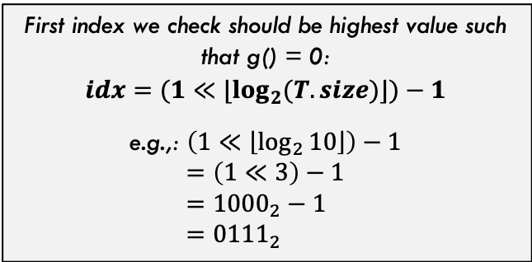
Threshold Search
Consider the operation:
thresholdSearch(int t): Given a threshold value $t$, return the smallest index $i$ such that $Sum\left[0,i\right]≥t$
A =
3
7
1
4
5
4
3
1
1
2
T =
3
10
1
15
5
9
3
28
1
3
This is great for a first check because we quickly check an entire prefix sum and know if the answer index is to the right or to the left (feels like binary search) without calling the sum() function
Notice that some indices store full prefixes (g() function takes them to 0:
0 $g\left(0\right)=g\left({0000}_{2}\right)={0000}_{2}=0$
1 $g\left(1\right)=g\left({0001}_{2}\right)={0000}_{2}=0$
3 $g\left(3\right)=g\left({0011}_{2}\right)={0000}_{2}=0$
7 $g\left(7\right)=g\left({0111}_{2}\right)={0000}_{2}=0$
First index we check should be highest value such that g() = 0:
$$idx=(1≪{⌊log}_{2}{(T.size)}⌋)−1$$
e.g.,: $\left(1≪\left\lfloor \log_{2}{10}\right\rfloor \right)−1$
$$=\left(1≪3\right)−1 \\ ={1000}_{2}−1 \\ ={0111}_{2}$$

Slide 33
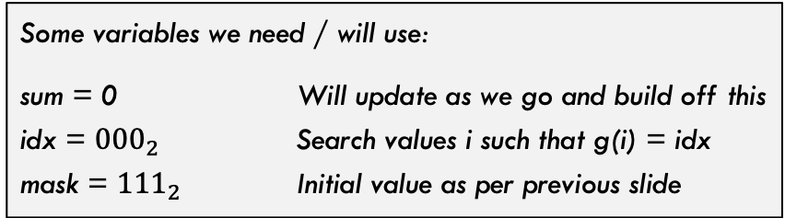
Threshold Search
Consider the operation:
thresholdSearch(int t): Given a threshold value $t$, return the smallest index $i$ such that $Sum\left[0,i\right]≥t$
A =
3
7
1
4
5
4
3
1
1
2
T =
3
10
1
15
5
9
3
28
1
3
Some variables we need / will use:
sum = 0 Will update as we go and build off this
idx = ${000}_{2}$ Search values i such that g(i) = idx
mask = ${111}_{2}$ Initial value as per previous slide

Slide 34
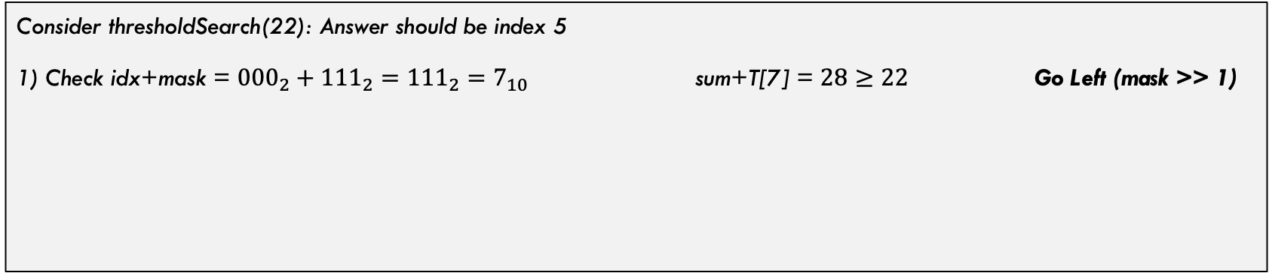
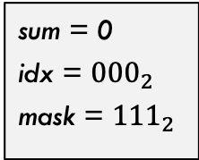
Threshold Search
Consider the operation:
thresholdSearch(int t): Given a threshold value $t$, return the smallest index $i$ such that $Sum\left[0,i\right]≥t$
A =
3
7
1
4
5
4
3
1
1
2
T =
3
10
1
15
5
9
3
28
1
3
sum = 0
idx = ${000}_{2}$
mask = ${111}_{2}$
Consider thresholdSearch(22): Answer should be index 5
1) Check idx+mask = ${000}_{2}+{111}_{2}={111}_{2}=7_{10}$ sum+T[7] = $28≥22$ Go Left (mask >> 1)

Slide 35
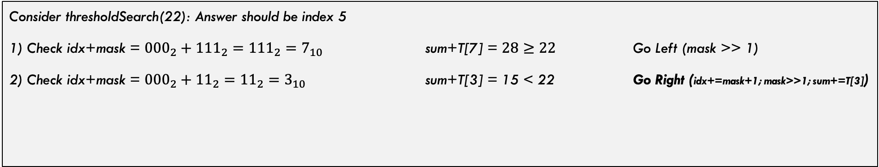
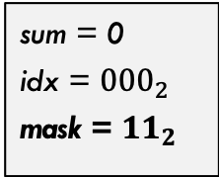
Threshold Search
Consider the operation:
thresholdSearch(int t): Given a threshold value $t$, return the smallest index $i$ such that $Sum\left[0,i\right]≥t$
A =
3
7
1
4
5
4
3
1
1
2
T =
3
10
1
15
5
9
3
28
1
3
sum = 0
idx = ${000}_{2}$
mask = ${11}_{2}$
Consider thresholdSearch(22): Answer should be index 5
1) Check idx+mask = ${000}_{2}+{111}_{2}={111}_{2}=7_{10}$ sum+T[7] = $28≥22$ Go Left (mask >> 1)
2) Check idx+mask = ${000}_{2}+{11}_{2}={11}_{2}=3_{10}$ sum+T[3] = 15 < 22 Go Right (idx+=mask+1; mask>>1; sum+=T[3])

Slide 36
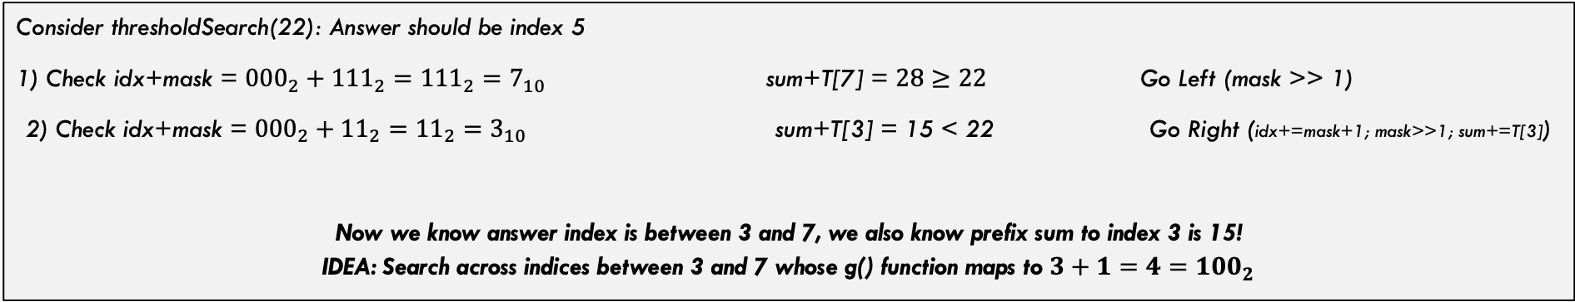
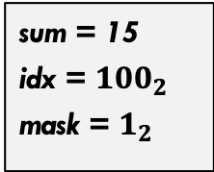
Threshold Search
Consider the operation:
thresholdSearch(int t): Given a threshold value $t$, return the smallest index $i$ such that $Sum\left[0,i\right]≥t$
A =
3
7
1
4
5
4
3
1
1
2
T =
3
10
1
15
5
9
3
28
1
3
sum = 15
idx = ${100}_{2}$
mask = $1_{2}$
Consider thresholdSearch(22): Answer should be index 5
1) Check idx+mask = ${000}_{2}+{111}_{2}={111}_{2}=7_{10}$ sum+T[7] = $28≥22$ Go Left (mask >> 1)
2) Check idx+mask = ${000}_{2}+{11}_{2}={11}_{2}=3_{10}$ sum+T[3] = 15 < 22 Go Right (idx+=mask+1; mask>>1; sum+=T[3])
Now we know answer index is between 3 and 7, we also know prefix sum to index 3 is 15!
IDEA: Search across indices between 3 and 7 whose g() function maps to $3+1=4={100}_{2}$

Slide 37
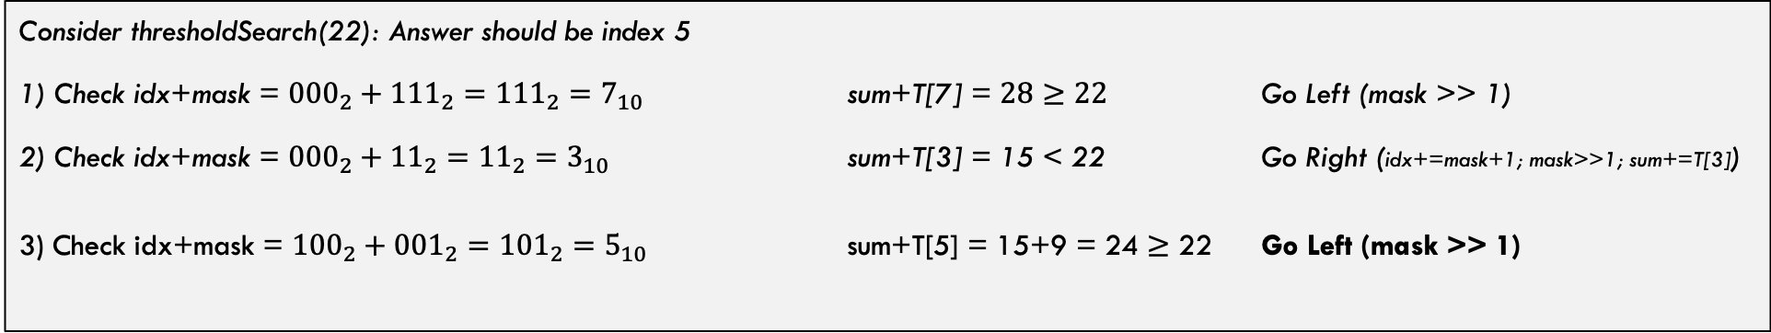
Threshold Search
Consider the operation:
thresholdSearch(int t): Given a threshold value $t$, return the smallest index $i$ such that $Sum\left[0,i\right]≥t$
A =
3
7
1
4
5
4
3
1
1
2
T =
3
10
1
15
5
9
3
28
1
3
sum = 15
idx = ${100}_{2}$
mask = $1_{2}$
Consider thresholdSearch(22): Answer should be index 5
1) Check idx+mask = ${000}_{2}+{111}_{2}={111}_{2}=7_{10}$ sum+T[7] = $28≥22$ Go Left (mask >> 1)
2) Check idx+mask = ${000}_{2}+{11}_{2}={11}_{2}=3_{10}$ sum+T[3] = 15 < 22 Go Right (idx+=mask+1; mask>>1; sum+=T[3])
3) Check idx+mask = ${100}_{2}+{001}_{2}={101}_{2}=5_{10}$ sum+T[5] = 15+9 = 24 $≥$ 22 Go Left (mask >> 1)

Slide 38
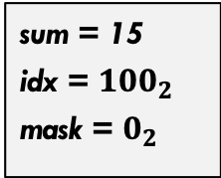
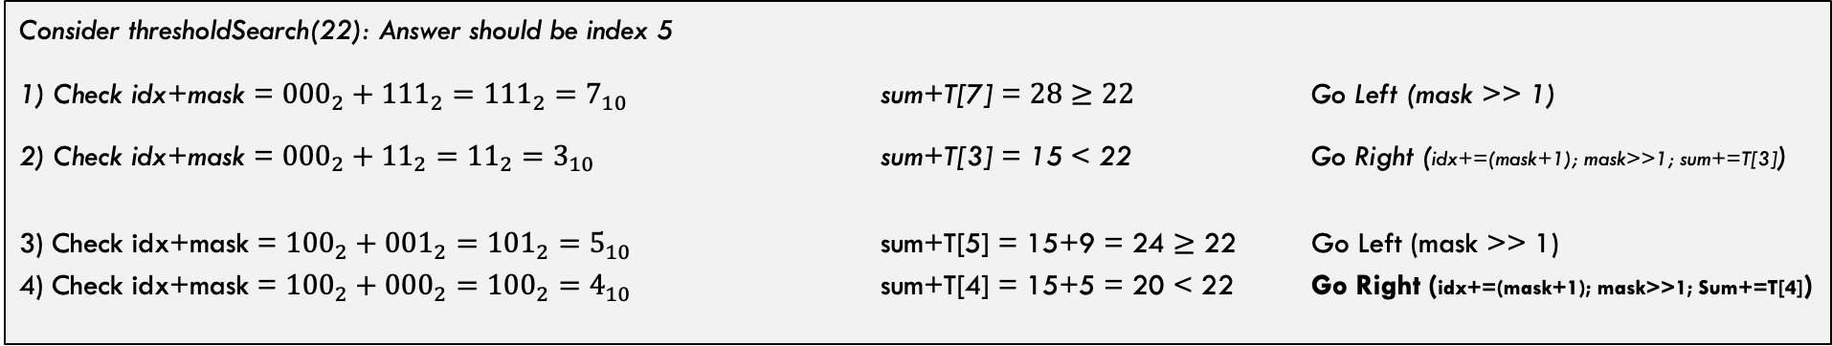
Threshold Search
Consider the operation:
thresholdSearch(int t): Given a threshold value $t$, return the smallest index $i$ such that $Sum\left[0,i\right]≥t$
A =
3
7
1
4
5
4
3
1
1
2
T =
3
10
1
15
5
9
3
28
1
3
sum = 15
idx = ${100}_{2}$
mask = $0_{2}$
Consider thresholdSearch(22): Answer should be index 5
1) Check idx+mask = ${000}_{2}+{111}_{2}={111}_{2}=7_{10}$ sum+T[7] = $28≥22$ Go Left (mask >> 1)
2) Check idx+mask = ${000}_{2}+{11}_{2}={11}_{2}=3_{10}$ sum+T[3] = 15 < 22 Go Right (idx+=(mask+1); mask>>1; sum+=T[3])
3) Check idx+mask = ${100}_{2}+{001}_{2}={101}_{2}=5_{10}$ sum+T[5] = 15+9 = 24 $≥$ 22 Go Left (mask >> 1)
4) Check idx+mask = ${100}_{2}+{000}_{2}={100}_{2}=4_{10}$ sum+T[4] = 15+5 = 20 < 22 Go Right (idx+=(mask+1); mask>>1; Sum+=T[4])

Slide 39
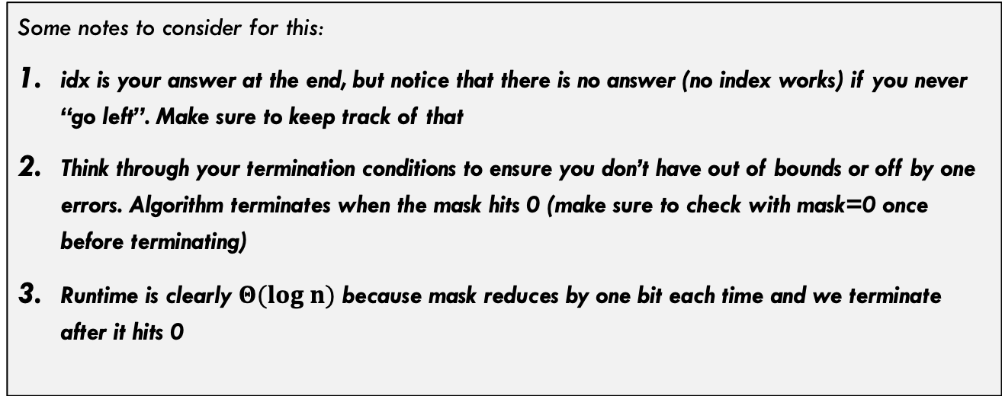
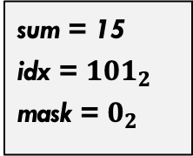
Threshold Search
Consider the operation:
thresholdSearch(int t): Given a threshold value $t$, return the smallest index $i$ such that $Sum\left[0,i\right]≥t$
A =
3
7
1
4
5
4
3
1
1
2
T =
3
10
1
15
5
9
3
28
1
3
sum = 15
idx = ${101}_{2}$
mask = $0_{2}$
Some notes to consider for this:
idx is your answer at the end, but notice that there is no answer (no index works) if you never “go left”. Make sure to keep track of that
Think through your termination conditions to ensure you don’t have out of bounds or off by one errors. Algorithm terminates when the mask hits 0 (make sure to check with mask=0 once before terminating)
Runtime is clearly $Θ(log n)$ because mask reduces by one bit each time and we terminate after it hits 0

Slide 40
Conclusion

Slide 41
Conclusions
Strengths:
  Works great for simple f(), but complicated for some functions (min over l,r is not trivial)
  Logarithmic time complexity for both queries and updates
  Once understood conceptually, very easy implementation
  Easy to extend to 2D arrays (see reading for details)
Weaknesses:
  Some functions aren’t natural to implement because you can’t build off smaller solutions (e.g., min…which section of the array is the min actually in!?)
Other cool things:
  There is a variation that indexes from 1 in the array (see reading if you want to use this version)
  2D summation Fenwick tree is not too difficult to do (check out reading for details)
  Can also support range updates and index queries with some fancy tricks…

