Slide 1
CS4501: Adv. Algo.
Course Introduction
Advanced Algorithms and Implementations
Mark Floryan

Slide 2
Course Objectives

Slide 3
Course Objectives
Students who complete the course will:
Solve challenging optimizations by modeling problems as linear programs and using / understanding linear programming algorithms.
Take advantage of representation structures of data to more efficiently store and retrieve data.
Apply analysis concepts to determine the efficacy of approximation algorithms where the optimal solution is unlikely to be found.
Gain an understanding of common algorithmic ideas when working with geometric problems including convex hulls, and large geometric data sets.
Be exposed to numerous small but useful algorithms that can be used as common sub-routines to solve larger problems.

Slide 4
Course introduction

Slide 5
Lectures
Lecture Time
  Tu/Th 11:00 – 12:15 @ Thornton Hall E316
Lectures will be recorded and posted on Canvas -> Lecture Recordings
  Using Panopto, so no live broadcast
  A note about recordings…they are a privilege, not a right.
Lectures will cover course topics, example code, etc.

Slide 6
Lectures
Lectures are held in-person, Tu/Th
Tuesday: Traditional in-person lectures. Attendance required (more on that later). Recordings available for review.
Thursday: Combination of homework labs (I’ll explain verbally), quizzes (2 of them), and partial lectures.
Last three (ish) lectures: Are reserved for final project presentations (more on that in a bit as well).

Slide 7
General Info
See syllabus on course website for general information
Pre-requisites:
  CS 3100 (DSA2) if you are in the new curriculum (most of you, probably)
  CS 4102 (Algo) if you are in the old curriculum (Does this apply to anybody anymore?)
  Math topics: proof by induction, proof by contradiction, etc. (Basically everything in DMT 1)
  Data Structures: General proficiency with everything from DSA1 and 2.
Teaching Assistants
  Undergraduates (3)
  Both will hold office hours, which will start next week
    Locations and hours mostly set on course website
  Also, we’ll use Piazza for questions.
    Post all questions about HW, topics, etc. to Piazza NOT email to instructors!

Slide 8
Course Website
https://markfloryan.github.io/advAlgo/
Contains most of the important info for the course:
  Homework
  Slides
  Syllabus
  Etc…

Slide 9
Other Course Tools
Piazza: Use for course discussion among students and Tas regarding course content
Gradescope: For submitting homework and seeing your grades, etc.
Possible Google Forms when necessary…
All of these will be linked from Collab and from course website

Slide 10
General Expectations

Slide 11
Expectations
I view a course as a social contract between you and me. Here is how I view the contract for this particular course:
What I am asking of you:
What I will give in return:
Lecture attendance is required
This classroom is a no technology zone (except for the projector, and certain specific call activities)
On “lab days”, work on the problem and actively engage
Plus all the normal expectations (be respectful to your peers, etc.)
Not too much homework (six auto-graded programming assignments)
Limited lectures where I talk the whole time (Tuesdays and partial Thursdays)
Help solving the HW in class (more later)
A sprinkling of “time off”
No Final Exam (small final project instead)
Quizzes will be short and simple, relatively low stress (and only 2 of them)

Slide 12
Course Structure / Overview

Slide 13
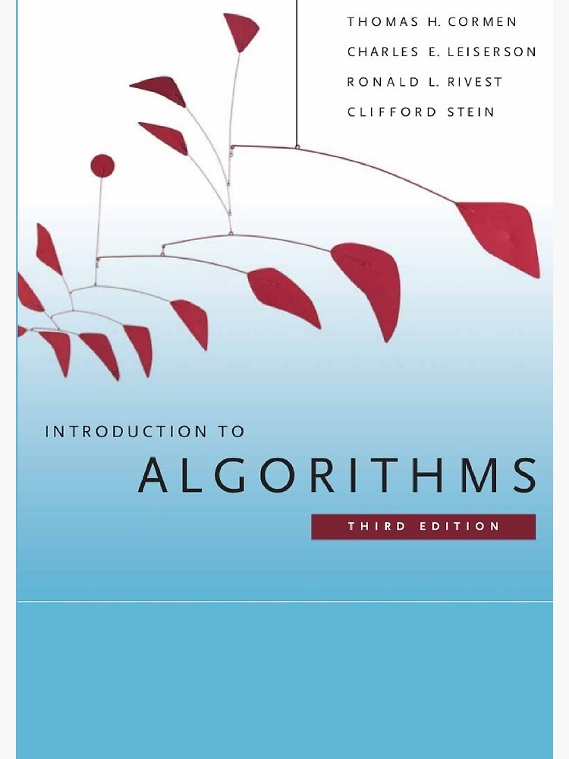
Textbook?
Most of the material comes sporadically from two different sources
1) CLRS Algorithms Book ( a couple of selected chapters )
2) https://cp-algorithms.com/ (website of curated algorithms)

Slide 14
Topics
The course is divided into 7 high-level topics
  1: Fenwick Trees
  2: Segment Trees
  3: Linear Programming
  4: Computational Geometry
  5: Van Emde Boas Trees
  6: Approximation Algorithms
  7: Little Algorithms (Your final project)

Slide 15
Homework
6 Programming Challenges (Warm-up + 1 per first five topics)
Programming HW:
  Is written in Java, Python, or C++
  ICPC style programming challenges. Will give problem statement and sample input output.
  You need to:
    Design and implement a working algorithm
    Come up with your own test cases if your code doesn’t work
    Make sure your code is fast enough / works on the biggest test cases

Slide 16
Homework schedule
6 Programming Challenges (Warm-up + 1 per first five topics)
Thursday Before Due Date: Problem is revealed in class and we spend class time working on the assignment. You can freely discuss with one another during this time and I will walk around and help.
Tue. After That: Programming challenge is due
Sun. After That: Everyone gets auto-extension of 5 days if you need it. NO extensions for ANY REASON after that.

Slide 17
Homework Grades
Homeworks will be graded on a traditional percentage scale:
  Out of 10 points (or similar)
  Based on the number of test cases that you pass
  Gradescope will give you this feedback

Slide 18
Quizzes
Short assessments of your knowledge across 2-3 modules
  Meant to ensure you have knowledge of the individual topics from lecture to a sufficient degree.
  Usually about two pages worth of traditional exam material.
Quiz Schedule as of right now:
  Thu., Mar. 12 Topics 1-3 from previous slide
  Thu., Apr. 16 Topics 4-5 from previous slide

Slide 19
Final Exam
No final exam in this class. Final project instead (See next slide)

Slide 20
Final Project
In small groups, you will:
  Select a small(ish) algorithm to study and implement
  Develop a few slides to teach it
  Create a homework assignment that applies it (including the solution to the problem)
  Teach it to the class (during last few lectures)
I will get the algorithm choices to you by Spring Break with more details.
Due date is last few days of lecture (that is when presentations will happen)

Slide 21
Attendance / Participation

Slide 22
Attendance is Required
Why: Because I feel that your presence is how I will “prove” that you have been exposed to the material. This justifies fewer quizzes and fewer lectures.
How: 20 names will be chosen at random from the roster each class. If you are chosen and not present, you lose 2 percent on final grade.
When: All classes (including Thursday homework lab days)
Exceptions: None except UVa officially recognized religious observances and SDAC accommodations

Slide 23
Grading Overview

Slide 24
Grading Overview
Final letter grade will be a weighted average:
Homework: 40 percent (split over about 6 homeworks)
Quizzes: 30 percent (15 percent each)
Attendance: 12 percent (2 percent off for each miss)
Final Project: 18 percent

Slide 25
I think that is all…
Any questions…

