Slide 1
Van Emde Boas Trees
Advanced Algorithms Mark Floryan CLRS Ch. 20

Slide 2
Advanced Tree Structures
In this deck we will look at:
- Van Emde Boas Trees

Slide 3
Motivation: Fast, Balanced Search Trees

Slide 4
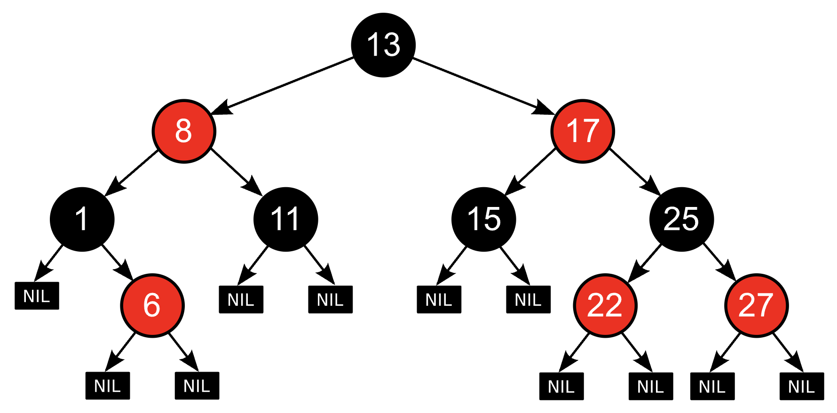



Motivation: Data Structures So Far
Operations are $Θ(\log{n)}$ time
Recall that problem of sorting has lower bound of $Θ(n log n)$
So, any data structure that supports insert and extract-min must have ONE of these operations be $Ω(\log{n)}$. Why?
GOAL: Design a set data structure for which all operations are $o(\log{n)}$

Slide 5
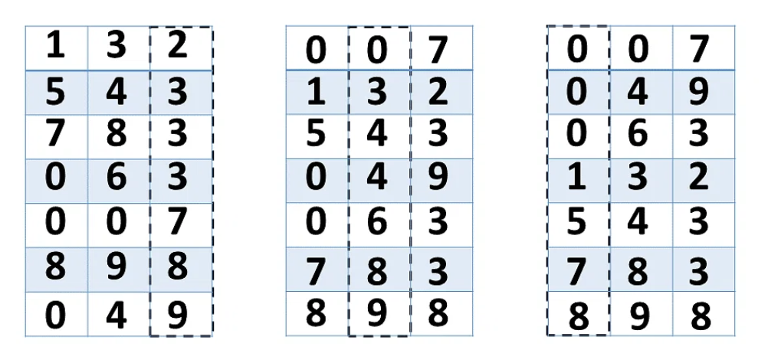
Main Idea + Example
IDEA: Exploit the representation of the data to achieve better runtimes.
If keys are integers within a known bounded range, we can take advantage of their bit representation achieve o(log n) performance for all operations.
Radix Sort does this. Exploit the digit-based integer representation to sort in o(n log n) time. Sort by ones place, then tens, then hundreds, etc.

Slide 6
Quick Aside: Radix Sort

Slide 7


Radix sort
IDEA: Exploit How data is represented to get fast sorted runtimes.
Sort by ones digit in $O(n)$ time.
Stable sort by each digit after until all digits exhausted
Then, stable sort by tens digit, again in $O(n)$ time

Slide 8
The algorithm
Original Unsorted List
170
45
75
90
2
24
802
66
First pass simply places each element into one of our “buckets” (lists) based on the least significant digit.
90
802
75
170
2
24
45
66
0
1
2
3
4
5
6
7
8
9
Buckets: To Sort Into

Slide 9
The algorithm
Simply concatenate the lists to finish this iteration of the loop
90
802
75
170
2
24
45
66
0
1
2
3
4
5
6
7
8
9
170
90
2
802
24
45
75
66

Slide 10
The algorithm
Partially Sorted List
170
90
2
802
24
45
75
66
Do it again with the tens digit
802
75
02
24
45
66
170
90
0
1
2
3
4
5
6
7
8
9
02
802
24
45
66
170
75
90

Slide 11

The algorithm
Partially Sorted List
002
802
024
045
066
170
075
090
090
Runtime is $Θ(kn)$ where k is the number of maximum digits in your data. You have to do one linear pass for each digit.
075
066
045
024
002
170
802
0
1
2
3
4
5
6
7
8
9
Final Sorted List
002
024
045
066
075
090
170
802

Slide 12
Python code
def getDigit(n, b, k): return (n // b ** k) % b # pulls the selected digit
def mkBlanks(k): return [ [] for i in range(k) ] # create buckets
def split(l, b, k): x = mkBlanks(b) for i in l: x[getDigit(i, b, k)].append(i) #add to bucket return x
def merge(x): # concatenate lists back in order l = [] for sublist in x: for item in sublist: l.append(item) return l
def maxAbs(l): return max(abs(x) for x in l) # largest abs value element of a list
def radixSort(l, b): passes = int(log(maxAbs(l), b) + 1) # How many passes to do t = list(l) for i in range(passes): t = merge(split(t, b, i)) return t

Slide 13
Back to VeB Trees

Slide 14
Developing a Fast Set Data-Structure
Overall Approach:
1. First look at overall idea of exploiting bit representations to make faster trees.
2. Then, look at a first implementation of a Van Emde Boas trees (proto vEB trees) that has a few problems)
3. Finally, fix those problems and finalize our implementation (proper vEB trees)

Slide 15
Motivation: Data Structures So Far
Our Data Structure will support the operations, given a set of integers:
Search(i): return true iff i is in the set Insert(i): insert i into the set (no duplicates) Delete(i): delete i from the set Minimum() return minimum element in the set Maximum() return maximum element in the set Successor(i) given i, find the next largest element in the set Predecessor(i) given i, find the next smallest element in the set
Two variables of interest:
n: Number of elements in the set
u: Universe size (all elements in set must be contained within [0 .. u-1]

Slide 16
Super-Imposing Bits and Sqrt(u) Runtimes

Slide 17
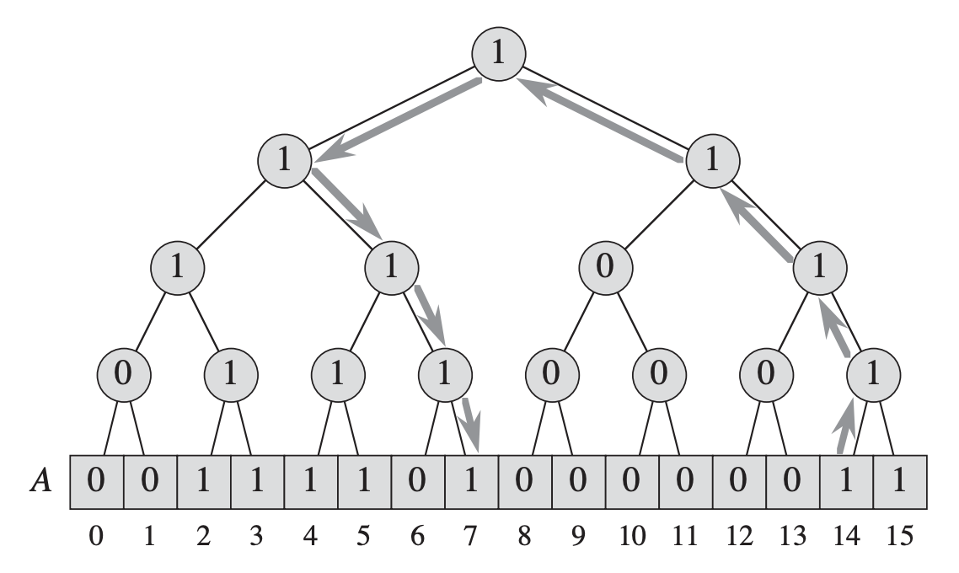
Direct Addressing With Binary Tree
Initial idea: Initialize an array of bits. A[i] is set to 1 iff i is currently inserted into the set
How would we implement
insert delete search predecessor / successor minimum / maximum
Let u be the universe size (integers from 0 to u-1 can be in the set). Here u=16.

Slide 18
Direct Addressing With Binary Tree
Create some higher level nodes, each one tells if you if something in it’s “group” is in the set or not. Check these nodes first
How would we implement
insert delete search predecessor / successor minimum / maximum
Let u be the universe size (integers from 0 to u-1 can be in the set). Here u=16.

Slide 19
Direct Addressing With Binary Tree
Internal nodes represent where or not at least one element from that range is in the set. 0 if none.
How would we implement
insert delete search predecessor / successor minimum / maximum
Let u be the universe size (integers from 0 to u-1 can be in the set). Here u=16. Arrows show traversal of predecessor(14)

Slide 20
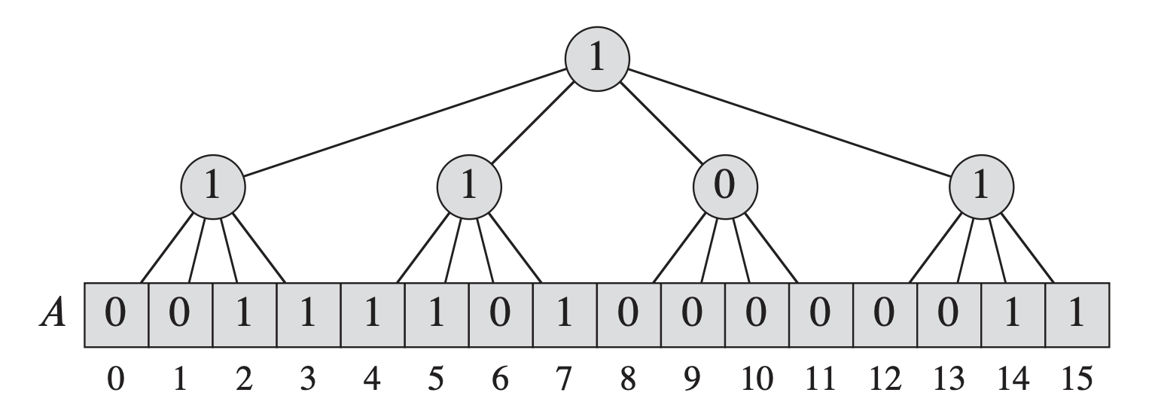
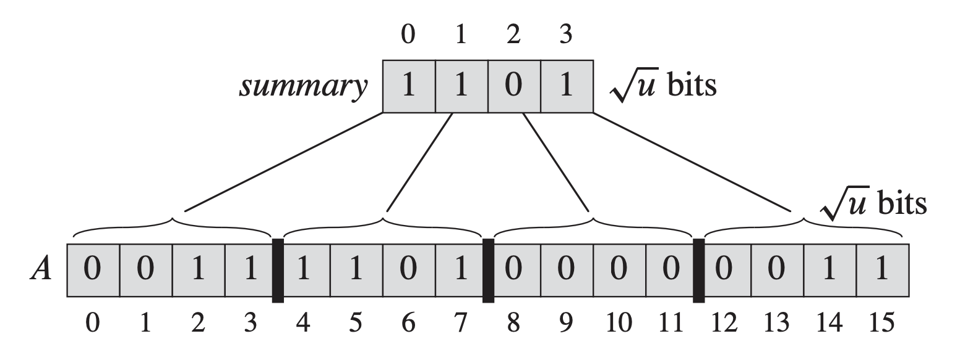


Direct Addressing Constant Height
Super impose a tree of with branching factor $\sqrt{u}=2^{k}$. Tree will always have height 2!!
Here we have $$k=2 \\ u=2^{2k}=2^{4}=16 \\ 2^{k}=2^{2}=4$$
Seems slower because $\sqrt{u}∈ω(\log{u)}$, but this gives us the key idea of vEB trees, so still good to make note of!!
In reality, don’t need root node. Store second layer as array called summary. How do we implement each operation??

Slide 21
Proto-vEB Trees

Slide 22
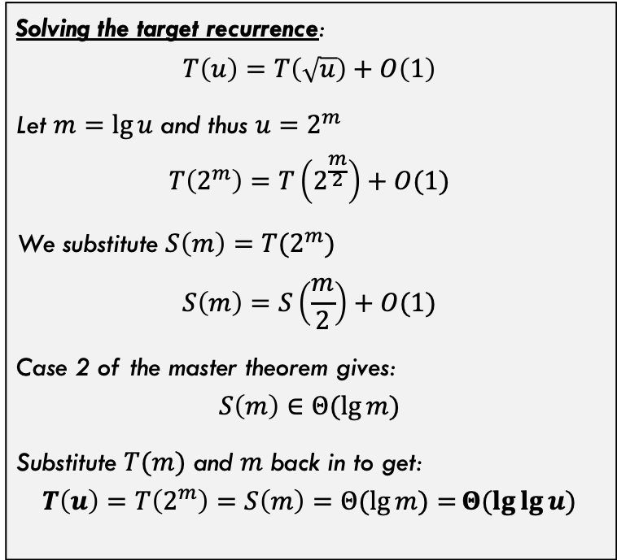


A Recursive Structure
A recursive structure: Same idea but recursive, shrink the universe by sqrt(u) at each level of recursion until we hit some minimum size.
Solving the target recurrence:
$$T\left(u\right)=T\left(\sqrt{u}\right)+O\left(1\right)$$
Let $m=\lg{u}$ and thus $u=2^{m}$
$$T\left(2^{m}\right)=T\left(2^{\frac{m}{2}}\right)+O(1)$$
We substitute $S\left(m\right)=T(2^{m})$ $$S\left(m\right)=S\left(\frac{m}{2}\right)+O(1)$$
Case 2 of the master theorem gives:
$$S\left(m\right)∈Θ(\lg{m)}$$
Substitute $T(m)$ and $m$ back in to get:
$$T\left(u\right)=T\left(2^{m}\right)=S\left(m\right)=Θ(\lg{m)=}Θ(\lg{\lg{u)}}$$
Assume $u={2^{k}}^{k}$ for some k (will relax this later)
Let’s aim for the recurrence:
$$T\left(u\right)=T\left(\sqrt{u}\right)+O(1)$$
So, we want to shrink by $\sqrt{u}$ on each step and do constant additional work. We will get $Θ(\lg{\lg{u)}}$ runtimes

Slide 23
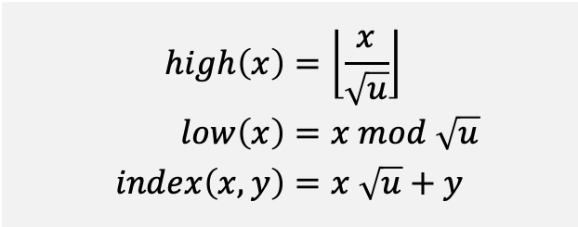


Addressing Clusters
Note in example below, index 7 is in cluster 1 and index 3 within cluster 1
We can use some simple arithmetic operations to address specific clusters and elements within clusters
$$high\left(x\right)=\left\lfloor \frac{x}{\sqrt{u}}\right\rfloor \\ low\left(x\right)=x mod \sqrt{u} \\ index\left(x,y\right)=x \sqrt{u}+y$$
Example: Let $x=7_{10}$
$$high\left(7\right)=\left\lfloor \frac{7}{\sqrt{16}}\right\rfloor =\left\lfloor \frac{7}{4}\right\rfloor =1$$ $$low\left(7\right)=7 mod \sqrt{u}=7 mod 4=3$$ $$index\left(1,3\right)=1\sqrt{16}+3=4+3=7$$
Where x is the index of A we are want to traverse to
Note that we have the identity $$index\left(high\left(x\right), low\left(x\right)\right)=x$$

Slide 24
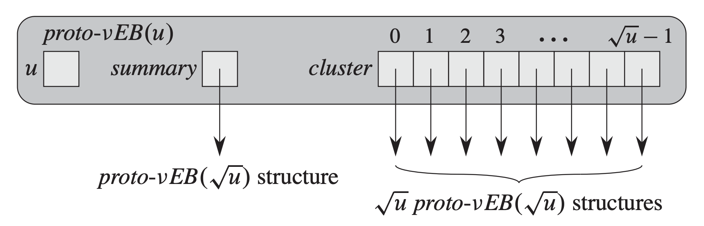
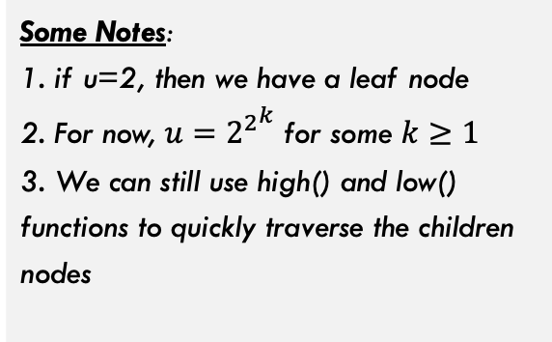
Proto-vEB Structure
A first attempt at a node structure for a recursive vEB-Tree
We store the universe size (e.g., u=16 in previous slide)
Some Notes: 1. if u=2, then we have a leaf node 2. For now, $u={2^{2}}^{k}$ for some $k≥1$ 3. We can still use high() and low() functions to quickly traverse the children nodes
These clusters recursively store Proto-vEB structures which (eventually) contain the array telling us which elements are in the set
summary stores information about whether each cluster contains at least one element

Slide 25
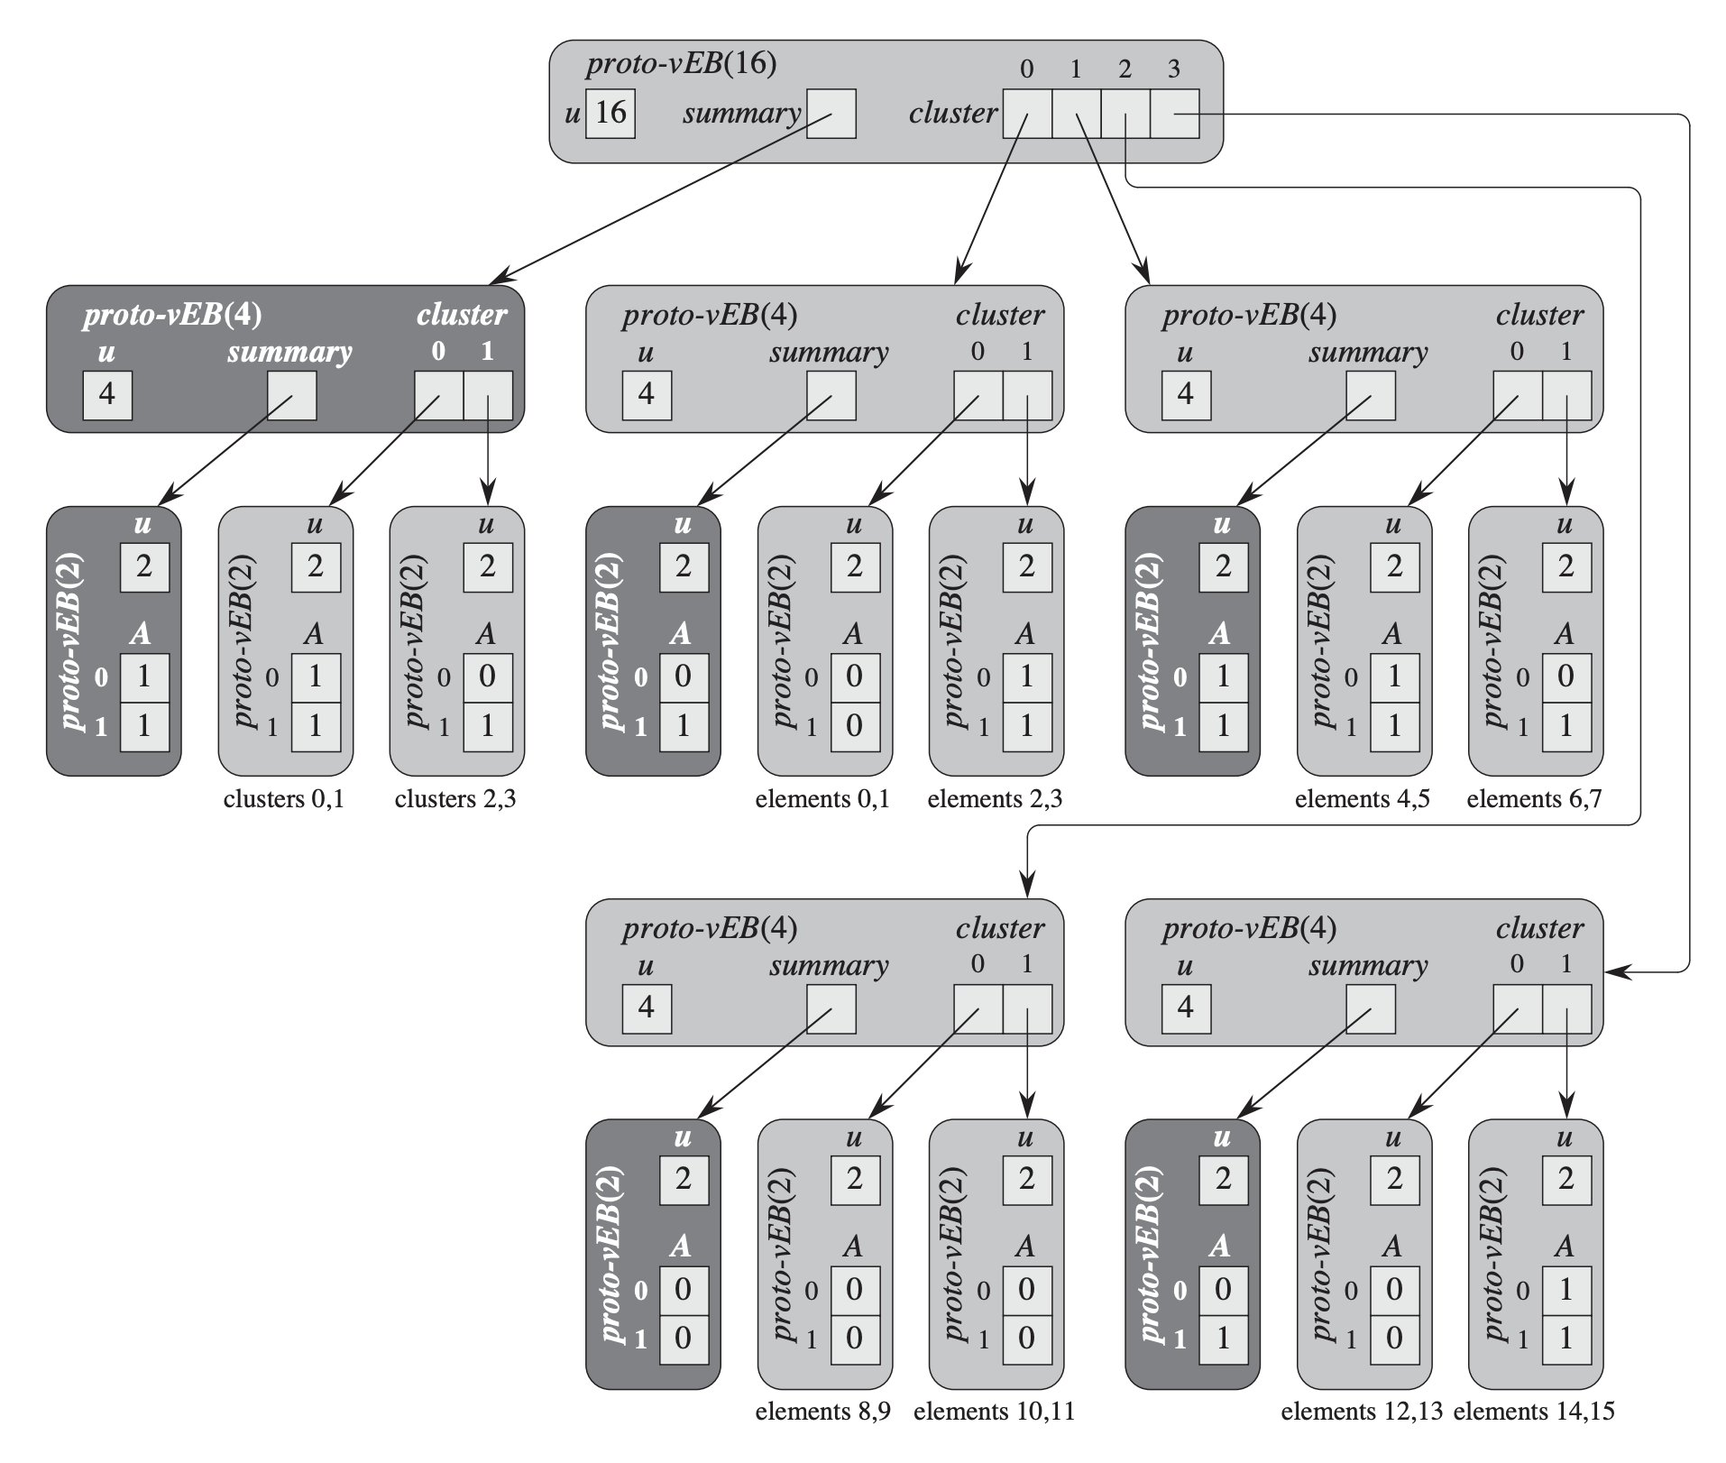
Proto-vEB Structure
This Proto-vEB Tree stores the set {2, 3, 4, 5, 7, 14, 15}
Can you answer the following:
Where are the actual data bits (for the members of the set) stored?
How could I tell if cluster 1 has at least one element using only summary elements?

Slide 26
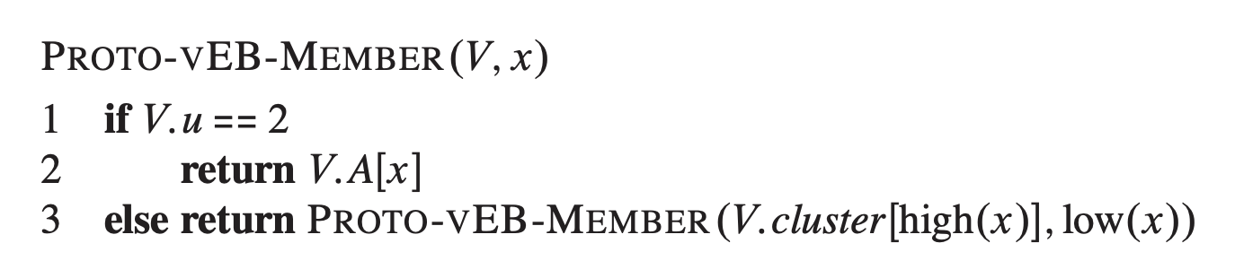

Operations On Proto-vEB Structure
Determining whether a value is in the set
One recursive call, so we achieve the target recurrence and runtime: $$T\left(u\right)=T\left(\sqrt{u}\right)+O\left(1\right)=Θ(\lg{\lg{u)}}$$

Slide 27
Proto-vEB Structure
This Proto-vEB Tree stores the set {2, 3, 4, 5, 7, 14, 15}
Example Runs:
member(14)
member(9)

Slide 28
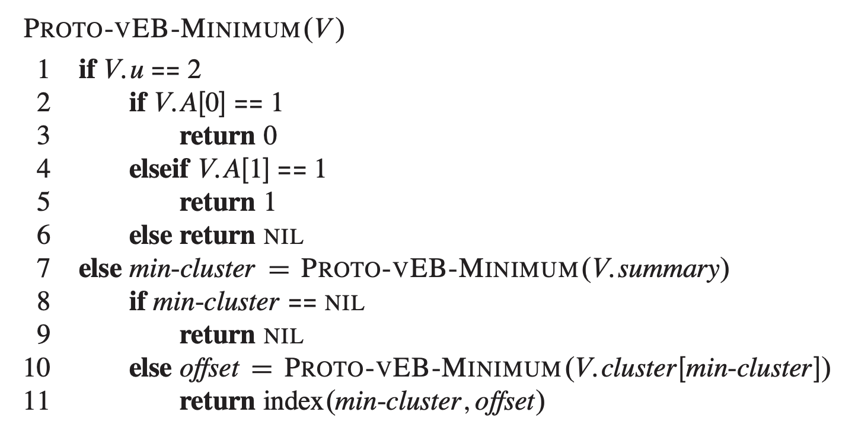
Operations On Proto-vEB Structure
Minimum (Maximum is similar / analogous)

Slide 29
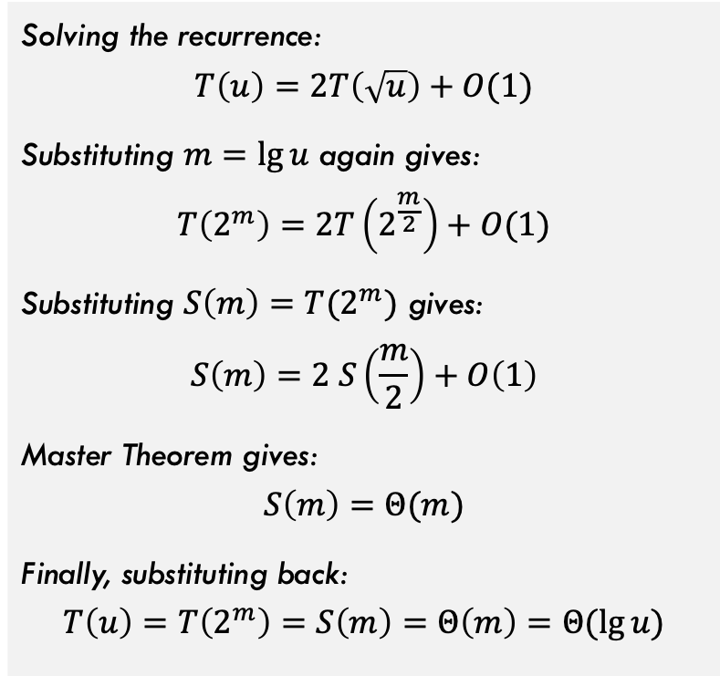
Operations On Proto-vEB Structure
Minimum (Maximum is similar / analogous)
Solving the recurrence:
$$T\left(u\right)=2T\left(\sqrt{u}\right)+O(1)$$
Substituting $m=\lg{u}$ again gives: $$T\left(2^{m}\right)=2T\left(2^{\frac{m}{2}}\right)+O(1)$$
Substituting $S\left(m\right)=T(2^{m})$ gives: $$S\left(m\right)=2 S\left(\frac{m}{2}\right)+O\left(1\right)$$
Master Theorem gives: $$S\left(m\right)=Θ(m)$$
Finally, substituting back: $$T\left(u\right)=T\left(2^{m}\right)=S\left(m\right)=Θ\left(m\right)=Θ(\lg{u)}$$
2 recursive calls leads to recurrence $T\left(u\right)=2T\left(\sqrt{u}\right)+O(1)$
So, this is slower than the $Θ(\lg{\lg{u)}}$ target, will fix later!

Slide 30
Proto-vEB Structure
This Proto-vEB Tree stores the set {2, 3, 4, 5, 7, 14, 15}
Example Runs:
Minimum(root)

Slide 31
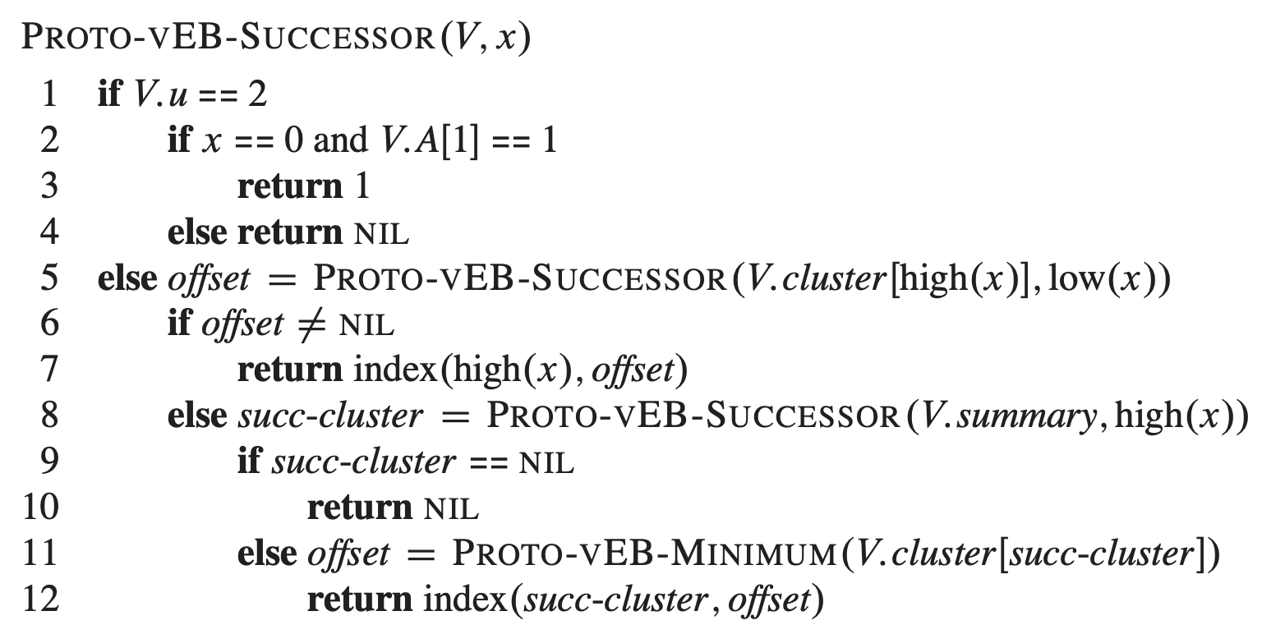
Operations On Proto-vEB Structure
Successor (Predecessor is similar / analogous)

Slide 32
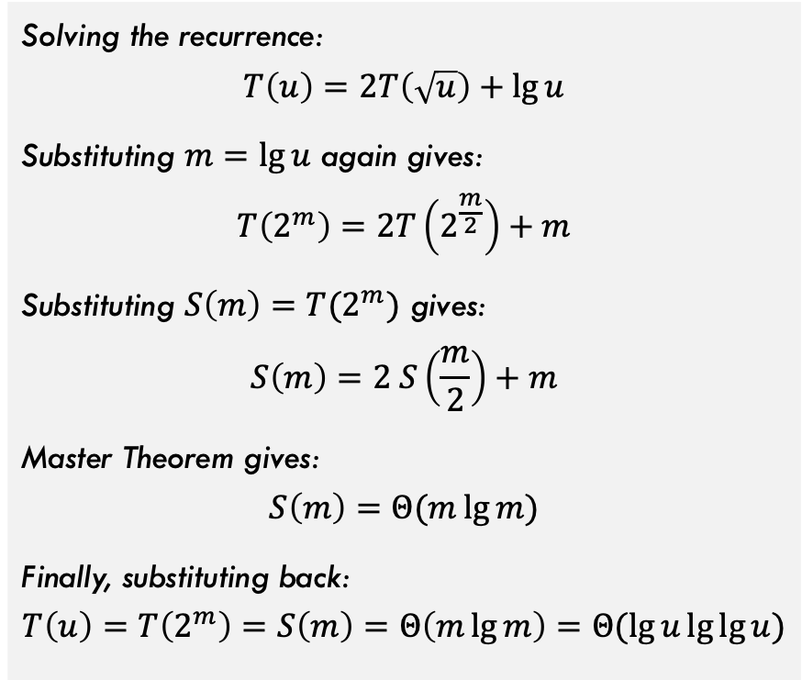

Operations On Proto-vEB Structure
Successor (Predecessor is similar / analogous)
Solving the recurrence:
$$T\left(u\right)=2T\left(\sqrt{u}\right)+\lg{u}$$
Substituting $m=\lg{u}$ again gives: $$T\left(2^{m}\right)=2T\left(2^{\frac{m}{2}}\right)+m$$
Substituting $S\left(m\right)=T(2^{m})$ gives: $$S\left(m\right)=2 S\left(\frac{m}{2}\right)+m$$
Master Theorem gives: $$S\left(m\right)=Θ(m\lg{m})$$
Finally, substituting back: $$T\left(u\right)=T\left(2^{m}\right)=S\left(m\right)=Θ\left(m\lg{m}\right)=Θ(\lg{u\lg{\lg{u}})}$$
Call to Minimum() is $Θ(\lg{u)}$ time So recurrence is $$T\left(u\right)=2T\left(\sqrt{u}\right)+Θ(\lg{\sqrt{u})}=2T\left(\sqrt{u}\right)+Θ(\lg{u)}$$
Again, slower than the $Θ(\lg{\lg{u)}}$ target, will fix later!

Slide 33
Proto-vEB Structure
This Proto-vEB Tree stores the set {2, 3, 4, 5, 7, 14, 15}
Example Runs:
Successor(2)
Successor(7)

Slide 34
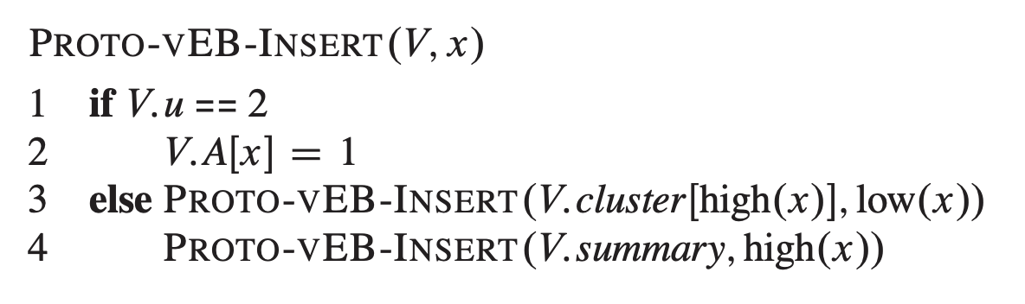


Operations On Proto-vEB Structure
Inserting an element
Two recursive calls (one on the summary and one on the cluster). Recurrence is $T\left(u\right)=2T\left(\sqrt{u}\right)+O(1)$
Same recurrence as Minimum function, so $Θ(\lg{u)}$ time

Slide 35

Operations On Proto-vEB Structure
Delete
Left as an exercise, but some issues mentioned here:
Cannot just set summary bit to 0
Need to quickly check if ALL bits in that cluster have become 0 (how to do this)?
Should be able to get this to same runtime as insert: $Θ(\lg{u)}$

Slide 36

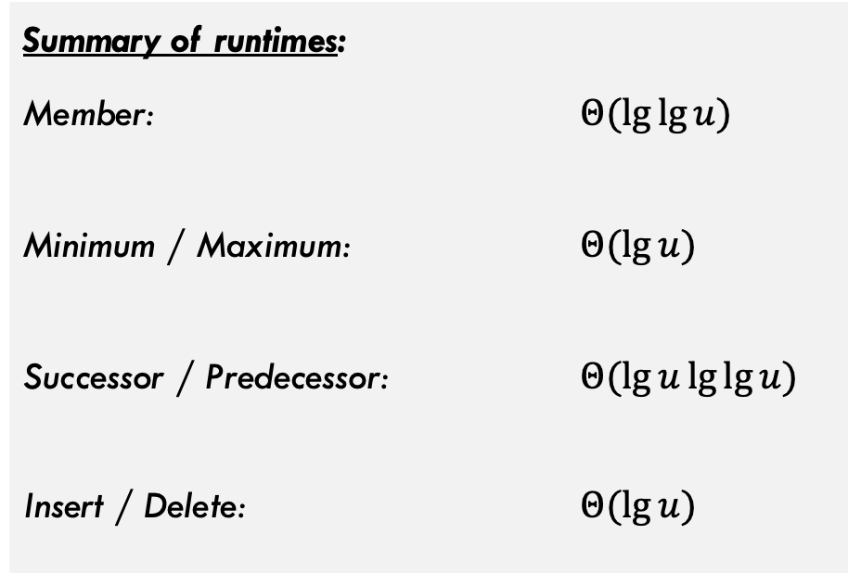
Operations On Proto-vEB Structure
Summary of runtimes:
Member: $Θ(\lg{\lg{u)}}$
Minimum / Maximum: $Θ(\lg{u)}$
Successor / Predecessor: $Θ(\lg{u\lg{\lg{u)}}}$
Insert / Delete: $Θ(\lg{u)}$
Only Member() hits the $Θ(\lg{\lg{u)}}$ target!

Slide 37
Van Emde Boas Trees

Slide 38
Van Emde Boas Trees
How to get our runtimes to lg lg u time?
Need to figure out how to remove some of the recursive calls from our implementation.
Idea: Store some extra info in each node that will reduce number of necessary recursive calls!

Slide 39
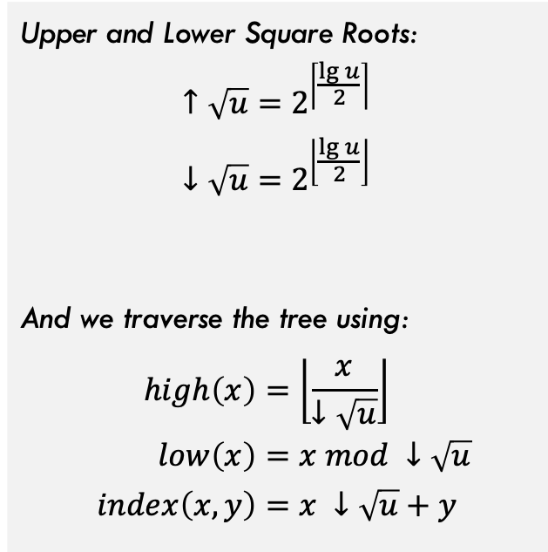



Quick Aside on Universe Size
Earlier we said $u=2^{2^{k}}$ for some $k≥1$. We can relax this condition to allow for odd powers of 2 (e.g., $2^{3}$)
These equations split odd powers of two into uneven groups. Consider $u=2^{3}=8$
Upper square root of 8 is $2^{\left\lceil \frac{\lg{8}}{2}\right\rceil }=2^{2}=4$ (requires 2 bits to represent) Lower square root of 8 is $2^{\left\lfloor \frac{\lg{8}}{2}\right\rfloor }=2^{1}=2$ (requires 1 bit to represent)
Upper and Lower Square Roots:
$$↑\sqrt{u}=2^{\left\lceil \frac{\lg{u}}{2}\right\rceil } \\ ↓\sqrt{u}=2^{\left\lfloor \frac{\lg{u}}{2}\right\rfloor }$$
And we traverse the tree using:
$$high\left(x\right)=\left\lfloor \frac{x}{↓\sqrt{u}}\right\rfloor \\ low\left(x\right)=x mod ↓\sqrt{u} \\ index\left(x,y\right)=x ↓\sqrt{u}+y$$
So, when $u=8$, we get 4 clusters each of size 2!

Slide 40
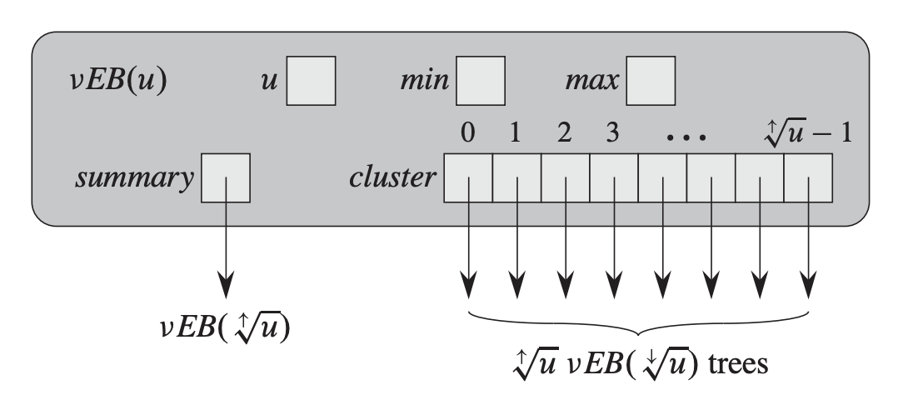
Adding More Data to VEB Trees
Store the minimum element in this entire vEB-Tree. However, this minimum is removed from all sub-trees
Store the max element in this vEB-Tree. This max DOES appear in sub-trees.
These updates will help in the following ways:
The Minimum and Maximum operations do not need to recurse…are computed in constant time.
The successor operation can avoid making a recursive call to determine whether the successor lies within high(x) because successor is in same cluster if x < max
Can easily tell if vEB tree has 0, 1, or more than 1 elements by checking min and max values. This will help speed up insert / delete.
When vEB tree is empty, we can insert by simply changing min and max values. Similar for delete when vEB tree has exactly 1 value.

Slide 41
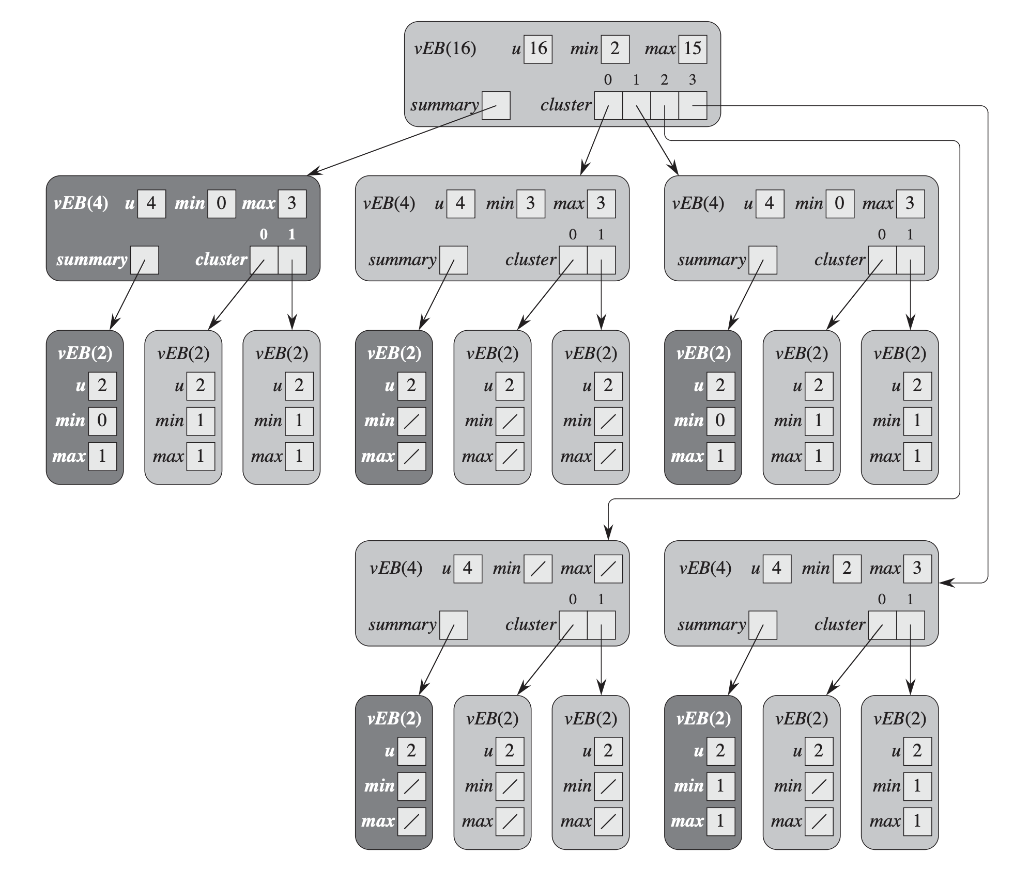
Example VEB-Tree
This vEB Tree stores the set {2, 3, 4, 5, 7, 14, 15}
See pg. 549 of CLRS for recurrence proof. Almost exactly same as the one we did earlier.

Slide 42
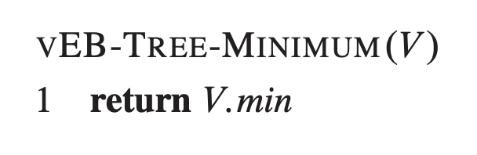
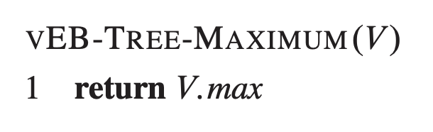
VEB-Tree Operations: Minimum/Maximum
Minimum / Maximum:

Slide 43
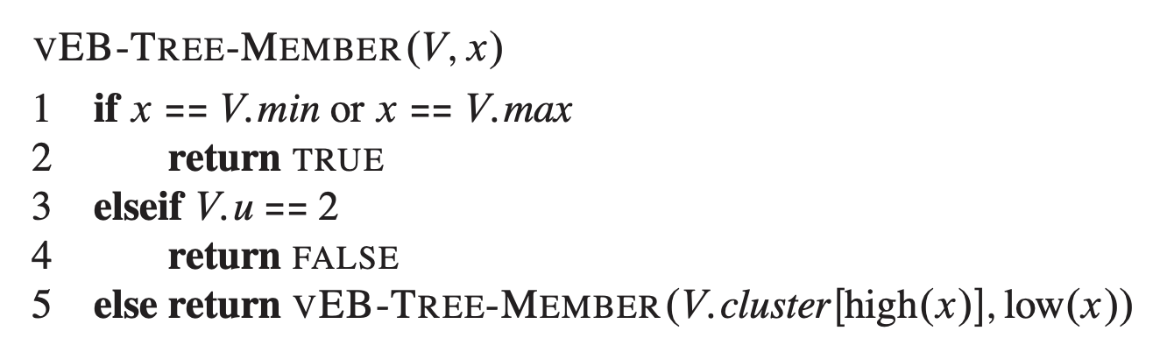
VEB-Tree Operations: Member / Search
Member(V, x)
Note that if the element we are looking for will be the min or max at some point if it is present

Slide 44
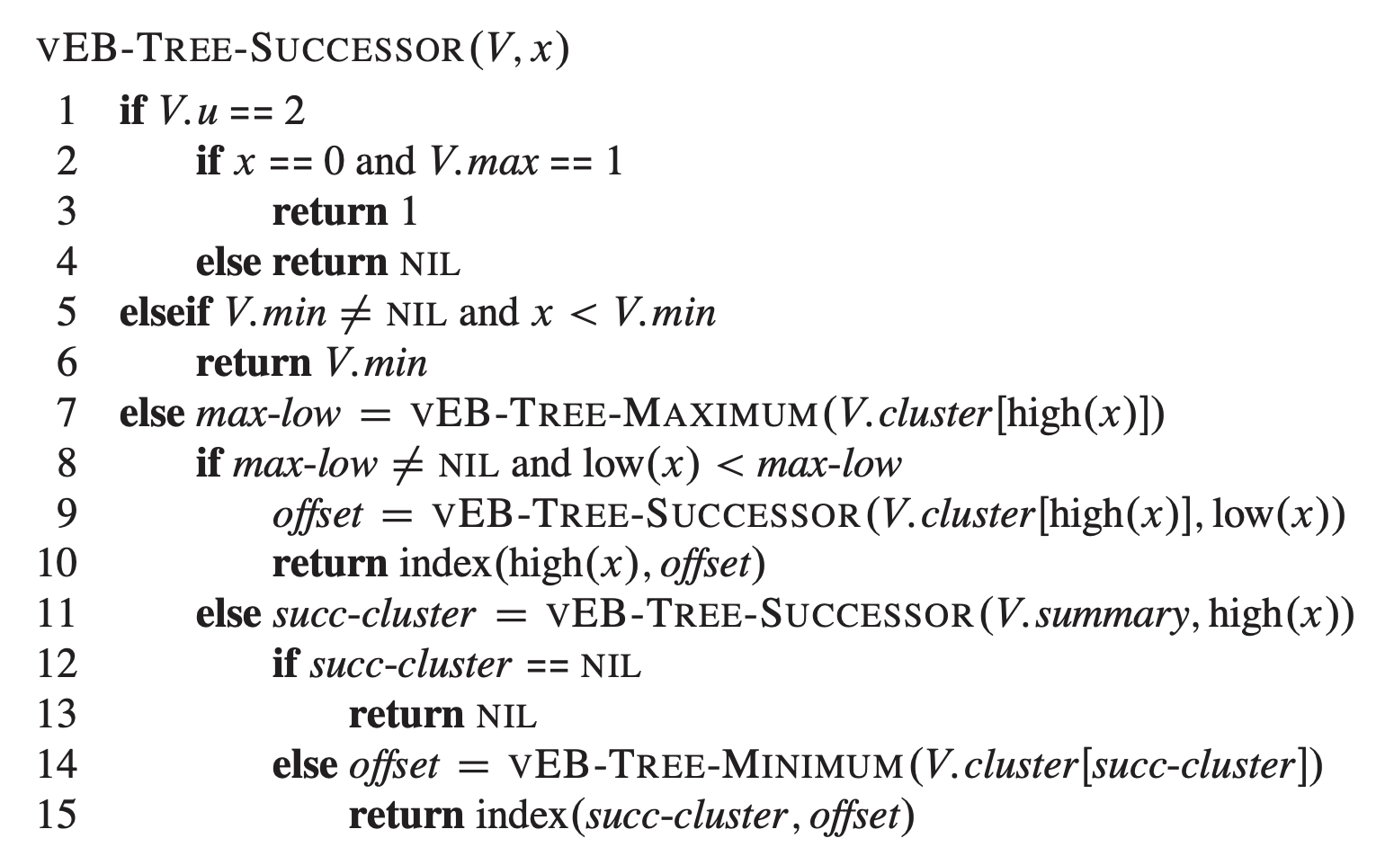
VEB-Tree Operations: Successor
Successor(V, x)

Slide 45
VEB-Tree Operations: Successor
Example: Successor(V, 5)
Successor(this, 5) high(5) = 1 low(5) = 1
max-low=3
Recall that this tree stores: {2, 3, 4, 5, 7, 14, 15}

Slide 46
VEB-Tree Operations: Successor
Example: Successor(V, 5)
Successor(this, 1) high(1) = 0 low(1) = 1
max-low=1
succ-cluster=1
Recall that this tree stores: {2, 3, 4, 5, 7, 14, 15}

Slide 47
VEB-Tree Operations: Successor
Example: Successor(V, 5)
Successor(this, 0)
return 1
Recall that this tree stores: {2, 3, 4, 5, 7, 14, 15}

Slide 48
VEB-Tree Operations: Successor
Example: Successor(V, 5)
Successor(this, 1) high(1) = 0 low(1) = 1
min will return 1 succ-cluster is 1
index(succ-cluster, offset) = index(1,1) = 1*2 + 1 = 3
Recall that this tree stores: {2, 3, 4, 5, 7, 14, 15}

Slide 49
VEB-Tree Operations: Successor
Example: Successor(V, 5)
Successor(this, 5) high(5) = 1 low(5) = 1
offset = 3 (from prev. slide) index(1,3) = 1*4 + 3 = 7
Recall that this tree stores: {2, 3, 4, 5, 7, 14, 15}

Slide 50
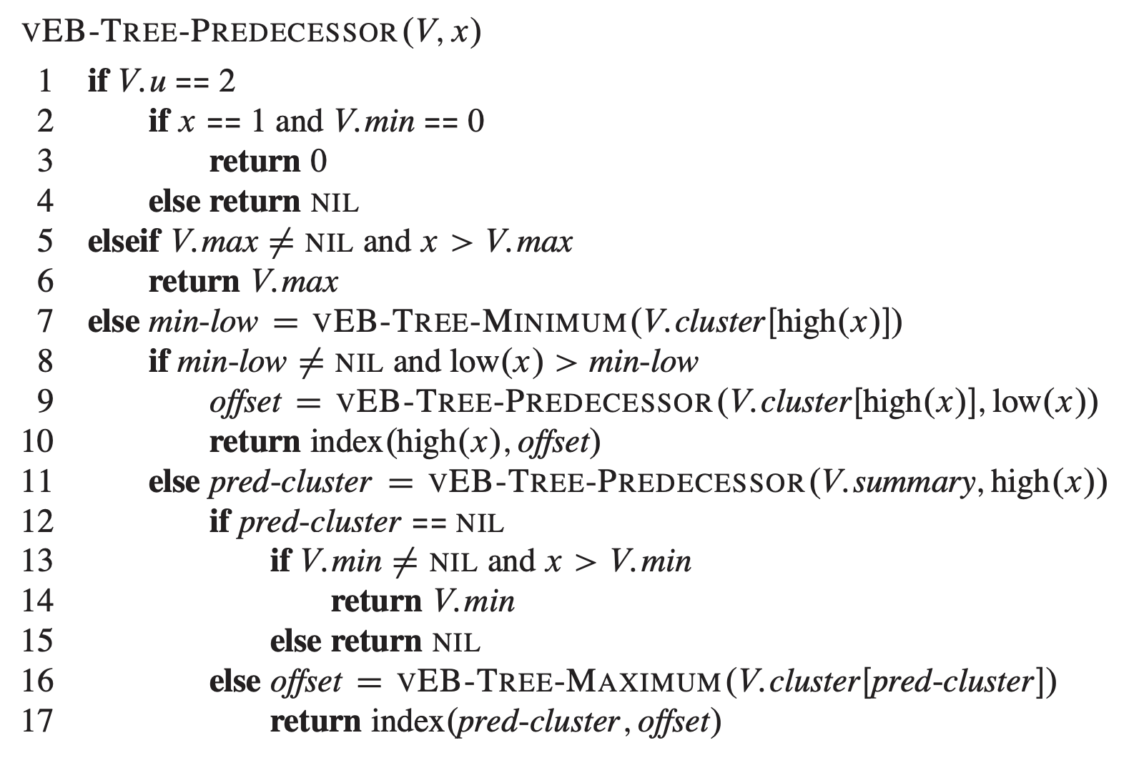
VEB-Tree Operations: Predecessor
Predecessor(V, x)

Slide 51
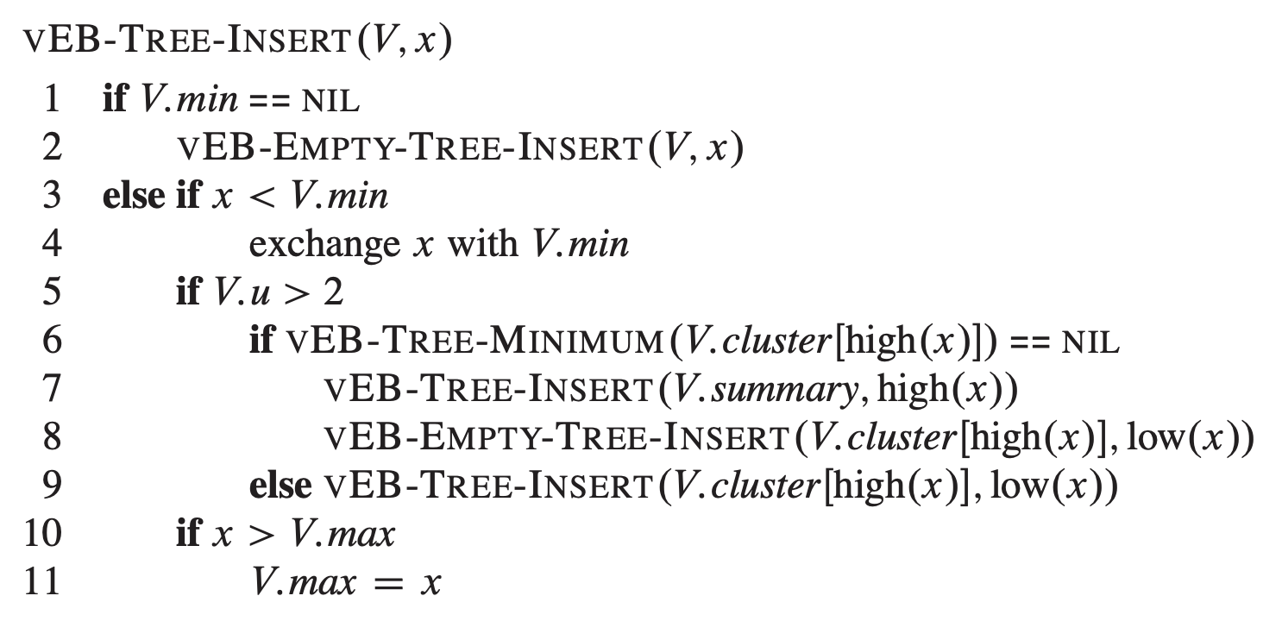
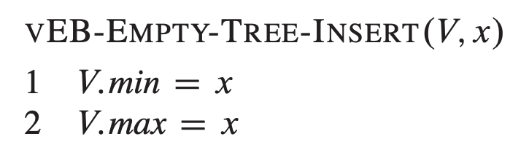
VEB-Tree Operations: Insert
Insert(V, x)

Slide 52
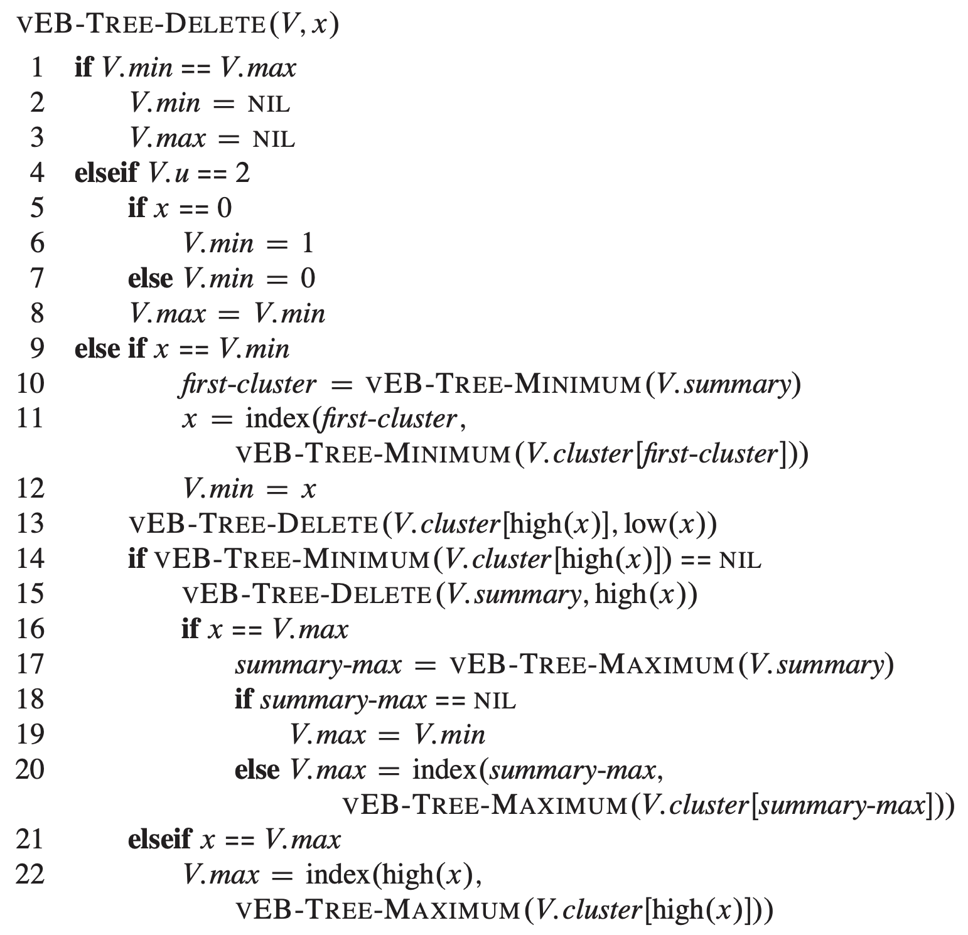
VEB-Tree Operations: Delete
Delete(V, x)

Slide 53
Conclusion

Slide 54
Conclusions
Van Emde Boas Tree:
Are very fast, and a function of the universe (u) size
Takes advantage of the binary representations of integers to improve runtime
Is NOT generalizable to sets of any objects / things

