Slide 1
DFA Minimization: Hopcroft’s Algorithm
Advanced Algorithms Kai dove, Peter Tessier, Kenneth Nguyen Wikipedia and some youtube videos

Slide 2
DFA Minimization
In this deck we will look at: - Intro: Problem/Motivation/Application - Naïve Approach - Hopcroft’s Algorithm Overview and Definitions - Time Complexity - Conclusion

Slide 3
Introduction: DFA Minimization

Slide 4
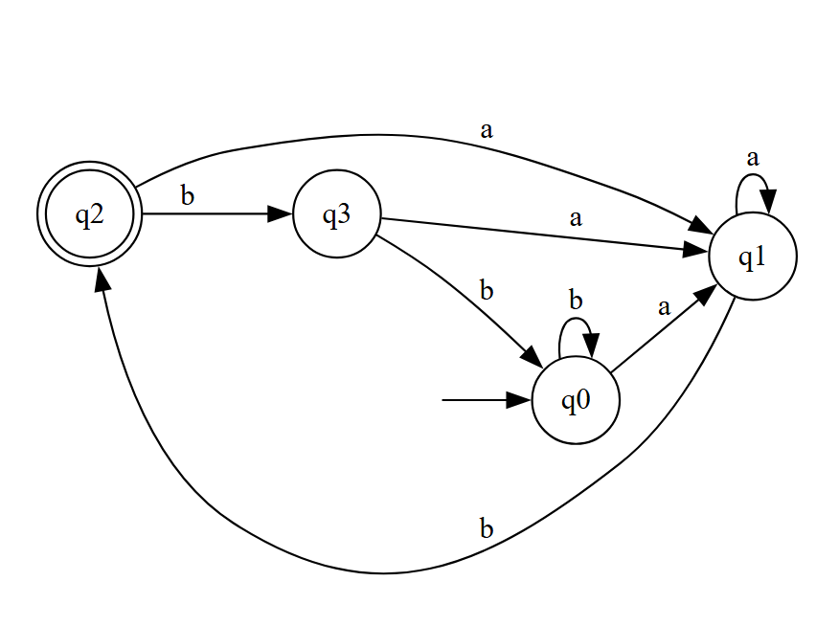
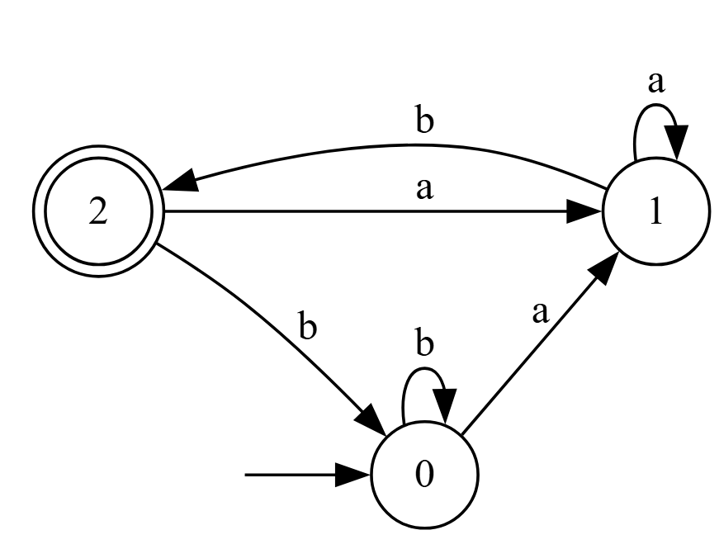
Problem: DFA Minimization
Given any DFA M = (Q, Σ, δ, q0, F), can we find a minimal DFA M_{min} = (Q_{min}, Σ, δ_{min,} q0_{min}, F_{min}) that recognizes the same language and can run in non-quadratic time?
I.e., L(M_{min}) = L(M), and if any other M’ = (Q’, Σ, δ’, q0’, F’) satisfies L(M’) = L(M_{min}), then we have |Q_{min}| ≤ |Q’|.
Bloated DFA (4 states)
Minimized DFA (3 states)
DFAs can quickly become bloated with redundant states and tangled edges
Indistinguishable states have been merged

Slide 5
First, Some quick Definitions
Indistinguishable
Two states, p and q, are indistinguishable if, for every word w∈ Σ*, the DFA either accepts both from p and q or rejects both. Thus, they can be merged.
Inaccessible
A state, q, is inaccessible if the DFA is never in the state for any word w∈ Σ* that is fed into it.
s
the size of the input alphabet Σ
n
The number of states in the DFA.
q2, ε → ✅ q3, ε → ❌ ⇒ q2 ≁ q3
q0, b → ❌ q1, b → ✅ ⇒ q0 ≁ q1
q0, a → q1 q3, a → q1
q0, b → q0 q3, b → q0
Any word starts with a or b ⇒ q0 ~ q3

Slide 6
Naïve Approach
Why is this Naïve?
Checks all pairs, even inaccessible states
Repeated checks for transitions
Brute-forces the workload
Worst case: O(n²s) time
Create a table of every pair of states
 | q0 | q1 | q2 | q3
q1 | x
q2 | x | x
q3 |  | x | x
For every state, check transition behavior and mark if distinguishable
If a transition goes to distinguishable states, also mark them
Loop until no new cells are marked, unmarked cells are merged

Slide 7
Motivation: DFA Minimization So Far
 | Moore’s Algorithm (Naïve approach) | Brzozowski’s Algorithm
Description | Exhaustively check all state pairs for distinguishability | Reverse the DFA twice and determinize it each time
Time Complexity | O(n²s) | O(2^{n}) (determinization step)
GOAL: Minimize the given DFA in a time complexity of O(n s log n)

Slide 8
Hopcroft’s Algorithm

Slide 9
DFA Minimization Algorithm Overview
Overall Approach:
Start with two blocks: accepting vs. non-accepting states
Use a queue, W, to track which blocks might cause further splits
Repeatedly split blocks based on which states transition into others on each symbol
Only split when necessary: skip blocks that behave the same
Always pick the smaller splitter to keep the algorithm fast
Stop when no more splits can be made
Final blocks = groups of equivalent (indistinguishable) states. Each block is a state in the minimized DFA
Define M_{min} = (Q_{min}, Σ, δ_{min,} q0_{min}, F_{min}) in terms of these blocks
Hopcroft's Algorithm used here

Slide 10
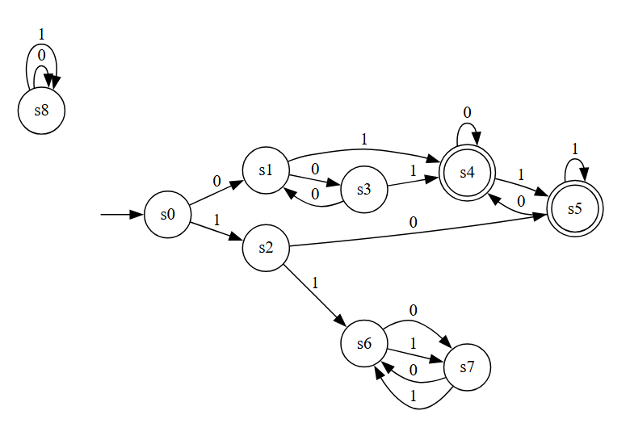
Hopcroft’s Algorithm Example
1. Create a list of the current partitions, P, using the remaining accepting and non-accepting states
s0 | s1 | s2 | s3 | s6 | s7 | s4 | s5

Slide 11
Hopcroft’s Algorithm Example
1. Create a list of the current partitions, P, using the remaining accepting and non-accepting states
P
s0 | s1 | s2 | s3 | s6 | s7 | s4 | s5
2. Create the queue of splitters, W
W
s4 | s5

Slide 12
Hopcroft’s Algorithm Example
1. Create a list of the current partitions, P, using the remaining accepting and non-accepting states
P
s0 | s1 | s2 | s3 | s6 | s7 | s4 | s5
2. Create the queue of splitters, W
W
s4 | s5
3. Split blocks further based on the transitions into the splitters given the inputs (0,1).

Slide 13
Hopcroft’s Algorithm Example
4. Split blocks further based on the transitions into the splitters given the inputs (0,1).
P
s0 | s1 | s2 | s3 | s6 | s7 | s4 | s5
W
s4 | s5
 | 0 | 1
s0 | s1 | s2
s1 | s3 | s4
s2 | s5 | s6
s3 | s1 | s4
s4 | s4 | s5
s5 | s4 | s5
s6 | s7 | s7
s7 | s6 | s6
States that transition into the splitter states are marked for the next partitioning

Slide 14
Hopcroft’s Algorithm Example
4/5/6. Split the block accordingly based on the marked states and choose the smallest splitter to use next
P
s0 | s6 | s7 | s2 | s1 | s3 | s4 | s5
W
s2
 | 0 | 1
s0 | s1 | s2
s2 | s5 | s6
s6 | s7 | s7
s7 | s6 | s6

Slide 15
Hopcroft’s Algorithm Example
4/5/6. Split the block accordingly based on the marked states
and choose the smallest splitter to use next
P
s6 | s7 | s0 | s2 | s1 | s3 | s4 | s5
W
s0
 | 0 | 1
s0 | s1 | s2
s6 | s7 | s7
s7 | s6 | s6
7. No states enter s0 on either of the inputs of 0 or 1, the algorithm can no longer partition any blocks

Slide 16
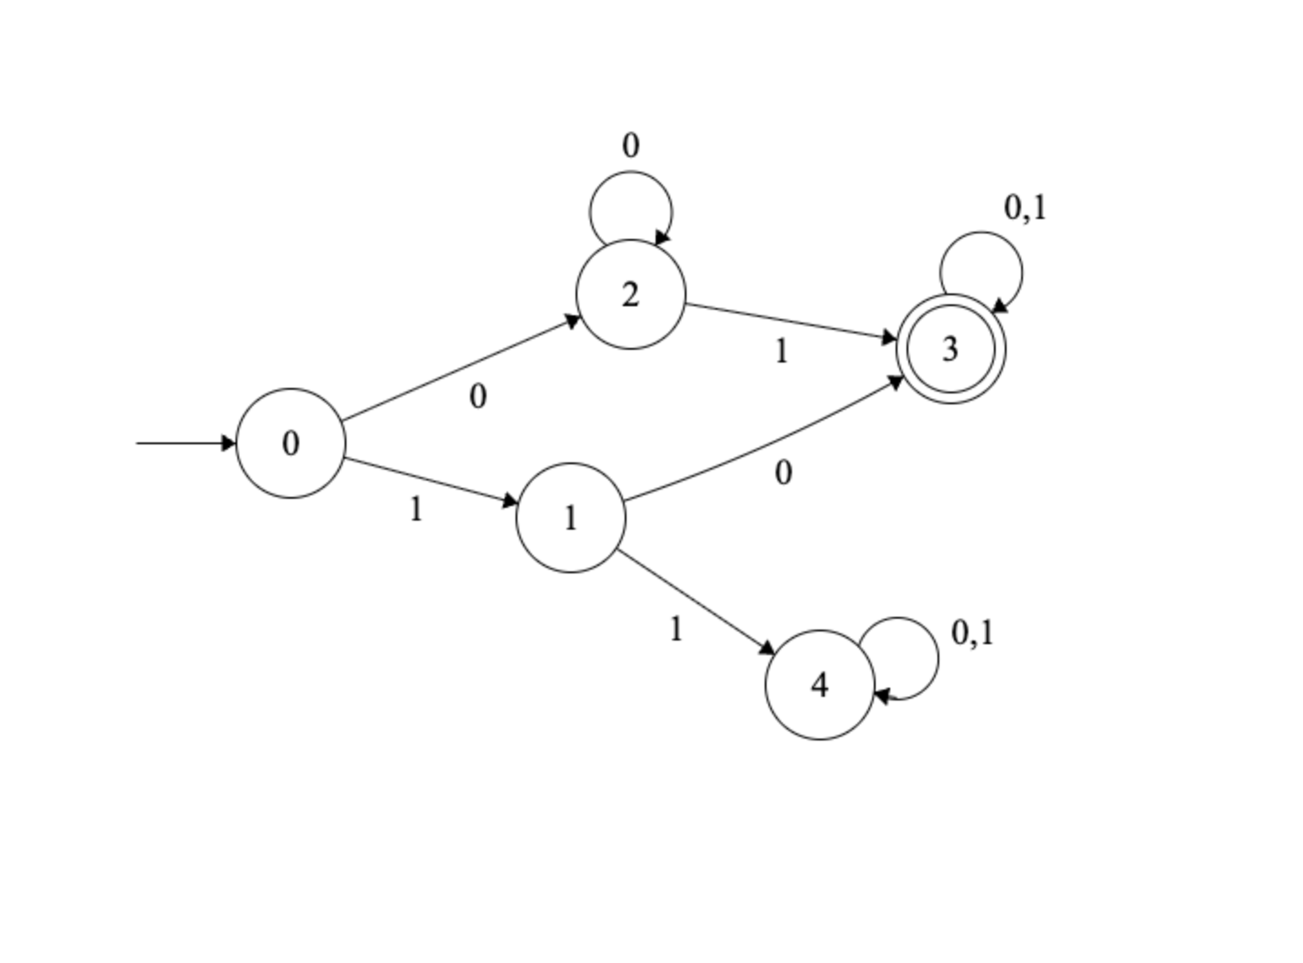
Hopcroft’s Algorithm Example
8. Each block can now be represented as it’s own state in the minimized DFA
P
s6 | s7 | s0 | s2 | s1 | s3 | s4 | s5
Original | Minimized
s0 | 0
s2 | 1
s1,s3 | 2
s4,s5 | 3
s6,s7 | 4
L = Strings with both 0 and 1 that do not start with a 11

Slide 17
Using Hopcroft's Blocks
Define M_{min} = (Q_{min}, Σ, δ_{min,} q0_{min}, F_{min}) in terms of these blocks​
0,1
0
Q_{min} = exactly those blocks
δ_{min}([q], a) = [δ(q,a)]
q0_{min} = [q0]
F_{min} = {[q] for q in Q}
δ_{min}({1,3}, 0) = [δ(1,0)]
= [δ(3,0)] = [3] = [1] = {1,3}
1
0,1

Slide 18
Hopcroft’s Algorithm Time Complexity and Pseudocode
Time Complexity:
Hopcroft’s algorithm works by refining “blocks” of states with transition-focused “splitters”
It only processes transitions when they cause a new split and since we’re only using the smaller split half, no state is checked more than log n times.
Each DFA has n states and s symbols in the alphabet, so there are n × s transitions. Since each transition is only affected by at most log n splits, total time is O(n s log n). Much faster than either Moore’s or Brzozowski’s.
P := {F, Q \ F}
W := {F, Q \ F}
while (W is not empty) do
choose and remove a set A from W
for each c in Σ do
let X be the set of states for which a transition on c leads to a state in A
for each set Y in P for which X ∩ Y is nonempty and Y \ X is nonempty do
replace Y in P by the two sets X ∩ Y and Y \ X
if Y is in W
replace Y in W by the same two sets
else
if |X ∩ Y| <= |Y \ X|
add X ∩ Y to W
else
add Y \ X to W

