Slide 1
Voronoi Diagrams
Tommy Le, Andy Phan, Prabhath Tangella, Alexander Yao

Slide 2
Computational Geometry
In this deck we will look at:
Voronoi Diagrams
Fortune’s Construction

Slide 3
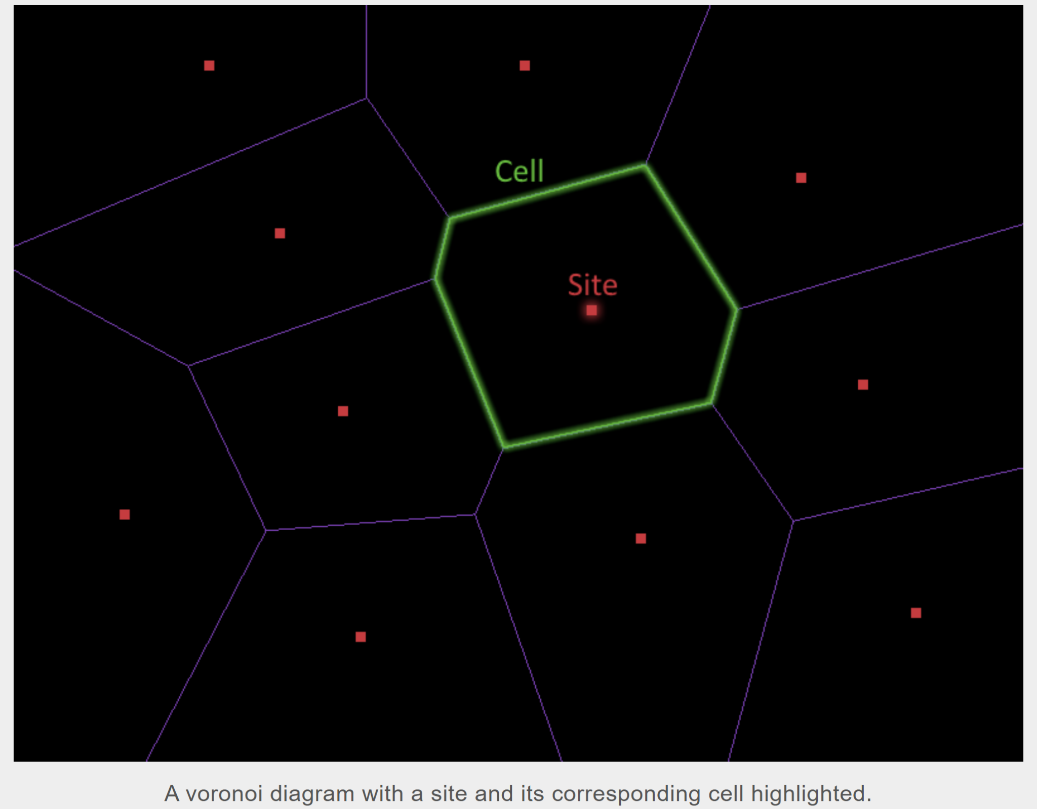
Voronoi Diagram
A Voronoi diagram partitions the plane into regions around a set of points (called sites), where each region contains all locations closer to one site than to any other.

Slide 4
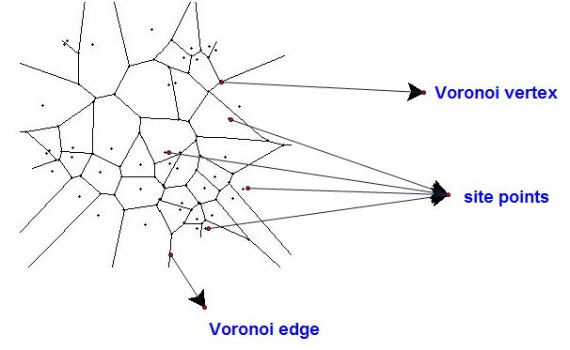
Key Concepts & Terminology
Site:
A fixed point in the plane that acts as the “center” of a region in a Voronoi diagram.
Voronoi…
Cell: The region of all points closest to a given site.
Edge: A line segment or ray forming the boundary between two cells; consists of points equidistant to two sites.
Vertex: A point where three or more edges meet; equidistant to three (or more) sites.

Slide 5
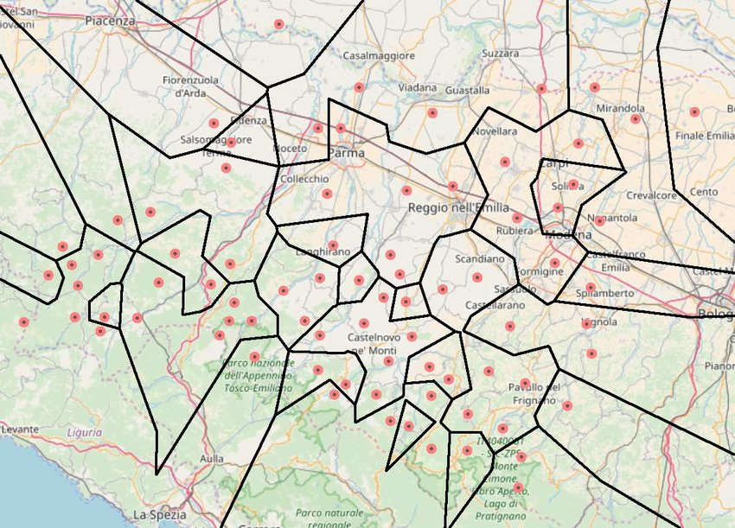
Motivation
A Voronoi diagram helps us answer one of the most fundamental questions in spatial analysis: “Which point is closest?”
Real-life example:
Notes:
Real-life example of a Voronoi diagram is finding the closest service, like a post office, to a given location. Imagine a city with multiple post office locations. A Voronoi diagram would divide the city into regions, where each region is closer to a specific post office than any other. If you live within a particular region, that region's associated post office would be the closest to you

Slide 6
Examples In Nature

Slide 7
Any initial ideas on how to construct a Voronoi diagram?

Slide 8
Naive Approach
For each point in the plane, determine the closest site (brute force)
Assign that point to the site’s region
Time Complexity: O(n²) or worse (especially if working pixel by pixel or grid-based)

Slide 9
Improved Approach
Divide-and-conquer algorithm
Break the plane down into smaller regions and create the Voronoi diagrams for those regions
Time Complexity: O(n log n) but…
The merge step for these algorithms is complicated and involves tracing Voronoi edges and stitching cells together

Slide 10
Better Approach: Fortune’s Construction

Slide 11
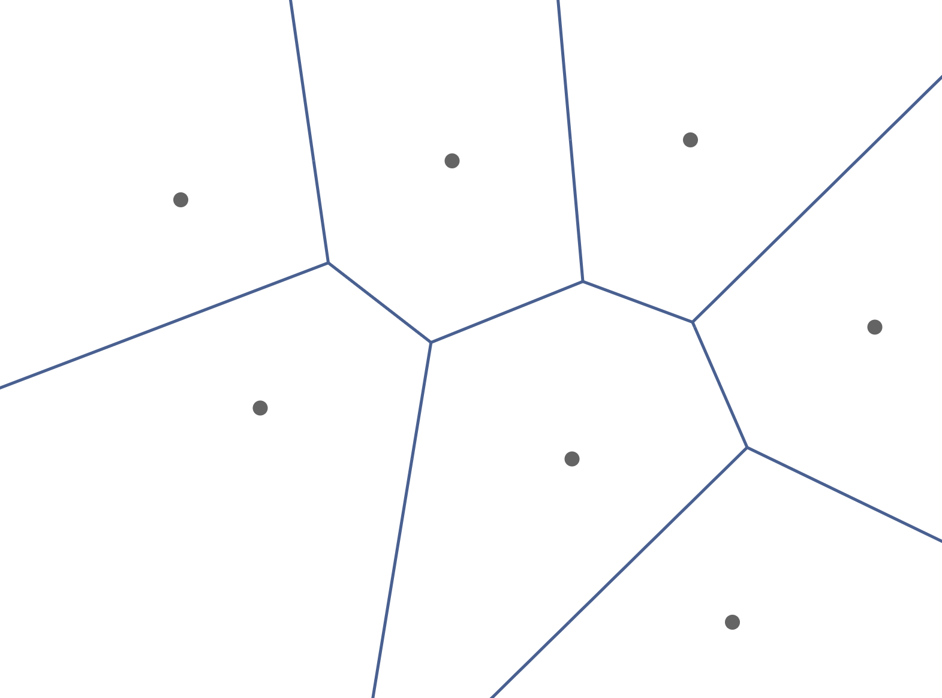
Fortune’s Construction
We would like to use a line-sweep algorithm to process all the points, but there are limitations…
Sweep Line
B
A
The sweep line processing site B actually creates an edge behind the line

Slide 12
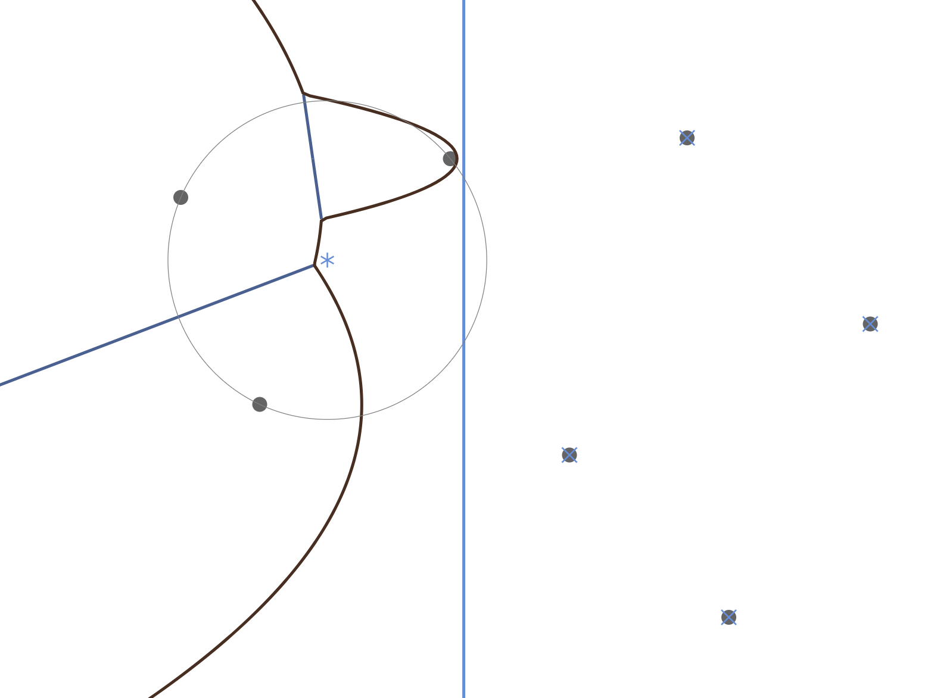
Fortune’s Construction
Solution: add a second line (called the beach line) that keeps track of which parts of the diagram we are certain
Beach Line
Sweep Line
B
A
Any future sites cannot change these edges

Slide 13
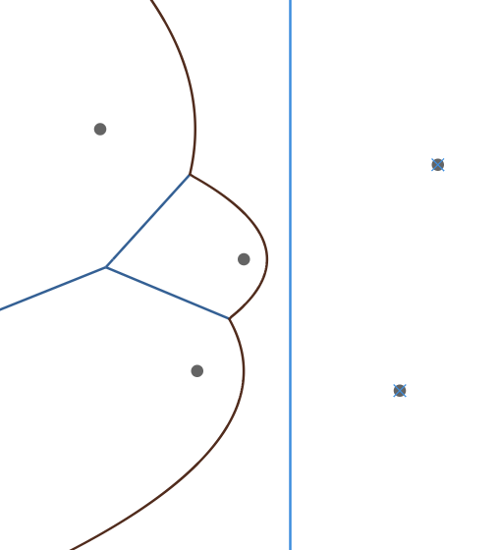
Fortune’s Construction
Construction in O(n log n) time using a sweep line algorithm
As the sweep line passes each site, it inserts a parabolic arc stemming from the site into the beach line
This sweep line could be horizontal or vertical, and we will denote the direction of the sweep line with arrows

Slide 14
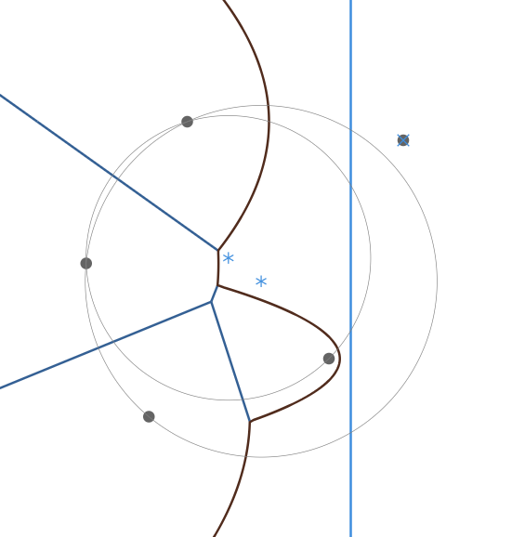
Fortune’s Construction
Fortune’s Construction uses three data structures
Event heap to act as the sweep line (Red)
Beachline tree to store the beachline (Green)
Edge list to store processed edges (Yellow)
Also uses many geometry formulas such as
Projection (of directrix on to parabola)
Circumcenter (of three points)
Parametric intersection (of two edges)

Slide 15
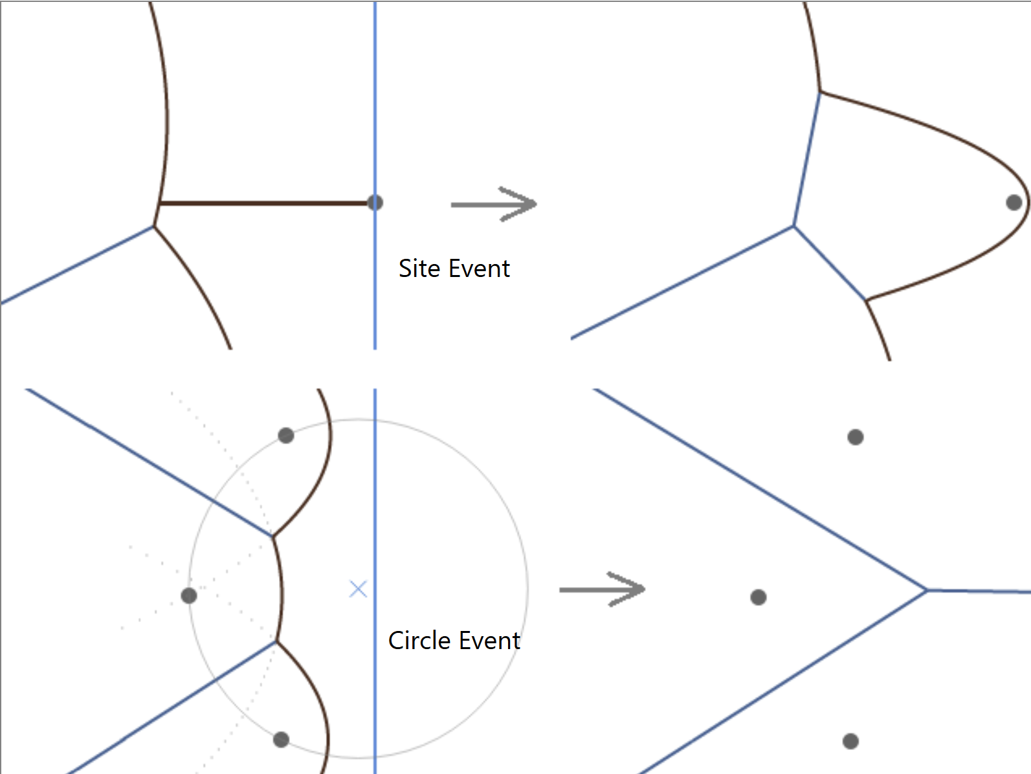
Fortune’s Construction: Event Heap
Fortune’s Construction uses a Event Heap to simulate the sweep line, where the Events are the only points that could affect the diagram
Site Event:
Triggered when the sweep line reaches a new site
Action: Insert an arc into the beach line
Circle Event:
Triggered when three arcs converge in the beach line
Action: Remove arc from beach line and add vertex
All other “events” are ignored

Slide 16
Fortune’s Construction: Events
Site Event
Processed during the initialization phase
Event corresponds to site position, and will never change
Circle Event
Processed dynamically during runtime
Events correspond to when three arcs intersect, but can be changed
A processed site event can cancel a circle event

Slide 17
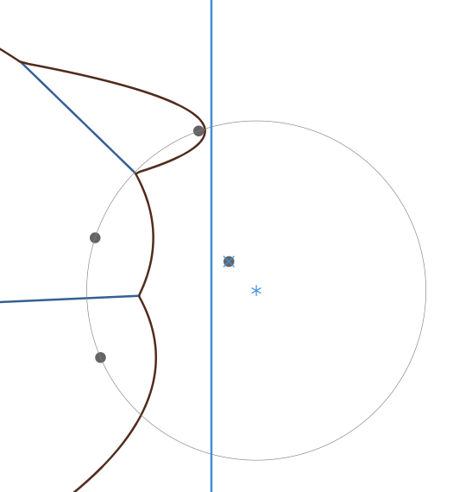
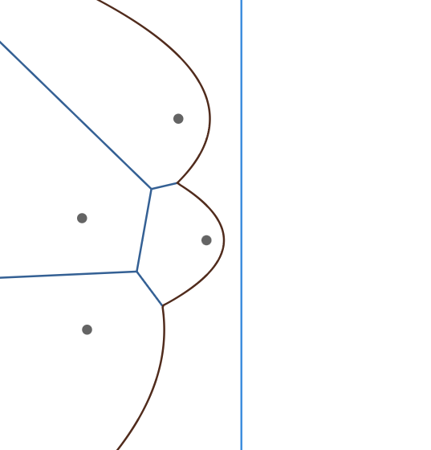
Fortune’s Construction: Events
Any new site within the circle will cancel the circle event
X-value of circle event
We can only process the circle event once the sweep line passes over the entire circle without encountering a circle event

Slide 18
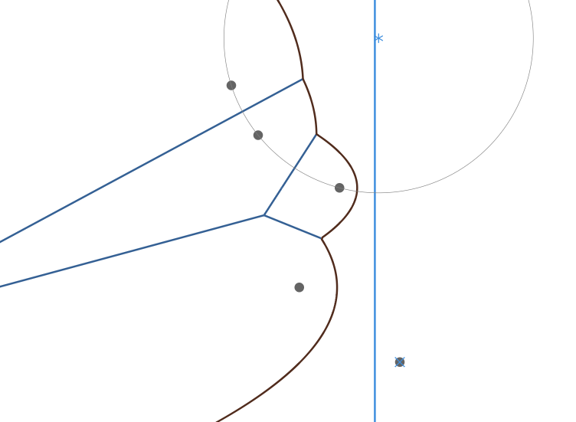
Fortune’s Construction: Beachline Tree
In order to quickly determine where arcs should be inserted or removed, we store the arcs in a binary search tree (which can be optimized with AVL, etc)
Arc Node:
Stores the arc generated by a site on the beach line
Also stores its own circle event
We will denote arc nodes by their sites
Breakpoint Node:
Stores the incomplete edge generated by two arcs intersecting
Also stores the two site events from the two arcs
We will denote breakpoint nodes with brackets
Arc Nodes
Breakpoint Nodes

Slide 19
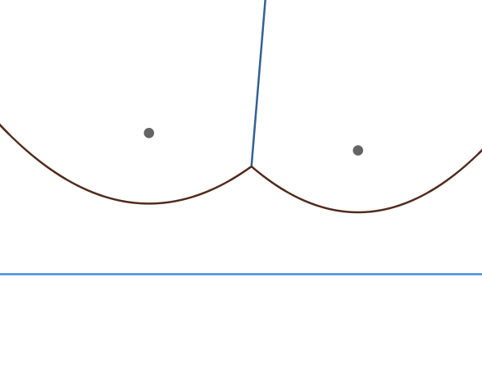
Fortune’s Construction: Beachline Tree
Breakpoint Node [A, B]
[A, B]
A
B
A
B
Arc Node A
Arc Node B
Note that the leaf nodes are the arcs that make up the beachline

Slide 20
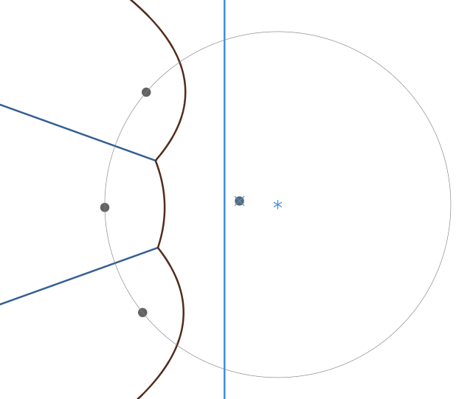
Fortune’s Construction: Beachline Tree
[A, C]
[B, A]
[A, C]
A
B
[B, A]
C
C
B
A
D
This tree can be balanced for better efficiency

Slide 21
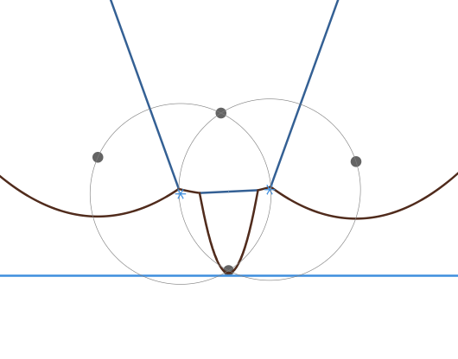
Fortune’s Construction: Beachline Tree Search
When the sweep line passes site D, we need to insert arc node D into the tree
We can project D onto the beachline to figure out which arc it splits
[B, A]
[B, A]
A
[A, C]
A
[A, C]
B
B
C
C
D
D

Slide 22

Geometry: Projection
(x_{f}, y_{f})
During the search, we determine if extending a breakpoint will be to the left or right of the projected point
(x, f(x))
(x, y_{d})

Slide 23
Fortune’s Construction: Beachline Tree Search
We can find the exact arc where a new arc will be inserted by traversing the tree in a binary-search fashion
The extended incomplete edge is to left of the projection so we travel left
[B, A]
[A, C]
A
[A, C]
B
C
[B, A]
C
This time we travel right using the same logic
D
B
A
Correct arc for where D should be inserted

Slide 24
Fortune’s Construction: Beachline Tree Insertion
Once we have found the right arc for the insertion, we can add new breakpoints and modify the tree to insert the new arc, as well as handling newly formed arcs
Before
After
[A, C]
[A, C]
[B, A]
[A, C]
A
[B, A]
C
B
C
[B, A]
C
B
[A, D]
B
A
D
A
[D, A]
D
A

Slide 25
Fortune’s Construction: Beachline Tree Insertion
Before
After
[A, C]
[A, D]
[B, A]
A
[A, C]
[B, A]
C
[B, A]
[D, A]
B
C
[A, D]
B
[A, D]
B
A
D
[A, C]
D
A
[D, A]
A
C
D
A
This step just balances the tree
Notice that [A, D] and [D, A] contain the same incomplete edge

Slide 26
Fortune’s Construction: Beachline Tree Deletion
Similar to insertion, we can remove specific breakpoints and arcs to remove an arc from the beachline tree
Before
After
[A, D]
[A, D]
[B, A]
A
[A, C]
B
[B, A]
[D, A]
[B, A]
[D, C]
[A, D]
C
B
A
D
[A, C]
B
A
D
C
D
A
C
This arc processes its circle event and needs to be removed

Slide 27
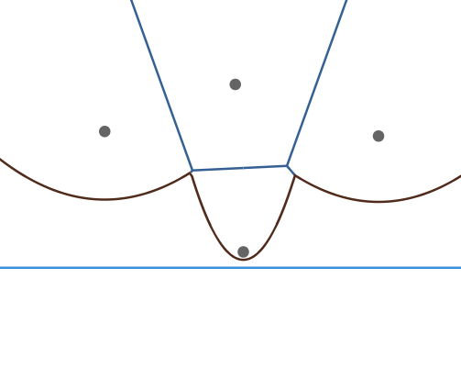
Fortune’s Construction: Beachline Tree Deletion
[B, A]
A
[A, C]
[A, D]
B
C
[A, D]
[D, C]
[B, A]
[D, C]
B
A
D
C

Slide 28
Fortune’s Construction: Edge Set
This half-edge has reached a circle event, so we can compute its endpoint
Notice that the edges contained within the breakpoint nodes are incomplete edges, or half-edges
These half-edges only contain their startpoint, but eventually we process their endpoint and complete the edge
The half-edges are contained within an Edge Set, and are used to compute circle events using their intersection
This half-edge is still being computed

Slide 29
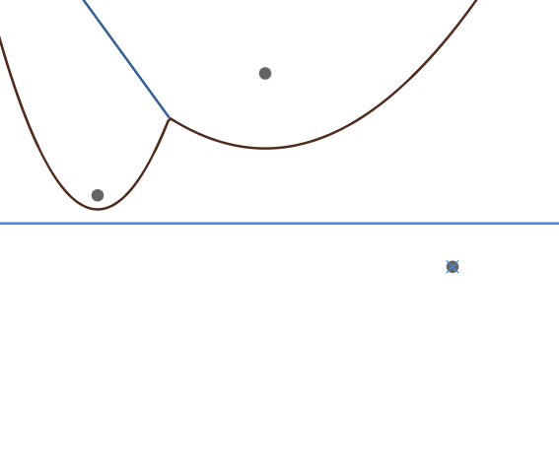
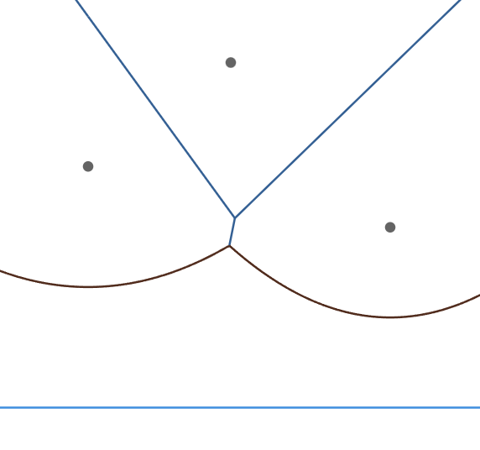
Fortune’s Construction: Edge Set
Site Event
Compute the half-edge formed between the newly inserted arc and neighboring arcs
Circle Event
Create a new half-edge that starts where the two half-edges intersect, and complete the two half-edges

Slide 30
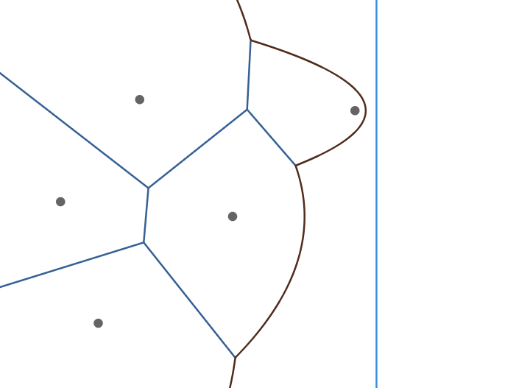
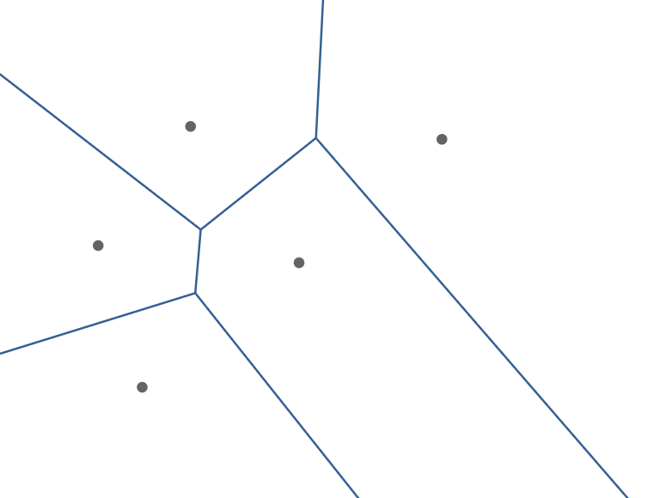
Fortune’s Construction: Postprocessing
During the postprocessing step, we have to clean up all the remaining half-edges and extend them to intersect with the boundary polygon
We can keep track which edges belong to which site to find the polygons faster

Slide 31
Fortune’s Construction: Overall Algorithm
# Initialization
initialize data structures
add site events to Event Heap
# Algorithm
while Event Heap is not empty:
pop event off Event Heap
if event is a site event:
add arc node to Beachline Tree
add half-edges to Edge Set
cancel any relevant circle events
check for circle events with neighboring arcs in tree and add to Event Heap
else:
remove arc node from Beachline Tree
complete half-edges in Edge Set
check for circle events with neighboring arcs in tree and add to Event Heap
# Postprocessing
for each half-edge in Edge Set, determine if half-edge is complete or needs to be extended
construct polygons out of the half edges
Note that a LOT of geometric formulas used for the calculations have been excluded here

Slide 32
Credits: Jeroen van Hoof

Slide 33
Demo
https://www.cs.tufts.edu/comp/163/demos/fortune/

