Slide 1
Mo’s Algorithm
Sebastian Condyles, Josh Huddleston, Keshav Tarafdar
Cole Frankenhoff
Material from:
https://cp-algorithms.com/data_structures/sqrt_decomposition.html#mos-algorithm

Slide 2
Motivation
Goal: Given an array of elements A and a list of queries for some function (ex. Sum, mode, mean, etc.), how can we answer them efficiently?
Support the following operations:
1. Calculate (for any l,r) the value of f(l,r)=f(a_l,…,a_r) for each query in a list of queries Q
2. Use no more than O(n) memory (so no more than list A itself)
**Note: This will work for any function f(), but sum(l, r) is a common first one to start with

Slide 3
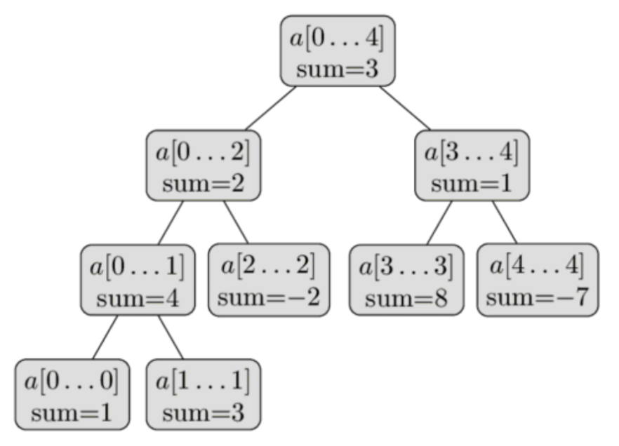
Range Queries
Segment Trees - stores function answers for whole ranges.
This prevents having to recurse down to leaf nodes if whole range of a node is contained in a query, which makes query runtime O(logn).

Slide 4
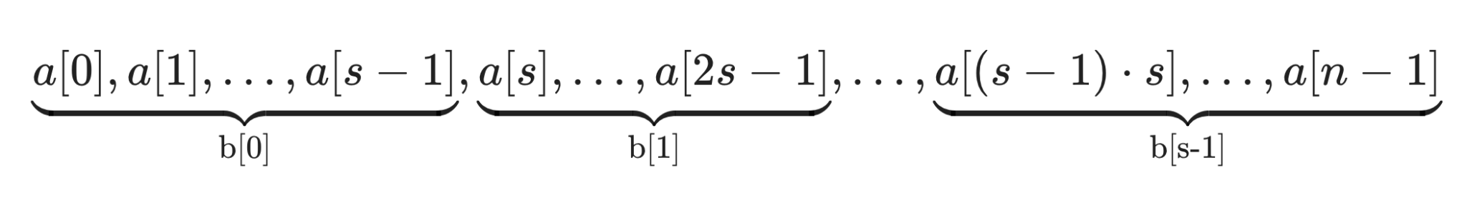
Sqrt Decomposition
Input: A function f(l, r) that operates on a range of elements, a merge operator and a list of elements with size n. Let s = sqrt(n)
Create a list L of size sqrt(n), where every element l[k] stores the range query in the sqrt(n)-sized block. Formally, L[k] = f(k*s, (k + 1) * s).
To compute f(L, r), manually compute the value of f(L, start of right block), f(start of right block, r), and the values of every block in between
Formally: f(l, l + s - l % s) + sum(l[(l + s) % s]...l[k) + f(r - r % s, r)

Slide 5
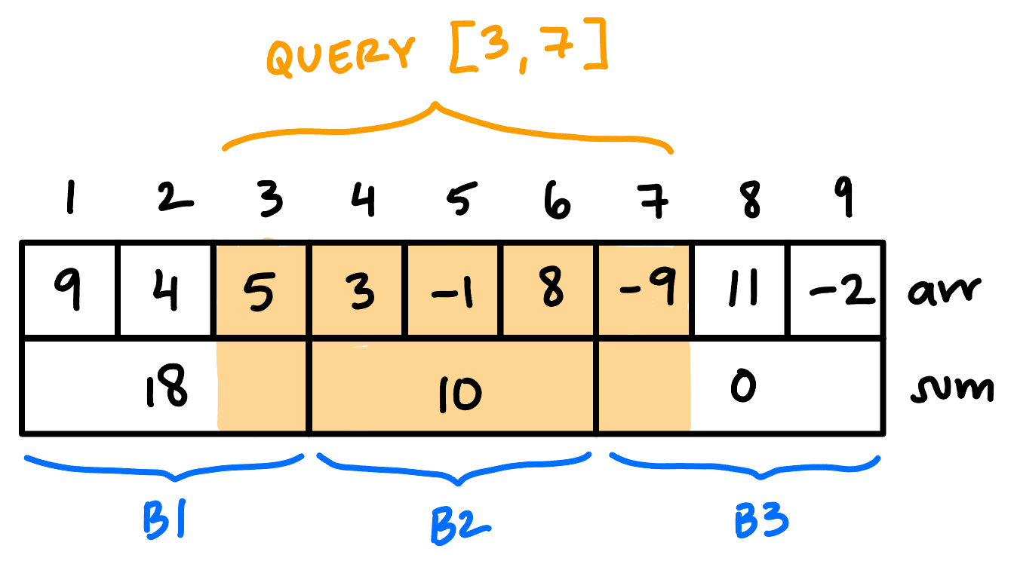
Sqrt Decomposition
Runtime complexity: O(n) to precompute values, O(q * sqrt(n)) to execute q queries
Update time is O(1) for most functions
Outperforms segment trees in cases when there are far more updates than queries, small input size, and cases where space is a large concern
Multiple queries end up with precomputed windows
What if there was a way to optimize these away?
Repeated queries?

Slide 6
Mo’s Algorithm Intuition
See example with n=9
And keys beside
Block size, sqrt(9) = 3
Query input (l,r) order :
0 4 → (0, 4)
1 3 → (0, 3)
6, 8 → (2, 8)
4 8 → (1, 8)
3 5 → (1, 5)
Sorted queries:
1, 3
0, 4
3, 5
4, 8
6, 8
Instead of precomputing query answers in a data structure (segment tree), we now answer many queries in a row, sorted to minimize redundant computations
Keeps sqrt decomposition idea of blocks without storing answers for b[k] ahead
Key idea: For each query (l, r), calculate key ( l // sqrt(n), r ) i.e. sort first by the block of the left index, then by the right index, both ascending

Slide 7

Mo’s Data Structure
Mo’s algorithm relies on a custom range data structure, which reflects the value of function f over the range [cur_left, cur_right]. It must support three operations, in constant time:
-Remove element: remove the value at an index, and update the value of the data structure appropriately. Either decrease cur_right or increase cur_left
-Add element: add a new element, and update the data structure. Either increases cur_right or decreases cur_left -Compute value of range: get the value of f(cur_left, cur_right)

Slide 8
Pseudocode 1:Setup
Input:
- L: list of n elements
- Q: list of queries (left, right, index)
//Intuition–Divide L into blocks of size sqrt(n), and sort Q based on the leftmost query blocks with right query as a tiebreaker.
Let block_size = sqrt(n)
Sort Q using the following comparator:
If two qs are in Divide L into blocks, and sort Q based on the block indexes of ea
Notes:
INSERT SOME GRAPHIC

Slide 9
Pseudocode 2: Algorithm
1. Sort Q by (left, then right)
2. Initialize:
- moe = Moe(L)
- cur_left = 0, cur_right = -1
- answers = [ ] of size len(Q)
3. For each query q in Q:
- Shrink right: while cur_right > q.right → remove & cur_right--
- Expand right: while cur_right < q.right → cur_right++ & add
- Shrink left: while cur_left < q.left → remove & cur_left++
- Expand left: while cur_left > q.left → cur_left-- & add
- Store answer at q.index
4. Return answers

Slide 10
Ex. Count Distinct Elements
3 | 1 | 1 | 2 | 3 | 4 | 2 | 1
0 1 2 3 4 5 6 7
Block size = ⌈√8⌉ = 3
Queries: (0,3) (2,7) (1,5)
Block of left index: 0 0 0
Sorted queries → (0,3) (1,5) (2,7)
First step:
curL | curR | Subarray | Freq. | Distinct Count
0 | -1 | [ ] | { } | 0

Slide 11
Ex. Count Distinct Elements
3 | 1 | 1 | 2 | 3 | 4 | 2 | 1
0 1 2 3 4 5 6 7
Queries: (0,3) (2,7) (1,5) → (0,3) (1,5) (2,7)
Answer: 3
curL | curR | Subarray | Freq. | Distinct Count
0 | 0 | [3] | {3: 1} | 1
0 | 1 | [3, 1] | {3: 1, 1: 1} | 2
0 | 2 | [3, 1, 1] | {3: 1, 1: 2} | 2
0 | 3 | [3, 1, 1, 2] | {3: 1, 1: 2, 2: 1} | 3

Slide 12
Ex. Count Distinct Elements
3 | 1 | 1 | 2 | 3 | 4 | 2 | 1
0 1 2 3 4 5 6 7
Queries: (0,3) (2,7) (1,5) → (0,3) (1,5) (2,7)
Answer: 4
curL | curR | Subarray | Freq. | Distinct Count
0 | 3 | [3, 1, 1, 2] | {3: 1, 1: 2, 2: 1} | 3
1 | 3 | [1, 1, 2] | {1: 2, 2: 1} | 2
1 | 4 | [1, 1, 2, 3] | {1: 2, 2: 1, 3: 1} | 3
1 | 5 | [1, 1, 2, 3, 4] | {1: 2, 2: 1, 3: 1, 4: 1} | 4
(Q1)

Slide 13
Ex. Count Distinct Elements
3 | 1 | 1 | 2 | 3 | 4 | 2 | 1
0 1 2 3 4 5 6 7
Queries: (0,3) (2,7) (1,5) → (0,3) (1,5) (2,7)
Answer: 4
curL | curR | Subarray | Freq. | Distinct Count
1 | 5 | [1, 1, 2, 3, 4] | {1: 2, 2: 1, 3: 1, 4: 1} | 4
2 | 5 | [1, 2, 3, 4] | {1: 1, 2: 1, 3: 1, 4: 1} | 4
2 | 6 | [1, 2, 3, 4, 2] | {1: 1, 2: 2, 3: 1, 4: 1} | 4
2 | 7 | [1, 2, 3, 4, 2, 1] | {1: 2, 2: 2, 3: 1, 4: 1} | 4
(Q2)

Slide 14
Thought Bubble
We never recomputed anything from scratch, 11 total pointer moves handled all 3 queries
(8 + 3) * √8 ≈ 16 total operations, vs. 3 * 8 = 24 operations with naive method
For a large number of queries, this √n factor can make a huge difference!
Ex. n = 10⁵

Slide 15
Mo’s Algorithm 2
The very first query will be O(n) because nothing has been computed yet. The value f(l_0, r_0), 0 being the idx of the first query, is stored in memory
For each of the following queries, you call add() or remove() element-by-element when shrinking or expanding, changing your computed answer as you go, then returning when curr_l = l_i and curr_r = r_i
Ex. First query is f(1, 6). Second query is (0, 4). Steps in order below curr_l--; add(curr_l), (curr_l = 0 now) remove(curr_r), curr_r--; (curr_r = 5 now) remove(curr_r), curr_r--; (curr_r = 4 now) curr_l = 0, curr_r = 4. Now equal to l and r of query, so return answer

Slide 16
Some Important Notes for Your Understanding
Mo’s Algorithm is NOT a tree
it is NOT a divide-and-conquer algorithm
Mo’s algorithm only “divides” once by square root of N and does not divide any further. There is no recursion, you are simply keeping track of curr_l and curr_r and updating the query answer step by step

Slide 17
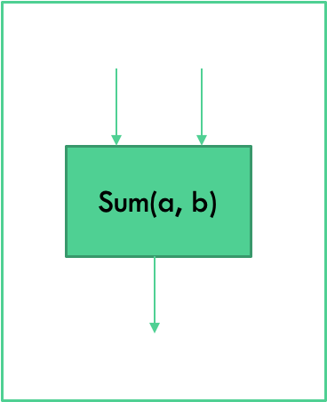
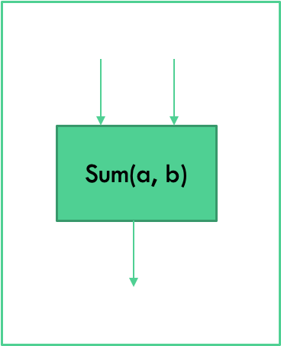
What Kind of Function Is Supported by Mo’s Algorithm?
Similar to Fenwick Trees
Most efficient functions for Mo’s are invertible
Uninvertible like min/max are not supported
Have to store data about every possible query and/or previous queries, which defeats the purpose of Mo’s (this is where segment trees would apply)
SOME uninvertible functions can be implemented with helper data structures
Mode, median, ex. store frequencies of elements in a hash map

Slide 18
Ex. Mode
8 | 3 | 4 | 5 | 3 | 2 | 3 | 1 | 3 | 2
0 1 2 3 4 5 6 7 8 9
Queries: (0,4) (1,4) (0,6) (4,9)
Naive scan: O(n * |Q|) = 10 * 4 = 40 steps
We will use 3 data structures:
freq dictionary mapping numbers to their current frequency
buckets[] list of sets (index: frequency, value: elements that currently have that frequency)
modeFreq int (highest non-empty bucket index)
add(idx) and remove(idx) each touch exactly one freq entry and up to 2 bucket cells → O(1).

Slide 19
Ex. Mode
8 | 3 | 4 | 5 | 3 | 2 | 3 | 1 | 3 | 2
0 1 2 3 4 5 6 7 8 9
Queries: (0,4) (1,4) (0,6) (4,9)
Block size = ⌈√10⌉ = 4
Query | Left-block | Secondary key r | Sorted order
(0,4) | 0 | 4 | 1
(1,4) | 0 | 4 | 2
(0, 6) | 1 | 6 | 3
(4,9) | 1 | 9 | 4

Slide 20
Ex. Mode
8 | 3 | 4 | 5 | 3 | 2 | 3 | 1 | 3 | 2
0 1 2 3 4 5 6 7 8 9
Queries: (0,4) (1,4) (0,6) (4,9)
idx | val | freq[val] | modeFreq | buckets
0 | 8 | 1 | 1 | {1: {8}}

Slide 21
Ex. Mode
8 | 3 | 4 | 5 | 3 | 2 | 3 | 1 | 3 | 2
0 1 2 3 4 5 6 7 8 9
Queries: (0,4) (1,4) (0,6) (4,9)
idx | val | freq[val] | modeFreq | buckets
0 | 8 | 1 | 1 | {1: {8}}
1 | 3 | 1 | 1 | {1: {8,3}}

Slide 22
Ex. Mode
8 | 3 | 4 | 5 | 3 | 2 | 3 | 1 | 3 | 2
0 1 2 3 4 5 6 7 8 9
Queries: (0,4) (1,4) (0,6) (4,9)
idx | val | freq[val] | modeFreq | buckets
0 | 8 | 1 | 1 | {1: {8}}
1 | 3 | 1 | 1 | {1: {8,3}}
2 | 4 | 1 | 1 | {1: {8,3,4}}

Slide 23
Ex. Mode
8 | 3 | 4 | 5 | 3 | 2 | 3 | 1 | 3 | 2
0 1 2 3 4 5 6 7 8 9
Queries: (0,4) (1,4) (0,6) (4,9)
idx | val | freq[val] | modeFreq | buckets
0 | 8 | 1 | 1 | {1: {8}}
1 | 3 | 1 | 1 | {1: {8,3}}
2 | 4 | 1 | 1 | {1: {8,3,4}}
3 | 5 | 1 | 1 | {1: {8,3,4,5}}

Slide 24
Ex. Mode
8 | 3 | 4 | 5 | 3 | 2 | 3 | 1 | 3 | 2
0 1 2 3 4 5 6 7 8 9
Queries: (0,4) (1,4) (0,6) (4,9) → answer = (3, 2)
idx | val | freq[val] | modeFreq | buckets
0 | 8 | 1 | 1 | {1: {8}}
1 | 3 | 1 | 1 | {1: {8,3}}
2 | 4 | 1 | 1 | {1: {8,3,4}}
3 | 5 | 1 | 1 | {1: {8,3,4,5}}
4 | 3 | 2 | 2 | {1: {8,4,5}, 2: {3}}

Slide 25
Ex. Mode
8 | 3 | 4 | 5 | 3 | 2 | 3 | 1 | 3 | 2
0 1 2 3 4 5 6 7 8 9
Queries: (0,4) (1,4) (0,6) (4,9) → answer = (3, 2)
idx | val | freq[val] | modeFreq | buckets
1 | 3 | 1 | 1 | {1: {3}}
2 | 4 | 1 | 1 | {1: {3,4}}
3 | 5 | 1 | 1 | {1: {3,4,5}}
4 | 3 | 2 | 2 | {1: {4,5}, 2: {3}}

Slide 26
Ex. Mode
8 | 3 | 4 | 5 | 3 | 2 | 3 | 1 | 3 | 2
0 1 2 3 4 5 6 7 8 9
Queries: (0,4) (0,6) (4,9)
idx | val | freq[val] | modeFreq | buckets
0 | 8 | 1 | 1 | {1: {8}}
1 | 3 | 1 | 1 | {1: {8,3}}
2 | 4 | 1 | 1 | {1: {8,3,4}}
3 | 5 | 1 | 1 | {1: {8,3,4,5}}
4 | 3 | 2 | 2 | {1: {8,4,5}, 2: {3}}

Slide 27
Ex. Mode
8 | 3 | 4 | 5 | 3 | 2 | 3 | 1 | 3 | 2
0 1 2 3 4 5 6 7 8 9
Queries: (0,4) (1,4) (0,6) (4,9)
idx | val | freq[val] | modeFreq | buckets
0 | 8 | 1 | 1 | {1: {8}}
1 | 3 | 1 | 1 | {1: {8,3}}
2 | 4 | 1 | 1 | {1: {8,3,4}}
3 | 5 | 1 | 1 | {1: {8,3,4,5}}
4 | 3 | 2 | 2 | {1: {8,4,5}, 2: {3}}
5 | 2 | 1 | 2 | {1: {8,4,5,2}, 2: {3}}

Slide 28
Ex. Mode
8 | 3 | 4 | 5 | 3 | 2 | 3 | 1 | 3 | 2
0 1 2 3 4 5 6 7 8 9
Queries: (0,4) (1,4) (0,6) (4,9) → answer = (3, 3)
idx | val | freq[val] | modeFreq | buckets
0 | 8 | 1 | 1 | {1: {8}}
1 | 3 | 1 | 1 | {1: {8,3}}
2 | 4 | 1 | 1 | {1: {8,3,4}}
3 | 5 | 1 | 1 | {1: {8,3,4,5}}
4 | 3 | 2 | 2 | {1: {8,4,5}, 2: {3}}
5 | 2 | 1 | 2 | {1: {8,4,5,2}, 2: {3}}
6 | 3 | 3 | 3 | {1: {4,5,2}, 3: {3}}

Slide 29
Ex. Mode
8 | 3 | 4 | 5 | 3 | 2 | 3 | 1 | 3 | 2
0 1 2 3 4 5 6 7 8 9
Queries: (0,4) (1,4) (0,6) (4,9) → answer = (3, 3)
remove(1), remove(2), remove(3), add(5), add(6), add(7), add(8), add(9)
idx | val | freq[val] | modeFreq | buckets
4 | 3 | 1 | 1 | {1: {3}}
5 | 2 | 1 | 1 | {1: {3,2}}
6 | 3 | 2 | 2 | {1: {2}, 2: {3}}
7 | 1 | 1 | 2 | {1: {2,1}, 2: {3}}
8 | 3 | 3 | 3 | {1: {2,1}, 3: {3}}
9 | 2 | 2 | 3 | {1: {1}, 2: {2}, 3: {3}}

Slide 30
Another Thought Bubble
18 total operations, instead of 22 with naive method
Upper bound of total updates ≤ (n + |Q|) * b
For n = 10, |Q| = 4, b = 3 → (10 + 4) * 3 = 42 updates
Little memory use, freq and buckets are both ≤ n
Tie handling is O(1), only the top-frequency bucket is checked

Slide 31
Time Complexity
Let Q be the number of queries, N be the size of the data array, and S be the block size.
We need to sort the queries to utilize Mo’s effectively. O(Q log(⁡Q))
For each of the N / S blocks, we increment to the right index of the query range at most N times, because the queries within a block are sorted by right index. O(N²/S)
Between queries within blocks, the left index of the query range changes by at most the block size S. This occurs at most Q times. O(QS)
Between queries in different blocks, the left index of the query range changes by at most 2N throughout the entire execution. O(2N)
When using S ≈ √(N), the total runtime is O(Q log(⁡Q) + N√(N) + Q√(N) + 2N), which is equivalent to O(Q log(⁡Q) + (N + Q)√(N)). In most cases, Qlog(Q) << N√(N), so the runtime is dominated by the (N + Q)√(N) term.

Slide 32
Practical Applications
Large amount of offline range queries and only O(n) extra memory
Competitive programming problems, such as Spoj’s DQUERY or Codeforces’ Powerful Array

