Slide 1
Fast Fourier Transform
Andrew Balch, Evan Conway, Elliott Druga, Zoe Hamilton

Slide 2
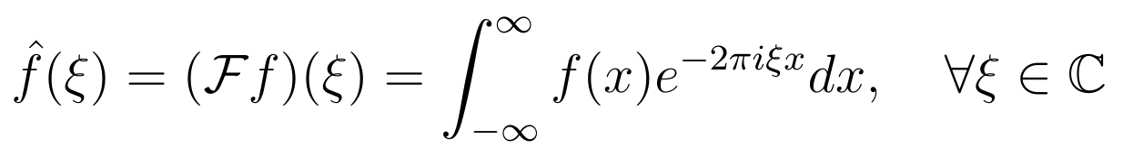
The Fourier Transform (FT)
Transforms an input function in the time domain (red)
to a function in the frequency domain (blue)
For example, transforming a musical chord into
its pitch intensities
Can also work in reverse! (if both functions are absolutely integrable
The output function is defined by complex numbers
(i.e. numbers that have both a real and imaginary
component)
From Fourier transform - Wikipedia

Slide 3
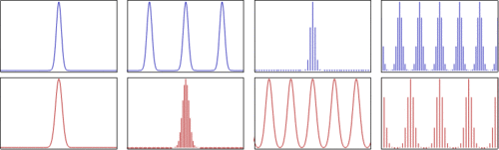
The Discrete Fourier Transform (DFT)
In computing, we represent continuous functions as discretely-sampled, finite series of data
But, the FT is still useful, with many applications in music, math, science, etc.
The DFT (red) generalizes the FT (blue) to a summation over evenly-spaced data in sampled over time:
From Discrete Fourier transform - Wikipedia

Slide 4
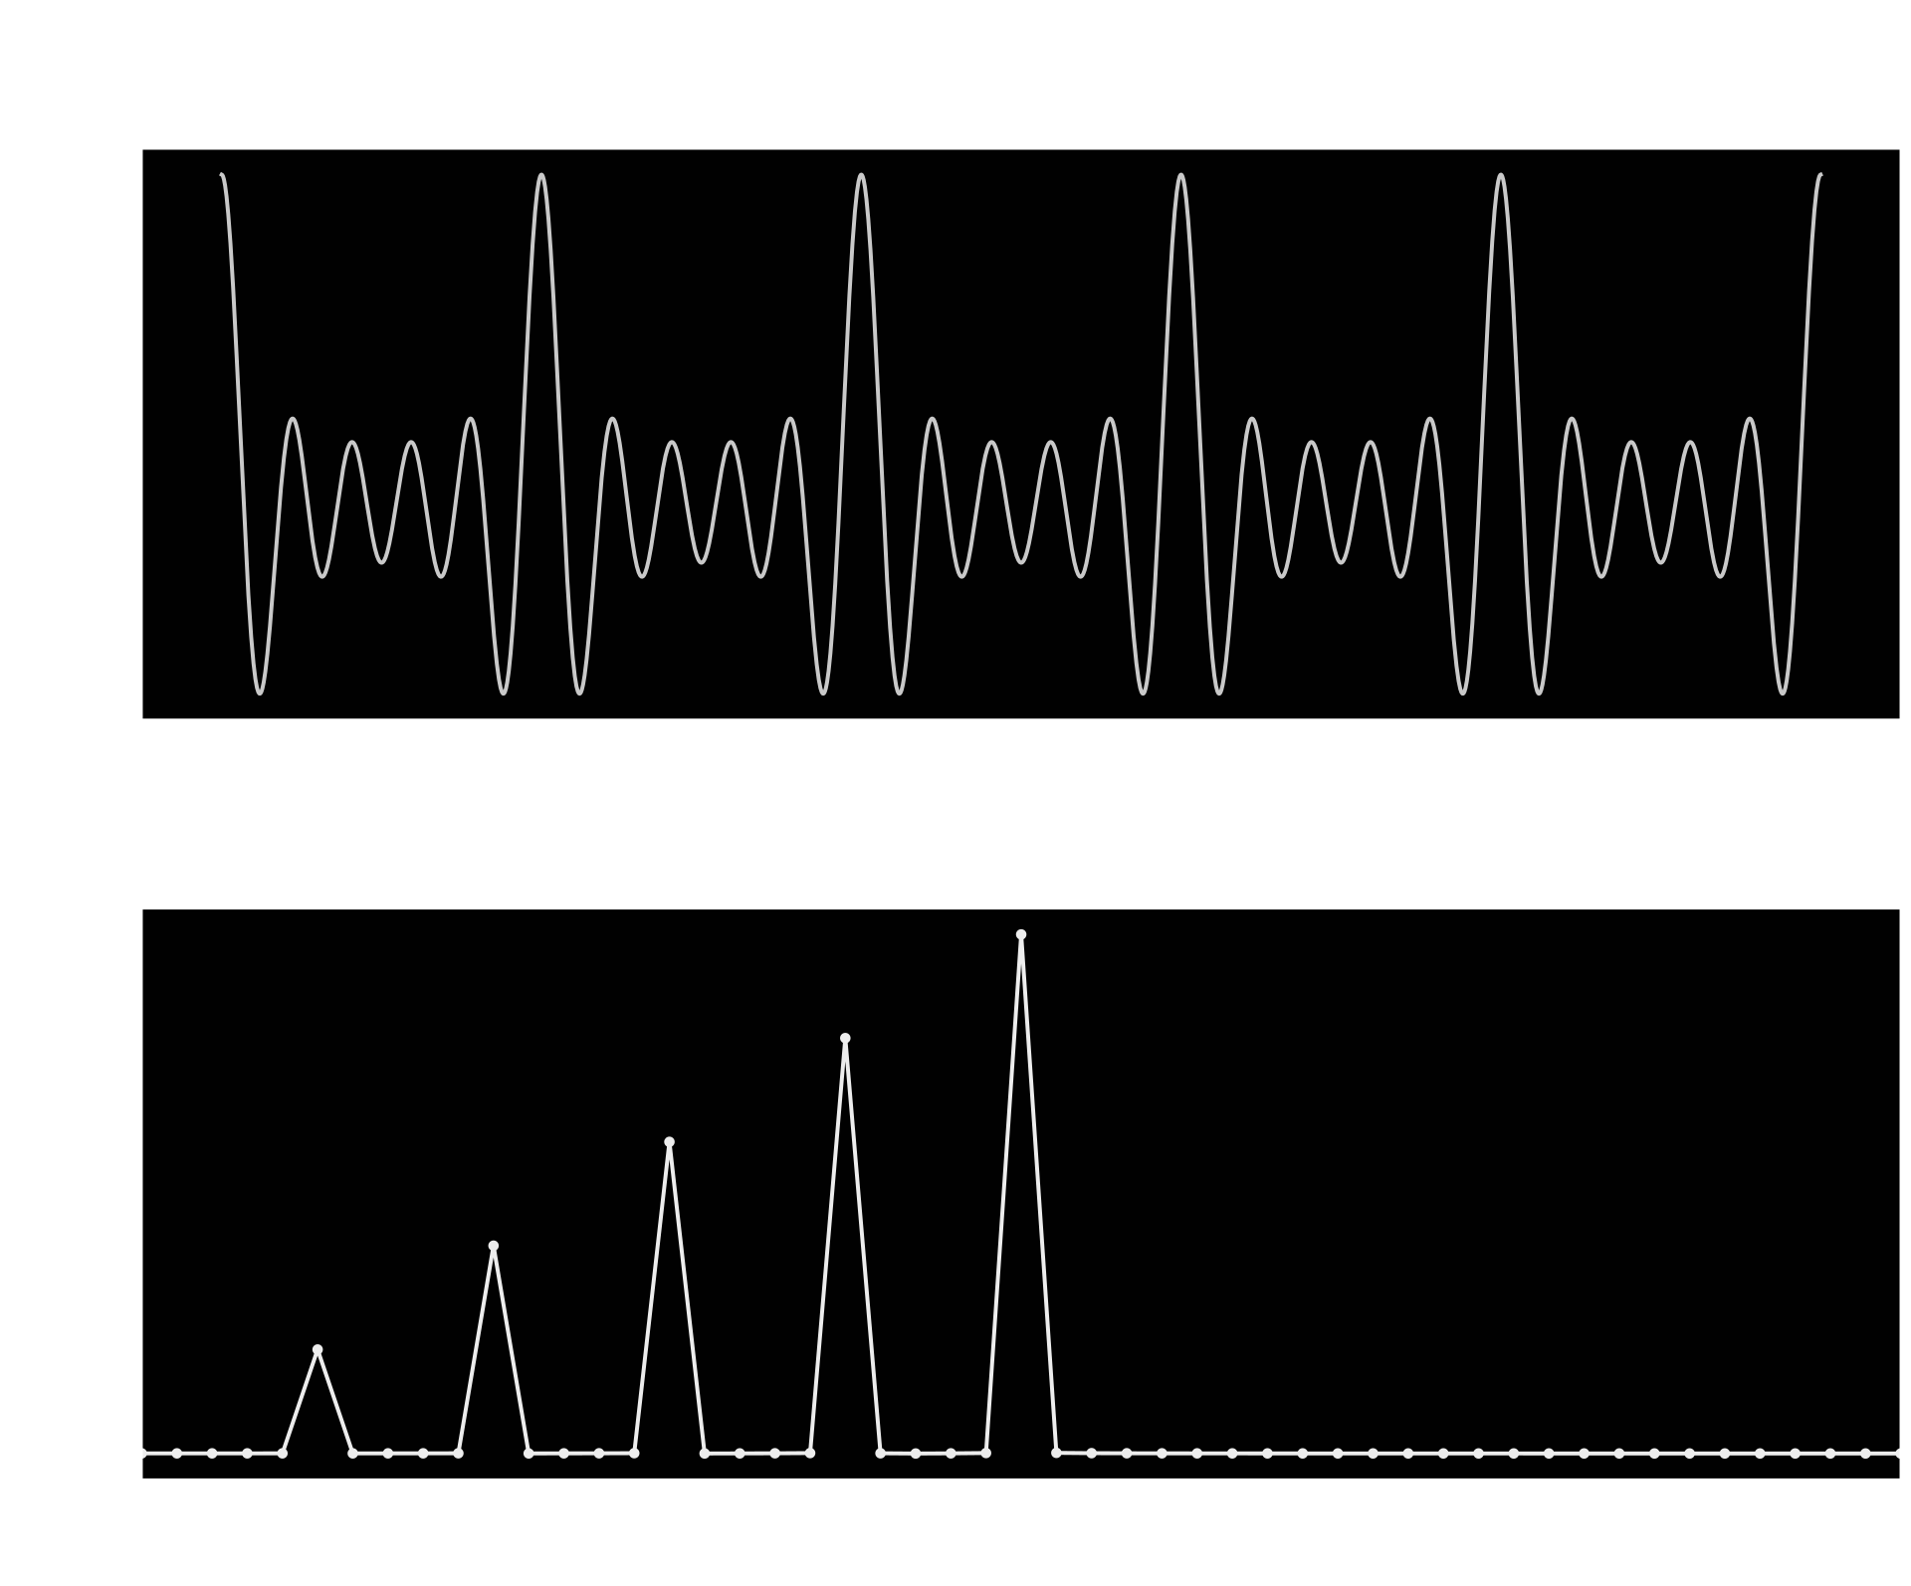
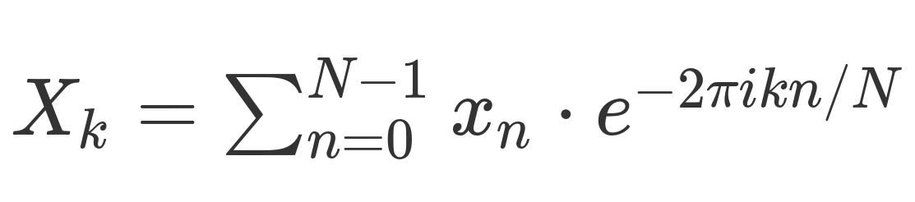
Calculating the DFT
Given n points in time domain, calculate n points in the frequency domain using this formula
O(n²) if calculated by the formula directly
Fast Fourier Transform (FFT) reduces to O(n log(n))
Notes:
Elliott

Slide 5
Algorithm Overview
The primary issue with the naive O(n²) algorithm is that we do not reuse our work in any way. Instead, we calculate every combination of n and k.
To get to O(n log(n)), we will create a divide and conquer algorithm, using a mergesort-esque structure (divide into two problems of half size, merge in linear time)
In order to merge, we will exploit certain properties of the complex exponential that allow us to reuse our prior work.

Slide 6
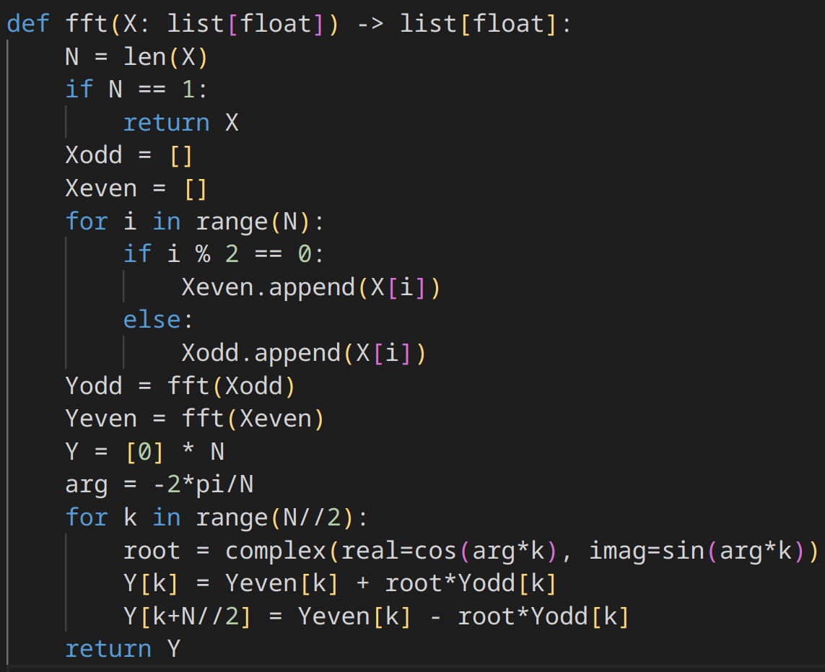
Splitting
Intuition:
Use recursion to divide input data into sub-problems
Splitting is easy! Just calculate the DFT of the odd and even indices
Base case: N = 1 -> DFT is just the value
But how can we merge into a valid DFT, while still being fast?

Slide 7
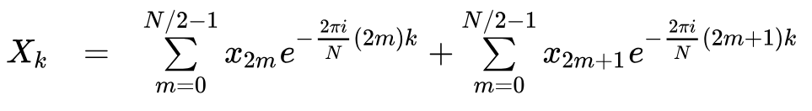
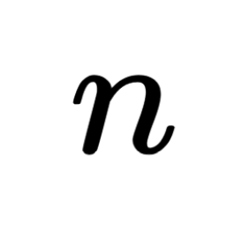
Merging
This bit actually does the work to merge the sub-solutions
As a full DFT for a single X_{k}:
Can we avoid doing both of these summations?

Slide 8

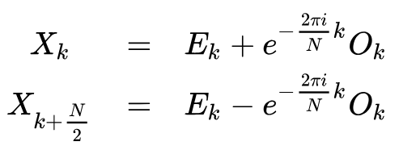
Merging: Leveraging Periodicities
From the definition of a DFT, we have
Which we simplify to… (E_{k} as even FFT and O_{k} as odd FFT)
Then note that
Because of the periodicity of the complex exponential!
Same term!
Notes:
Andrew

Slide 9
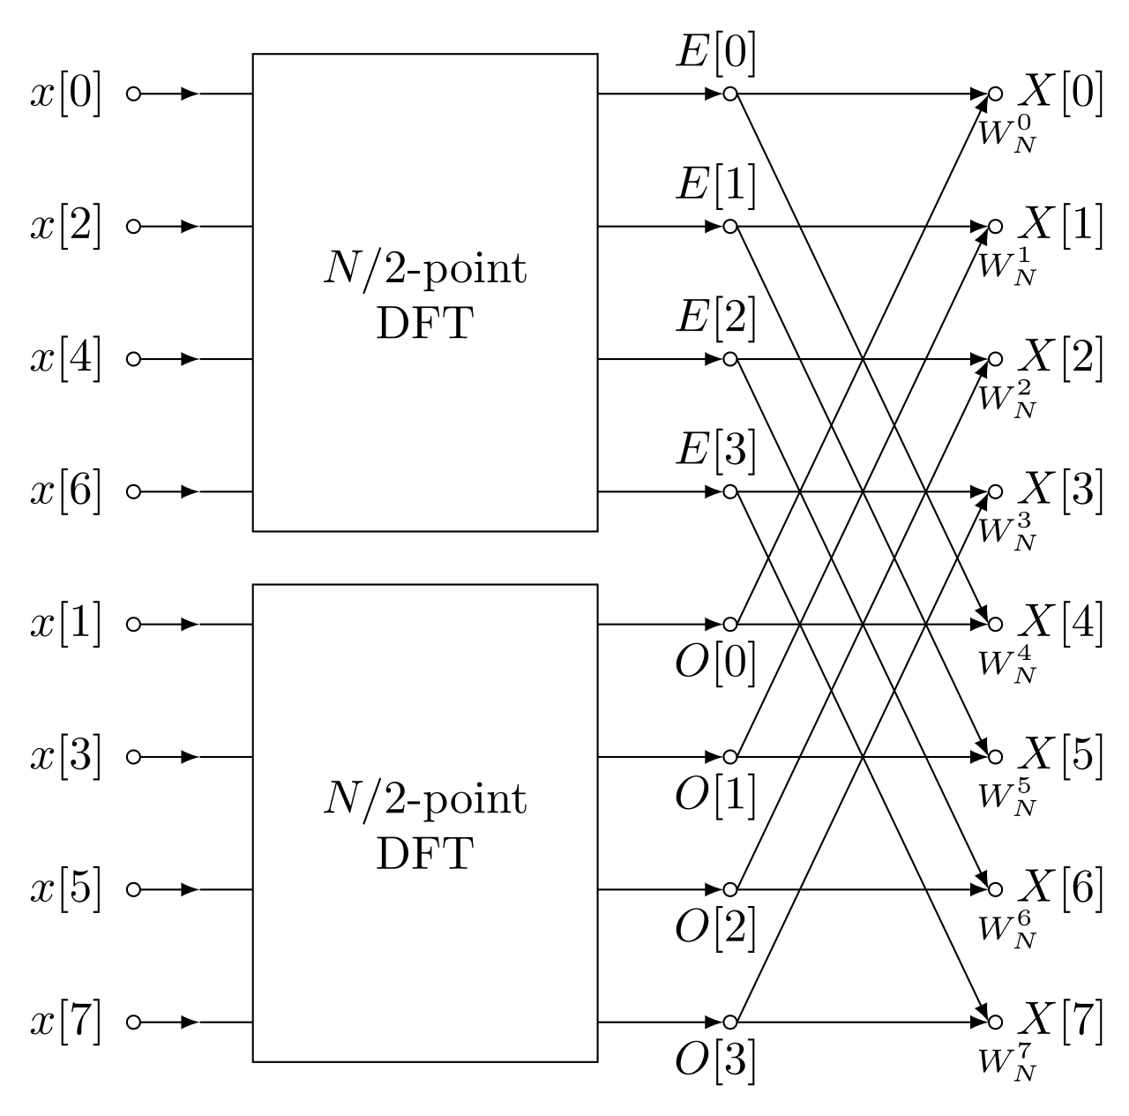
Merging
This means that we can calculate the full DFT using only the even DFT and the odd DFT
Notes:
Andrew

Slide 10

Runtime Analysis
We can merge in linear time! So, we have the following recurrence relation:
…which gives us O(n log(n)) by the Master Theorem! (specifically, case 2)
Notes:
Elliott

Slide 11
Example: Splitting
Let’s try to get the DFT of (1, 2, 3, 4)
Splitting by even and odd indices gives (1, 3) and (2, 4) respectively
Evens: (1, 3) splits to (1) and (3). The DFT of a single number of itself, so on this side we have E = 1 and O = 3. Since k = 0, our complex exponential is equal to 1, so our DFT is (1 + 3, 1 - 3) = (4, -2)
Odds: (2, 4) splits to (2) and (4). This means that we have E = 2 and O = 4. Our DFT is then (2 + 4, 2 - 4) = (6, -2)

Slide 12
Example: Merging
With E = (4, -2) and O = (6, -2), we now want to merge back again. We can note that we only need to deal with k = 0, where the complex exponential is 1, and k = 1, where it is -i.
k = 0 (indices 0 and 2): E₀ + O₀ = 4 + 6 = 10, E₀ - O₀ = 4 - 6 = -2
k = 1 (indices 1 and 3): E₁ - O₁i = -2 + 2i, E₁ + O₁i = -2 - 2i
This means that our DFT is (10, -2 + 2i, -2, -2 - 2i)

Slide 13
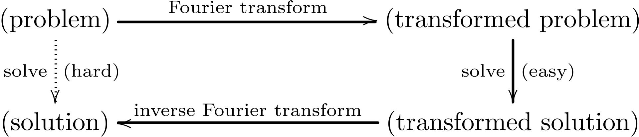
Fourier Transform Reduction Pattern
Many problems that are difficult to solve in their original form can be solved quickly in the frequency domain
With the FFT, we can apply a Fourier transform, solve, and then apply the inverse Fourier transform for a total solving time of O(n log(n))
One application: speed up polynomial multiplication from O(n²) to O(n log(n))
Notes:
Evan

Slide 14
References
https://www.algorithm-archive.org/contents/cooley_tukey/cooley_tukey.html
https://en.wikipedia.org/wiki/Fast_Fourier_transform
https://en.wikipedia.org/wiki/Cooley%E2%80%93Tukey_FFT_algorithm
https://people.scs.carleton.ca/~maheshwa/courses/5703COMP/16Fall/FFT_Report.pdf
https://cp-algorithms.com/algebra/fft.html

