Slide 1
Fast Fourier Transform
Andrew Balch, Evan Conway, Elliott Druga, Zoe Hamilton

Slide 2
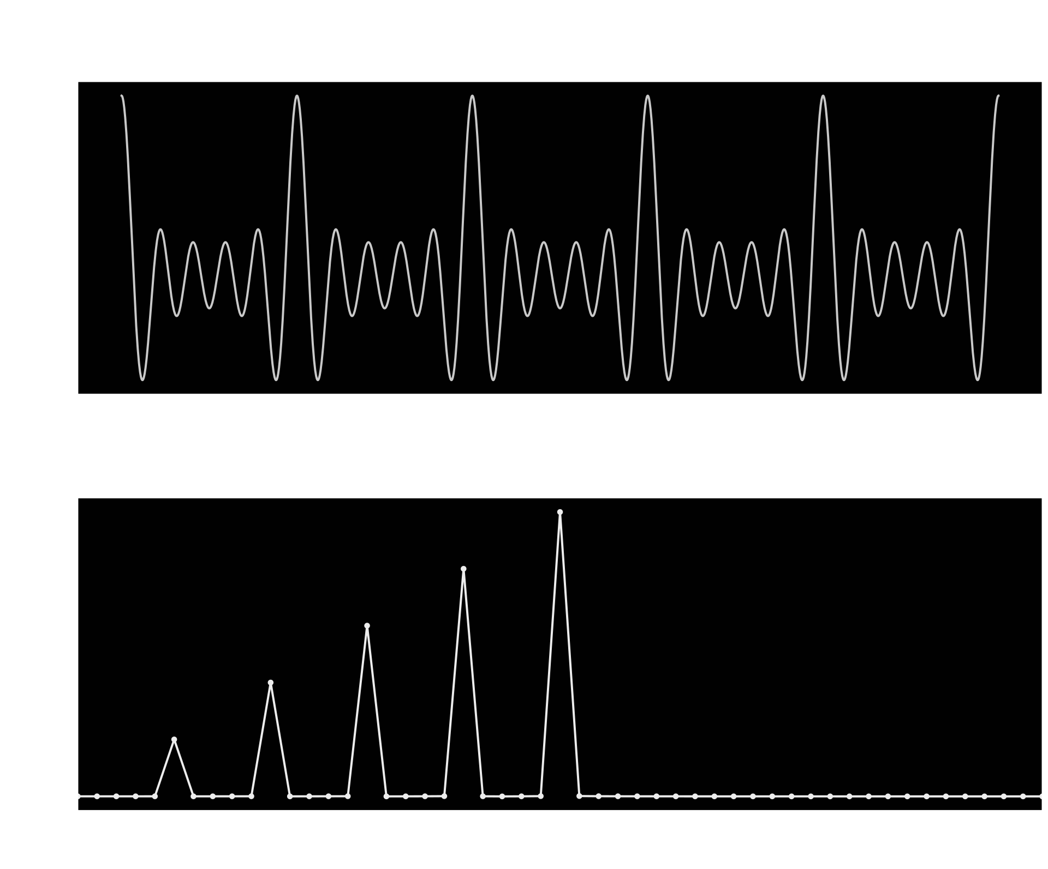
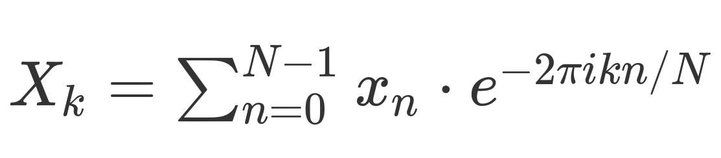
Motivation: Discrete Fourier Transform (DFT)
Many applications in music, math, science, etc.
Converts a signal from time to frequency domain
Given n points in time domain, calculate n points in the frequency domain using this formula
O(n²) if calculated by the formula directly
Fast Fourier Transform (FFT) reduces to O(n log(n))
Notes:
Elliott

Slide 3
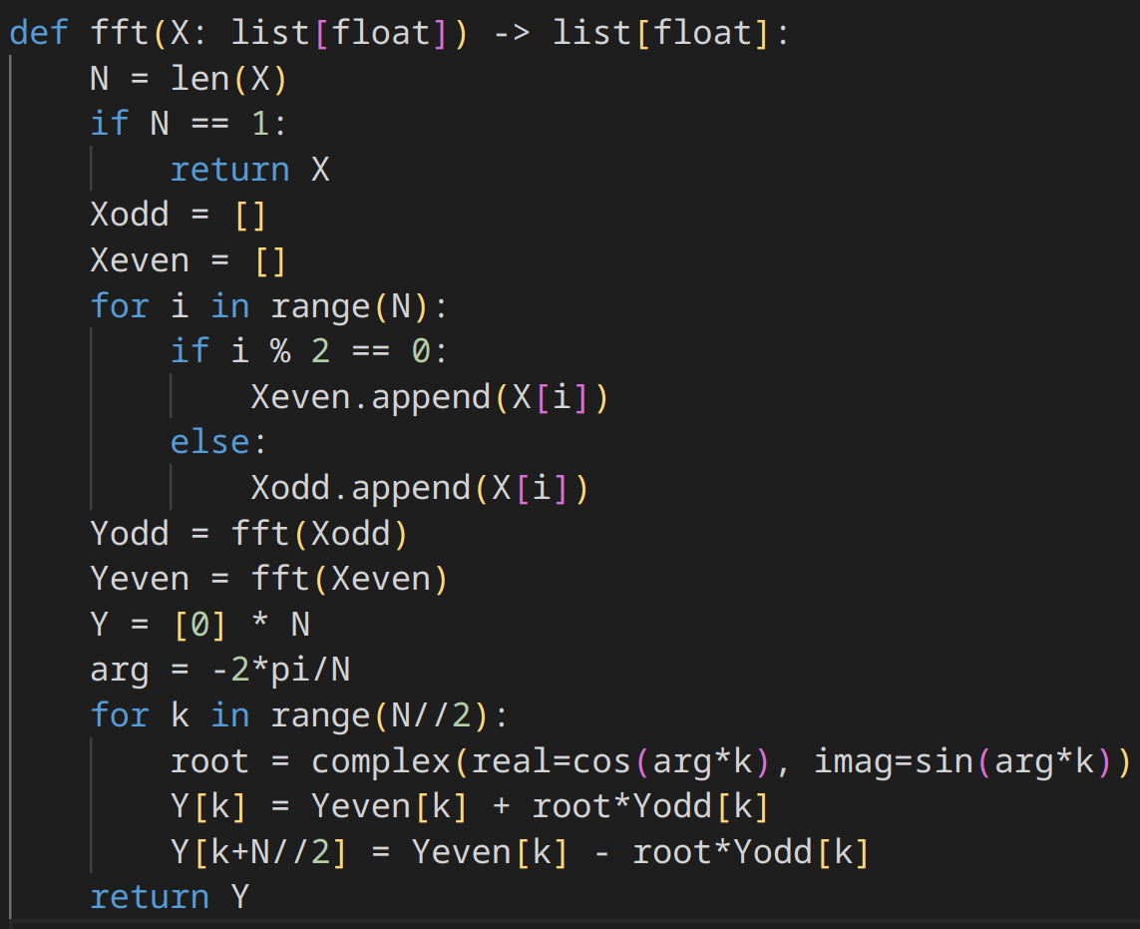
Gotta go fast!
Cooley-Tukey FFT
First, divide the input by odd and even indices
Then, recursively calculate the DFT on these subsets
Notes:
Zoe

Slide 4
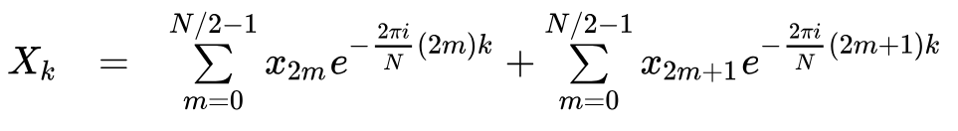
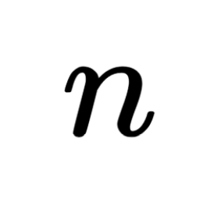
Gotta go fast!
This bit actually does the work to merge the sub-solutions
As a full DFT for a single X_{k}:
Can we avoid doing both of these summations?
Notes:
Zoe

Slide 5

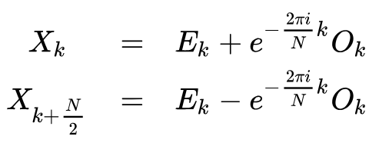
Gotta go fast!
Sorry… Math time!
Simplifies to… (E_{k} as even FFT and O_{k} as odd FFT)
Then note that
Because of the periodicity of the complex exponential!
Same term!
Notes:
Andrew

Slide 6
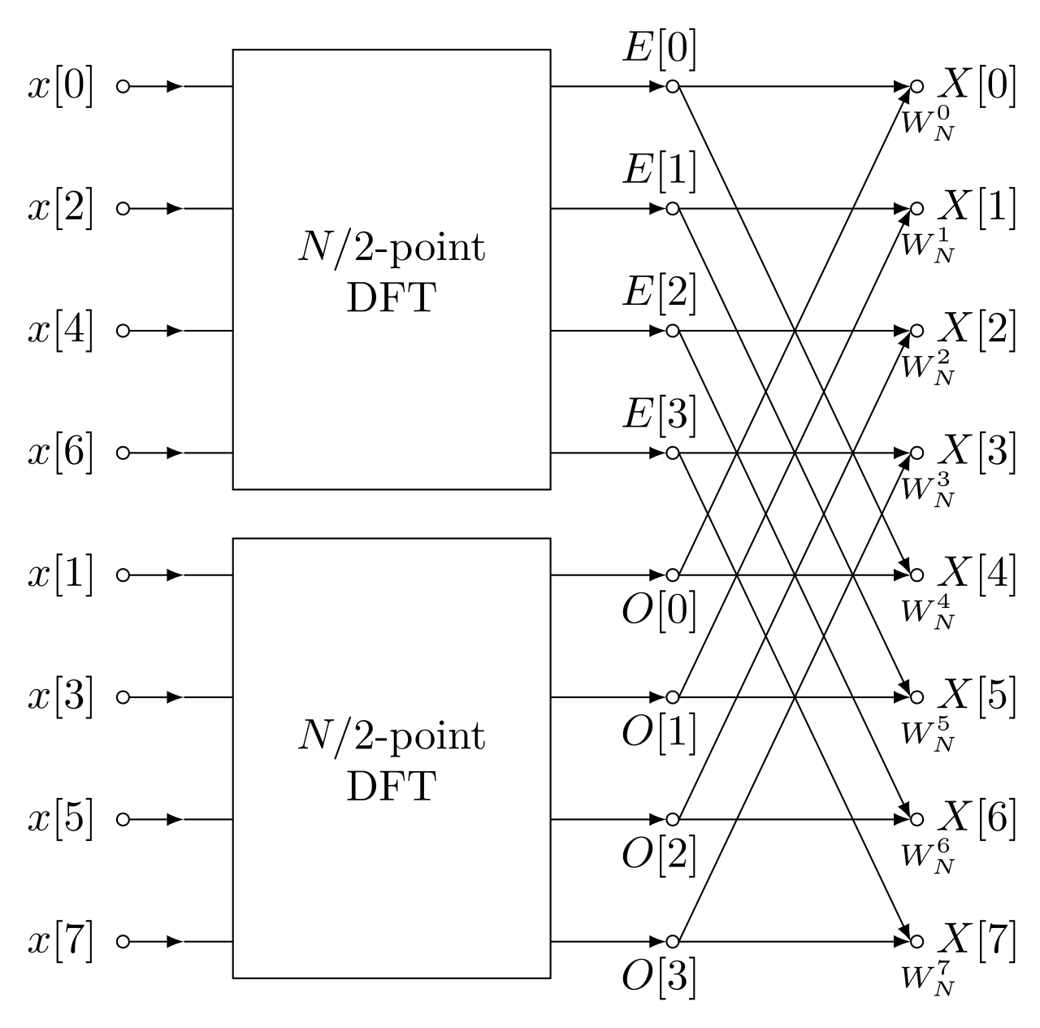
Gotta go fast!
This means that we can calculate the full DFT using only the even DFT and the odd DFT
Notes:
Andrew

Slide 7

Runtime Analysis
We have the following recurrence relation:
Split into two half-size problems
Linear time to merge our results
…which gives us O(n log(n)) by the Master Theorem! (specifically, case 2)
Notes:
Evan

Slide 8
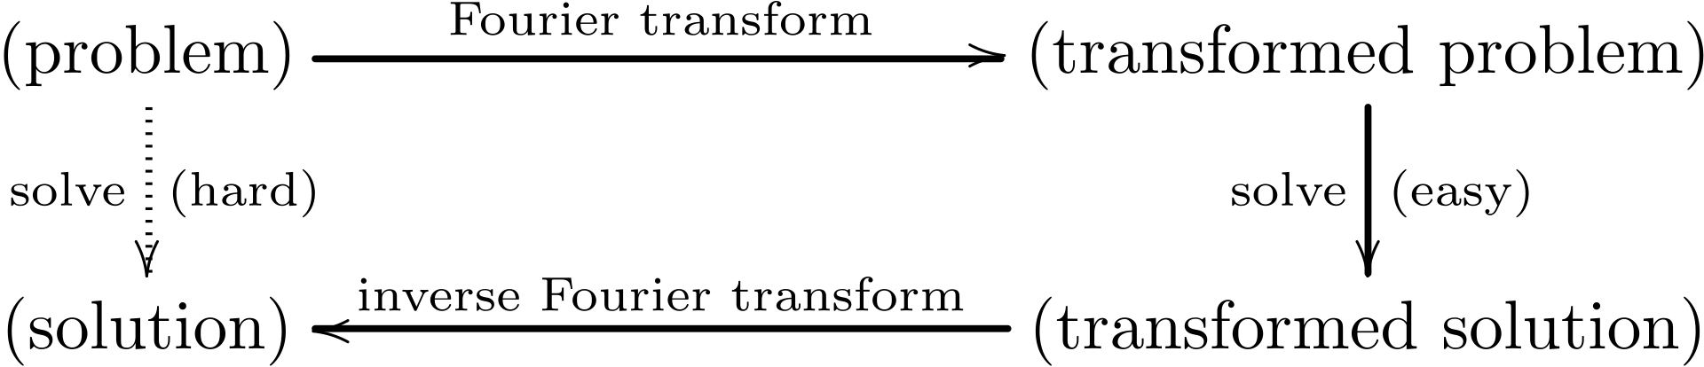
Fourier Transform Reduction Pattern
Many problems that are difficult to solve in their original form can be solved quickly in the frequency domain
With the FFT, we can apply a Fourier transform, solve, and then apply the inverse Fourier transform for a total solving time of O(n log(n))
One application: speed up polynomial multiplication from O(n²) to O(n log(n))
Notes:
Evan

Slide 9
References
https://www.algorithm-archive.org/contents/cooley_tukey/cooley_tukey.html
https://en.wikipedia.org/wiki/Fast_Fourier_transform
https://en.wikipedia.org/wiki/Cooley%E2%80%93Tukey_FFT_algorithm
https://people.scs.carleton.ca/~maheshwa/courses/5703COMP/16Fall/FFT_Report.pdf
https://cp-algorithms.com/algebra/fft.html

