Slide 1
Toom-Cook Multiplication
Barrett, Mikhail, Shreyas, Vincent

Slide 2
Background
Notes:
m

Slide 3
Numbers as polynomials
Notes:
m

Slide 4
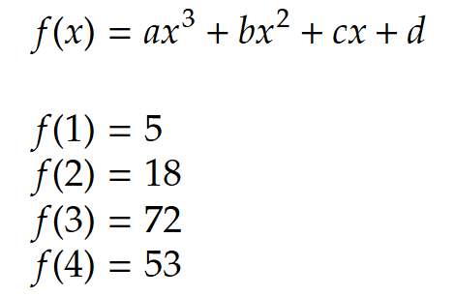
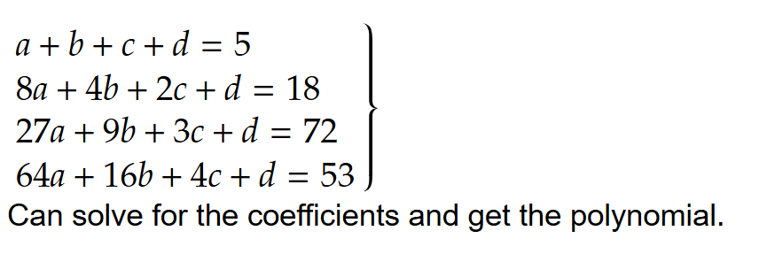
Polynomial interpolation
4 unknowns (coefficients),
4 equations (points)
To find a 3rd degree polynomial, we need to know 4 points
To find a nth degree polynomial, we need to know n+1 points
Notes:
m

Slide 5
Karatsuba

Slide 6
Karatsuba Multiplication
Divide and conquer
Writes numbers as polynomials
Uses polynomial interpolation to evaluate the final product
Does 3 small multiplications instead of 1 big one
Notes:
s

Slide 7
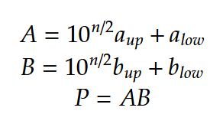
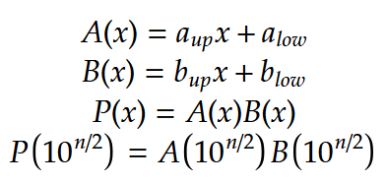
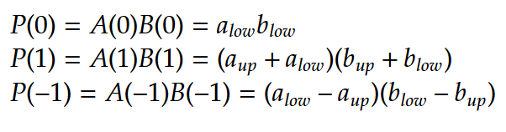

Karatsuba Multiplication
A and B are n-digit numbers
Nah, they’re polynomials
big
(n digit)
big
(n digit)
Use interpolation to find
small
(n/2 digit)
small
(n/2 digit)
Notes:
m

Slide 8
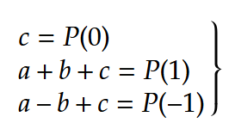
Doesn’t interpolation use computation?
Yes, but only a little bit
Small (n/2 digit)
Addition, subtraction, dividing by 2 are all O(n)
Notes:
v

Slide 9


Runtime
Interpolation
Finding P(1), P(0), P(-1)
Notes:
b

Slide 10
3-way Toom-Cook
Notes:
v

Slide 11
What’s wrong with Karatsuba?
A and B are linear equations
Linear equations are lame
We split A and B into only 2 parts
Didn’t use interpolation as much as we could
Notes:
s

Slide 12
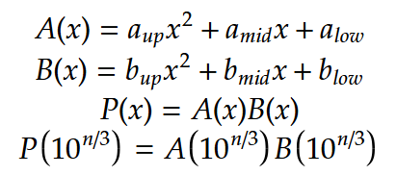
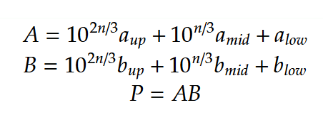
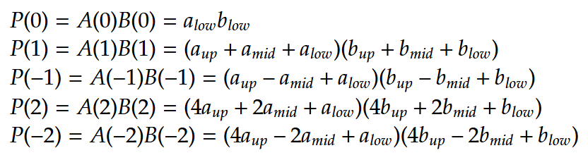

3-way Toom-Cook Multiplication
A and B are numbers
A and B are polynomials
big
(n digit)
big
(n digit)
Use interpolation to find
small
(n/3 digit)
small
(n/3 digit)
Notes:
v

Slide 13
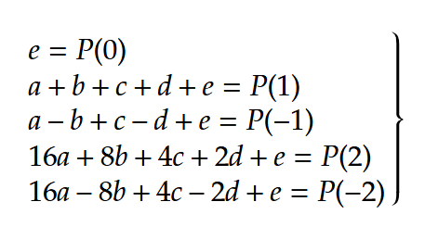
Is interpolation more costly this time?
Yes, but only a little bit
Addition, subtraction, even dividing by 16 are all O(n) because it’s (n/3) by (2) digit division
Notes:
v

Slide 14


Runtime
Interpolation
Finding P(1), P(0), P(-1), P(2), P(-2)
Notes:
b

Slide 15

Does it go past 3?
You can do k-way Toom-Cook with runtime
Slow in practice
Big constant factor that grows with k (a lot of linear algebra to interpolate)
3-way Toom-Cook is only used on 100+ digit multiplication
4-way is even less commonly used
Parallelization can be used for evaluating at small points to improve runtime (evaluations are independent)
Notes:
s

