Slide 1
Toom-Cook Multiplication
Barrett, Mikhail, Shreyas, Vincent

Slide 2
Naive Multiplication

Slide 3
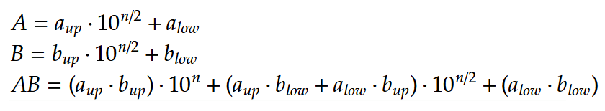
Naive Multiplication
Divide and conquer
Split 1 big multiplication into 4 little ones
Actually pretty slow
O(n^2)

Slide 4
Background

Slide 5
Numbers as polynomials

Slide 6
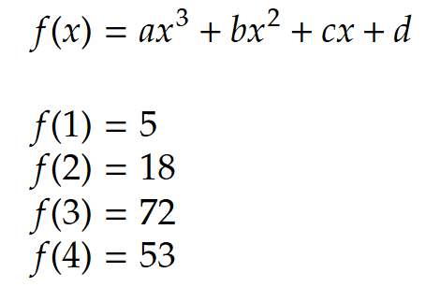
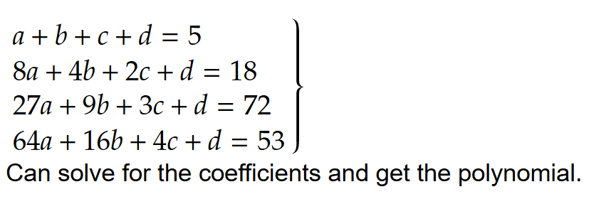
Polynomial interpolation
4 unknowns (coefficients),
4 equations (points)
To find a 3rd degree polynomial, we need to know 4 points
To find a nth degree polynomial, we need to know n+1 points

Slide 7
Karatsuba

Slide 8
Karatsuba Multiplication
Divide and conquer
Writes numbers as polynomials
Uses polynomial interpolation to evaluate the final product
Does 3 small multiplications instead of 1 big one

Slide 9
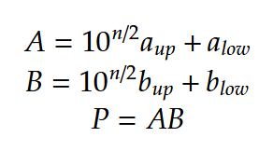
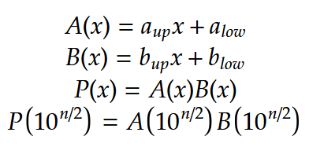
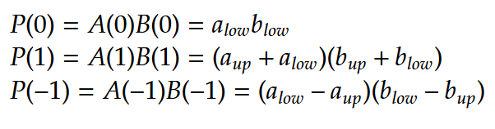

Karatsuba Multiplication
A and B are numbers
Nah, they’re polynomials
big
(n digit)
big
(n digit)
Use interpolation to find
small
(n/2 digit)
small
(n/2 digit)

Slide 10
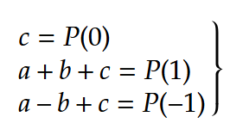
Doesn’t interpolation use computation?
Yes, but only a little bit
Small (n/2 digit)
Addition, subtraction, dividing by 2 are all O(n)

Slide 11


Runtime
Interpolation
Finding P(1), P(0), P(-1)

Slide 12
3-way Toom-Cook

Slide 13
What’s wrong with Karatsuba?
A and B are linear equations
Linear equations are lame
We split A and B into only 2 parts
Didn’t use interpolation as much as we could

Slide 14
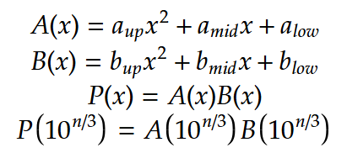
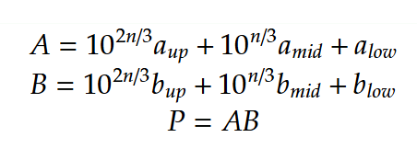
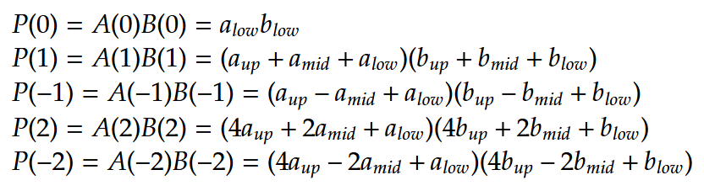

3-way Toom-Cook Multiplication
A and B are numbers
A and B are polynomials
big
(n digit)
big
(n digit)
Use interpolation to find
small
(n/3 digit)
small
(n/3 digit)

Slide 15
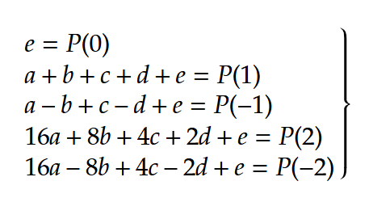
Is interpolation more costly this time?
Yes, but only a little bit
Addition, subtraction, even dividing by 16 are all O(n) because it’s (n/3) by (2) digit division

Slide 16


Runtime
Interpolation
Finding P(1), P(0), P(-1), P(2), P(-2)

Slide 17
k-way Toom-Cook

Slide 18
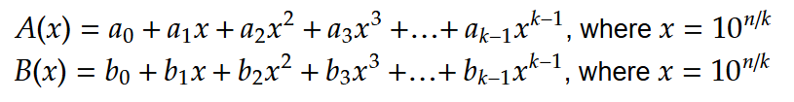
1. Splitting up the number
Split the number into k blocks
The resulting polynomials are degree k-1
The product is degree 2k-2

Slide 19
2. Evaluating at small points
Product is degree 2k-2
Need 2k-1 points to evaluate (2k-1 unknowns)

Slide 20

3. Interpolate
Do O(n) work to interpolate
For a fixed k, there is a constant amount of linear algebra, and each linear algebra operation is O(n)

Slide 21


Runtime
Is that even good?

Slide 22
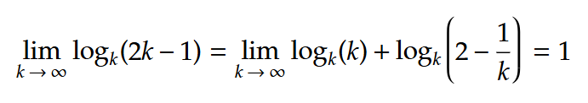

Asymptotic asymptotic runtime
Eventually linear? As fast as addition?

Slide 23
Real runtime
Big constant factor that grows with k (a lot of linear algebra to interpolate)
3-way Toom-Cook is only used on 100+ digit multiplication
4-way is even less commonly used
Parallelization can be used for evaluating at small points to improve runtime (evaluations are independent)

