Slide 1
Decidability
Discrete Mathematics and Theory 2 Mark Floryan

Slide 2
Goals!
1. Let’s revisit the concept of decidable languages, and find some.
2. Let’s find some examples of undecidable languages, and even some examples of unrecognizable languages.
3. Let’s introduce the concept of reductions, which can expedite / simplify proofs that certain problems are undecidable or unrecognizable.

Slide 3
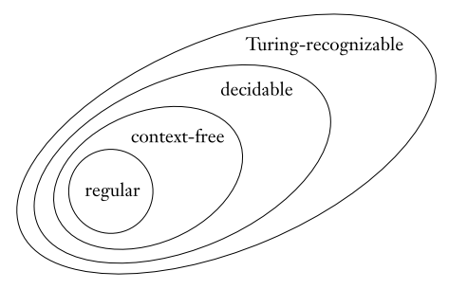
The big Picture!

Slide 4
Part 1: Decidable Languages

Slide 5
Decidable Languages
Recall that a decidable language is a language for which a Turing Machine exists that computes it and always halts.
Let’s look at a few more decidable languages and eventually start discovering some undecidable languages.

Slide 6
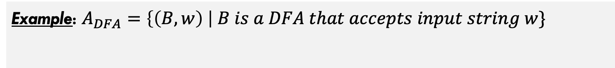
Decidable Languages
Example: $A_{DFA}=\left\{\left(B,w\right) \right| B is a DFA that accepts input string w\}$
Can you describe a Turing Machine that decides this language?

Slide 7
Decidable Languages
Example: $A_{DFA}=\left\{\left(B,w\right) \right| B is a DFA that accepts input string w\}$
M = “On input <B,w>:
Simulate B on input w
If B ends in accept state, accept. Otherwise, reject.”
w is finite, B is also guaranteed to halt. So the simulation must be possible and it must halt.
Let’s briefly discuss some of the implementation details involved in this.

Slide 8
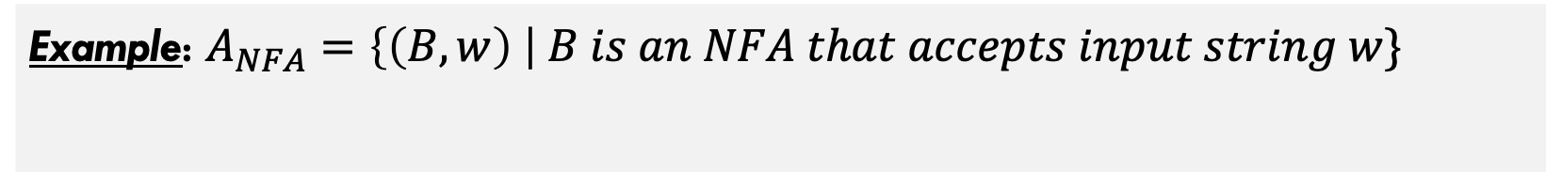
Decidable Languages
Example: $A_{NFA}=\left\{\left(B,w\right) \right| B is an NFA that accepts input string w\}$
How about this one? How would you design the machine this time?

Slide 9
Decidable Languages
Example: $A_{NFA}=\left\{\left(B,w\right) \right| B is an NFA that accepts input string w\}$
N = “On input <B,w>:
Convert NFA B into DFA C using procedure given previously.
Run Turing Machine M from previous slide on <C,w>
If M accepts, then accept. Otherwise, reject.”

Slide 10



More Decidable Languages
All of the following languages are similarly decidable:
$$A_{REX}=\left\{R,w \right| R is a reg. exp. that generates w\}$$
Does a given expression generate this string?
$$E_{DFA}=\left\{A \right| A is a DFA and L\left(A\right)=∅\}$$
Is language of the DFA empty?
$${EQ}_{DFA}=\left\{A,B \right| A,B are DFA∧L\left(A\right)=L(B)\}$$
Do two DFAs recognize the same language?
…and analogous languages for Context-Free Grammars (CFGs)

Slide 11
Part 2: Undecidable Languages

Slide 12
Do undecidable languages exiSt?
Are there problems that are unsolvable by computers (Turing Machines)?

Slide 13
Do undecidable languages exiSt?
Many of these problems are recognizable, but not decidable.
Are there problems that are unsolvable by computers (Turing Machines)?
This has profound philosophical implications in Computer Science. Some things are fundamental limitations that computers cannot overcome.
Yes! In fact, many simple and common problems are undecidable.

Slide 14
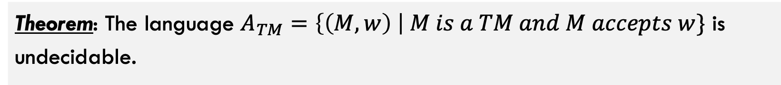
Do undecidable languages exist?
Theorem: The language $A_{TM}=\left\{\left(M,w\right) \right| M is a TM and M accepts w\}$ is undecidable.
This language is Turing-Recognizable though. Here is how:
U = “On input <M,w>:
Simulate M on input w
If M ever accepts, then accept.
If M ever reject, then reject.
Note that if M loops forever, then so will U

Slide 15
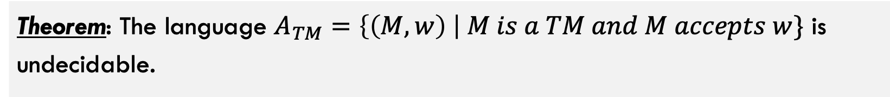
Do undecidable languages exist?
Theorem: The language $A_{TM}=\left\{\left(M,w\right) \right| M is a TM and M accepts w\}$ is undecidable.
Okay, let’s prove it. Intuitively, what is the potential issue here?
This is one of the most famous proofs in Computer Science

Slide 16
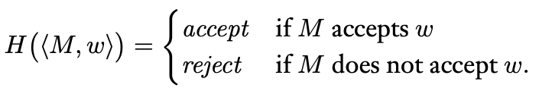

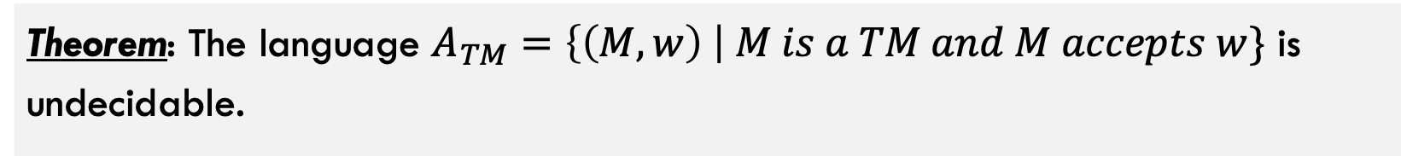
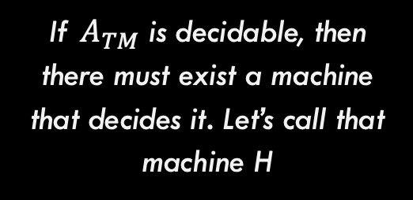
Do undecidable languages exist?
Theorem: The language $A_{TM}=\left\{\left(M,w\right) \right| M is a TM and M accepts w\}$ is undecidable.
Step 1: For the sake of contradiction, assume $A_{TM}$ is decidable
If $A_{TM}$ is decidable, then there must exist a machine that decides it. Let’s call that machine H

Slide 17
Do undecidable languages exist?
Theorem: The language $A_{TM}=\left\{\left(M,w\right) \right| M is a TM and M accepts w\}$ is undecidable.
Step 2: Construct a new machine D that uses H as a subroutine.
D
Input <M>
accept
reject
H(<M, M>)
reject
accept

Slide 18
Some Comments on Machine D
D
Input <M>
accept
reject
H(<M, M>)
reject
accept
Notice that we flip the output here. This will be important for creating the contradiction
What does it mean to run a machine with itself as input? Is this even possible?

Slide 19
Some Comments on Machine D
Step 3: Run the machine D with itself (D) as input. What happens?
D
Input <D>
accept
reject
H(<D, D>)
reject
accept
Notice that D is running with itself as input in two places, once overall (green square) and once simulated inside of H
Which means these outputs should match because they are the output of the exact same thing (D running on D as input)

Slide 20
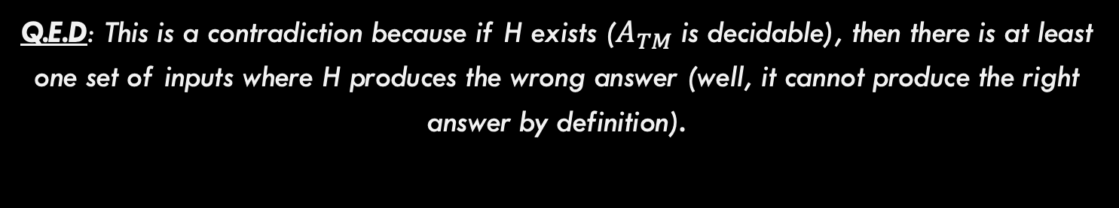
Some Comments on Machine D
Step 3: Run the machine D with itself (D) as input. What happens?
D
Input <D>
accept
reject
H(<D, D>)
reject
accept
Q.E.D: This is a contradiction because if H exists ($A_{TM}$ is decidable), then there is at least one set of inputs where H produces the wrong answer (well, it cannot produce the right answer by definition).

Slide 21
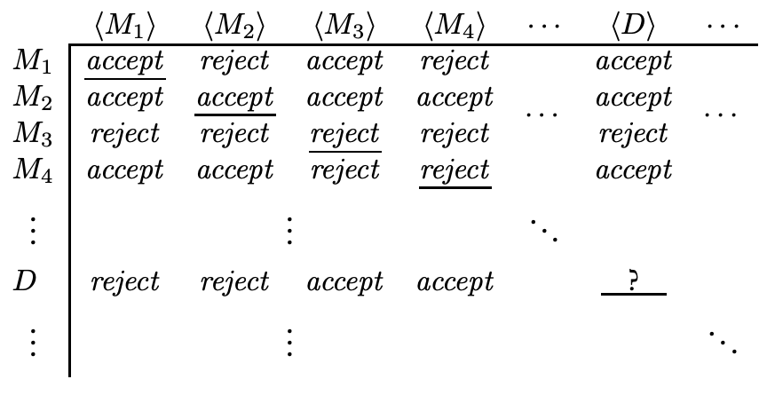
Do undecidable languages exist?
This is really a proof by diagonalization

Slide 22
Do undecidable languages exist?
This is really a proof by diagonalization
Each entry is a machine’s output when another machine’s description is given as input
But this entry has to be both accept and reject at the same time, leading to the contradiction
D is defined to be the machine that has the opposite output from the corresponding diagonal (see green outlines)

Slide 23
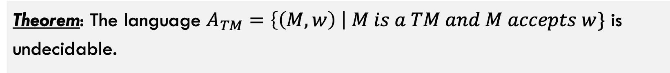
Do undecidable languages exist?
Theorem: The language $A_{TM}=\left\{\left(M,w\right) \right| M is a TM and M accepts w\}$ is undecidable.
Thus it is proven, and there is at least one undecidable language

Slide 24
Part 3: Non-Recognizable Languages?

Slide 25
Non-Turing Recognizability?
Is it possible to find languages that are NOT Turing recognizable?
Yes, but we will need to discuss the idea of the complement of a language first.

Slide 26

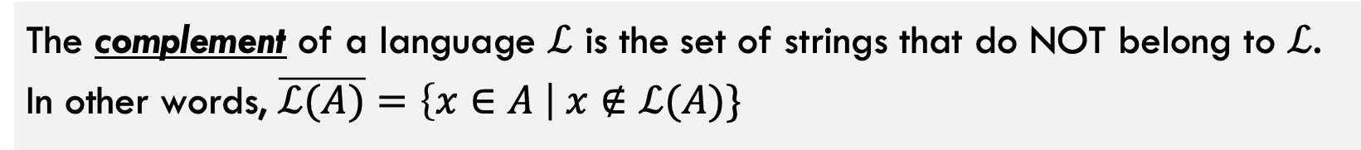

Definition: Complement of a Language
The complement of a language $ℒ$ is the set of strings that do NOT belong to $ℒ$. In other words, $\overline{ℒ(A)}=\left\{x∈A \right| x∉ℒ(A)\}$
Some Examples:
$$ℒ(A)$$
$$\overline{ℒ(A)}$$
Strings containing less than ten 1’s
Strings containing ten or more 1’s
DFA <D> accepts string <w>
DFA <D> rejects string <w>
TM <M> halts on input <w>
TM <M> loops forever on input <w>

Slide 27
More on complements
TM <M> halts on input <w>
Accept: Input on tape is in language
Some Turing Machine
Executes on input / tape
In language above, Accepts (Yes) is easy because if machine halts we are sure it is a Yes
Reject: Input on tape is NOT in language
However, detecting the Looping Forever case is difficult to ascertain. Is the machine just taking a long time?
Loop: TM runs forever, never reaching accept or reject state

Slide 28
More on complements
TM <M> loops forever on input <w>
Accept: Input in language
Some Turing Machine
Executes on input / tape
Now, Rejecting (No) is easy. If we halt then we output Reject (No).
Reject: Input Not in language
Loop: TM runs forever
Now, distinguishing between Halt (Yes) and Looping Forever is hard. Is the machine just taking a long time and we should really reject or is it actually looping forever?

Slide 29



Co-Turing Recognizable
A language $ℒ$ is co-Turing recognizable iff the complement $\overline{ℒ}$ is Turing recognizable.
$$ℒ(A)$$
$$\overline{ℒ(A)}$$
TM <M> loops forever on input <w>
TM <M> halts on input <w>
Is recognizable as shown earlier

Slide 30
Another way to define decidability
Theorem: A language is decidable if and only if it is Turing-recognizable and it is co-Turing-recognizable
How to prove this?
Direction 1: If language is decidable → It is T-Rec. and Co-T-Rec.
Direction 2: If language is T-Rec. and Co-T-Rec. → It is decidable

Slide 31
Proving the theorem
Theorem: A language is decidable if and only if it is Turing-recognizable and it is co-Turing-recognizable
Direction 1: If language is decidable → It is T-Rec. and Co-T-Rec.
Recognizer
D
If D accepts, accept
Input w
If D rejects, reject
Assume language A is decidable
Thus, a machine that decides A (let’s call it D) must exist
Co-Recognizer
D
If D accepts, reject
Input w
If D rejects, accept

Slide 32
Proving the theorem
Theorem: A language is decidable if and only if it is Turing-recognizable and it is co-Turing-recognizable
Direction 2: If language is T-Rec. and Co-T-Rec. → It is decidable
Recognizer
R
D
Recognizer
Assume A is TR and Co-TR
Thus, machines that recognize each exists
R
If R accepts, accept
Non-deterministically run R and CR in parallel
Input w
Co-Recognizer
Co-Recognizer
CR
CR
If CR accepts, reject
Use these to construct a decider for A

Slide 33
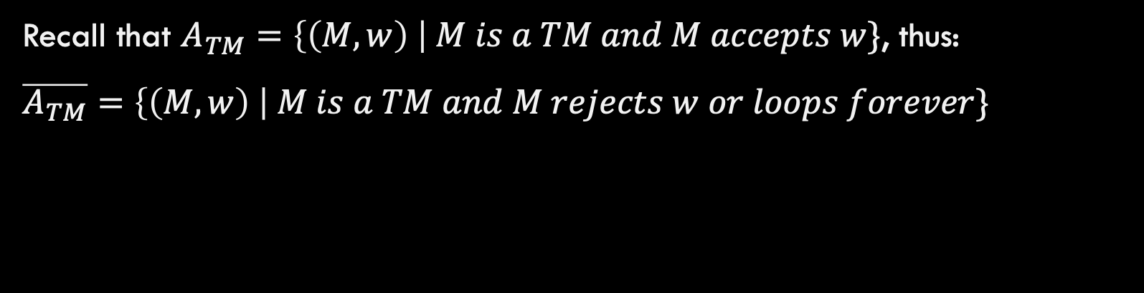

UnRecognizability!
Finally ready to find an unrecognizable language
Theorem: $\overline{A_{TM}}$ is unrecognizable.
Recall that $A_{TM}=\left\{\left(M,w\right) \right| M is a TM and M accepts w\}$, thus:
$\overline{A_{TM}}=\left\{\left(M,w\right) \right| M is a TM and M rejects w or loops forever\}$

Slide 34

UnRecognizability!
Finally ready to find an unrecognizable language
Theorem: $\overline{A_{TM}}$ is unrecognizable.
Can you prove it?
Assume for sake of contradiction that $\overline{A_{TM}}$ is recognizable
This means that $\overline{A_{TM}}$ (assumed) and $A_{TM}$ (proven earlier) are both recognizable
Thus, $A_{TM}$ is decidable by earlier theorem (both it and complement are recognizable)
Contradiction! $A_{TM}$ is undecidable as proven earlier.

Slide 35
Part 4: Introduction to Reducibility

Slide 36
What is Reducibility?
Reduction: A process through which problems are related to one another through comparison. This comparison establishes that one problem can be solved if the other is.
Problem: I wanted to visit Japan (during Covid)! Wife’s Obaachan was sick.
Get Covid Visa Exception
This one was hard!
Book ticket(s)
Travel on plane, etc.
These are all easy!
Go visit Obaachan

Slide 37
What is Reducibility?
Reduction: A process through which problems are related to one another through comparison. This comparison establishes that one problem can be solved if the other is.
Problem: I wanted to visit Japan (during Covid)! Wife’s Obaachan was sick.
Problem: Get Covid Visa Exception.
Get Covid Visa Exception
Retrieve Marriage Paperwork (Japan)
Now this one is hard!
Book ticket(s)
Acquire invite from citizen
Reduces to
Travel on plane, etc.
Bring paperwork to embassy in DC
Go visit Obaachan
…

Slide 38
What is Reducibility?
Problem: I wanted to visit Japan (during Covid)! Wife’s Obaachan was sick.
Problem: Get Covid Visa Exception.
Get Covid Visa Exception
Retrieve Marriage Paperwork (Japan)
Book ticket(s)
Acquire invite from citizen
Reduces to
Travel on plane, etc.
Bring paperwork to embassy in DC
Go visit Obaachan
…
Question: What if it is a FACT that “me getting to Japan during Covid is impossible”? What can you then conclude is also impossible? Why?

Slide 39
Reduction Process
Reduction: A reduction exists between problems A and B if a solution to B can be used to develop a solution for A.
Problem A
Solve problem B
Problem B
Do easy work
Reduces to
Solve problem B
Do more easy work
…

Slide 40



The Halting Problem
The Halting Problem: Given a Turing machine, does it halt: $$Halt_{TM}=\left\{\left(M,w\right) \right| M is a TM and M halts on input w\}$$
$$A_{TM}(M,w)$$
Accept if M accepts
$$Halt_{TM}(M,w)$$
Reject if M rejects
Reduces to
Does M halt on w?
Reject if M loops forever
If I can solve the problem in green, then I can solve both of these problems!!

Slide 41


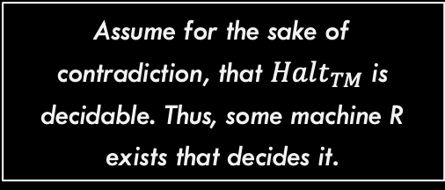
The Halting Problem
$$A_{TM}(M,w)$$
Accept if M accepts
$$Halt_{TM}(M,w)$$
Reject if M rejects
Reduces to
Does M halt on w?
Reject if M loops forever
Machine M, on input w:
- Invoke R on (M,w) to see if M halts. If not, reject. - Else simulate M on input w: - If M accepts, then accept. - If M rejects, then reject.
Assume for the sake of contradiction, that $Halt_{TM}$ is decidable. Thus, some machine R exists that decides it.
Then, this machine would decide Atm, but that contradicts our theorem that ATM is undecidable. Thus, halt is also undecidable

Slide 42
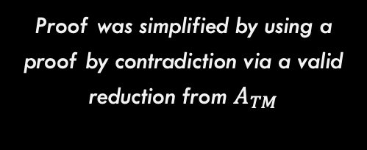

The Halting Problem
Theorem: $Halt_{TM}$ is undecidable
Proof was simplified by using a proof by contradiction via a valid reduction from $A_{TM}$

Slide 43

TM Emptiness Testing
Emptiness Test: Can you use a similar reduction to show $E_{TM}$ is undecidable?
$$E_{TM}=\left\{M \right| M is a TM and L\left(M\right)=∅ \}$$
In other words, test whether the given machine never accepts

Slide 44
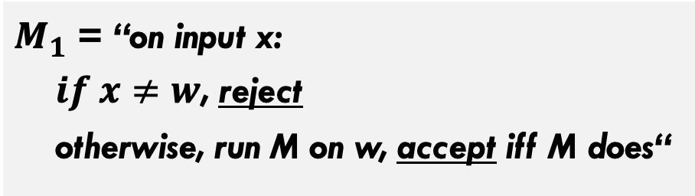

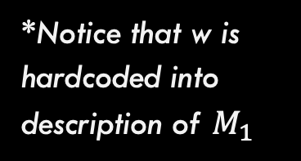
TM Emptiness Testing
Emptiness Test: Can you use a similar reduction to show $E_{TM}$ is undecidable?
$$E_{TM}=\left\{M \right| M is a TM and L\left(M\right)=∅ \}$$
Step 0: Assume, for sake of contradiction, a machine R decides $E_{TM}$
Step 1: Modify M:
*Notice that w is hardcoded into description of $M_{1}$
$M_{1}$ = “on input x: $if x≠w$, reject otherwise, run M on w, accept iff M does“
Why is this helpful?

Slide 45
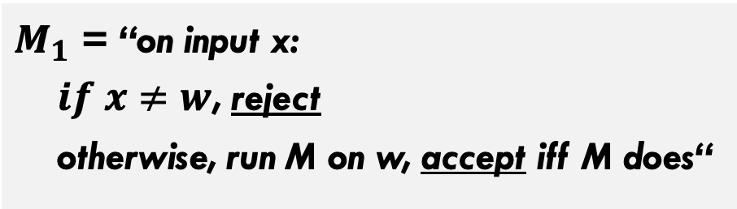

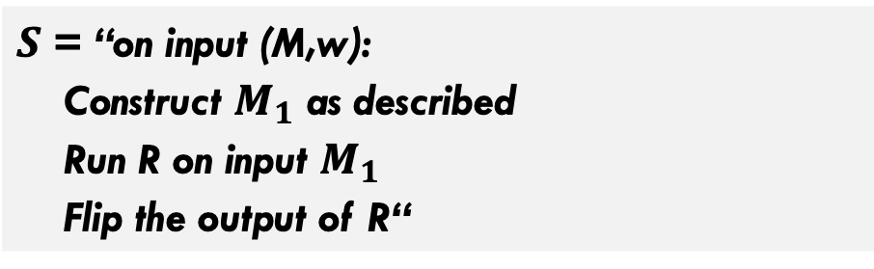
TM Emptiness Testing
Emptiness Test: Can you use a similar reduction to show $E_{TM}$ is undecidable?
$$E_{TM}=\left\{M \right| M is a TM and L\left(M\right)=∅ \}$$
Step 0: Assume, for sake of contradiction, a machine R decides $E_{TM}$
Step 1: Modify M:
Step 2: Solve Atm
$M_{1}$ = “on input x: $if x≠w$, reject otherwise, run M on w, accept iff M does“
$S$ = “on input (M,w): Construct $M_{1}$ as described Run R on input $M_{1}$ Flip the output of R“
Key Idea: M1 can only accept w
So, testing emptiness on M1 = testing acceptance of M on w

Slide 46
TM Emptiness Testing
Emptiness Test: Can you use a similar reduction to show $E_{TM}$ is undecidable?
$$E_{TM}=\left\{M \right| M is a TM and L\left(M\right)=∅ \}$$
Thus, $E_{TM}$ is undecidable via reduction from $A_{TM}$!!

Slide 47
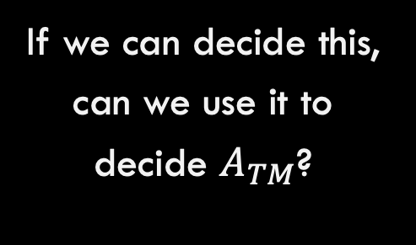

One More Example
Regular?: Prove this language is undecidable through reduction.
$$Reg_{TM}=\left\{M \right| M is a TM and L\left(M\right) is a regular language\}$$
If we can decide this, can we use it to decide $A_{TM}$?
Similar idea! Construct a machine that recognizes non-regular languages

Slide 48
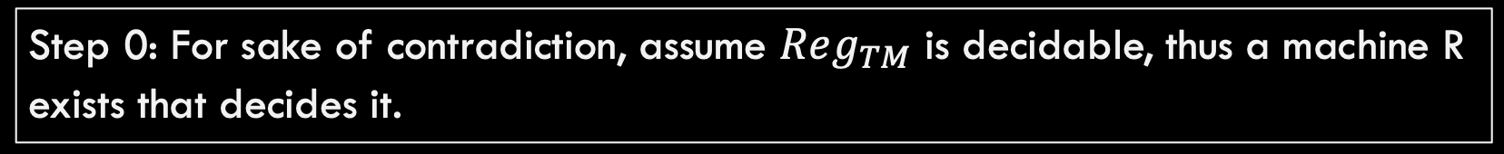

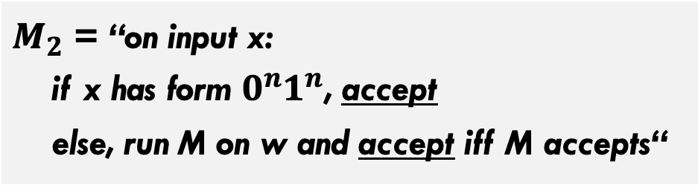

One More Example
Regular?: Prove this language is undecidable through reduction.
$$Reg_{TM}=\left\{M \right| M is a TM and L\left(M\right) is a regular language\}$$
Step 0: For sake of contradiction, assume $Reg_{TM}$ is decidable, thus a machine R exists that decides it.
Step 1: Construct $M_{2}$:
Similar idea! Construct a machine that recognizes non-regular languages
$M_{2}$ = “on input x: if x has form $0^{n}1^{n}$, accept else, run M on w and accept iff M accepts“

Slide 49
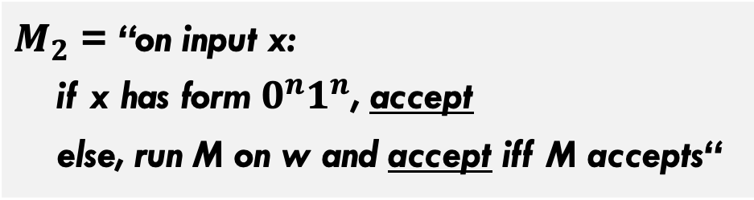

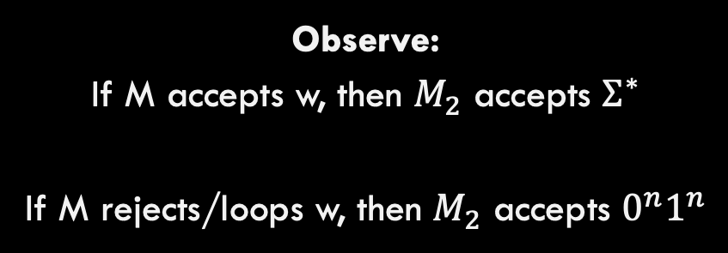
One More Example
Regular?: Prove this language is undecidable through reduction.
$$Reg_{TM}=\left\{M \right| M is a TM and L\left(M\right) is a regular language\}$$
Step 0: For sake of contradiction, assume $Reg_{TM}$ is decidable, thus a machine R exists that decides it.
Observe: If M accepts w, then $M_{2}$ accepts $Σ^{∗}$ If M rejects/loops w, then $M_{2}$ accepts $0^{n}1^{n}$
Step 1: Construct $M_{2}$:
$M_{2}$ = “on input x: if x has form $0^{n}1^{n}$, accept else, run M on w and accept iff M accepts“

Slide 50
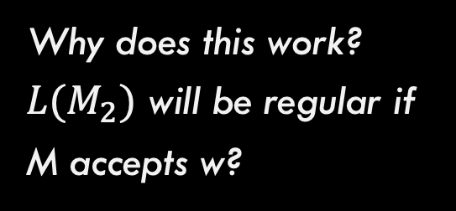
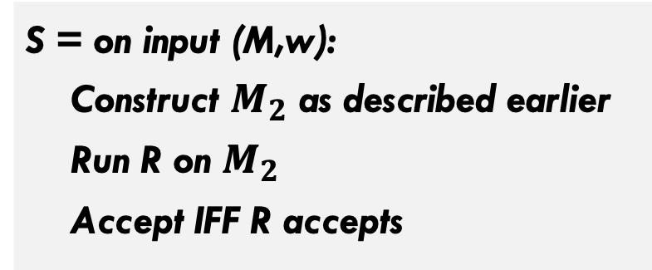

One More Example
Regular?: Prove this language is undecidable through reduction.
$$Reg_{TM}=\left\{M \right| M is a TM and L\left(M\right) is a regular language\}$$
Step 0: For sake of contradiction, assume $Reg_{TM}$ is decidable, thus a machine R exists that decides it.
Step 2: Recognize $A_{TM}$
S = on input (M,w): Construct $M_{2}$ as described earlier Run R on $M_{2}$ Accept IFF R accepts
Why does this work? $L(M_{2})$ will be regular if M accepts w?

