Slide 1
Defining “Computation”
Discrete Mathematics and Theory 2 Mark Floryan

Slide 2
Goals!
1. What exactly is “computation”. What exactly do we mean by “computation”? Let’s define these things clearly and explicitly.
2. What is the birds-eye view of theory of computation (for our course!). Are there different ways to “compute” that have strengths and weaknesses?
3. What ”Math” do we need in order to start thinking about computation properly, and why?

Slide 3
Part 1: What is Computation? What is a Computer?

Slide 4
What is a Computer?
Class discussion:
What is a computer? What do you think?

Slide 5
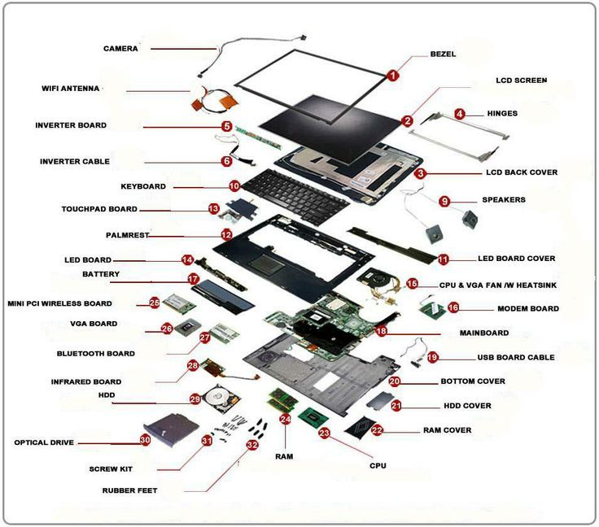
Discussion: What parts are necessary at minimum?

Slide 6
My Answer
CPU (Instruction Set) Memory (RAM)
Input
Output

Slide 7
My Answer
This is a computer!
Computing Machine / Program / Algorithm
Input
Output
Can be from a mouse/keyboard, or from a network socket, or whatever!
Same! Can be to a monitor, or anything else!

Slide 8
Defining INPUT and Output
Computing Machine / Program / Algorithm
Input
Output
Let’s focus on these two first!!

Slide 9
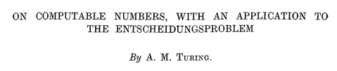
Defining INPUT and Output
Computing Machine
/ Program / Algorithm
Output
Input
What are the “types”?
What we compute on: representations of things (e.g. numbers)

Slide 10
Defining INPUT and Output
Computing Machine
/ Program / Algorithm
Output
Input
Input and output are strings
Black box is an implementation
What are we implementing?
Functions: Transformations from a set of strings to another set of strings. More on this soon!

Slide 11
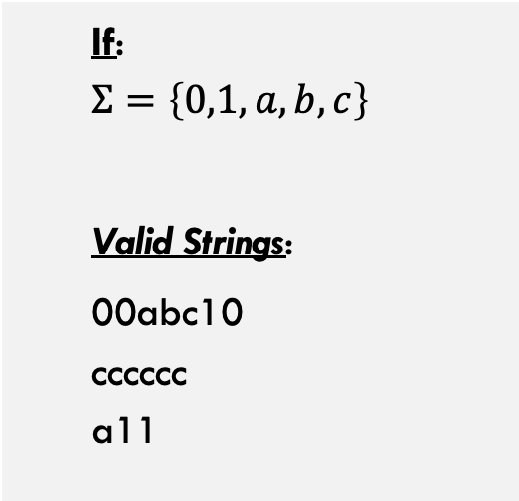
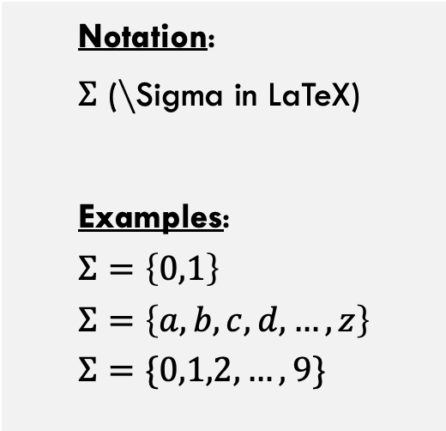
Defining INPUT and Output
An Alphabet is a finite set of characters
Strings are built up from an Alphabet
Notation:
$Σ$ (\Sigma in LaTeX)
Examples:
$$Σ=\left\{0,1\right\}$$
$$Σ=\left\{a,b,c,d,…,z\right\}$$
$$Σ=\{0,1,2,…,9\}$$
If:
$$Σ=\left\{0,1,a,b,c\right\}$$
Valid Strings:
00abc10 cccccc a11

Slide 12




Defining INPUT and Output
We can define structure of a string in various ways. Examples:
$$Σ^{n}$$
The set of all length n strings over alphabet $Σ$
The set of 3-bit strings. $${\left\{0,1\right\}}^{3}=\left\{\left(x_{0},x_{1},x_{2} \right) :x_{0},x_{1},x_{2}∈\left\{0,1\right\}\right\} \\ {\left\{0,1\right\}}^{3}=\left\{000,001,010,011,100,101,110,111\right\}$$
$${\left\{0,1\right\}}^{3}$$
Pop Quiz: If $\left|Σ\right|=m$, then $\left|Σ^{n}\right|=?$

Slide 13




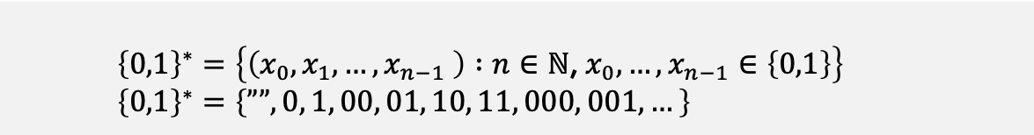
Defining Input and Output
The * operator refers to a string of any length, including 0
$$Σ^{∗}$$
The set of all strings over alphabet $Σ$ of any length (including 0)
$${\left\{0,1\right\}}^{∗}=\left\{\left(x_{0},x_{1},…,x_{n−1} \right) :n∈\text{ℕ}\text{, }x_{0},…,x_{n−1}∈\left\{0,1\right\}\right\} \\ {\left\{0,1\right\}}^{∗}=\left\{””, 0, 1, 00, 01, 10, 11, 000, 001,…\right\}$$
$${\left\{0,1\right\}}^{∗}$$
Note that:
${\left\{0,1\right\}}^{3}=\left\{000, 001, 010, 011,…\right\}$
The set of three-bit strings
Note that:
${\left\{0,1\right\}}^{∗}={\left\{0,1\right\}}^{0}∪{\left\{0,1\right\}}^{1}∪{\left\{0,1\right\}}^{2}∪…$
${\left\{0,1\right\}}^{∗}=\bigcup_{n∈ℕ}{{\left\{0,1\right\}}^{n}}$

Slide 14
Defining Computation
CPU (Instruction Set) Memory (RAM)
Input
Output
Ok! What about this part?

Slide 15

Computing a Function
Computing Machine
/ Program / Algorithm
Output
Input
Definition of computation is based on functions
A function $f$ is computable under a computing model if:
That model allows for an implementation (way of filling in the black box) such that,
For any input $x∈D$ (string representing an element from the domain of $f$)
The implementation “produces” the correct output

Slide 16
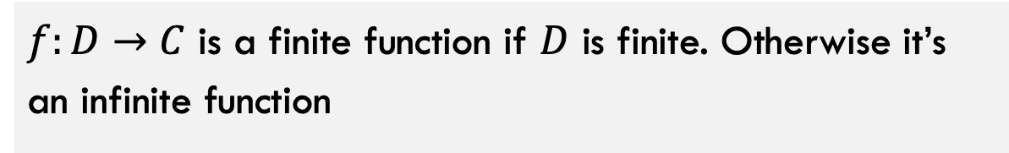
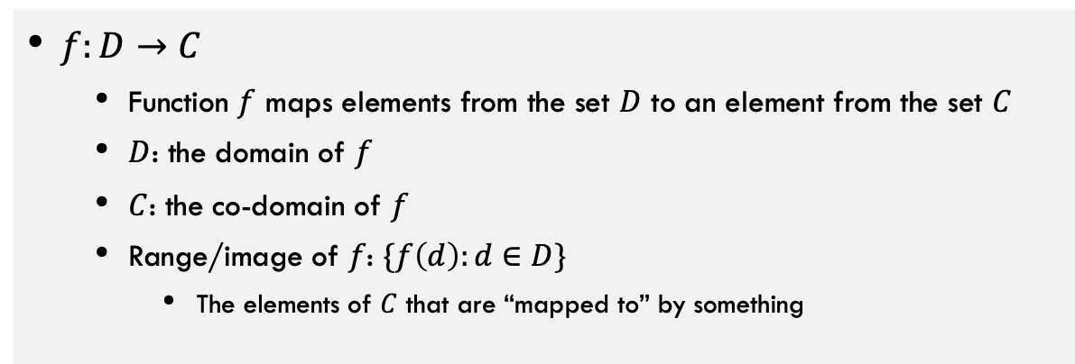
Defining Computation
Function: a “mapping” from input to output
$f:D→C$
Function $f$ maps elements from the set $D$ to an element from the set $C$
$D$: the domain of $f$
$C$: the co-domain of $f$
Range/image of $f$: $\{f\left(d\right):d∈D\}$
The elements of $C$ that are “mapped to” by something
Finite function: a function with a finite domain
$f:D→C$ is a finite function if $D$ is finite. Otherwise it’s an infinite function

Slide 17
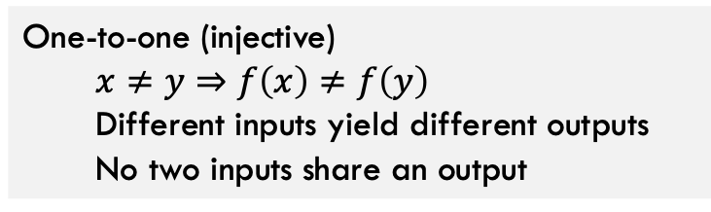
Injective Functions
Domain
Co-Domain
Domain
Co-Domain
INJECTIVE FUNCTION
NON-INJECTIVE FUNCTION
One-to-one (injective)
$$x≠y⇒f\left(x\right)≠f\left(y\right)$$
Different inputs yield different outputs
No two inputs share an output

Slide 18
Onto, Surjective Functions
Domain
Co-Domain
Domain
Co-Domain
SURJECTIVE FUNCTION
NON-SURJECTIVE FUNCTION
Everything in Co-Domain “receives” something

Slide 19
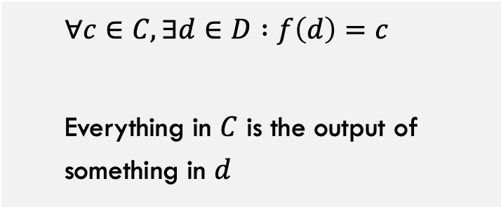
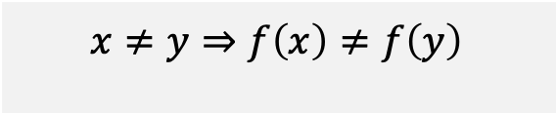
Properties of Functions
One-to-one (injective)
Onto (surjective)
$$x≠y⇒f\left(x\right)≠f\left(y\right)$$
$$∀c∈C, ∃d∈D :f\left(d\right)=c$$
Everything in $C$ is the output of something in $d$

Slide 20

Properties of Functions
One-to-one (injective)
$x≠y⇒f\left(x\right)≠f\left(y\right)$
Onto (surjective)
$∀c∈C, ∃d∈D :f\left(d\right)=c$
One-to-one Correspondence (bijective)
Both one-to-one and surjective
Everything in $C$ is mapped to by a unique element in $D$
All elements from domain and co-domain are perfectly “partnered”

Slide 21
Bijective Functions
Domain
Co-Domain
Because Onto:
Everything in Co-Domain “receives” something
Because 1-1:
Nothing in Co-Domain “receives” two things
BIJECTIVE FUNCTION
Conclusion:
Things in the Domain exactly “partner” with things in Co-Domain

Slide 22
Overview of Computation!
Computing Machine / Program / Algorithm
Input
Output
Input / Output are Strings
Computing Machine is something that implements a set of functions that we care about.

Slide 23
Part 2: Bird’s Eye View of Theory of Computation?

Slide 24
Overview of Theory of Computation
Defining Computation
Input
Computing Machine / Program / Algorithm
Output
Computational Models
Circuits
Finite Automata
Pushdown Automata
Turing Machine
RAM Model
<
<
<
=
Computational Complexity
Decidability
P, NP, NP-Hard
P-Space, Co-NP, etc

Slide 25
Part 3: Background Math

Slide 26
Objects That We’ll Need
Sets
Functions (already started looking at this)
Strings (already looked at this briefly)

Slide 27
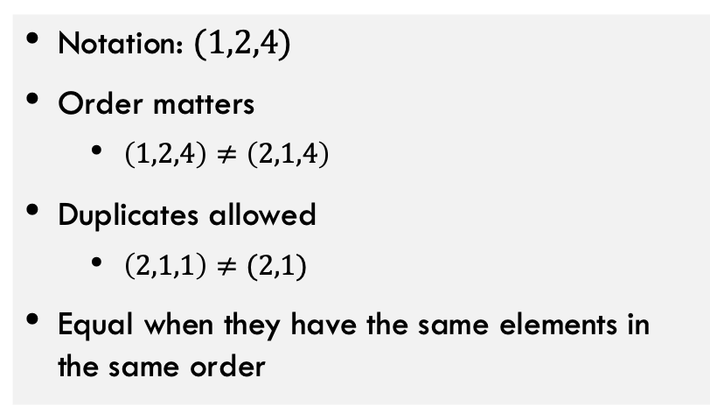
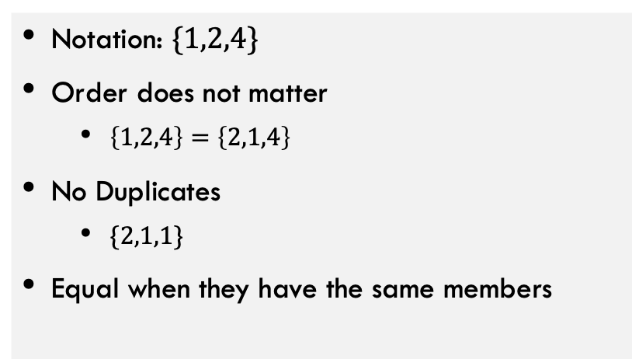
Review: Sets
Sets
Sequences/Tuples
Notation: $\{1,2,4\}$
Order does not matter
$\left\{1,2,4\right\}=\left\{2,1,4\right\}$
No Duplicates
$\{2,1,1\}$
Equal when they have the same members
Notation: $(1,2,4)$
Order matters
$\left(1,2,4\right)≠\left(2,1,4\right)$
Duplicates allowed
$\left(2,1,1\right)≠(2,1)$
Equal when they have the same elements in the same order

Slide 28


Review: Set Operators
$=$
$∈$
$⊆$
$⊇$
$⊂$
$⊃$
$∪$
$∩$
$∖$ or $−$
$×$
$𝒫\left(S\right)$

Slide 29
Review: Set Operators
$=$
$∈$
$⊆$
$⊇$
$⊂$
$⊃$
Set equality
$∪$
$∩$
$∖$ or $−$
$×$
$𝒫\left(S\right)$
Set Union
Set membership
Set Intersection
Subset
Set Difference
Superset
Cross Product
Proper Subset
Power Set
Proper Superset

Slide 30

Important Sets
$$∅$$
$$ℕ$$
$$ℤ$$
$$ℚ$$
$$\left\{0,1\right\}$$

Slide 31

Important Sets
$$∅$$
$$ℕ$$
$$ℤ$$
$$ℚ$$
$$\left\{0,1\right\}$$
Null Set; Set containing nothing
Natural Numbers = {0, 1, 2, 3, …}
Integers = {…, -3, -2, -1, 0, 1, 2, 3, …}
Rational Numbers = $\left\{\frac{x}{y}\right|x,y∈ℤ\}$
Set containing 0 and 1 (common alphabet for binary #s)

Slide 32
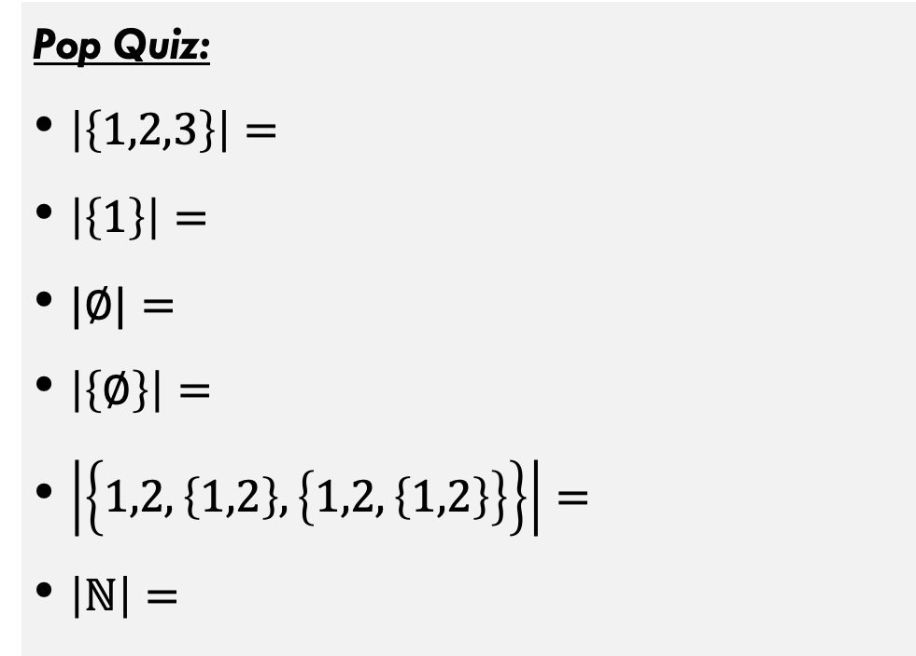

Set Cardinality
The number of distinct members of a set.
How many things I could put on the left hand side of $∈$ to make the statement true?
Pop Quiz:
$\left|\left\{1,2,3\right\}\right|=$
$\left|\left\{1\right\}\right|=$
$|∅|=$
$\left|\left\{∅\right\}\right|=$
$\left|\left\{1,2,\left\{1,2\right\},\left\{1,2,\left\{1,2\right\}\right\}\right\}\right|=$
$\left|ℕ\right|=$

Slide 33
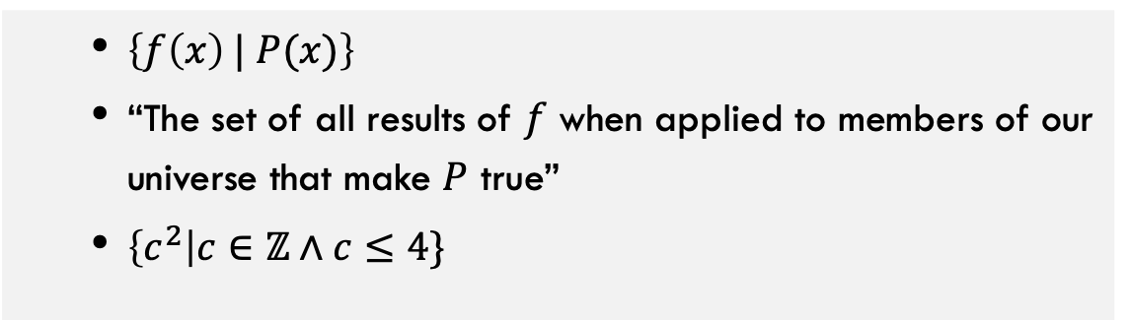
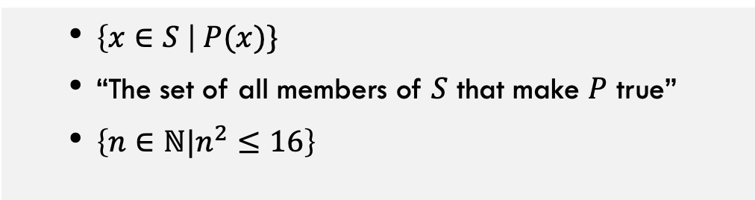
Set Builder Notation
$\left\{x∈S \right| P(x)\}$
“The set of all members of $S$ that make $P$ true”
$\left\{n∈ℕ|n^{2}≤16\right\}$
Version 1:
$\left\{f\left(x\right) | P(x)\right\}$
“The set of all results of $f$ when applied to members of our universe that make $P$ true”
$\left\{c^{2}\right|c∈ℤ∧c≤4\}$
Version 2:

Slide 34

Comparing Cardinalities with Functions
Two sets have the same cardinality if there is a bijection between them
What does it mean for a set to have cardinality 5?
It has a bijection with the set $\left[5\right]=\left\{0,1,2,3,4\right\}$
A finite set has cardinality $k$ if it has a bijection with the set $\left[k\right]=\left\{n :n∈\text{ℕ}∧n<k\right\}$
An infinite set has no bijections with any set $[k]$ for $k∈\text{ℕ}$

Slide 35
Are all functions computable?
How could we approach this question?

Slide 36
Implementing a Function
Examples of ways to implement a function:
Properties we want of implementations:

Slide 37
Coming Up!
For any “reasonable” model of computing, there will be some uncomputable functions

Slide 38
Review of this deck!
A computer is any process that can take strings as input and produce strings as output.
Computation of that machine / computer is a function (it maps inputs to outputs)
Moving forward:
More math background
Different types of computers and the pros / cons of each

