Slide 1
Cardinality
Discrete Mathematics and Theory 2 Mark Floryan

Slide 2
Goals!
1. How do we use functions to compare the sizes of sets? Why might this be useful as we move forward talking about computation?
2. Do all infinite sets have the same size? What can this tell us (already) about the theory of computation?

Slide 3



Reminder: Bijective Functions
Domain
Co-Domain
Because 1-1:
Nothing in Co-Domain “receives” two things
$\left|C\right|≥|D|$
Because Onto:
Everything in Co-Domain “receives” something
$\left|D\right|≥|C|$
BIJECTIVE FUNCTION
Conclusion:
Things in the Domain exactly “partner” with things in Co-Domain
**Note: This means that $\left|D\right|=|C|$

Slide 4
Practice: $\left|{\left\{0,1\right\}}^{n}\right|=2^{n}$ via bijection
Theorem: $\left|{\left\{0,1\right\}}^{n}\right|=2^{n}$
How do we show this? Any ideas?

Slide 5

$\left|{\left\{0,1\right\}}^{n}\right|=2^{n}$ via bijection
Proof idea:
Find a bijection $f_{n}:{\left\{0,1\right\}}^{n}↔\left\{x∈ℕ|x<2^{n}\right\}$
Given $b∈{\left\{0,1\right\}}^{n}$, what is $f_{n}\left(b\right)∈\left\{x∈ℕ|x<2^{n}\right\}$?
$f_{n}\left(b\right)=\sum_{i=0}^{n−1}{{b_{i}⋅2}^{i}}$
E.g. $1101=1⋅2^{0}+0⋅2^{1}+1⋅2^{2}+1⋅2^{3}=13$
In other words, let each item b map to the natural number corresponding to the binary representation!!

Slide 6
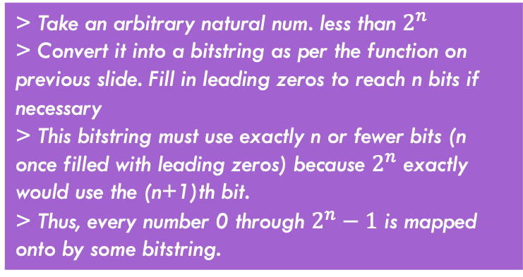
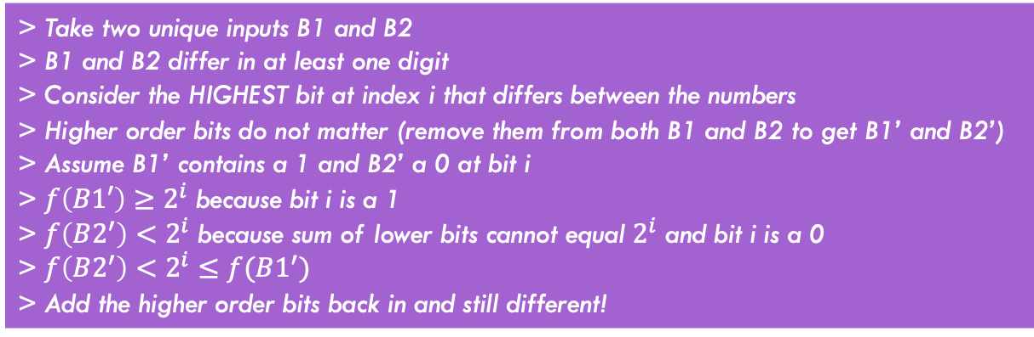

Practice: $\left|{\left\{0,1\right\}}^{n}\right|=2^{n}$ via bijection
Theorem: $\left|{\left\{0,1\right\}}^{n}\right|=2^{n}$
Is the mapping we provided injective (Every input has unique output)? Why?
Is the mapping we provided surjective (Every value less than $2^{n}$ is covered)? Why?
> Take two unique inputs B1 and B2
> B1 and B2 differ in at least one digit
> Consider the HIGHEST bit at index i that differs between the numbers
> Higher order bits do not matter (remove them from both B1 and B2 to get B1’ and B2’)
> Assume B1’ contains a 1 and B2’ a 0 at bit i
> $f\left(B1′\right)≥2^{i}$ because bit i is a 1
> $f\left(B2^{′}\right)<2^{i}$ because sum of lower bits cannot equal $2^{i}$ and bit i is a 0
> $f\left(B2^{′}\right)<2^{i}≤f(B1^{′})$
> Add the higher order bits back in and still different!
> Take an arbitrary natural num. less than $2^{n}$
> Convert it into a bitstring as per the function on previous slide. Fill in leading zeros to reach n bits if necessary
> This bitstring must use exactly n or fewer bits (n once filled with leading zeros) because $2^{n}$ exactly would use the (n+1)th bit.
> Thus, every number 0 through $2^{n}−1$ is mapped onto by some bitstring.

Slide 7
Practice 2
Theorem: For a finite set $S$, $\left|𝒫\left(S\right)\right|={|\left\{0,1\right\}}^{|S|}|$
How do we show this? Any ideas?

Slide 8

For a finite set $S$, $\left|𝒫\left(S\right)\right|={\left\{0,1\right\}}^{|S|}$
Find a function $f:𝒫\left(S\right)↔{\left\{0,1\right\}}^{|S|}$
Example: let $S=\left\{1,2,3\right\}$
$𝒫\left(S\right)=\left\{∅, \left\{1\right\}, \left\{2\right\}, \left\{3\right\}, \left\{1,2\right\}, \left\{1,3\right\}, \left\{2,3\right\}, \{1,2,3\}\right\}$
$f\left(\left\{1,2\right\}\right)=110$
$f\left(∅\right)=000$
Bijection: give each value of $S$ an index, for a particular subset of S, make the bit at that index 0 if it is absent, otherwise make it 1.

Slide 9
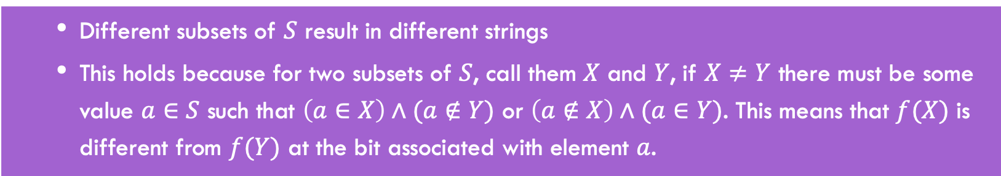
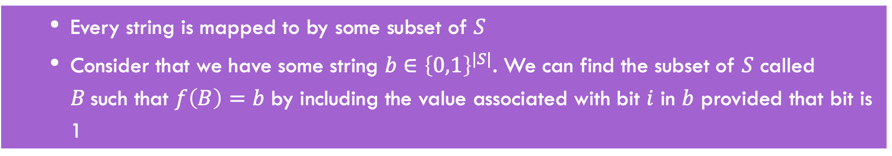
Why is this a bijection?
Show that it’s injective
Different subsets of $S$ result in different strings
This holds because for two subsets of $S$, call them $X$ and $Y$, if $X≠Y$ there must be some value $a∈S$ such that $\left(a∈X\right)∧(a∉Y)$ or $\left(a∉X\right)∧(a∈Y)$. This means that $f(X)$ is different from $f(Y)$ at the bit associated with element $a$.
Show that it’s surjective
Every string is mapped to by some subset of $S$
Consider that we have some string $b∈{\left\{0,1\right\}}^{|S|}$. We can find the subset of $S$ called $B$such that $f\left(B\right)=b$ by including the value associated with bit $i$ in $b$ provided that bit is 1

Slide 10
Part 3: Comparing Sizes of Infinite Sets

Slide 11
Infinite Cardinality
How do we compare the sizes of two infinite sets? Wait…do they not automatically have the same size?

Slide 12

Infinite Cardinality
We say that for (infinite) sets $A$ and $B$, that $\left|A\right|=|B|$ if there is a bijection $f:A↔B$

Slide 13

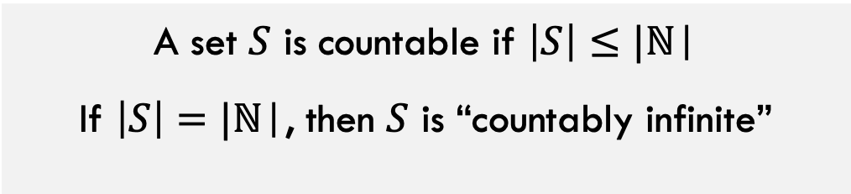
Countability and Uncountability
A set $S$ is countable if $\left|S\right|≤|\text{ℕ}\text{|}$
If $\left|S\right|=|\text{ℕ}\text{|}$, then $S$ is “countably infinite”
A set $S$ is countable if there is an onto (surjective) function from $\text{ℕ}$ to $S$
Otherwise a set is uncountable.

Slide 14
Practice: Show that $\left|{\left\{0,1\right\}}^{∗}\right|=|ℕ|$

Slide 15
${\left\{0,1\right\}}^{∗}$ is countable
Need to “represent” strings with naturals
Idea: build a “list” of all strings, represent each string by its index in that list

Slide 16

Listing all strings (bad way)
$f_{bad}:{\left\{0,1\right\}}^{∗}→ℕ$ can be defined as follows:
$f_{bad}\left(s\right)=$ the number that $s$ represents
Why is this function not a bijection?

Slide 17

Listing all strings
0
“”
1
0
2
1
3
00
4
01
5
10
11
6
000
001
010
011
100
101
110
111
7
8
9
10
11
12
13
14
Formulaic version:
$$f\left(w∈{\left\{0,1\right\}}^{∗}\right)=2^{|w|}−1+b(w)$$
**Where b(w) is the integer value of the binary bitstring w

Slide 18
Why is this a bijection?
Injective: different strings map to different numbers:
Different strings map to different nodes in the tree
No two nodes in the tree have the same index
Surjective: every number appears
We listed them one by one and there are an infinite number of nodes.
0
“”
1
0
2
1
3
00
4
01
5
10
11
6
000
001
010
011
100
101
110
111
7
8
9
10
11
12
13
14

Slide 19

Demonstrate that each of the following is countable
$ℤ^{+}=ℕ∖\left\{0\right\}$
$\{n∈ℕ|n is even\}$
$\{n∈ℕ|n is odd\}$
$ℤ$
$ℕ×ℕ$
$ℚ$

Slide 20

Proof: $ℤ^{+}$ is countable
$f_{+}:ℤ^{+}↔ℕ$

Slide 21

Proof: $\{n∈ℕ|n is even\}$ is countable
$f_{e}:\{n∈ℕ|n is even\}↔ℕ$

Slide 22

Proof: $\{n∈ℕ|n is odd\}$ is countable
$f_{0}:\{n∈ℕ|n is odd\}↔ℕ$

Slide 23

$ℤ$ is countable
To build $f_{z}:ℤ↔ℕ$
Idea: map natural numbers to evens, map negative numbers to odds
$f_{z}\left(x\right)=$
$f_{e}^{−1}(x)$ If $x∈ℕ$
$f_{o}^{−1}(−x)$ if $x∈ℤ^{−}$
Note that this means that if $A$ and $B$ are both countable then $A∪B$ is also countable!

Slide 24
$ℕ×ℕ$ is countable
Thoughts on how to prove it?

Slide 25


$ℕ×ℕ$ is countable
$$ℕ$$
0 1 2 3 4 5
$$ℕ$$
…
0
0,0 0,1 0,2 0,3 0,4 0,5
…
1
1,0 1,1 1,2 1,3 1,4 1,5
…
2
2,0 2,1 2,2 2,3 2,4 2,5
…
3
3,0 3,1 3,2 3,3 3,4 3,5
…
4
4,0 4,1 4,2 4,3 4,4 4,5
…
…
…
…
…
…

Slide 26

$ℚ$ is countable
Idea: there is a surjective mapping from $ℤ ×ℤ^{+}$ to $ℚ$
This one is left as an exercise (could be on homework or quiz)

Slide 27
Number of Programs As Number of Functions

Slide 28
How Many Python/Java programs?
How do we represent Java/Python programs?
How many things can we represent using that method?

Slide 29

How many functions $Σ^{∗}→Σ^{∗}$?
Short answer: Too many!
Uncountable
$\left|\left\{f \right|f:Σ^{∗}→Σ^{∗}\right\}|>|\text{ℕ}\text{|}$
Conclusion: Some functions cannot be computed by any java/python program
How to prove this?

Slide 30
How to show something is uncountable?

Slide 31
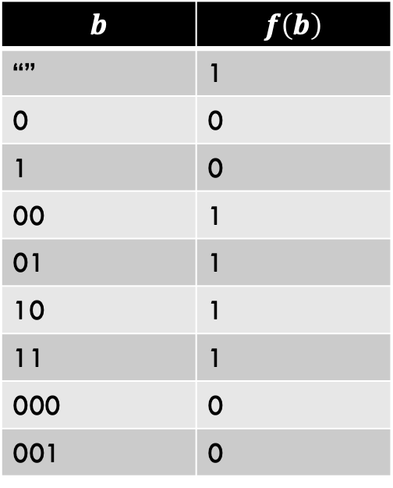

Uncountably many functions
$$b$$ | $$f\left(b\right)$$
“” | 1
0 | 0
1 | 0
00 | 1
01 | 1
10 | 1
11 | 1
000 | 0
001 | 0
If we show a subset of $\left\{f \right|f:Σ^{∗}→Σ^{∗}\}$is uncountable, then $\left\{f \right|f:Σ^{∗}→Σ^{∗}\}$ is uncountable too
Consider just the “yes/no” functions (decision problems):
$$\left\{f \right|f:{\{0,1\}}^{∗}→\{0,1\}\}$$

Slide 32

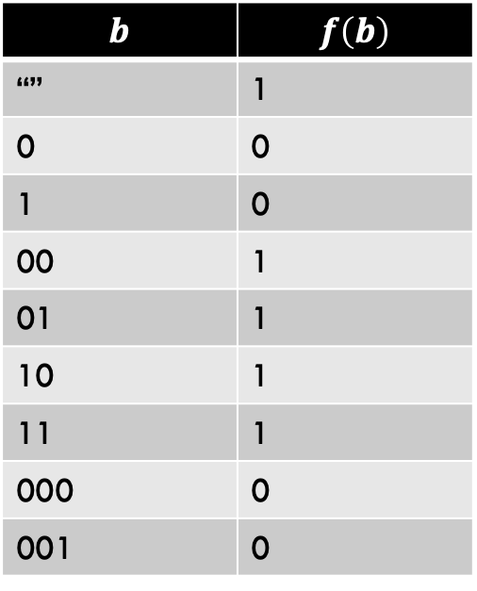
Goal: $\left\{f:{\left\{0,1\right\}}^{∗}→\{0,1\}\right\}$ is uncountable
$$b$$ | $$f\left(b\right)$$
“” | 1
0 | 0
1 | 0
00 | 1
01 | 1
10 | 1
11 | 1
000 | 0
001 | 0
Each function can be represented by a single infinite bitstring : ${\left\{0,1\right\}}^{∞}$ is a simpler representation of f
Show there is no onto mapping from $ℕ$ to ${\left\{0,1\right\}}^{∞}$
For example, this function can be fully described by the outputs only (the order of the inputs is fixed). So the right column (100111100…) fully describes this unique function

Slide 33


$$\left|{\left\{0,1\right\}}^{∞}\right|>|\text{ℕ}\text{|}$$
Idea:
show there is no way to “list” all infinite length binary strings
Any list of binary strings we could ever try will be leaving out elements of ${\left\{0,1\right\}}^{∞}$

Slide 34
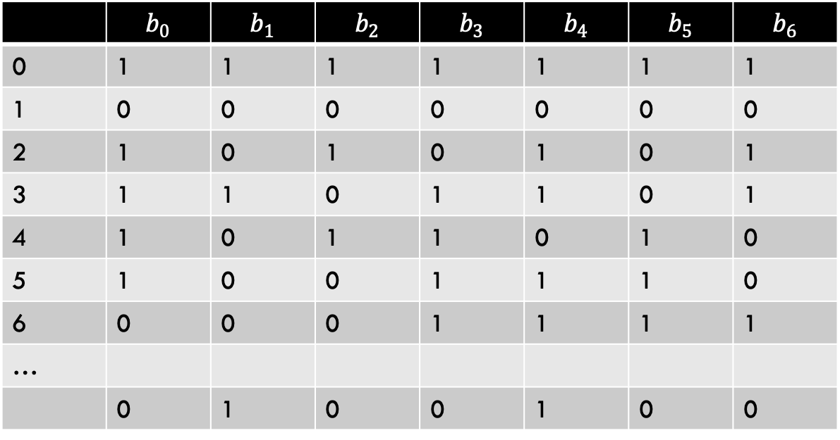
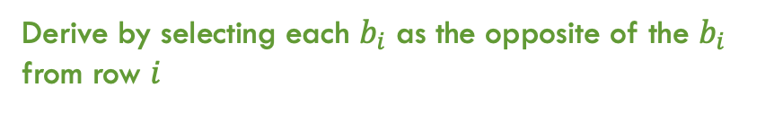

$$\left|{\left\{0,1\right\}}^{∞}\right|>|\text{ℕ}\text{|}$$
 | $$b_{0}$$ | $$b_{1}$$ | $$b_{2}$$ | $$b_{3}$$ | $$b_{4}$$ | $$b_{5}$$ | $$b_{6}$$
0 | 1 | 1 | 1 | 1 | 1 | 1 | 1
1 | 0 | 0 | 0 | 0 | 0 | 0 | 0
2 | 1 | 0 | 1 | 0 | 1 | 0 | 1
3 | 1 | 1 | 0 | 1 | 1 | 0 | 1
4 | 1 | 0 | 1 | 1 | 0 | 1 | 0
5 | 1 | 0 | 0 | 1 | 1 | 1 | 0
6 | 0 | 0 | 0 | 1 | 1 | 1 | 1
…
 | 0 | 1 | 0 | 0 | 1 | 0 | 0
Attempt at mapping $\text{ℕ}$ to ${\left\{0,1\right\}}^{∞}$
A string that our attempt missed
Derive by selecting each $b_{i}$ as the opposite of the $b_{i}$ from row $i$

Slide 35
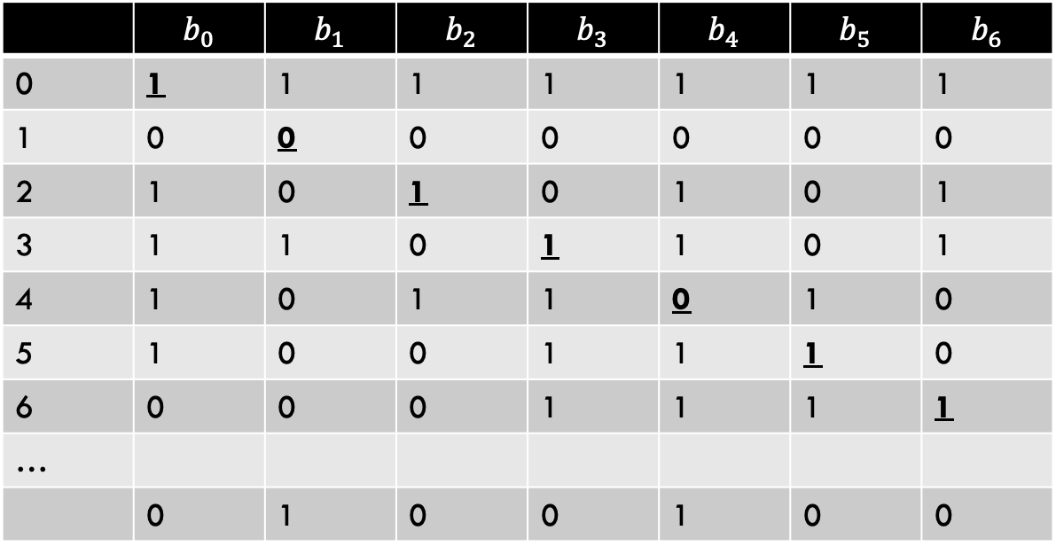
$$\left|{\left\{0,1\right\}}^{∞}\right|>|\text{ℕ}\text{|}$$
 | $$b_{0}$$ | $$b_{1}$$ | $$b_{2}$$ | $$b_{3}$$ | $$b_{4}$$ | $$b_{5}$$ | $$b_{6}$$
0 | 1 | 1 | 1 | 1 | 1 | 1 | 1
1 | 0 | 0 | 0 | 0 | 0 | 0 | 0
2 | 1 | 0 | 1 | 0 | 1 | 0 | 1
3 | 1 | 1 | 0 | 1 | 1 | 0 | 1
4 | 1 | 0 | 1 | 1 | 0 | 1 | 0
5 | 1 | 0 | 0 | 1 | 1 | 1 | 0
6 | 0 | 0 | 0 | 1 | 1 | 1 | 1
…
 | 0 | 1 | 0 | 0 | 1 | 0 | 0
Attempt at mapping $\text{ℕ}$ to ${\left\{0,1\right\}}^{∞}$
Take the bolded bits across the diagonal. Select a bitstring where each of these bits is flipped. In this example: 0100100…

Slide 36
Other countable/uncountable sets
Countable sets:
Integers
Rational numbers
Any finite set
Uncountable Sets:
Real numbers
The power set of any infinite set

Slide 37

Cantor’s Theorem
For any set $S$, $\left|S\right|<|2^{S}|$
Even if $S$ is infinite!
Idea:
$\left|S\right|≤|2^{S}|$ (why?)
There cannot be a bijection between $S$ and $2^{s}$
Not going to prove

Slide 38
Conclusion
There are countably many strings
And therefore text files representing python programs.
There are uncountably many functions
Some functions can’t be implemented

