Slide 1
CS3120 (DMT2)
Course Introduction
Discrete Mathematics and Theory 2
Mark Floryan, Ray Pettit

Slide 2
Quick Polls (Agree or Not?)
Q1: I have heard that DMT 2 is like…a really hard class!
Q2: I have heard that DMT 2 is a lot of work!
Q3: I have heard that DMT 2 material isn’t that important and that you will never really use it!

Slide 3
My Answers (1 to 10)
Q1: I have heard that DMT 2 is like…a really hard class!
8: Yes, the material is hard. There is no way around it <sad face>
Q2: I have heard that DMT 2 is a lot of work!
6: A lot of work to understand the concepts, but not a pile of work
Q3: I have heard that DMT 2 material isn’t that important and that you will never really use it!
3: This material is universal and timeless…I’ll explain a bit more verbally

Slide 4
Course Objectives

Slide 5
Course OBjectives
Students who complete the course will:
Improve their mathematical thinking skill and habits, including thinking precisely about definitions, stating assumptions carefully, critically reading arguments, and being able to write convincingly.
Be able to understand both finite and infinite formal models of computation and to reason about what they can and cannot compute.
Understand both intuitively and formally what makes some problems too expensive to solve, and what can be done in practice when an unsolvable or intractable problem is encountered.
Reason formally about the cost of computation, and be able to prove useful bounds on the costs of solving problems, including showing that certain problems are intractable.
Learn about some interesting aspects of theoretical computer science, including cryptography and machine learning.

Slide 6
Course introduction

Slide 7
General Info
See syllabus on course website for general information
Pre-requisites:
  CS 3100 (DSA2) if you are in the new curriculum (most of you, probably)
  CS 4102 (Algo) if you are in the old curriculum (Maybe a few of you)
  Math topics: proof by induction, proof by contradiction, etc. (Basically everything in DMT 1)
  Data Structures: Graphs and generally maturity proving things, etc.
Teaching Assistants
  Graduates (0):
    N/A
  Undergraduates (1)
    Michael Sy
  Both will hold office hours, which will start today
    Locations and hours mostly set on course website
  Also, we’ll use Piazza for questions.
    Post all questions about HW, topics, etc. to Piazza NOT email to instructors!

Slide 8
Course Website
https://markfloryan.github.io/dmt2/
Contains most of the important info for the course:
  Homework
  Slides
  Syllabus
  Etc…

Slide 9
Other Course Tools
Piazza: Use for course discussion among students and Tas regarding course content
Gradescope: For submitting homework and seeing your grades, etc.
Google Forms: Homework extension requests will be submitted through a form.
All of these will be linked from Collab and from course website

Slide 10
Expectations
Of you:
  When asked, prepare for things in advance
  Do NOT use laptops or phones in class!
  Participate in class activities when asked
  Act mature, professional.
  Please do not use a laptop in class
  Plan ahead.
  Don’t take advantage. Follow the Honor Code. (See the BOCM.)
Of me:
  Be fair, open, and considerate.
  Seek and listen to your feedback.
  Not to waste your time.
  Be effective in letting you know how you’re doing

Slide 11
Attendance
Attendance in-person is REQUIRED and is a substantial portion of your grade. I will justify this policy verbally now.
If you are on a phone/laptop, you aren’t really here and you will lose your attendance points.
I will take attendance every single day. Your grade will be deducted 2 percentage points for every absence.

Slide 12
General Info
Textbook:
  Introduction to the Theory of Computation, 2nd edition, by Michael Sipser
Other references:
  Your DMT 1 course materials if you need them, but we will review proof techniques early in the semester.
Other readings may be assigned
  We’ll see…

Slide 13
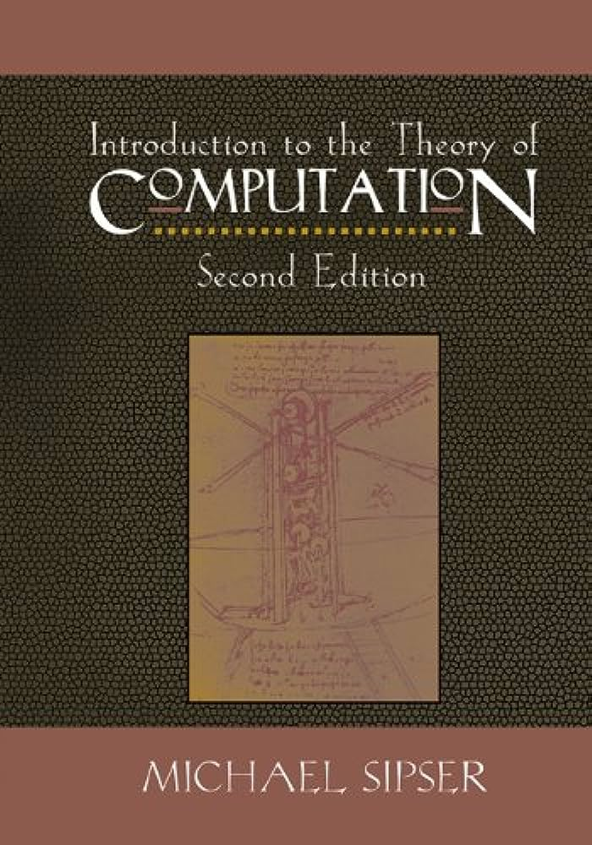
Textbook
You will very likely need to read and study material other than the slides.
There are options, but a textbook is the easiest option.
Introduction to the Theory of Computation by Sipser
  2nd edition!

Slide 14
Lectures
Lecture is in-person.
  MTWRF 10:30 am – 12:45 pm @ Rice Hall 340
I am NOT planning to record lectures…
Lectures will cover course topics, example problems, proofs, etc.

Slide 15
Modules
The course is divided into 4 modules
  1: Introduction, Cardinality, Regular Languages
  2: Context-Free Grammars
  3: Turing Machines and Decidability
  4: Complexity Theory

Slide 16
Modules (Cont’d)
Most modules are 4-6 (traditional) lectures worth of content, some are a bit more.
Each module involves:
  ~5 lectures worth of content
  1 or 2 homework assignments (usually just one though)
We will have traditional exams (more on that in a moment)

Slide 17
Exams
During summer courses, I do traditional exams due to time constraints
Quiz Schedule
  Fri., July 24 Midterm 1 (Covers module 1)
  Fri., July 31 Midterm 2 (Covers modules 2-3)
  Fri., Aug. 7 Final Exam (Module 4 + Cumulative)

Slide 18
Homeworks
Each of the modules has 1 or 2 homeworks associated (usually 1)
Written HW
  Solving small problems, analyzing runtimes, etc.
  Writing proofs, etc.
  Written in Latex (tutorial on course webpage)
  These are meant to be challenging!
Programming HW:
  Is written in Java
  We won’t have many of these (probably just 1)

Slide 19
Homework Grades
Homeworks will be graded on a traditional percentage scale:
  Out of 10 points (or similar)
  Regrades will be available (probably)
  Plan is to not grade these harshly at all, but to treat them as practice / preparation
Deadlines:
  We will have traditional homework deadlines, however…
  Everyone receives an automatic 3 day extension on each homework. There will be no additional time given for homework beyond this 3 day “extension” for any reason. You are meant to turn in your homework on time.

Slide 20
Homework Collaboration
You may work in groups of up to 3 on written assignments
  This is most of the assignments
  Once submission per group is fine. Gradescope supports this quite easily.
On programming assignments (currently, just 1) you are expected to work independently.

Slide 21
Homework Grade Philosophy
The purpose of homework is to PRACTICE!
I want you to:
  Attempt every problem on your own
  Then work with your group to get the solutions figured out
  Study the solutions for homeworks (these homework problems WILL appear on quizzes).

Slide 22
Grading Overview
Final letter grade will be a weighted average:
Homework: 20 percent (split over about 6 or 7 homeworks)
Attendance: 20 percent (4 percent deduction per absence)
Midterms: 30 percent (15 percent each over two midterms)
Final Exam: 30 percent

Slide 23
Office Hours
My office hours are informal. I’ll make myself available after class every day if you want to chat briefly.
TA will have office hours from 2-4 Mon – Thu (Tentatively)

Slide 24
Homework: Written
These assignments must be typeset in LaTeX
I will provide a couple tutorials, guides, and templates when the first assignment is given out
You may not embed images of text or formulas! You may NOT submit handwritten work!

Slide 25
Use of Online Code Etc.
Studying code or proofs online is permitted but only for getting ideas
Copying or reusing code or proofs from an online source violates the pledge
  You must cite sources of any online code you use in this way in a comment in your source file(s)
Remember: the purpose of the homework is
  To practice in an environment that is lower-stress
  To push yourself to solve think about the theory of computation and to prepare you for the quizzes, NOT just to get a grade.
  To work out the logical part of your brain ☺
  To focus on attempting to solve problems yourself before asking others for assistance.

Slide 26
Working in groups
For the homework, you may work together in groups of 3 or less (written assignments)
  Submit one homework per group (I believe Gradescope supports this)
For the programming homework, you may discuss the problems with your group of 3 or less, but you must:
  State who you worked with
  Type up your own implementation!

Slide 27
I think that is all…
Any questions…

