Slide 1
Complexity Theory
Discrete Mathematics and Theory 2 Mark Floryan

Slide 2
Goals!
1. Measuring Time and Space complexity of algorithms on Turing Machines (You already know a lot of this!)
2. Introducing the most famous complexity classes (P, NP, NP-Hard, etc.)
3. Showing how a difficult a problem is through the use of mapping reductions (you’ve already seen some of this in DSA2)!

Slide 3
Part 1: Introduction!

Slide 4
Overview of Theory of Computation
Defining Computation
Input
Computing Machine / Program / Algorithm
Output
Computational Models
Circuits
Finite Automata
Pushdown Automata
Turing Machine
RAM Model
<
<
<
=
Computational Complexity
Decidability
P, NP, NP-Hard
P-Space, Co-NP, etc

Slide 5
Part 1: Measuring Time and Space Complexity

Slide 6
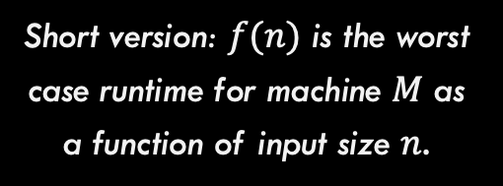
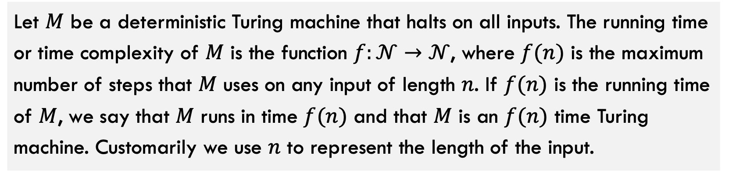
Time Complexity
Let $M$ be a deterministic Turing machine that halts on all inputs. The running time or time complexity of $M$ is the function $f:𝒩→𝒩$, where $f(n)$ is the maximum number of steps that $M$ uses on any input of length $n$. If $f(n)$ is the running time of $M$, we say that $M$ runs in time $f(n)$ and that $M$ is an $f(n)$ time Turing machine. Customarily we use $n$ to represent the length of the input.
You should already be familiar with this definition / concept
Short version: $f(n)$ is the worst case runtime for machine $M$ as a function of input size $n$.

Slide 7





Review: Time Complexity
The following items, you should already know from previous courses.
$O(f\left(n\right))$, $o(f\left(n\right))$
Asymptotic upper bounds
$Ω(f\left(n\right))$, $ω(f\left(n\right))$
Asymptotic lower bounds
$$Θ(f\left(n\right))$$
Asymptotic tight bound
$$1,\log\left(n\right), n, nlog\left(n\right), n^{2}, n^{3}$$
Some common complexity classes
$$\log_{a}{n}∈o\left(n^{b}\right)∈o(c^{n})$$
Every log is bounded by any polynomial is bounded by any exponential

Slide 8
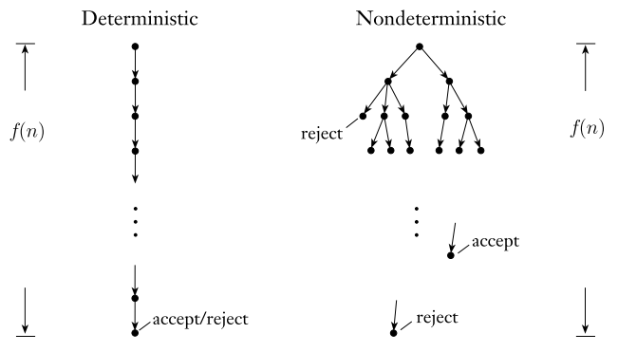
Quick note on Non-Deterministic Time
What about non-deterministic Turing machines (NTMs)? How do we measure running time of such a device?
With deterministic computation, we simply look at longest the one branch of computation can possibly be.
For non-deterministic deciders (does not loop forever), we measure the length of the longest branch of computation

Slide 9
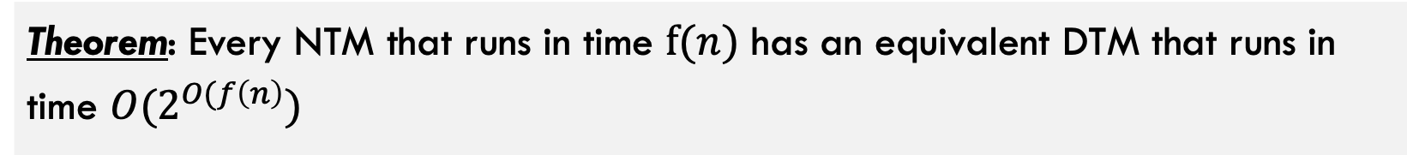
Quick note on Non-Deterministic Time
Theorem: Every NTM that runs in time $f(n)$ has an equivalent DTM that runs in time $O(2^{O(f\left(n\right)})$

Slide 10

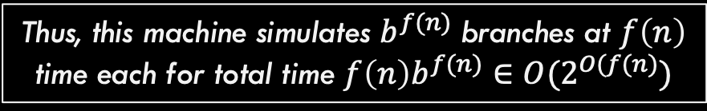
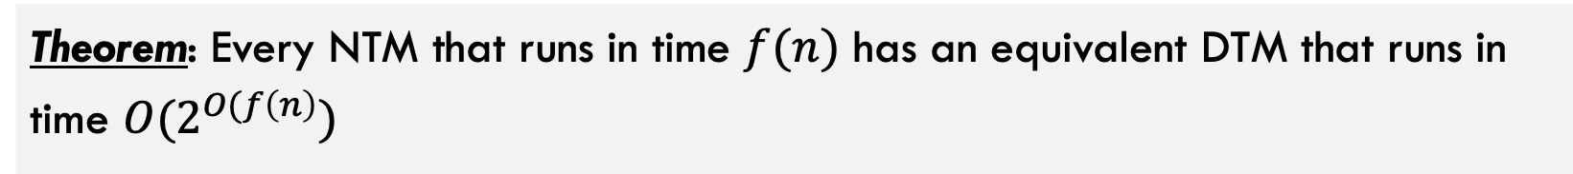


Comparing NTM and DTM
Theorem: Every NTM that runs in time $f(n)$ has an equivalent DTM that runs in time $O(2^{O(f\left(n\right)})$
Here, $f(n)$ is the longest branch of computation
let $b$ be the maximum number of branches this computation can have
The computation tree has at most $b^{f(n)}$ leaves and each branch to each node has length at most $f(n)$
Construct a DTM with three tapes that simulates this NTM as we did in the Turing Machine section earlier. This machines manually computes / simulates each branch individually.
Thus, this machine simulates $b^{f(n)}$ branches at $f\left(n\right)$ time each for total time $f\left(n\right)b^{f(n)}∈O(2^{O(f(n)})$

Slide 11
Part 1: Complexity Classes

Slide 12
Problem Types

Slide 13
Problem types
Given a problem we want to solve, there are three important variations of that problem
Traveling Salesperson Problem: Given a weighted graph G and start node s, find the minimum weight path starting and ending at s that visits every node exactly once.
Function Problem: Return the actual solution
Decision Problem: Convert problem to have Boolean output
Verification Problem: Given a solution, verify if it works
Given G and s, return the weight of the path P that minimizes the sum of the weights of the edges along P.
Given G, s, and integer k, can you find a valid path with total weight less than or equal to k?
Given G, s, path P, and integer k
Is path P valid and is it weight less than k?

Slide 14
Why Do These Matter?
Function Problem: Return the actual solution
Decision Problem: Convert problem to have Boolean output
Verification Problem: Given a solution, verify if it works
Given G and s, return the weight of the path P (list of nodes to visit in order) that minimizes the sum of the weights of the edges along P.
Given G, s, and integer k, can you find a valid path with total weight less than or equal to k?
Given G, s, path P, and integer k
Is path P valid and is it weight less than k?
Because if you can solve the decision problem, you can repeatedly invoke it with lower values of k until the Yes responses change to No
If you can solve the decision problem you can also solve the function problem Why?

Slide 15
Why Do These Matter?
Function Problem: Return the actual solution
Decision Problem: Convert problem to have Boolean output
Verification Problem: Given a solution, verify if it works
Given G and s, return the weight of the path P (list of nodes to visit in order) that minimizes the sum of the weights of the edges along P.
Given G, s, and integer k, can you find a valid path with total weight less than k?
Given G, s, path P, and integer k
Is path P valid and is it weight less than k?
Answer: Yes! If verifier exists, we can call the verifier over and over again with possible paths until we get a Yes response. We will see soon though that this is usually NOT efficient
If you can solve the verification problem, does it help you solve the decision problem?

Slide 16
Why Do These Matter?
Function Problem: Return the actual solution
Decision Problem: Convert problem to have Boolean output
Verification Problem: Given a solution, verify if it works
Given G and s, return the weight of the path P (list of nodes to visit in order) that minimizes the sum of the weights of the edges along P.
Given G, s, and integer k, can you find a valid path with total weight less than k?
Given G, s, path P, and integer k
Is path P valid and is it weight less than k?
We will focus on these two from now on because Turing machines return Yes/No answers.

Slide 17
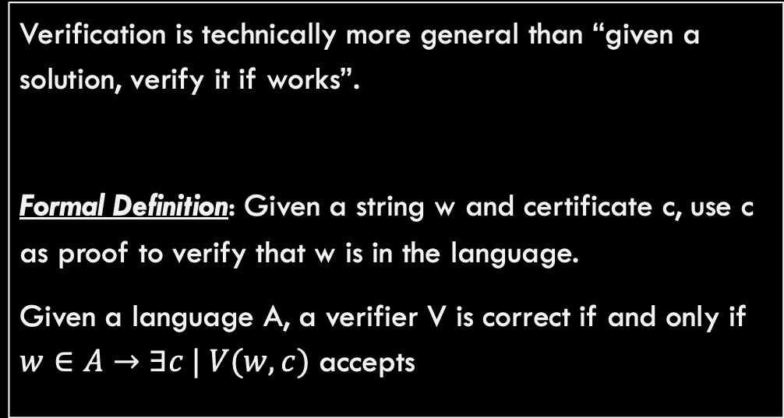
A note on Verification
Verification Problem: Given a solution, verify if it works
Given G, s, path P, and integer k
Is path P valid and is it weight less than k?
Verification is technically more general than “given a solution, verify it if works”.
Formal Definition: Given a string w and certificate c, use c as proof to verify that w is in the language.
Given a language A, a verifier V is correct if and only if $w∈A→∃c | V(w,c)$ accepts

Slide 18
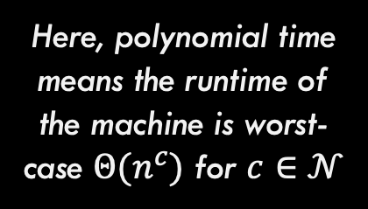
Comparing NTM and DTM
Theorem: A problem P is verifiable in polynomial time by a DTM if and only if it is solvable (decision problem) in polynomial time by an NTM
Here, polynomial time means the runtime of the machine is worst-case $Θ(n^{c})$ for $c∈𝒩$

Slide 19



Comparing NTM and DTM
Theorem: A problem P is verifiable in polynomial time by a DTM if and only if it is solvable (decision problem) in polynomial time by an NTM
Direction 1: If a problem is verifiable by a DTM in polynomial time, then it is solvable in polynomial time by an NTM.
Given: P is verifiable by a DTM. Thus, the DTM that verifies instances of this problem exists
NTM Solver for P
DTM Verifier for P
No
Possible solution 1
$$ε$$
$$ε$$
Possible solution 2
DTM Verifier for P
No
$$ε$$
Possible solution 3
DTM Verifier for P
Yes
$$ε$$
Potential solution s
DTM Verifier for P
Yes/No s is valid solution
Possible solution 4
DTM Verifier for P
No

Slide 20
Comparing NTM and DTM
Theorem: A problem P is verifiable in polynomial time by a DTM if and only if it is solvable (decision problem) in polynomial time by an NTM
Direction 2 (Harder): If a problem is solvable by an NTM in polynomial time, then it is verifiable in polynomial time by a DTM.
Given: P is solvable by an NTM. Thus, the NTM that exists
NTM Solver for P
Purple path that leads to Yes is a certificate for P. Why?
N
N
Y
N
Input
NTM Solver for P
Yes/No decision
N
N

Slide 21
Comparing NTM and DTM
Theorem: A problem P is verifiable in polynomial time by a DTM if and only if it is solvable (decision problem) in polynomial time by an NTM
Direction 2 (Harder): If a problem is solvable by an NTM in polynomial time, then it is verifiable in polynomial time by a DTM.
NTM Solver for P
Verifier for this language:
Given w (input) and c (list of which branch to take at each step
Simulate P
At each step, check c to see which branch to take
Accept iff P accepts
N
N
Y
N
N
N

Slide 22
Comparing NTM and DTM
Theorem: A problem P is verifiable in polynomial time by a DTM if and only if it is solvable (decision problem) in polynomial time by an NTM
This theorem is critical to remember! It will be very important in a moment.

Slide 23
Complexity Classes (Finally!)

Slide 24

The class P
Important: P is a set of problems (not solutions, not algorithms)
Example problems in this set include:
Sorting a list of numbers Inserting into a binary tree Computing the average of a list of numbers Printing “hello world” Find() in a hash table …and many more
P
The class P is the set of all problems that can be solved by a deterministic Turing machine in time $O(n^{c})$ such that $c∈𝒩$

Slide 25

The class NP
Remember: We also showed that any NTM solver has an equivalent exponential time DTM. So all problems in NP are solvable in exponential time.
Example problems in this set include:
Everything in P (will prove shortly) Traveling Salesperson Problem Circuit Satisfiability Vertex Cover Independent Set Subset Sum …and many more
NP
Equivalent Definition: By our recently proved theorem, this also means these problems can be verified in polynomial time using a deterministic Turing machine!
The class NP is the set of all problems that can be solved by a non-deterministic Turing machine in time $O(n^{c})$ such that $c∈𝒩$

Slide 26

$$P⊆NP$$
NP
Hard Problems
Proof:
Everything in P can be solved in polynomial time by a DTM, so it can definitely be verified as well (just ignore the certificate and solve the problem directly)
Is $P⊂NP$? This is still unknown today!
P
Easy Problems

Slide 27

$$P⊆NP$$
We are interested in finding the hardest problem in NP (at the VERY top of the bubble). Why? It is the MOST likely to not be in P if $P≠NP$
NP
Hard Problems
P
It is true that we DO NOT know if there are actually any unique problems in NP (that are not also in P).
Easy Problems

Slide 28
NP-Hard
NP
Hard Problems
Suppose we have find the hardest problem in NP
P
NP-Hard problems are defined to be all problems that are this hard OR harder.
Easy Problems

Slide 29
NP-Hard
NP-Hard
Goes up to indefinite difficulty.
NP
Hard Problems
Note that NP-Hard and NP intersect here. Problems in this intersection are the hardest problems in NP
P
Easy Problems

Slide 30
NP-Complete
NP-Hard
This section (purple) is the set of NP-Complete problems. The hardest problems in NP
NP
Hard Problems
Definition: A problem is NP-Complete if and only if the problem:
Is in NP
Is NP-Hard
P
Easy Problems

Slide 31

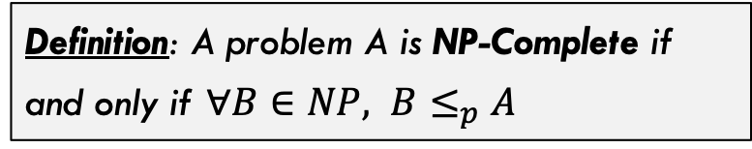
NP-Complete
NP-Hard
A different definition of NP-Complete
Definition: A problem A is NP-Complete if and only if $∀B∈NP, B≤_{p}A$
NP
Hard Problems
$B≤_{p}A$ means that problem A is harder than problem B, shown through a reduction, which we will see in a moment.
P
Easy Problems

Slide 32
More on Reductions: Mapping Reductions

Slide 33
What we have already seen
Reduction: A reduction exists between problems A and B if a solution to B can be used to develop a solution for A.
Problem A
Solve problem B
Problem B
Do easy work
Reduces to
Solve problem B
Do more easy work
…
This kind of reduction involves the decidability of Problems A and B. If B is decidable then A is decidable!

Slide 34



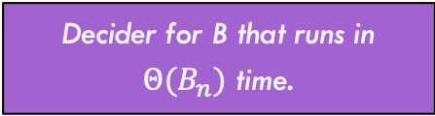
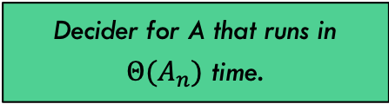
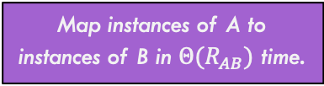
Mapping Reduction
A mapping reduction uses a reduction function R() to map instances of one problem (A) to instances of another problem (B) such that for any input string $w$, $A\left(w\right)==B(R\left(w\right))$
Map instances of A to instances of B in $Θ(R_{AB})$ time.
One way (green route) to solve A is to use the decider in $Θ(A_{n})$ time
Problem A
Problem B
Decider for A that runs in $Θ(A_{n})$ time.
Decider for B that runs in $Θ(B_{n})$ time.
Solution A
Solution B
Map solutions of B to solutions of A in $Θ({RS}_{BA})$ time.
Another way to solve A is to use the purple path. Takes:
$$Θ(R_{AB}+B_{n}+RS_{BA})$$

Slide 35




Reductions You’ve Probably seen before!
Reduction:
Details:
Max-Flow ${≤≥}_{Θ(1)}$ Min-Cut
No conversion necessary. Value of maximum flow is equal to capacity of minimum cut on the same, unaltered graph.
Bi-Partite Matching $≤_{Θ(\left|V\right|+\left|E\right|)}$ Max-Flow
Conversion involved adding capacities to edges, adding source and sink node, adding edges to / from source / sink node, etc.
FindMedian $≤_{Θ(1)}$ Sorting
No conversion necessary. Sort the list, then pull out the middle element in the array.
FindMin $≤_{Θ(1)}$ Sorting
No conversion necessary. Sort the list, then pull the first element in the array. Note that this one is a reduction to a HARDER problem. So won’t be used in practice.

Slide 36


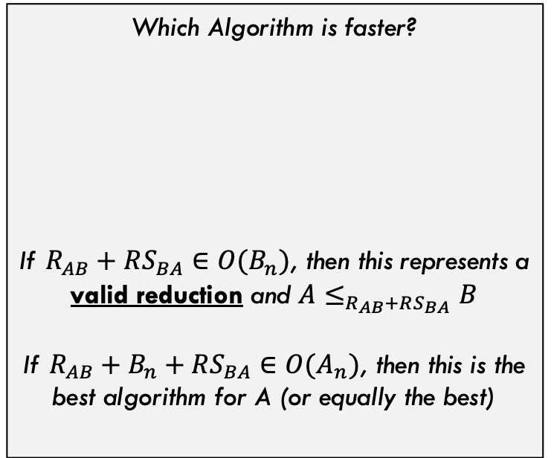

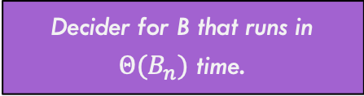
Runtime Comparison
Map instances of A to instances of B in $Θ(R_{AB})$ time.
Problem A
Problem B
Which Algorithm is faster?
If $R_{AB}+RS_{BA}∈O(B_{n})$, then this represents a valid reduction and $A≤_{R_{AB}+RS_{BA}}B$
If $R_{AB}+B_{n}+RS_{BA}∈O(A_{n})$, then this is the best algorithm for A (or equally the best)
$$A_{n}$$
Decider for A that runs in $Θ(A_{n})$ time.
Decider for B that runs in $Θ(B_{n})$ time.
$$R_{AB}+B_{n}+RS_{BA}$$
Solution A
Solution B
Map solutions of B to solutions of A in $Θ({RS}_{BA})$ time.

Slide 37



Runtime Comparison
Harder Problems (fastest algorithm has slower runtime)
$$B_{n}$$
$$A_{n}$$
Which Algorithm is faster?
$$A_{n}$$
$$R_{AB}+B_{n}+RS_{BA}∈Θ(B_{n})$$
Not surprisingly, if these two algorithms have same overall runtime, then either can be used (they are equivalent).
Easy Problems (fastest algorithm has very fast runtime)

Slide 38


Runtime Comparison
Harder Problems (fastest algorithm has slower runtime)
$$B_{n}$$
Which Algorithm is faster?
$$A_{n}$$
$$A_{n}$$
$$R_{AB}+B_{n}+RS_{BA}∈Θ(B_{n})$$
If solving A through reduction is SLOWER than directly solving A, this means problem B is simply harder than problem A (but the reduction is still valid)
Easy Problems (fastest algorithm has very fast runtime)

Slide 39


Runtime Comparison
Harder Problems (fastest algorithm has slower runtime)
$$A_{n}$$
Which Algorithm is faster?
$$A_{n}$$
$$B_{n}$$
$$R_{AB}+B_{n}+RS_{BA}∈Θ(B_{n})$$
If the reduction is FASTER than directly solving A, What does this mean? It means the reduction IS the best way to solve A (and this picture doesn’t make sense)
Easy Problems (fastest algorithm has very fast runtime)

Slide 40



Runtime Comparison
Harder Problems (fastest algorithm has slower runtime)
OLD $A_{n}$
Which Algorithm is faster?
$$A_{n}$$
$$A_{n}=B_{n}$$
$$R_{AB}+B_{n}+RS_{BA}∈Θ(B_{n})$$
…and the direct algorithm for A is obsolete. The reduction through problem B is the direct way to solve A
Easy Problems (fastest algorithm has very fast runtime)

Slide 41
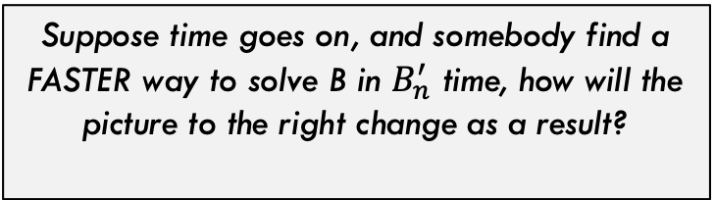


Runtime Comparison
Harder Problems (fastest algorithm has slower runtime)
Suppose time goes on, and somebody find a FASTER way to solve B in $B_{n}^{′}$ time, how will the picture to the right change as a result?
$$A_{n}=B_{n}$$
A now has a faster algorithm also! So improving B’s algorithm improves A’s. They are linked in this direction!
$${A′}_{n}=R_{AB}+{B′}_{n}+RS_{BA}$$
This is ONLY true if the reduction stays valid, meaning the conversion is still fast: $R_{AB}+RS_{BA}∈O(B_{n}^{′})$
Easy Problems (fastest algorithm has very fast runtime)

Slide 42


Runtime Comparison
Harder Problems (fastest algorithm has slower runtime)
Now suppose time goes on and someone finds a VERY fast algorithm for A. What could happen?
$${B′}_{n}$$
Now, the reduction may still be valid, but we are back to B being strictly harder than A
$${A′}_{n}$$
Easy Problems (fastest algorithm has very fast runtime)

Slide 43
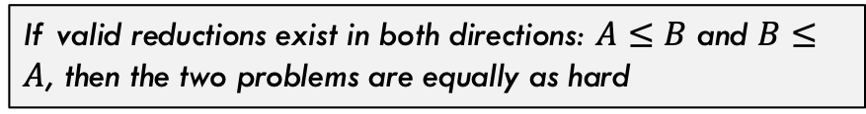
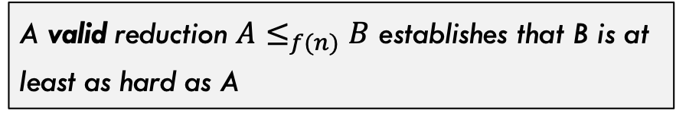
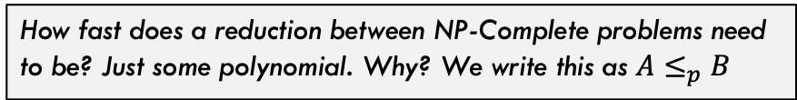
Big Picture
NP-Hard
Hard Problems
So, via reduction
A valid reduction $A≤_{f(n)}B$ establishes that B is at least as hard as A
NP
Some related facts!
If valid reductions exist in both directions: $A≤B$ and $B≤A$, then the two problems are equally as hard
NP-Complete problems are the hardest in NP, so by definition there is a valid reduction from anything in NP to them.
P
How fast does a reduction between NP-Complete problems need to be? Just some polynomial. Why? We write this as $A≤_{p}B$
Easy Problems

Slide 44
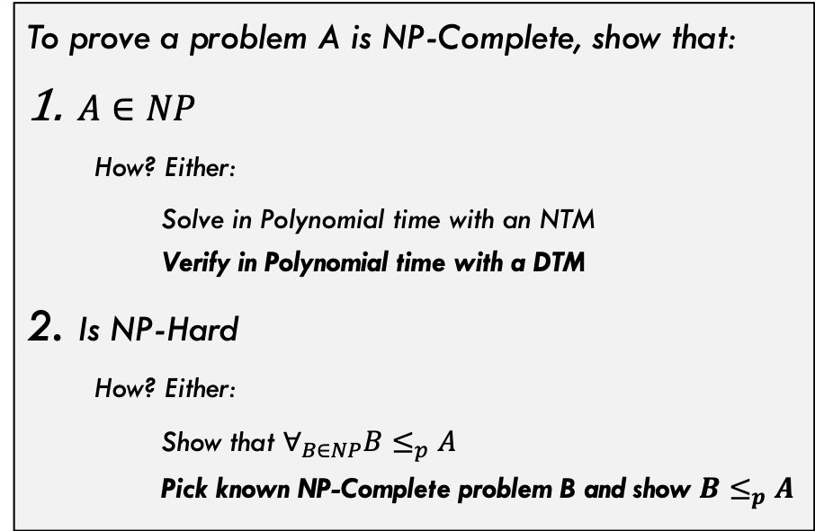
Proving NP-Completeness
NP-Hard
Usually we do the bolded ones
But for second step, we need a known NP-Complete problem. What was the first one?
NP
Hard Problems
To prove a problem A is NP-Complete, show that:
$A∈NP$
How? Either:
Solve in Polynomial time with an NTM Verify in Polynomial time with a DTM
Is NP-Hard
How? Either:
Show that $∀_{B∈NP}B≤_{p}A$ Pick known NP-Complete problem B and show $B≤_{p}A$
P
Easy Problems

Slide 45
Cook-Levin Theorem

Slide 46
Cook-Levin Theorem
Cook-Levin Theorem: The Satisfiability (SAT) problem is NP-Complete
Incredibly famous theorem. Established the first known NP-Complete problem!
Developed independently by Stephen Cook (US) and Leonid Levin (USSR) in 1971 & 1973

Slide 47
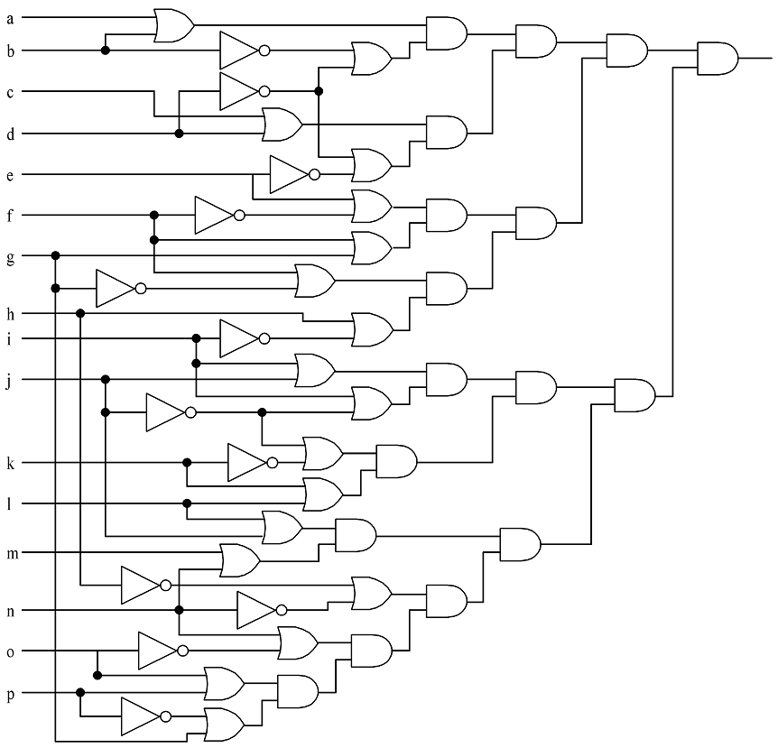
Circuit Satisfiability (Circuit-SAT)
Given a circuit with boolean inputs, AND, OR, and NOT gates…is it possible to assign values to the input such that the output is TRUE?

Slide 48
Circuit Satisfiability (Circuit-SAT)
Solutions:
1110111110011001
1010111111011001
0110111110111001
0110111110011001
1110111111011001
1010111110011001
1010111110111001
0110111111011001
1110111110111001

Slide 49
Circuit-Sat vs SAT
(v[0] || v[1]) && (!v[1] || !v[3]) && (v[2] || v[3]) && (!v[3] || !v[4]) && (v[4] || !v[5]) && (v[5] || !v[6]) && (v[5] || v[6]) && (v[6] || !v[15]) && (v[7] || !v[8]) && (!v[7] || !v[13]) && (v[8] || v[9]) && (v[8] || !v[9]) && (!v[9] || !v[10]) && (v[9] || v[11]) && (v[10] || v[11]) && (v[12] || v[13]) && (v[13] || !v[14]) && (v[14] || v[15])
These are two variations of the exact same problem. We will stick with the right side (SAT) from now on

Slide 50
Proof of the Cook-Levin Theorem

Slide 51
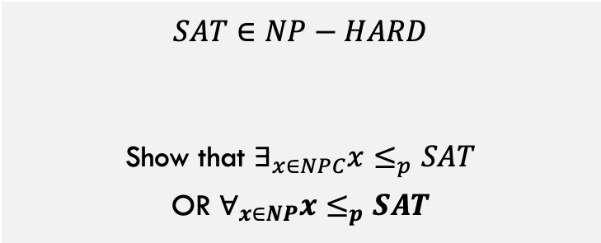
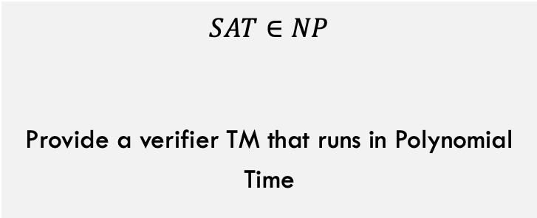
$$SAT∈NPC$$
To show that $SAT∈NPC$, we must show both that:
$$SAT∈NP$$
Provide a verifier TM that runs in Polynomial Time
$$SAT∈NP−HARD$$
Show that $∃_{x∈NPC}x≤_{p}SAT$ OR $∀_{x∈NP}x≤_{p}SAT$
Here, we must use the second (bold) option because there are not any NPC problems that exist yet! Ugh!!

Slide 52
$$SAT∈NPC$$
Let’s do this one first:
Verifier:
$$SAT∈NP$$
Provide a verifier TM that runs in Polynomial Time
Given variables V, formula F, and potential values for each variable V’:
Scan over formula F for first operator (Op) that should be applied (deepest in parens and/or lowest precedence)
Find the two variables X and Y on each side of Op, this gives X Op Y (example: V1 AND V7)
Apply operator Op to the values X and Y given by V’ or by result of a previous operation and replace X Op Y with this Boolean result.
Loop back to step 1 until only one Boolean remains. This Boolean is true if and only if the solution V’ is verified.
Needs to be polynomial runtime, is it? Yes!

Slide 53
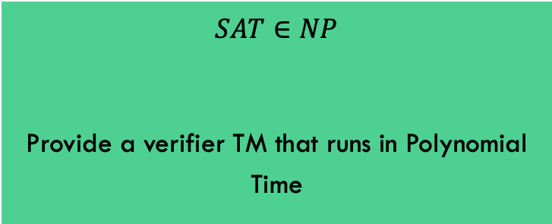
$$SAT∈NPC$$
To show that $SAT∈NPC$, we must show both that:
$$SAT∈NP$$
Provide a verifier TM that runs in Polynomial Time
$$SAT∈NP−HARD$$
Show that $∃_{x∈NPC}x≤_{p}SAT$ OR $∀_{x∈NP}x≤_{p}SAT$
This part is done!!

Slide 54
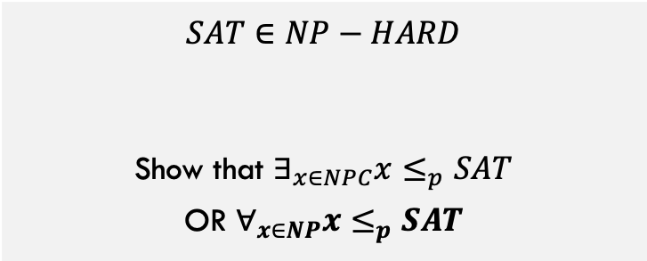
Sat is NP-Hard
$$SAT∈NP−HARD$$
Show that $∃_{x∈NPC}x≤_{p}SAT$ OR $∀_{x∈NP}x≤_{p}SAT$
As we stated. before, we have to use the second option because there (when this proof was done) are no NP-Complete problems yet!

Slide 55



Sat is NP-Hard
$$SAT∈NP−HARD$$
$$∀_{x∈NP}x≤_{p}SAT$$
Choose arbitrary $x∈NP$
Reduce problem x
To an instance of SAT
NTM Decider for x
$$x_{1} ∧ \overline{x_{2}} ∨\left(\overline{x_{3}}∧x_{2}\right)…$$
How are we going to do this?

Slide 56
Sat is NP-Hard
$$SAT∈NP−HARD$$
$$∀_{x∈NP}x≤_{p}SAT$$
Choose arbitrary $x∈NP$
Reduce problem x
To an instance of SAT
NTM Decider for x
Tape moved right AND 1 written to first cell of tape AND …
IDEA: For any generic problem x in NP, it has a decider NTM. Convert that NTM into a Boolean expression that describes the operation of the machine. Why is this a valid reduction?

Slide 57
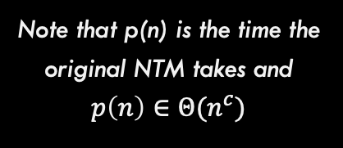
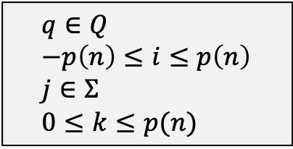
Variables We Need
Variable | Meaning | How many
T_{ijk} | True if tape cell i contains symbol j at step k of the computation | O(p(n)²)
H_{ik} | True if the M’s read/write head is at tape cell i at step k of the computation | O(p(n)²)
Q_{qk} | True if M is in state q at step k of the computation | O(p(n))
Some constraints:
$$q∈Q \\ −p\left(n\right)≤i≤p\left(n\right) \\ j∈Σ \\ 0≤k≤p(n)$$
Note that p(n) is the time the original NTM takes and $p\left(n\right)∈Θ(n^{c})$

Slide 58
Create a conjunction ‘B’ of…
Expression | Conditions | Interpretation | How many
T_{ij0} | Tape cell i initially contains symbol J | Initial tape state; blank symbols above n | O(p(n))
Q_{s0} |  | Initial state of the NTM | 1
H₀₀ |  | Initial position of the read/write head | 1
T_{ijk} → ¬T_{ij’k} | j != j’ | One symbol per tape cell | O(p(n)²)
T_{ijk} = T_{ij(k+1)} ∨ H_{jk} |  | Tape remains unchanged unless written | O(p(n)²)
Q_{qk} → ¬Q_{q’k} | q ≠ q’ | Only one state at a time | O(p(n))
H_{jk} → ¬H_{j’k} | i ≠ i’ | Only one head position at a time | O(p(n)²)
(H_{ik} ∧ Q_{qk} ∧ T_{iσk}) → (H_{(i+d)(k+1)} ∧ Q_{q’(k+1)} ∧ T_{iσ’(k+1)}) | (q, σ, q’, σ’, d) ∈ δ | Possible transitions at computation step k when head position is at position I | O(p(n)²)
∨_{f∈F} Q_{fp(n)} |  | Must finish in an accepting state | 1

Slide 59
Is the reduction Valid?
NTM for x accepts iff and only if SAT equation can be satisfied
The time and space complexity of the reduction is polynomial
If there is an accepting computation for the NTM on input I, then B is satisfiable by assigning T_{ijk}, H_{jk}, and Q_{jk} their intended interpretations.
Yes!
The number of sub-expressions is:
2p(n) + 4p(n)² + 3 = O(p(n)²)
and each is computed in less than that.

Slide 60
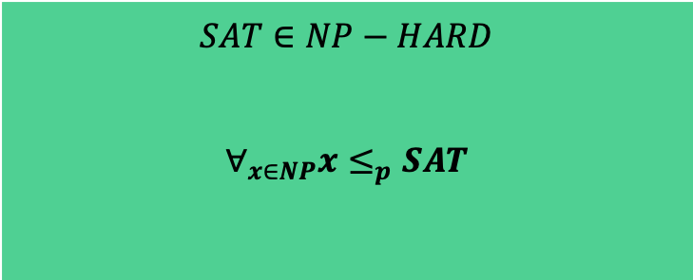
$$SAT∈NPC$$
To show that $SAT∈NPC$, we must show both that:
$$SAT∈NP$$
Provide a verifier TM that runs in Polynomial Time
$$SAT∈NP−HARD$$
$$∀_{x∈NP}x≤_{p}SAT$$
Thus, it is proven!!

Slide 61
Other NP-Complete Problems (Reductions)

Slide 62
3-SAT

Slide 63
3-SAT
3-SAT = Can a provided Boolean expression in 3-Conjunctive-Normal Form (3-CNF) be satisfied?
$$V=\left(v_{1}∨v_{2}∨\overline{v_{3}}\right)∧\left(v_{4}∨\overline{v_{1}}∨v_{2}\right)∧\left(v_{4}∨\overline{v_{3}}∨\overline{v_{1}}\right)∧…$$
Each Clause contains a disjunction (OR) of exactly 3 literals (or negated literals)
The expression must be a conjunction (AND) of multiple clauses
Is it easier to decide 3-SAT because the format is simpler?

Slide 64
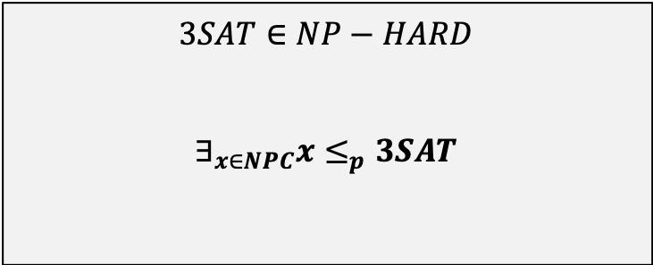
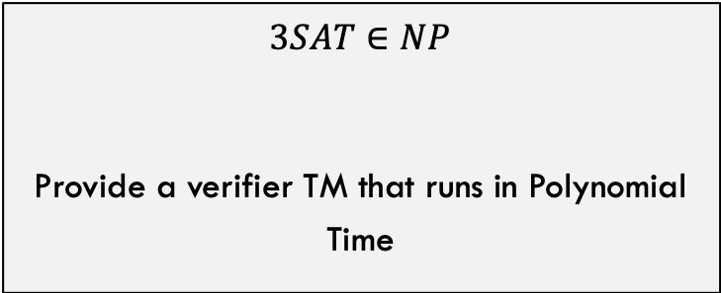
Showing that $3SAT∈NPC$
To show that $3SAT∈NPC$, we must show both that:
$$3SAT∈NP$$
Provide a verifier TM that runs in Polynomial Time
$$3SAT∈NP−HARD$$
$$∃_{x∈NPC}x≤_{p}3SAT$$
This time we can reduce from a concrete, known, NPC problem. We only have SAT so far, so that is what we will choose!
This one, as usual, is not difficult.

Slide 65
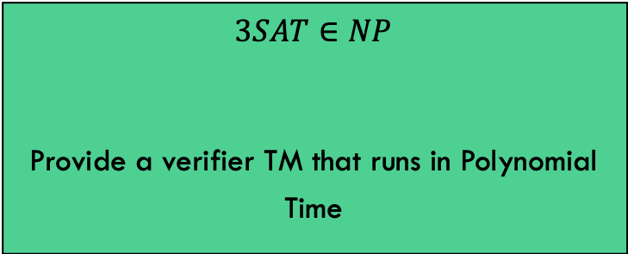
Showing that $3SAT∈NPC$
$$3SAT∈NP$$
Provide a verifier TM that runs in Polynomial Time
This is trivial. The verifier we developed for SAT will also work for 3SAT.

Slide 66
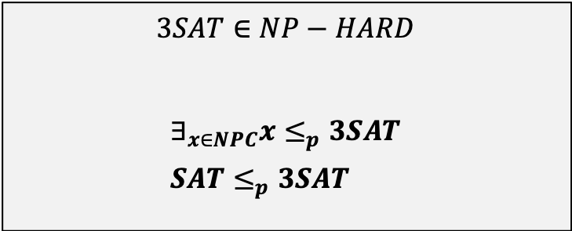
Showing that $3SAT∈NPC$
$$3SAT∈NP−HARD$$
$$∃_{x∈NPC}x≤_{p}3SAT \\ SAT≤_{p}3SAT$$
Need to show 3SAT is at least as hard as SAT. How? Show a reduction.
Given a generic SAT input, can we convert it into an equivalent formula in 3SAT?
SAT input x:
e.g., φ = ((x₁ → x₂) ∨ ¬((¬x₁ ↔ x₃) ∨ x₄)) ∧ ¬x₂
Equivalent 3SAT formula:
e.g., φ’_{i} = (¬y₁∨¬y₂∨¬x₂) ∧ (¬y₁∨y₂∨¬x₂) ∧ (¬y₁∨y₂∨x₂) ∧ (y₁∨¬y₂∨x₂)…

Slide 67
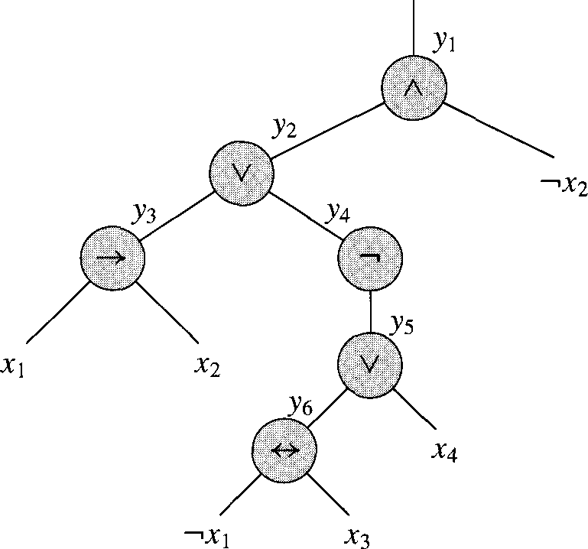
Converting SAT to 3-SAT, step 1
Input: φ = ((x₁ → x₂) ∨ ¬((¬x₁ ↔ x₃) ∨ x₄)) ∧ ¬x₂
Step 1: Parse the expression into an expression tree

Slide 68
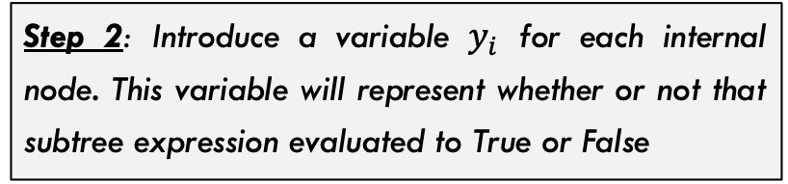
Converting SAT to 3-SAT, step 2
Step 2: Introduce a variable $y_{i}$ for each internal node. This variable will represent whether or not that subtree expression evaluated to True or False
We can then re-write our expression:
φ’ = y₁ ∧ (y₁ ↔ (y₂ ∧ ¬x₂)
∧ (y₂ ↔ (y₃ ∨ y₄))
∧ (y₃ ↔ (x₁ → x₂))
∧ (y₄ ↔ ¬y₅)
∧ (y₅ ↔ (y₆ ∨ x₄))
∧ (y₆ ↔ (¬x₁ ↔ x₃))

Slide 69
Converting SAT to 3-SAT, step 3
Step 3:
Build a truth table for each clause φ’_{i}:
y₁ | y₂ | _{X2} | (y₁ ↔ (y₂ ∧ ¬x₂))
1 | 1 | 1 | 0
1 | 1 | 0 | 1
1 | 0 | 1 | 0
1 | 0 | 0 | 0
0 | 1 | 1 | 1
0 | 1 | 0 | 0
0 | 0 | 1 | 1
0 | 0 | 0 | 1
φ’ = y₁ ∧ (y₁ ↔ (y₂ ∧ ¬x₂)
∧ (y₂ ↔ (y₃ ∨ y₄))
∧ (y₃ ↔ (x₁ → x₂))
∧ (y₄ ↔ ¬y₅)
∧ (y₅ ↔ (y₆ ∨ x₄))
∧ (y₆ ↔ (¬x₁ ↔ x₃))

Slide 70
Converting SAT to 3-SAT, step 4 / 5
Step 4: For each clause, construct a DNF (disjunctive normal form) for when it is False (based on truth table)
Step 5: Take this formula and negate it to get all the instances where the clause is true in CNF (conjunctive normal form).
y₁ | y₂ | x₂ | (y₁ ↔ (y₂ ∧ ¬x₂))
1 | 1 | 1 | 0
1 | 1 | 0 | 1
1 | 0 | 1 | 0
1 | 0 | 0 | 0
0 | 1 | 1 | 1
0 | 1 | 0 | 0
0 | 0 | 1 | 1
0 | 0 | 0 | 1
¬φ’_{i} = (y₁∧y₂∧x₂) ∨ (y₁∧¬y₂∧x₂) ∨ (y₁∧¬y₂∧¬x₂) ∨ (¬y₁∧y₂∧¬x₂)
¬φ’_{i} =
(y₁∧y₂∧x₂) ∨
(y₁∧¬y₂∧x₂) ∨
(y₁∧¬y₂∧¬x₂) ∨
(¬y₁∧y₂∧¬x₂)
Negate formula
φ’_{i} = (¬y₁∨¬y₂∨¬x₂) ∧ (¬y₁∨y₂∨¬x₂) ∧ (¬y₁∨y₂∨x₂) ∧ (y₁∨¬y₂∨x₂)

Slide 71
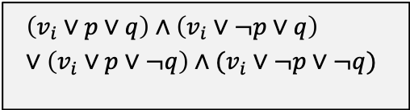





Converting SAT to 3-SAT, step 6
φ’_{i} = (¬y₁ ∨ ¬y₂ ∨ ¬x₂) ∧ (¬y₁ ∨ y₂ ∨ ¬x₂) ∧ (¬y₁ ∨ y₂ ∨ x₂) ∧ (y₁ ∨ ¬y₂ ∨ x₂)
Step 6: Almost done. This works but some clauses may have only 1 or 2 literals (3 are required for every single clause). Add dummy variables to force each clause to have three literals.
Case 1: Clause has 3 literals
Case 2: Clause has only 2 literals
Case 3: Clause has only 1 literal
$$(v_{i}∨v_{j}∨v_{k})$$
$$(v_{i}∨v_{j})$$
$$(v_{i})$$
Becomes: Introduce dummy variable p
Becomes: Introduce dummy variables p and q
Do nothing, already fine
$$\left(v_{i}∨p∨q\right)∧\left(v_{i}∨¬p∨q\right)∨\left(v_{i}∨p∨¬q\right)∧(v_{i}∨¬p∨¬q)$$
$$\left(v_{i}∨v_{j}∨v_{k}\right)$$
$$\left(v_{i}∨v_{j}∨p\right)∧\left(v_{i}∨v_{j}∨¬p\right)$$

Slide 72
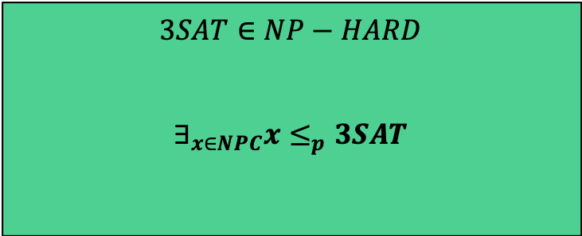
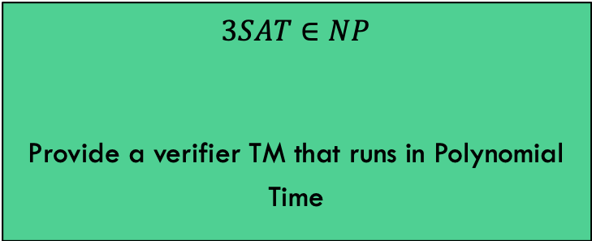
Showing that $3SAT∈NPC$
To show that $3SAT∈NPC$, we must show both that:
$$3SAT∈NP$$
Provide a verifier TM that runs in Polynomial Time
$$3SAT∈NP−HARD$$
$$∃_{x∈NPC}x≤_{p}3SAT$$
We are done!!

Slide 73
Cliques

Slide 74
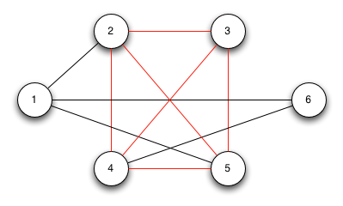
Clique
A Clique in a graph G is a set of nodes such that each one is connected to each other in the set
In other words, it is a maximal sub-graph of G
Problem: Find the maximum size clique in a graph G

Slide 75
Clique
A Clique in a graph G is a set of nodes such that each one is connected to each other in the set
Can we frame this as a Decision Problem?
Given a graph G and an integer k, return Yes iff G has a clique of size k or larger.

Slide 76
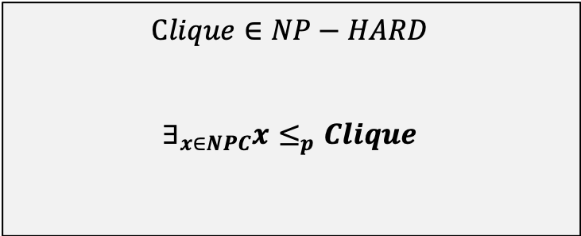
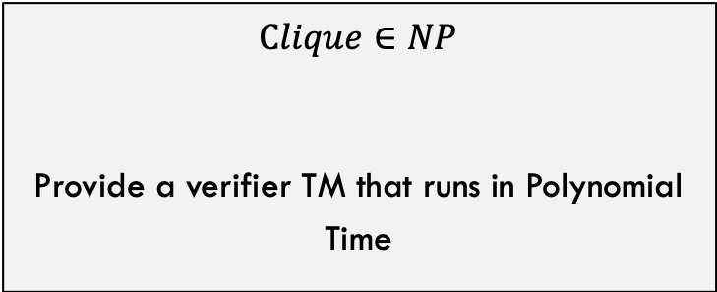
Showing that $Clique∈NPC$
To show that $Clique∈NPC$, we must show both that:
$$Clique∈NP$$
Provide a verifier TM that runs in Polynomial Time
$$Clique∈NP−HARD$$
$$∃_{x∈NPC}x≤_{p}Clique$$
As usual, this one is pretty simple
For this one, we can choose SAT or 3-SAT

Slide 77
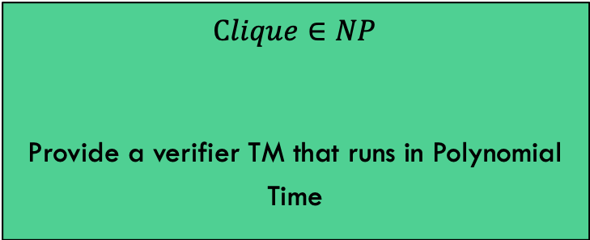

Showing that $Clique∈NPC$
$$Clique∈NP$$
Provide a verifier TM that runs in Polynomial Time
Verifier:
Given G, k, and a subset $V^{′}⊆V$ of nodes
Verify that number of nodes in V’ is k or larger
For each pair of nodes (p,q) in V’:
check that edge p,q exists in G
If not, return NO
Return YES

Slide 78
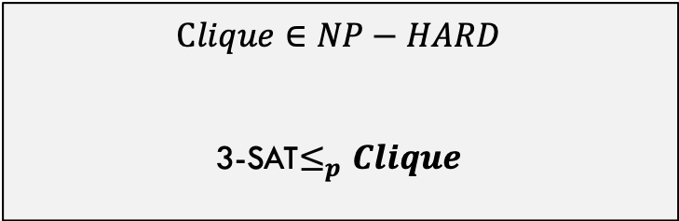
Showing that $Clique∈NPC$
$$Clique∈NP−HARD$$
3-SAT$≤_{p}Clique$
We choose 3-SAT
Goal: Given a generic 3-SAT input, can we convert it into graph and integer k such that the 3-SAT formula is satisfiable IFF the graph has a click of at least size k?
Input: 3SAT formula:
e.g., φ’_{i} = (¬y₁∨¬y₂∨¬x₂) ∧ (¬y₁∨y₂∨¬x₂) ∧ (¬y₁∨y₂∨x₂) ∧ (y₁∨¬y₂∨x₂)…
Graph G and integer k
Converting a Boolean formula into a graph is strange, right? Let’s see how it works!

Slide 79
$3SAT≤_{p}Clique$, Intuition
Consider this 3-SAT formula:
$$θ=\left(x_{1}∨\overline{x_{2}}∨\overline{x_{3}}\right)∧\left(\overline{x_{1}}∨x_{2}∨x_{3}\right)∧(x_{1}∨x_{2}∨x_{3})$$
With a 3-Sat formula, we have:
A bunch of “things” (variables)
Some can be assigned TRUE without issue (they are “connected”)
Each clause must have a TRUE item that is connected (valid) with the other items in the other clauses
TIP: When doing a reduction, think about the “spirit” of how the problems relate to each other

Slide 80










$3SAT≤_{p}Clique$, Step 1
Consider this 3-SAT formula:
$$θ=\left(x_{1}∨\overline{x_{2}}∨\overline{x_{3}}\right)∧\left(\overline{x_{1}}∨x_{2}∨x_{3}\right)∧(x_{1}∨x_{2}∨x_{3})$$
$$\overline{x_{1}}$$
$$x_{2}$$
$$x_{3}$$
G
Step 1: Create a graph G with nodes where each variable in $θ$ represents a node in G
$$x_{1}$$
$$x_{1}$$
$$\overline{x_{2}}$$
$$x_{2}$$
$$\overline{x_{3}}$$
$$x_{3}$$

Slide 81

$3SAT≤_{p}Clique$, Step 1
Consider this 3-SAT formula:
$$θ=\left(x_{1}∨\overline{x_{2}}∨\overline{x_{3}}\right)∧\left(\overline{x_{1}}∨x_{2}∨x_{3}\right)∧(x_{1}∨x_{2}∨x_{3})$$
$$\overline{x_{1}}$$
$$x_{2}$$
$$x_{3}$$
G
Step 1: Create a graph G with nodes where each variable in $θ$ represents a node in G
$$x_{1}$$
$$x_{1}$$
Goal: The nodes we choose in our clique will be the same variable we choose to set to TRUE in $θ$
$$\overline{x_{2}}$$
$$x_{2}$$
$$\overline{x_{3}}$$
$$x_{3}$$

Slide 82
$3SAT≤_{p}Clique$, Step 2
Consider this 3-SAT formula:
$$θ=\left(x_{1}∨\overline{x_{2}}∨\overline{x_{3}}\right)∧\left(\overline{x_{1}}∨x_{2}∨x_{3}\right)∧(x_{1}∨x_{2}∨x_{3})$$
$$\overline{x_{1}}$$
$$x_{2}$$
$$x_{3}$$
G
Step 2: Connect any two nodes that are in different clauses AND can be set to true at the same time
We connect these two because they do not conflict
$$x_{1}$$
$$x_{1}$$
$$\overline{x_{2}}$$
$$x_{2}$$
We cannot connect these two because they contradict one another
$$\overline{x_{3}}$$
X
$$x_{3}$$

Slide 83
$3SAT≤_{p}Clique$, Step 2
Consider this 3-SAT formula:
$$θ=\left(x_{1}∨\overline{x_{2}}∨\overline{x_{3}}\right)∧\left(\overline{x_{1}}∨x_{2}∨x_{3}\right)∧(x_{1}∨x_{2}∨x_{3})$$
$$\overline{x_{1}}$$
$$x_{2}$$
$$x_{3}$$
G
Step 2: Connect any two nodes that are in different clauses AND can be set to true at the same time
$$x_{1}$$
$$x_{1}$$
$$\overline{x_{2}}$$
$$x_{2}$$
$$\overline{x_{3}}$$
$$x_{3}$$

Slide 84

$3SAT≤_{p}Clique$, Step 3
Consider this 3-SAT formula:
$$θ=\left(x_{1}∨\overline{x_{2}}∨\overline{x_{3}}\right)∧\left(\overline{x_{1}}∨x_{2}∨x_{3}\right)∧(x_{1}∨x_{2}∨x_{3})$$
$$\overline{x_{1}}$$
$$x_{2}$$
$$x_{3}$$
G
k=3
Step 3: Set k equal to the number of clauses in $θ$
$$x_{1}$$
$$x_{1}$$
$$\overline{x_{2}}$$
$$x_{2}$$
$$\overline{x_{3}}$$
$$x_{3}$$

Slide 85










$3SAT≤_{p}Clique$, Proof
Consider this 3-SAT formula:
$$θ=\left(x_{1}∨\overline{x_{2}}∨\overline{x_{3}}\right)∧\left(\overline{x_{1}}∨x_{2}∨x_{3}\right)∧(x_{1}∨x_{2}∨x_{3})$$
Claim: $θ$ is satisfiable IFF G contains a clique of size 3
G
$$\overline{x_{1}}$$
$$x_{2}$$
$$x_{3}$$
k=3
$$x_{1}$$
$$x_{1}$$
Intuition: One clique of size 3 is shown. The nodes in the clique represent three variables, one per clause, that can be set to TRUE without issue.
$$\overline{x_{2}}$$
$$x_{2}$$
$$\overline{x_{3}}$$
$$x_{3}$$

Slide 86











$3SAT≤_{p}Clique$, Proof
Consider this 3-SAT formula:
$$θ=\left(x_{1}∨\overline{x_{2}}∨\overline{x_{3}}\right)∧\left(\overline{x_{1}}∨x_{2}∨x_{3}\right)∧(x_{1}∨x_{2}∨x_{3})$$
Direction 1: $θ$ is satisfiable → G contains a clique of size k
$$\overline{x_{1}}$$
$$x_{2}$$
$$x_{3}$$
G
k=3
Proof: $θ$ is satisfiable This means at least one variable is true in each clause Take one true variable from each clause (k total) Find their nodes in G These nodes MUST be a clique of size k Each of the k nodes is connected to each other: They are in a different clause They can both be assigned true Q.E.D.
$$x_{1}$$
$$x_{1}$$
$$\overline{x_{2}}$$
$$x_{2}$$
$$\overline{x_{3}}$$
$$x_{3}$$

Slide 87











$3SAT≤_{p}Clique$, Proof
Consider this 3-SAT formula:
$$θ=\left(x_{1}∨\overline{x_{2}}∨\overline{x_{3}}\right)∧\left(\overline{x_{1}}∨x_{2}∨x_{3}\right)∧(x_{1}∨x_{2}∨x_{3})$$
Direction 2: G contains a clique of size k → $θ$ is satisfiable
$$\overline{x_{1}}$$
$$x_{2}$$
$$x_{3}$$
G
k=3
Proof: G contains a clique of size k Select the k nodes Find their respective variables in $θ$ Each of these variables must be in a different clause By how G was constructed Each variable can be set to TRUE without issue By definition of how edges were added to G Thus, these variables must satisfy $θ$
$$x_{1}$$
$$x_{1}$$
$$\overline{x_{2}}$$
$$x_{2}$$
$$\overline{x_{3}}$$
$$x_{3}$$

Slide 88
Vertex Cover

Slide 89
Vertex Cover
A Vertex Cover (VC) on a graph G = (V,E) is a subset of vertices S ⊆ V such that every edge in the graph is connected to at least one vertex in S
Decision Problem: Does a given graph G have a vertex cover of size k or smaller?
1
2
3
4
5
The purple nodes represent a vertex cover of size 3 on this graph. Notice that every edge touches one of these nodes
6
7

Slide 90
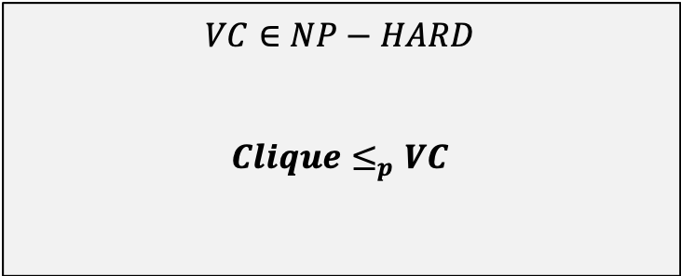
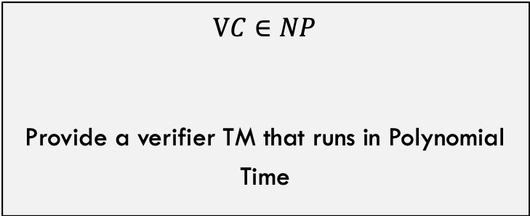
Showing that $VC∈NPC$
To show that $VC∈NPC$, we must show both that:
$$VC∈NP$$
Provide a verifier TM that runs in Polynomial Time
$$VC∈NP−HARD$$
$$Clique≤_{p}VC$$
As usual, this one is pretty simple
Let’s use Clique this time

Slide 91
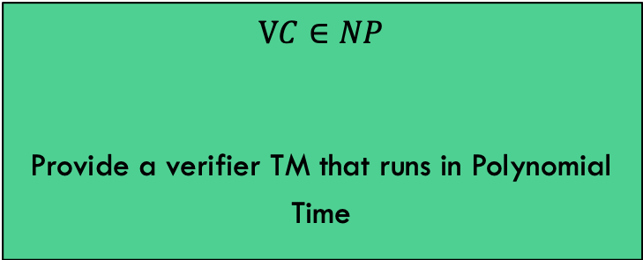
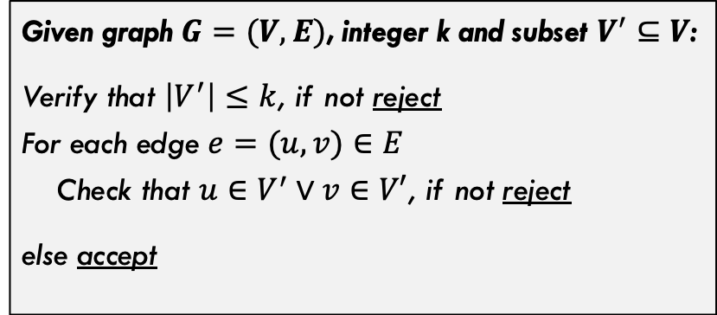
Showing that $VC∈NPC$
$$VC∈NP$$
Provide a verifier TM that runs in Polynomial Time
Given graph $G=(V,E)$, integer k and subset $V^{′}⊆V$:
Verify that $\left|V^{′}\right|≤k$, if not reject For each edge $e=(u,v)∈E$ Check that $u∈V^{′}∨v∈V′$, if not reject
else accept

Slide 92
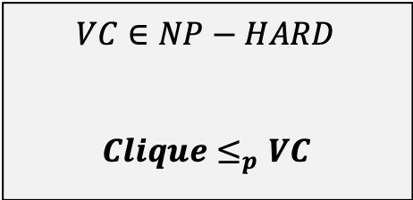
Showing that $VC∈NPC$
$$VC∈NP−HARD$$
$$Clique≤_{p}VC$$
Given a graph G, integer k, and looking for a clique of size k
graph G’, integer k’, and looking for a vertex cover of size k’
G
G’
1
2
k=?
k=4
3
4
?
5
6

Slide 93
Showing that $VC∈NPC$
Given a graph G, integer k, and looking for a clique of size k
graph G’, integer k’, and looking for a vertex cover of size k’
Simply flip the edges that exist in G and set k to $\left|V\right|−k$
1
2
G
1
2
G
k=4
k=2
3
4
3
4
5
6
5
6

Slide 94
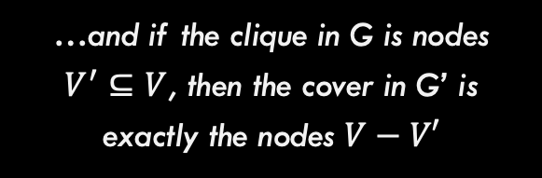
Showing that $VC∈NPC$
Claim: G has a clique of size k IFF G’ has a VC of size $\left|V\right|−k$
1
2
G
1
2
G
k=4
k=2
3
4
3
4
5
6
5
6
…and if the clique in G is nodes $V^{′}⊆V$, then the cover in G’ is exactly the nodes $V−V′$

Slide 95
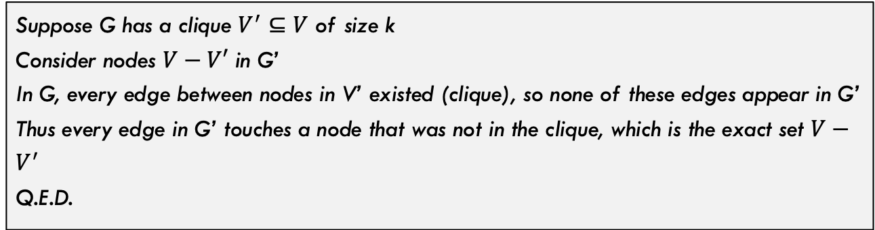
Showing that $VC∈NPC$
Claim: G has a clique of size k IFF G’ has a VC of size $\left|V\right|−k$
1
2
G
1
2
G
k=4
k=2
3
4
3
4
5
6
5
6
Proof Direction 1:
Suppose G has a clique $V^{′}⊆V$ of size k Consider nodes $V−V′$ in G’ In G, every edge between nodes in V’ existed (clique), so none of these edges appear in G’ Thus every edge in G’ touches a node that was not in the clique, which is the exact set $V−V^{′}$ Q.E.D.

Slide 96
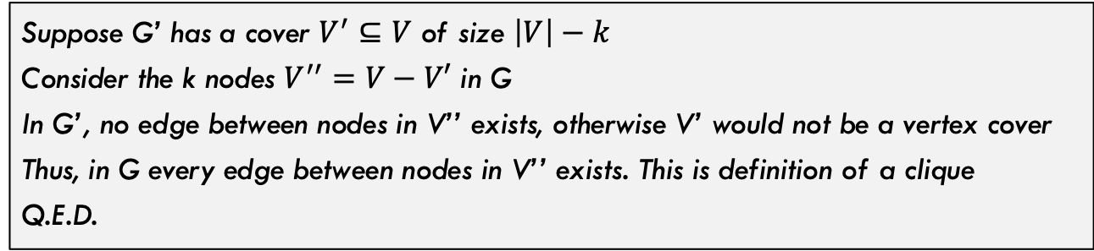
Showing that $VC∈NPC$
Claim: G has a clique of size k IFF G’ has a VC of size $\left|V\right|−k$
1
2
G
1
2
G
k=4
k=2
3
4
3
4
5
6
5
6
Proof Direction 2:
Suppose G’ has a cover $V^{′}⊆V$ of size $\left|V\right|−k$ Consider the k nodes $V^{′′}=V−V′$ in G In G’, no edge between nodes in V’’ exists, otherwise V’ would not be a vertex cover Thus, in G every edge between nodes in V’’ exists. This is definition of a clique Q.E.D.

Slide 97
More On Reductions

Slide 98
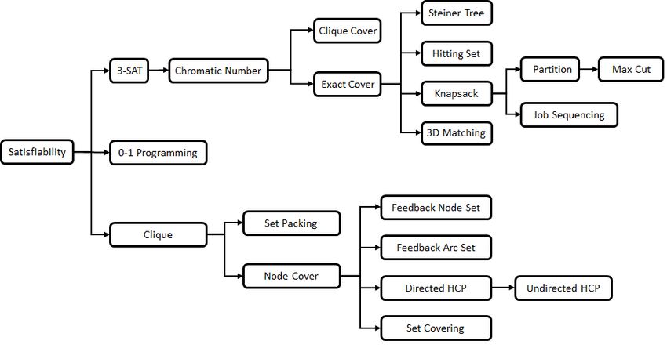
More reductions!
In 1972, Richard Karp showed a number of problems were NP-complete
The problems were known to be “hard”, but how “hard” was not really quantified until then

Slide 99
Does P=NP
NP-Hard
To this day, we still do not know if P and NP are distinctly separate. But, we have a lot of known NP-Complete problems
NP
Hard Problems
What would happen if someone found an algorithm to solve one of these famous NP-Complete problems that ran in polynomial time?
P
Easy Problems

Slide 100
NP-Hard
P-Hard NP-Hard
If someone finds a polynomial time algorithm to ANY np-complete problem, then
NP
P=NP
P
Suddenly, through various reductions there is a fast (polynomial) algorithm for every NP problem!

Slide 101
Another reduction: 3-Coloring

Slide 102

3-Coloring
Problem Statement: Given graph G, and three colors c1, c2, c3 (not really given as input), can we color the graph with these colors such that no adjacent nodes have the same color.
Turns out that 3-Coloring is NP-Complete, and problems like this should start “feeling” NP-Complete to you.

Slide 103


Showing that $3C∈NPC$
To show that $3C∈NPC$, we must show both that:
$$3C∈NP$$
Provide a verifier TM that runs in Polynomial Time
3$C∈NP−HARD$
$$3SAT≤_{p}VC$$
As usual, this one is pretty simple
Let’s use 3-SAT this time

Slide 104


Showing that $VC∈NPC$
$$3C∈NP$$
Provide a verifier TM that runs in Polynomial Time
Given graph $G=(V,E)$, and color assignments C for each node in V:
Verify that only 3 unique colors exist in C, if not reject Verify that each node was assigned exactly one color in C, if not reject
For each edge $e=(u,v)∈E$ Check that $C\left[u\right]≠C[v]$, if not reject
else accept

Slide 105




$$3SAT≤_{p}3C$$
$$3C∈NP−HARD$$
$$3SAT≤_{p}VC$$
Given a boolean formula in 3-CNF $θ$ that we want to test satisfiability on
graph G that is 3-Colorable if and only if $θ$ is satisfiable
G
$$θ=\left(u∨¬v∨w\right)∧(v∨x∨¬y)$$

Slide 106

$$3SAT≤_{p}3C$$
$$θ=\left(u∨¬v∨w\right)∧(v∨x∨¬y)$$
The graph we construct needs to: - Model the fact that variables can only be set to True and False.
- Model the variables and the fact that each variable XOR its negation can be True.
- Model the fact that at least one variable per clause must be chosen.

Slide 107
$$3SAT≤_{p}3C$$
$$θ=\left(u∨¬v∨w\right)∧(v∨x∨¬y)$$
The graph we construct needs to: - Model the fact that variables can only be set to True and False.
- Model the variables and the fact that each variable XOR its negation can be True.
- Model the fact that at least one variable per clause must be chosen.
T
F
Whatever color these top two nodes are assigned will represent True / False for the remainder of the coloring.
N
Notice that if we connect a variable (node) to this Neutral node, then that variable MUST take on the color assigned to True or False

Slide 108


$$3SAT≤_{p}3C$$
$$θ=\left(u∨¬v∨w\right)∧(v∨x∨¬y)$$
The graph we construct needs to: - Model the variables and the fact that each variable XOR its negation can be True.
- Model the fact that at least one variable per clause must be chosen.
T
F
N
This variable cannot take the Neutral color so it must be the opposite of whatever u took. One is true, the other is false.
$$u$$
$$¬u$$
This variable is connect to the Neutral, so it MUST take the True color or the false color.

Slide 109










$$3SAT≤_{p}3C$$
$$θ=\left(u∨¬v∨w\right)∧(v∨x∨¬y)$$
The graph we construct needs to: - Model the variables and the fact that each variable XOR its negation can be True.
- Model the fact that at least one variable per clause must be chosen.
T
F
N
$$u$$
$$¬u$$
$$v$$
$$¬v$$
$$w$$
$$¬w$$
So far, so good. By assigning every node one of three colors, we can effectively choose which variables to set to True / False!
$$x$$
$$¬x$$
$$y$$
$$¬y$$

Slide 110
$$3SAT≤_{p}3C$$
$$θ=\left(u∨¬v∨w\right)∧(v∨x∨¬y)$$
The graph we construct needs to:
- Model the fact that at least one variable per clause must be chosen.
In 1
Claim: Three fully-connected nodes can act as an OR gate. The output node can be colored with the True color IFF at least one of the input nodes is colored with the true color.
out
In 2
True / True
True / False
False / False
T
F
T
F
F
T
T
T
F
T
N
F
N
F
N

Slide 111
$$3SAT≤_{p}3C$$
$$θ=\left(u∨¬v∨w\right)∧(v∨x∨¬y)$$
The graph we construct needs to:
- Model the fact that at least one variable per clause must be chosen.
True / False
Quick Aside: Notice that in some cases, we can color the output to the neutral color. We will handle this issue in a moment.
But, it is still the case that we CAN color the output True if and only if one of the input nodes is colored True.
T
F
N
F
T

Slide 112

$$3SAT≤_{p}3C$$
$$θ=\left(u∨¬v∨w\right)∧(v∨x∨¬y)$$
The graph we construct needs to:
- Model the fact that at least one variable per clause must be chosen.
In 1
Corollary: We can combine two of these widgets to produce an OR gate across three variables. The output is colorable as TRUE if and only if one of the three inputs is colored TRUE
In 2
out
In 3
Example 1: False / False / True
Example 2: False / False / False
F
T
F
T
F
N
F
N
F
N
T
F
N
F
T
F
F
T

Slide 113










$$3SAT≤_{p}3C$$
Notice that the outputs of the gates are connected to the False and Neutral terminals. This is because we NEED the output of each clause to be colored True!
$$θ=\left(u∨¬v∨w\right)∧(v∨x∨¬y)$$
T
F
N
Clause 1
F
T
F
$$u$$
$$¬u$$
N
T
N
$$v$$
$$¬v$$
$$w$$
$$¬w$$
Clause 2
F
$$x$$
$$¬x$$
T
F
N
T
$$y$$
$$¬y$$
N

Slide 114
(VERY informal) proof of reduction
Sat(Φ) → G is 3-Colorable
Assume Φ is satisfiable
3 colors (true, false, base)
Color B,T,F with these colors
Color variable nodes with T and F depending on their satisfying values for Φ
Or gates always colorable so that they represent correct OR (output is true iff one or more inputs true)
Thus G is 3-Colorable
G is 3-Colorable → Sat(Φ)
Assume G is 3-Colorable
Color the graph
Let the colors of the B,T,F nodes represent base, true, and false respectively.
Re-arrange OR gate colors slightly if necessary so output is always T or F
Let variable assignments be the color they were given
These assignments satisfy Φ

Slide 115
Co-NP

Slide 116
Algorithmic Complement
Given a problem X, we can define the complement, X’
Take the decision version of the problem X
Change all the ‘yes’ answers to ‘no’ and visa-versa
Consider the problem of if a number is prime
The complement problem is if a number is composite

Slide 117
co-NP
NP contains the set of problems for which proof of a ‘yes’ solution is easily verifiable
To show a ‘yes’ instance, I just have to show one: exists quantifier
To show no instances, I have to show it’s ‘no’ for all: for all quantifier
To show that there is no satisfiable set of truth values for a SAT problem, you have to show each possible one
co-NP contains the set of problems for which proof of no solutions is easily verifiable

Slide 118
co-NP examples
SAT: given a expression, is there a satisfiable set of truth assignments?
To prove a ‘yes’ instance, you just (quickly) check a given (correct) answer (polynomial time)
To prove there are no instances, you must show for all (exponential time)
co-SAT: given an expression, are there no satisfiable set of truth assignments?
To prove a ‘no’ instance (which means there is a satisfiable truth assignment), we just (quickly) check a given (correct) answer (polynomial time)
To prove ‘yes’, you must show for all (exponential time)

Slide 119
co-NP
Consider subset-sum: given a finite set of integers, is there a non-empty subset which sums to zero?
To prove a ‘yes’, specify the non-empty subset
The complement asks, “given a finite set of integers, does every non-empty subset have non-zero sum?”
To prove a ‘no’, specify a non-empty subset

Slide 120
P is closed under complement
Meaning P = P’
For problems in P: finding a ‘yes’ instance or finding there are no instances are both polynomial time
For problems in P’: finding a ‘no’ instance or finding there are yes instances are both polynomial time
For NP/co-NP, one way was exponential

Slide 121
Does NP = co-NP?
We don’t know for sure
We know that P ⊆ NP
Likewise, P ⊆ co-NP
Given a problem in P, it’s complement P’ is also in P
P’ is in co-NP
Thus P ⊆ co-NP

Slide 122
NP and co-NP
We’ll show that if P = NP then NP = co-NP
We don’t think that P = NP, but we can still show the conditional is true
Assume P = NP…
Let X ∈NP
Then, X ∈ P because P=NP
X’ ∈ P because P closed under complement
X’ ∈ NP because P=NP
X ∈ co-NP because definition of co-NP
Same Exact argument backwards for the other way
Thus, if P = NP then NP = co-NP

Slide 123
Conclusions / Other Complexity classes

Slide 124
A couple complexity classes we won’t see:
EXPTIME
Deterministic exponential time
NEXPTIME
Non-Deterministic exponential time
PSPACE
Deterministic Polynomial Space
NPSPACE
Non-Deterministic Polynomial Space
EXPSPACE
Deterministic Exponential Space
NEXPSPACE
Non-Deterministic Exponential Space
PSPACE = NPSPACE and EXPSPACE = NEXPSPACE
(WOAH! That’s pretty cool!)

Slide 125

Complexity class diagram

Slide 126
Conclusions!
In this module, we learned:
1. Problem types (function, decision, verification), runtimes of DTMs and NTMs, relationships between DTM and NTM runtimes for types of problems.
2. The basic complexity classes (P, NP, NP-Hard, NPC) and how they relate to one another.
3. What a reduction is and how it is used to compare the difficulty of two different problems.
4. How to prove that a problem is NP-Complete.

Slide 127
If we have time
https://www.youtube.com/watch?v=oS8m9fSk-Wk

