Slide 1
Context-Free Languages
Discrete Mathematics and Theory 2 Mark Floryan

Slide 2
Goals!
1. Very quick review of the Chomsky Hierarchy (overall picture).
2. Our second model of computation, the pushdown automata!! Let’s add memory to that finite state machine!!
3. What languages can this new model of computation now recognize? Can we find languages it cannot recognize now?

Slide 3
Part 1: Reminder of where we are / Chomsky Hierarchy

Slide 4
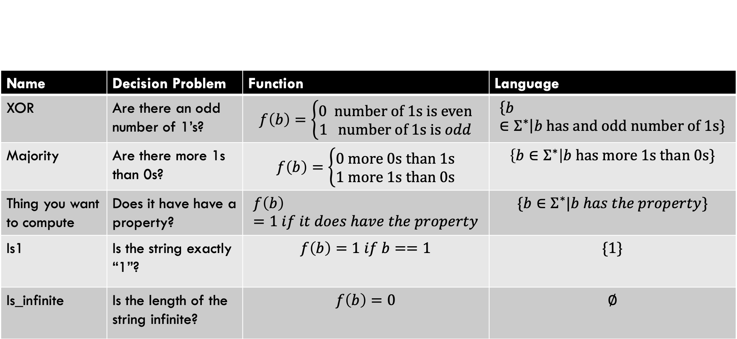
Types of Problems
Name | Decision Problem | Function | Language
XOR | Are there an odd number of 1’s? | $$f\left(b\right)=\left\{\begin{aligned}0 number of 1s is even \\ 1 number of 1s is odd\end{aligned}\right.$$ | $$\left\{b∈Σ^{∗}\right|b has and odd number of 1s\}$$
Majority | Are there more 1s than 0s? | $$f\left(b\right)=\left\{\begin{aligned}0 more 0s than 1s \\ 1 more 1s than 0s\end{aligned}\right.$$ | $$\left\{b∈Σ^{∗}\right|b has more 1s than 0s\}$$
Thing you want to compute | Does it have have a property? | $$f\left(b\right)=1 if it does have the property$$ | $$\{b∈Σ^{∗}|b has the property\}$$
Is1 | Is the string exactly “1”? | $$f\left(b\right)=1 if b==1$$ | $$\{1\}$$
Is_infinite | Is the length of the string infinite? | $$f\left(b\right)=0$$ | $$∅$$

Slide 5
Chomsky Hierarchy
A description of languages and their relationship to one another
Each language has a computational model that recognizes it
In this deck, we will see the context-free languages and the machines that recognize them

Slide 6
Overview of This Deck
These are all equivalent in their expressive power.
Pushdown Automata
NFA w/ a stack. Can recognize exactly the context-free languages
Context-Free Languages:
A Class of languages that are more expressive than regular languages
Context-Free Grammar:
A “string” description of a context-free language (by definition)
At the end of this deck, we will also see that context-free languages have a pumping lemma that can be used to prove some languages are NOT context-free.
For now, we allow non-determinism freely with this computational model. We will discuss (briefly) the ramifications for this later in the deck.

Slide 7
Part 2: Context-Free Grammars

Slide 8
Introduction: What is a Context-Free Grammar

Slide 9
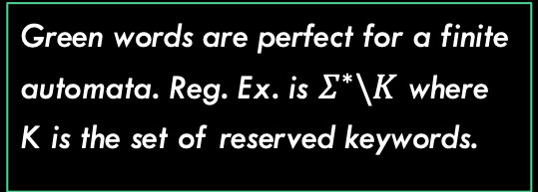

Quick Aside: Finite Automata and Regular Languages
Motivating Question: Computational models are often of interest in the application of programming languages and compilers. Given a program, is it a valid program in the given language that does not contain any syntax errors.
String x = “hellothere123”; double y = 23.456;
int z = 67.8; //syntax error
Purple words do not need any “computation” to confirm. Just make sure the word matches something in a set of known valid keywords for types.
Regular expressions really shine here. Each type has an automata that recognizes if string is in the valid format.
for String: $“Σ^{∗}”$ for double: ${\left[0−9\right]}^{+}.{\left[0−9\right]}^{+}∪{\left[0−9\right]}^{+}$
for int: ${\left[0−9\right]}^{+}$
Green words are perfect for a finite automata. Reg. Ex. is $Σ^{∗}\backslash K$ where K is the set of reserved keywords.

Slide 10

Quick Aside: Finite Automata and Regular Languages
Motivating Question: Computational models are often of interest in the application of programming languages and compilers. Given a program, is it a valid program in the given language that does not contain any syntax errors.
String x = “hellothere123”; double y = 23.456;
int z = 67.8; //syntax error
Can even handle some entire lines of code with finite automata. declarations of double:
$$double Σ^{+}={\left[0−9\right]}^{+}.{\left[0−9\right]}^{+}∪{\left[0−9\right]}^{+};$$
But in reality, code is more complicated than this. Consider:
the right side of assignment can be a bigger expression, or maybe result of an if statement.
For loops can have nothing inside or a whole set of assignments.

Slide 11
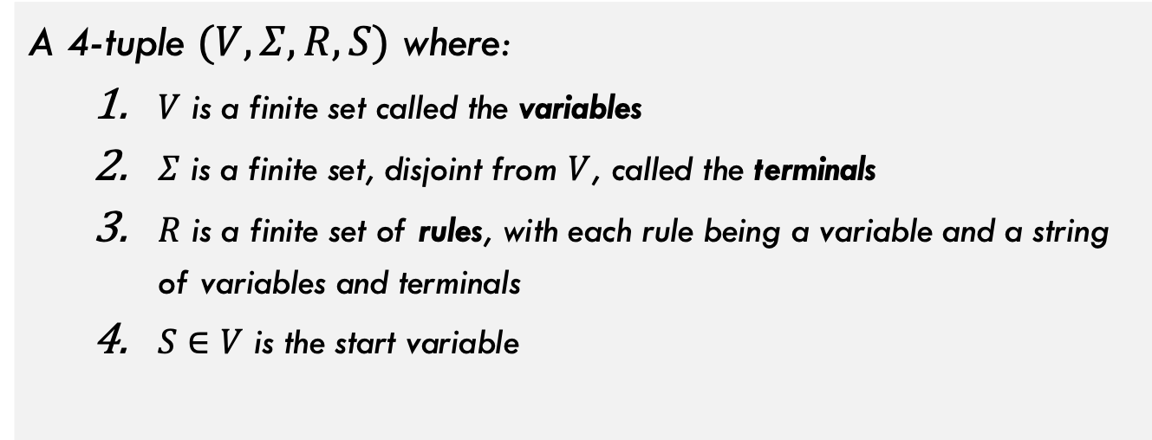
Formal Definition of a CFG
A context free grammar is:
A 4-tuple $(V, Σ, R, S)$ where:
$V$ is a finite set called the variables
$Σ$ is a finite set, disjoint from $V$, called the terminals
$R$ is a finite set of rules, with each rule being a variable and a string of variables and terminals
$S∈V$ is the start variable

Slide 12

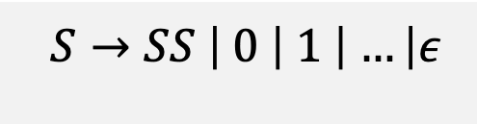
Some Simple Examples
Alphabet for all these grammars:
$$Σ=\{0, 1, …, 9, a, b,…, z, . , +, −, =, ;\}$$
Variables are denoted with capital letters. The first variable here is called the start variable
$$A={(Σ−\{.,+,−,=,;\})}^{∗}$$
Terminal characters like these cannot be replaced, but ensure the expression will eventually be completed through enough substitutions
$$S→SS \left| 0 \right| 1 \left| …\right|ε$$
Each of these production rules can be applied to substitute for variables of the same name
Example: Generate String “x10”:
S SS SSS xSS x1S x10

Slide 13




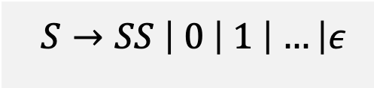

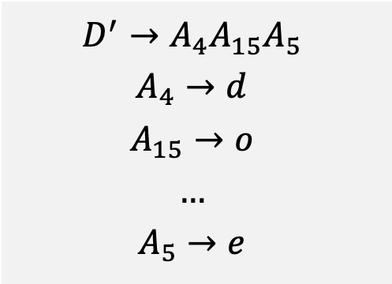
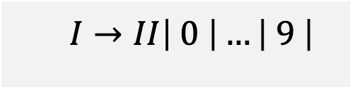

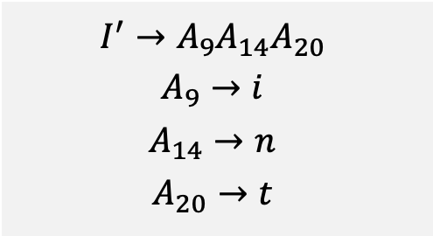
Some Simple Examples
Alphabet for all these grammars:
$$Σ=\{0, 1, …, 9, a, b,…, z, . , +, −, =, ;\}$$
$$I=d^{+}$$
$$D=d^{+}.d^{+}$$
$$I→II\left| 0 \right|…\left| 9 \right|$$
$$D→I.I$$
$A$ from previous slide
$$S→SS \left| 0 \right| 1 \left| …\right|ε$$
$I′=$ “int”
$D′=$ “double”
$$I^{′}→A_{9}A_{14}A_{20} \\ A_{9}→i \\ A_{14}→n \\ A_{20}→t$$
$$D^{′}→A_{4}A_{15}A_{5} \\ A_{4}→d \\ A_{15}→o \\ … \\ A_{5}→e$$
Repeated application of first rule to expand the size of the string then replace each S with individual characters.

Slide 14
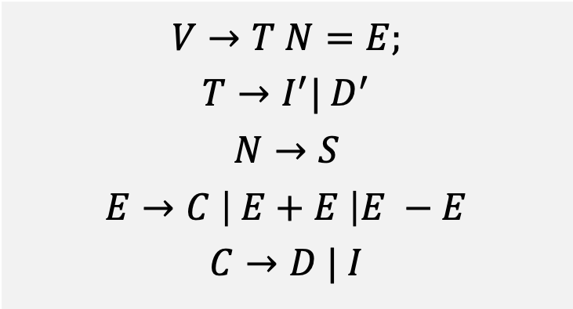
Example Context-Free Grammar
Recall from previous slides that:
I’ and D’ lead to “int” and “double”
S leads to any string of numbers and letters (variable name)
I and D lead to valid int and double values respectively
$$V→T N=E; \\ T→I^{′}| D^{′} \\ N→S \\ E→C \left| E+E \right|E −E \\ C→D | I$$

Slide 15



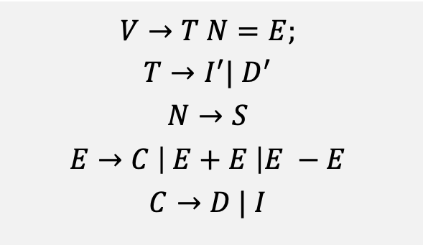
Example Context-Free Grammar
$$V→T N=E; \\ T→I^{′}| D^{′} \\ N→S \\ E→C \left| E+E \right|E −E \\ C→D | I$$
Derivation of that string:
V
T N = E;
E + E
$$D′$$
S
C
C
Example string in this grammar:
$$double myvar=3.4+5;$$
D
$$I$$
double
myvar
=
3.4
+
5
;

Slide 16
Another Example CFG
We learned last time that the language $L=0^{n}1^{n}$ is NOT regular.
Can you generate a context-free grammar that recognizes it?
Hint: You do not need regular expressions as terminal characters here. Your terminal characters will be 0 and 1.

Slide 17


Another Example CFG
We learned last time that the language $L=0^{n}1^{n}$ is NOT regular.
S → B B → 0B1 B → $ε$
Example Derivation of $0^{3}1^{3}$:
S B 0B1 00B11 000B111 000111

Slide 18
Challenge
Can you generate the following grammar on your own:
The grammar of all well formed arithmetic expressions containing at most two variables (x and y), parentheses, and two operators (+ and *).
Example string: (x+y)*(x*x)

Slide 19
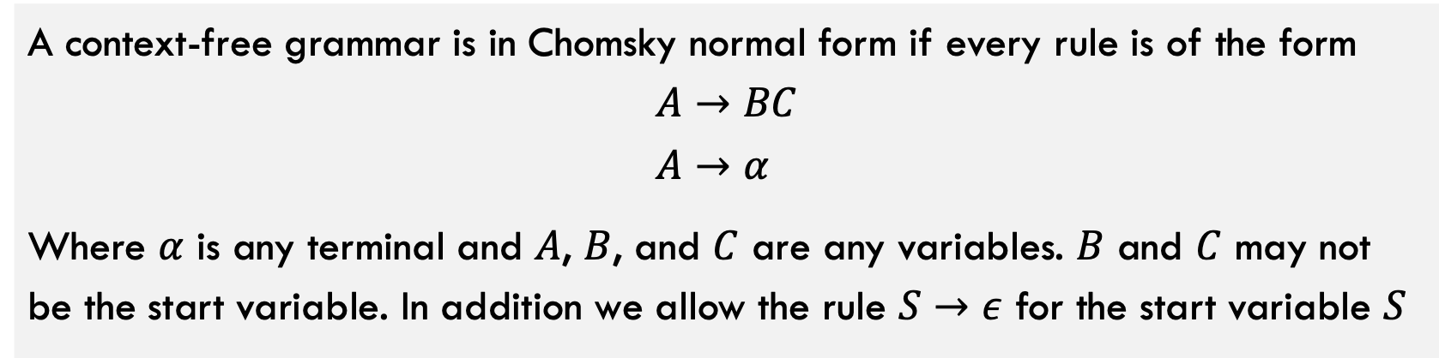
Chomsky Normal Form
A context-free grammar is in Chomsky normal form if every rule is of the form
$$A→BC \\ A→α$$
Where $α$ is any terminal and $A$, $B$, and $C$ are any variables. $B$ and $C$ may not be the start variable. In addition we allow the rule $S→ε$ for the start variable $S$
Why is this useful? Well, it is easier to do proofs about grammars if you can assume the grammar is always in a simplified form (fewer cases to handle).
But can any context-free grammar be in Chomsky normal form?

Slide 20
Chomsky Normal Form
A context-free grammar is in Chomsky normal form if every rule is of the form
$$A→BC \\ A→α$$
Where $α$ is any terminal and $A$, $B$, and $C$ are any variables. $B$ and $C$ may not be the start variable. In addition we allow the rule $S→ε$ for the start variable $S$
Theorem: Any context-free language is generated by a context-free grammar in Chomsky normal form.
We are NOT going to prove this one. Just trust me (proof is in the book on pg. 107/108 if you are interested).

Slide 21
Part 2: Pushdown Automata

Slide 22
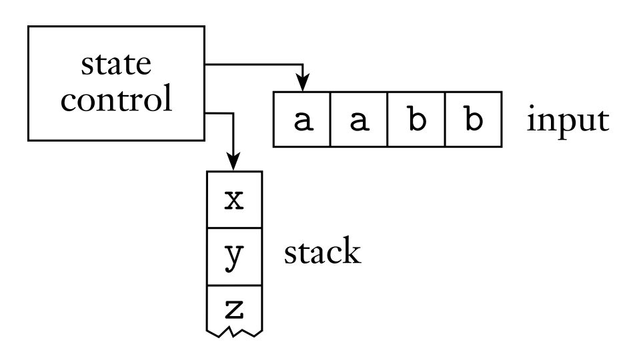
Pushdown Automata
This state control is just a DFA/NFA just like before!
Input is read in character by character (same as NFA)
Pushdown Automata: Informally, is a machine that combines an NFA (state control) but adds a stack. The machine can push and pop to the stack
The stack provides the machine with memory. The machine can push or pop from the top of the stack only during any state transition (one push or pop per transition)

Slide 23

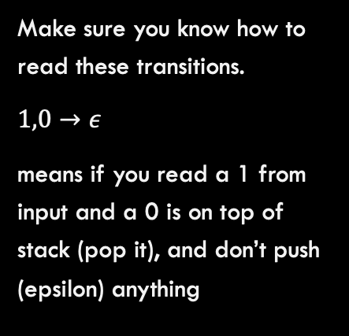





Pushdown Automata
This pushdown automata recognizes the language:
$$L=0^{n}1^{n} | n≥0$$
Q1
$$ε, ε→\$$$
Q2
Q1
$$0,ε→0$$
Make sure you know how to read these transitions.
$1,0→ε$
means if you read a 1 from input and a 0 is on top of stack (pop it), and don’t push (epsilon) anything
$$1,0→ε$$
Q4
$$ε, \$→ε$$
Q3
Q4
$$1,0→ε$$

Slide 24

Pushdown Automata
This pushdown automata recognizes the language:
$$L=0^{n}1^{n} | n≥0$$
Let’s step through w/ input:
000111
Q1
$$ε, ε→\$$$
Q2
Q1
$$0,ε→0$$
$$1,0→ε$$
Q4
$$ε, \$→ε$$
Q3
Q4
$$1,0→ε$$

Slide 25

Pushdown Automata
This pushdown automata recognizes the language:
$$L=a^{i}b^{j}c^{k} | i,j,k≥0 and i=j or i=k$$
Basic Idea: Push the a’s to the stack and then read them off to match them to either the b’s or the c’s
Do not be afraid to use non-determinism here. We don’t really know whether to match the number of a’s with the b’s or the c’s. Can we try both?

Slide 26












Pushdown Automata
This pushdown automata recognizes the language:
$$L=a^{i}b^{j}c^{k} | i,j,k≥0 and i=j or i=k$$
$$b,a→ε$$
$$c,ε→ε$$
Q1
Q3
Q1
Q4
$$ε,\$→ε$$
$$ε, ε→\$$$
$$ε,ε→ε$$
Q2
Q5
$$ε,ε→ε$$
Q6
$$ε,\$→ε$$
Q4
$$ε,ε→ε$$
Q7
$$a, ε→a$$
b$, ε→ε$
c$, a→ε$

Slide 27
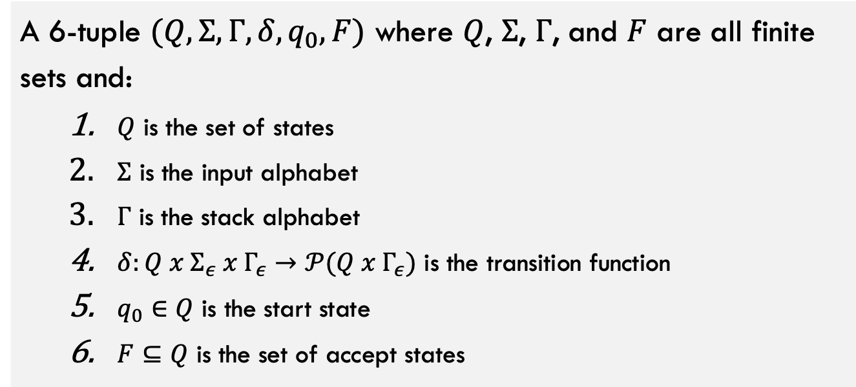
Formal Definition Pushdown Automata
A pushdown automata is:
A 6-tuple $(Q, Σ, Γ, δ, q_{0}, F)$ where $Q$, $Σ$, $Γ$, and $F$ are all finite sets and:
$Q$ is the set of states
$Σ$ is the input alphabet
$Γ$ is the stack alphabet
$δ:Q x Σ_{ε} x Γ_{ε}→𝒫(Q x Γ_{ε})$ is the transition function
$q_{0}∈Q$ is the start state
$F⊆Q$ is the set of accept states

Slide 28
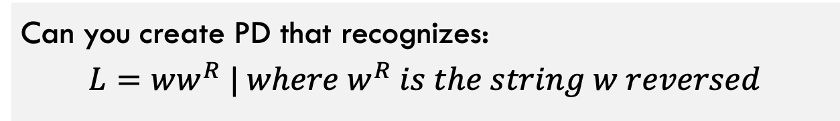
Try it on your own!
Can you create PD that recognizes:
$$L=ww^{R} | where w^{R} is the string w reversed$$

Slide 29
Equivalence with Context-Free Grammars

Slide 30
You know the drill!
Theorem: A language L is context-free if and only if some pushdown automata recognizes it
How to prove:
Direction 1: Assume L is context-free, show how to construct the pushdown automata for it.
Direction 2: Assume we have a pushdown automata, show how to construct the context-free grammar that describes it.

Slide 31
You know the drill!
Theorem: A language L is context-free if and only if some pushdown automata recognizes it
Direction 1: Assume L is context-free, show how to construct the pushdown automata for it.

Slide 32
You know the drill!
Theorem: A language L is context-free if and only if some pushdown automata recognizes it
Direction 1: Assume L is context-free, show how to construct the pushdown automata for it.
High level idea of proof:
Let L be a context-free grammar, this means it can be described by a set of substitutions of variables / terminals (see formal definition of CFG)
To construct the PDA that recognizes it:
Put the start variable on the stack
Loop: Pop a variable off the stack, look at rules that can be substituted for, non-deterministically branch off for each one and put new symbol on the stack.
If terminal is on the stack, pop it and check. it against the next character of input.

Slide 33
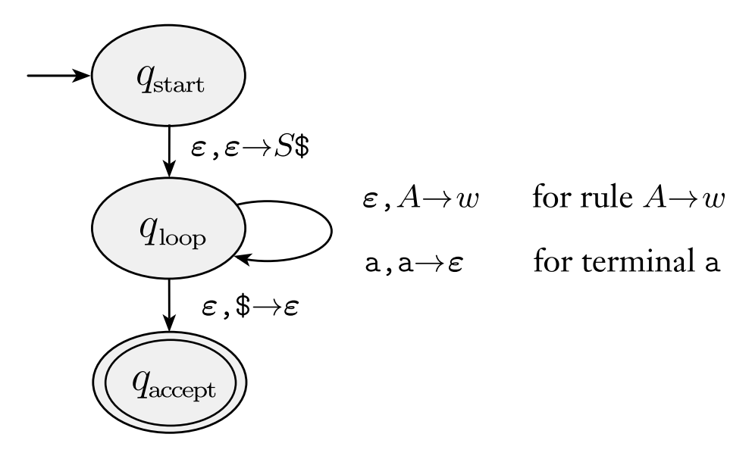
You know the drill!
Theorem: A language L is context-free if and only if some pushdown automata recognizes it
Direction 1: Assume L is context-free, show how to construct the pushdown automata for it.
Start by pushing $ onto the stack following by start variable S
if we see a variable A on top of stack (e.g., ), pop A off and push the things it can be substituted with onto stack one character at a time
This main loop has a non-deterministic condition for every possible rule substitution
If we see a terminal a on top of stack, pop it off and check it against the next character of input

Slide 34
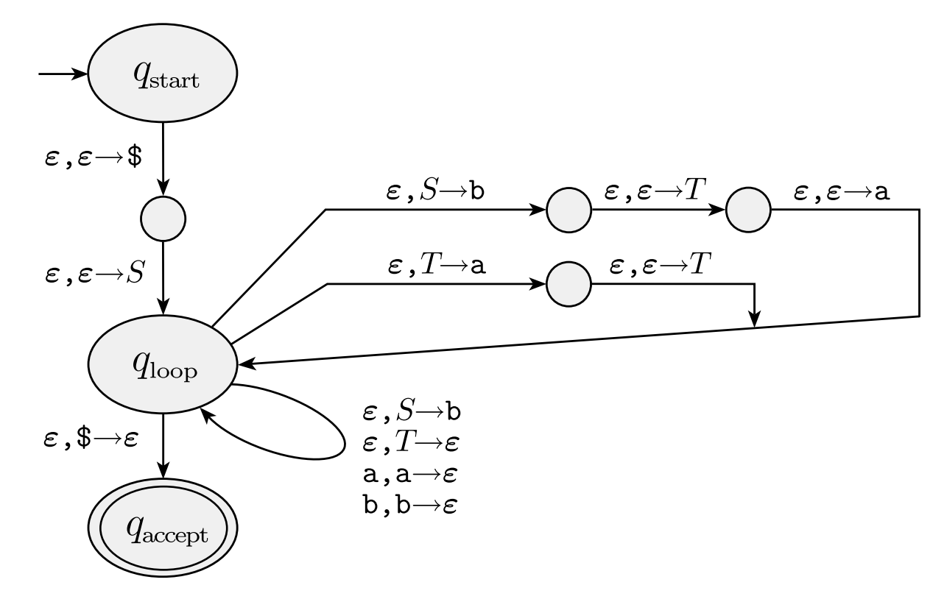

You know the drill!
Theorem: A language L is context-free if and only if some pushdown automata recognizes it
Direction 1: Assume L is context-free, show how to construct the pushdown automata for it.
EXAMPLE: Consider the grammar:
$$S→aTb | b \\ T→Ta | ε$$

Slide 35
You know the drill!
Theorem: A language L is context-free if and only if some pushdown automata recognizes it
Direction 2: Assume we have a pushdown automata, show how to construct the context-free grammar that describes it.

Slide 36
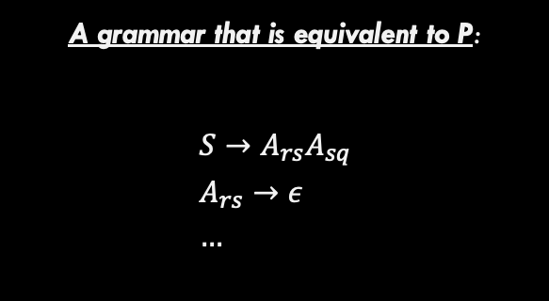
You know the drill!
Theorem: A language L is context-free if and only if some pushdown automata recognizes it
Direction 2: Assume we have a pushdown automata, show how to construct the CFG that describes it.
Start with an arbitrary PDA, called P
A grammar that is equivalent to P:
$$S→A_{rs}A_{sq} \\ A_{rs}→ε \\ …$$
Convert into

Slide 37
You know the drill!
Theorem: A language L is context-free if and only if some pushdown automata recognizes it
Direction 2: Assume we have a pushdown automata, show how to construct the CFG that describes it.
Start with an arbitrary PDA, called P
Step 1: Let’s simplify P a little bit so we know SOMETHING about it’s structure.
We make the following changes to P:
1. If P has multiple accept states, change it to have only one 2. If P has elements on the stack before accepting, empty the stack first 3. Every transition either pushes a symbol, or pops a symbol, but not both
These changes are not too difficult to make. I will verbally describe how to do all 3 of these.

Slide 38
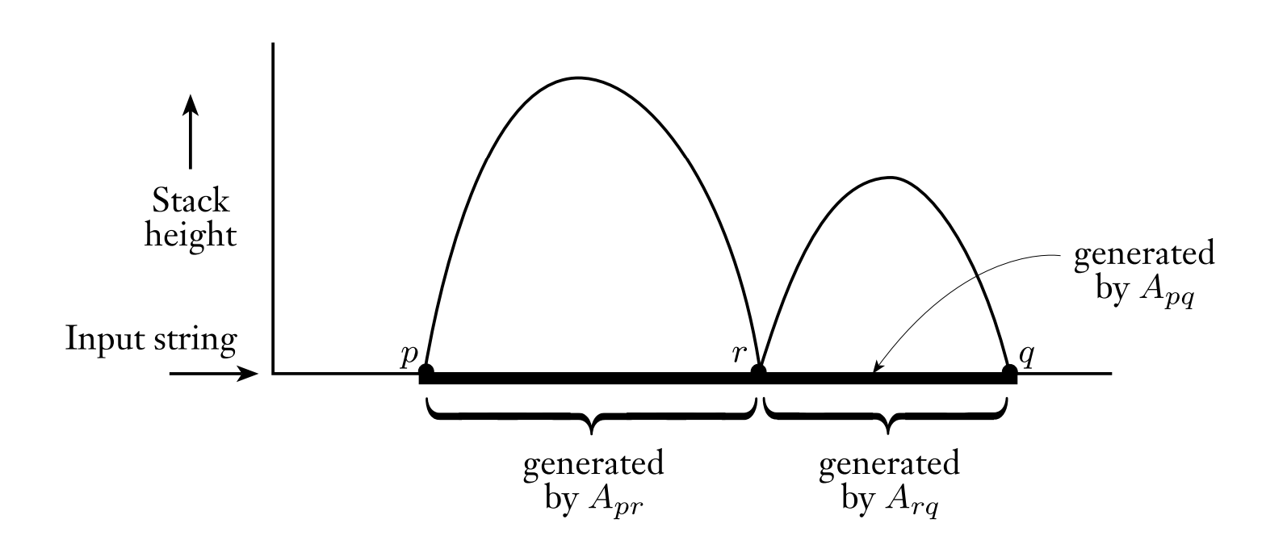

You know the drill!
Theorem: A language L is context-free if and only if some pushdown automata recognizes it
Direction 2: Assume we have a pushdown automata, show how to construct the CFG that describes it.
Overall idea: We need to get from start state (empty stack) to accept state (empty stack)
Variable $A_{pq}$ represents moving from state p to state q without changing the state of the stack
Notice that in this case, we move from state p to r (without altering stack) and then again from r to q (without altering stack)

Slide 39
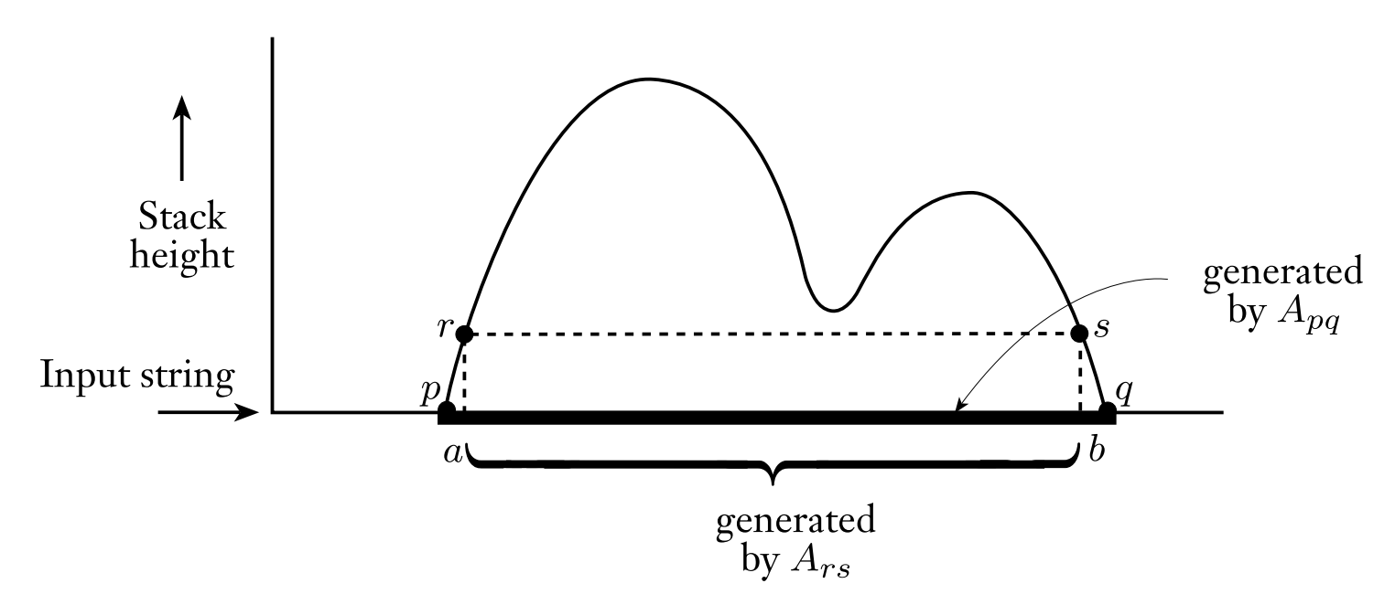
You know the drill!
Theorem: A language L is context-free if and only if some pushdown automata recognizes it
Direction 2: Assume we have a pushdown automata, show how to construct the CFG that describes it.
Situation can also look like this. Stack moves up and down but eventually comes back to being empty. The first symbol that is pushed must match the last symbol popped.

Slide 40
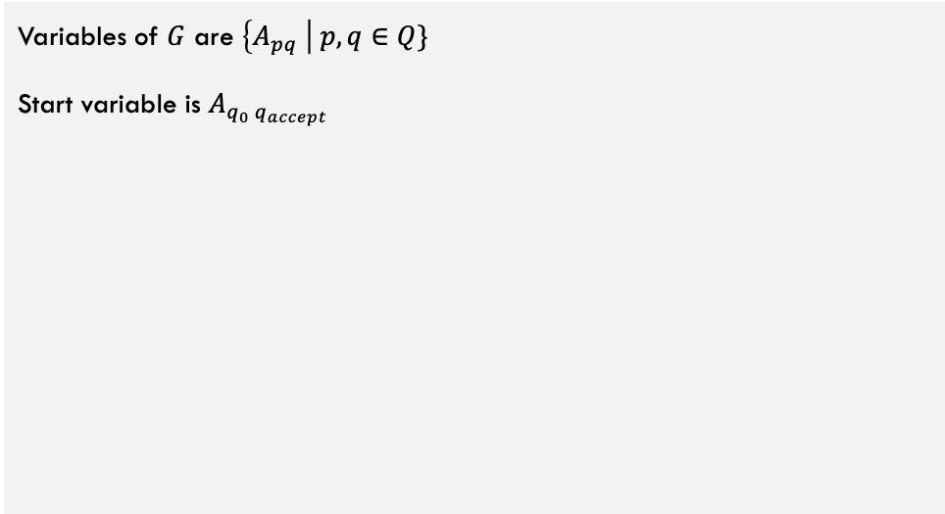
You know the drill!
Theorem: A language L is context-free if and only if some pushdown automata recognizes it
Direction 2: Assume we have a pushdown automata, show how to construct the CFG that describes it.
Given a PDA $P=\left(Q,Σ,Γ,δ,q_{0},\left\{q_{accept}\right\}\right)$, construct grammar $G$:
Variables of $G$ are $\left\{A_{pq} \right| p,q∈Q\}$
Start variable is $A_{q_{0} q_{accept}}$
Let’s start constructing the grammar from the PDA. The variables represent moving from each pair of states p,q by using, but not altering the stack (empty stack to empty stack).
start variable will simply be a dummy variable that represents getting from the start state to the accept state

Slide 41
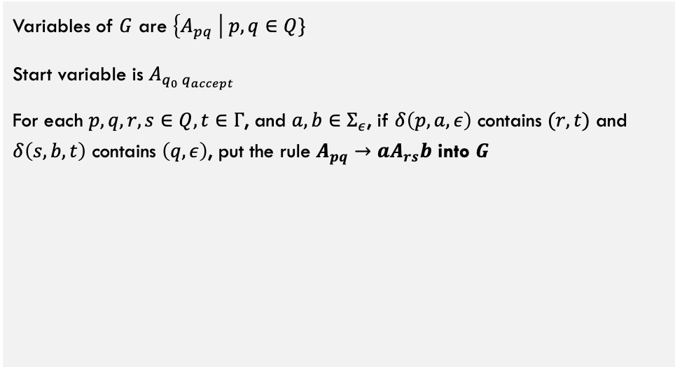
You know the drill!
Theorem: A language L is context-free if and only if some pushdown automata recognizes it
Direction 2: Assume we have a pushdown automata, show how to construct the CFG that describes it.
Given a PDA $P=\left(Q,Σ,Γ,δ,q_{0},\left\{q_{accept}\right\}\right)$, construct grammar $G$:
Variables of $G$ are $\left\{A_{pq} \right| p,q∈Q\}$
Start variable is $A_{q_{0} q_{accept}}$
For each $p,q,r,s∈Q, t∈Γ$, and $a,b∈Σ_{ε}$, if $δ\left(p,a,ε\right)$ contains $(r,t)$ and $δ\left(s,b,t\right)$ contains $\left(q,ε\right)$, put the rule $A_{pq}→aA_{rs}b$ into $G$
This next rule covers every pair of states the push and pop the same symbol (e.g., first step is to push a symbol t, then a bunch of stuff happens, then eventually we pop off the t).

Slide 42
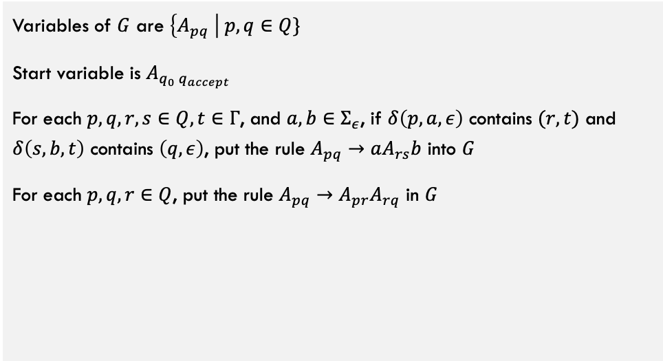
You know the drill!
Theorem: A language L is context-free if and only if some pushdown automata recognizes it
Direction 2: Assume we have a pushdown automata, show how to construct the CFG that describes it.
Given a PDA $P=\left(Q,Σ,Γ,δ,q_{0},\left\{q_{accept}\right\}\right)$, construct grammar $G$:
Variables of $G$ are $\left\{A_{pq} \right| p,q∈Q\}$
Start variable is $A_{q_{0} q_{accept}}$
For each $p,q,r,s∈Q, t∈Γ$, and $a,b∈Σ_{ε}$, if $δ\left(p,a,ε\right)$ contains $(r,t)$ and $δ\left(s,b,t\right)$ contains $\left(q,ε\right)$, put the rule $A_{pq}→aA_{rs}b$ into $G$
For each $p,q,r∈Q$, put the rule $A_{pq}→A_{pr}A_{rq}$ in $G$
This rule covers all cases where you empty the stack twice (at least). Once from state p to r and again from state r to q.

Slide 43
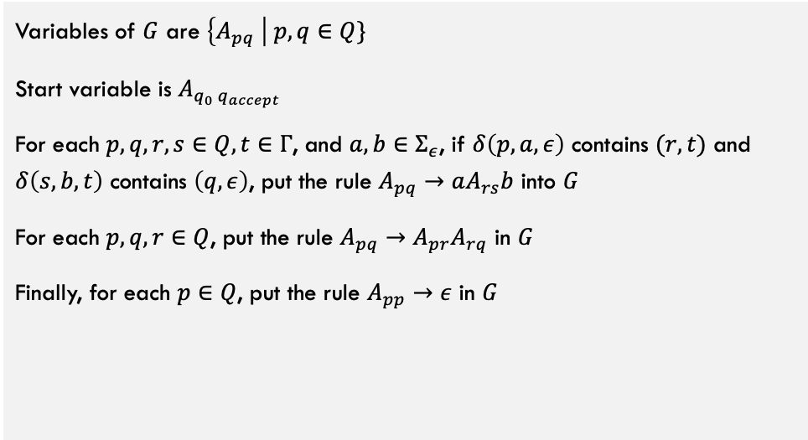
You know the drill!
Theorem: A language L is context-free if and only if some pushdown automata recognizes it
Direction 2: Assume we have a pushdown automata, show how to construct the CFG that describes it.
Given a PDA $P=\left(Q,Σ,Γ,δ,q_{0},\left\{q_{accept}\right\}\right)$, construct grammar $G$:
Variables of $G$ are $\left\{A_{pq} \right| p,q∈Q\}$
Start variable is $A_{q_{0} q_{accept}}$
For each $p,q,r,s∈Q, t∈Γ$, and $a,b∈Σ_{ε}$, if $δ\left(p,a,ε\right)$ contains $(r,t)$ and $δ\left(s,b,t\right)$ contains $\left(q,ε\right)$, put the rule $A_{pq}→aA_{rs}b$ into $G$
For each $p,q,r∈Q$, put the rule $A_{pq}→A_{pr}A_{rq}$ in $G$
Finally, for each $p∈Q$, put the rule $A_{pp}→ε$ in $G$
Last rule, base case! Nothing needs to happen when going from a state p to itself.

Slide 44
You know the drill!
Theorem: A language L is context-free if and only if some pushdown automata recognizes it
Direction 2: Assume we have a pushdown automata, show how to construct the CFG that describes it.
Given a PDA $P=\left(Q,Σ,Γ,δ,q_{0},\left\{q_{accept}\right\}\right)$, construct grammar $G$:
So, is it the case that if a string X accepts in the original automata P, then this grammar will definition accept it (and similarly for rejection)?
Yes, let’s verbally describe why.
Variables of $G$ are $\left\{A_{pq} \right| p,q∈Q\}$
Start variable is $A_{q_{0} q_{accept}}$
For each $p,q,r,s∈Q, t∈Γ$, and $a,b∈Σ_{ε}$, if $δ\left(p,a,ε\right)$ contains $(r,t)$ and $δ\left(s,b,t\right)$ contains $\left(q,ε\right)$, put the rule $A_{pq}→aA_{rs}b$ into $G$
For each $p,q,r∈Q$, put the rule $A_{pq}→A_{pr}A_{rq}$ in $G$
Finally, for each $p∈Q$, put the rule $A_{pp}→ε$ in $G$

Slide 45
Example!
Q1
$$ε, ε→\$$$
Q2
Q1
$$0,ε→0$$
$$1,0→ε$$
Q4
$$ε, \$→ε$$
Q3
Q4
$$1,0→ε$$
Stack is empty when we start and stop, good!
Only one start and accept state, good!
All transitions only push, pop but not both. Yep!

Slide 46
Example!
Q1
$$ε, ε→\$$$
Q2
Q1
$$0,ε→0$$
$$1,0→ε$$
Q4
$$ε, \$→ε$$
Q3
Q4
$$1,0→ε$$

Slide 47
We did it!
Theorem: A language L is context-free if and only if some pushdown automata recognizes it
Great! So, pushdown automata and context-free grammars are equivalent in their descriptive power, and they are MORE powerful than regular languages / NFAs

Slide 48
Part 3: Non-Context-Free Languages

Slide 49
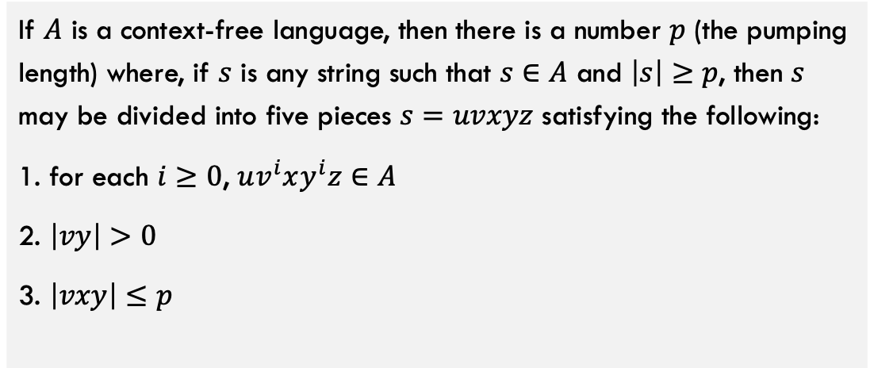
Pumping Lemma for CFL
The pumping lemma for context-free languages:
If $A$ is a context-free language, then there is a number $p$ (the pumping length) where, if $s$ is any string such that $s∈A$ and $\left|s\right|≥p$, then $s$ may be divided into five pieces $s=uvxyz$ satisfying the following:
1. for each $i≥0$, $uv^{i}xy^{i}z∈A$
2. $\left|vy\right|>0$
3. $\left|vxy\right|≤p$

Slide 50
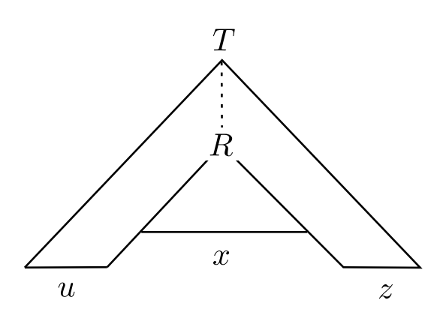
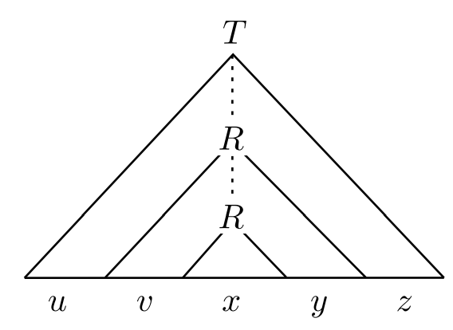
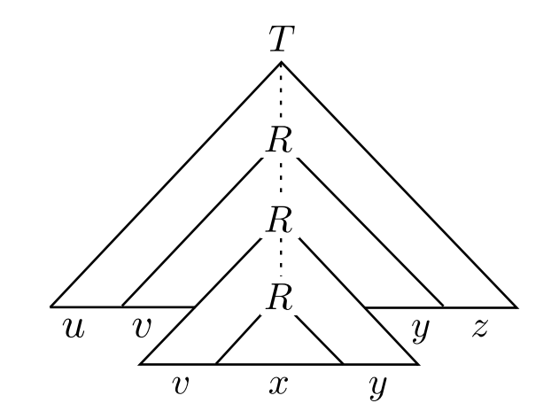
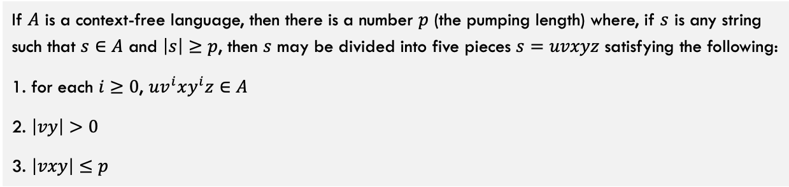
Pumping Lemma for CFL
The pumping lemma for context-free languages:
If $A$ is a context-free language, then there is a number $p$ (the pumping length) where, if $s$ is any string such that $s∈A$ and $\left|s\right|≥p$, then $s$ may be divided into five pieces $s=uvxyz$ satisfying the following:
1. for each $i≥0$, $uv^{i}xy^{i}z∈A$
2. $\left|vy\right|>0$
3. $\left|vxy\right|≤p$
Pump down to remove v and y
Here, R is a variable that is “re-used”
Pump up to add v and y

Slide 51
Pumping Lemma for CFL
Regarding the pumping length p
How to choose p? Given the number of variables and the number of characters that can be substituted for each, we can calculate a tree height that guarantees some variable occurs twice (pigeonhole principle).
p needs to be set so that the length of uvxyz is long enough to guarantee that some variable R is “re-used”.
Then, find a length for uvxyz that guarantees that tree height. Your book shows the exact calculation if you are interested.
Condition 3 of the lemma says that the substring vxy is less than or equal to the pumping length p

Slide 52
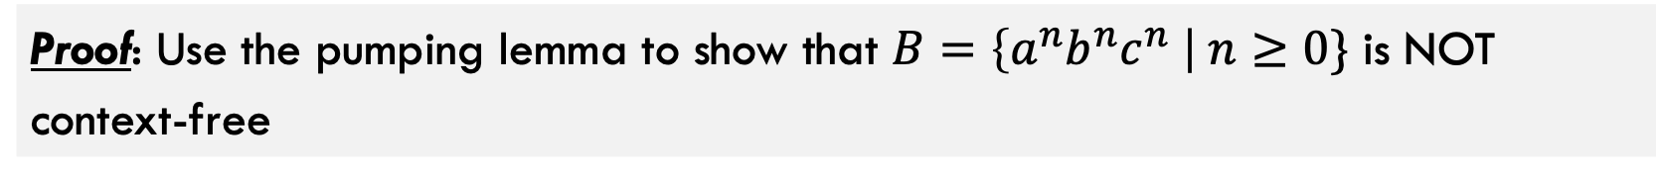
Example!
Proof: Use the pumping lemma to show that $B=\left\{a^{n}b^{n}c^{n} \right| n≥0\}$ is NOT context-free

Slide 53
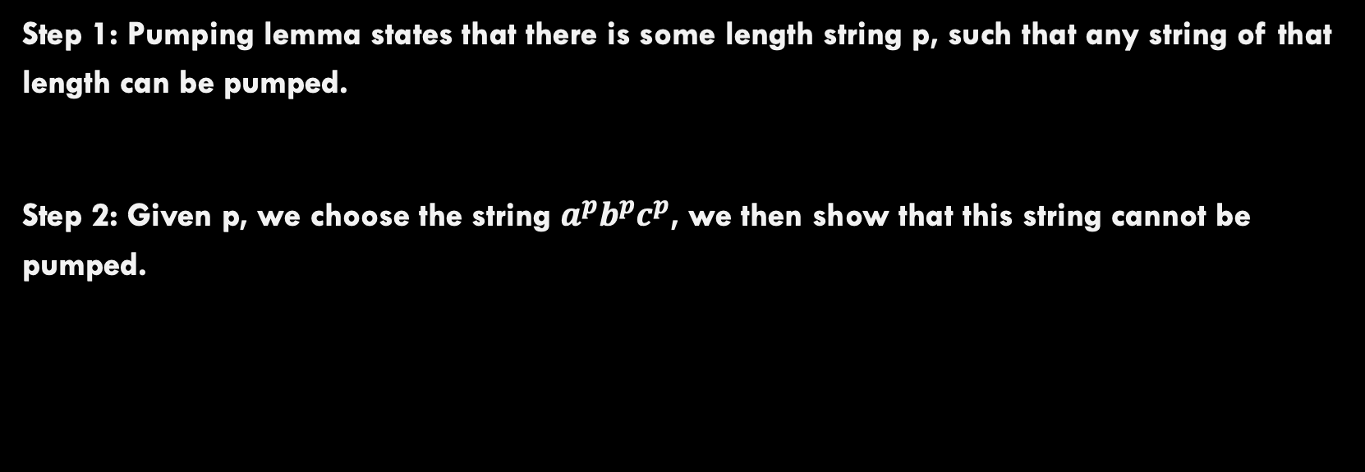
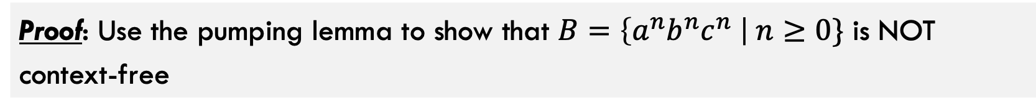
Example!
Proof: Use the pumping lemma to show that $B=\left\{a^{n}b^{n}c^{n} \right| n≥0\}$ is NOT context-free
Step 1: Pumping lemma states that there is some length string p, such that any string of that length can be pumped.
Step 2: Given p, we choose the string $a^{p}b^{p}c^{p}$, we then show that this string cannot be pumped.

Slide 54
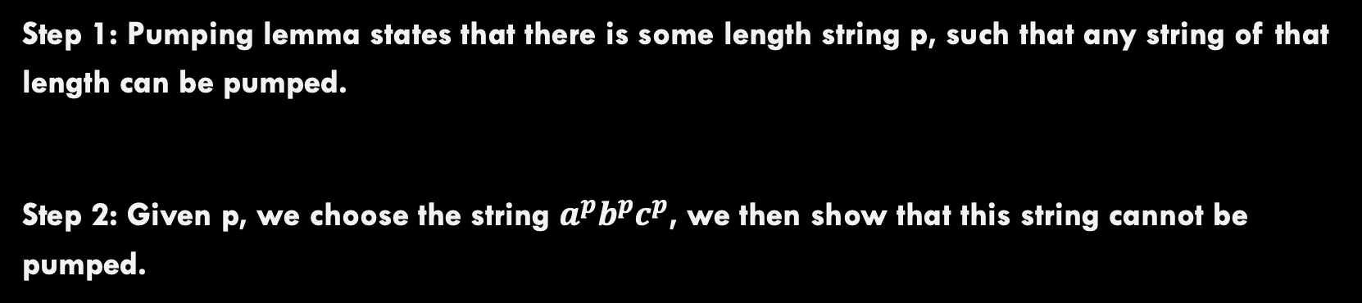
Example!
Proof: Use the pumping lemma to show that $B=\left\{a^{n}b^{n}c^{n} \right| n≥0\}$ is NOT context-free
Step 1: Pumping lemma states that there is some length string p, such that any string of that length can be pumped.
Step 2: Given p, we choose the string $a^{p}b^{p}c^{p}$, we then show that this string cannot be pumped.
Case 1: divide string such that v and y both contain only one character each.
Contradiction: There are 3 different letters so when pumped, there won’t be equal numbers of a, b, and c
Case 2: divide string such that at least one of v and y contain two characters.
Contradiction: When pumped, the letters will be out of order (e.g., aabb becomes aabbaabb)

Slide 55
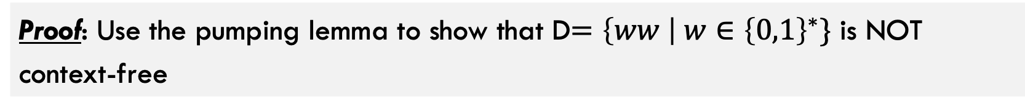
Example!
Proof: Use the pumping lemma to show that D$=\left\{ww \right| w∈{\left\{0,1\right\}}^{∗}\}$ is NOT context-free

Slide 56

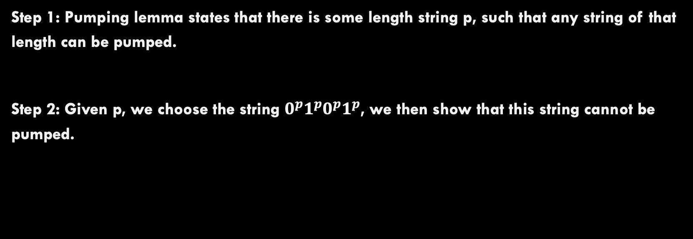
Example!
Proof: Use the pumping lemma to show that D$=\left\{ww \right| w∈{\left\{0,1\right\}}^{∗}\}$ is NOT context-free
Step 1: Pumping lemma states that there is some length string p, such that any string of that length can be pumped.
Step 2: Given p, we choose the string $0^{p}1^{p}0^{p}1^{p}$, we then show that this string cannot be pumped.

Slide 57
About Determinism versus Non-Determinism with Pushdown Automata

Slide 58
What we know about Computation so far
NPDA is non-deterministic pushdown automata. Remember that everything we’ve done so far is allowing non-determinism.
Context-Free Languages = NPDAs
Regular Languages = Regular Expressions = DFA = NFA
With regular languages, determinism and non-determinism models were equivalently descriptive.

Slide 59
What we know about Computation so far
Non-determinism is a MORE powerful descriptor within context-free languages. There are some languages that determinism cannot recognize (see book for details)
Non-Deterministic CFGs = NPDAs
Deterministic Context-Free Languages = DPDAs
Regular Languages = Regular Expressions = DFA = NFA
This means that programming language designers need to be careful because non-deterministic machines cannot currently be built. Need to stay in this middle section here

Slide 60
Conclusions

Slide 61
What you Learned in this Deck!
These are all equivalent in their expressive power.
Pushdown Automata
NFA w/ a stack. Can recognize exactly the context-free languages
Context-Free Languages:
A Class of languages that are more expressive than regular languages
Context-Free Grammar:
A “string” description of a context-free language (by definition)
Using another pumping lemma, we can find languages that are non-context free. Next we will see the most general computational model: The Turing Machine!

