Slide 1
Dynamic Programming Introduction
Data Structures and Algorithms 2 Mark Floryan

Slide 2
Dynamic Programming and Greedy Approach
TOPICS:
Intro to Dynamic Programming
Memoization
Example DP Problem:
Log Cutting

Slide 3













Motivating Example
How many scalar multiplications are required to multiply matrices A and B in this example?
$$c_{1}=2$$
$$5$$
$$c_{2}=5$$
$$r_{1}=3$$
$$×$$
$$r_{2}=2$$
$$=$$
$$3$$
$$A$$
$$B$$
$r_{1}c_{2}$ elements in result matrix to compute
Total is:
$$r_{1}c_{2}c_{1}=\left(3\right)\left(5\right)\left(2\right)=30$$
$c_{1}$ multiplications per element in result

Slide 4















Trickier Example
How many scalar multiplications are required to multiply matrices A, B and C in this example?
$$4$$
$$2$$
$$4$$
$$5$$
$$3$$
$$×$$
$$2$$
$$×$$
$$5$$
$$=$$
$$3$$
$$A$$
$$B$$
$$C$$
Same formula:
$$\left(r_{1}c_{1}c_{2}\right)+\left(r_{1}c_{2}c_{3}\right)=\left[\left(3\right)\left(2\right)\left(5\right)\right]+[(3)(5)(4)]=90$$
Can actually be done in just 64! Think about why this might be?

Slide 5
Dynamic Programming and Greedy Approach
With Greedy Algorithms, problem had optimal substructure and there was a known choice to make at each step of the problem that guaranteed an optimal solution
Make Change for A cents
Choose largest coin
Choose second largest coin
Choose third largest coin
Choose fourth largest coin
…
This was ALWAYS the right choice, never a need to look back

Slide 6
Dynamic Programming and Greedy Approach
With Dynamic Programming, problem has optimal substructure but we don’t know which choice at each step will lead to optimal solution
Strategy: Try all possible combinations. Will need to use optimizations to make this efficient
If we have non-traditional coins
Make Change for A cents
Choose largest coin
Choose second largest coin
Choose third largest coin
Choose fourth largest coin
…
Choose largest coin
Choose second largest coin
Choose third largest coin
Choose fourth largest coin

Slide 7
Reminder: Optimization Problems
Infeasible solutions
Optimal Solution(s)
Feasible solutions
Quality of
Feasible solutions
Objective function f(x)
Returns the quality of solution x
Infeasible solutions

Slide 8
Memoization

Slide 9

Remember Fibonacci numbers?
Formula: $f\left(n\right)=f\left(n−1\right)+f(n−2)$
long fib(int n) { assert(n >= 0); if ( n == 0 ) return 0; if ( n == 1 ) return 1; return fib(n-1) + fib(n-2); }
This is a BAD implementation! Repeats function calls repeatedly and runtime is obscenely exponential.

Slide 10

Remember Fibonacci numbers?
F(5)
Formula: $f\left(n\right)=f\left(n−1\right)+f(n−2)$
long fib(int n) { assert(n >= 0); if ( n == 0 ) return 0; if ( n == 1 ) return 1; return fib(n-1) + fib(n-2); }
F(4)
F(3)
F(3)
F(2)
F(2)
F(1)
Entire sub-trees are repeated!!
F(2)
F(1)
F(1)
F(0)
F(1)
F(0)
F(1)
F(0)

Slide 11

Remember Fibonacci numbers?
F(5)
Formula: $f\left(n\right)=f\left(n−1\right)+f(n−2)$
long fib(int n) { assert(n >= 0); if ( n == 0 ) return 0; if ( n == 1 ) return 1; return fib(n-1) + fib(n-2); }
F(4)
F(3)
F(3)
F(2)
F(2)
F(1)
Look at how many recursive calls are repeated!
F(2)
F(1)
F(1)
F(0)
F(1)
F(0)
F(1)
F(0)
What is the runtime of this implementation?
$$Θ(2^{n})$$

Slide 12
Memoization
Memoization: A programming technique in which solutions to subproblems are stored in memory. Future invocations of that same subproblem can reference the previously stored solution instead of recomputing
F(5)
F(4)
F(3)
When you call a subproblem (e.g., f(3)) the first time, compute the answer! This will computer the answer and store solutions to f(3), f(2), f(1), and f(0) in an array!
F(3)
F(2)
F(2)
F(1)
The branches don’t need to recompute, just lookup the answer!
F(1)
F(0)

Slide 13
Memoization
F(5)
Key Idea: You need to be able to lookup a solution to a subproblem in constant time!
F(4)
F(3)
Value is -1 if that subproblem not solved yet, otherwise table contains the solution!
Last cell is the fib number we want to calculate! Here it is 11
F(3)
F(2)
F(2)
F(1)
results[] :
0
1
1
2
-1
-1
-1
-1
-1
-1
-1
-1
F(1)
F(0)
0
1
2
3
4
5
6
7
8
9
10
11
Memoization table. Stores solutions to subproblems!

Slide 14
Memoization and Fibonacci
long results[]
long fib(int n):
results = {-1}*n
return fibRec(n)
long fibRec(int n):
if ( results[n] != -1 ):
return results[n]
long val
if ( n == 0 || n ==1 ):
val = n
else
val = fibRec(n-1)+ fibRec(n-2)
results[n] = val
return val

Slide 15
Memoization and Fibonacci
long results[]
long fib(int n):
results = {-1}*n
return fibRec(n)
long fibRec(int n):
if ( results[n] != -1 ):
return results[n]
long val
if ( n == 0 || n ==1 ):
val = n
else
val = fibRec(n-1)+ fibRec(n-2)
results[n] = val
return val
Make array filled with -1 everywhere and kick off the recursion!
If subproblem already solved, just return the answer and don’t do any recursion!
Normal recursive implementation
Before returning, store the result in results so other subproblem calls can use it!

Slide 16

Memoization and Fibonacci
long results[]
long fib(int n):
results = {-1}*n
return fibRec(n)
long fibRec(int n):
if ( results[n] != -1 ):
return results[n]
long val
if ( n == 0 || n ==1 ):
val = n
else
val = fibRec(n-1)+ fibRec(n-2)
results[n] = val
return val
Runtime: $Θ(n)$
Why?: Because each cell in results is computed exactly once. Future calls return in constant time.
This is called Top-Down Dynamic Programming

Slide 17
Memoization and Fibonacci
long results[]
long fib(int n):
results = {-1}*n
return fibRec(n)
long fibRec(int n):
if ( results[n] != -1 ):
return results[n]
long val
if ( n == 0 || n ==1 ):
val = n
else
val = fibRec(n-1)+ fibRec(n-2)
results[n] = val
return val
Why is this called Top-Down Dynamic Programming? Let’s step through it!
results[] :
0
1
2
3
4
5
6
7
8
9
10
11

Slide 18
Bottom-Up Dynamic Programming
Bottom-Up Dynamic Programming: Involves solving the base cases first and then filling in the solutions in (usually) increasing order. This is typically NOT recursive

Slide 19
Bottom-Up Fibonacci
fib(int n):
long result[n+1]
result[0] = 0; result[1] = 1
for i = 2 to n:
result[i] = result[i-1] + result[i-2]
return result[n]

Slide 20
Bottom-Up Fibonacci
fib(int n):
long result[n+1]
result[0] = 0
result[1] = 1
for i = 2 to n:
result[i] = result[i-1] + result[i-2]
return result[n]
results[] :
0
1
2
3
4
5
6
7
8
9
10
11

Slide 21
Dynamic Programming and Log Cutting

Slide 22
Process for Dynamic Programming
Step 1:
Recognize what the sub-problems are
Step 2:
Identify the recursive structure of the problem in terms of its sub-problems (At the top level, what is the “last thing” done?)
Step 3:
Formulate a data structure (array, table) that can look-up solution to any sub-problem in constant time
Step 4:
Develop an algorithm that loops through data structure solving each sub-problem one at a time (either bottom-up or top-down)

Slide 23
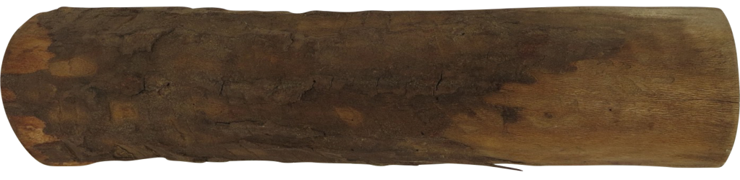
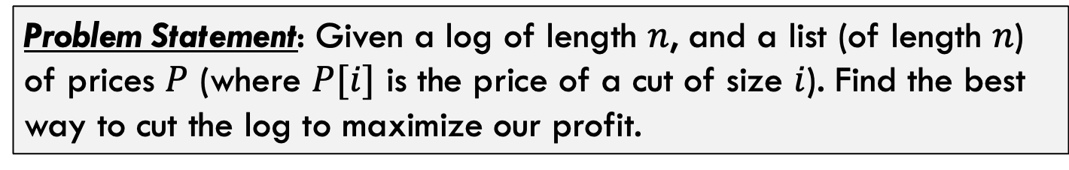
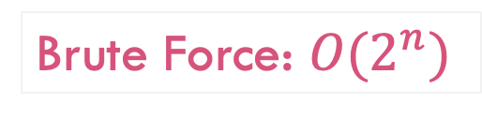
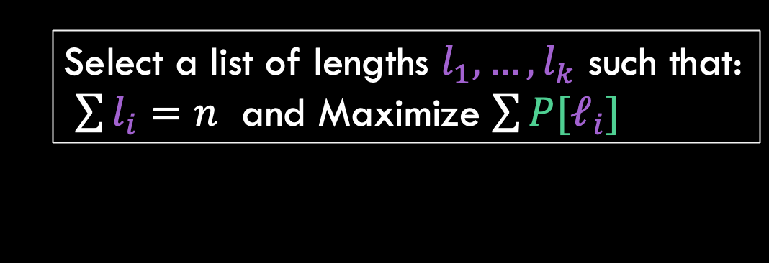
Log Cutting
Problem Statement: Given a log of length $n$, and a list (of length $n$) of prices $P$ (where $P[i]$ is the price of a cut of size $i$). Find the best way to cut the log to maximize our profit.
Price:
0
1
5
8
9
10
17
17
20
24
30
Length:
0
1
2
3
4
5
6
7
8
9
10
Select a list of lengths $l_{1}, …, l_{k}$ such that:
$\sum{l_{i}=n}$ and Maximize $\sum{{P[ℓ}_{i}]}$
Brute Force: $O(2^{n})$

Slide 24
Process for Dynamic Programming
Step 1:
Recognize what the sub-problems are

Slide 25
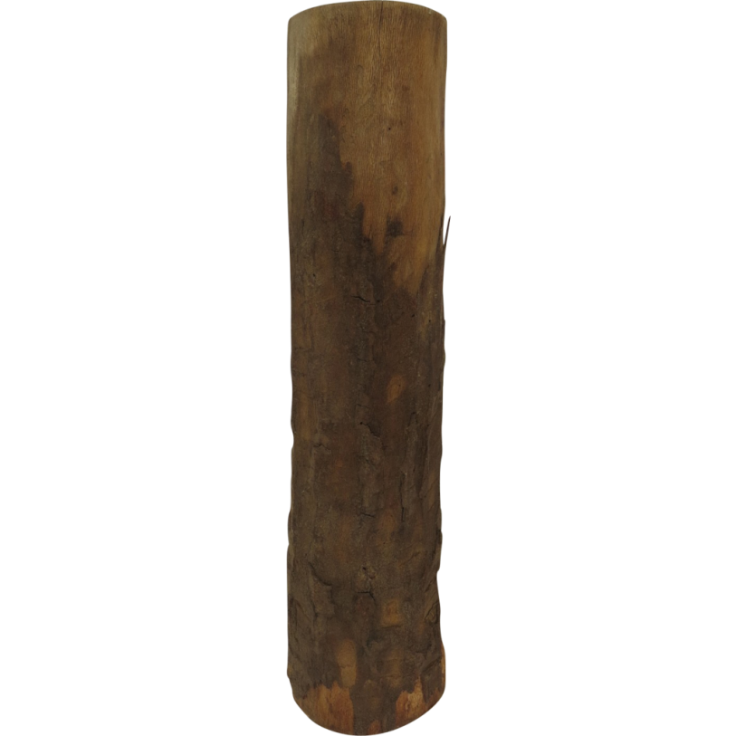
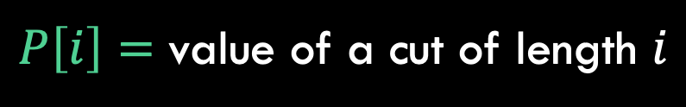


1. Identify Sub-Problems
$P\left[i\right]=$ value of a cut of length $i$
$Cut(j)=$ value of best way to cut a log of length $j$
$$Cut(j)$$
best way to cut a log of length $j$
Notice that cut(n) ranges from cut(0) all the way to cut(n)

Slide 26
Process for Dynamic Programming
Step 1:
Recognize what the sub-problems are
Step 2:
Identify the recursive structure of the problem in terms of its sub-problems (At the top level, what is the “last thing” done?)

Slide 27
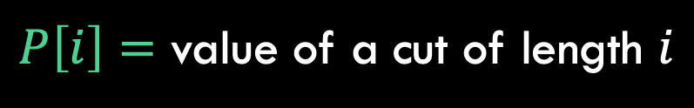



2. Identify Recursive Structure
$P\left[i\right]=$ value of a cut of length $i$
$Cut(n)=$ value of best way to cut a log of length $n$
$$Cut(n−ℓ_{k})$$
$${P[l}_{k}]$$
best way to cut a log of length $n−ℓ_{k}$
Last Cut
Key Idea: Somewhere the very last cut was made. The solution is the value you get for the last cut plus the optimal way to cut up the rest of the log

Slide 28




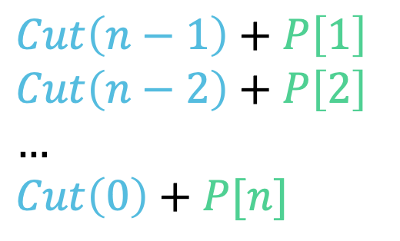
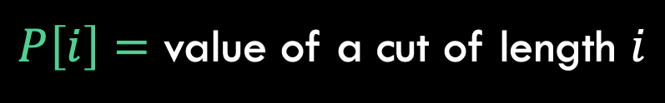
2. Identify Recursive Structure
$P\left[i\right]=$ value of a cut of length $i$
$Cut(n)=$ value of best way to cut a log of length $n$
$Cut\left(n−1\right)+P\left[1\right]$
$Cut\left(n−2\right)+P\left[2\right]$
$…$
$Cut\left(0\right)+P[n]$
$Cut\left(n\right)=max⁡$
Try every possible place to put the last cut!
$$Cut(n−ℓ_{k})$$
$$l_{k}$$
best way to cut a log of length $n−ℓ_{k}$
Last Cut

Slide 29
Process for Dynamic Programming
Step 1:
Recognize what the sub-problems are
Step 2:
Identify the recursive structure of the problem in terms of its sub-problems (At the top level, what is the “last thing” done?)
Step 3:
Formulate a data structure (array, table) that can look-up solution to any sub-problem in constant time

Slide 30

3. Formulate a Look-Up Data Structure
Cell 0 is a base case cell. By definition the profit is 0
$Cut(i)$:
0
Length:
0
1
2
3
4
5
6
7
8
9
10
Each cell Cut[i] stores the optimal profit you can get by cutting up a log of size i
The solution we are looking for (n) will be in this last cell!
For example, Cut[5] would store the optimal profit from cutting up a log of size 5

Slide 31
Process for Dynamic Programming
Step 1:
Recognize what the sub-problems are
Step 2:
Identify the recursive structure of the problem in terms of its sub-problems (At the top level, what is the “last thing” done?)
Step 3:
Formulate a data structure (array, table) that can look-up solution to any sub-problem in constant time
Step 4:
Develop an algorithm that loops through data structure solving each sub-problem one at a time (either bottom-up or top-down)

Slide 32

3. Algorithm to Fill In Solutions
Solve smallest sub-problem first
CutProfit(n):
Cut[n] = […]
Cut[0] = 0
…
Price:
1
5
8
9
10
17
17
20
24
30
Length:
1
2
3
4
5
6
7
8
9
10
$Cut$:
0
Length:
0
1
2
3
4
5
6
7
8
9
10
0

Slide 33


3. Algorithm to Fill In Solutions
Then the next largest subproblem
CutProfit(n):
Cut[n] = […]
Cut[0] = 0
for i = 1 to n:
?????
Price:
1
5
8
9
10
17
17
20
24
30
Length:
1
2
3
4
5
6
7
8
9
10
$Cut$:
0
1
Length:
0
1
2
3
4
5
6
7
8
9
10
$Cut\left[1\right]=Cut\left[0\right]+P\left[1\right]{=1}$

Slide 34

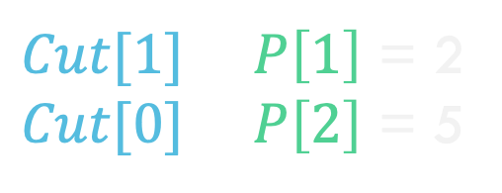
3. Algorithm to Fill In Solutions
Then the next largest subproblem
CutProfit(n):
Cut[n] = […]
Cut[0] = 0
for i = 1 to n:
?????
Price:
1
5
8
9
10
17
17
20
24
30
Length:
1
2
3
4
5
6
7
8
9
10
$Cut$:
0
1
5
Length:
0
1
2
3
4
5
6
7
8
9
10
$Cut[1]+P\left[1\right]$ = 2
$Cut[0]+P\left[2\right]$ = 5
$Cut[2]=max⁡$

Slide 35
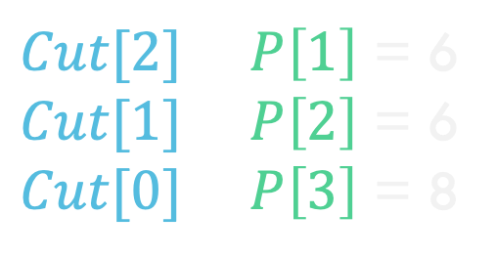

3. Algorithm to Fill In Solutions
Then the next largest subproblem
CutProfit(n):
Cut[n] = […]
Cut[0] = 0
for i = 1 to n:
best = 0
for j = 1 to i:
best = max(Cut[i-j]+P[j],best)
Cut[i] = best
Price:
1
5
8
9
10
17
17
20
24
30
Length:
1
2
3
4
5
6
7
8
9
10
$Cut$:
0
1
5
8
Length:
0
1
2
3
4
5
6
7
8
9
10
$Cut[2]+P\left[1\right]$ = 6
$Cut[1]+P\left[2\right]$ = 6
$Cut[0]+P\left[3\right]$ = 8
$Cut[3]=max⁡$

Slide 36
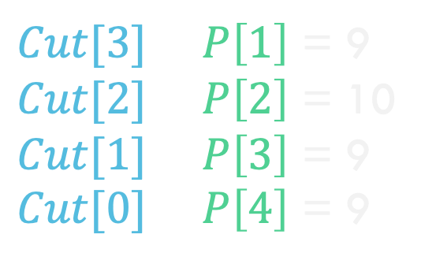

3. Algorithm to Fill In Solutions
Then the next largest subproblem
CutProfit(n):
Cut[n] = […]
Cut[0] = 0
for i = 1 to n:
best = 0
for j = 1 to i:
best = max(Cut[i-j]+P[j],best)
Cut[i] = best
Price:
1
5
8
9
10
17
17
20
24
30
Length:
1
2
3
4
5
6
7
8
9
10
$Cut$:
0
1
5
8
10
Length:
0
1
2
3
4
5
6
7
8
9
10
$Cut[3]+P\left[1\right]$ = 9
$Cut[2]+P\left[2\right]$ = 10
$Cut[1]+P\left[3\right]$ = 9
$Cut[0]+P\left[4\right]$ = 9
$Cut[3]=max⁡$

Slide 37
3. Algorithm to Fill In Solutions
Then the next largest subproblem
1
5
8
9
10
17
17
20
24
30
CutProfit(n):
Cut[] = new [n+1]
Cut[0] = 0
for i = 1 to n:
best = 0
for j = 1 to i:
best = max(Cut[i-j]+P[j],best)
Cut[i] = best
return Cut[n]
Price:
Length:
1
2
3
4
5
6
7
8
9
10
$Cut$:
0
1
5
8
10
13
17
18
22
25
30
Length:
0
1
2
3
4
5
6
7
8
9
10
Solution is here in the last cell, so just return it!

Slide 38


3. Algorithm to Fill In Solutions
Then the next largest subproblem
CutProfit(n):
Cut[] = new [n+1]
Cut[0] = 0
for i = 1 to n:
best = 0
for j = 1 to i:
best = max(Cut[i-j]+P[j],best)
Cut[i] = best
return Cut[n]
$Cut$:
0
1
5
8
10
13
17
18
22
25
30
Length:
0
1
2
3
4
5
6
7
8
9
10
Runtime is $Θ(n^{2})$

Slide 39
Process for Dynamic Programming
Step 1:
Recognize what the sub-problems are
Step 2:
Identify the recursive structure of the problem in terms of its sub-problems (At the top level, what is the “last thing” done?)
Step 3:
Formulate a data structure (array, table) that can look-up solution to any sub-problem in constant time
Step 4:
Develop an algorithm that loops through data structure solving each sub-problem one at a time (either bottom-up or top-down)

Slide 40
How to find the actual cuts

Slide 41

Extra: Finding the Actual Solution
This gives the value of the solution, what about the actual list of where to cut the log?
$Cut$:
0
1
5
8
10
13
17
18
22
25
30
Length:
0
1
2
3
4
5
6
7
8
9
10
Idea: Keep track of where the last cut was for each subproblem!

Slide 42

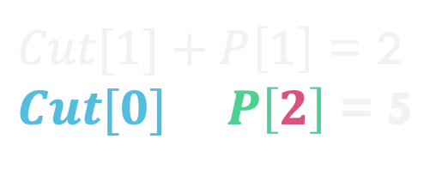

Extra: Finding the Actual Solution
This gives the value of the solution, what about the actual list of where to cut the log?
$Cut$:
0
1
5
8
10
13
17
18
22
25
30
Length:
0
1
2
3
4
5
6
7
8
9
10
$Choices$:
0
1
2
Length:
0
1
2
3
4
5
6
7
8
9
10
Idea: Keep track of where the last cut was for each subproblem!
e.g., Choices[2]=2 because last cut was a piece of size 2
$Cut[1]+P\left[1\right]$ = 2
$Cut[0]+P\left[2\right]$ = 5
$Cut[2]=max⁡$

Slide 43


Extra: Finding the Actual Solution
$Cut$:
0
1
5
8
10
13
17
18
22
25
30
Length:
0
1
2
3
4
5
6
7
8
9
10
$Choices$:
0
1
2
3
2
2
6
1
2
3
10
Length:
0
1
2
3
4
5
6
7
8
9
10
So in this case, the optimal solution is to just sell the entire log of size 10

Slide 44

Extra: Finding the Actual Solution
$Cut$:
0
1
5
8
10
13
17
18
22
25
30
CutProfit(n):
Cut[] = new [n+1]
Choices[] = new [n+1]
Cut[0] = 0
Choices[0] = 0
for i = 1 to n:
best = 0
for j = 1 to i:
if best < Cut[i-j]+P[j]:
best = Cut[i-j]+P[j]
Choices[i] = j
Cut[i] = best
return Cut[n]
Length:
0
1
2
3
4
5
6
7
8
9
10
$Choices$:
0
1
2
3
2
2
6
1
2
3
10
Length:
0
1
2
3
4
5
6
7
8
9
10

Slide 45


Extra: Finding the Actual Solution
$Cut$:
0
1
5
8
10
13
17
18
22
25
30
Length:
0
1
2
3
4
5
6
7
8
9
10
$Choices$:
0
1
2
3
2
2
6
1
2
3
10
Length:
0
1
2
3
4
5
6
7
8
9
10
Let’s use this choices array to figure out how to achieve a profit of 25 with a log of size 9?

Slide 46
Extra: Finding the Actual Solution
$Cut$:
0
1
5
8
10
13
17
18
22
25
30
Length:
0
1
2
3
4
5
6
7
8
9
10
$Choices$:
0
1
2
3
2
2
6
1
2
3
10
Length:
0
1
2
3
4
5
6
7
8
9
10
Solution: 3
Left: 6
This 3 means that we cut off and sell a log piece of size 3
Log of size 6 left so backtrack to index 6

Slide 47
Extra: Finding the Actual Solution
$Cut$:
0
1
5
8
10
13
17
18
22
25
30
Length:
0
1
2
3
4
5
6
7
8
9
10
$Choices$:
0
1
2
3
2
2
6
1
2
3
10
Length:
0
1
2
3
4
5
6
7
8
9
10
Solution: 3 6
Left: 0
This 6 means that we cut off and sell a log piece of size 6
Log of size 0 left so backtrack to index 0

Slide 48
Extra: Finding the Actual Solution
$Cut$:
0
1
5
8
10
13
17
18
22
25
30
Length:
0
1
2
3
4
5
6
7
8
9
10
$Choices$:
0
1
2
3
2
2
6
1
2
3
10
Length:
0
1
2
3
4
5
6
7
8
9
10
Solution: 3 6
Once we hit index 0 we are done. Solution is to split log into sizes 3 and 6 and sell those two pieces!

Slide 49
Extra: Finding the Actual Solution
$Cut$:
0
1
5
8
10
13
17
18
22
25
30
Length:
0
1
2
3
4
5
6
7
8
9
10
$Choices$:
0
1
2
3
2
2
6
1
2
3
10
Length:
0
1
2
3
4
5
6
7
8
9
10
Solution: 3 6
BackTrack(Choices):
i = n
while i > 0:
print Choices[i]
i = i – Choices[i]
With dynamic programming, it is VERY common to have the array store the value of solutions only and then use backtracking to compute the solution itself!

Slide 50
What did we learn?
What is dynamic programming? General Approach
First Example: Log cutting

