Slide 1
Dynamic Programming Weighted Interval Scheduling
Data Structures and Algorithms 2 Mark Floryan

Slide 2
Dynamic Programming and Greedy Approach
TOPICS:
Weighted Activity Selection

Slide 3
Weighted Activity Selection

Slide 4
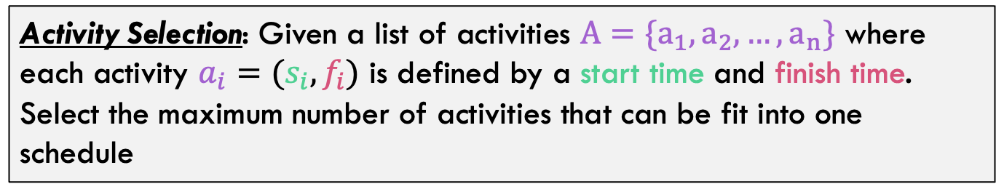
Activity-Selection Problem
Activity Selection: Given a list of activities $A=\{a_{1},a_{2},…,a_{n}\}$ where each activity $a_{i}=(s_{i},f_{i})$ is defined by a start time and finish time. Select the maximum number of activities that can be fit into one schedule
greedy-interval (s, f)
n = s.length
A = {a₁}
k = 1 # last added
for m = 2 to n
if s[m] ≥ f[k]
A = A U {a_{m}}
k = m
return A
We just want the most activities possible, they are all equally “good”. This was solved with a greedy algorithm!

Slide 5
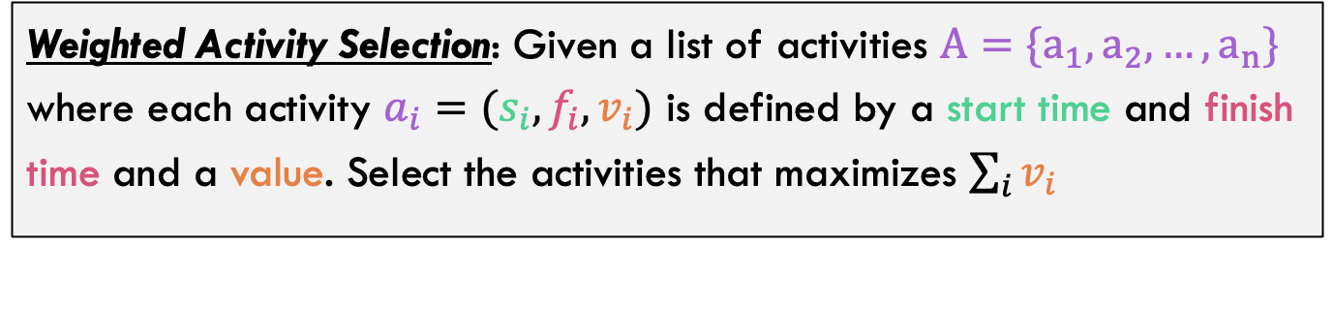
Weighted Activity-Selection Problem
Weighted Activity Selection: Given a list of activities $A=\{a_{1},a_{2},…,a_{n}\}$ where each activity $a_{i}=(s_{i},f_{i},v_{i})$ is defined by a start time and finish time and a value. Select the activities that maximizes $\sum_{i}{v_{i}}$
Now each activity has a value, we want the activities that maximize the total value! Will the greedy algorithm solve this version?

Slide 6
Greedy solution to the weighted version
Would the greedy algorithm work on the weighted test case below?
1
3
1
Greedy chooses intervals 1 and 3 for value 2
But selecting just interval 2 for value 3 is better
1
1
3
3
1
1

Slide 7
Process for Dynamic Programming
Step 1:
Recognize what the sub-problems are

Slide 8



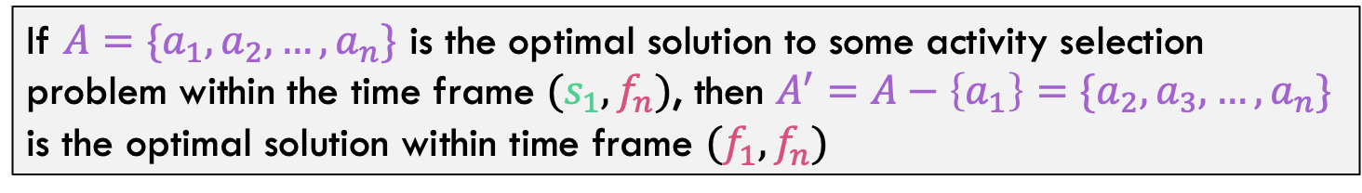




Recall: Optimal Substructure
If $A=\{a_{1},a_{2},…,a_{n}\}$ is the optimal solution to some activity selection problem within the time frame $(s_{1},f_{n})$, then $A^{′}=A−\left\{a_{1}\right\}=\{a_{2},a_{3},…,a_{n}\}$ is the optimal solution within time frame $(f_{1},f_{n})$
$$s_{1}$$
$$f_{n}$$
$$a_{1}$$
$$a_{2}$$
$$a_{3}$$
$$a_{n}$$
$$f_{1}$$
Notice that intervals that cross this gap are NOT considered by the subproblem.

Slide 9


Sub-Problem Definition
$$a_{i}$$
$$a_{n}$$
Sub-problem definition:
Let Opt(i) be the optimal solution (maximum value) when only considering the first i intervals

Slide 10
Process for Dynamic Programming
Step 1:
Recognize what the sub-problems are
Step 2:
Identify the recursive structure of the problem in terms of its sub-problems (At the top level, what is the “last thing” done?)

Slide 11

Recursive Structure
Key Idea: Consider the last interval in the range of this subproblem. Is it in the optimal solution or not?
$$a_{i}$$

Slide 12





Recursive Structure
$$a_{i}$$
$$a_{i}$$
$$a_{i}$$
If $a_{i}$ is in the optimal solution, then we need to recurse down only on intervals that DO NOT conflict with $a_{i}$
If $a_{i}$ is NOT in the optimal solution, then we need to recurse down to all intervals except $a_{i}$

Slide 13



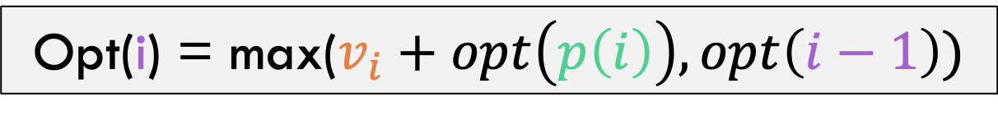


Recursive Structure
What is $p(i)$? Largest index $x$ such that interval $x$ does not conflict with interval $i$
$$v_{i}+opt(p\left(i\right))$$
$$opt(i−1)$$
$$a_{i}$$
$$a_{i}$$
Take the best option, so final formula is:
Opt(i) = max($v_{i}+opt\left(p\left(i\right)\right), opt\left(i−1\right))$

Slide 14
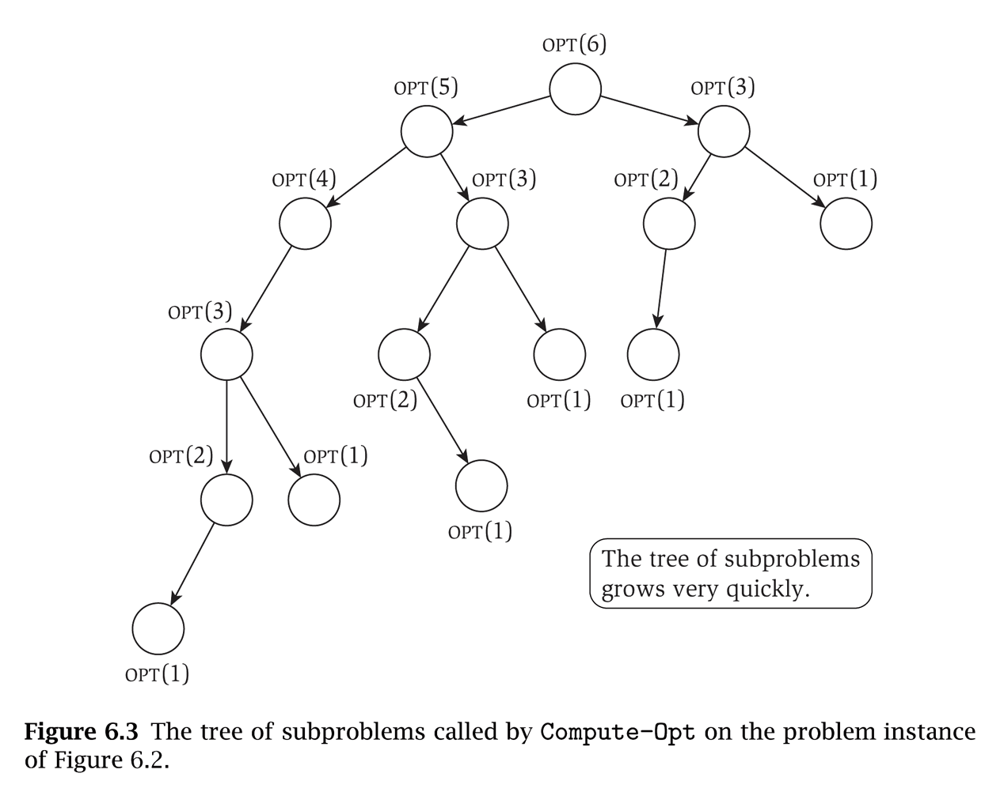
Exponential Time!
Notice that the sub-problems are being re-computed each time

Slide 15
Process for Dynamic Programming
Step 1:
Recognize what the sub-problems are
Step 2:
Identify the recursive structure of the problem in terms of its sub-problems (At the top level, what is the “last thing” done?)
Step 3:
Formulate a data structure (array, table) that can look-up solution to any sub-problem in constant time

Slide 16

Sub-Problem Definition
$$a_{i}$$
$$a_{n}$$
e.g., this subproblems optimal solution will go in this cell here
Final solution will eventually end up here in the last cell
Opt[]
…
…
…
…
20
…
…
Index
0
1
2
3
4
5
6
Create an array, Opt[] such that each cell stores the maximum value for the first i intervals

Slide 17
Process for Dynamic Programming
Step 1:
Recognize what the sub-problems are
Step 2:
Identify the recursive structure of the problem in terms of its sub-problems (At the top level, what is the “last thing” done?)
Step 3:
Formulate a data structure (array, table) that can look-up solution to any sub-problem in constant time
Step 4:
Develop an algorithm that loops through data structure solving each sub-problem one at a time (either bottom-up or top-down)

Slide 18












index
Opt(A):
A.sortByFinishTime()
opt[] = new [A.size() + 1]
opt[0] = 0
…
$$v_{1}=2$$
1
$$p\left(1\right)=0$$
2
$$v_{2}=4$$
$$p\left(2\right)=0$$
3
$$v_{3}=4$$
$$p\left(3\right)=1$$
4
$$v_{4}=7$$
$$p\left(4\right)=0$$
5
$$V_{5}=2$$
$$p\left(5\right)=3$$
6
$$V_{6}=1$$
$$p\left(6\right)=3$$
Base Case: When no intervals, solution is just 0 Make sure to sort by finish time!
Opt[]
0
Index
0
1
2
3
4
5
6

Slide 19


index
Opt(A):
A.sortByFinishTime()
opt[] = new [A.size() + 1]
opt[0] = 0
for i = 1 to n:
opt[i] = max(opt[i-1],
A[i].v + opt[p(i)])
…
$$v_{1}=2$$
1
$$p\left(1\right)=0$$
2
$$v_{2}=4$$
$$p\left(2\right)=0$$
3
$$v_{3}=4$$
$$p\left(3\right)=1$$
4
$$v_{4}=7$$
$$p\left(4\right)=0$$
5
$$V_{5}=2$$
$$p\left(5\right)=3$$
6
$$V_{6}=1$$
$$p\left(6\right)=3$$
Opt[]
0
2
Compare:
opt[i-1]: 0
A[i].v + opt[0]: 2 + 0 = 2
Index
0
1
2
3
4
5
6

Slide 20




index
Opt(A):
A.sortByFinishTime()
opt[] = new [A.size() + 1]
opt[0] = 0
for i = 1 to n:
opt[i] = max(opt[i-1],
A[i].v + opt[p(i)])
…
$$v_{1}=2$$
1
$$p\left(1\right)=0$$
2
$$v_{2}=4$$
$$p\left(2\right)=0$$
3
$$v_{3}=4$$
$$p\left(3\right)=1$$
4
$$v_{4}=7$$
$$p\left(4\right)=0$$
5
$$V_{5}=2$$
$$p\left(5\right)=3$$
6
$$V_{6}=1$$
$$p\left(6\right)=3$$
Opt[]
0
2
4
Compare:
opt[i-1]: 2
A[i].v + opt[0]: 4 + 0 = 4
Index
0
1
2
3
4
5
6

Slide 21




index
Opt(A):
A.sortByFinishTime()
opt[] = new [A.size() + 1]
opt[0] = 0
for i = 1 to n:
opt[i] = max(opt[i-1],
A[i].v + opt[p(i)])
…
$$v_{1}=2$$
1
$$p\left(1\right)=0$$
2
$$v_{2}=4$$
$$p\left(2\right)=0$$
3
$$v_{3}=4$$
$$p\left(3\right)=1$$
4
$$v_{4}=7$$
$$p\left(4\right)=0$$
5
$$V_{5}=2$$
$$p\left(5\right)=3$$
6
$$V_{6}=1$$
$$p\left(6\right)=3$$
Opt[]
0
2
4
6
Compare:
opt[i-1]: 4
A[i].v + opt[0]: 4 + 2 = 6
Index
0
1
2
3
4
5
6

Slide 22



index
Opt(A):
A.sortByFinishTime()
opt[] = new [A.size() + 1]
opt[0] = 0
for i = 1 to n:
opt[i] = max(opt[i-1],
A[i].v + opt[p(i)])
…
$$v_{1}=2$$
1
$$p\left(1\right)=0$$
2
$$v_{2}=4$$
$$p\left(2\right)=0$$
3
$$v_{3}=4$$
$$p\left(3\right)=1$$
4
$$v_{4}=7$$
$$p\left(4\right)=0$$
5
$$V_{5}=2$$
$$p\left(5\right)=3$$
6
$$V_{6}=1$$
$$p\left(6\right)=3$$
Opt[]
0
2
4
6
7
Compare:
opt[i-1]: 6
A[i].v + opt[0]: 7 + 0 = 7
Index
0
1
2
3
4
5
6

Slide 23


index
Opt(A):
A.sortByFinishTime()
opt[] = new [A.size() + 1]
opt[0] = 0
for i = 1 to n:
opt[i] = max(opt[i-1],
A[i].v + opt[p(i)])
…
$$v_{1}=2$$
1
$$p\left(1\right)=0$$
2
$$v_{2}=4$$
$$p\left(2\right)=0$$
3
$$v_{3}=4$$
$$p\left(3\right)=1$$
4
$$v_{4}=7$$
$$p\left(4\right)=0$$
5
$$V_{5}=2$$
$$p\left(5\right)=3$$
6
$$V_{6}=1$$
$$p\left(6\right)=3$$
Opt[]
0
2
4
6
7
8
Compare:
opt[i-1]: 7
A[i].v + opt[0]: 2 + 6 = 8
Index
0
1
2
3
4
5
6

Slide 24


index
Opt(A):
A.sortByFinishTime()
opt[] = new [A.size() + 1]
opt[0] = 0
for i = 1 to n:
opt[i] = max(opt[i-1],
A[i].v + opt[p(i)])
…
$$v_{1}=2$$
1
$$p\left(1\right)=0$$
2
$$v_{2}=4$$
$$p\left(2\right)=0$$
3
$$v_{3}=4$$
$$p\left(3\right)=1$$
4
$$v_{4}=7$$
$$p\left(4\right)=0$$
5
$$V_{5}=2$$
$$p\left(5\right)=3$$
6
$$V_{6}=1$$
$$p\left(6\right)=3$$
Opt[]
0
2
4
6
7
8
8
Compare:
opt[i-1]: 8
A[i].v + opt[0]: 1 + 6 = 7
Index
0
1
2
3
4
5
6

Slide 25

index
Opt(A):
A.sortByFinishTime()
opt[] = new [A.size() + 1]
opt[0] = 0
for i = 1 to n:
opt[i] = max(opt[i-1],
A[i].v + opt[p(i)])
return opt[A.size()]
$$v_{1}=2$$
1
$$p\left(1\right)=0$$
2
$$v_{2}=4$$
$$p\left(2\right)=0$$
3
$$v_{3}=4$$
$$p\left(3\right)=1$$
4
$$v_{4}=7$$
$$p\left(4\right)=0$$
5
$$V_{5}=2$$
$$p\left(5\right)=3$$
6
$$V_{6}=1$$
$$p\left(6\right)=3$$
Opt[]
0
2
4
6
7
8
8
Value in this last cell is the solution!!
Runtime is $Θ(n∗f(p\left(i\right)))$
Index
0
1
2
3
4
5
6

Slide 26
Computing P(j)

Slide 27
index
Opt(A):
A.sortByFinishTime()
opt[] = new [A.size() + 1]
opt[0] = 0
for i = 1 to n:
opt[i] = max(opt[i-1],
A[i].v + opt[p(i)])
return opt[A.size()]
$$v_{1}=2$$
1
$$p\left(1\right)=0$$
2
$$v_{2}=4$$
$$p\left(2\right)=0$$
3
$$v_{3}=4$$
$$p\left(3\right)=1$$
4
$$v_{4}=7$$
$$p\left(4\right)=0$$
5
$$V_{5}=2$$
$$p\left(5\right)=3$$
6
$$V_{6}=1$$
$$p\left(6\right)=3$$
How to compute these p-values? Can we do better than linear time per value?

Slide 28













Opt(A):
A.sortByFinishTime()
opt[] = new [A.size() + 1]
opt[0] = 0
for i = 1 to n:
opt[i] = max(opt[i-1],
A[i].v + opt[p(i)])
return opt[A.size()]
index
$$v_{1}=2$$
1
$$p\left(1\right)=0$$
2
$$v_{2}=4$$
$$p\left(2\right)=0$$
3
$$v_{3}=4$$
$$p\left(3\right)=1$$
4
$$v_{4}=7$$
$$p\left(4\right)=0$$
5
$$V_{5}=2$$
$$p\left(5\right)=3$$
6
$$V_{6}=1$$
$$p\left(6\right)=3$$
p(i):
low = 0, high = i-1
while(low < high):
mid = (low + high)2
if Comp(mid, i):
low = mid
else
high = mid-1
return low
Comp(I1,I2):
if I1==0 return true
return A[I2].s >= A[I1].f
Binary search brings the cost of p() to $Θ(\log{n)}$, so total runtime is:
$$Θ(n\log{n)}$$

Slide 29
Backtracking to find actual Intervals

Slide 30
index
Opt(A):
A.sortByFinishTime()
opt[] = new [A.size() + 1]
opt[0] = 0
for i = 1 to n:
opt[i] = max(opt[i-1],
A[i].v + opt[p(i)])
return opt[A.size()]
$$v_{1}=2$$
1
$$p\left(1\right)=0$$
2
$$v_{2}=4$$
$$p\left(2\right)=0$$
3
$$v_{3}=4$$
$$p\left(3\right)=1$$
4
$$v_{4}=7$$
$$p\left(4\right)=0$$
5
$$V_{5}=2$$
$$p\left(5\right)=3$$
6
$$V_{6}=1$$
$$p\left(6\right)=3$$
Opt[]
0
2
4
6
7
8
8
How do we find the actual intervals?
Index
0
1
2
3
4
5
6

Slide 31












index
Opt(A):
A.sortByFinishTime()
c[] = new [A.size() + 1]
opt[] = new [A.size() + 1]
opt[0] = 0
for i = 1 to n:
opt[i] = max(opt[i-1],
A[i].v + opt[p(i)])
c[i] = (A[i].v + opt[p(i)]
>= opt[i-1)
return opt[A.size()]
$$v_{1}=2$$
1
$$p\left(1\right)=0$$
2
$$v_{2}=4$$
$$p\left(2\right)=0$$
3
$$v_{3}=4$$
$$p\left(3\right)=1$$
4
$$v_{4}=7$$
$$p\left(4\right)=0$$
5
$$V_{5}=2$$
$$p\left(5\right)=3$$
6
$$V_{6}=1$$
$$p\left(6\right)=3$$
Opt[]
0
2
4
6
7
8
8
Index
0
1
2
3
4
5
6
Simply keep track of whether or not you chose the last interval or not!
C[]
F
T
T
T
T
T
F
Index
0
1
2
3
4
5
6

Slide 32
C[]
F
T
T
T
T
T
F
backtrack(c):
idx = c.size()-1
while(idx > 0:
if c[idx]:
print “Using interval idx”
idx = p(idx)
else
idx = idx - 1
Index
0
1
2
3
4
5
6
p[]
0
0
0
1
0
3
3
Index
0
1
2
3
4
5
6
Goal: Backtrack from last index to discover which intervals were used
Output:
…

Slide 33
C[]
F
T
T
T
T
T
F
backtrack(c):
idx = c.size()-1
while(idx > 0:
if c[idx]:
print “Using interval idx”
idx = p(idx)
else
idx = idx - 1
Index
0
1
2
3
4
5
6
p[]
0
0
0
1
0
3
3
Index
0
1
2
3
4
5
6
Goal: Backtrack from last index to discover which intervals were used
Output:
Using interval 5 …

Slide 34
C[]
F
T
T
T
T
T
F
backtrack(c):
idx = c.size()-1
while(idx > 0:
if c[idx]:
print “Using interval idx”
idx = p(idx)
else
idx = idx - 1
Index
0
1
2
3
4
5
6
p[]
0
0
0
1
0
3
3
Index
0
1
2
3
4
5
6
Goal: Backtrack from last index to discover which intervals were used
Output:
Using interval 5
Using interval 3

Slide 35
C[]
F
T
T
T
T
T
F
backtrack(c):
idx = c.size()-1
while(idx > 0:
if c[idx]:
print “Using interval idx”
idx = p(idx)
else
idx = idx - 1
Index
0
1
2
3
4
5
6
p[]
0
0
0
1
0
3
3
Index
0
1
2
3
4
5
6
Goal: Backtrack from last index to discover which intervals were used
Output:
Using interval 5
Using interval 3
Using interval 1

Slide 36
C[]
F
T
T
T
T
T
F
backtrack(c):
idx = c.size()-1
while(idx > 0:
if c[idx]:
print “Using interval idx”
idx = p(idx)
else
idx = idx - 1
Index
0
1
2
3
4
5
6
p[]
0
0
0
1
0
3
3
Index
0
1
2
3
4
5
6
Goal: Backtrack from last index to discover which intervals were used
Output:
Using interval 5
Using interval 3
Using interval 1

Slide 37
Opt(A):
A.sortByFinishTime()
c[] = new [A.size() + 1]
opt[] = new [A.size() + 1]
opt[0] = 0
for i = 1 to n:
opt[i] = max(opt[i-1],
A[i].v + opt[p(i)])
c[i] = (A[i].v + opt[p(i)]
<= opt[i-1)
return opt[A.size()]
p(i):
low = 0, high = i-1
while(low < high):
mid = (low + high)2
if Comp(mid, i):
low = mid
else
high = mid-1
return low
backtrack(c):
idx = c.size()-1
while(idx > 0:
if c[idx]:
print “Using interval idx”
idx = p(idx)
else
idx = idx - 1
Comp(I1,I2):
if I1==0 return true
return A[I2].s >= A[I1].f

Slide 38
What did we learn!
TOPICS:
Weighted Activity Selection
Another Example of DP
Another Example of backtracking!

