Slide 1
Sequences (String Edit Distance, Longest Common Subsequence)
Data Structures and Algorithms 2 Mark Floryan

Slide 2
Sequences
Problems about the relationship between two sequences
Strings (sequence of characters)
Text (sequence of words)
Genetic sequences (sequence of nucleotides)
Etc.
How similar are two sequences?
How one could be transformed to the other?
What do they share in common?
String Edit Distance
Longest Common Subsequence

Slide 3
Sequence Alignment
How could we define the similarity of two strings?
An alignment is an attempt at matching the characters in one string to another in order to analyze their similarity. The alignment contains mismatched characters, insertions or deletions (gaps)
o | c | u | r | r | a | n | c | e | -
o | c | c | u | r | r | e | n | c | e
o | c | - | u | r | r | a | n | c | e
o | c | c | u | r | r | e | n | c | e
6 mismatches, 1 gap
1 mismatch, 1 gap
o | c | - | u | r | r | - | a | n | c | e
o | c | c | u | r | r | e | - | n | c | e
0 mismatches, 3 gaps

Slide 4
String Edit Distance

Slide 5


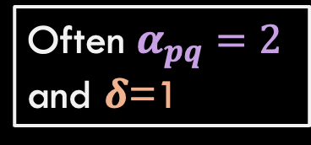
Edit Distance
[Levenshtien 1966, Needleman-Wunsch 1970]
Gap penalty $δ$ and a mismatch penalty $α_{pq}$ for pair p and q
Cost/distance = sum of gap and mismatch penalties
A | T | C | G | A | C | T | C | A | G | T
A | T | - | G | A | C | A | G | A | G | T
Often $α_{pq}=\text{2}$ and $δ$=1
$cost= δ + α_{TA}+ α_{CG}$
Applications: Spelling correction, bioinformatics, text processing and analysis, speech recognition, computer file difference (diff), birdsong analysis, …

Slide 6
An Example of the Problem
Love’s Labours Lost (Quarto, 1598)
Mee thought all his senses were lokt in his eye As iewels in christall for some prince to buy Who tendring their owne worth from where they were glast Did poynt you to buy them along as you past
Love’s Labours Lost (First Folio, 1623)
Me thought all his sences were lockt in his eye As iewels in christall for some prince to buy Who tendring their own worth from whence they were glast Did point out to buy them along as you past
Are these different? If so, where?

Slide 7
An Example of the Problem
Love’s Labours Lost (Quarto, 1598)
Mee thought all his senses were lokt in his eye As iewels in christall for some prince to buy Who tendring their owne worth from where they were glast Did poynt you to buy them along as you past
Love’s Labours Lost (First Folio, 1623)
Me thought all his sences were lockt in his eye As iewels in christall for some prince to buy Who tendring their own worth from whence they were glast Did point out to buy them along as you past
A lot of differences! Are there all different words though?

Slide 8
An Example of the Problem
Love’s Labours Lost (Quarto, 1598)
Mee thought all his senses were lokt in his eye As iewels in christall for some prince to buy Who tendring their owne worth from where they were glast Did poynt you to buy them along as you past
Love’s Labours Lost (First Folio, 1623)
Me thought all his sences were lockt in his eye As iewels in christall for some prince to buy Who tendring their own worth from whence they were glast Did point out to buy them along as you past
Most scholars would say only two are substantive variants

Slide 9


Ok, what now then?
Use $α_{pq}$ to address Early ModE spellings
senses/sences, poynt/point, yfaith/i'faith
String 1
String 2
String Edit Distance Algorithm
Edit Distance greater than some threshold $δ$?
Use a gap penalty to lessen impact of some insertions
fierworke/fier-worke, youle/you’l, yfaith/i’faith
Different word or misspelling!
Variation of same word!

Slide 10

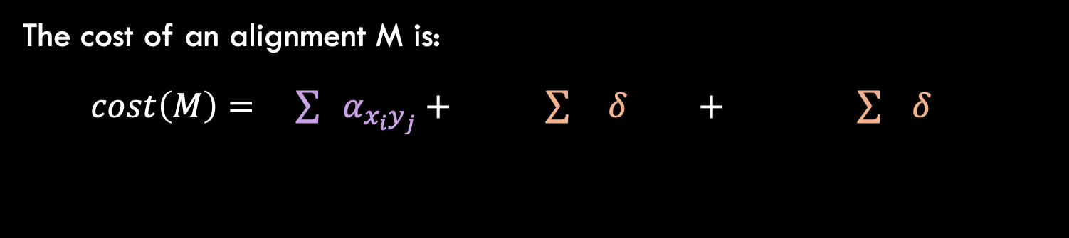


Sequence Alignment: Problem Statement
Problem: Given two strings X = x₁ … x_{m} and Y = y₁ … y_{n} find a min-cost alignment. An alignment M is a set of ordered pairs (x_{i} , y_{j}) such that each character appears in one pair and there are no crossings (Two pairs (x_{i1}, y_{j1}) and (x_{i2}, y_{j2}) cross if i₁ < i₂ but j₁ > j₂
The cost of an alignment M is:
$cost\left(M\right)= \sum{{ α}_{{x_{i}y}_{j}}}+ \sum{ δ} + \sum{ δ}$
$$x_{i}, y_{j}∈M$$
${i :x}_{i}$unmatched
${j:y}_{j}$unmatched
mismatches
gaps

Slide 11
Example: Alignment and Matching
Example: an alignment of X = CGACTA and Y = GACAGA
x₁ | x₂ | x₃ | x₄ | x₅ |  | x₆
C | G | A | C | T | - | A
- | G | A | C | A | G | A
 | y₁ | y₂ | y₃ | y₄ | y₅ | y₆
$$M=\{ \left(x_{2},y_{1}\right),\left(x_{3},y_{2}\right), \left(x_{4},y_{3}\right), \left(x_{5},y_{4}\right), \left(x_{6},y_{6}\right) \}$$

Slide 12
Process for Dynamic Programming
Step 1:
Recognize what the sub-problems are

Slide 13
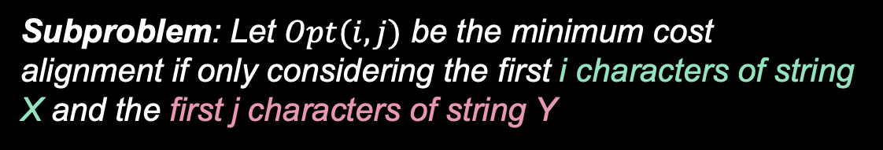
SubProblem Definition
For example, Opt(3,2) considers only first 3 characters of X (CGA) and first 2 characters of Y (GA). Image shows the likely optimal alignment.
x₁ | x₂ | x₃ | x₄ | x₅ |  | x₆
C | G | A | C | T | - | A
- | G | A | C | A | G | A
 | y₁ | y₂ | y₃ | y₄ | y₅ | y₆
Subproblem: Let $Opt(i,j)$ be the minimum cost alignment if only considering the first i characters of string X and the first j characters of string Y

Slide 14
Process for Dynamic Programming
Step 1:
Recognize what the sub-problems are
Step 2:
Identify the recursive structure of the problem in terms of its sub-problems (At the top level, what is the “last thing” done?)

Slide 15



Base Cases
Base Case: At least one of i or j is equal to 0
C | G | A | - | - | - | -
- | - | - | - | - | - | -
- | - | - | - | - | - | -
- | G | A | - | - | - | -
Answer is just the gap penalty times the number of characters!
$i⋅δ$ if $j=0$
$$opt\left(i,j\right)=$$
$j⋅δ$ if $i=0$

Slide 16
Recursive Cases
Example: an alignment of X = CGAC and Y = GACAG
x₁ | x₂ | x₃ | x₄
C | G | A | C | - | - | -
G | A | C | A | G | - | -
y₁ | y₂ | y₃ | y₄ | y₅
Examine the last two characters only. In the minimum alignment, it must be the case that either:
These characters are matched
Last character in X is unmatched (not sure about Y)
Last character in Y is unmatched (not sure about X)

Slide 17




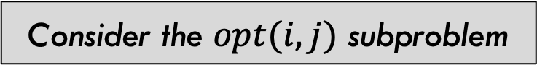
Recursive Cases
Consider the $opt(i,j)$ subproblem
Characters $i$ and $j$ should be matched
Take mismatch penalty if applicable and solve $opt(i−1,j−1)$
Take gap penalty for X and solve $opt(i−1,j)$
Last character in X is unmatched
Last character in Y is unmatched (not sure about X)
Take gap penalty for Y and solve $opt(i,j−1)$

Slide 18
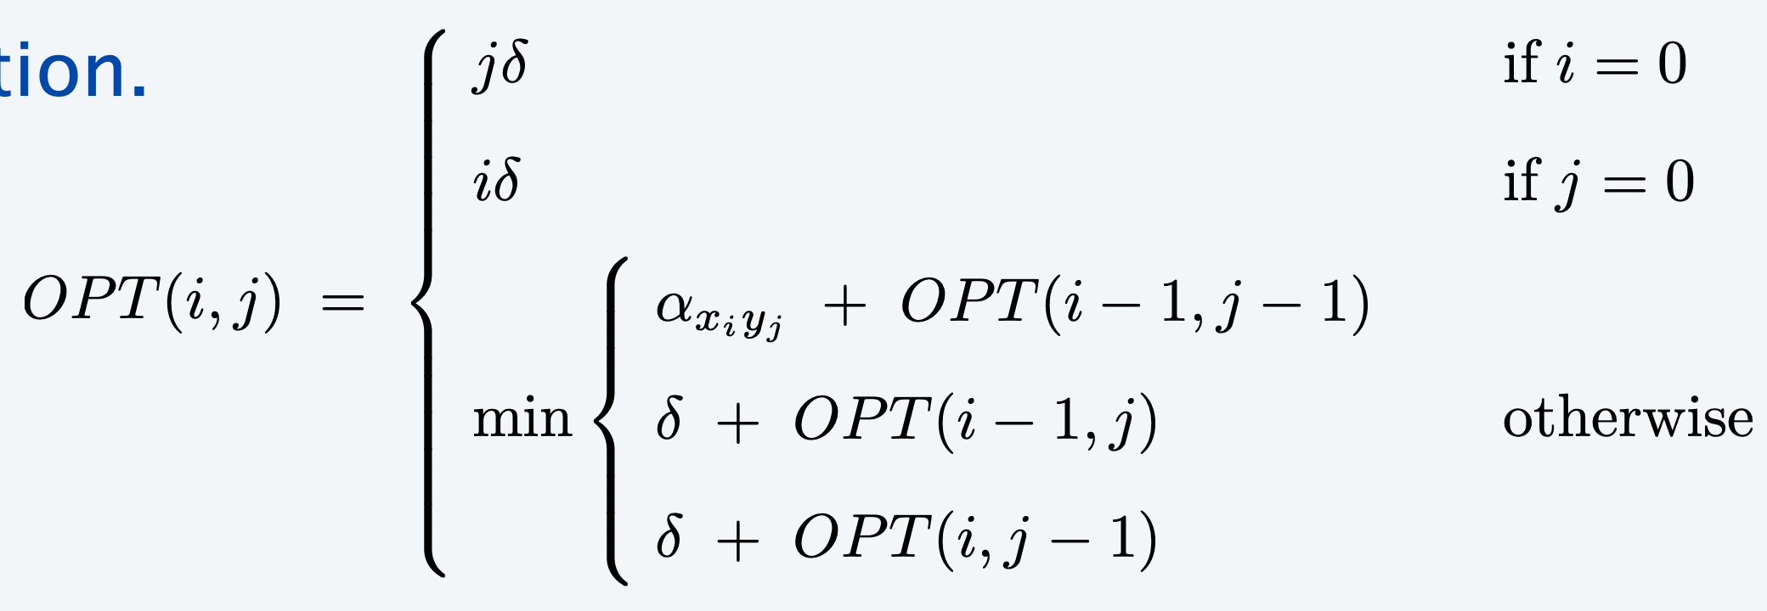

Final Formula
Consider the $opt(i,j)$ subproblem

Slide 19
Process for Dynamic Programming
Step 1:
Recognize what the sub-problems are
Step 2:
Identify the recursive structure of the problem in terms of its sub-problems (At the top level, what is the “last thing” done?)
Step 3:
Formulate a data structure (array, table) that can look-up solution to any sub-problem in constant time

Slide 20
Small Example
Y = “army” → X = “air”
Y
 |  | a | r | m | y
 | 0 | 1 | 2 | 3 | 4
a | 1 | 0 | 1 | 2 | 3
i | 2
r | 3
Each cell stores the minimum cost of any alignment for the substrings associated. Final answer is in lower-right corner
X

Slide 21
Process for Dynamic Programming
Step 1:
Recognize what the sub-problems are
Step 2:
Identify the recursive structure of the problem in terms of its sub-problems (At the top level, what is the “last thing” done?)
Step 3:
Formulate a data structure (array, table) that can look-up solution to any sub-problem in constant time
Step 4:
Develop an algorithm that loops through data structure solving each sub-problem one at a time (either bottom-up or top-down)

Slide 22
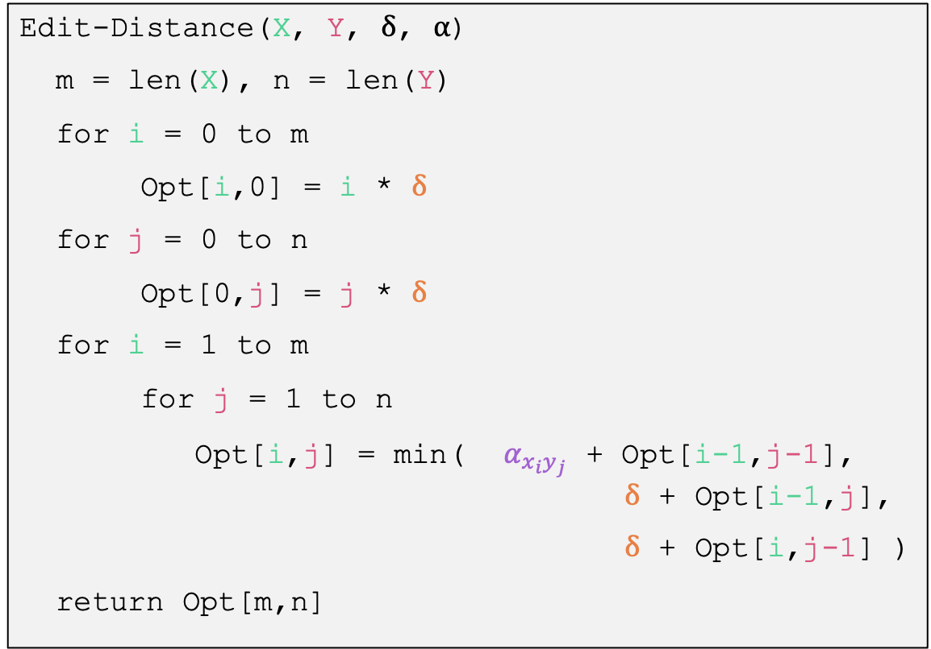
Bottom-up Implementation
Edit-Distance(X, Y, $δ$, $α$)
m = len(X), n = len(Y)
for i = 0 to m
Opt[i,0] = i * $δ$
for j = 0 to n
Opt[0,j] = j * $δ$
for i = 1 to m
for j = 1 to n
Opt[i,j] = min( $α_{{x_{i}y}_{j}}$ + Opt[i-1,j-1], $δ$ + Opt[i-1,j],
$δ$ + Opt[i,j-1] )
return Opt[m,n]
Time complexity?
Constant time to file each cell in the table. So Θ(n ・ m).
Space complexity the same.

Slide 23
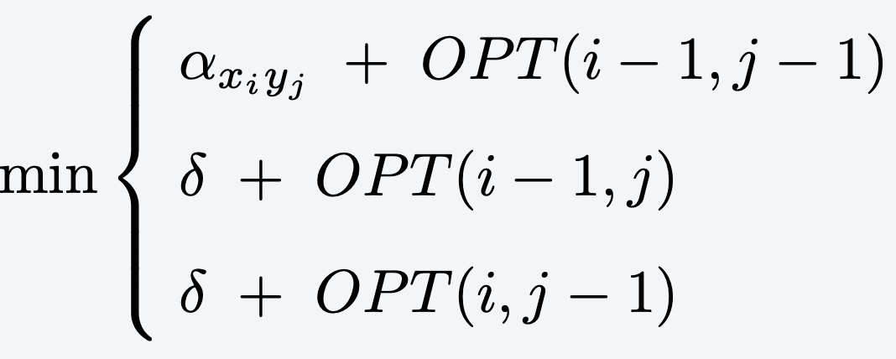

Small Example
Y = “army” → X = “air”
$α_{pq}=\text{2}$ and $δ$=1
Y
 |  | a | r | m | y
 | 0 | 1 | 2 | 3 | 4
a | 1 | 0 | 1 | 2 | 3
i | 2
r | 3
X

Slide 24

Small Example
Y = “army” → X = “air”
Prefix strings are X₂=“ai” and Y₁=“a”
$\left(x_{2},y_{1}\right)∈M$. The cost will be: mismatch cost + Opt(1,0) = 2+1 = 3
$x_{i}$ (“i”) aligns after Y₁ The cost will be: gap cost + Opt(1,1) = 1+0 = 1
$y_{j}$ (“a”) aligns after X₂ The cost will be: gap cost + Opt(2,0) = 1+2 = 3
$α_{pq}=\text{2}$ and $δ$=1
Y
 |  | a | r | m | y
 | 0 | 1 | 2 | 3 | 4
a | 1 | 0 | 1 | 2 | 3
i | 2 | ??
r | 3
X₂ | a | i
Y₁ |  | a
X
X₂ | a | i
Y₁ | a | -
X₂ | a | i | -
Y₁ |  |  | a

Slide 25

Complete Solution
army → air
Y
$α_{pq}=\text{2}$ and $δ$=1
 |  | a | r | m | y
 | 0 | 1 | 2 | 3 | 4
a | 1 | 0 | 1 | 2 | 3
i | 2 | 1 | 2 | 3 | 4
r | 3 | 2 | 1 | 2 | 3
X

Slide 26

Backtrack to Get the Edit
Y
$α_{pq}=\text{2}$ and $δ$=1
army → air
y != r and we came from left: Delete y How do we know we didn’t come diagonally?
m != r and we came from left: Delete m
r == r Keep r and move diagonally (x₃, y₂) added to alignment M
a != i and we came from above: Insert i
a == a Keep a and move diagonally (x₁, y₁) added to alignment M
 |  | a | r | m | y
 | 0 | 1 | 2 | 3 | 4
a | 1 | 0 | 1 | 2 | 3
i | 2 | 1 | 2 | 3 | 4
r | 3 | 2 | 1 | 2 | 3
X
x₁ | x₂ | x₃ | x₄ | x₅
a | i | r | - | -
a | - | r | m | y
y₁ |  | y₂ | y₃ | y₄

Slide 27
Summary on Sequence Alignment
Model for meaning of “similar”
Alignment, with flexible costs for mismatches and gaps
Recursive structure based on whether last items in each sequence are part of the “match” (perhaps with mismatch cost)
Remember, if not matched, part of a gap (insertion)
3 cases
Table stores partial solutions for prefixes of both strings
Time- and space-complexity is Θ(n ・ m)
Want to learn more?
Proof of correctness is shortest-path induction proof for a graph model of table
Another algorithm (Hirschberg) reduces space complexity to Θ(n + m)

Slide 28
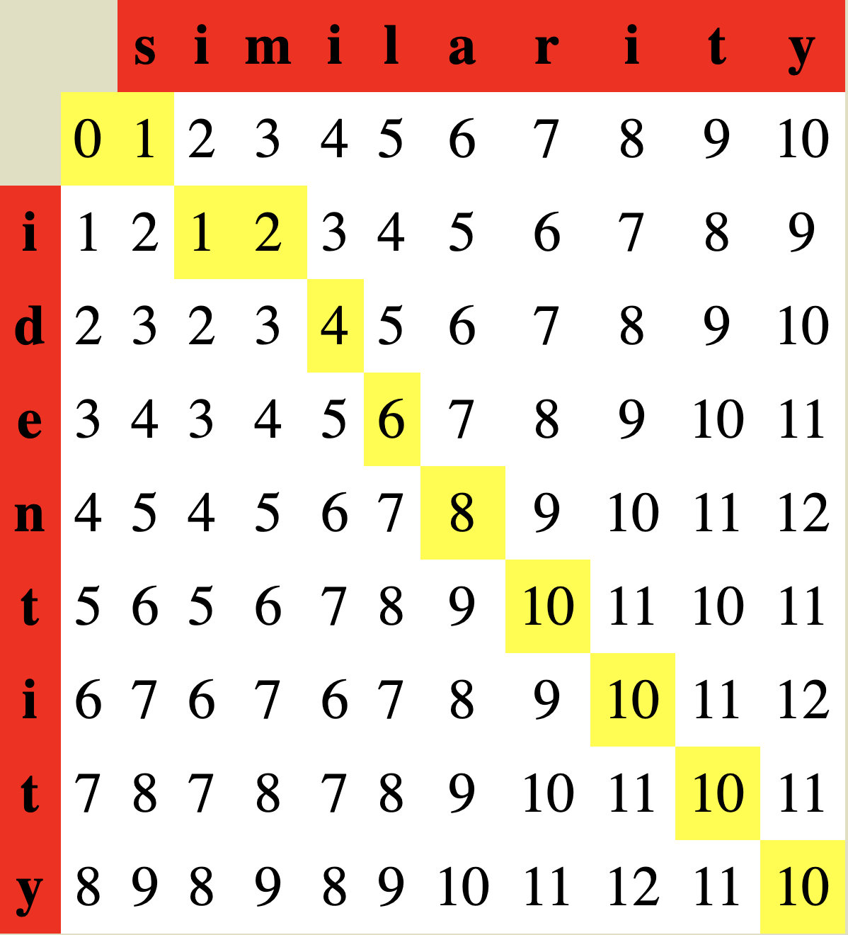
Larger Example

Slide 29
Longest Common Subsequence

Slide 30
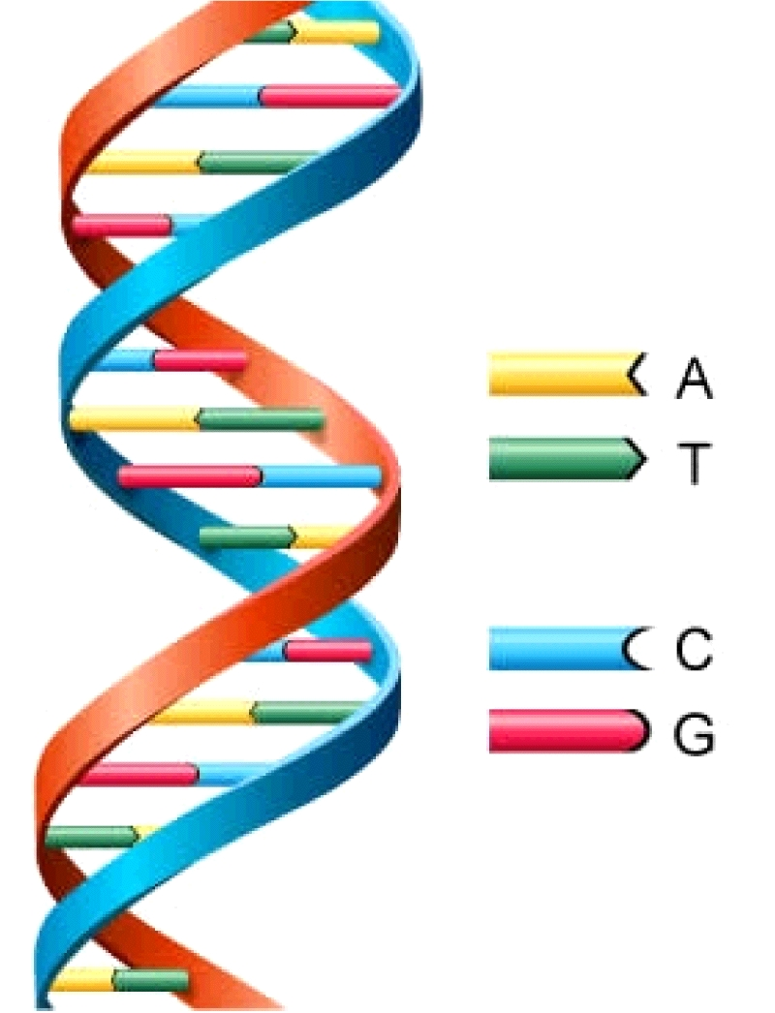
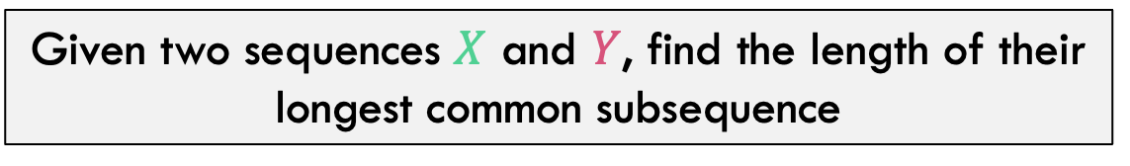

Longest Common Subsequence
Given two sequences $X$ and $Y$, find the length of their longest common subsequence
Example:
X = ATCTGAT Y = TGCATA
X = AT C TGAT Y = TGCAT A
Note this is an alignment where matched items are equal
Brute force: Compare every subsequence of $X$ with $Y$: $Ω(2^{n})$
Applications other than bioinformatics?
Of course, Including version control!
http://cbx33.github.io/gitt/afterhours3-1.html

Slide 31
Process for Dynamic Programming
Step 1:
Recognize what the sub-problems are

Slide 32
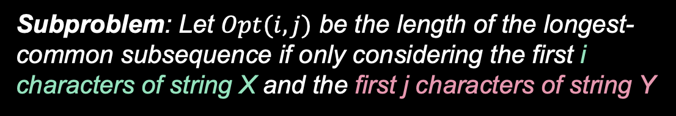
SubProblem Definition
For example, Opt(3,3) considers only first 3 characters of X (ATC) and first 3 characters of Y (TGC).
x₁ | x₂ | x₃ | x₄ | x₅ |  | x₆
A | T | C | T | G | A | T
T | G | C | A | T | A | -
 | y₁ | y₂ | y₃ | y₄ | y₅ | y₆
Subproblem: Let $Opt(i,j)$ be the length of the longest-common subsequence if only considering the first i characters of string X and the first j characters of string Y

Slide 33
Process for Dynamic Programming
Step 1:
Recognize what the sub-problems are
Step 2:
Identify the recursive structure of the problem in terms of its sub-problems (At the top level, what is the “last thing” done?)

Slide 34

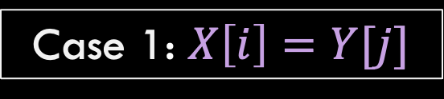
Identify Recursive Structure
Let $LCS\left(i,j\right)=$ length of the LCS for the first $i$ characters of $X$, first $j$ character of $Y$
X = ATCTGCG T
Y = TGCATA T
Case 1: $X\left[i\right]=Y[j]$
$$LCS\left(i,j\right)=LCS\left(i−1, j−1\right)+1$$
No reason not to match the last two characters if they are the same. Match them and solve the smaller subproblem and add 1

Slide 35


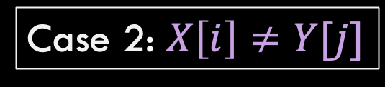
Identify Recursive Structure
Let $LCS\left(i,j\right)=$ length of the LCS for the first $i$ characters of $X$, first $j$ character of $Y$
Case 2: $X\left[i\right]≠Y[j]$
X = ATCTGCGA
Y = TGCATA C
X = ATCTGCG A
Y = TGCATAC
$LCS\left(i,j\right)=LCS\left(i,j−1\right)$
$LCS\left(i,j\right)=LCS\left(i−1,j\right)$

Slide 36

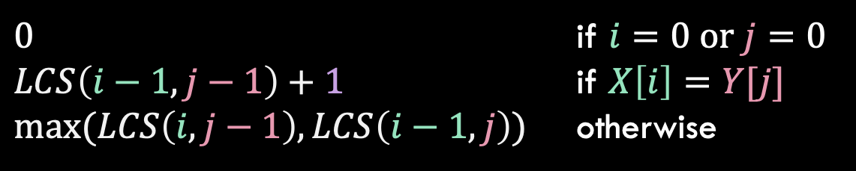
Identify Recursive Structure
Let $LCS\left(i,j\right)=$ length of the LCS for the first $i$ characters of $X$, first $j$ character of $Y$
$0$ if $i=0$ or $j=0$
$LCS\left(i−1,j−1\right)+1$ if $X\left[i\right]=Y[j]$
$\max{(LCS\left(i,j−1\right),LCS\left(i−1,j\right))}$ otherwise
$$LCS\left(i,j\right)=$$

Slide 37
Process for Dynamic Programming
Step 1:
Recognize what the sub-problems are
Step 2:
Identify the recursive structure of the problem in terms of its sub-problems (At the top level, what is the “last thing” done?)
Step 3:
Formulate a data structure (array, table) that can look-up solution to any sub-problem in constant time

Slide 38



























Data Structure for lookups
$$X=$$
$$A$$
$$T$$
$$C$$
$$T$$
$$G$$
$$A$$
$$T$$
$$Y=$$
$$0$$
$$1$$
$$2$$
$$3$$
$$4$$
$$5$$
$$6$$
$$7$$
$$0$$
0 | 0 | 0 | 0 | 0 | 0 | 0 | 0
0 | 0 | 1 | 1 | 1 | 1 | 1 | 1
0 | 0 | 1 | 1 | 1 | 2 | 2 | 2
0 | 0 | 1 | 2 | 2 | 2 | 2 | 2
0 | 1 | 1 | 2 | 2 | 2 | 3 | 3
0 | 1 | 2 | 2 | 3 | 3 | 3 | 4
0 | 1 | 2 | 2 | 3 | 3 | 4 | 4
$$T$$
$$1$$
$$G$$
$$2$$
$$C$$
$$3$$
$$A$$
$$4$$
$$T$$
$$5$$
$$A$$
$$6$$
Each cell location [i,j] stores the solution to the i,j subproblem

Slide 39
Process for Dynamic Programming
Step 1:
Recognize what the sub-problems are
Step 2:
Identify the recursive structure of the problem in terms of its sub-problems (At the top level, what is the “last thing” done?)
Step 3:
Formulate a data structure (array, table) that can look-up solution to any sub-problem in constant time
Step 4:
Develop an algorithm that loops through data structure solving each sub-problem one at a time (either bottom-up or top-down)

Slide 40




















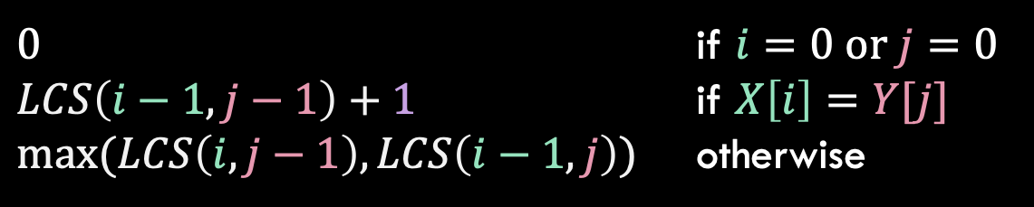





Solve in a Good Order
$0$ if $i=0$ or $j=0$
$LCS\left(i−1,j−1\right)+1$ if $X\left[i\right]=Y[j]$
$\max{(LCS\left(i,j−1\right),LCS\left(i−1,j\right))}$ otherwise
$$LCS\left(i,j\right)=$$
$$X=$$
$$A$$
$$T$$
$$C$$
$$T$$
$$G$$
$$A$$
$$T$$
$$Y=$$
$$0$$
$$1$$
$$2$$
$$3$$
$$4$$
$$5$$
$$6$$
$$7$$
$$0$$
0 | 0 | 0 | 0 | 0 | 0 | 0 | 0
0 | 0 | 1 | 1 | 1 | 1 | 1 | 1
0 | 0 | 1 | 1 | 1 | 2 | 2 | 2
0 | 0 | 1 | 2 | 2 | 2 | 2 | 2
0 | 1 | 1 | 2 | 2 | 2 | 3 | 3
0 | 1 | 2 | 2 | 3 | 3 | 3 | 4
0 | 1 | 2 | 2 | 3 | 3 | 4 | 4
$$T$$
$$1$$
$$G$$
$$2$$
$$C$$
$$3$$
$$A$$
$$4$$
$$T$$
$$5$$
$$A$$
$$6$$
To fill in cell $(i,j)$ we need cells $\left(i−1,j−1\right),\left(i−1,j\right),(i,j−1)$
Fill from Top->Bottom, Left->Right (with any preference)

Slide 41

LCS Length Algorithm
LCS-Length(X, Y)
1. n = length(X)
2. m = length(Y)
3. for i = 1 to m M[i,0] = 0
4. for j = 1 to n M[0,j] = 0
5. for i = 1 to m
6. for j = 1 to n
7. if ( X[i] == Y[j] )
8. M[i,j] = M[i-1,j-1] + 1
9. else M[i,j] = max( M[i-1,j], M[i,j-1] )
10. return M[m,n]
Run Time: $Θ(n⋅m)$ (for $\left|X\right|=n$, $\left|Y\right|=m$)

Slide 42

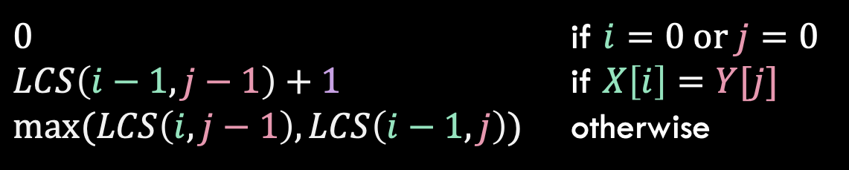
Reconstructing the LCS
$0$ if $i=0$ or $j=0$
$LCS\left(i−1,j−1\right)+1$ if $X\left[i\right]=Y[j]$
$\max{(LCS\left(i,j−1\right),LCS\left(i−1,j\right))}$ otherwise
$$LCS\left(i,j\right)=$$
$$X=$$
$$A$$
$$T$$
$$C$$
$$T$$
$$G$$
$$A$$
$$T$$
$$Y=$$
$$0$$
$$1$$
$$2$$
$$3$$
$$4$$
$$5$$
$$6$$
$$7$$
$$0$$
0 | 0 | 0 | 0 | 0 | 0 | 0 | 0
0 | 0 | 1 | 1 | 1 | 1 | 1 | 1
0 | 0 | 1 | 1 | 1 | 2 | 2 | 2
0 | 0 | 1 | 2 | 2 | 2 | 2 | 2
0 | 1 | 1 | 2 | 2 | 2 | 3 | 3
0 | 1 | 2 | 2 | 3 | 3 | 3 | 4
0 | 1 | 2 | 2 | 3 | 3 | 4 | 4
$$T$$
$$1$$
$$G$$
$$2$$
$$C$$
$$3$$
$$A$$
$$4$$
$$T$$
$$5$$
$$A$$
$$6$$
Start from bottom right,
if symbols matched, print that symbol then go diagonally
else go to largest adjacent

Slide 43
Reconstructing the LCS
$0$ if $i=0$ or $j=0$
$LCS\left(i−1,j−1\right)+1$ if $X\left[i\right]=Y[j]$
$\max{(LCS\left(i,j−1\right),LCS\left(i−1,j\right))}$ otherwise
$$LCS\left(i,j\right)=$$
$$X=$$
$$A$$
$$T$$
$$C$$
$$T$$
$$G$$
$$A$$
$$T$$
$$Y=$$
$$0$$
$$1$$
$$2$$
$$3$$
$$4$$
$$5$$
$$6$$
$$7$$
$$0$$
0 | 0 | 0 | 0 | 0 | 0 | 0 | 0
0 | 0 | 1 | 1 | 1 | 1 | 1 | 1
0 | 0 | 1 | 1 | 1 | 2 | 2 | 2
0 | 0 | 1 | 2 | 2 | 2 | 2 | 2
0 | 1 | 1 | 2 | 2 | 2 | 3 | 3
0 | 1 | 2 | 2 | 3 | 3 | 3 | 4
0 | 1 | 2 | 2 | 3 | 3 | 4 | 4
$$T$$
$$1$$
$$G$$
$$2$$
$$C$$
$$3$$
$$A$$
$$4$$
$$T$$
$$5$$
$$A$$
$$6$$
Start from bottom right,
if symbols matched, print that symbol then go diagonally
else go to largest adjacent

Slide 44
Reconstructing the LCS
$0$ if $i=0$ or $j=0$
$LCS\left(i−1,j−1\right)+1$ if $X\left[i\right]=Y[j]$
$\max{(LCS\left(i,j−1\right),LCS\left(i−1,j\right))}$ otherwise
$$LCS\left(i,j\right)=$$
$$X=$$
$$A$$
$$T$$
$$C$$
$$T$$
$$G$$
$$A$$
$$T$$
$$Y=$$
$$0$$
$$1$$
$$2$$
$$3$$
$$4$$
$$5$$
$$6$$
$$7$$
$$0$$
0 | 0 | 0 | 0 | 0 | 0 | 0 | 0
0 | 0 | 1 | 1 | 1 | 1 | 1 | 1
0 | 0 | 1 | 1 | 1 | 2 | 2 | 2
0 | 0 | 1 | 2 | 2 | 2 | 2 | 2
0 | 1 | 1 | 2 | 2 | 2 | 3 | 3
0 | 1 | 2 | 2 | 3 | 3 | 3 | 4
0 | 1 | 2 | 2 | 3 | 3 | 4 | 4
$$T$$
$$1$$
$$G$$
$$2$$
$$C$$
$$3$$
$$A$$
$$4$$
$$T$$
$$5$$
$$A$$
$$6$$
Start from bottom right,
if symbols matched, print that symbol then go diagonally
else go to largest adjacent

Slide 45
Top-Down Solution with Memoization
We need two functions; one will be recursive.
LCS-Length(X, Y) // Y is M’s cols.
1. n = length(X)
2. m = length(Y)
3. Create table M[m,n]
4. Assign -1 to all cells M[i,j]
// get value for entire sequences
5. return LCS-recur(X, Y, M, m, n)
LCS-recur(X, Y, M, i, j)
1. if (i == 0 || j == 0) return 0
// have we already calculated this subproblem?
2. if (M[i,j] != -1) return M[i,j]
3. if ( X[i] == Y[j] )
M[i,j] = LCS-recur(X, Y, M, i-1, j-1) + 1
5. else
6. M[i,j] = max( LCS-recur(X, Y, M, i-1, j), LCS-recur(X, Y, M, i, j-1) )
7. return M[i,j]

