Slide 1
More Dynamic Programming Seam Carving
Data Structures and Algorithms 2 Mark Floryan

Slide 2
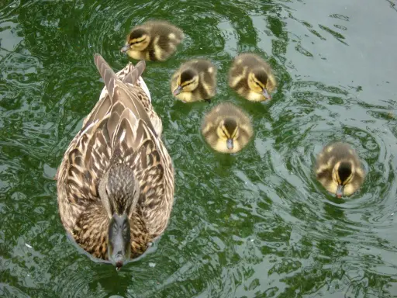
Seam Carving
Seam Carving is a method for image resizing that does not scale or crop the image

Slide 3
Cropping
Cropping simply removes a block of pixels

Slide 4
Scaling
Scaling removes stripes of pixels

Slide 5
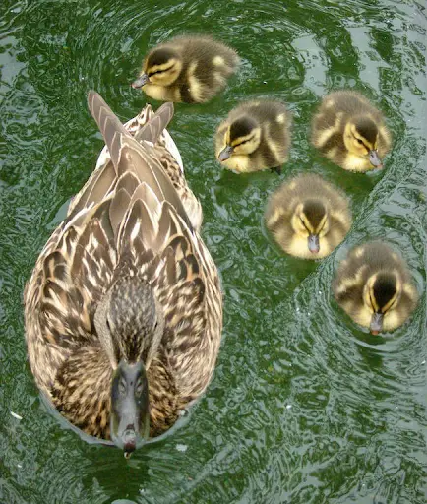

Seam Carving
There are more pleasing ways to scale images!
Seam Carving removes least energy seams of pixels

Slide 6
Comparison
Cropping
Scaling
Carving

Slide 7

Energy of a seam
For each pixel in the image, we will calculate the energy of the pixel. The energy of a seam is simply the sum of the energies of the pixels in the seam.
$$e\left(p\right)=energy of pixel p$$

Slide 8

Energy of a seam
For each pixel in the image, we will calculate the energy of the pixel. The energy of a seam is simply the sum of the energies of the pixels in the seam.
$$e\left(p\right)=energy of pixel p$$
Restriction: seam pixels go up or diagonally up, not to the side
Options for energy:
Change in color from neighbor pixels
Shortest Path (more color = more distance)
Specific choice doesn’t matter

Slide 9
Process for Dynamic Programming
Step 1:
Recognize what the sub-problems are

Slide 10

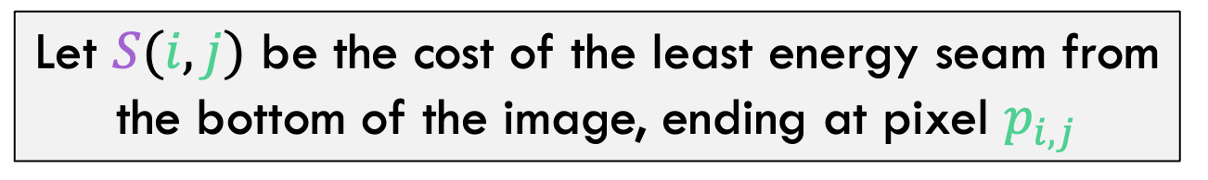
Defining the sub-Problem
Let $S(i,j)$ be the cost of the least energy seam from the bottom of the image, ending at pixel $p_{i,j}$
$$p_{i,j}$$

Slide 11
Process for Dynamic Programming
Step 1:
Recognize what the sub-problems are
Step 2:
Identify the recursive structure of the problem in terms of its sub-problems (At the top level, what is the “last thing” done?)

Slide 12


Defining the sub-Problem
Assume we know $S(i,j)$ for all $j≤n−1$ and want to calculate $p_{i,j}$
$$p_{i,j}$$
Known through n-1
m

Slide 13

Defining the sub-Problem
Assume we know $S(i,j)$ for all $j≤n−1$ and want to calculate $p_{i,j}$
$$p_{i,j}$$
Known through n-1
m

Slide 14
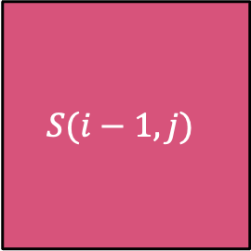

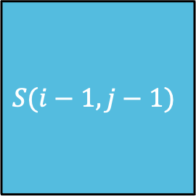
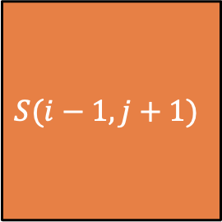
Defining the sub-Problem
$$S(i,j)$$
$$S(i−1,j−1)$$
$$S(i−1,j)$$
$$S(i−1,j+1)$$

Slide 15

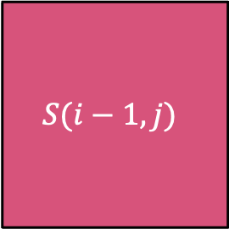

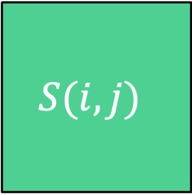

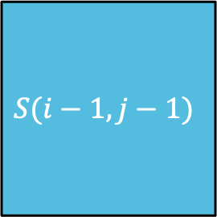
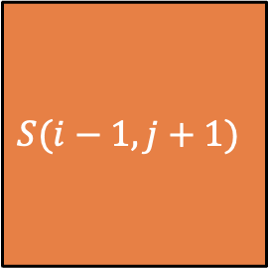

Defining the sub-Problem
$$S(i,j)$$
$$S(i−1,j−1)$$
$$S(i−1,j)$$
$$S(i−1,j+1)$$
$$S\left(i−1,j−1\right)$$
$$S\left(i,j\right)=e\left(p_{i,j}\right)+ min$$
$$S\left(i−1,j\right)$$
$$S\left(i−1,j+1\right)$$

Slide 16
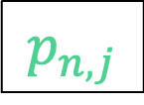

Defining the sub-Problem
Want to delete the minimum energy seam from top to bottom. $\min_{k}{S(n,k)}$
$$p_{n,j}$$
n
m

Slide 17
Process for Dynamic Programming
Step 1:
Recognize what the sub-problems are
Step 2:
Identify the recursive structure of the problem in terms of its sub-problems (At the top level, what is the “last thing” done?)
Step 3:
Formulate a data structure (array, table) that can look-up solution to any sub-problem in constant time

Slide 18
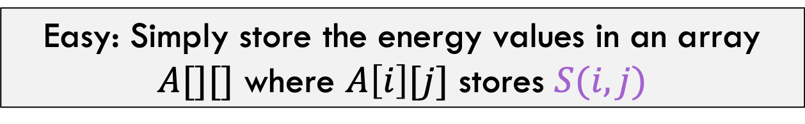
Defining the sub-Problem
Easy: Simply store the energy values in an array $A[][]$ where $A\left[i\right][j]$ stores $S(i,j)$

Slide 19
Process for Dynamic Programming
Step 1:
Recognize what the sub-problems are
Step 2:
Identify the recursive structure of the problem in terms of its sub-problems (At the top level, what is the “last thing” done?)
Step 3:
Formulate a data structure (array, table) that can look-up solution to any sub-problem in constant time
Step 4:
Develop an algorithm that loops through data structure solving each sub-problem one at a time (either bottom-up or top-down)

Slide 20

Bringing it all together
Initialize $S\left(1,k\right)=e(p_{1,k})$ for each pixel in row 1
n
m

Slide 21





Bringing it all together
Initialize $S\left(1,k\right)=e(p_{1,k})$ for each pixel in row 1
$$S\left(i−1,j−1\right)$$
$$S\left(i,j\right)=e\left(p_{i,j}\right)+ min$$
$$S\left(i−1,j\right)$$
for all $i≥2$
$$S\left(i−1,j+1\right)$$
n
m

Slide 22

Bringing it all together
Initialize $S\left(1,k\right)=e(p_{1,k})$ for each pixel in row 1
$$S\left(i−1,j−1\right)$$
$$S\left(i,j\right)=e\left(p_{i,j}\right)+ min$$
$$S\left(i−1,j\right)$$
for all $i≥2$
$$S\left(i−1,j+1\right)$$
Pick minimum top row $S\left(n,k\right)$ backtrack to delete pixels
n
m

Slide 23



Bringing it all together
Initialize $S\left(1,k\right)=e(p_{1,k})$ for each pixel in row 1
$$Θ(m)$$
$$S\left(i−1,j−1\right)$$
$$S\left(i,j\right)=e\left(p_{i,j}\right)+ min$$
$$S\left(i−1,j\right)$$
for all $i≥2$
$$Θ(n⋅m)$$
$$S\left(i−1,j+1\right)$$
Pick minimum top row $S\left(n,k\right)$ backtrack to delete pixels
$$Θ(n+m)$$
n
m

Slide 24
Repeated Seam Removal
Backtracking to remove pixels. Only need to update pixels near the ones removed.
n
m

Slide 25

Repeated Seam Removal
Backtracking to remove pixels. Only need to update pixels near the ones removed.
$$Θ\left(n+m\right)+Θ(2n)$$
n
m

