Slide 1
A brief Introduction to Machine Learning
Data Structures and Algorithms 2 Mark Floryan and Aaron Bloomfield

Slide 2
Roadmap: Goals for this deck
Learn a little bit about what machine learning is, some of the basic terms, and what they mean.
Learn a couple of VERY simple ML algorithms as a stepping point to upper level CS electives
Understand the basics of modern AI so you are ready to learn more in the future!

Slide 3
Introduction, “Learning”, Features, etc.

Slide 4
What is Machine Learning?
Wikipedia
Statistical algorithms that can effectively generalize and thus perform tasks without explicit instructions
Oxford Languages
The use and development of computer systems that are able to learn and adapt without following explicit instructions, by using algorithms and statistical models to analyze and draw inferences from patterns in data

Slide 5
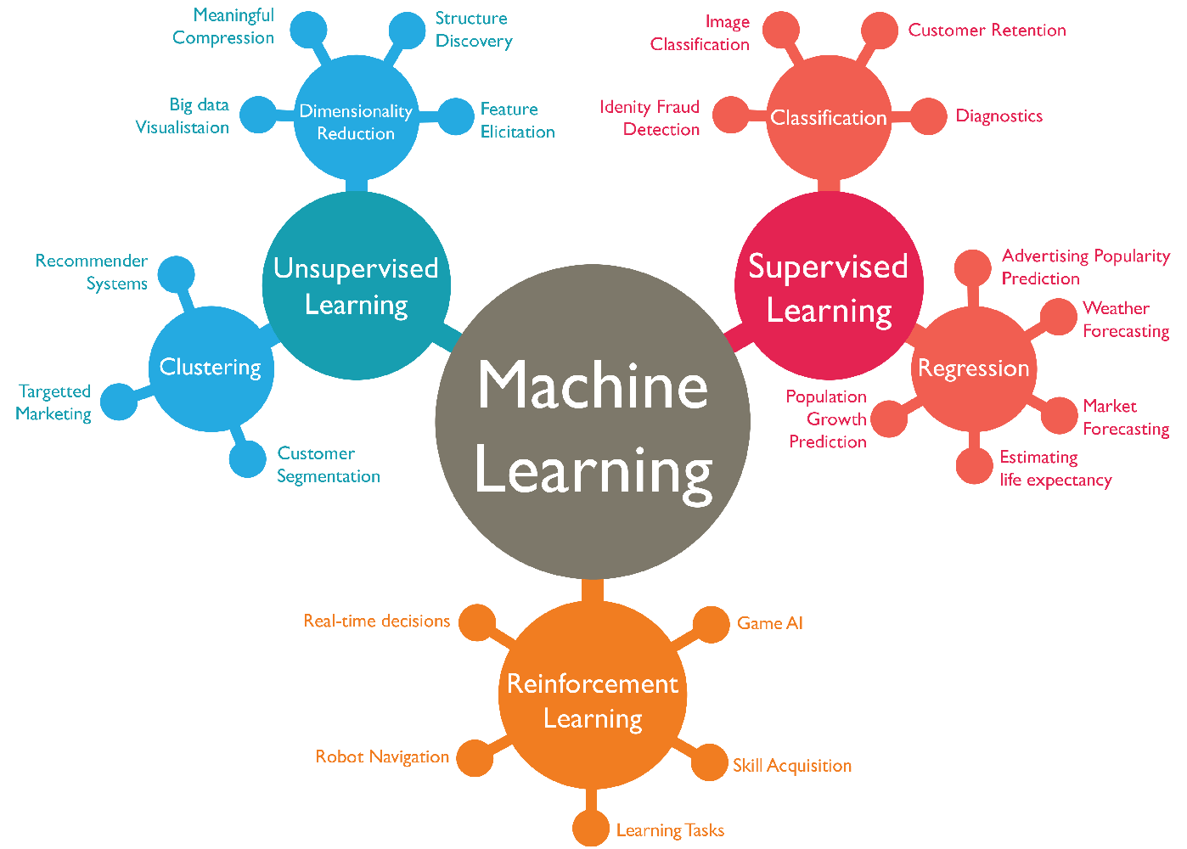
What is Machine Learning?

Slide 6
One Common ML Paradigm?
Training data is data acquired or crafted that represents the real word and provides real examples of the information needed to learn the task at hand. Examples include user’s movie preferences and movie data, images of animals, social media conversations, etc.
Training Data

Slide 7
One Common ML Paradigm?
Training data consists of features. Features are the different kinds of information the algorithm will learn about. Many machine learning algorithms are calculating correlations between these features and how well they predict an outcome of interest.
Training Data
Student | Earned an A in 2100? | 4^{th-}Year? | Works Hard? | Drinks? | Will earn A in 3100?
Richard | Yes | Yes | No | Yes | No
Allen | Yes | Yes | Yes | No | Yes
Alison | No | No | Yes | No | No
Jeff | No | Yes | No | Yes | No
Gail | Yes | No | Yes | Yes | Yes
Simon | No | Yes | Yes | Yes | No

Slide 8
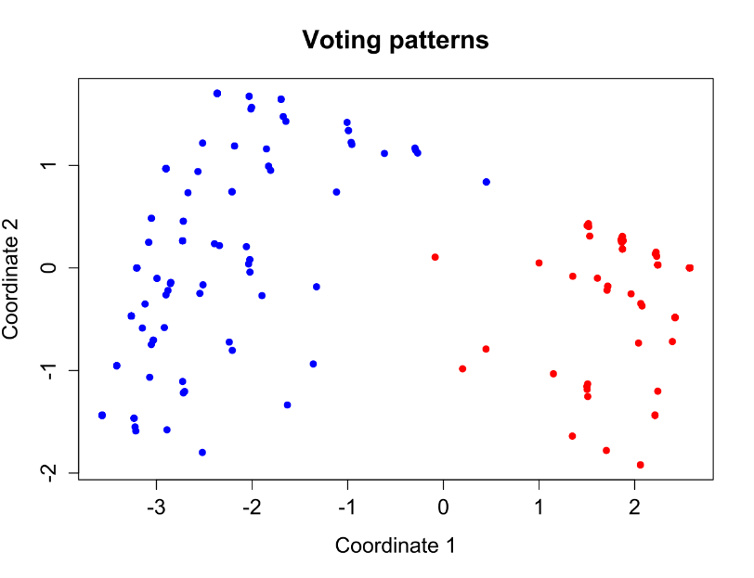
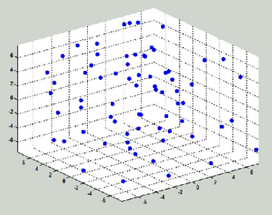
One Common ML Paradigm?
Features are often numerical, meaning they can be plotted in n-dimensional space!
Student | Grade in 2100? | Years in college? | Hrs work per week? | Drinks per week? | Grade in 3100?
Richard | 95 | 4 | 2 | 12 | 77
Allen | 97 | 4 | 7 | 0 | 91
Alison | 76 | 2 | 6 | 0 | 67
Jeff | 78 | 4 | 3 | 10 | 77
Gail | 96 | 3 | 8 | 2 | 95
Simon | 85 | 4 | 8 | 4 | 88
Training Data
How similar are two students in our training set? One measure is to plot in n-dimensional space and find Euclidean distance!

Slide 9
One Common ML Paradigm?
Training Data

Slide 10
One Common ML Paradigm?
Model Training Algorithm
ML Model
Training Data
Training data is input (along with other things sometimes) to a training algorithm. These algorithms look at the data and try to minimize some function that makes predictions about future data points. The algorithm outputs a model that can make decision on future instances of data.

Slide 11
One Common ML Paradigm?
A different set of Test Data is often used to test the model’s accuracy. If the model only works on the training data but not the test data, then the model is not good (often due to overfitting).
Test Data
Model Training Algorithm
ML Model
Training Data
A model’s responses are questions to answers of that model: What kind of bird is this? What movie should I recommend to this person? Etc. Answers will be based on patterns in the training data
Model Response

Slide 12
One Common ML Paradigm?
Test Data
Human Requests
Model Training Algorithm
ML Model
End users Scientists,
Etc.
Training Data
Once the model’s responses are of good overall quality, real humans, scientists, end users, etc. can use the model to ask questions and get predictions for future data points
Model Response

Slide 13
One Common ML Paradigm?
Lastly, the model’s responses can be used to build more training data to further improve the model.
Test Data
Human Requests
Model Training Algorithm
ML Model
End users Scientists,
Etc.
Training Data
Data Scientists / Data Refiners
Model Response

Slide 14
One Common ML Paradigm?
Test Data
Human Requests
Model Training Algorithm
ML Model
End users Scientists,
Etc.
Training Data
Data Scientists / Data Refiners
Model Response

Slide 15
Types of Learning
Rote
Directly memorizing what is learned
Unsupervised Learning
Learning by finding patterns in data despite data not having direct meaning
Supervised Learning
Learning by example, where an expert gives you feedback on “correct” responses
Reinforcement Learning
Learning by practicing and reinforcing actions that work will punishing actions that do not work

Slide 16
Rote Learning
Rote
Directly memorizing what is learned
Memorizing what is learned
Difficult to transfer knowledge to different domains or different problems
Easy (-ish) to recall the information
Hard to apply the information
Computers are GREAT at this
Storing information and retrieving it
String knowledge = “America declared independence in 1776”;
The computer is learning (in some sense)
…but there are big limitations with what it can do with that knowledge

Slide 17
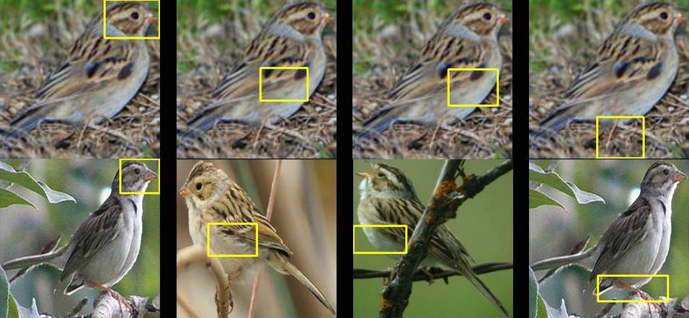
Unsupervised Learning
Unsupervised Learning
Learning by finding patterns in data despite data not having direct meaning
Birds! We may not know what the birds are called, but we can group them based on shared features (feather color, stripes, head shape, beak shape, etc.)

Slide 18

Another Example: Unsupervised Learning
Unsupervised Learning
Learning by finding patterns in data despite data not having direct meaning
Suppose you know nothing about movies / movie genres and just start watching 2-3 movies per day.
What will happen after watching enough movies? Will you learn about movie genres? Anything else you would learn completely on your own?

Slide 19
supervised Learning
Supervised Learning
Learning by example, where an expert gives you feedback on “correct” responses
email
spam
Here, a human (probably) has gone through and marked emails as spam or not, so we can learn what spam emails look like!
email
spam
Supervised learning algorithms have some form of ground truth available
email
legit
email
legit
email
legit
email
spam
email
spam
email
legit
…

Slide 20
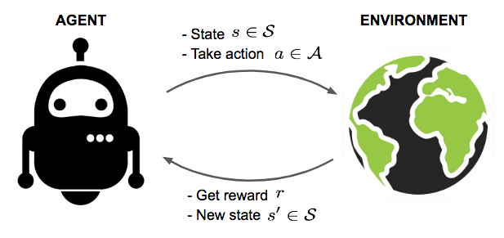
Reinforcement Learning
Reinforcement Learning
Learning by practicing and reinforcing actions that work will punishing actions that do not work
Image credit: Lil'Log

Slide 21
That Taxonomy Again…

Slide 22
Unsupervised Learning and Clustering

Slide 23
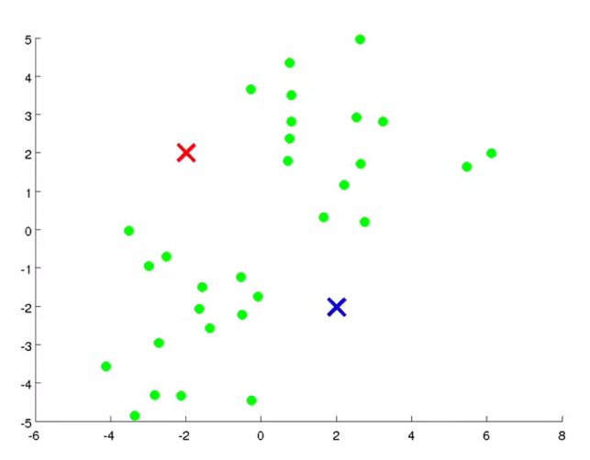
Clustering
Goal: Divide samples in the data set into some number of k groups where items in each group are highly similar to one another.
In this example, how many clusters do there seem to be? One challenge is choosing the right k (set of groups) to find.
Applications: Market Segmentation
Organize Data Centers Social Network Analysis
Recommender Tools

Slide 24
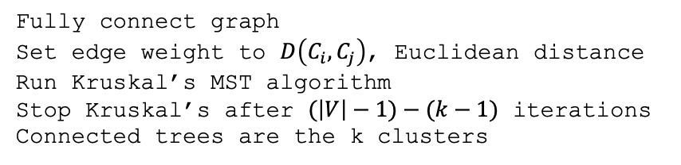
Clustering Using MSTs
Algorithm: Find the Minimum Spanning Tree using Kruskal’s algorithm but stop when there are exactly k trees left.
Fully connect graph
Set edge weight to $D\left(C_{i},C_{j}\right)$, Euclidean distance
Run Kruskal’s MST algorithm
Stop Kruskal’s after $(\left|V\right|−1)−(k−1)$ iterations
Connected trees are the k clusters
Alternatively, stop after distance becomes too large (over some threshold) and see how many clusters you get!

Slide 25
Clustering Using MSTs
Algorithm: Find the Minimum Spanning Tree using Kruskal’s algorithm but stop when there are exactly k trees left.
Notes:
Easy to implement!
Will always terminate and find clusters!
Very fast!
Can lead to long skinny clusters that are not ideal solution
Can lead to very unbalanced clusters (num points per cluster)
https://en.wikipedia.org/wiki/Single-linkage_clustering

Slide 26
Clustering
Goal: Divide samples in the data set into some number of k groups where items in each group are highly similar to one another.
Let’s look at a second algorithm!
K-means clustering!
Idea: Pick a k, each cluster (here, k=2) has a centroid!
Try to move each centroid to central location in cluster!
Points belong to group of closest centroid!

Slide 27
Clustering
Goal: Divide samples in the data set into some number of k groups where items in each group are highly similar to one another.
This algorithm has two very important methods:
Assign(C, P);
Assigns each point to belong to the closest centroid in set C
Average(c, P);
Of points in P assigned to centroid c, what is average position?

Slide 28
Clustering Based on Centroids
K-Means(P, k):
Create set C, exactly k randomized centroids
Do until assignment of points does not change:
Assign(C, P)
For each cluster c in C:
c = Average(c, P)
return C

Slide 29
How it Works: The Initial State
K-Means(P, k):
Create set C, exactly k randomized centroids
Do until assignment of points does not change:
Assign(C, P)
For each cluster c in C:
c = Average(c, P)
return C

Slide 30
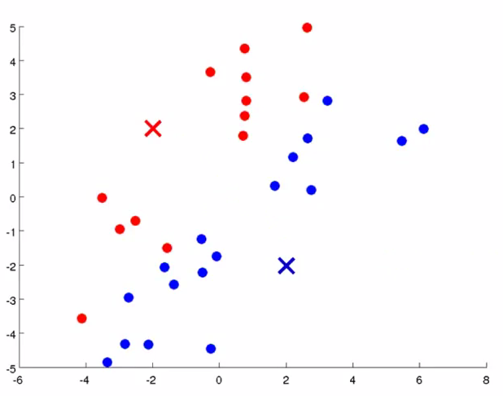
How it Works: The Initial State
K-Means(P, k):
Create set C, exactly k randomized centroids
Do until assignment of points does not change:
Assign(C, P)
For each cluster c in C:
c = Average(c, P)
return C

Slide 31
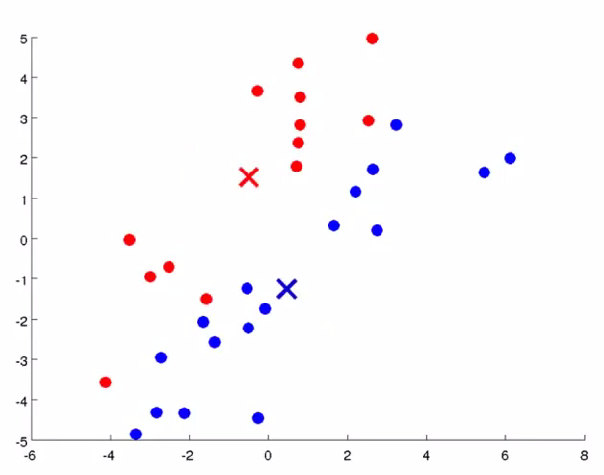
How it Works: The Initial State
K-Means(P, k):
Create set C, exactly k randomized centroids
Do until assignment of points does not change:
Assign(C, P)
For each cluster c in C:
c = Average(c, P)
return C

Slide 32
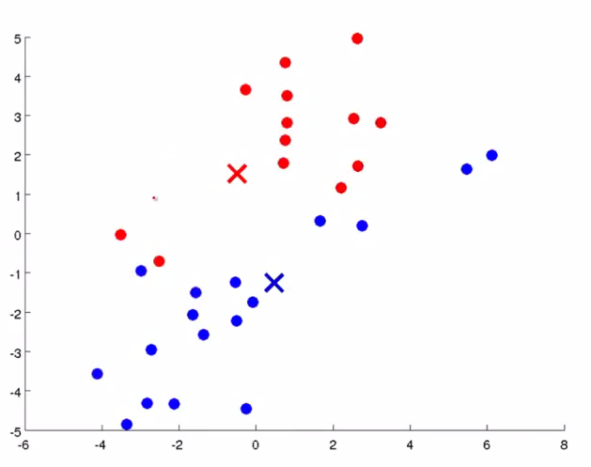
How it Works: The Initial State
K-Means(P, k):
Create set C, exactly k randomized centroids
Do until assignment of points does not change:
Assign(C, P)
For each cluster c in C:
c = Average(c, P)
return C

Slide 33
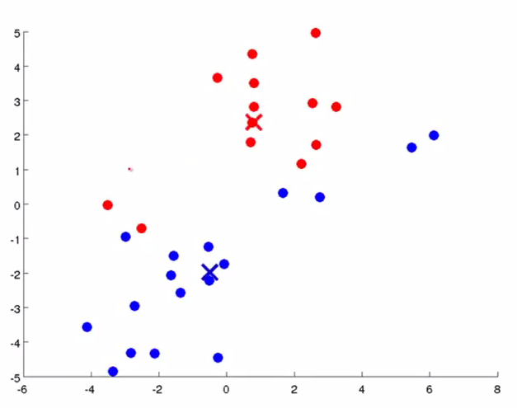
How it Works: The Initial State
K-Means(P, k):
Create set C, exactly k randomized centroids
Do until assignment of points does not change:
Assign(C, P)
For each cluster c in C:
c = Average(c, P)
return C

Slide 34
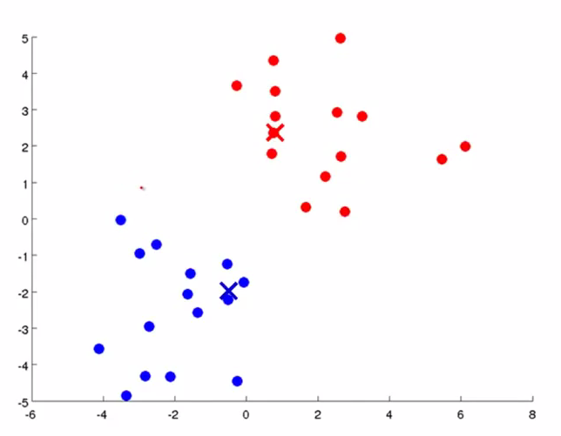
How it Works: The Initial State
K-Means(P, k):
Create set C, exactly k randomized centroids
Do until assignment of points does not change:
Assign(C, P)
For each cluster c in C:
c = Average(c, P)
return C

Slide 35
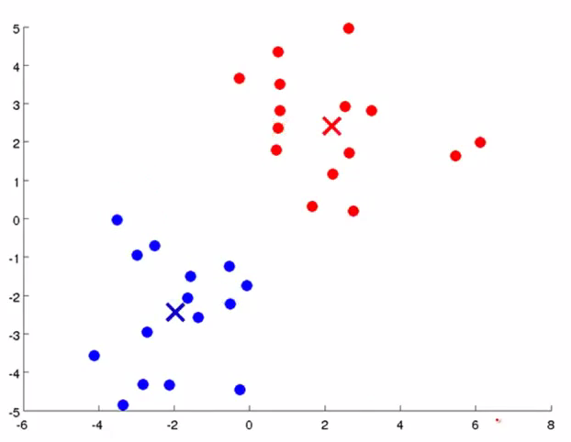
How it Works: The Initial State
K-Means(P, k):
Create set C, exactly k randomized centroids
Do until assignment of points does not change:
Assign(C, P)
For each cluster c in C:
c = Average(c, P)
return C

Slide 36
How it Works: The Initial State
K-Means(P, k):
Create set C, exactly k randomized centroids
Do until assignment of points does not change:
Assign(C, P)
For each cluster c in C:
c = Average(c, P)
return C

Slide 37
How it Works: The Initial State
K-Means(P, k):
Create set C, exactly k randomized centroids
Do until assignment of points does not change:
Assign(C, P)
For each cluster c in C:
c = Average(c, P)
return C
What factors affect the time-complexity?
Obviously n, the number of observations
k, the number of clusters
i, the number of iterations before we converge
d, the dimensionality of the observations
Overall, the algorithm is O(ndki)
https://en.wikipedia.org/wiki/K-means_clustering

Slide 38
Supervised Learning: K-Nearest Neighbors

Slide 39
supervised Learning
Supervised Learning
Learning by example, where an expert gives you feedback on “correct” responses
Student | Earned an A in 2100? | 4^{th-}Year? | Works Hard? | Drinks? | Will earn A in 3100?
Richard | Yes | Yes | No | Yes | No
Allen | Yes | Yes | Yes | No | Yes
Alison | No | No | Yes | No | No
Jeff | No | Yes | No | Yes | No
Gail | Yes | No | Yes | Yes | Yes
Simon | No | Yes | Yes | Yes | No
Supervised learning algorithms have some form of ground truth available. Training set provides the TRUE answer. Model should then work to predict elements of a test set correctly.
Alex | Yes | No | Yes | No | ???

Slide 40

supervised Learning
Supervised Learning
Learning by example, where an expert gives you feedback on “correct” responses
Student | Earned an A in 2100? | 4^{th-}Year? | Works Hard? | Drinks? | Will earn A in 3100?
Richard | Yes | Yes | No | Yes | No
Allen | Yes | Yes | Yes | No | Yes
Alison | No | No | Yes | No | No
Jeff | No | Yes | No | Yes | No
Gail | Yes | No | Yes | Yes | Yes
Simon | No | Yes | Yes | Yes | No
Possible Learned Rule:
$$\left(4thYear∧¬Drink\right)∨(¬4thYear∧Drink)$$
What’s the issue with this learned rule?
Alex | Yes | No | Yes | No | YES

Slide 41
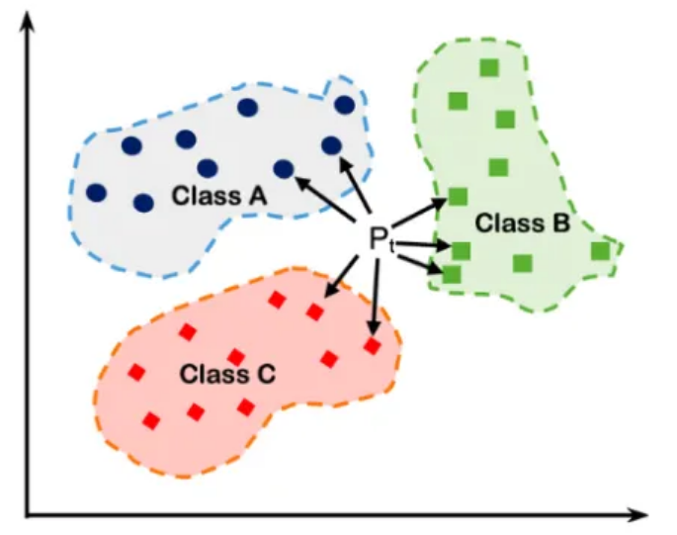
K-Nearest Neighbors
Algorithm
K-Nearest Neighbors:
Model Building – Do nothing, just plot the training set
This algorithm does nothing in the training phase. Just plot the points in n-dimensional space

Slide 42
K-Nearest Neighbors
Algorithm
K-Nearest Neighbors:
Model Building – Do nothing, just plot the training set
Choose k – The number of “closest elements” you want to compare against
Higher k means better prediction!
Lower k means faster prediction!
Here, k=7

Slide 43
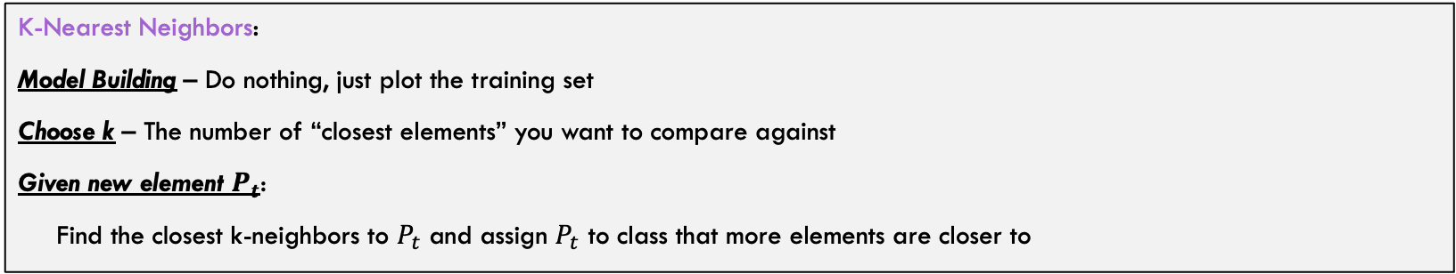

K-Nearest Neighbors
Algorithm
K-Nearest Neighbors:
Model Building – Do nothing, just plot the training set
Choose k – The number of “closest elements” you want to compare against
Given new element $P_{t}$:
Find the closest k-neighbors to $P_{t}$ and assign $P_{t}$ to class that more elements are closer to
In this case, we assign $P_{t}$ to class B because 3 elements from class B are close to $P_{t}$

Slide 44
k-Nearest Neighbors Details
If the data has certain properties, this approach works surprisingly well!
But certain properties can contribute to poor performance
If size of the classes represented in the test set are very different, ”majority wins” gives a skewed result
Can address this with some kind of weighting (of votes, or of distances)
Best choice of k may be difficult to choose
One option: try different values on your test set and choose which gives best results on that data
Too many features, and curse of dimensionality
Feature extraction is one technique to address this
Again, you can evaluate possible improvements using the test set
Note that k-NN does not depend on any statistical distribution of the data
Being “non-parametric” is an advantage for some problems
Many good write-ups on the web about k-NN including Wikipedia

Slide 45
Basics of Reinforcement Learning

Slide 46
Reinforcement Learning Definitions
Reinforcement learning is learning what to do — how to map situations to actions — so as to maximize a numerical reward signal.
- Sutton & Barto, 2018
Reinforcement learning (RL) is an area of machine learning concerned with how software agents ought to take actions in an environment in order to maximize the notion of cumulative reward.
- Wikipedia https://en.wikipedia.org/wiki/Reinforcement_learning

Slide 47
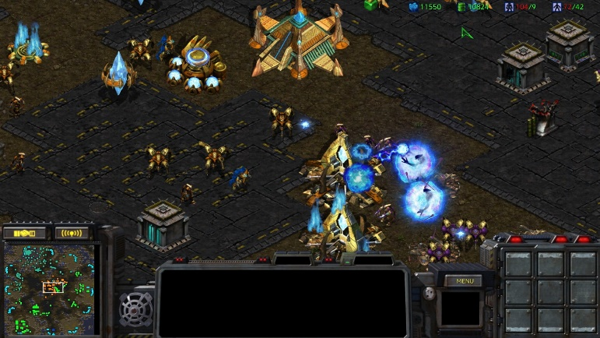
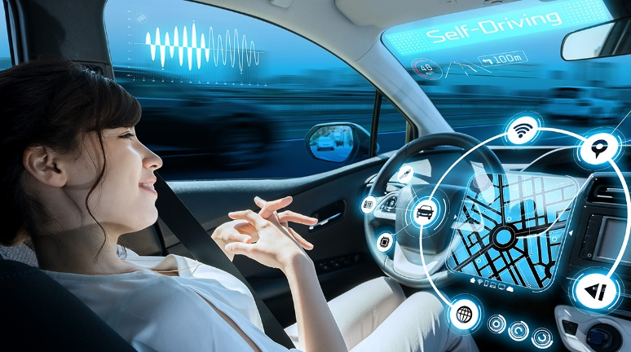

Reinforcement learning
RL can address a family of problems that involve sequential decision making
Game playing
Self-driving car
Conversational System

Slide 48
A view of agent and environment interaction
Image credit: Lil'Log

Slide 49
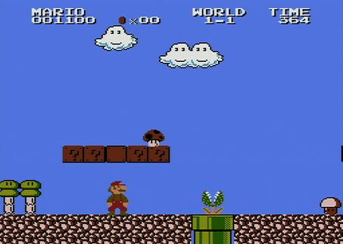
Reinforcement Learning
Learning by practicing and reinforcing actions that work will punishing actions that do not work
GOAL: An agent that plays mario automatically
States:
small mario, big mario, in air, on ground, etc.
Actions:
move left, move right, jump, etc.
Reward:
becoming big, becoming small, falling in pit, hitting question mark block, making progress to the right, etc. (each of these would have a numerical reward)

Slide 50
Reinforcement Learning
Learning by practicing and reinforcing actions that work will punishing actions that do not work
Want to explore more?
Tutorial: Training a Mario-playing RL Agent https://pytorch.org/tutorials/intermediate/mario_rl_tutorial.html

Slide 51
UVA CS Department and ML/AI

Slide 52
ML/AI and UVA CS Faculty
Faculty with Primary Area in ML/AI
Faculty with Secondary Area in ML/AI
Faculty Name | Primary Area | Secondary Area
Doryab, Afsaneh | ML/AI | HCI
Farnoud, Farzad | ML/AI | Theory/Alg
Fioretto, Nando | ML/AI | Theory/Alg
Fletcher, Tom | ML/AI | Graphics
Ji, Yangfeng | ML/AI
Li, Jundong | ML/AI
Meng, Yu | ML/AI
Qi, Jane | ML/AI
Vullikanti, Anil | ML/AI | Theory/Alg
Wei, Chen-Yu | ML/AI | Theory/Alg
Zhang, Aidong | ML/AI
Zhang, Miaomiao | ML/AI | Image/Vision
Zhang, Shangtong | ML/AI
Faculty Name | Primary Area | Secondary Area
Behl, Madhur | CPS | ML/AI
Feng, Lu | CPS | ML/AI
Iqbal, Tariq | CPS | ML/AI
Kuo, Yen-Ling | CPS | ML/AI
Cheng, Zezhou | Graphics | ML/AI
Basit, Nada | CS Education | ML/AI
Nguyen, Rich | CS Education | ML/AI
Note: CPS is Cyberphysical Systems

Slide 53
CS Courses in ML/AI (in last 2 years)
CS 4710 Artificial Intelligence
CS 4774 Machine Learning
CS 4501 Optimization
CS 4501 Machine Learning in Image Analysis
CS 4501 Introduction to Reinforcement Learning
CS 4501 Statistical Learning and Graphical Models
CS 6316 Machine Learning
CS 6666 Data Mining - Principles and Algorithms
CS 6501 Machine Learning in Image Analysis
CS 6501 Learning for Interactive Robots
CS 6501 Reinforcement Learning
CS 6501 Natural Language Processing
CS 6501 Risks and Benefits of Generative AI and LLMs
CS 6501 Learning in Robotics
CS 6501 Probabilistic Machine Learning
CS 6501 Computational Behavior Modeling

