Slide 1
Greedy Algorithms Bridge Crossing
CS 3100 – DSA2
Mark Floryan

Slide 2
Bridge Crossing

Slide 3
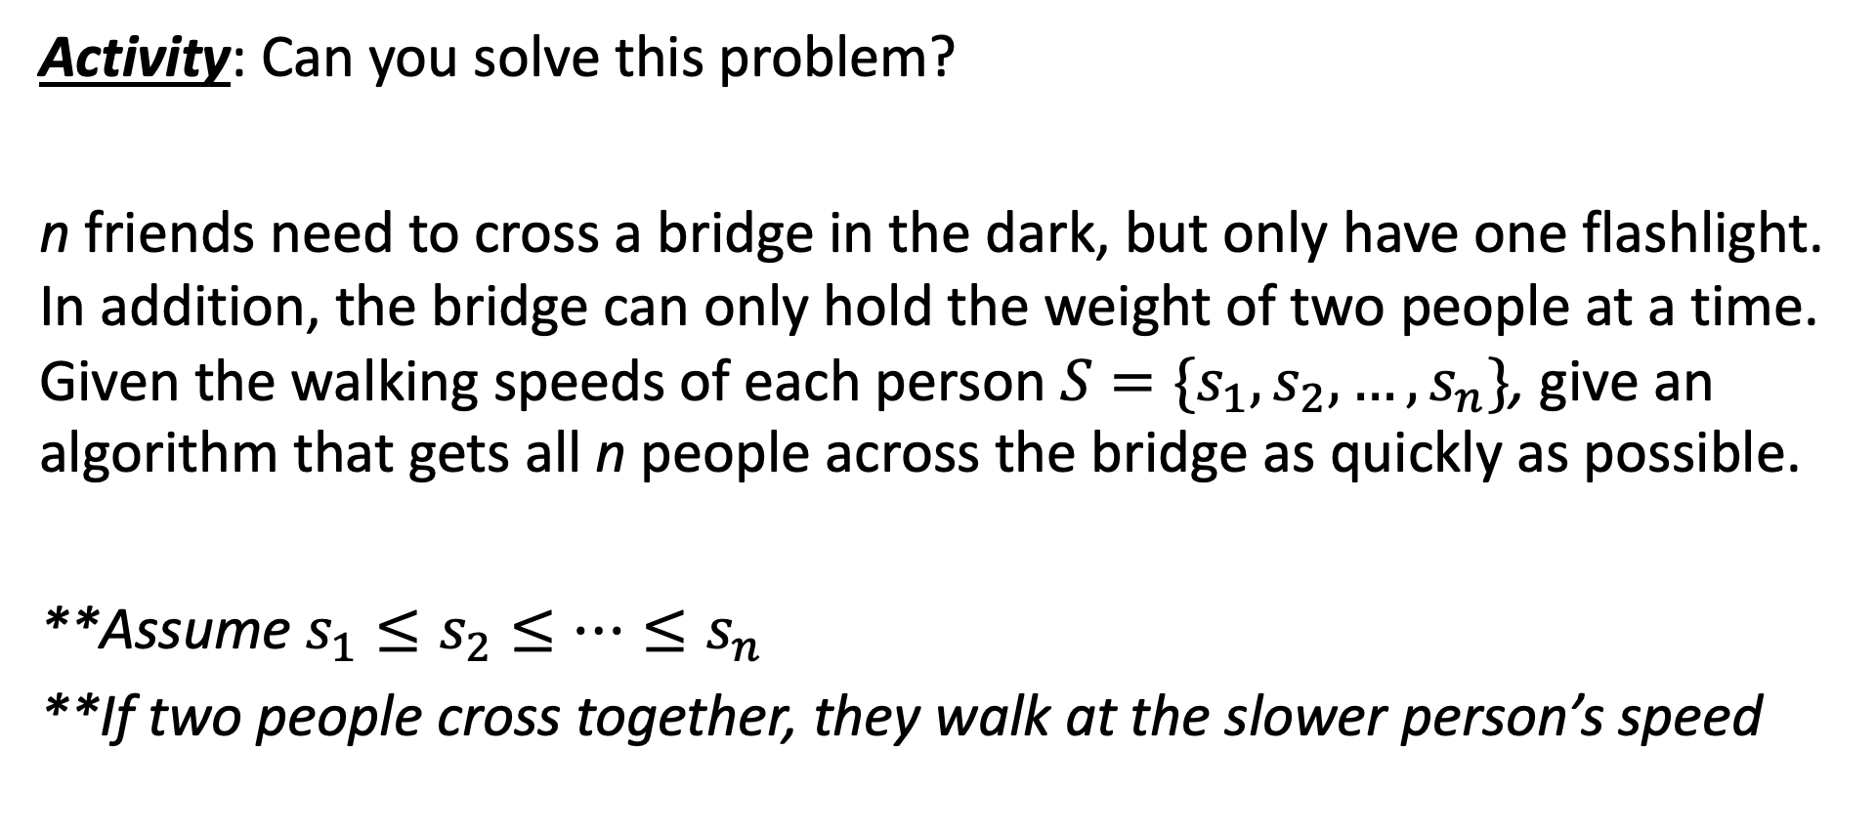
Can you solve it??
Activity: Can you solve this problem?
n friends need to cross a bridge in the dark, but only have one flashlight. In addition, the bridge can only hold the weight of two people at a time. Given the walking speeds of each person $S=\{s_{1},s_{2},…,s_{n}\}$, give an algorithm that gets all n people across the bridge as quickly as possible.
**Assume $s_{1}≤s_{2}≤…≤s_{n}$
**If two people cross together, they walk at the slower person’s speed

Slide 4
Optimal Substructure…
Does this problem have optimal substructure?
Consider an optimal solution S =:
Pi
Pj
Pi
Pj
Pk
Pk
Pi
Pk
Pk
...
If this is optimal overall,
then is this optimal for “rest” of the schedule?
Pj
Pk
Pk
Pi
Pk
Pk
...

Slide 5
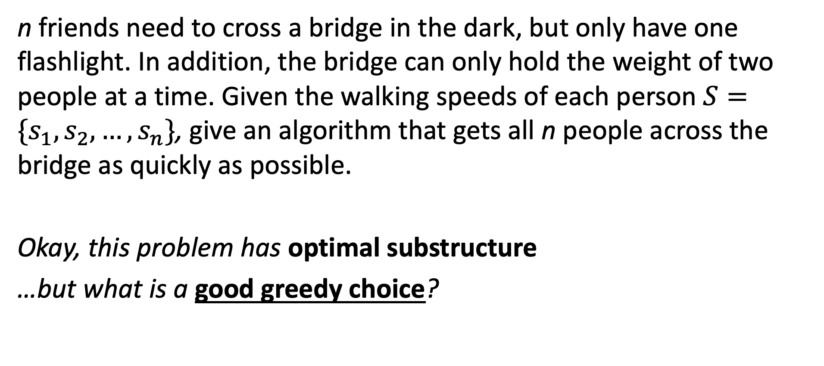
Greedy Choice!
n friends need to cross a bridge in the dark, but only have one flashlight. In addition, the bridge can only hold the weight of two people at a time. Given the walking speeds of each person $S=\{s_{1},s_{2},…,s_{n}\}$, give an algorithm that gets all n people across the bridge as quickly as possible.
Okay, this problem has optimal substructure
…but what is a good greedy choice?

Slide 6
Greedy Choice!
Hint 1:
There are a lot of ways to think about the greedy choice here, but consider this: are there any people who, once across, will never come back to the original side of the bridge (you can be ”done” with them)?
Hint 2:
You don’t need the greedy choice to be one move across the bridge. You can greedily choose the first few moves that accomplish some sub-goal…

Slide 7
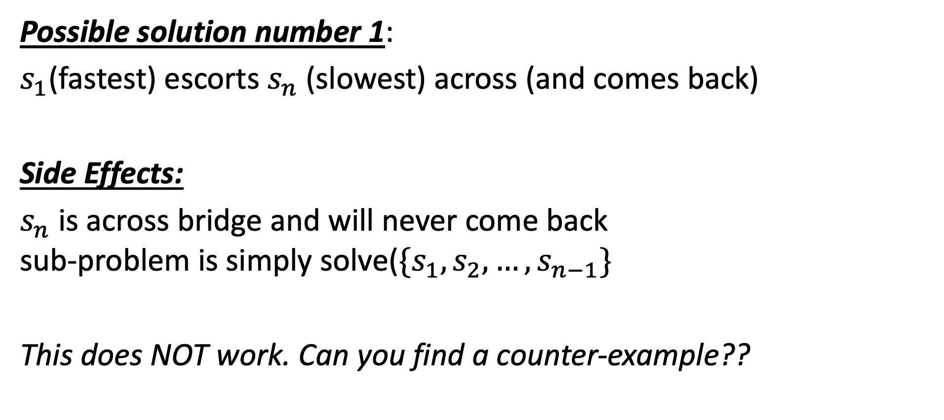
Can you solve it??
Possible solution number 1:
$s_{1}$(fastest) escorts $s_{n}$ (slowest) across (and comes back)
Side Effects:
$s_{n}$ is across bridge and will never come back sub-problem is simply solve($\{s_{1},s_{2},…,s_{n−1}\}$
This does NOT work. Can you find a counter-example??

Slide 8
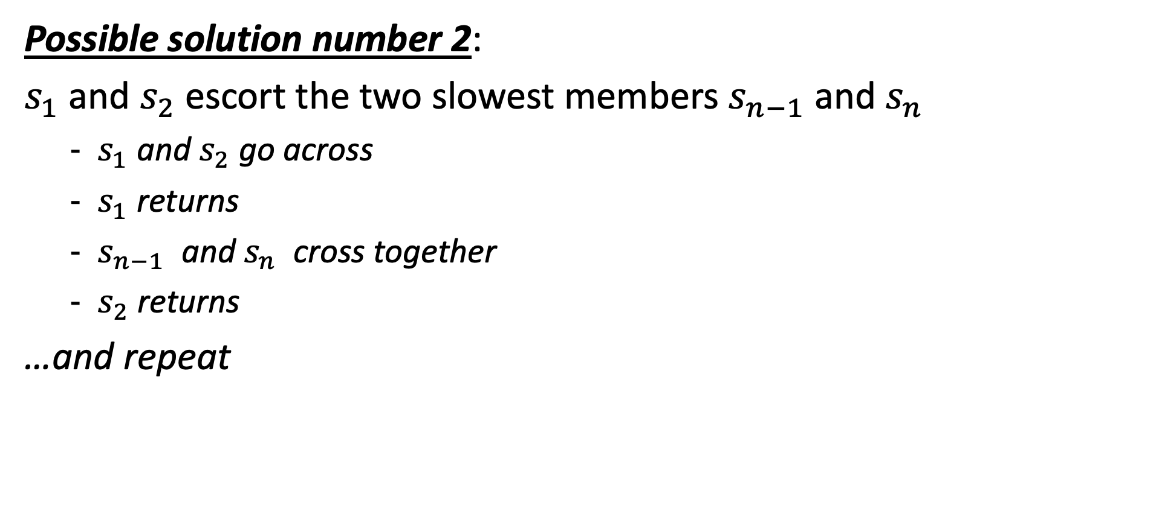
Can you solve it??
Possible solution number 2:
$s_{1}$ and $s_{2}$ escort the two slowest members $s_{n−1}$ and $s_{n}$
$s_{1}$ and $s_{2}$ go across
$s_{1}$ returns
$s_{n−1}$ and $s_{n}$ cross together
$s_{2}$ returns
…and repeat

Slide 9
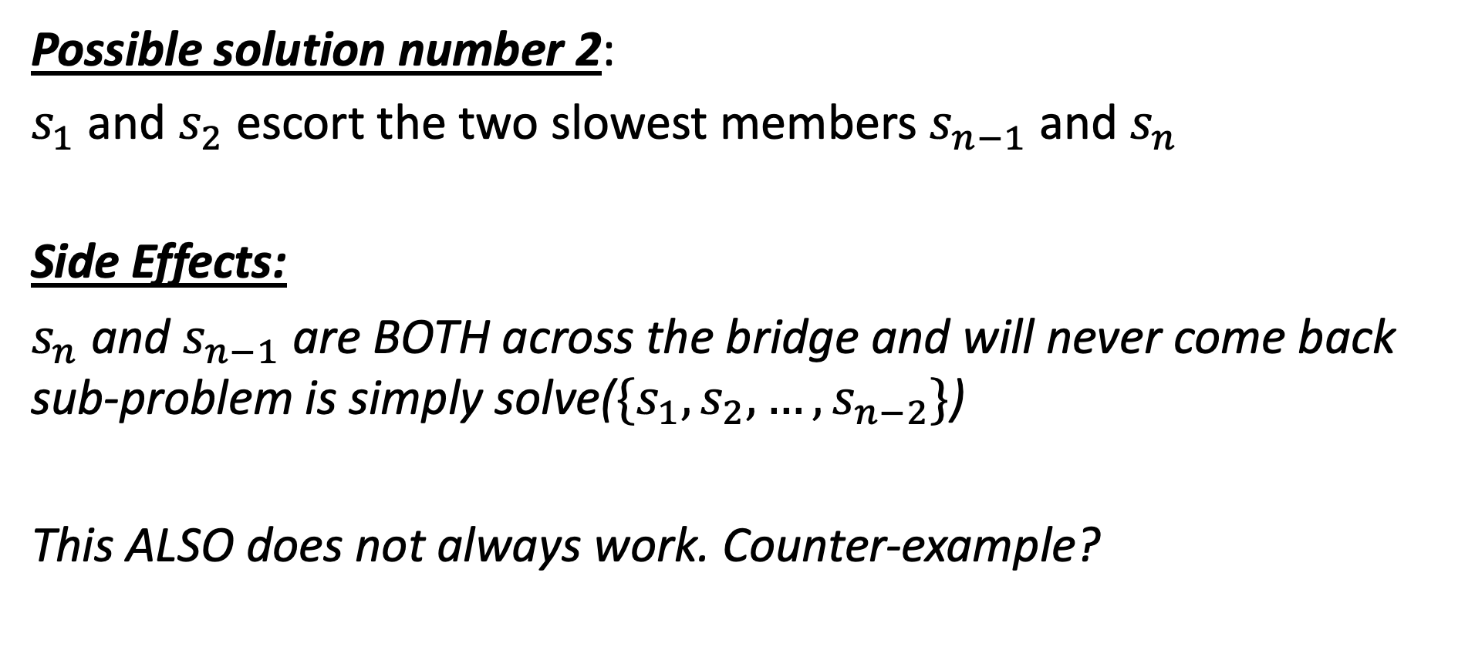
Can you solve it??
Possible solution number 2:
$s_{1}$ and $s_{2}$ escort the two slowest members $s_{n−1}$ and $s_{n}$
Side Effects:
$s_{n}$ and $s_{n−1}$ are BOTH across the bridge and will never come back sub-problem is simply solve(${\{s}_{1},s_{2},…,s_{n−2}\}$)
This ALSO does not always work. Counter-example?

Slide 10
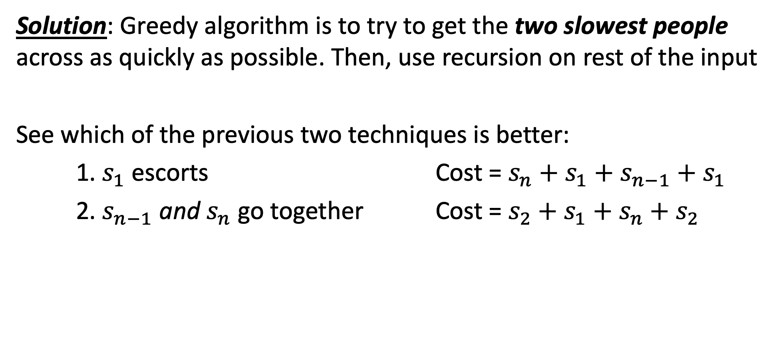
Solution
Solution: Greedy algorithm is to try to get the two slowest people across as quickly as possible. Then, use recursion on rest of the input
See which of the previous two techniques is better:
1. $s_{1}$ escorts Cost = $s_{n}+s_{1}+s_{n−1}+s_{1}$
2. $s_{n−1}$ and $s_{n}$ go together Cost = $s_{2}+s_{1}+s_{n}+s_{2}$

Slide 11
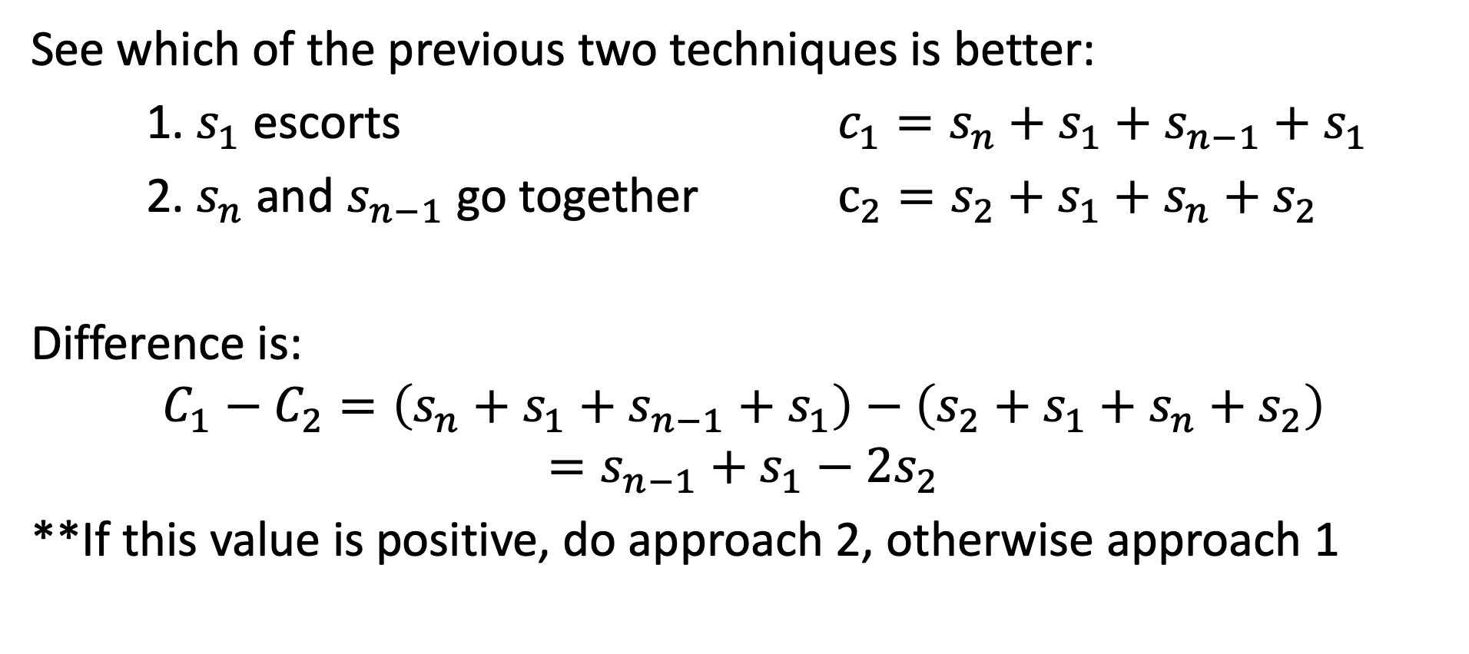
Solution
See which of the previous two techniques is better:
1. $s_{1}$ escorts ${c_{1}=s}_{n}+s_{1}+s_{n−1}+s_{1}$
2. $s_{n}$ and $s_{n−1}$ go together $c_{2}=s_{2}+s_{1}+s_{n}+s_{2}$
Difference is:
$$C_{1}−C_{2}=\left(s_{n}+s_{1}+s_{n−1}+s_{1}\right)−\left(s_{2}+s_{1}+s_{n}+s_{2}\right)$$
$$=s_{n−1}+s_{1}−2s_{2}$$
**If this value is positive, do approach 2, otherwise approach 1

