Slide 1
Greedy Algorithms: Activity Selection
Data Structures and Algorithms 2 Mark Floryan and Aaron Bloomfield

Slide 2
CLRS Readings
Chapter 16, Greedy Algorithms
Intro, page 414
Section 16.1, Activity Selection

Slide 3
Activity Selection

Slide 4
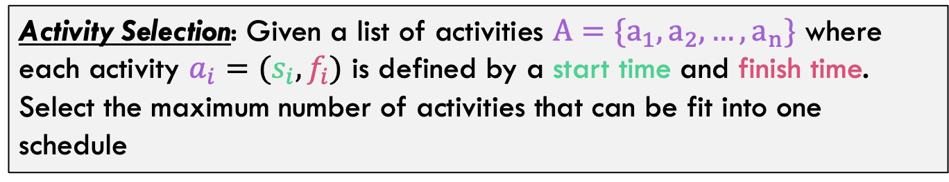
Activity-Selection Problem
Activity Selection: Given a list of activities $A=\{a_{1},a_{2},…,a_{n}\}$ where each activity $a_{i}=(s_{i},f_{i})$ is defined by a start time and finish time. Select the maximum number of activities that can be fit into one schedule
We just want the most activities possible, they are all equally “good”
This problem is sometimes called Interval Scheduling

Slide 5
The Activities!
Id | Start | Finish | Activity
1 | 9:00 | 10:45 | Fractals, Recursion and Crayolas
2 | 9:15 | 10:15 | Tropical Drink Engineering with Prof. Bloomfield
3 | 9:30 | 12:30 | Managing Keyboard Fatigue with Swedish Massage
4 | 9:45 | 10:30 | Applied ChemE: Suntan Oil or Lotion?
5 | 9:45 | 11:15 | Optimization, Greedy Algorithms, and the Buffet Line
6 | 10:15 | 11:00 | Hydrodynamics and Surfing
7 | 10:15 | 11:30 | Computational Genetics and Infectious Diseases
8 | 10:30 | 11:45 | Turing Award Speech Karaoke
9 | 11:00 | 12:00 | Pool Tanning for Engineers
10 | 11:00 | 12:15 | Mechanics, Dynamics and Shuffleboard Physics
11 | 12:00 | 12:45 | Discrete Math Applications in Gambling

Slide 6
Generalizing Start, End
Id | Start | Finish | Len | Activity
1 | 0 | 6 | 7 | Fractals, Recursion and Crayolas
2 | 1 | 4 | 4 | Tropical Drink Engineering with Prof. Bloomfield
3 | 2 | 13 | 12 | Managing Keyboard Fatigue with Swedish Massage
4 | 3 | 5 | 3 | Applied ChemE: Suntan Oil or Lotion?
5 | 3 | 8 | 6 | Optimization, Greedy Algorithms, and the Buffet Line
6 | 5 | 7 | 3 | Hydrodynamics and Surfing
7 | 5 | 9 | 5 | Computational Genetics and Infectious Diseases
8 | 6 | 10 | 5 | Turing Award Speech Karaoke
9 | 8 | 11 | 4 | Pool Tanning for Engineers
10 | 8 | 12 | 5 | Mechanics, Dynamics and Shuffleboard Physics
11 | 12 | 14 | 3 | Discrete Math Applications in Gambling

Slide 7
Optimal Substructure
Does this problem have optimal substructure? Yes, but we need to think about the exact nature of the subproblems
If this is optimal overall
5 activities!
Then is this optimal too?
**Note that subproblem ONLY contains intervals that start after finish time of first activity

Slide 8
Optimal Substructure Proof
If this is optimal…
But this is NOT
Then there is a better solution for this time frame
Which can be recombined with first activity to produce better than optimal solution. Contradiction!
Q.E.D. Problem has optimal substructure!

Slide 9



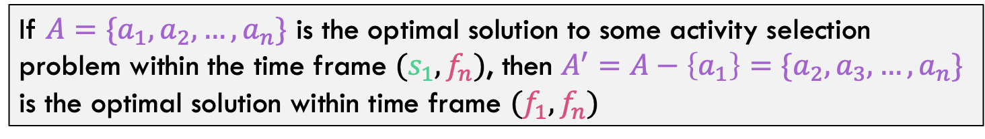




Optimal Substructure
If $A=\{a_{1},a_{2},…,a_{n}\}$ is the optimal solution to some activity selection problem within the time frame $(s_{1},f_{n})$, then $A^{′}=A−\left\{a_{1}\right\}=\{a_{2},a_{3},…,a_{n}\}$ is the optimal solution within time frame $(f_{1},f_{n})$
$$s_{1}$$
$$f_{n}$$
$$a_{1}$$
$$a_{2}$$
$$a_{3}$$
$$a_{n}$$
$$f_{1}$$
Notice that intervals that cross this gap are NOT considered by the subproblem.

Slide 10
Greedy Approach
ActivitySelect(Activities):
Select some first activity to schedule
Eliminate activities incompatible selected one
Repeat until no activity left
Hard Part: What is a good greedy
choice for selecting next item?

Slide 11
Some Possible Greedy Choices
Pick the activity that has the least conflicts (i.e. overlaps).
Pick the next compatible activity that starts earliest.
Pick the next compatible activity that finishes the earliest.
Pick the shortest activity activity first.
Pick the next compatible activity that finishes the latest.
Pick the activity that has the MOST conflicts (i.e. overlaps)?
Or something else…

Slide 12
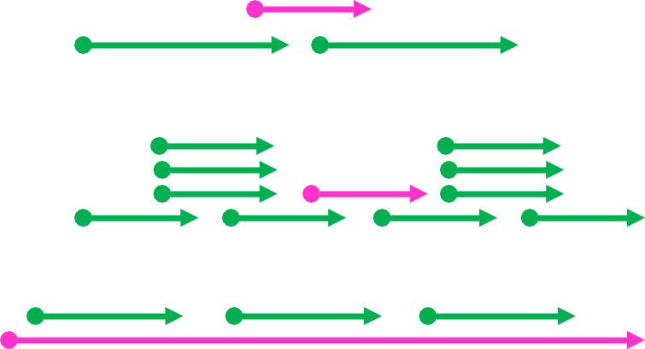

Some Possible Greedy Choices
Identify a greedy choice property
Shortest interval
Fewest conflicts
Earliest start
Earliest end

Slide 13
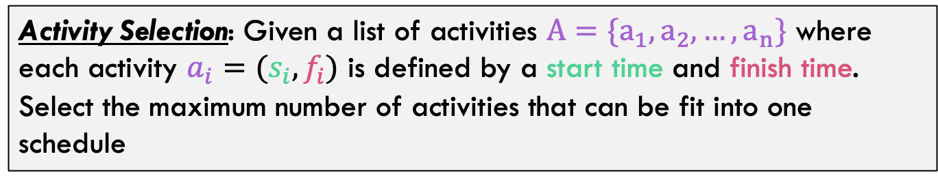
Example
Activity Selection: Given a list of activities $A=\{a_{1},a_{2},…,a_{n}\}$ where each activity $a_{i}=(s_{i},f_{i})$ is defined by a start time and finish time. Select the maximum number of activities that can be fit into one schedule
3
4
6
2
1
5
What is the optimal solution?

Slide 14
Activity Selection: A Greedy Algorithm
Pick the next compatible activity that finishes the earliest.
Turns out this one is correct. Intuition: This one maximizes the size of the subproblem!

Slide 15
Back to Semester at Sea…
Id | Start | Finish | Len | Activity
1 | 0 | 6 | 7 | Fractals, Recursion and Crayolas
2 | 1 | 4 | 4 | Tropical Drink Engineering with Prof. Bloomfield
3 | 2 | 13 | 12 | Managing Keyboard Fatigue with Swedish Massage
4 | 3 | 5 | 3 | Applied ChemE: Suntan Oil or Lotion?
5 | 3 | 8 | 6 | Optimization, Greedy Algorithms, and the Buffet Line
6 | 5 | 7 | 3 | Hydrodynamics and Surfing
7 | 5 | 9 | 5 | Computational Genetics and Infectious Diseases
8 | 6 | 10 | 5 | Turing Award Speech Karaoke
9 | 8 | 11 | 4 | Pool Tanning for Engineers
10 | 8 | 12 | 5 | Mechanics, Dynamics and Shuffleboard Physics
11 | 12 | 14 | 3 | Discrete Math Applications in Gambling
Solution: 2, 6, 9, 11

Slide 16
Visualizing these Activities
ID | Start | End |  | 0 | 1 | 2 | 3 | 4 | 5 | 6 | 7 | 8 | 9 | 10 | 11 | 12 | 13 | 14
1 | 0 | 6
2 | 1 | 4
3 | 2 | 13
4 | 3 | 5
5 | 3 | 8
6 | 5 | 7
7 | 5 | 9
8 | 6 | 10
9 | 8 | 11
10 | 8 | 12
11 | 12 | 14

Slide 17
Visualizing these Activities
ID | Start | End |  | 0 | 1 | 2 | 3 | 4 | 5 | 6 | 7 | 8 | 9 | 10 | 11 | 12 | 13 | 14
1 | 0 | 6
2 | 1 | 4
3 | 2 | 13
4 | 3 | 5
5 | 3 | 8
6 | 5 | 7
7 | 5 | 9
8 | 6 | 10
9 | 8 | 11
10 | 8 | 12
11 | 12 | 14

Slide 18
Visualizing these Activities
ID | Start | End |  | 0 | 1 | 2 | 3 | 4 | 5 | 6 | 7 | 8 | 9 | 10 | 11 | 12 | 13 | 14
1 | 0 | 6
2 | 1 | 4
3 | 2 | 13
4 | 3 | 5
5 | 3 | 8
6 | 5 | 7
7 | 5 | 9
8 | 6 | 10
9 | 8 | 11
10 | 8 | 12
11 | 12 | 14

Slide 19
Visualizing these Activities
ID | Start | End |  | 0 | 1 | 2 | 3 | 4 | 5 | 6 | 7 | 8 | 9 | 10 | 11 | 12 | 13 | 14
1 | 0 | 6
2 | 1 | 4
3 | 2 | 13
4 | 3 | 5
5 | 3 | 8
6 | 5 | 7
7 | 5 | 9
8 | 6 | 10
9 | 8 | 11
10 | 8 | 12
11 | 12 | 14

Slide 20
Visualizing these Activities
ID | Start | End |  | 0 | 1 | 2 | 3 | 4 | 5 | 6 | 7 | 8 | 9 | 10 | 11 | 12 | 13 | 14
1 | 0 | 6
2 | 1 | 4
3 | 2 | 13
4 | 3 | 5
5 | 3 | 8
6 | 5 | 7
7 | 5 | 9
8 | 6 | 10
9 | 8 | 11
10 | 8 | 12
11 | 12 | 14

Slide 21
Recursive Greedy Algorithm
RECURSIVE-ACTIVITY-SELECTOR(s, f, k, n)
1 m = k + 1 // start with the activity after last added
2 while m ≤ n and s[m] < f[k] // find first activity to finish
3 m = m + 1
4 if m ≤ n
5 return {a_{m}} U RECURSIVE-ACTIVITY-SELECTOR(s, f, m, n)
6 else return Ø
Initial call: RECURSIVE-ACTIVITY-SELECTOR(s, f, 0, n)
Run time is θ(n), assuming the activities are already sorted by finish times

Slide 22
Non-recursive algorithm
greedy-interval (s, f)
n = s.length
A = {a₁}
k = 1 # last added
for m = 2 to n
if s[m] ≥ f[k]
A = A U {a_{m}}
k = m
return A
s is an array of the intervals’ start times
f is an array of the intervals’ finish times, sorted
A is the array of the intervals to schedule
How long does this take?

Slide 23
Proving Correctness

Slide 24
Proving the Greedy Choice Property?
Claim: The activity with the earliest finish time is guaranteed to be a member of some optimal solution
Proof Overview:
Assume earliest finish time activity NOT in optimal schedule
Describe what optimal solution must look like instead
Show we can switch in the earliest finish time item without changing the optimality of the solution (take one thing out, put one thing in)

Slide 25

Does Greedy Always Find Optimal Solution?
Claim: The activity with the earliest finish time is guaranteed to be a member of some optimal solution
$$i_{1}$$

Slide 26
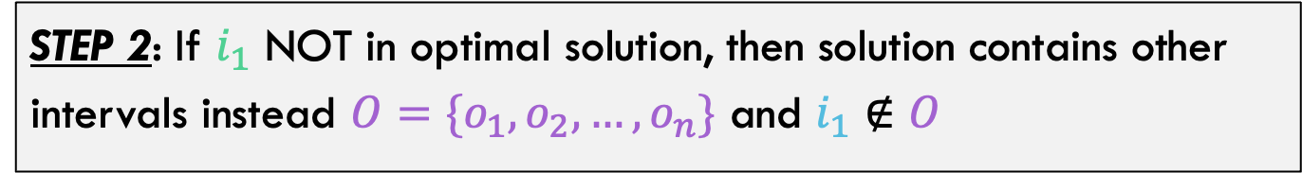




Does Greedy Always Find Optimal Solution?
STEP 1: Assume $i_{1}$ is NOT in the optimal solution.
STEP 2: If $i_{1}$ NOT in optimal solution, then solution contains other intervals instead $O=\{o_{1},o_{2},…,o_{n}\}$ and $i_{1}∉O$
$$o_{1}$$
$$i_{1}$$
$$o_{2}$$
*Note: This picture is just an EXAMPLE to help you visualize. Not good enough for a proof on its own

Slide 27


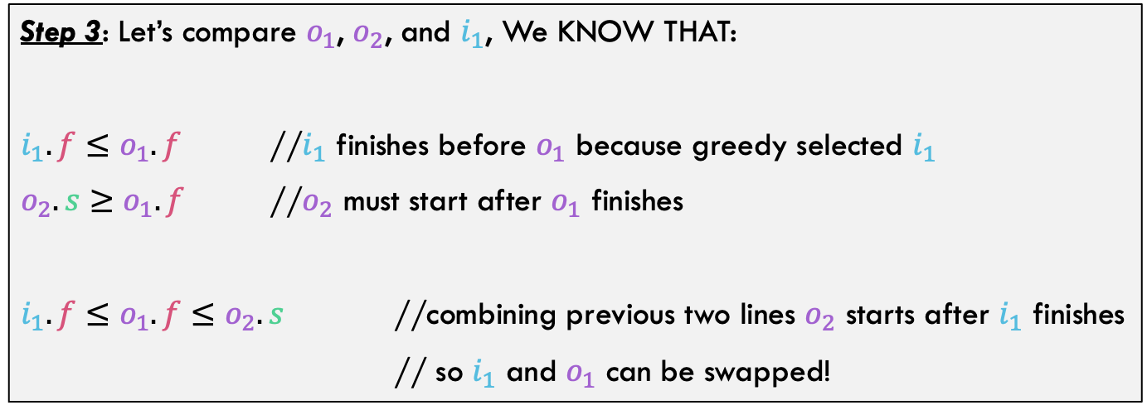

Does Greedy Always Find Optimal Solution?
$$o_{1}$$
$$i_{1}$$
$$o_{2}$$
Step 3: Let’s compare $o_{1}$, $o_{2}$, and $i_{1}$, We KNOW THAT:
$i_{1}.f≤o_{1}.f$ //$i_{1}$ finishes before $o_{1}$ because greedy selected $i_{1}$
$o_{2}.s≥o_{1}.f$ //$o_{2}$ must start after $o_{1}$ finishes
$i_{1}.f≤o_{1}.f≤o_{2}.s$ //combining previous two lines $o_{2}$ starts after $i_{1}$ finishes
// so $i_{1}$ and $o_{1}$ can be swapped!

Slide 28


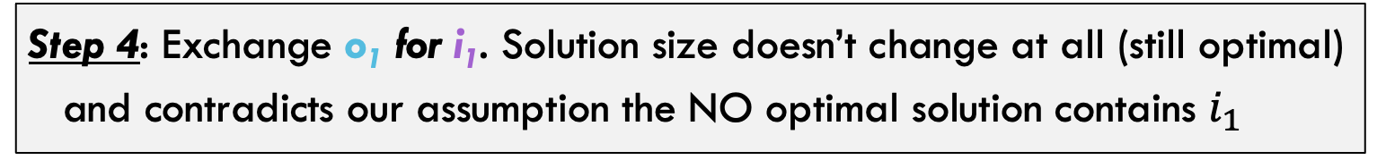

Does Greedy Always Find Optimal Solution?
From previous step:
$i_{1}.f≤o_{1}.f≤o_{2}.s$ // so $i_{1}$ and $o_{1}$ can be swapped!
Step 4: Exchange o₁ for i₁. Solution size doesn’t change at all (still optimal) and contradicts our assumption the NO optimal solution contains $i_{1}$
$$o_{1}$$
$$i_{1}$$
$$o_{2}$$
Q.E.D. Greedy Choice Property Proven

Slide 29
What did we learn
Activity Selection
Has many possible Greedy Choices that could be made. Not obvious which was correct.
Optimal Substructure:
Was a function of changing the time frame within which the subproblem was solved
Greedy Choice Property:
Another example of proving the greedy choice property!

