Slide 1
Graphs – Basic Structure and BFS
Data Structures and Algorithms II Mark Floryan
CLRS Chapter 22.1 and 22.2

Slide 2
Graphs Introduction

Slide 3
Module 1 Topics
In this deck:
What is a Graph? How do we representation Graphs in code?
How do we traverse a graph? First, we will see breadth-first search
Future decks:
Traversing a graph using depth-first search
Topological sorting on graphs
Finding strongly connected components

Slide 4
Graphs - Introduction

Slide 5
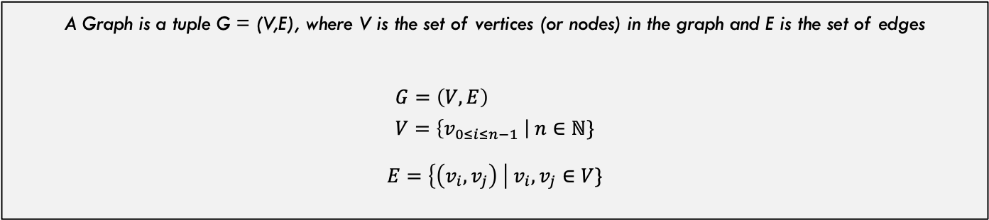
What is a Graph?
This graph models the relation: X is a proper factor of Y
6
Graphs are made up of nodes and edges connecting those nodes
10
2
4
8
3
9
5
1
7
Note that the edges have arrowheads. This means the direction matters. This is called a Directed Graph
A Graph is a tuple G = (V,E), where V is the set of vertices (or nodes) in the graph and E is the set of edges
$$G=\left(V,E\right) \\ V=\left\{v_{0≤i≤n−1} \right| n∈ℕ\}$$ $E=\left\{\left(v_{i},v_{j}\right) \right| v_{i},v_{j}∈V\}$

Slide 6
Another Example: Airline Routes
LGA
Note the lack of arrow heads, this is called an undirected graph because the edges don’t have a particular direction.
IAD
NRT
CHO
LAX
CLT
In this case the relationship is inferred to exist in both directions. The order of the tuple (CHO, LGA) versus (LGA, CHO) does not matter

Slide 7
Real-World Graph Examples
Internet Traffic: Nodes are routers / servers; edges are wired connections
GPS Navigation: Nodes are intersections; edges are roads
Social Networks: Nodes are users, edges are friendship connections
Puzzle Solving (e.g., Rubik’s Cube): Nodes are configurations; connect similar configurations
Neural Networks: Nodes are perceptrons, edges are synapses between them
Markov Decision Processes: Nodes are states an agent can be in, edges are transitions between states

Slide 8
There are a lot of Graphs Terms
B
Degree of a vertex: Number of edges connected to that vertex
A
In this graph, node A has degree 2 and node B has degree 1
C
Indegree vs. Outdegree: Number of edges coming in versus out of a node
A
Node A has in-degree of 2 and out-degree of 1
Loop: An edge from a node back onto itself
Some graphs / problems allow loops, some don’t. Always good to ask / check! In general, these are NOT allowed unless explicitly noted
A

Slide 9


What is the SIZE of A graph
Graph size is based on the number of nodes and number of edges. These are denoted by $|V|$ and $\left|E\right|$ respectively
6
10
2
4
8
3
9
What is the maximum number of edges in a graph? Depends on:
Undirected (loops): ${(\left|V\right|∗\left(\left|V\right|−1\right))}^{2}$
Undirected (no loops): $\frac{{(\left|V\right|∗\left(\left|V\right|−1\right))}^{2}}{2}$
Directed (loops): ${\left|V\right|}^{2}$
Directed (no loops): $\frac{{\left|V\right|}^{2}}{2}$
5
1
7

Slide 10
More Graph Terms!
B
Path: Sequence of nodes that are adjacent to one another
A
D
A simple path is one that does not repeat any nodes
C
Connected Graph: All nodes reachable from others
A
A
A
A
C
C
C
C
B
B
B
B
Connected!
Not Connected
Strongly Connected!
Weakly Connected!

Slide 11
Cycle
B
Cycle: A path that starts and ends at the same node
A
D
A – B – C is a CYCLE in this graph!
C
e
Acyclic: Graph does NOT contain any cycles
B
A
D
All linked-lists and trees do not have any cycles!
C
e

Slide 12
Definitions: Weighted Graph
LGA
A weighted graph is one in which each edge is associate with a weight (integer or real value).
$800
$400
NRT
IAD
$1600
$60
CHO
$900
LAX
$50
One question we might ask of a weighted graph:
What is the cheapest way to get from CHO to NRT?
CLT
$250

Slide 13
Graphs - Representation

Slide 14

Graph Representation 1: Adjacency Matrix
Adjacency Matrix
Represent the graph by creating a matrix of size $|V|$ by $|V|$. Each entry at position $(i,j)$ stores the presence (1) or absence (0) of the edge between nodes $i$ and $j$
$$\left(\begin{matrix}0 & 1 & 1 & 0 & 0 & 0 & 0 \\ 1 & 0 & 1 & 1 & 0 & 0 & 0 \\ 1 & 1 & 0 & 1 & 0 & 1 & 0 \\ 0 & 1 & 1 & 0 & 0 & 1 & 0 \\ 0 & 0 & 0 & 0 & 0 & 1 & 0 \\ 0 & 0 & 1 & 1 & 1 & 0 & 1 \\ 0 & 0 & 0 & 0 & 0 & 1 & 0\end{matrix}\right)$$
0
1
2
3
4
5
6

Slide 15
Graph Representation 1: Adjacency List
Adjacency List
Represent the graph by an array of size $|V|$. Each entry $i$ contains a linked-list of node number i’s neighbors
0
1
2
0
1
1
2
0
3
2
3
5
0
1
2
3
3
1
2
5
4
5
4
5
6
5
4
6
2
3
6
5

Slide 16
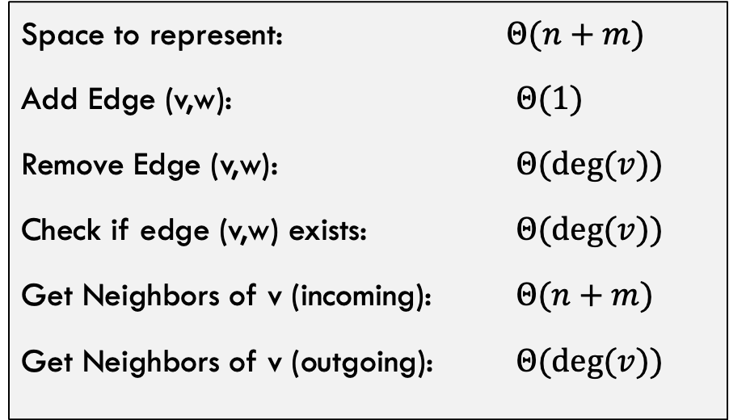
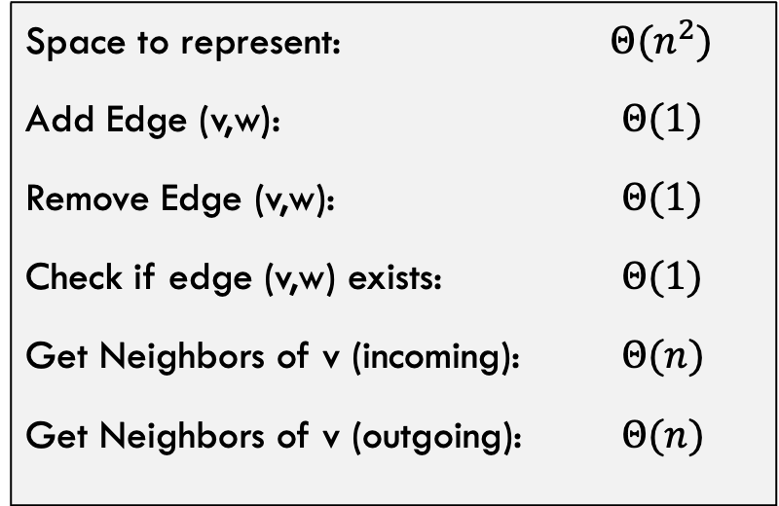
Runtime Comparison
Adjacency List
Adjacency Matrix
Space to represent: $Θ(n+m)$
Add Edge (v,w): $Θ(1)$
Remove Edge (v,w): $Θ(deg⁡(v))$
Check if edge (v,w) exists: $Θ(deg⁡(v))$
Get Neighbors of v (incoming): $Θ(n+m)$
Get Neighbors of v (outgoing): $Θ(deg⁡(v))$
Space to represent: $Θ(n^{2})$
Add Edge (v,w): $Θ(1)$
Remove Edge (v,w): $Θ(1)$
Check if edge (v,w) exists: $Θ(1)$
Get Neighbors of v (incoming): $Θ(n)$
Get Neighbors of v (outgoing): $Θ(n)$

Slide 17
Pros and Cons
Adjacency Matrix
Adjacency List
Constant time to lookup existence of edge
Easy to find the outgoing (row) or incoming (column) edges if needed
Easy to implement
Potentially a lot of 0’s to traverse / store
Uses less space (especially for sparse graphs)
Don’t need to traverse over possibly many 0’s like in a matrix
Inserting a new node always constant time
Also easy to implement
Existence of edge is linear time

Slide 18
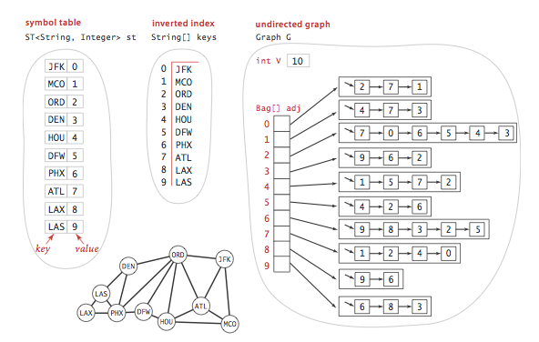
Quick Implementation Detail
Often, we have keys that are strings (like airport codes) but our graph representations are arrays that are indexed by integers.
We often use a separate lookup table to map string keys to integer indices in the graph.

Slide 19
Discussion: How to store weighted Graphs?

Slide 20
Breadth-First Search

Slide 21
Breadth-First Search: What’s the Point?
Two purposes:
Traverse the graph: Visit every node and do something. Order is not obvious.
Learn something about the distance (number of nodes away) each node is from the starting node
Recall traversing a binary search tree. We used pre, in, and post-order traversals. Graph traversals are similar but require a bit more thought

Slide 22
BFS: Input and Output
Shortest distance from s to each node in G (distance = number of edges)
Breadth-First Search
A graph G
Breadth-Frist Tree of G with root s. The paths in this BFS tree represent the shortest paths from s to each node in G
A single starting vertex s

Slide 23
Breadth-First Search: Overall Strategy
Throughout the traversal, each node in the graph will be in one of three states:
Graph traversals need to store these nodes in some manner. For BFS:
Each node has a member variable denoting its current color:
White: This node has not been seen yet
s.color = black;
Gray: This node has been seen but NOT processed
In addition, we store all the grayNodes in a queue so we can process them in order
Queue grayNodes;
Black: This node has been processed (we are done with it)

Slide 24
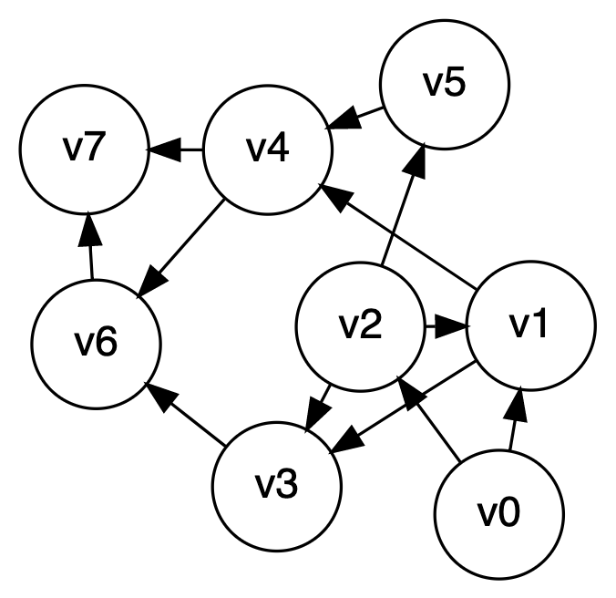
Breadth-first search, quick example
Let’s start at V0

Slide 25
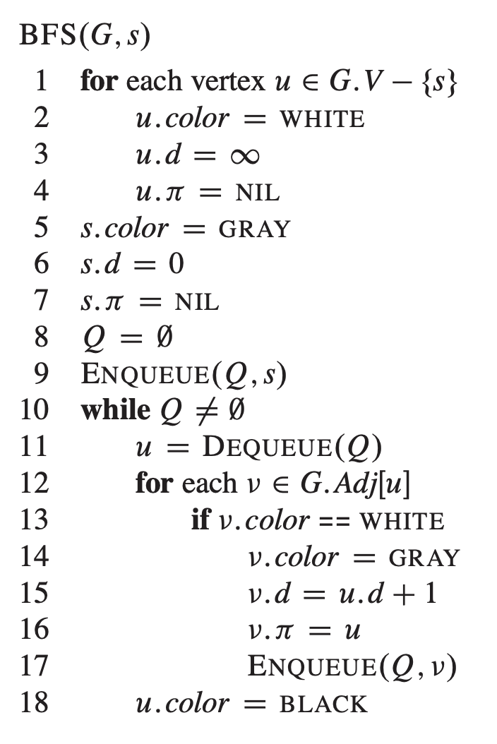
Breadth-first search implementation

Slide 26
Breadth-first search implementation
Color field keeps track of node color. Gray nodes all stored on the queue for ease of access as we traverse
d is the distance of this node from the start node
Pi is the parent node. This is the node through which you come to get to this node the quickest

Slide 27

Breadth-first search implementation
What is the runtime of BFS:
$$Θ(V+E)$$
Do you see why? This while loop runs once for each node and the inner for-loop runs once per edge total (not each time)

Slide 28
Correctness of BFS
First, some observations!

Slide 29
Breadth-first search: Some Properties
Does BFS always compute ẟ(s,v) correctly, where ẟ(s,v) is the shortest path (number of edges) from s to any vertex v?
Lemma 1:
Let $G=(V,E)$ be a directed or undirected graph, and let $s ε$ V be an arbitrary vertex. Then, for any edge $\left(u,v\right)ε E$ , it is the case that $\text{ẟ(}\text{s}\text{,}\text{v}\text{)}$ $≤$ ẟ(s,u) + 1

Slide 30
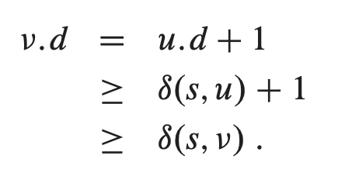
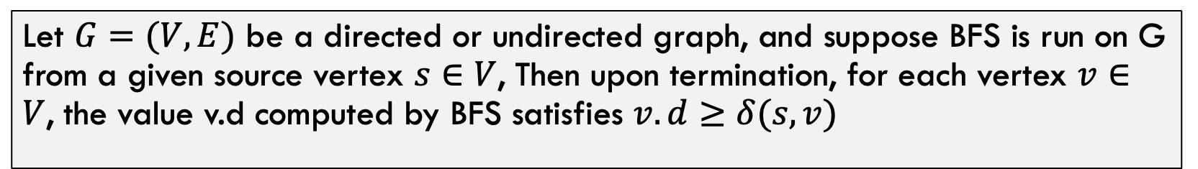
Breadth-first search: Some Properties
Lemma 2:
Let $G=(V,E)$ be a directed or undirected graph, and suppose BFS is run on G from a given source vertex $s∈V$, Then upon termination, for each vertex $v∈V$, the value v.d computed by BFS satisfies $v.d≥δ(s,v)$
**Note that this is a weak bound! Just says distance will not be better than best path.
Proof:
//By how code updates v.d
//By inductive hypothesis
//By Lemma 1 on previous slide

Slide 31
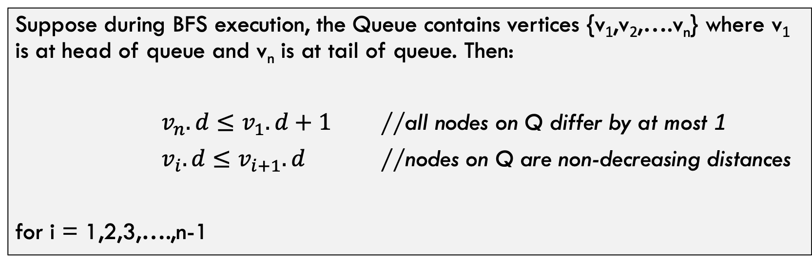
Breadth-first search: Some Properties
Lemma 3:
Suppose during BFS execution, the Queue contains vertices {v₁,v₂,….v_{n}} where v₁ is at head of queue and v_{n} is at tail of queue. Then:
$v_{n}.d≤v_{1}.d+1$ //all nodes on Q differ by at most 1
$v_{i}.d≤v_{i+1}.d$ //nodes on Q are non-decreasing distances
for i = 1,2,3,….,n-1
Intuitively, why is this lemma true?

Slide 32
Correctness of BFS

Slide 33
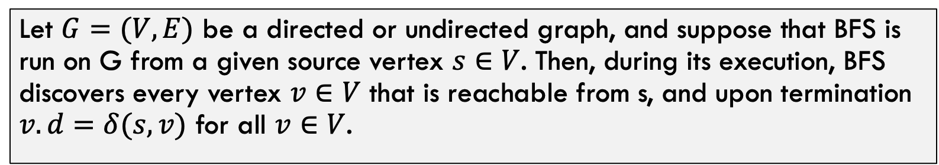
Proof of Correctness
Claim:
Let $G=(V,E)$ be a directed or undirected graph, and suppose that BFS is run on G from a given source vertex $s∈V$. Then, during its execution, BFS discovers every vertex $v∈V$ that is reachable from s, and upon termination $v.d=δ(s,v)$ for all $v∈V$.

Slide 34
REMINDER: The Code!
Vertices here have some properties:
color = white/gray/black
d = distance from start node
pi = node through which d is achieved

Slide 35
Proof of Correctness
Proof by Contradiction:
Assume that BFS does NOT work.
Then…there MUST exist at least one node v such that $v.d≠δ(s,v)$
There might be more, but let v be such a node with the smallest $δ(s,v)$ value
Meaning the ”closest one to s” that BFS incorrectly calculates.
This is a good choice because we can assume all nodes with smaller d value were computed correctly! Nice!

Slide 36
Proof of Correctness
So, this incorrectly calculated node v has the following property:
$$v.d>δ\left(s,v\right)=δ\left(s,u\right)+1=u.d+1$$
By definition of
optimal path
By how we chose
v
Because of Lemma 2!

Slide 37
Proof of Correctness
$$v.d>δ\left(s,v\right)=δ\left(s,u\right)+1=u.d+1$$
So…at some point during execution. The node u is popped off the queue and the edge e=(u,v) is followed and node v is processed. Three cases:
Case 1: v is white
Case 2: v is gray
Case 3: v is black

Slide 38

Proof of Correctness
$$v.d>δ\left(s,v\right)=δ\left(s,u\right)+1=u.d+1$$
Case 1: v is white
If v is white, algorithm sets $v.d=u.d+1$ (line 15).
Contradiction! above formula shows $v.d>u.d+1$

Slide 39

Proof of Correctness
$$v.d>δ\left(s,v\right)=δ\left(s,u\right)+1=u.d+1$$
Case 2: v is gray
if v is gray, then v is currently on the queue.
v was turned gray by dequeuing some other node w, setting $v.d=w.d+1$
Order on queue: w, then u, then v, Lemma 3 gives $w.d≤u.d≤v.d$
So: $v.d=w.d+1≤u.d+1$
^^Contradiction!

Slide 40

Proof of Correctness
$$v.d>δ\left(s,v\right)=δ\left(s,u\right)+1=u.d+1$$
Case 3: v is black
if v is black, then v was previously on queue ahead of u
queue distance values monotonically increasing, so $v.d≤u.d$ (Lemma 3)
Thus $v.d≤u.d<u.d+1$
^^Contradiction!!

Slide 41

Proof of Correctness
Finishing out the proof!
If BFS is wrong then either:
$$v.d<δ\left(s,v\right)$$
No! By Lemma 2
$$v.d>δ(s,v)$$
No! By proof by contradiction / 3 cases
Thus, $v.d=δ(s,v)$

Slide 42
Bipartite Graphs

Slide 43
Definition: Bipartite
A (undirected) graph is Bipartite provided every vertex can be assigned to one of two teams such that every edge “crosses” teams
Alternative: Every vertex can be given one of two colors such that no edges connect same-color nodes
Not Bipartite! No color can be assigned to node 4!
2
5
2
5
Bipartite!
8
8
1
1
4
4
9
9
3
3
7
7
6
6

Slide 44
Odd Length Cycles
A graph is bipartite if and only if it has no odd length cycles
2
5
2
5
8
8
1
1
4
4
9
9
3
3
7
7
6
6

Slide 45
BFS: Bipartite Graph?
BFS(g, s):
toVisit.enqueue(s)
depth[s] = 0
depth = [-1,-1,-1,…] #V times
While toVisit not empty:
cur = toVisit.dequeue()
layer = depth[cur]
for v in neighbors(cur):
if v does not have a depth:
depth[v] = layer + 1
toVisit.enqueue(v)
Here is BFS, how do we adapt to detect if graph is bipartite?
2
5
8
1
4
9
3
7
6

Slide 46
BFS: Bipartite Graph?
BFS(g, s):
toVisit.enqueue(s)
depth[s] = 0
depth = [-1,-1,-1,…] #V times
While toVisit not empty:
cur = toVisit.dequeue()
layer = depth[cur]
for v in neighbors(cur):
if v does not have a depth:
depth[v] = layer + 1
toVisit.enqueue(v)
elif depth[v] == depth[cur]:
return False
return True
Here is BFS, how do we adapt to detect if graph is bipartite?
2
5
8
1
4
9
3
7
6

Slide 47
BFS Tree for a Bipartite Graph
A
B
E
B
C
H
A
D
E
D
F
I
C
H
G
G
Tree edges Non-tree edges
F
I
Notes:
Solution for previous slide

Slide 48
BFS Tree for a Non-Bipartite Graph
A
B
E
B
C
H
A
D
E
D
F
I
C
H
G
Tree edges Non-tree edges
G
F
I
Notes:
Solution for previous slide

Slide 49
What did we learn in this section
Graphs:
How to represent them, pros and cons of each approach
BFS:
Traversing a graph. Pretty simple algorithm once you get the hang of it
Bipartite Graphs:
Structure property of graphs. BFS can help us find this property. Will be important later!

