Slide 1
Recurrence Relations
CS 3100: Data Structures and Algorithms II
Mark Floryan

Slide 2
Recurrence Relations

Slide 3


Recurrence Relations
This is an example of a recurrence relation:
$$T\left(n\right)=2T\left(\frac{n}{2}\right)+n$$
In general, how do we solve these formulas?
Especially when our algorithm has one with a non-traditional form: e.g., $T\left(n\right)=3T\left(\frac{3n}{4}\right)+\log_{5}{(n^{2})}$

Slide 4
Methods for Solving Recurrence Relations
Several methods for solving these:
Directly Solve: Roll the recurrence out and solve for a closed-form
Substitution Method: Guess the runtime and check the solution (by induction)
Recurrence Trees: Draw it out and count it manually!
Master Theorem: A proven theorem that provides a solution automatically!

Slide 5
Directly Solving (or Iteration Method)

Slide 6
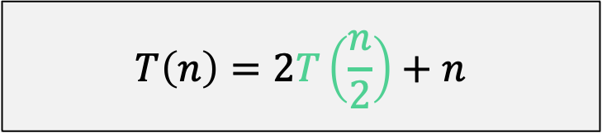
Directly Solve (unrolling the recurrence)
For Mergesort:
$$T\left(n\right)=2T\left(\frac{n}{2}\right)+n$$

Slide 7
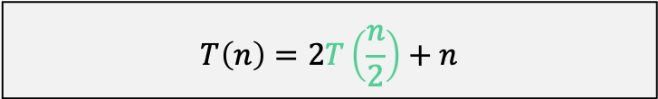
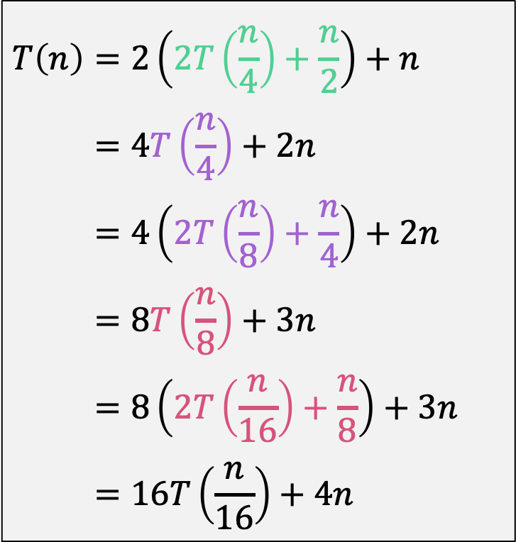
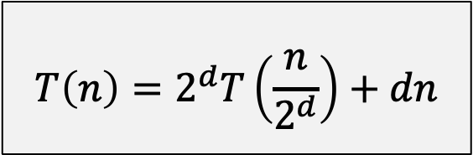
Directly Solve (unrolling the recurrence)
$$T\left(n\right)=2T\left(\frac{n}{2}\right)+n$$
$$T\left(n\right)=2\left(2T\left(\frac{n}{4}\right)+\frac{n}{2}\right)+n \\ =4T\left(\frac{n}{4}\right)+2n \\ =4\left(2T\left(\frac{n}{8}\right)+\frac{n}{4}\right)+2n \\ =8T\left(\frac{n}{8}\right)+3n \\ =8\left(2T\left(\frac{n}{16}\right)+\frac{n}{8}\right)+3n \\ =16T\left(\frac{n}{16}\right)+4n$$
What is the general pattern here? How does this formula change as you continue to unroll?
$$T\left(n\right)=2^{d}T\left(\frac{n}{2^{d}}\right)+dn$$

Slide 8
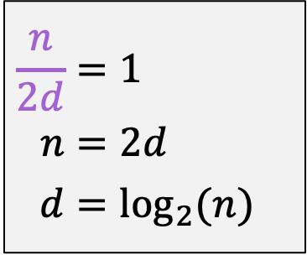
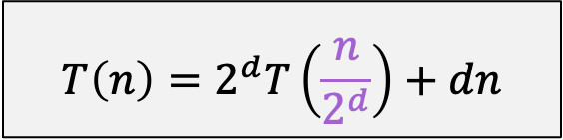
Directly Solve (unrolling the recurrence)
$$T\left(n\right)=2^{d}T\left(\frac{n}{2^{d}}\right)+dn$$
$$\frac{n}{2d}=1 \\ n=2d \\ d=\log_{2}{(n)}$$
Next Step: When does this parameter hit 1? This is when the T() term finally goes away
Assume n is power of 2. Remember that T(1)=1.

Slide 9
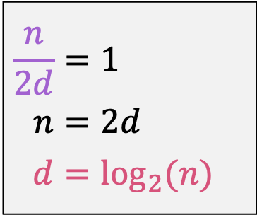
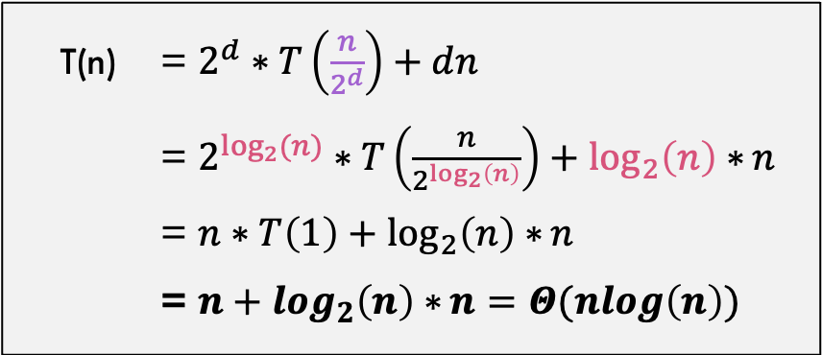

Directly Solve (unrolling the recurrence)
$$\frac{n}{2d}=1 \\ n=2d \\ d=\log_{2}{(n)}$$
T(n) = $2^{d}∗T\left(\frac{n}{2^{d}}\right)+dn$
= $2^{\log_{2}{(n)}}∗T\left(\frac{n}{2^{\log_{2}\left(n\right)}}\right)+\log_{2}\left(n\right)∗n$
= $n∗T\left(1\right)+\log_{2}\left(n\right)∗n$
= $n+\log_{2}\left(n\right)∗n=Θ(nlog\left(n\right))$
…from previous slide
We are done! Solution is $Θ(nlog\left(n\right))$

Slide 10
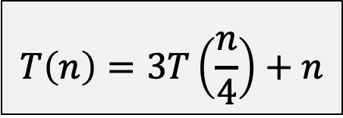
Another Example!!
Consider:
$$T\left(n\right)=3T\left(\frac{n}{4}\right)+n$$

Slide 11
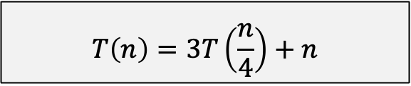
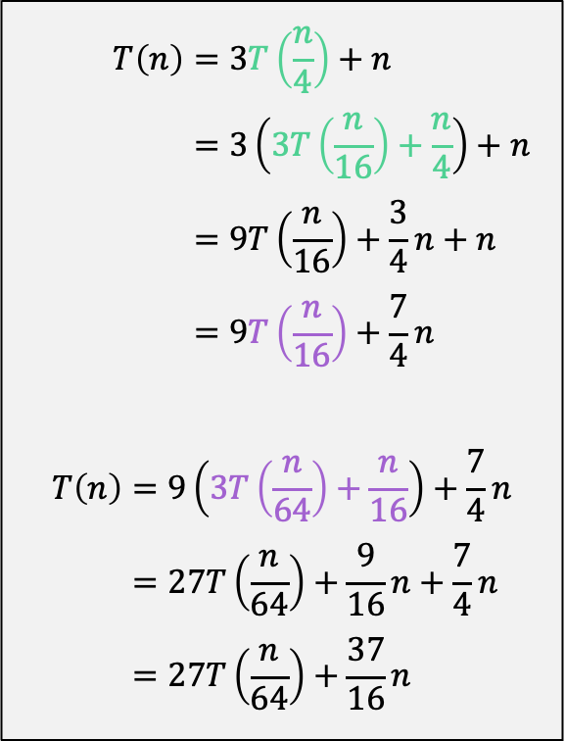
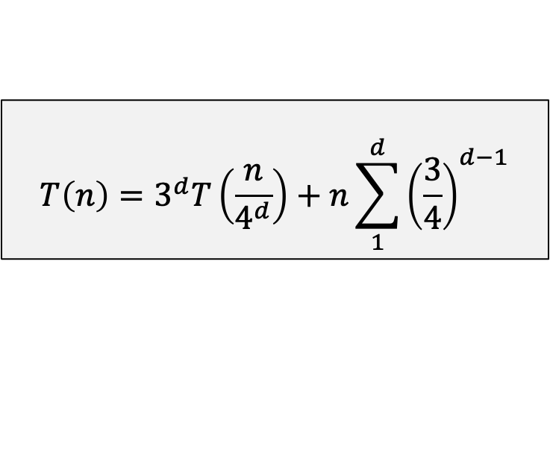
Unroll the recurrence
$$T\left(n\right)=3T\left(\frac{n}{4}\right)+n$$
$$T\left(n\right)=3T\left(\frac{n}{4}\right)+n \\ =3\left(3T\left(\frac{n}{16}\right)+\frac{n}{4}\right)+n \\ =9T\left(\frac{n}{16}\right)+\frac{3}{4}n+n \\ =9T\left(\frac{n}{16}\right)+\frac{7}{4}n$$
$$T\left(n\right)=9\left(3T\left(\frac{n}{64}\right)+\frac{n}{16}\right)+\frac{7}{4}n \\ =27T\left(\frac{n}{64}\right)+\frac{9}{16}n+\frac{7}{4}n \\ =27T\left(\frac{n}{64}\right)+\frac{37}{16}n$$
General pattern is:
$$T\left(n\right)=3^{d}T\left(\frac{n}{4^{d}}\right)+n\sum_{1}^{d}{{\left(\frac{3}{4}\right)}^{d−1}}$$

Slide 12
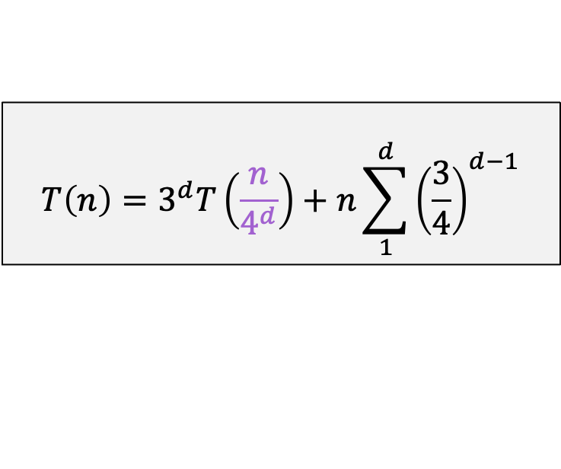

Directly Solve (unrolling the recurrence)
$$T\left(n\right)=3^{d}T\left(\frac{n}{4^{d}}\right)+n\sum_{1}^{d}{{\left(\frac{3}{4}\right)}^{d−1}}$$
$$\frac{n}{4d}=1 \\ n=4d \\ d=\log_{4}{(n)}$$
Next Step: When does this parameter hit 1? This is when the T() term finally goes away

Slide 13
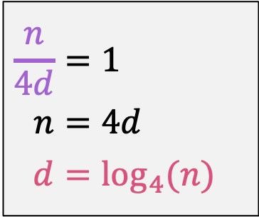
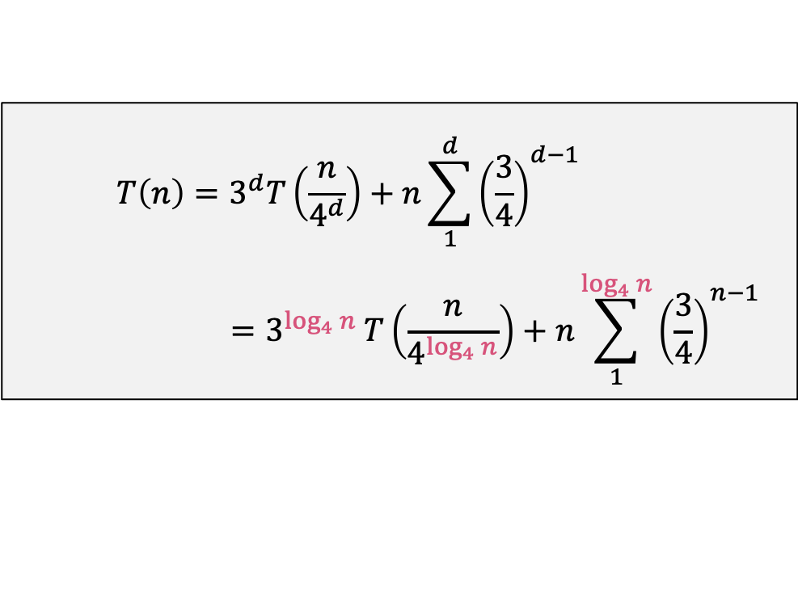
Directly Solve (unrolling the recurrence)
$$\frac{n}{4d}=1 \\ n=4d \\ d=\log_{4}{(n)}$$
$$T\left(n\right)=3^{d}T\left(\frac{n}{4^{d}}\right)+n\sum_{1}^{d}{{\left(\frac{3}{4}\right)}^{d−1}} \\ =3^{\log_{4}{n}} T\left(\frac{n}{4^{\log_{4}{n}}}\right)+n\sum_{1}^{\log_{4}{n}}{{\left(\frac{3}{4}\right)}^{n−1}}$$
…from previous slide

Slide 14




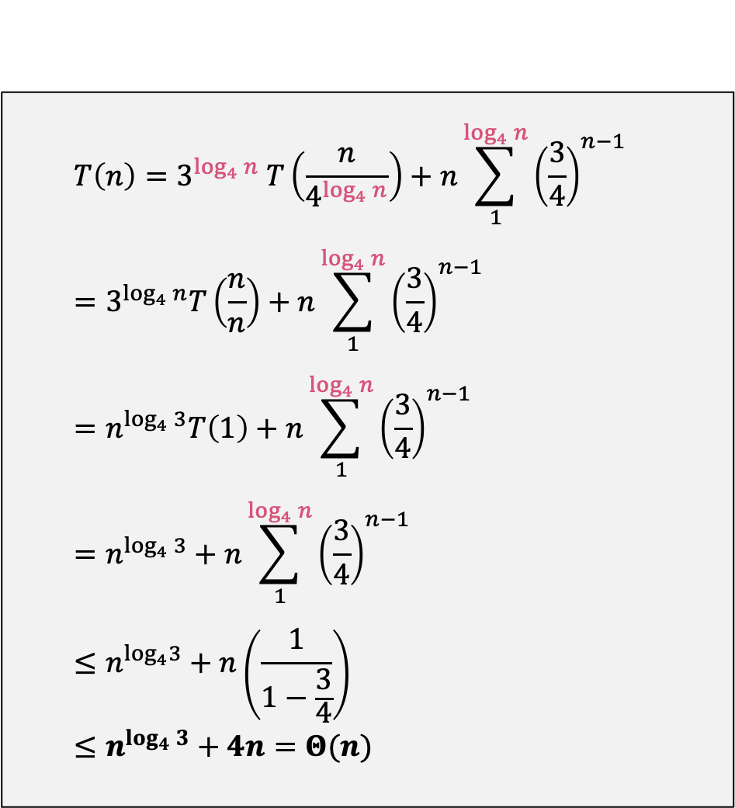
Directly Solve (unrolling the recurrence)
$$T\left(n\right)=3^{\log_{4}{n}} T\left(\frac{n}{4^{\log_{4}{n}}}\right)+n\sum_{1}^{\log_{4}{n}}{{\left(\frac{3}{4}\right)}^{n−1}} \\ =3^{\log_{4}{n}}T\left(\frac{n}{n}\right)+n\sum_{1}^{\log_{4}{n}}{{\left(\frac{3}{4}\right)}^{n−1}} \\ =n^{\log_{4}{3}}T\left(1\right)+n\sum_{1}^{\log_{4}{n}}{{\left(\frac{3}{4}\right)}^{n−1}} \\ =n^{\log_{4}{3}}+n\sum_{1}^{\log_{4}{n}}{{\left(\frac{3}{4}\right)}^{n−1}} \\ ≤n^{\log_{4}3}+n\left(\frac{1}{1−\frac{3}{4}}\right) \\ ≤n^{\log_{4}{3}}+4n=Θ(n)$$
By simplification of $4^{\log_{4}{n}}=n$
By log rule $a^{\log_{b}{c}}=c^{\log_{b}{a}}$
Because $T\left(1\right)=1$
Geometric series: $\sum_{1}^{∞}{{\left(\frac{a}{b}\right)}^{n}}=\frac{1}{1−\frac{a}{b}}$

Slide 15
Substitution Method

Slide 16
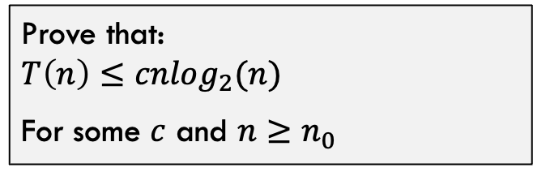
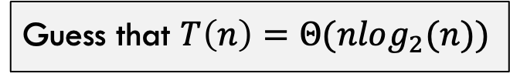

Iteration or Substitution Method
Strategy:
Example:
Look at recurrence carefully
$$T\left(n\right)=2T\left(\frac{n}{2}\right)+n$$
Guess the solution
Guess that $T\left(n\right)=Θ(nlog_{2}(n))$
Check solution w/ induction
Prove that: $$T\left(n\right)≤cnlog_{2}(n)$$
For some $c$ and $n≥n_{0}$

Slide 17
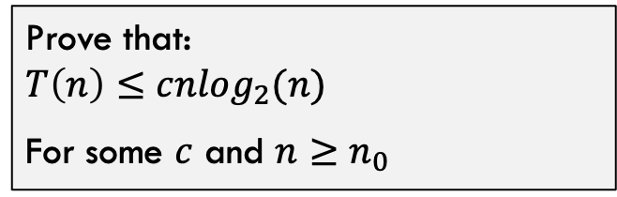
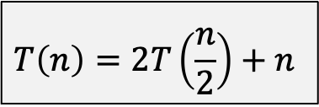
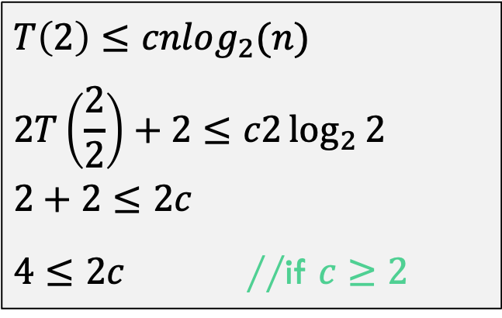
Iteration or Substitution Method
$$T\left(n\right)=2T\left(\frac{n}{2}\right)+n$$
Prove that: $$T\left(n\right)≤cnlog_{2}(n)$$
For some $c$ and $n≥n_{0}$
Base Case (n=2):
$$T\left(2\right)≤cnlog_{2}(n) \\ 2T\left(\frac{2}{2}\right)+2≤c2\log_{2}{2} \\ 2+2≤2c$$ $4≤2c$ //if $c≥2$

Slide 18
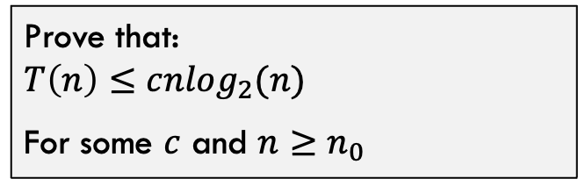
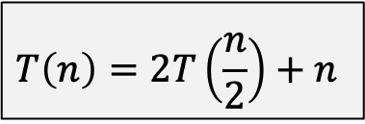
Iteration or Substitution Method
$$T\left(n\right)=2T\left(\frac{n}{2}\right)+n$$
Prove that: $$T\left(n\right)≤cnlog_{2}(n)$$
For some $c$ and $n≥n_{0}$
Inductive Hypothesis:
Assume for all $i<k$ that $T\left(i\right)≤c∗i∗\log_{2}{(i)}$

Slide 19
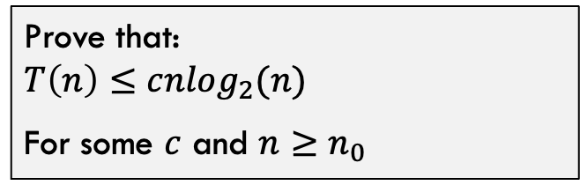

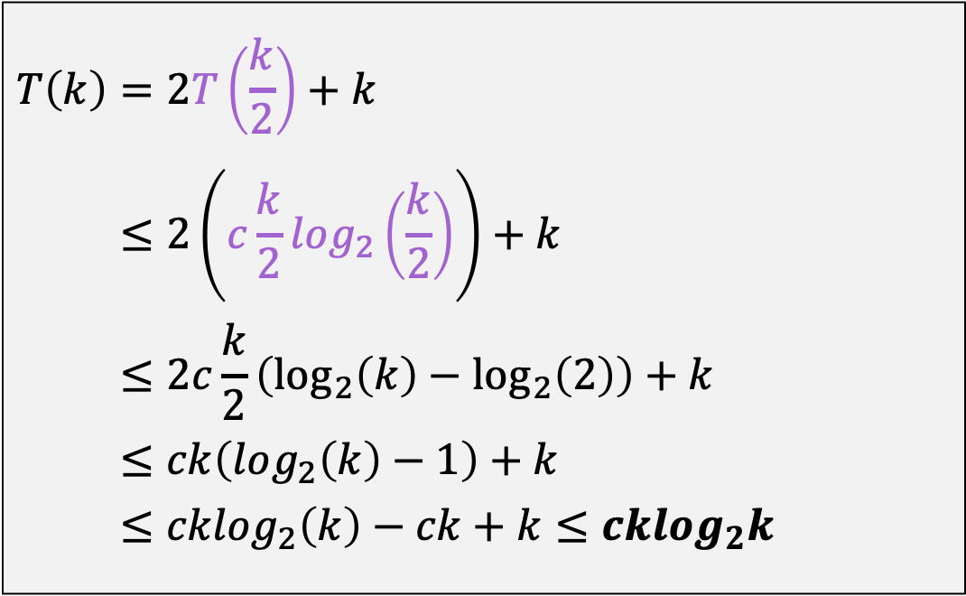
Iteration or Substitution Method
$$T\left(n\right)=2T\left(\frac{n}{2}\right)+n$$
Prove that: $$T\left(n\right)≤cnlog_{2}(n)$$
For some $c$ and $n≥n_{0}$
Inductive Step:
$$T\left(k\right)=2T\left(\frac{k}{2}\right)+k \\ ≤2\left(c\frac{k}{2}log_{2}\left(\frac{k}{2}\right)\right)+k \\ ≤2c\frac{k}{2}\left(\log_{2}\left(k\right)−\log_{2}\left(2\right)\right)+k \\ ≤ck\left(log_{2}\left(k\right)−1\right)+k \\ ≤cklog_{2}\left(k\right)−ck+k≤cklog_{2}k$$

Slide 20
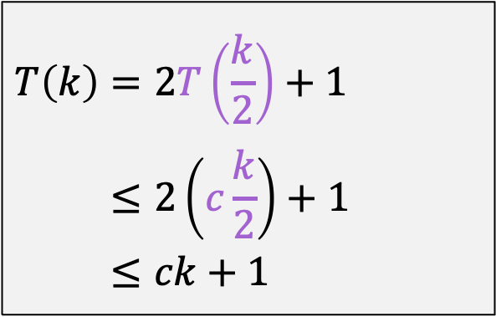
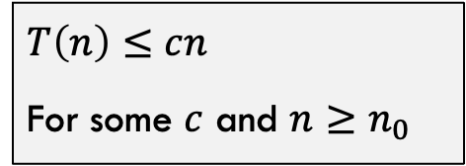
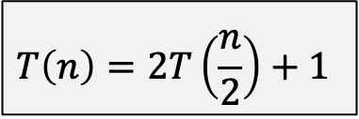
Substitution Method: Subtleties
Consider
Inductive Step:
$$T\left(n\right)=2T\left(\frac{n}{2}\right)+1$$
$$T\left(k\right)=2T\left(\frac{k}{2}\right)+1 \\ ≤2\left(c\frac{k}{2}\right)+1 \\ ≤ck+1$$
Prove That:
$$T\left(n\right)≤cn$$
For some $c$ and $n≥n_{0}$
This is NOT correct. Need to prove exact form of inductive hypothesis! How do we fix this?

Slide 21

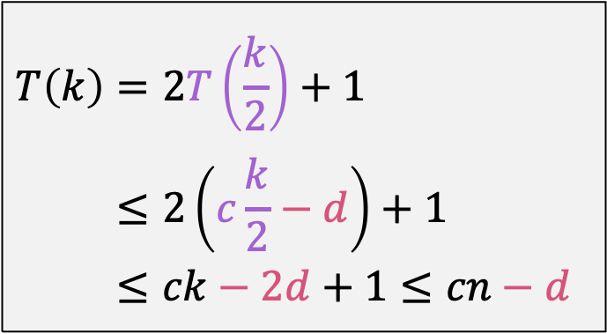
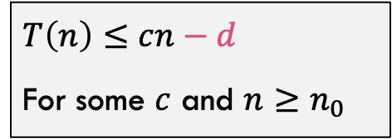
Substitution Method: Subtleties
Consider
Inductive Step:
$$T\left(n\right)=2T\left(\frac{n}{2}\right)+1$$
$$T\left(k\right)=2T\left(\frac{k}{2}\right)+1 \\ ≤2\left(c\frac{k}{2}−d\right)+1 \\ ≤ck−2d+1≤cn−d$$
Prove That:
$$T\left(n\right)≤cn−d$$
For some $c$ and $n≥n_{0}$
With this constant decrease, we can now prove the exact form of the inductive hypothesis!
We were only “over” by 1, so weaken the claim to be some constant less than $c∗n$

Slide 22
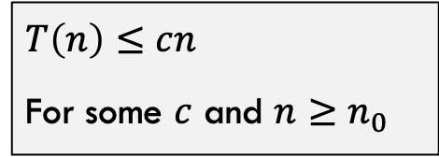
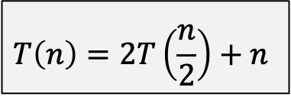
Substitution Method: Another Pitfall
Consider
Prove That:
$$T\left(n\right)=2T\left(\frac{n}{2}\right)+n$$
$$T\left(n\right)≤cn$$
For some $c$ and $n≥n_{0}$
Note that this guess is INCORRECT! We want to see what happens when the proof fails!

Slide 23

Substitution Method: Another Pitfall
Consider
Inductive Step:
$$T\left(n\right)=2T\left(\frac{n}{2}\right)+n$$
$$T\left(k\right)=2T\left(\frac{k}{2}\right)+k \\ ≤2\left(c\frac{k}{2}\right)+k \\ ≤ck+k$$
Prove That:
$$T\left(n\right)≤cn$$
For some $c$ and $n≥n_{0}$
Did not prove the exact form, so proof failed. Why does the trick of removing a constant to weaken the claim not work this time?

Slide 24
Recursion Tree Method

Slide 25



















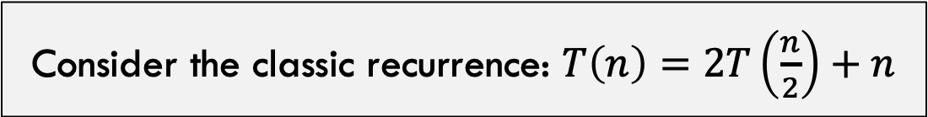



Recursion Tree Method
Consider the classic recurrence: $T\left(n\right)=2T\left(\frac{n}{2}\right)+n$
$$T(n)$$
$$n$$
Count up the recursive work. Parameter value is in green box, amount of work done is in blue box
$$T(\frac{n}{2})$$
$$\frac{n}{2}$$
$$T(\frac{n}{2})$$
$$\frac{n}{2}$$
$$T(\frac{n}{4})$$
$$\frac{n}{4}$$
$$T(\frac{n}{4})$$
$$\frac{n}{4}$$
$$T(\frac{n}{4})$$
$$\frac{n}{4}$$
$$T(\frac{n}{4})$$
$$\frac{n}{4}$$
……………
……………
$$T(1)$$
$$1$$
$$T(1)$$
$$1$$
$$T(1)$$
$$1$$
……………
$$T(1)$$
$$1$$

Slide 26



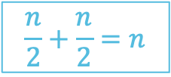





















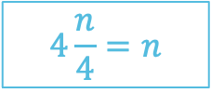
Recursion Tree Method
Count up the recursive work. Parameter value is in green box, amount of work done is in blue box
$$T(n)$$
$$n$$
$$n$$
$$T(\frac{n}{2})$$
$$\frac{n}{2}$$
$$T(\frac{n}{2})$$
$$\frac{n}{2}$$
$$\frac{n}{2}+\frac{n}{2}=n$$
$$T(\frac{n}{4})$$
$$\frac{n}{4}$$
$$T(\frac{n}{4})$$
$$\frac{n}{4}$$
$$T(\frac{n}{4})$$
$$\frac{n}{4}$$
$$T(\frac{n}{4})$$
$$\frac{n}{4}$$
$$4\frac{n}{4}=n$$
……………
……………
$$T(1)$$
$$1$$
$$T(1)$$
$$1$$
$$T(1)$$
$$1$$
……………
$$T(1)$$
$$1$$
$$n(1)=n$$

Slide 27



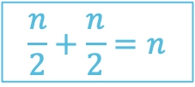






















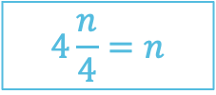
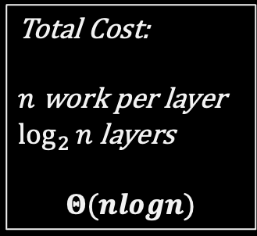
Recursion Tree Method
Count up the recursive work. Parameter value is in green box, amount of work done is in blue box
$$T(n)$$
$$n$$
$$n$$
How many layers:
$$\log_{2}{n}$$
$$T(\frac{n}{2})$$
$$\frac{n}{2}$$
$$T(\frac{n}{2})$$
$$\frac{n}{2}$$
$$\frac{n}{2}+\frac{n}{2}=n$$
Total Cost:
$n$ work per layer
$\log_{2}{n}$ layers
$$Θ(nlogn)$$
$$T(\frac{n}{4})$$
$$\frac{n}{4}$$
$$T(\frac{n}{4})$$
$$\frac{n}{4}$$
$$T(\frac{n}{4})$$
$$\frac{n}{4}$$
$$T(\frac{n}{4})$$
$$\frac{n}{4}$$
$$4\frac{n}{4}=n$$
……………
……………
$$T(1)$$
$$1$$
$$T(1)$$
$$1$$
$$T(1)$$
$$1$$
……………
$$T(1)$$
$$1$$
$$n(1)=n$$

Slide 28
The Master Theorem

Slide 29
The Master Theorem
Given: a divide and conquer algorithm
Then, the Master Theorem gives us a cookbook for the algorithm’s running time
Some textbooks has a simpler version they call the “Main Recurrence Theorem”

Slide 30

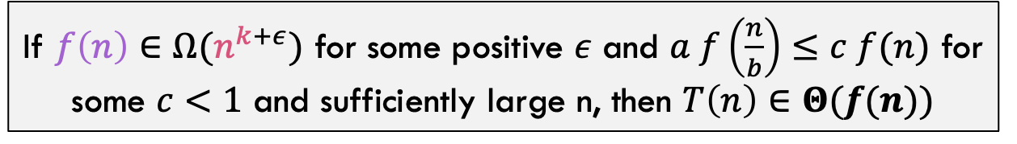
The Master Theorem (from Cormen)
The Master Theorem:
Consider $T\left(n\right)=a T\left(\frac{n}{b}\right)+f(n)$ Let $k=\frac{\lg{a}}{\lg{b}}=\log_{b}{a}$
Case 1:
If $f\left(n\right)∈O(n^{k−ε})$ for some positive $ε$, then $T\left(n\right)∈Θ(n^{k})$
Case 2:
If $f\left(n\right)∈Θ(n^{k})$ then $T\left(n\right)∈Θ\left(f\left(n\right)\log{n}\right)=Θ(n^{k}\log{n})$
Case 3:
If $f\left(n\right)∈Ω(n^{k+ε})$ for some positive $ε$ and $a f\left(\frac{n}{b}\right)≤c f(n)$ for some $c<1$ and sufficiently large n, then $T\left(n\right)∈Θ(f(n))$

Slide 31
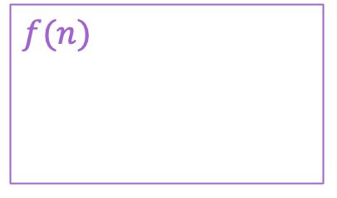

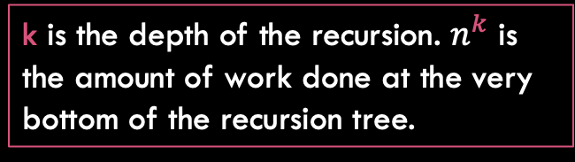
The Master Theorem (from Cormen)
The Master Theorem:
Consider $T\left(n\right)=a T\left(\frac{n}{b}\right)+f(n)$ Let $k=\frac{\lg{a}}{\lg{b}}=\log_{b}{a}$
$f(n)$ represents how much work is done by the top level of recursion
k is the depth of the recursion. $n^{k}$ is the amount of work done at the very bottom of the recursion tree.

Slide 32














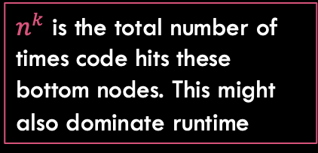





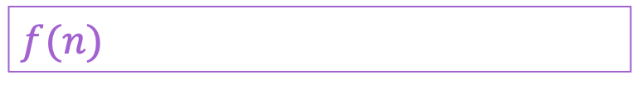
The Master Theorem (from Cormen)
The Master Theorem:
Consider $T\left(n\right)=a T\left(\frac{n}{b}\right)+f(n)$ Let $k=\frac{\lg{a}}{\lg{b}}=\log_{b}{a}$
$$T(n)$$
$$f(n)$$
$f(n)$ might dominate the runtime
$$T(\frac{n}{2})$$
$$\frac{n}{2}$$
$$T(\frac{n}{2})$$
$$\frac{n}{2}$$
$$T(\frac{n}{4})$$
$$\frac{n}{4}$$
$$T(\frac{n}{4})$$
$$\frac{n}{4}$$
$$T(\frac{n}{4})$$
$$\frac{n}{4}$$
$$T(\frac{n}{4})$$
$$\frac{n}{4}$$
……………
……………
$n^{k}$ is the total number of times code hits these bottom nodes. This might also dominate runtime
$$T(1)$$
$$1$$
$$T(1)$$
$$1$$
$$T(1)$$
$$1$$
……………
$$T(1)$$
$$1$$

Slide 33
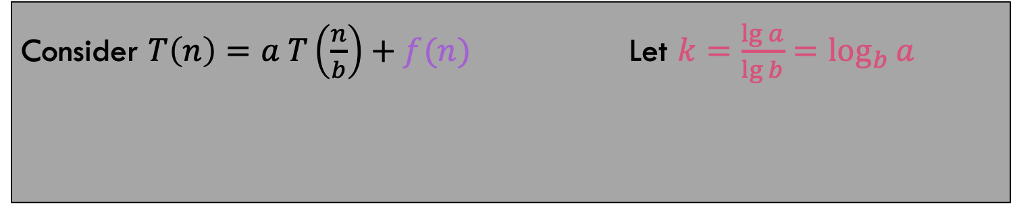











The Master Theorem (from Cormen)
The Master Theorem:
Consider $T\left(n\right)=a T\left(\frac{n}{b}\right)+f(n)$ Let $k=\frac{\lg{a}}{\lg{b}}=\log_{b}{a}$
Case 1:
If $f\left(n\right)∈O(n^{k−ε})$ for some positive $ε$, then $T\left(n\right)∈Θ(n^{k})$
$$T(n)$$
$$f(n)$$
$n^{k}$ is strictly worse, so it IS the runtime! The base cases dominate the runtime!
……………
……………
$$T(1)$$
$$1$$
$$T(1)$$
$$1$$
$$T(1)$$
$$1$$
……………
$$T(1)$$
$$1$$

Slide 34



The Master Theorem (from Cormen)
The Master Theorem:
Consider $T\left(n\right)=a T\left(\frac{n}{b}\right)+f(n)$ Let $k=\frac{\lg{a}}{\lg{b}}=\log_{b}{a}$
Case 2:
If $f\left(n\right)∈Θ(n^{k})$ then $T\left(n\right)∈Θ\left(f\left(n\right)\log{n}\right)=Θ(n^{k}\log{n})$
$$T(n)$$
$$f(n)$$
$n^{k}$ and $f(n)$ have same runtime! You do $n^{k}$ work at each layer for $\log{n}$ layers!
……………
……………
$$T(1)$$
$$1$$
$$T(1)$$
$$1$$
$$T(1)$$
$$1$$
……………
$$T(1)$$
$$1$$

Slide 35
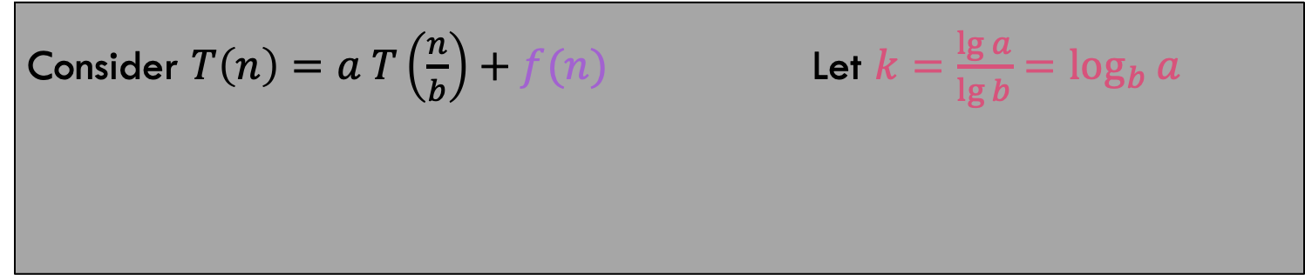





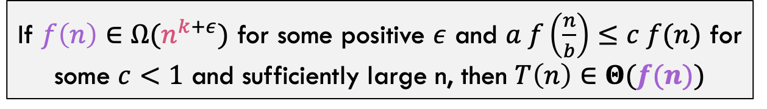




The Master Theorem (from Cormen)
The Master Theorem:
Consider $T\left(n\right)=a T\left(\frac{n}{b}\right)+f(n)$ Let $k=\frac{\lg{a}}{\lg{b}}=\log_{b}{a}$
Case 3:
If $f\left(n\right)∈Ω(n^{k+ε})$ for some positive $ε$ and $a f\left(\frac{n}{b}\right)≤c f(n)$ for some $c<1$ and sufficiently large n, then $T\left(n\right)∈Θ(f(n))$
$$T(n)$$
$$f(n)$$
$f(n)$ dominates the runtime so it is the total runtime. But what about that weird condition!!
……………
……………
$$T(1)$$
$$1$$
$$T(1)$$
$$1$$
$$T(1)$$
$$1$$
……………
$$T(1)$$
$$1$$

Slide 36











The Master Theorem (from Cormen)
The Master Theorem:
Consider $T\left(n\right)=a T\left(\frac{n}{b}\right)+f(n)$ Let $k=\frac{\lg{a}}{\lg{b}}=\log_{b}{a}$
Case 3:
If $f\left(n\right)∈Ω(n^{k+ε})$ for some positive $ε$ and $a f\left(\frac{n}{b}\right)≤c f(n)$ for some $c<1$ and sufficiently large n, then $T\left(n\right)∈Θ(f(n))$
$$T(n)$$
$$f(n)$$
$f(n)$ work at one layer of recursion
$$T\left(\frac{n}{b}\right)$$
$$f\left(\frac{n}{b}\right)$$
$$T\left(\frac{n}{b}\right)$$
$$f\left(\frac{n}{b}\right)$$
$$T\left(\frac{n}{b}\right)$$
$$f\left(\frac{n}{b}\right)$$
$af\left(\frac{n}{b}\right)$ work at the next layer of recursion
Top layer only dominates if $af\left(\frac{n}{b}\right)≤c f(n)$

Slide 37
The Master Theorem (from Cormen)
The Master Theorem:
Consider $T\left(n\right)=a T\left(\frac{n}{b}\right)+f(n)$ Let $k=\frac{\lg{a}}{\lg{b}}=\log_{b}{a}$
Case 1:
If $f\left(n\right)∈O(n^{k−ε})$ for some positive $ε$, then $T\left(n\right)∈Θ(n^{k})$
Case 2:
If $f\left(n\right)∈Θ(n^{k})$ then $T\left(n\right)∈Θ\left(f\left(n\right)\log{n}\right)=Θ(n^{k}\log{n})$
Case 3:
If $f\left(n\right)∈Ω(n^{k+ε})$ for some positive $ε$ and $a f\left(\frac{n}{b}\right)≤c f(n)$ for some $c<1$ and sufficiently large n, then $T\left(n\right)∈Θ(f(n))$

Slide 38
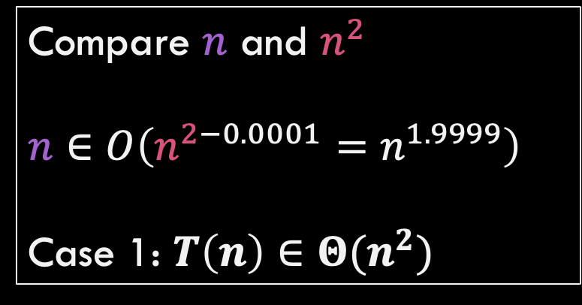



Using the Master Theorem
$$T\left(n\right)=9T\left(\frac{n}{3}\right)+n$$
$$k=\log_{3}{9}=2 \\ n^{k}=n^{2}$$
$$f\left(n\right)=n$$
Compare $n$ and $n^{2}$
$$n∈O\left(n^{2−0.0001}=n^{1.9999}\right)$$ Case 1: $T\left(n\right)∈Θ(n^{2})$

Slide 39






Problems to Try
The Master Theorem:
Consider $T\left(n\right)=a T\left(\frac{n}{b}\right)+f(n)$ Let $k=\frac{\lg{a}}{\lg{b}}=\log_{b}{a}$
Case 1:
If $f\left(n\right)∈O(n^{k−ε})$ for some positive $ε$, then $T\left(n\right)∈Θ(n^{k})$
Case 2:
If $f\left(n\right)∈Θ(n^{k})$ then $T\left(n\right)∈Θ\left(f\left(n\right)\log{n}\right)=Θ(n^{k}\log{n})$
Case 3:
If $f\left(n\right)∈Ω(n^{k+ε})$ for some positive $ε$ and $a f\left(\frac{n}{b}\right)≤c f(n)$ for some $c<1$ and sufficiently large n, then $T\left(n\right)∈Θ(f(n))$
$$T\left(n\right)=T\left(\frac{n}{2}\right)+\log{n}$$
$$T\left(n\right)=2 T\left(\frac{n}{2}\right)+n$$
$$T\left(n\right)=T\left(\frac{n}{2}\right)+n$$
$$T\left(n\right)=2 T\left(\frac{n}{2}\right)+n\log{n}$$

Slide 40
More Master Theorem Examples

Slide 41

Problems to Try
Let’s try these?
$T\left(n\right)=7T\left(\frac{n}{3}\right)+n^{2}$
$T\left(n\right)=3T\left(\frac{n}{3}\right)+\frac{n}{2}$
$T\left(n\right)=4T\left(\frac{n}{2}\right)+\frac{n}{\log{n}}$
$T\left(n\right)=3T\left(\frac{n}{3}\right)+\frac{n}{\log{n}}$

