Slide 1
Divide and Conquer Algorithms
CS3100: Data Structures And Algorithms 2 Mark Floryan

Slide 2
Module 3: Divide and Conquer

Slide 3
Topics
Algorithm Design Strategy: Divide and Conquer
Simple Examples:
Mergesort and MaxSum
Solving Recurrence Relations
Four different Strategies
Advanced Div. and Con. Examples:
Closest Pair of Points
QuickSelect
Strassen’s Algorithm

Slide 4
Divide & Conquer

Slide 5
Divide and Conquer: A Strategy
Divide and Conquer: An algorithmic design strategy in which a problem is broken down into smaller problems. These smaller problems are solved (usually recursively) and the solutions to these smaller problems is then recombined into a solution for the original problem
Big Problem
The form of these smaller problems much match the bigger problem EXACTLY
Smaller Problem
Smaller Problem
Usually a lot more recursion happens here (smaller problem broken down again into even smaller ones)
Smaller Solution
Smaller Solution
Combine Small Solutions Back Into Big Solution

Slide 6
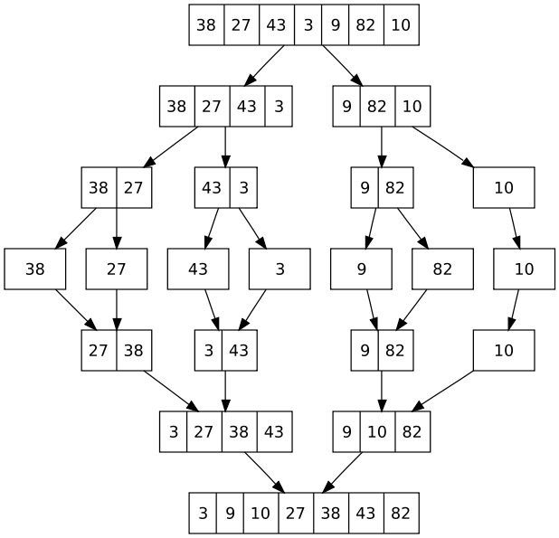
Mergesort is Classic Divide & Conquer

Slide 7
Divide and Conquer: A Strategy
Divide and Conquer: An algorithmic design strategy in which a problem is broken down into smaller problems. These smaller problems are solved (usually recursively) and the solutions to these smaller problems is then recombined into a solution for the original problem
Big Problem
solve(I):
n = size(I)
if (n <= smallsize)
solution = directlySolve(I)
else
divide I into I₁, …, I_{k}
for each i in {1, …, k}
S_{i} = solve(I_{i});
solution = combine(S₁, …, S_{k})
return solution;
Smaller Problem
Smaller Problem
Usually a lot more recursion happens here (smaller problem broken down again into even smaller ones)
Smaller Solution
Smaller Solution
Combine Small Solutions Back Into Big Solution

Slide 8

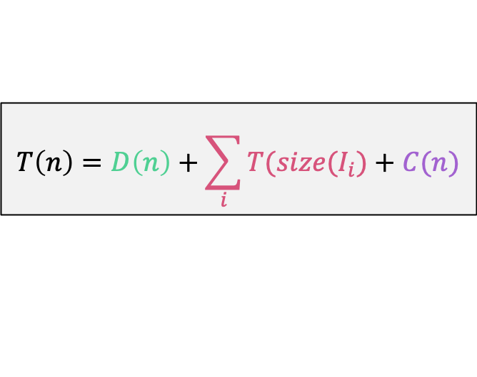

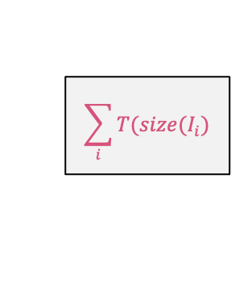
Cost for a Divide & Conquer Algorithm
A cost to divide:
$$D(n)$$
solve(I):
n = size(I)
if (n <= smallsize)
solution = directlySolve(I)
else
divide I into I₁, …, I_{k}
for each i in {1, …, k}
S_{i} = solve(I_{i});
solution = combine(S₁, …, S_{k})
return solution;
A cost to solve subproblems:
$$\sum_{i}{T(size(I_{i})}$$
A cost to combine:
$$C(n)$$
$$T\left(n\right)=D\left(n\right)+\sum_{i}{T(size(I_{i})}+C(n)$$
Total Cost:
Runtime is a recursive formula, will need to figure out how to analyze these!

Slide 9
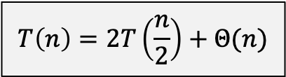

Algorithm: Mergesort
def mergesort(list, first, last):
if first < last:
mid = (first+last)/2
mergesort(list, first, mid)
mergesort(list, mid+1, last)
merge(list, first, mid, last)
return
$$T\left(n\right)=2T\left(\frac{n}{2}\right)+Θ(n)$$
Notice the divide runtime and the conquer runtime are combined here for a total of $Θ(n)$

Slide 10
Simple Example: Find Max

Slide 11
Exercise: Find Max AND Second Max
Problem Statement:
Given a list of elements (integers), find both the maximum and second maximum element
Let’s try to solve this with divide-and-conquer, as an exercise!
What is the straightforward solution that simply loops through the list?

Slide 12
Recursive calls are OF THE SAME FORM
FindMax(list, 0, n)
[x₀, x₁, x₂, …, x_{n}]
FindMax(list, 0, n/2)
[x₁, …, x_{n/2}]
FindMax(list, n/2+1, n)
[x_{n/2+1}, …, x_{n}]
A LOT MORE RECURSION HAPPENS HERE
max1, max2
combine()
return real max1, max2
max1, max2

Slide 13
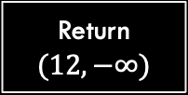
Find Max AND Second Max
Base Case:
def maxAndSecondMax(list, first, last):
if first == last:
return (list[first], -infinity)
…
N = 1:
a =
12
Return $(12,−∞)$
Why do we not need a base case for zero or two elements?

Slide 14
Find Max AND Second Max
Divide:
def maxAndSecondMax(list, first, last):
if first == last:
return (list[first], -infinity)
mid = (first+last)/2
left = maxAndSecondMax(list,first,mid)
right = maxAndSecondMax(list,mid+1,last)
12
4
22
1
6
12
4
22
1
6
Why do we not need a base case for zero or two elements?

Slide 15
Find Max AND Second Max
Conquer:
def maxAndSecondMax(list, first, last):
if first == last:
return (list[first], -infinity)
mid = (first+last)/2
left = maxAndSecondMax(list,first,mid)
right = maxAndSecondMax(list,mid+1,last)
max = Max(left[0], right[0])
sec = Max(Min(left[0],right[0]), max(left[1],right[1])
return (max, sec)
12
4
22
1
6
left = (22,12)
right = (6,1)
max = Max(22,6)
secondMax = Max(6,12)

Slide 16

Exercise: Find Max AND Second Max
Runtime:
$$T\left(n\right)=2T\left(\frac{n}{2}\right)+Θ(1)$$
Why?
Two subproblems of half the list each.
Combine and Divide are both constant time
This is $Θ(n)$. So…not better than just scanning the array.

Slide 17
Another Example: Maximum Subarray

Slide 18
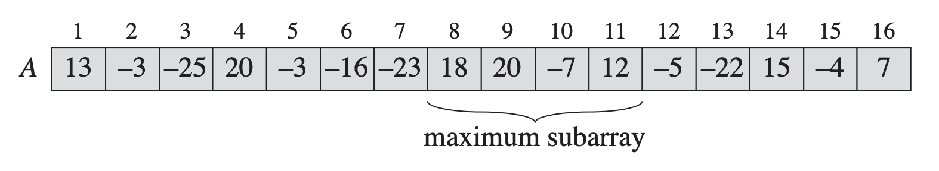
Maximum Subarray Problem
Given a list A of positive and negative integers, return the indices i and j such that:
i <= j
0 <= i, j <= A.length
A[i…j] maximizes sum of elements in range i, j
Example:

Slide 19

Brute-Force
max = -inf, maxI, maxJ for i from 0 to n-1: for j from i to n-1: sum=0 for k from i to j: sum += A[k] if sum > max: max = sum maxI = i maxJ = j return (maxI, maxJ)
Runtime:
$$Θ(n^{3})$$

Slide 20

Better Brute-Force
max = -inf, maxI, maxJ sums[n] sums[0] = A[0] for i from 1 to n-1: sums[i] = sums[i-1]+A[i] for i from 0 to n-1: for j from i to n-1: sum=sums[j]-sums[i]+A[i] if sum > max: max = sum maxI = i maxJ = j return (maxI, maxJ)
Compute sum from index 0 to i and store in an array sums[]
Runtime:
$$Θ(n^{2})$$
The sum from index i to j is just the total sum through index j minus the total sum through index i

Slide 21

Can we do better?
Let’s use divide-and-conquer to get an nlogn runtime
Going for: $T\left(n\right)=2T\left(\frac{n}{2}\right)+n=Θ(nlogn)$

Slide 22

Can we do better?
Base Case:
def maxSubArray(A, first, last):
if first == last:
if A[i] > 0: return (first,last,A[i]) else return (-1,-1,0)
…
i=8
N = 1:
a =
12
Return $(8,8,12)$
(Start index, end index, sum) What do we do if element is negative?

Slide 23
Can we do better?
Divide:
def maxSubArray(A, first, last):
if first == last:
if A[i] > 0: return (first,last,A[i]) else return (-1,-1,0)
mid = (first+last)/2
left = maxSubArray(A, first, mid)
right = maxSubArray(A, mid+1, last)
20
-7
12
-5
-22
20
-7
12
-5
-22

Slide 24
Can we do better?
Conquer:
def maxSubArray(A, first, last):
if first == last:
if A[i] > 0: return (first,last,A[i]) else return (-1,-1,0)
mid = (first+last)/2
left = maxSubArray(A, first, mid)
right = maxSubArray(A, mid+1, last)
if left[2] > right[2]: return left
else return right
20
-7
12
-5
-22
(9,11,25)
(-1,-1,0)
In this case, the solution is the left one. Is the solution ALWAYS the left or right solution?

Slide 25
Can we do better?
Conquer:
def maxSubArray(A, first, last):
if first == last:
if A[i] > 0: return (first,last,A[i]) else return (-1,-1,0)
mid = (first+last)/2
left = maxSubArray(A, first, mid)
right = maxSubArray(A, mid+1, last)
divide = dividingLineSolution(A,first,last)
maxSol = Max(left[2],right[2],divide[2])
if left[2] == maxSol: return left
if right[2] == maxSol: return right
Else return divide
20
-7
12
-5
-22
(9,11,25)
(-1,-1,0)
Solution could be across the dividing line!

Slide 26
How to find Solution Across Dividing Line
Accumulate sum from array as we move left from dividing line
…
-21
-5
18

Slide 27
How to find Solution Across Dividing Line
Accumulate sum from array as we move left from dividing line
Best is 18. this takes linear time!
-19
-32
-29
-4
-24
-21
-5
18

Slide 28
How to find Solution Across Dividing Line
Accumulate sum from array as we move left from dividing line
Best is 18. this takes linear time!
Do same on this side…best is 25
-19
-32
-29
-4
-24
-21
-5
18
20
13
25
20
-2
13
9
16

Slide 29
How to find Solution Across Dividing Line
Best overall that divides the line is best two concatenated
18
20
13
25
REMEMBER! Best solution is not necessarily one that crosses the line! Might be solution on left, solution on right, OR solution that crosses divide line. Return the highest of all three!

Slide 30
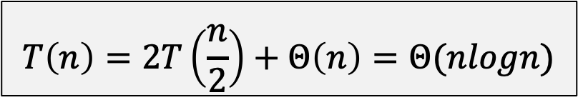
We are Done!
def maxSubArray(A, first, last):
if first == last:
if A[i] > 0: return (first,last,A[i]) else return (-1,-1,0)
mid = (first+last)/2
left = maxSubArray(A, first, mid)
right = maxSubArray(A, mid+1, last)
divide = dividingLineSolution(A,first,last)
maxSol = Max(left[2],right[2],divide[2])
if left[2] == maxSol: return left
if right[2] == maxSol: return right
Else return divide
Runtime:
$$T\left(n\right)=2T\left(\frac{n}{2}\right)+Θ\left(n\right)=Θ(nlogn)$$

Slide 31
Divide and Conquer: Bottom-line
Powerful technique for a wide array of problems
Don’t let a lot of “extra” work fool you:
Sometimes recursive pays off
But you need to know when
Algorithm analysis!

